Slide 1
ElasticSearch
For beginners
Shefali Lachhar

Slide 2
Overview of elasticsearch
Open source
Distributed
Scalable
Search Engine

Slide 3
ELASTICSearch
Based on Ancient Search engine (Index of the book)
ElasticSearch is built on search software i.e. LUCENE (apache). SQL (10 sec) ES (10ms)
Enables full text search
Uses simple Json for query langaguage.

Slide 4
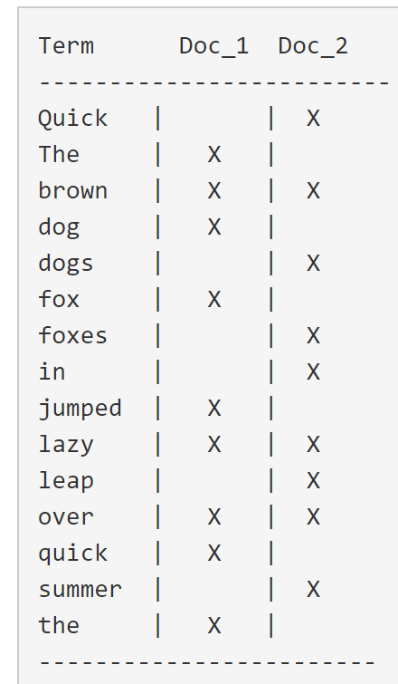
Inverted Index
Doc_1 =>
The quick brown fox jumped over the lazy dog
Doc_2 =>
Quick brown foxes leap over lazy dogs in summer

Slide 5
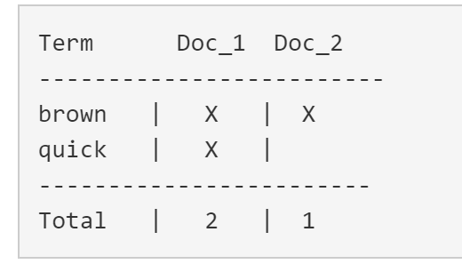
If you search for “quick brown”. We just need to find the documents in which each term appears.

Slide 6
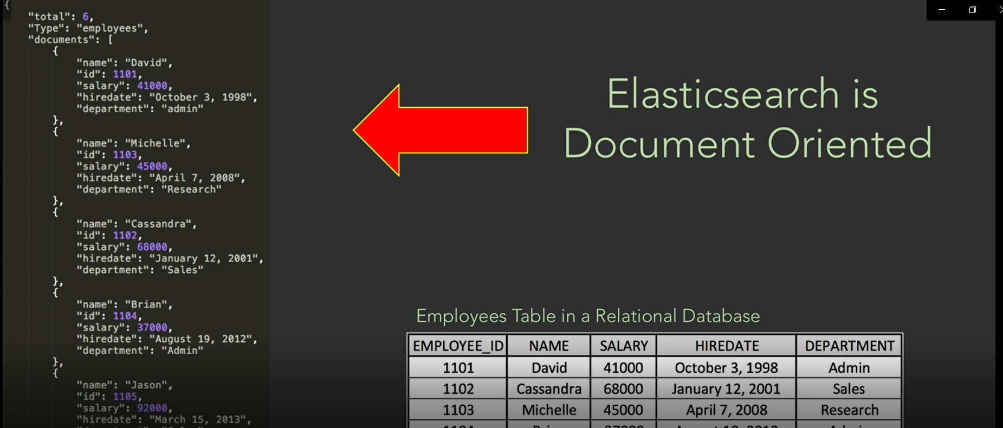

Slide 7
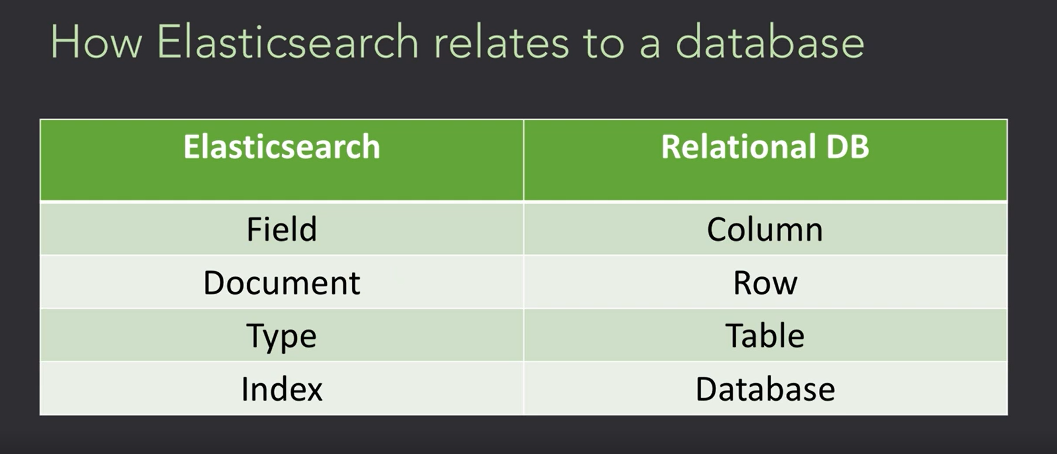

Slide 8
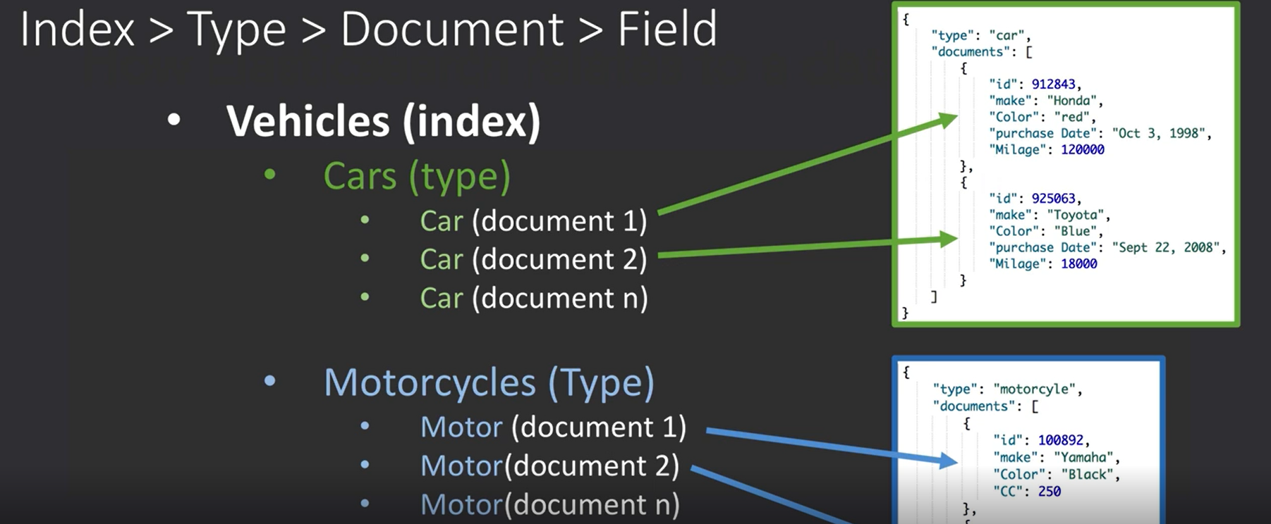

Slide 9
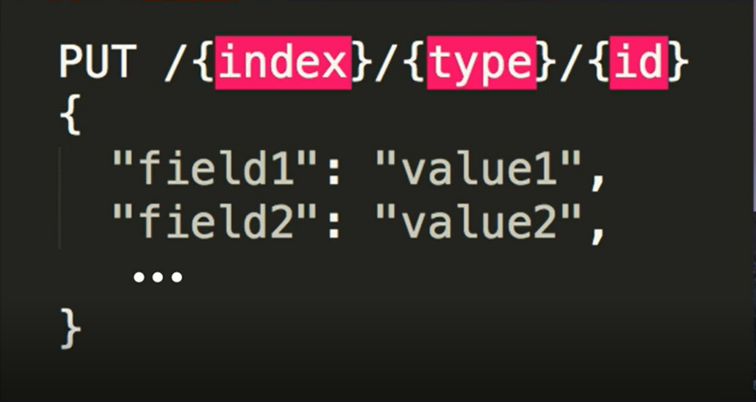
ElasticSearch exposed as REST API

Slide 10
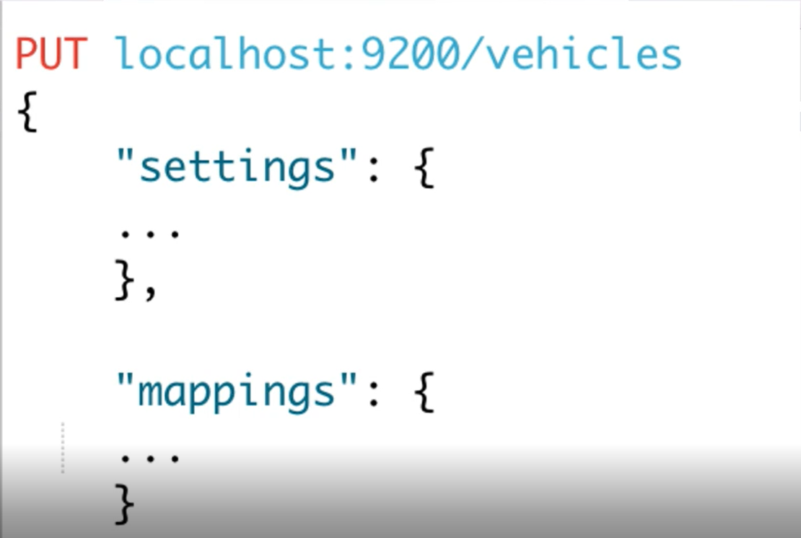
SCHEMA

Slide 11
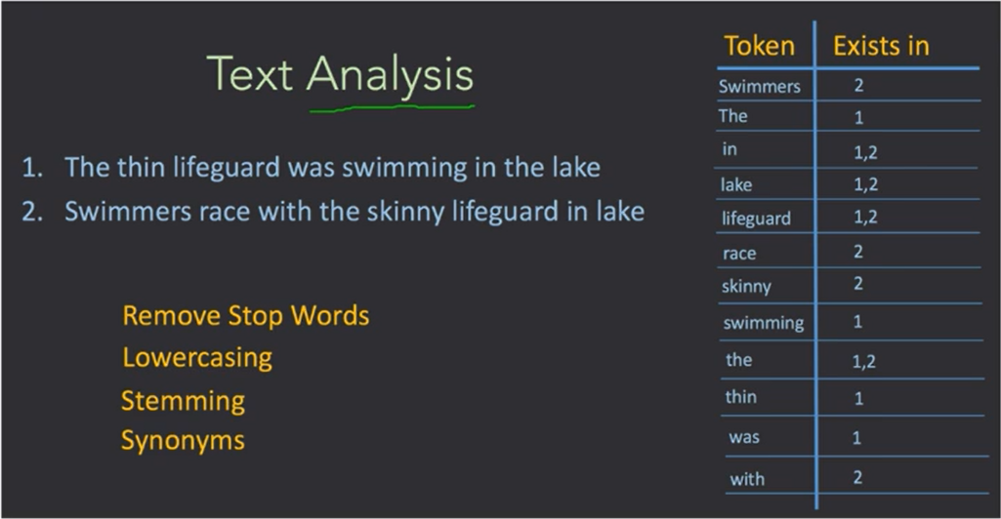
Tokenization
Filters

Slide 12
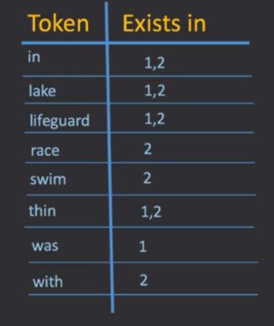
Type of analyzers
Type of Analyzers
Standard
Whitespace
Simple
Stop
Pattern
Custom (we can create)

Slide 13
We USE ELSTICSEARCH

