Slide 1
Data Quality
The Implications for Decision-Making

Slide 2
Introduction
This presentation will examine the issues surrounding data quality in the information technology (IT) field. It will examine the reasons behind the drive for data quality, how data quality is defined and the specific attributes associated with data quality. Further, applications requiring data quality will be discussed. Finally, the ways in which data quality can be achieved and the implementation policies required will be examined.

Slide 3
Why Is Data Quality Necessary?
GIGO
In a nutshell…
It’s embarrassing when you inform your customers that your database shows that they are dead!

Slide 4
But, to delve deeper, we will look at the:
Operational
Tactical
Strategic
Impacts Of Data Quality

Slide 5
Operational Impacts of Data Quality
Customer satisfaction
  Order accuracy
  Shipping accuracy
  Billing accuracy
Operational costs
  40 to 60% of service organization cost
Job satisfaction

Slide 6
Tactical Impacts of Data Quality
Day-to-day decision-making
Complicates implementation of data warehouses
Can undermine re-engineering efforts
Breeds mistrust between organizations
  They feel they have to maintain their own databases

Slide 7
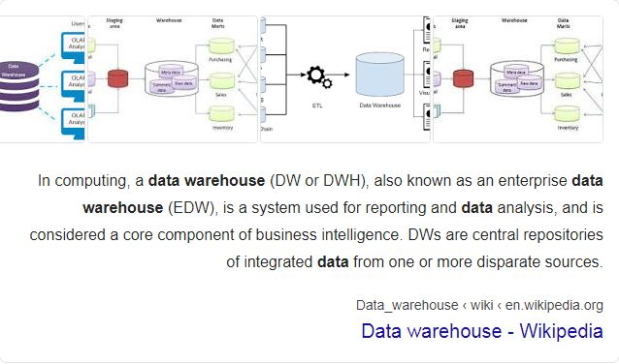
Complicates implementation of data warehouses

Slide 8

Strategic Impacts of Data Quality
Managers need external data regarding:
  Customers
  Competitors
  Technologies
To gauge the effectiveness of strategy, progress must be measured
The strategic process may be compromised while dealing with data quality induced operational and tactical problems

Slide 9
Two Definitions of Data Quality
Technical
Business
The measure of the agreement between the data views presented by an information system and that same data in the real world
Measured 0 to 100%
High-quality data are data that meet business needs

Slide 10
The Facets of Data Quality
“Top Five”
Uniqueness
Accuracy
Consistency
Completeness
Validity
Timeliness

Slide 11
Application and Data Types
Web-based data collection
Payroll and financial accounting
Space shuttle telemetry
Battlefield information
All data are not equally important

Slide 12
Achieving Data Quality
The problem: As databases grow, companies depend on them more, but they also contain more (harder to find) errors.
A data quality program requires:
Continuous data quality audits
Cleanup and restructuring of data schemas
Standards and software tools for maintaining data quality continuously

Slide 13
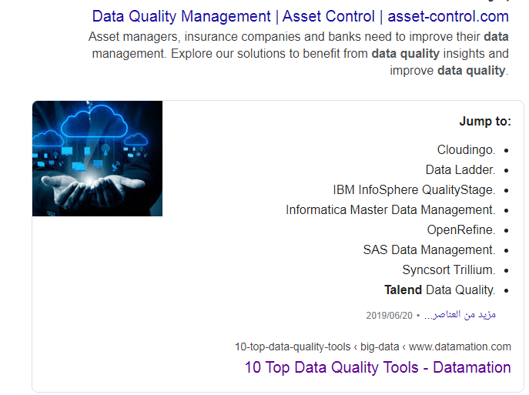

https://www.datamation.com/big-data/10-top-data-quality-tools.html

Slide 14
Basic Quality Enforcement
Inconsistent file naming
Inconsistent field lengths
Inconsistent field orders
Inconsistent descriptions
Incomplete entries
Inconsistent identities
Inconsistent value assignment

Slide 15
Rule-Based Constraints
In the past, rules embedded into programs
Better; Rule-based constraints
  No need to recompile to change rules
  Rules easily expressed and much more flexible

Slide 16
Automatic Error Detection
Anomalies are exceptions to expected patterns. They may indicate:
An error in the data
A faulty rule
An interesting data point
Note that the rules by which anomalies are found may be deduced from the data.

Slide 17
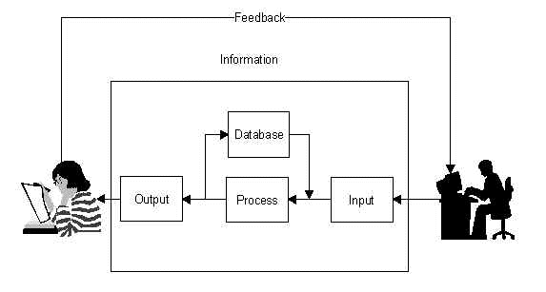
Real-World Information Systems

Slide 18
Data Cleansing
Data cleansing or data cleaning is the process of detecting and correcting (or removing) corrupt or inaccurate records from a record set, table, or database and refers to identifying incomplete, incorrect, inaccurate or irrelevant parts of the data and then replacing, modifying, or deleting the dirty data
First generation tools
  Platform specific
  Logic embedded in code
  Knowledge leaves with the consultants
Second generation tools

Slide 19
Data Cleansing –
Second Generation Tools
Versatile and powerful
Portable and platform independent
Standards based
Globally functional
Extensible and customizable
Easy to use

Slide 20
Data Quality Policies
For Suppliers and Creators
Understand who uses the data and for what purposes
Actively solicit users’ needs
Implement measures of data quality
Implement process management

Slide 21
Data Quality Policies
For Processors
Provide databases to minimize redundancy
Avoid duplication of data entry
Safeguard data from harm or unauthorized access
Make data readily available to legitimate business users
Ensure that new IT is designed to promote data quality

Slide 22
Data Quality Policies
For Users
Develop clear and operable definitions of data requirements
Provide the crucial feedback
Ensure that the data are properly interpreted
Ensure that data are used for only legitimate business purposes
Protect the rights to privacy of all

Slide 23
Problem?
How do I know when I have a data quality problem?
Extensive data inspection and rework
Multiple or redundant databases
Inability to implement strategy
Frustration with data, data suppliers, and IT

Slide 24

To Succeed
They keys to success in a data quality program:
Recognize the impact of poor data quality
Align management emphasis on quality – quality data are a crucial business asset
Apply proper process management

Slide 25
Measuring the Impact
Judge your data quality program by its Return on Investment (ROI).

Slide 26
Business/
Technical Value
ROI Measures
Improved business decision-making.
Data quality is improved, which provides business users with more accurate systems and reports.
Reduction of IT-related problems.
Improved data quality reduces many system related problems and IT expenses.
Increased system value to the business.
Decision support system (DSS) business users are likely to make better decisions if they are aware of possible errors skewing report numbers.
Improved system performance.
As data quality improves, system errors are reduced, which improves system performance.

Slide 27
Thanks
And, keep your data clean!

