Slide 1
Quality Assurance and Implementation
16
Kendall & Kendall
Systems Analysis and Design, 9e
Kendall & Kendall Copyright © 2014 Pearson Education, Inc. Publishing as Prentice Hall

Slide 2
Learning Objectives
Recognize the importance of users and analysts taking a total quality approach to improve the quality of software design and maintenance.
Realize the importance of documentation, testing, maintenance, and auditing.
Understand how service-oriented architecture and cloud computing is changing the nature of information system design.
Kendall & Kendall Copyright © 2014 Pearson Education, Inc. Publishing as Prentice Hall
16-<number>

Slide 3
Learning Objectives (continued)
Design appropriate training programs for users of the new system.
Recognize the differences among physical conversion strategies, and be able to recommend an appropriate one to a client.
Address security, disaster preparedness, and disaster recovery concerns for traditional and Web-based systems.
Understand the importance of evaluating the new system, and be able to recommend a suitable evaluation technique to a client.
Kendall & Kendall Copyright © 2014 Pearson Education, Inc. Publishing as Prentice Hall
16-<number>

Slide 4
Major Topics
Six Sigma
Quality assurance
Walkthroughs
Structure charts
Modules
Documentation
Testing
Kendall & Kendall Copyright © 2014 Pearson Education, Inc. Publishing as Prentice Hall
16-<number>

Slide 5
Major Topics (continued)
Client-server computing
Network types
Groupware
Training
Security
Organizational metaphors
Evaluation
Kendall & Kendall Copyright © 2014 Pearson Education, Inc. Publishing as Prentice Hall
16-<number>

Slide 6
Six Sigma
A culture built on quality
Uses a top-down approach
Project leader is called a Black Belt
Project members are called Green Belts
Master Black Belts have worked on many projects and are available as a resource to project teams
Kendall & Kendall Copyright © 2014 Pearson Education, Inc. Publishing as Prentice Hall
16-<number>
Notes:
Total quality management (TQM) is essential throughout all the systems development steps.
The concept of quality has broadened over the years to reflect an organizational, rather than an exclusively production, approach.
The goal of six sigma is to eliminate all defects.
Six sigma is a methodology, a philosophy and a culture.

Slide 7
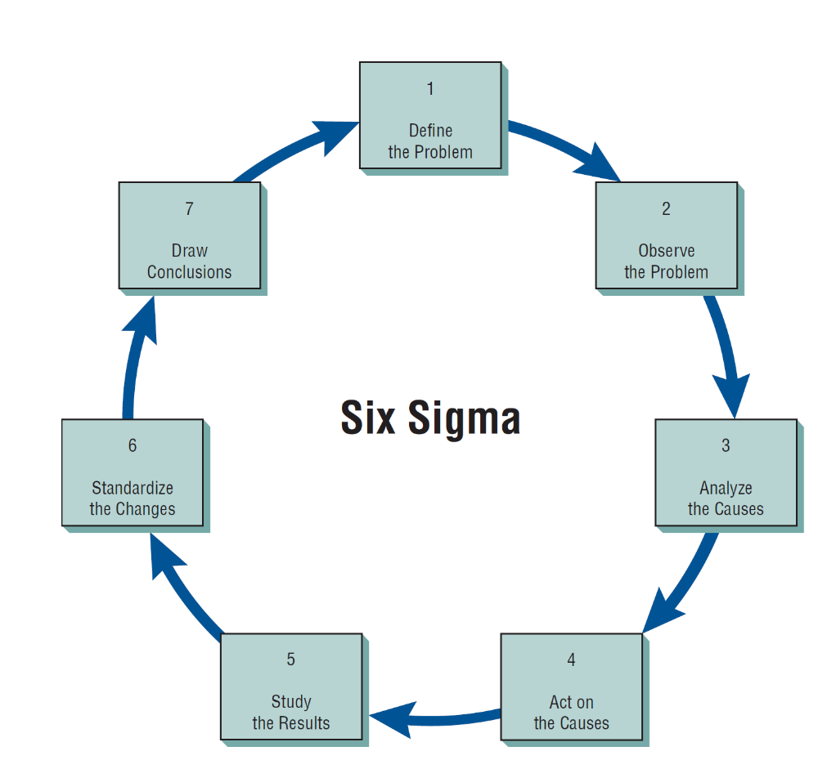
Every Systems Analyst Should Understand the Methodology and Philosophy of Six Sigma (Figure 16.1)
Kendall & Kendall Copyright © 2014 Pearson Education, Inc. Publishing as Prentice Hall
16-<number>

Slide 8
Responsibility for Total Quality Management
Full organizational support of management must exist
Early commitment to quality from the analyst and business users
Kendall & Kendall Copyright © 2014 Pearson Education, Inc. Publishing as Prentice Hall
16-<number>
Notes:
Full organizational support of management must exist—means establishing a context for management people to consider seriously how the quality of information systems and information itself affects their work. Achieved by providing on-the-job time for IS quality circles, which consist of six to eight organizational peers specifically charged with considering both how to improve information systems and how to implement improvements.
Early commitment to quality from the analyst and business users—results in an evenly paced effort toward quality throughout the systems development life cycle.
Getting the users involved in spelling out quality standards for information systems will help the analyst avoid expensive mistakes in unwanted or unnecessary systems development.

Slide 9
Structured Walkthroughs
https://www.tutorialspoint.com/software_testing_dictionary/structured_walkthrough.htm
One of the strongest quality management actions is to do structured walkthroughs routinely
Use peer reviewers to monitor the system’s programming and overall development
Point out problems
Allow the programmer or analyst to make suitable changes
Kendall & Kendall Copyright © 2014 Pearson Education, Inc. Publishing as Prentice Hall
16-<number>
Notes:
The point of the structured walkthrough is to evaluate the product systematically on an ongoing basis.

Slide 10
Involved in Structured Walkthroughs
The person responsible for the part of the system being reviewed
A walkthrough coordinator
A programmer or analyst peer
A peer who takes notes about suggestions
Kendall & Kendall Copyright © 2014 Pearson Education, Inc. Publishing as Prentice Hall
16-<number>
Notes:
Structured walkthroughs involve at least four people.
Coordinator—ensures that the others adhere to any roles assigned to them and to ensure that any activities scheduled are accomplished.
Programmer or analyst—there to listen.
Programmer or analyst peer—present to point out errors or potential problems.
Note taker—records what is said so that the others present can interact without encumbrance.

Slide 11
The Top-Down Approach
Top-down design allows the systems analyst to ascertain overall organizational objectives and how they are best met in an overall system
The system is divided into subsystems and their requirements
Kendall & Kendall Copyright © 2014 Pearson Education, Inc. Publishing as Prentice Hall
16-<number>
Notes:
The top-down approach means looking at the large picture of the system and then exploding it into smaller parts or subsystems.

Slide 12
Advantages of the Top-Down Approach
Avoiding the chaos of attempting to design a system all at once
Enables separate systems analysis teams to work in parallel on different but necessary subsystems
Prevents losing sight of what the system is suppose to do
Kendall & Kendall Copyright © 2014 Pearson Education, Inc. Publishing as Prentice Hall
16-<number>
Notes:
Avoiding the chaos of attempting to design a system all at once—attempting to get all subsystems in place and running at once is agreeing to fail.
Enables separate systems analysis teams to work in parallel on different but necessary subsystems—can save time.

Slide 13
Modular Development
Breaking the programming into logical, manageable portions or modules
Works well with top-down design
Each individual module should be functionally cohesive, accomplishing only one function
Kendall & Kendall Copyright © 2014 Pearson Education, Inc. Publishing as Prentice Hall
16-<number>
Notes:
This kind of programming works well with top-down design because it emphasizes the interfaces between modules and does not neglect them until later in systems development.

Slide 14
Advantages of Modular Programming
Modules are easier to write and debug
Modules are easier to maintain
Modules are easier to grasp because they are self-contained subsystems
Kendall & Kendall Copyright © 2014 Pearson Education, Inc. Publishing as Prentice Hall
16-<number>
Notes:
Modules are easier to write and debug:
Tracing an error in a module is less complicated.
A problem in one module should not cause problems in others.
Modules are easier to maintain—modifications will usually be limited to a few modules and will not be spread over an entire program.
Modules are easier to grasp because they are self-contained subsystems—a reader can pick up a code listing and understand its function.

Slide 15
Guidelines for Modular Programming
Keep each module to a manageable size
Pay particular attention to the critical interfaces (The data and control variables that are passed to other modules)
Minimize the number of modules the user must modify when making changes
Maintain the hierarchical relationships set up in the top-down phases
Kendall & Kendall Copyright © 2014 Pearson Education, Inc. Publishing as Prentice Hall
16-<number>

Slide 16
Using Structure Charts to Design Systems
The recommended tool for designing a modular, top-down system is a structure chart
A structure chart is simply a diagram consisting of rectangular boxes, representing the modules, and connecting lines
Hollow circle arrows represent data being passed up and down the structure
Filled-in circle arrow represents a control switch or flag
Kendall & Kendall Copyright © 2014 Pearson Education, Inc. Publishing as Prentice Hall
16-<number>

Slide 17
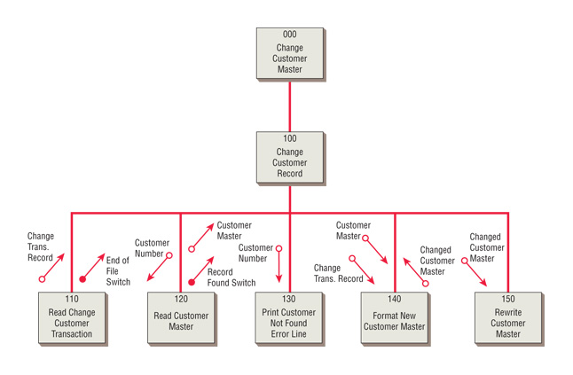
A structure chart encourages top-down design using modules (Figure 16.3)
Kendall & Kendall Copyright © 2014 Pearson Education, Inc. Publishing as Prentice Hall
16-<number>
Notes:
Modules 000 and 100 are control modules, representing the entire program.
Module 190 is a transformational module that formats the RESERVATION RECORD and performs module 200 to write the RESERVATION RECORD.
Modules 130, 140, 150, 170, 180, 200 are functional modules, performing only one task.

Slide 18
Service Oriented Architecture (SOA)
The SOA approach is to make individual SOA services that are unassociated or only loosely coupled to one another
Each service executes one action
Each service can be used in other applications within the organization or even in other organizations
Kendall & Kendall Copyright © 2014 Pearson Education, Inc. Publishing as Prentice Hall
16-<number>

Slide 19
Service Oriented Architecture (SOA) (continued)
A service can use certain defined protocols so that it can communicate with other services
The burden of connecting services in a useful fashion, is a process called orchestration
This can even be accomplished by selecting services from a menu of services and monitoring them by setting up an SOA dashboard
Kendall & Kendall Copyright © 2014 Pearson Education, Inc. Publishing as Prentice Hall
16-<number>

Slide 20
Service Oriented Architecture (SOA) (continued)
In order to set up a SOA, services must be:
  Modular
  Reusable
  Work together with other modules (interoperability)
  Able to be categorized and identified
  Able to be monitored
  Comply with industry-specific standards
Kendall & Kendall Copyright © 2014 Pearson Education, Inc. Publishing as Prentice Hall
16-<number>

Slide 21
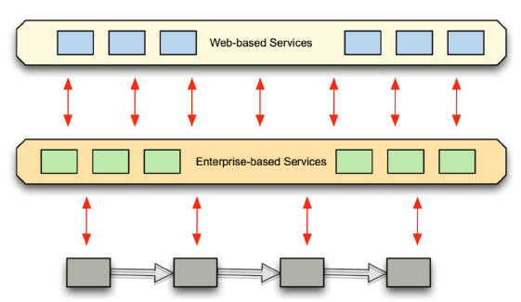
Modules in service-oriented architecture are independent and can be ubiquitous (Figure 16.4)
Kendall & Kendall Copyright © 2014 Pearson Education, Inc. Publishing as Prentice Hall
16-<number>

Slide 22
System Documentation
Procedure manuals
The FOLKLORE method
Kendall & Kendall Copyright © 2014 Pearson Education, Inc. Publishing as Prentice Hall
16-<number>
Notes:
There is no single standard design and documentation technique in use today. Each technique has its own advantages and disadvantages, because each one has unique properties.

Slide 23
Procedure Manuals
The English-language component of documentation
Key sections:
  Introduction
  How to use the software
  What to do if things go wrong
  A technical reference section
  An index
  Information on how to contact the manufacturer
Kendall & Kendall Copyright © 2014 Pearson Education, Inc. Publishing as Prentice Hall
16-<number>
Notes:
Procedure Manuals—may also contain program codes, flowcharts, and so on; intended to communicate to those who use them.

Slide 24
Procedure Manuals (continued)
Procedure manual complaints:
  They are poorly organized
  It is hard to find needed information
  The specific case in question does not appear in the manual
  The manual is not written in plain English
Kendall & Kendall Copyright © 2014 Pearson Education, Inc. Publishing as Prentice Hall
16-<number>

Slide 25
The FOLKLORE Method
Collects information in categories:
  Customs
  Tales
  Sayings
  Art forms
Kendall & Kendall Copyright © 2014 Pearson Education, Inc. Publishing as Prentice Hall
16-<number>
Notes:
Created to supplement other document techniques.
FORKLORE—gathers information that is often shared among users but is seldom written down.
Customs—tries to capture in writing what users are currently doing to get all programs to run without problems.
Tales—stories that users tell regarding how the system worked.
Sayings—brief statements representing generalizations or advice.
Art forms—flowcharts, diagrams, and tables that users draw sometimes may be more useful than flowcharts drawn by the original system author.

Slide 26
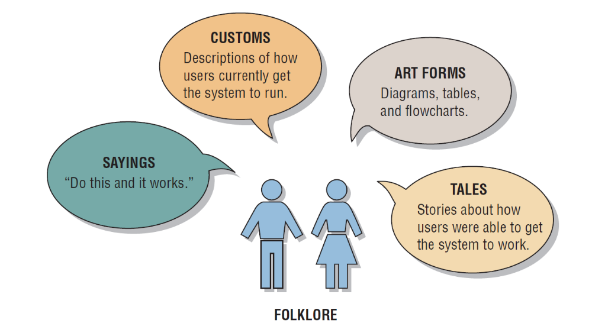
Customs, Tales, Sayings, and Art Forms Used in the FOLKLORE Method of Documentation Apply to Information Systems (Figure 16.5)
Kendall & Kendall Copyright © 2014 Pearson Education, Inc. Publishing as Prentice Hall
16-<number>
Notes:
The danger of relying on FOLKLORE is that the information gathered from users may be correct, partially correct, or incorrect.

Slide 27
Choosing a Design and Documentation Technique
Is it compatible with existing documentation?
Is it understood by others in the organization?
Does it allow you to return to working on the system after you have been away from it for a period of time?
Kendall & Kendall Copyright © 2014 Pearson Education, Inc. Publishing as Prentice Hall
16-<number>

Slide 28
Choosing a Design and Documentation Technique (continued)
Is it suitable for the size of the system you are working on?
Does it allow for a structured design approach if that is considered to be more important than other factors?
Does it allow for easy modification?
Kendall & Kendall Copyright © 2014 Pearson Education, Inc. Publishing as Prentice Hall
16-<number>

Slide 29
Testing, Maintenance, and Auditing
The testing process
Maintenance practices
Auditing
Kendall & Kendall Copyright © 2014 Pearson Education, Inc. Publishing as Prentice Hall
16-<number>
Notes:
Once the analyst has designed and coded the system, testing, maintenance, and auditing of it are prime considerations.

Slide 30
The Testing Process
Program testing with test data
Link testing with test data
Full system testing with test data
Full system testing with live data
Kendall & Kendall Copyright © 2014 Pearson Education, Inc. Publishing as Prentice Hall
16-<number>
Notes:
All the system’s newly written or modified application programs— as well as new procedural manuals, new hardware, and all system interfaces—must be tested thoroughly.

Slide 31
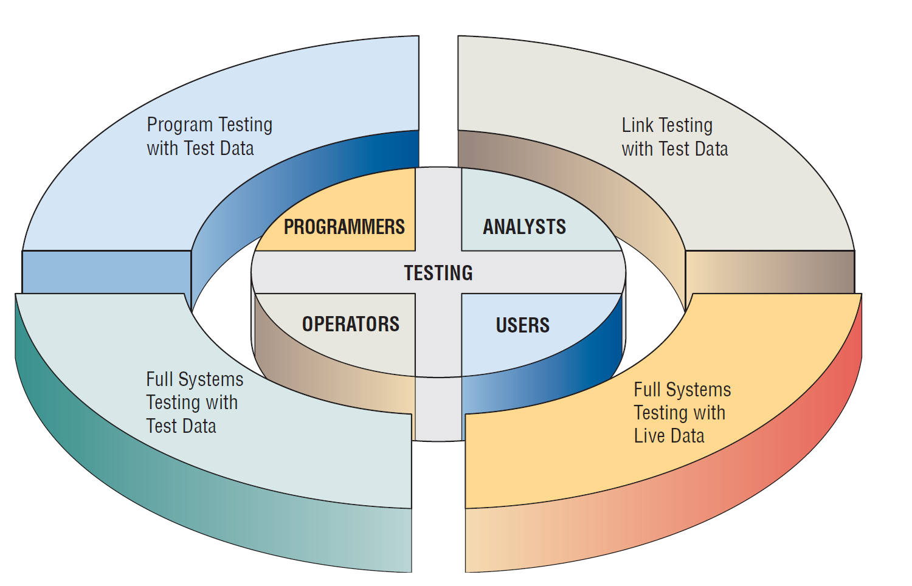
Programmers, Analysts, Operators, and Users All Play Different Roles in Testing Software and Systems
(Figure 16.6)
Kendall & Kendall Copyright © 2014 Pearson Education, Inc. Publishing as Prentice Hall
16-<number>
Notes:
Programmers, analysts, operators, and users all play different roles in the various aspects of testing.

Slide 32
Program Testing with Test Data
Desk check programs
Test with both valid and invalid data
Check output for errors and make any needed corrections
Kendall & Kendall Copyright © 2014 Pearson Education, Inc. Publishing as Prentice Hall
16-<number>
Notes:
Desk check programs—the programmer follows each step in the program on paper to check whether the routine works as it is written.
Test with both valid and invalid data—these data are run to see if base routines work and also to catch errors.
Check output for errors and make any needed corrections—the analyst might point out to the programmer omissions of data types to be added in later tests.

Slide 33
Link Testing with Test Data
Also referred to as string testing
Checks to see if programs that are interdependent actually work together as planned
Test for normal transactions
Test with invalid data
Kendall & Kendall Copyright © 2014 Pearson Education, Inc. Publishing as Prentice Hall
16-<number>
Notes:
Test for normal transactions—those that make up the bulk of the load.
Test with invalid data—if the system works with normal transactions, variations are added, including invalid data used to ensure that the system can properly detect errors.

Slide 34
Full System Testing with
Test Data
Adequate documentation in procedure manuals
Are procedure manuals clear enough?
Do work flows actually “flow”?
Is output correct and do users understand this output?
Kendall & Kendall Copyright © 2014 Pearson Education, Inc. Publishing as Prentice Hall
16-<number>
Notes:
When link tests are concluded, the system as a complete entity must be tested.
Operators and end users become actively involved in testing.
Adequate documentation in procedure manuals—to afford correct and efficient operation.
Are procedure manuals clear enough—do they communicate how data should be prepared for input.
Do work flows actually “flow”—those work flows necessitated by the new or modified system.
Is output correct and do users understand this output—do users understand that this is how it will look in its final form.

Slide 35
Full System Testing with Live Data
Comparison of the new system’s output with what you know to be correctly processed output
Only small amounts of live data are used
Kendall & Kendall Copyright © 2014 Pearson Education, Inc. Publishing as Prentice Hall
16-<number>
Notes:
Live data—data that have been successfully processed through the existing system.

Slide 36
Maintenance Practices
Reduce maintenance costs
Improve the existing software
Update software in response to the changing organization
Ensure channels for feedback
Kendall & Kendall Copyright © 2014 Pearson Education, Inc. Publishing as Prentice Hall
16-<number>
Notes:
The better the system design, the easier it will be to maintain and the less money the business will have to spend on maintenance.
Reduce maintenance costs—software maintenance can devour upwards of 50 percent of the total data processing budget for a business. Approximately 70 percent of software errors have been attributable to inappropriate software design.
Improve the existing software—rather than to respond to a crisis or failure.
Update software in response to the changing organization—emergency and adaptive maintenance comprises less than half of all system maintenance.
Ensure channels for feedback—users must be able to communicate problems and suggestions easily to those who will be maintaining the system.
Classification scheme—designates the perceived importance of the maintenance being suggested.

Slide 37
Auditing
Having an expert who is not involved in setting up or using the system examine information in order to ascertain its reliability
There are internal and external auditors
Internal auditors study the controls used in the information system to make sure that they are adequate
External auditors are used when the information system processes data that influences a company’s financial statements
Kendall & Kendall Copyright © 2014 Pearson Education, Inc. Publishing as Prentice Hall
16-<number>
Notes:
Internal auditors work for the same organization that owns the information system.
External auditors are hired from the outside.

Slide 38
Implementing Distributed Systems
Can be conceived of as an application of telecommunications
  Includes work stations that can communicate with each other and with data processors
  May have different hierarchical architectural configurations of data processors that communicate with one another
Kendall & Kendall Copyright © 2014 Pearson Education, Inc. Publishing as Prentice Hall
16-<number>
Notes:
The information architecture model that will likely dominate networking in the next few years is that of client/server.

Slide 39
Client-Server Technology
The client-server model refers to a design model that can be thought of as applications running on a network
The client is a networked computer that uses small programs to do front-end processing, including communicating with the user
Kendall & Kendall Copyright © 2014 Pearson Education, Inc. Publishing as Prentice Hall
16-<number>
Notes:
If a file server crashes all clients using the applications on the server are affected.
A print server on a LAN is accessible to all workstations.
Web Servers are software, not a combination of software and hardware as print servers and file servers are.

Slide 40
Client-Server Model Advantages, Disadvantages
Advantage—greater computer power and greater opportunity to customize applications
Disadvantage—more expensive and applications must be written as two separate software components each running on separate machines
Kendall & Kendall Copyright © 2014 Pearson Education, Inc. Publishing as Prentice Hall
16-<number>
Notes:
Although lower processing costs are cited as a benefit of the C/S model, there is very little actual data available to prove it.
There are well-documented high start-up or switch-over costs associated with a movement to a C/S architecture.

Slide 41
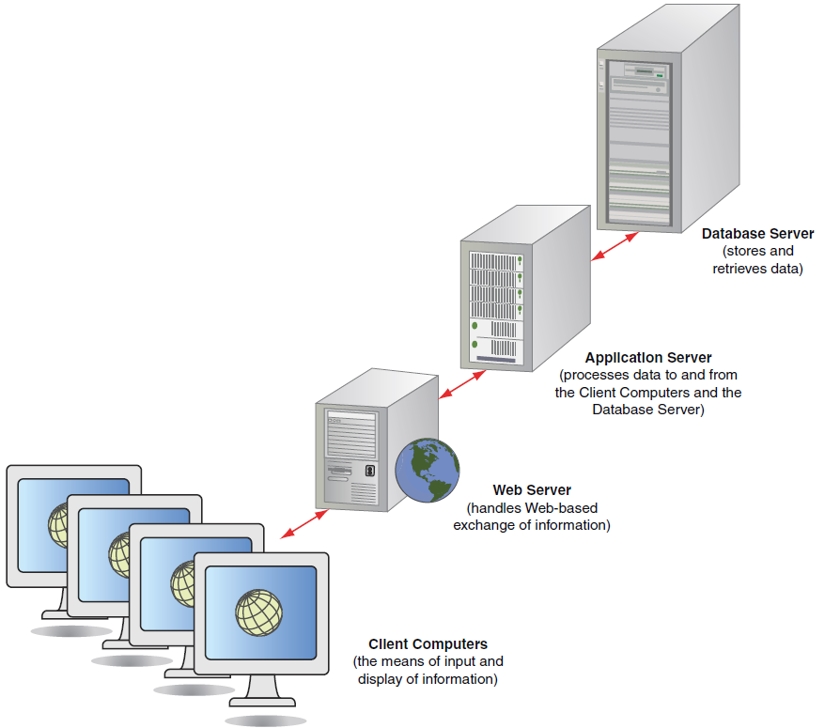
A Three-Tiered Client/Server Configuration (Figure 16.7)
Kendall & Kendall Copyright © 2014 Pearson Education, Inc. Publishing as Prentice Hall
16-<number>

Slide 42
Cloud Computing
Organizations and individual users can use:
  Web services
  Database services
  Application services over the Internet
Done without having to invest in corporate or personal hardware, software, or software tools
Kendall & Kendall Copyright © 2014 Pearson Education, Inc. Publishing as Prentice Hall
16-<number>

Slide 43
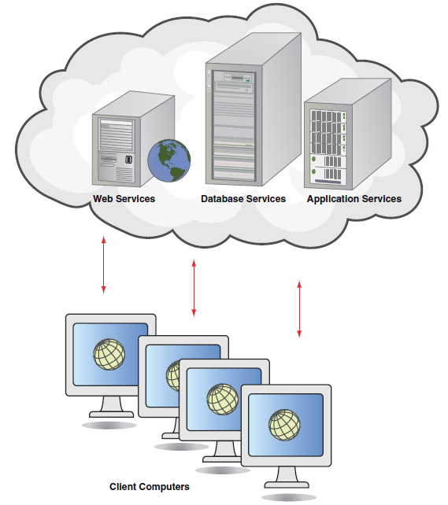
Cloud Computing (Figure 16.8)
Kendall & Kendall Copyright © 2014 Pearson Education, Inc. Publishing as Prentice Hall
16-<number>

Slide 44
Cloud Computing
A large collection of corporate users jointly bear the lowered cost
Realize increases in peak-load capacity
Companies also hope to improve their ability to perform disaster recovery
Kendall & Kendall Copyright © 2014 Pearson Education, Inc. Publishing as Prentice Hall
16-<number>

Slide 45
ERP and Cloud Computing
Many of the issues and challenges associated with implementing ERP systems can be mitigated by ERP offerings that take advantage of cloud computing
Kendall & Kendall Copyright © 2014 Pearson Education, Inc. Publishing as Prentice Hall
16-<number>

Slide 46
Network Modeling
Draw a network decomposition diagram to provide an overview of the system
Draw a hub connectivity diagram
Explode the hub connectivity diagram to show the various workstations and how they are connected
Kendall & Kendall Copyright © 2014 Pearson Education, Inc. Publishing as Prentice Hall
16-<number>
Notes:
A top-down approach is taken.

Slide 47
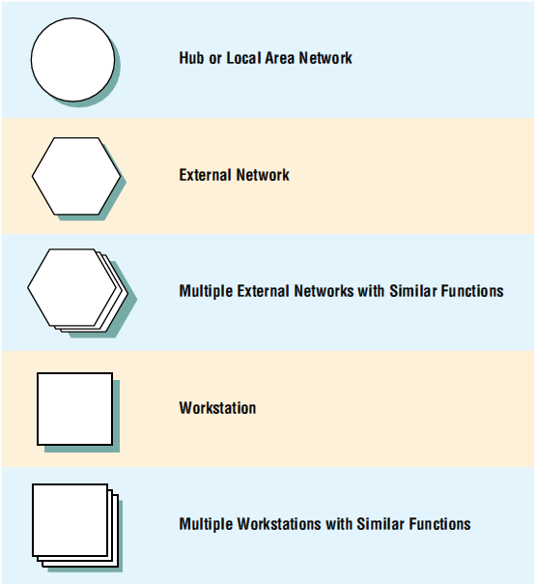
Use Special Symbols When Drawing Network Decomposition and Hub Connectivity Diagrams
(Figure 16.9)
Kendall & Kendall Copyright © 2014 Pearson Education, Inc. Publishing as Prentice Hall
16-<number>

Slide 48
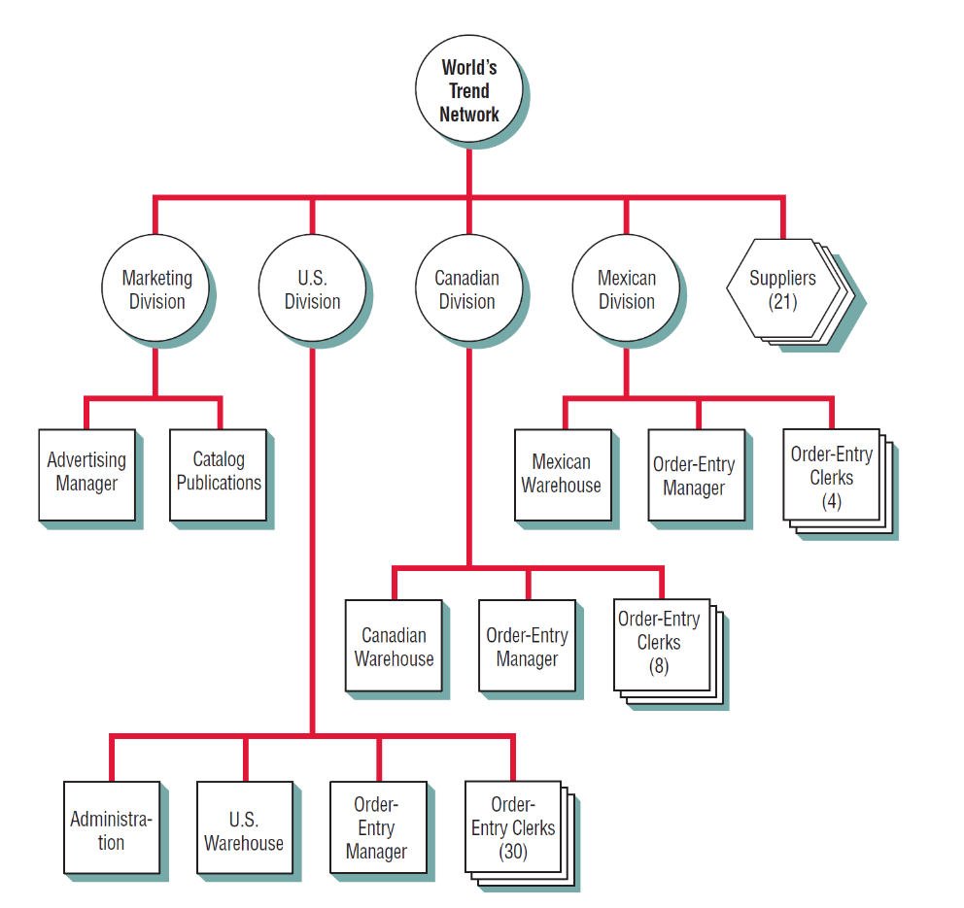
A Network Decomposition Diagram for World’s Trend (Figure 16.10)
Kendall & Kendall Copyright © 2014 Pearson Education, Inc. Publishing as Prentice Hall
16-<number>
Notes:
Start by drawing a circle at the top.
Draw a number of circles on the level below, which represent hubs for different divisions, centers, etc.
Show the workstations connected to each hub.

Slide 49
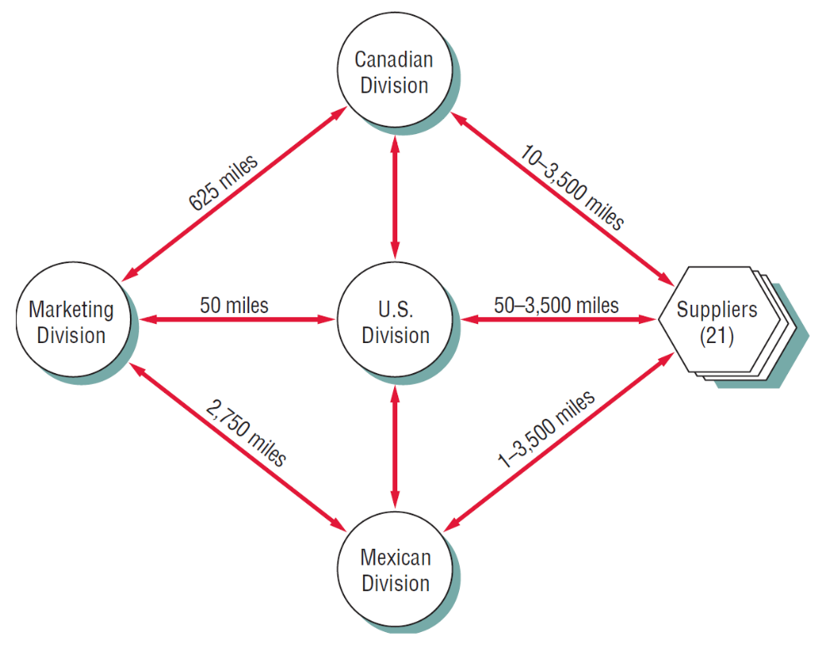
A Hub Connectivity Diagram for World’s Trend (Figure 16.11)
Kendall & Kendall Copyright © 2014 Pearson Education, Inc. Publishing as Prentice Hall
16-<number>
Notes:
Shows how the major hubs are connected.
Start by drawing all the hubs. Then experiment to see which links are necessary. Once that is done, redraw the diagram so it is attractive and communicates well to users.

Slide 50
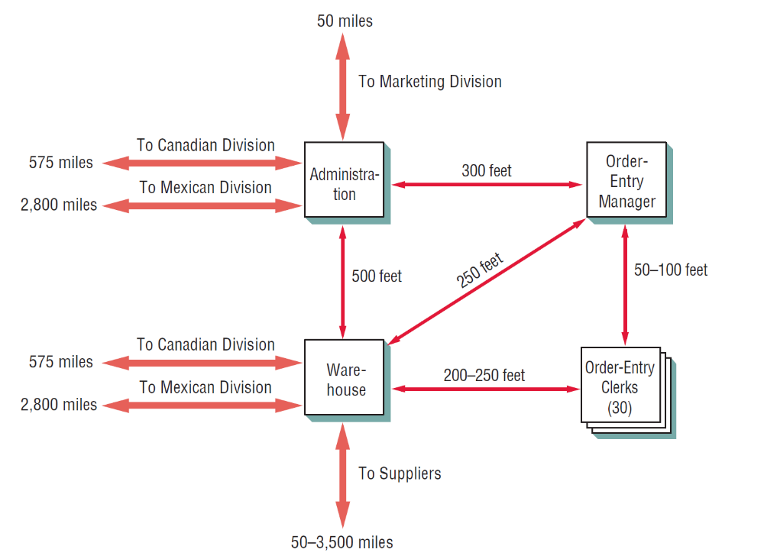
A Workstation Connectivity Diagram for World’s Trend (Figure 16.12)
Kendall & Kendall Copyright © 2014 Pearson Education, Inc. Publishing as Prentice Hall
16-<number>
Notes:
The purpose of network modeling is to show the connectivity of workstations in some detail.

Slide 51
Training
Who to train
People who train users
Training objectives
Training methods
Training sites
Training materials
Kendall & Kendall Copyright © 2014 Pearson Education, Inc. Publishing as Prentice Hall
16-<number>
Notes:
Training strategies are determined by who is being trained and who will train them.

Slide 52
Who to Train
All people who will have primary or secondary use of the system
Ensure that users of different skill levels and job interests are separated
Kendall & Kendall Copyright © 2014 Pearson Education, Inc. Publishing as Prentice Hall
16-<number>
Notes:
It is trouble to include novices in the same training sessions as experts—novices are quickly lost and experts are rapidly bored with basics

Slide 53
People Who Train Users
Vendors
Systems analysts
External paid trainers
In-house trainers
Other system users
Kendall & Kendall Copyright © 2014 Pearson Education, Inc. Publishing as Prentice Hall
16-<number>
Notes:
Vendors—often provide offsite one or two day training sessions on their equipment.
Systems analysts—know the organization so can often provide good training.
External paid trainers—may have broad experience in teaching people how to use a variety of computers.
In-house trainers—usually familiar with the skills and learning preferences of personnel and can tailor materials to their needs.
Other system users—let the trainer train a group of users who then act as trainers.

Slide 54
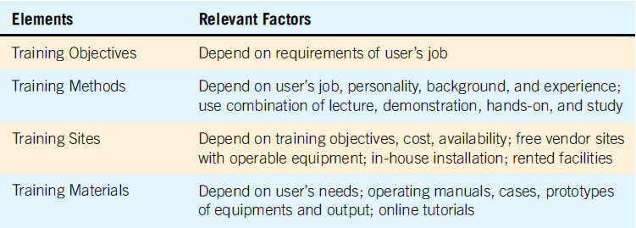
Appropriate Training Objectives, Methods, Sites, and Materials Are Contingent on Many Factors (Figure 16.13)
Kendall & Kendall Copyright © 2014 Pearson Education, Inc. Publishing as Prentice Hall
16-<number>
Notes:
Four major guidelines:
establishing measurable objectives
using appropriate training methods
selecting suitable training sites
employing understandable training materials
Training objectives—let trainees know what is expected of them and allow for evaluation of training when it is complete.
Training materials—users jobs determine what they need to know, and their personalities, experience, and backgrounds determine how they learn best.
Training sites—onsite vs. offsite
Training materials—must be clearly written for the correct audience with a minimum of jargon. Should also be well indexed and available to everyone who needs them.

Slide 55
Conversion Strategies
Direct changeover
Parallel conversion
Gradual or phased conversion
Modular prototype conversion
Distributed conversion
Kendall & Kendall Copyright © 2014 Pearson Education, Inc. Publishing as Prentice Hall
16-<number>
Notes:
There is no single best way to proceed with conversion.

Slide 56
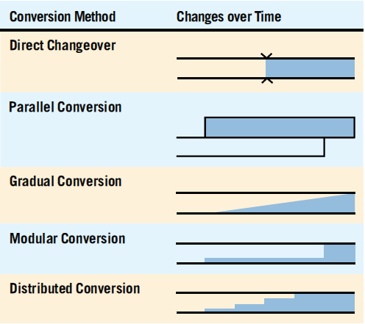
Five Conversion Strategies for Information Systems (Figure 16.14)
Kendall & Kendall Copyright © 2014 Pearson Education, Inc. Publishing as Prentice Hall
16-<number>

Slide 57
Direct Changeover
Old system stops, new one starts
Needs extensive testing
Risky approach to conversion
Users may resent being forced into using an unfamiliar system without recourse
No adequate way to compare new results to old
Kendall & Kendall Copyright © 2014 Pearson Education, Inc. Publishing as Prentice Hall
16-<number>

Slide 58
Parallel Conversion
Run the old and new systems at the same time
The advantage is that you can check new data against old data
The disadvantage is doubling employees’ workloads
Kendall & Kendall Copyright © 2014 Pearson Education, Inc. Publishing as Prentice Hall
16-<number>

Slide 59
Gradual Conversion
Combines best features of parallel and direct conversion
Volume of transactions is gradually increased
Advantage is that users get involved with the system gradually
Agile methodologies use this conversion approach
Kendall & Kendall Copyright © 2014 Pearson Education, Inc. Publishing as Prentice Hall
16-<number>

Slide 60
Modular Prototype Conversion
Each module is tested and put into use
The advantage is that each module is thoroughly tested before being used
Users are familiar with each module as it becomes operational
Object-oriented methodologies often use this approach
Kendall & Kendall Copyright © 2014 Pearson Education, Inc. Publishing as Prentice Hall
16-<number>

Slide 61
Distributed Conversion
When there are many installations of the same system, such as at branch offices
Install software at one office
Advantage is that problems can be detected and contained
Disadvantage is that even when one conversion is successful, each site will have its own peculiarities to work through
Kendall & Kendall Copyright © 2014 Pearson Education, Inc. Publishing as Prentice Hall
16-<number>
Notes:
No particular conversion approach is equally suitable for every system implementation.

Slide 62
Other Conversion Considerations
Ordering equipment
Ordering any external materials supplied to the information system
Appointing a manager to supervise the preparation of the installation site
Planning, scheduling, and supervising programmers and data entry personnel
Kendall & Kendall Copyright © 2014 Pearson Education, Inc. Publishing as Prentice Hall
16-<number>
Notes:
Ordering equipment—up to three months ahead of planned conversion.
Ordering any external materials supplied to the information system—toner cartridges, paper, preprinted forms, and magnetic media.
Many of the project management techniques; Gantt charts, PERT, successfully communicating with team members are useful for planning and controlling implementation.

Slide 63
Security Concerns
Physical security
Logical security
Behavioral security
Kendall & Kendall Copyright © 2014 Pearson Education, Inc. Publishing as Prentice Hall
16-<number>
Notes:
As more people in the organization gain greater computer power, gain access to the Web, or connect to intranets and extranets, security becomes increasingly difficult and complex.

Slide 64
Security Concerns (continued)
Physical security is securing the computer facility, its equipment, and software through physical means (backing up data)
Logical security refers to logical controls in the software itself (passwords, firewall)
Behavioral security is building and enforcing procedures to prevent the misusing of computer hardware and software
Kendall & Kendall Copyright © 2014 Pearson Education, Inc. Publishing as Prentice Hall
16-<number>
Notes:
Physical security—machine-readable badges, human sign-in/sign-out system, closed circuit television cameras to monitor computer areas, backing up data frequently and storing backups in a fireproof, waterproof area.
Logical security—passwords, firewall.
Behavioral security—employees should clearly understand what is expected of them, what is prohibited, and the extend of their rights and responsibilities.

Slide 65
Special Security Considerations for Ecommerce
Virus protection software
Email filtering products
URL filtering products
Firewalls, gateways, and virtual private networks
Intrusion detection products
Kendall & Kendall Copyright © 2014 Pearson Education, Inc. Publishing as Prentice Hall
16-<number>

Slide 66
Special Security Considerations for Ecommerce (continued)
Vulnerability management products
Security technologies such as secure socket layering (SSL) for authentication
Encryption technologies
Public key infrastructure (PKI) use and obtaining a digital certificate
Kendall & Kendall Copyright © 2014 Pearson Education, Inc. Publishing as Prentice Hall
16-<number>

Slide 67
Privacy Considerations for Ecommerce
Start with a corporate policy on privacy
Only ask for information required to complete the transaction
Make it optional for customers to fill out personal information on the website
Kendall & Kendall Copyright © 2014 Pearson Education, Inc. Publishing as Prentice Hall
16-<number>
Notes:
Start with a corporate policy on privacy—make sure it is prominently displayed.
Make it optional for customers to fill out personal information on the website—always give customers an opportunity to maintain the confidentiality of their personal data by not responding.

Slide 68
Disaster Recovery Planning
Identify teams responsible for managing a crisis
Eliminate single points of failure
Determine data replication technologies that match the organization’s timetable
Create detailed relocation and transportation plans
Kendall & Kendall Copyright © 2014 Pearson Education, Inc. Publishing as Prentice Hall
16-<number>
Notes:
Disasters might be natural or man-made:
power outage
hurricane or earthquake
9/11
Disaster preparedness suggests what a company should do if it encounters a crisis.
Disaster recover looks at how a business can continue in the aftermath of a disaster and how it can restore essential systems within the IT infrastructure.

Slide 69
Disaster Recovery Planning (continued)
Provide recovery solutions that include an off-site location
Ensure the physical and psychological well-being of employees and others
Kendall & Kendall Copyright © 2014 Pearson Education, Inc. Publishing as Prentice Hall
16-<number>

Slide 70
Identify Who Is Responsible
Whether business operations will continue
How to support communications
Where people will be sent if the business is uninhabitable
Where personnel will go in an emergency
Seeing to the personal and psychological needs
Restoring the main computing and working environments
Kendall & Kendall Copyright © 2014 Pearson Education, Inc. Publishing as Prentice Hall
16-<number>

Slide 71
Single Points of Failure and Data Replication Technologies
Redundancy of data provides the key for servers running Web applications
SNAs and data mirroring
Kendall & Kendall Copyright © 2014 Pearson Education, Inc. Publishing as Prentice Hall
16-<number>
Notes:
Storage area networks (SNAs)
Data mirroring—synchronous remote replication

Slide 72
Relocation and Transportation Plans
Send employees home
Remain on site
Relocate to a recovery facility
Kendall & Kendall Copyright © 2014 Pearson Education, Inc. Publishing as Prentice Hall
16-<number>
Notes:
A one-page memo should be sent to everyone that contains evacuation routes and employee assembly points.

Slide 73
Communication Channels
Email
Emergency information Web page
Emergency hotline
Emergency response agencies
Kendall & Kendall Copyright © 2014 Pearson Education, Inc. Publishing as Prentice Hall
16-<number>
Notes:
Must be able to communicate in the event of email failure.

Slide 74
Recovery Solutions and Support for the Well-Being of Employees
Recovery involves an off-site location and converting paper documents to digital formats
Well-being of employees might include providing water or safety kits
Kendall & Kendall Copyright © 2014 Pearson Education, Inc. Publishing as Prentice Hall
16-<number>
Notes:
One way to learn what should comprise a personal workspace disaster supplies kit is to go to the American Red Cross website (www.redcross.org).

Slide 75
Evaluation Techniques
Cost-benefit analysis
Revised decision evaluation approach
User involvement evaluations
The information system utility approach
Kendall & Kendall Copyright © 2014 Pearson Education, Inc. Publishing as Prentice Hall
16-<number>

Slide 76
Information System Utility Approach (continued)
Ownership utility answers the question of who should receive output
Goal utility answers the why of information systems by asking whether the output has value in helping the organization achieve its objectives
Place utility answers the question of where information is distributed
Kendall & Kendall Copyright © 2014 Pearson Education, Inc. Publishing as Prentice Hall
16-<number>

Slide 77
Information System Utility Approach (continued)
Form utility answers the question of what kind of output is distributed to the decision maker
Time utility answers the question of when information is delivered
Actualization utility involves how the information is introduced and used by the decision maker
Kendall & Kendall Copyright © 2014 Pearson Education, Inc. Publishing as Prentice Hall
16-<number>

Slide 78
Website Evaluation
Know how often the website is visited
Learn details about specific pages on the site
Find out more about the website’s visitors
Kendall & Kendall Copyright © 2014 Pearson Education, Inc. Publishing as Prentice Hall
16-<number>

Slide 79
Website Evaluation (continued)
Discover if visitors can properly fill out the forms you designed
Find out who is referring website visitors to the client’s site
Determine what browsers visitors are using
Find out if the client’s website visitors are interested in advertising
Kendall & Kendall Copyright © 2014 Pearson Education, Inc. Publishing as Prentice Hall
16-<number>

Slide 80
Summary
TQM
  Designing systems and software with a top-down, modular approach
  Designing and documenting systems and software using systematic methods
  Testing systems and software so that they can be easily maintained and audited
Kendall & Kendall Copyright © 2014 Pearson Education, Inc. Publishing as Prentice Hall
16-<number>

Slide 81
Summary (continued)
Six Sigma
  Define the problem
  Observe the problem
  Analyze the causes
  Act on the causes
  Study the results
  Standardize the changes
  Draw conclusions
Kendall & Kendall Copyright © 2014 Pearson Education, Inc. Publishing as Prentice Hall
16-<number>

Slide 82
Summary (continued)
Structure charts
Procedure manuals
FOLKLORE
Testing
System maintenance
Auditing
Kendall & Kendall Copyright © 2014 Pearson Education, Inc. Publishing as Prentice Hall
16-<number>

Slide 83
Summary
Implementation
Distributed systems
  Client-server
Training users and personnel
Conversion
  Direct changeover
  Parallel
  Phased
  Gradual
  Modular prototype
Kendall & Kendall Copyright © 2014 Pearson Education, Inc. Publishing as Prentice Hall
16-<number>

Slide 84
Summary (continued)
Security
  Physical
  Logical
  Behavioral
Organizational metaphors
Evaluation
Kendall & Kendall Copyright © 2014 Pearson Education, Inc. Publishing as Prentice Hall
16-<number>

Slide 85

Copyright © 2014 Pearson Education, Inc.
Publishing as Prentice Hall
16-<number>

