Slide 1
Subdue Graph Visualizer
by
Gayathri Sampath, M.S. (CSE)
University of Texas at Arlington
Supervising Committee
Dr. Lawrence Holder
Dr. Diane Cook
Dr. Lynn Peterson

Slide 2
Motivation
Visual description aids pattern discovery and analysis
Existing tools are not suitable to sufficiently display domain information
Need for a tool that
  Displays objects specified by the user using simple and complex shapes
  Allows the user to view the input and substructure graphics in navigable windows
  Allows text in the graphics
  Interacts easily with Subdue

Slide 3
Outline of Presentation
Subdue
Input Database
Other Visualization Tools
Subdue Graph Visualizer
Experiments
Screen shots
Conclusion

Slide 4
Subdue
Finds patterns in structural data
Input is in graph form
Uses MDL principle to discover substructures
Substructures discovered compress the input graph
The best substructures are chosen based on their compression value
Search continues until computational limit reached or all substructures have been found
Notes:
Data with relationships between the attributes
Graph contains vertices and edges
Substructures are subgraphs in the input graph
Substructures need not be identical
For these input, what are you using? Computational limit or all substructures?

Slide 5
Sample Input Database
T1
S1
C1
R1
T2
T3
T4
S2
S3
S4
Notes:
Very common example with Subdue
When subdue executes – with a computational limit of 3, it finds 6 substructures
Intuitively we can see that triangle on square is a recurring substructure
Others are triangle, square, triangle with text,etc
These are chosen based on their compression value

Slide 6
Portion of Input graph
shape
object
triangle
on
shape
shape
object
square
object
circle
on
on
shape
object
rectangle

Slide 7
Sample Substructure and Instances
T1
T2
object
shape
triangle
S1
S2
on
T3
T4
object
shape
square
S3
S4

Slide 8
Other Visualization Tools
Dotty
GraphEd
DaVinci
VCG
OpenGL
SGV
Basic Geometric Shapes
Text
Interface to Subdue
Define new shapes
Multiple windows
Window navigation
Color objects in window

Slide 9
Subdue Graph Visualizer
Programmed in Java and uses socket programming to communicate with Subdue
Draws input and substructures in separate windows
Has the ability to display color and text
Allows the user to specify new shapes as combination of pre-existing shapes

Slide 10
SGV Process…
Specify graphics in input graph
Start both programs
Socket communication is established
Subdue sends input filename first
SGV opens input file, parses the graphics and stores the specification
SGV displays main input graph in a window

Slide 11
…SGV Process…
Subdue sends substructure information as and when discovered
SGV displays substructures in a separate window and stores substructures in a list
The substructures are ordered on compression value
When Subdue finishes, socket communication is terminated and Subdue exits
SGV is still active for user interaction

Slide 12
…SGV Process
User can peruse the substructures in the substructure window
As each substructure is viewed, all instances of this substructure are highlighted in the main graph window
Main window has capability to zoom
Both windows have capability to scroll

Slide 13
Sample from Input file
v 11 triangle ((polygon (( 150.0 200.0) ( 250.0 200.0) (200.0 100.0)) (color blue fill no)))
The first part is similar to input to Subdue
Graphics specifies that the figure is a polygon with vertices at the three coordinates given, the color of the polygon is blue and it is not shaded.
A polygon is interpreted as any shape with one or more coordinates

Slide 14
Sample from Input File
v 19 circle ((circle (750.0 200.0 ) 100.0 (color green fill no)) )
v 5 object ((text "Square" (200.0 250.0 ) (font Courier size 12) (color green) ) )
Circle graphics specifies that the object is a ‘circle’ with the center at the coordinates given and radius 100
For text, attributes font type and font size are also specified
The color and fill specifications are similar to polygon
More than one graphics object can be included for each vertex or edge

Slide 15
Experiments
Tested on 3 input cases
  Input consisting of basic geometric shapes
  More complex input but with basic geometric shapes
  A chemical structure consisting of single and double bonds

Slide 16
Screen shots

Slide 17
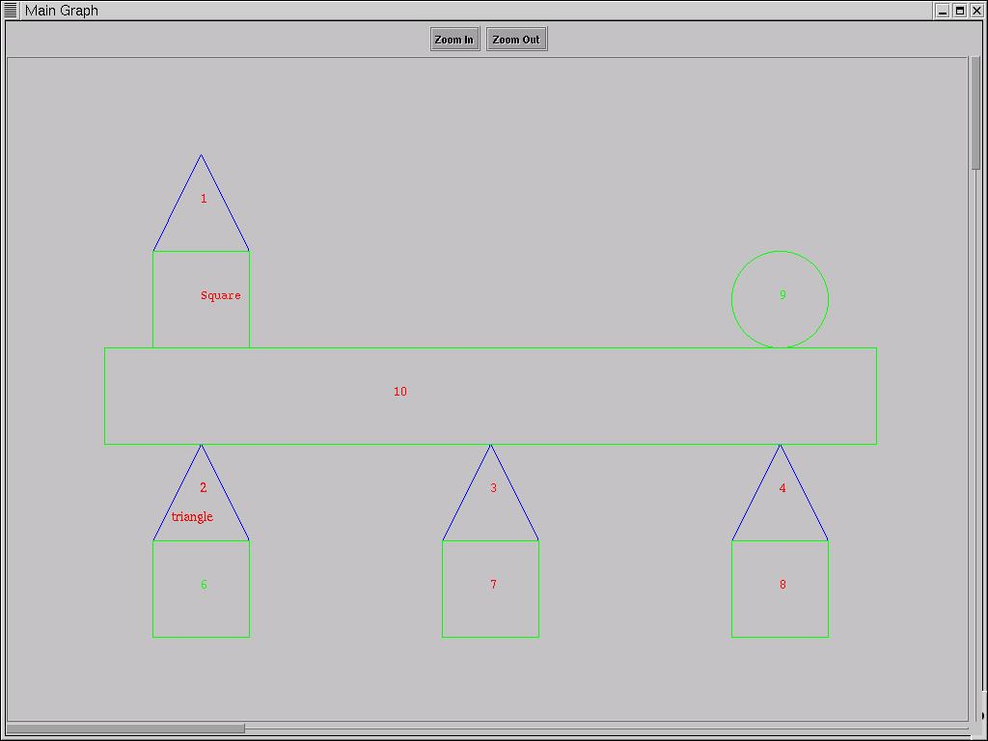
Input graph for sample input consisting of geometric shapes

Slide 18
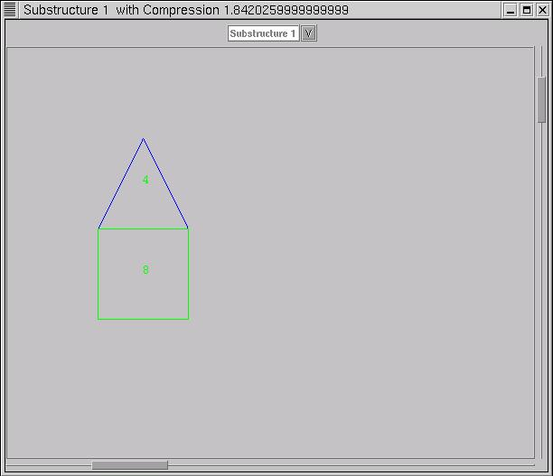
Sample substructure

Slide 19
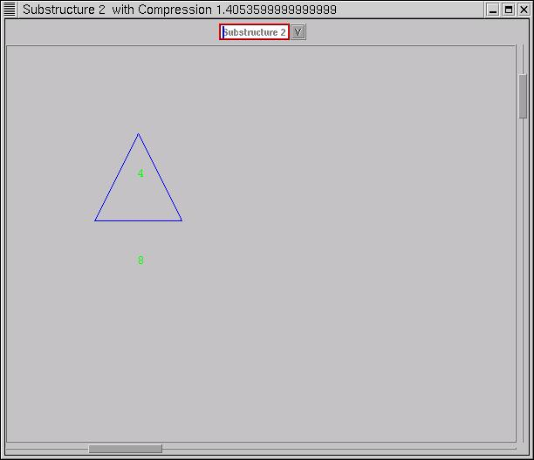
Another substructure

Slide 20
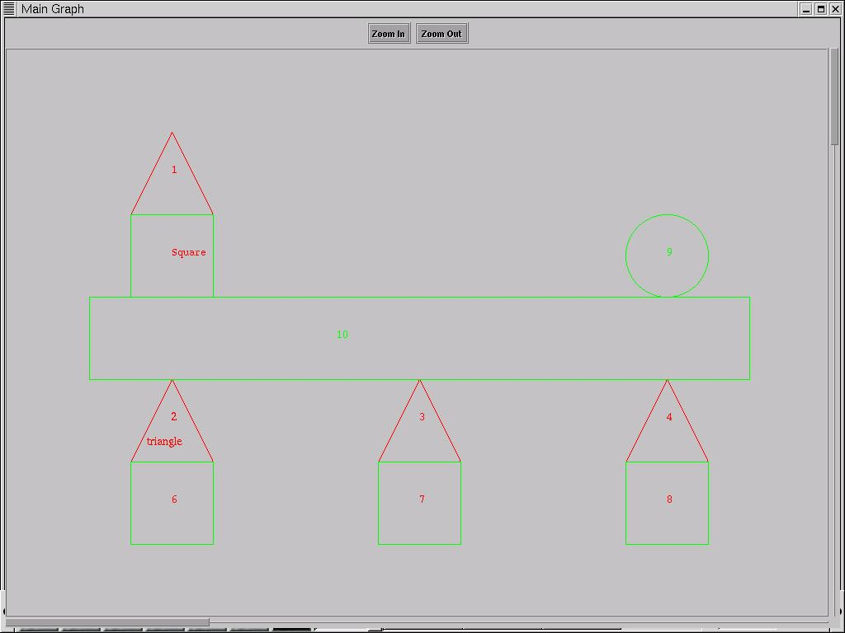
Main graph with substructure highlighted

Slide 21
Conclusion
SGV is able to display input and output in multiple navigable windows
SGV input can be configured to draw most shapes
Flexible color and font specifications
SGV can be very easily adapted to future modifications and requirements of Subdue
The grammar for input specification can be easily modified to accept more graphics concepts
SGV does not interrupt Subdue while execution – therefore there is no noticeable delay in Subdue run time.

Slide 22
Future Work
SGV can be altered to work for parallel implementation of Subdue
SGV can be modified to work for multiple iterations of Subdue

