Slide 1
DETAILED DEMO DECK
Smartphone-First Telematics
Dual camera (driver + road) · AI distraction detection · Geofencing · Live dashcam
FleetCo Management · https://fleetcomanagement.org · October 8, 2026
Smartphone Telematics Demo · https://fleetcomanagement.org · Slide 1

Slide 2
AGENDA
What you will review in this session (80+ slides)
Part 1–2 — Context and capability matrix (phone vs hardware telematics)
Part 3 — FleetCo Driver today: GPS, live dashcam, Safety AI backend
Part 3B — Dual-camera review: iPhone & Android front (driver) + rear (road) at the same time
Part 4 — Proposed build: native dual cam, AI on both streams, geofencing, optional OBD
Part 5–6 — Geofencing scenarios and AI distraction detection (detailed event types)
Part 7–12 — Diagnostics, architecture, costs, legal, roadmap, live demo script
Part 14 — Website messaging · Appendix — downloads and code references
Smartphone Telematics Demo · https://fleetcomanagement.org · Slide 2

Slide 3
EXECUTIVE SUMMARY
Recommendation in one slide
Dual monitoring goal: rear camera on the road + front (selfie) camera on the driver, recording together while on shift — AI flags distraction (phone, eyes off road, drowsiness, etc.).
Android: many devices support true front+rear concurrent capture via Camera2 (Android 11+); must detect support at runtime — not every model qualifies.
iPhone: simultaneous front+rear is supported natively (AVCaptureMultiCamSession, A12+), but not reliably via browser getUserMedia alone — ship a Capacitor dual-cam native plugin for iOS (and premium Android).
AI: Gemini vision already uses separate road vs cabin prompts in drivingSafetyAi.js — sample frames from BOTH streams during live dashcam; managers review DrivingSafetyEvent queue.
Also in PhonePulse: geofence alerts, background GPS, optional BLE OBD — see later parts of this deck.
Smartphone Telematics Demo · https://fleetcomanagement.org · Slide 3

Slide 4
PART 1 · CONTEXT
The telematics buyer question
Fleet managers want real-time visibility, safety scoring, and geofence alerts — often quoted as part of a “full telematics ecosystem.”
Traditional vendors sell a vehicle-mounted device + monthly SaaS per asset ($25–$45/unit/mo is common).
SMB carriers already issue phones and use FleetCo for dispatch, ROs, and driver workflows.
Strategic question: Can we extend the driver app instead of mandating new hardware on every unit?
Smartphone Telematics Demo · https://fleetcomanagement.org · Slide 4

Slide 5
PART 1 · CONTEXT
Three capabilities you asked about
Safety & compliance
Operations & maintenance
Real-time AI distraction monitoring (phone, eyes off road, drowsiness)
Live or near-live video to the office
Event log tied to driver, unit, and GPS
Localized geofencing alerts (yard, customer, restricted zones)
Advanced engine diagnostics (DTCs, J1939 on heavy trucks)
Integration with FleetCo portal (map, ROs, notifications)
Smartphone Telematics Demo · https://fleetcomanagement.org · Slide 5

Slide 6
PART 1 · CONTEXT
Dedicated telematics box vs company phone
Dimension | Hardware telematics | FleetCo phone-first
Upfront cost | $150–$500+ per install | $0 extra if phone already issued
Time to deploy | Installer visit or ship/wait | App update + driver permissions
Engine data | Native OBD/J1939 | Requires optional dongle
Driver video AI | Vendor-specific DVR | Gemini on road/cabin frames
Contract lock-in | Often multi-year | Your existing FleetCo subscription
Smartphone Telematics Demo · https://fleetcomanagement.org · Slide 6

Slide 7
PART 1 · CONTEXT
Where this fits FleetCo pricing
Tailored scope · telematics · custom integrations · dedicated account team
Per-unit SaaS
Enterprise
$35/unit/mo
Full portal · driver app · pay only for units you run · 5% off annual
Telematics features become a differentiator inside the same login
Custom telematics scope
LiveKit, Gemini usage, OBD rollout at scale
Dedicated account team for mixed fleets (light + heavy duty)
Smartphone Telematics Demo · https://fleetcomanagement.org · Slide 7

Slide 8
PART 2 · CAPABILITY MATRIX
Can newest iPhone / Android do it without extra vehicle hardware?
Capability | Phone-only? | FleetCo today
Live GPS while driving | Yes — with native app permissions | Yes — DriverLocation ~30s while clocked in
Geofence enter/exit alerts | Yes — server or native regions | Partial — map shapes, no auto alerts yet
AI distraction / phone use | Partial — cloud vision on camera frames | Backend built; not on live stream yet
Dual camera (road + driver) | Yes natively; WebView varies | JS dual stream today; native plugin recommended
Live dashcam to office | Yes — foreground camera + stream | Yes — LiveKit or chunked live
Live ECU / J1939 diagnostics | No — needs vehicle bus adapter | Manual DTC entry + AI explain only
Harsh braking from vehicle CAN | No without bus | Could approximate with phone IMU (future)
Smartphone Telematics Demo · https://fleetcomanagement.org · Slide 8

Slide 9
PART 2 · LIMITS
What we will not over-promise on the website
Continuous tamper-proof ELD-grade logging from phone sensors alone (FMCSA hardware rules differ from fleet GPS).
Full J1939 parameter groups (fuel rate, DEF, aftertreatment) without a J1939-capable adapter or OEM feed.
DVR-quality 360° coverage — phone mount = one or two angles, not four camera angles.
Background cabin monitoring on iOS when the app is not active — OS privacy limits apply.
Smartphone Telematics Demo · https://fleetcomanagement.org · Slide 9

Slide 10
PART 2 · LIMITS
What we can promise confidently
Clocked-in drivers appear on Fleet Map with speed, heading, and trails when GPS is allowed.
Office can watch live dashcam when driver starts Live Dashcam (optional LiveKit for lower latency).
Safety events (distraction, phone_use, etc.) can be stored as DrivingSafetyEvent records with map context.
Customers can receive push/email when geofence rules fire — after server-side geofence engine ships.
Smartphone Telematics Demo · https://fleetcomanagement.org · Slide 10

Slide 11
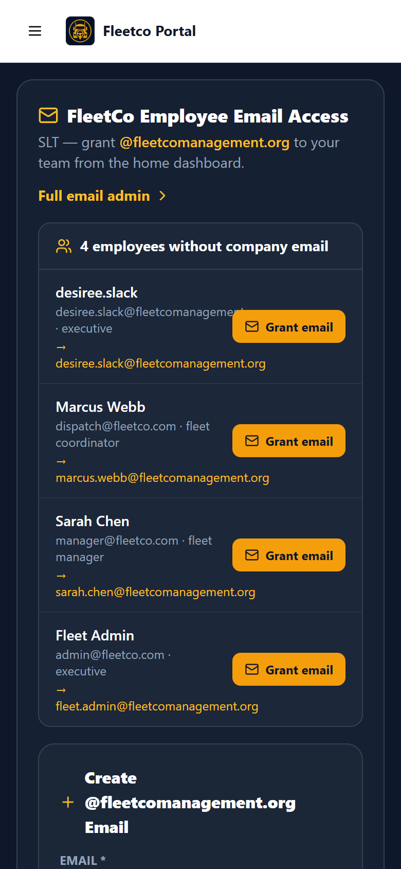
PART 3 · TODAY
Driver app home — telematics entry point
Package: org.fleetcomanagement.driver (Capacitor native shell)
Dashcam, Time Clock, POD, inspections from one mobile hub
Permissions gate: camera + location before full features
iOS Safari: camera often requires tap on Dashcam (policy-compliant UX)
FleetCo Driver — mobile home
Smartphone Telematics Demo · https://fleetcomanagement.org · Slide 11

Slide 12

PART 3 · TODAY
Time clock ties GPS to shifts
useDriverLocation pings every 30 seconds while clocked in
Creates DriverLocation rows: lat, lng, speed, heading, unit, trailer
Source field: driver_app — visible on Fleet Map & Route Dashboard
Offline queue coalesces GPS writes in IndexedDB when cell drops
Time clock + GPS permission
Smartphone Telematics Demo · https://fleetcomanagement.org · Slide 12

Slide 13
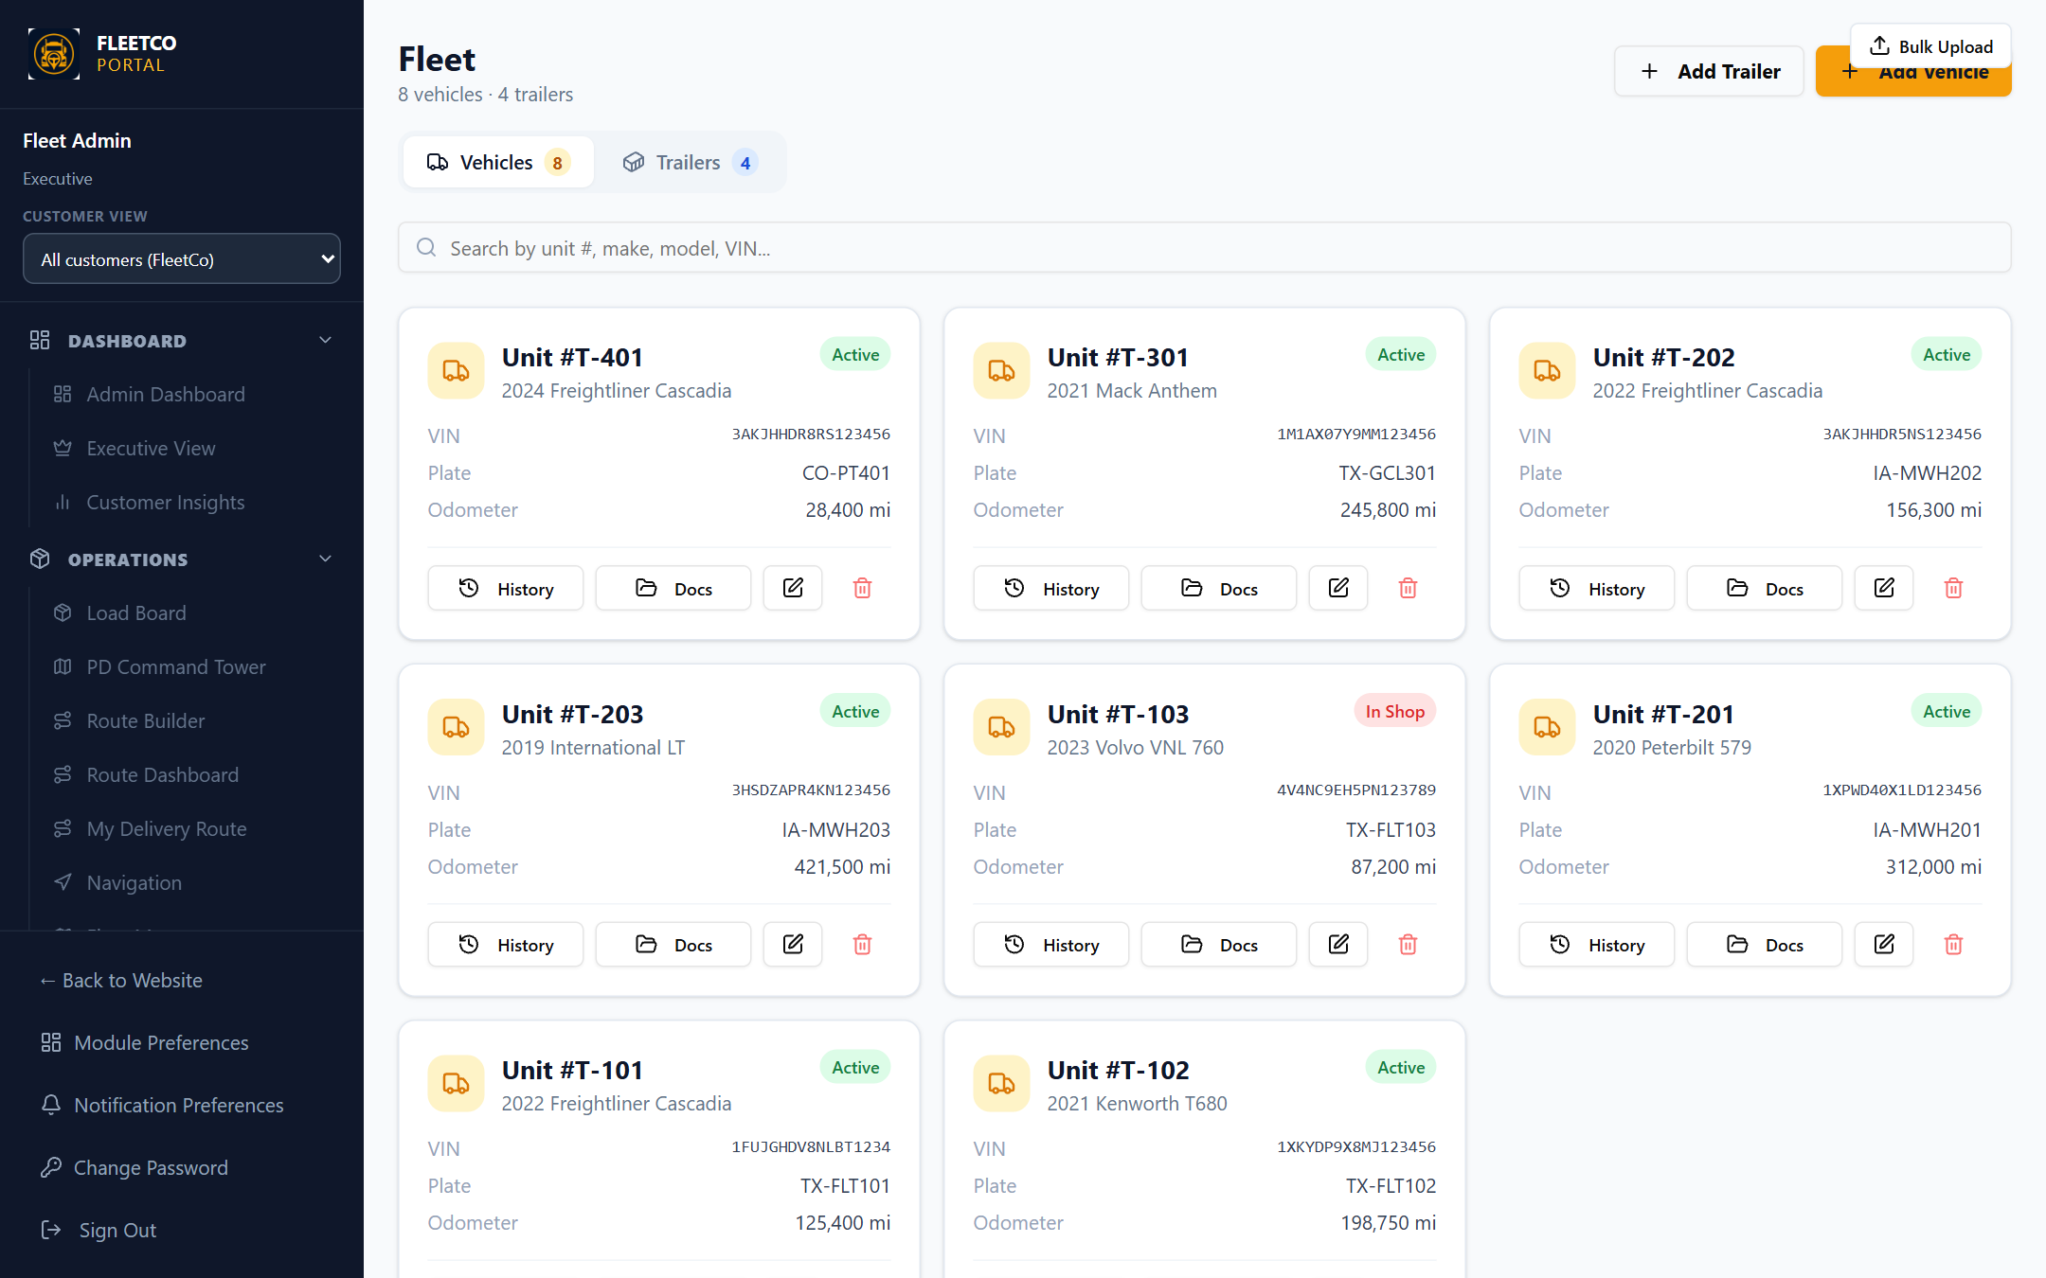
PART 3 · TODAY
Portal fleet map — live positions
Fleet Map subscribes to DriverLocation for near-real-time markers
Circle and rectangle overlays support geofence-style visualization
Per-vehicle map colors and unit labels for dispatch clarity
Proposed: evaluate geofence polygons on each ping server-side
Fleet units / map context
Smartphone Telematics Demo · https://fleetcomanagement.org · Slide 13

Slide 14
PART 3 · TODAY
Live dashcam pipeline (already shipped)
Driver actions
Start Live Dashcam from driver UI while on shift
Android: DashcamForegroundService keeps camera alive
Modes: LiveKit WebRTC if configured, else chunked upload (~3–5s delay)
Office actions
Watch live session from portal live stream components
Recordings retained per LiveStreamRecording policy
Safety AI hook point: sample JPEG from stream every N seconds
Smartphone Telematics Demo · https://fleetcomanagement.org · Slide 14

Slide 15
PART 3 · TODAY
Safety AI backend (Gemini vision)
Module: server/drivingSafetyAi.js — analyzes frames for lane_departure, distraction, phone_use, drowsiness, etc.
Creates DrivingSafetyEvent entities with severity, confidence, lat/lng, speed
Customer flag: driver_safety_ai_enabled can disable per fleet
Requires GEMINI_API_KEY in production; sub-0.55 confidence events filtered out
Gap: analyzeDashcamFrameAsync exists but photo capture path disabled — must attach to live chunks
Smartphone Telematics Demo · https://fleetcomanagement.org · Slide 15

Slide 16
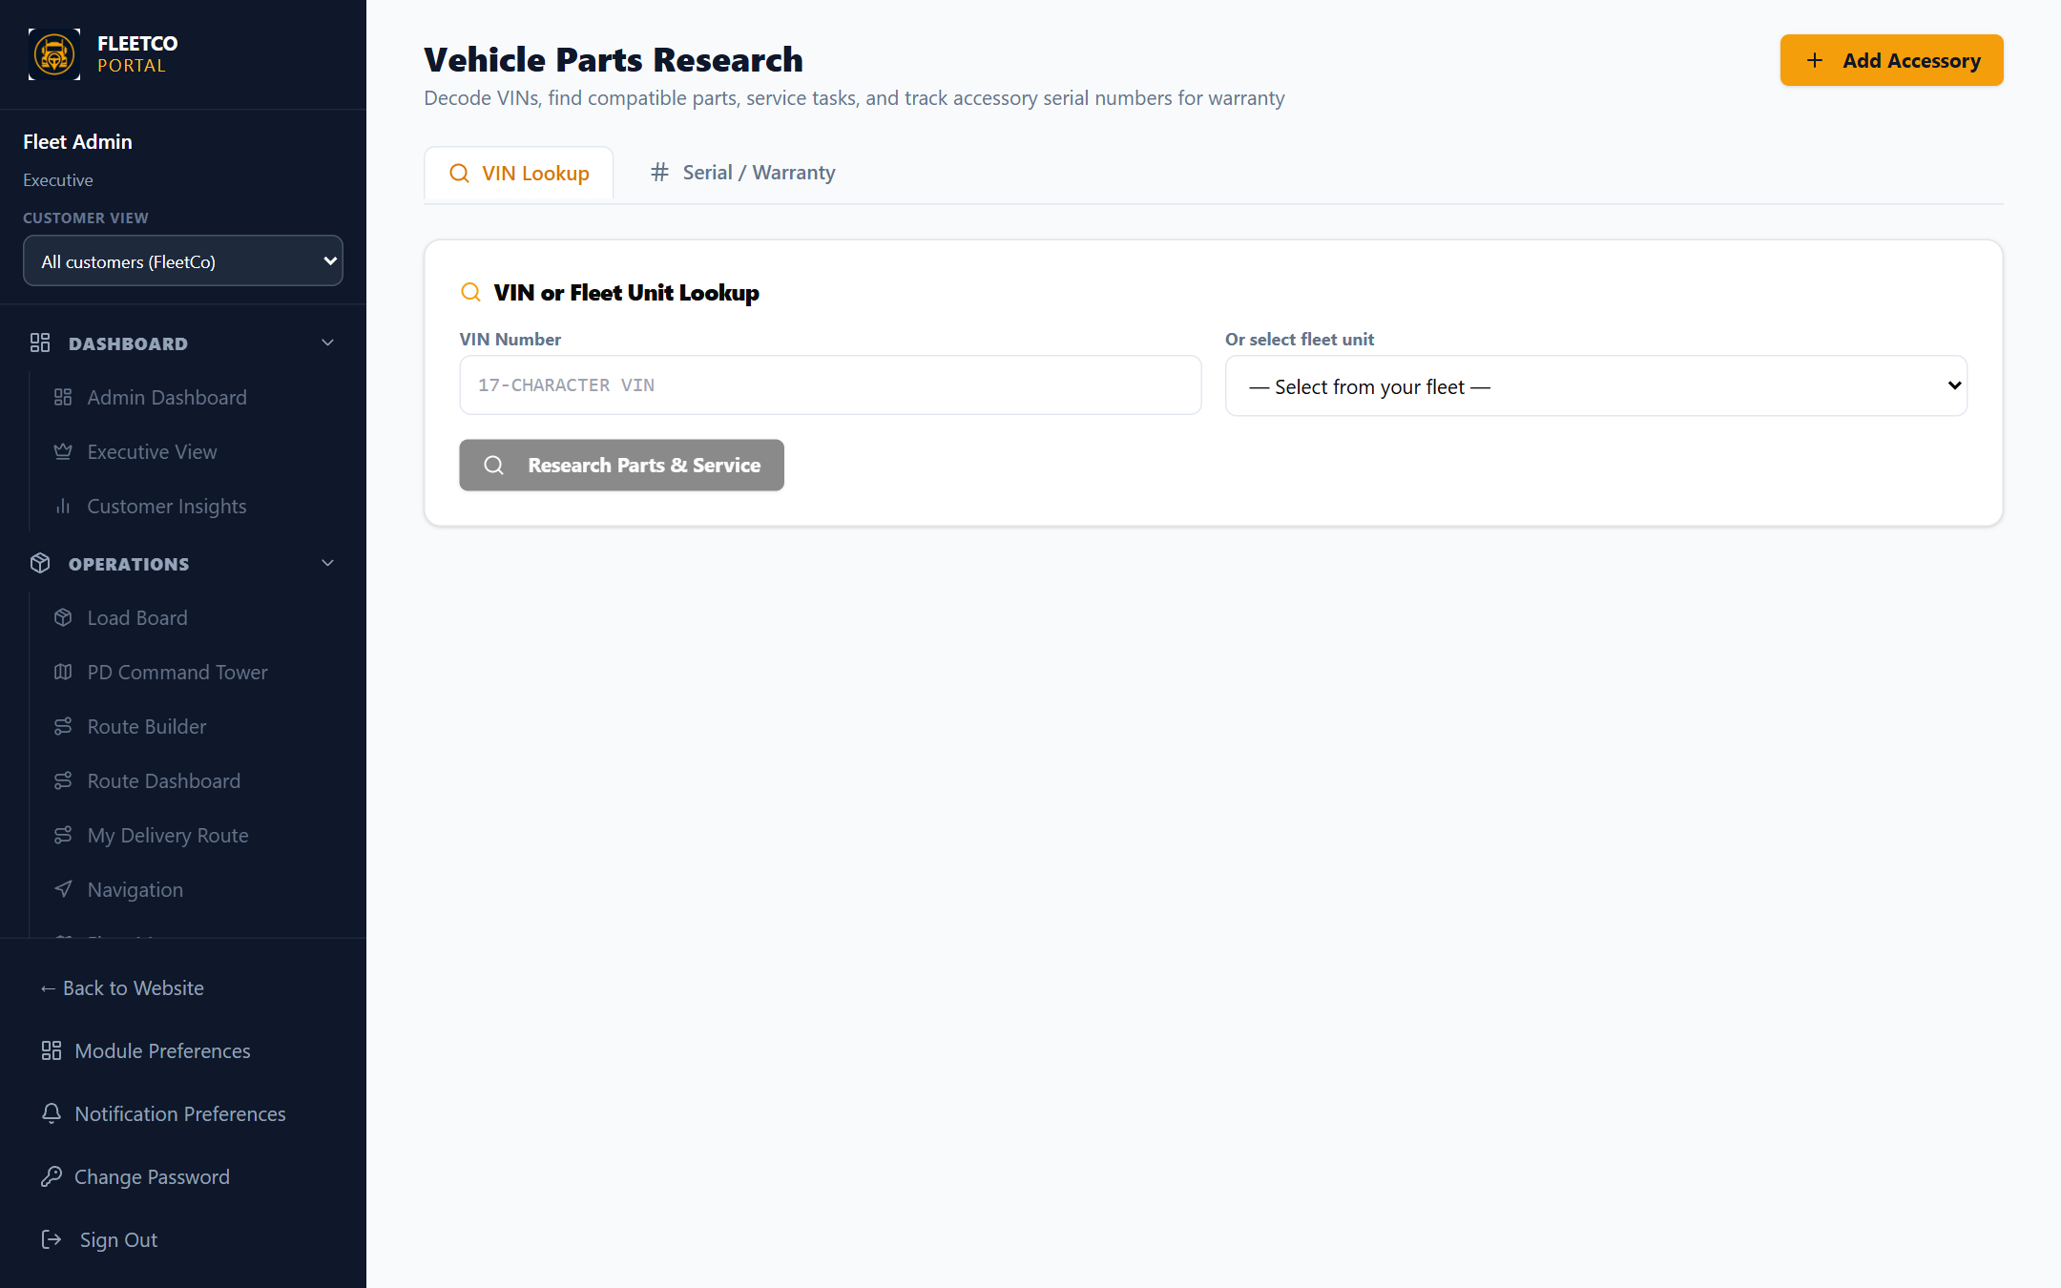
PART 3 · TODAY
Diagnostics module — shop workflow today
Portal → Diagnostics stores DTC records per vehicle
Supports OBD-II, J1939, J1708 labels — data entry is manual
AI Assistant interprets pasted codes for mechanics
Not connected to driver phone or Bluetooth adapter yet
Vehicle / diagnostics context
Smartphone Telematics Demo · https://fleetcomanagement.org · Slide 16

Slide 17
PART 3 · TODAY
Dual camera — current FleetCo code (WebView layer)
What the app does now
Gap vs product goal
startDualCameraStreams() opens road (environment) then cabin (user) via getUserMedia
Returns dualSupported: true only if BOTH streams open — see nativeBridge.js
Customer toggle: driver_dual_camera_enabled on Customer / Driver Media
Dashcam mode dual_monitoring exists in server DASHCAM_MODES list
Capacitor WebView on iPhone often fails second stream → road-only fallback
Live dashcam today primarily streams road camera to office
Safety AI (analyzeDashcamFrameAsync) ready but not fed from live dual streams yet
Next step: native dual-cam capture (Part 3B review)
Smartphone Telematics Demo · https://fleetcomanagement.org · Slide 17

Slide 18
PART 3B · DUAL CAMERA
Product goal: two cameras, one session
Rear / “back” camera (environment): wide view of lanes, traffic, road hazards — mounted on dash or windshield.
Front / “selfie” camera (user): faces the driver (not screen recording) — detects glance away, phone at ear, head nodding.
Both should run together while the driver is clocked in and Live Dashcam (or dual monitoring) is active.
Office receives live road video; AI periodically analyzes JPEG samples from road AND driver cameras.
Smartphone Telematics Demo · https://fleetcomanagement.org · Slide 18

Slide 19
PART 3B · DUAL CAMERA
Physical setup on the phone
Mounting (typical OTR cab)
[Windshield mount — landscape]
Back camera → road ahead (primary live stream to fleet)
Front camera → driver face (cabin AI stream)
Tips: avoid blocking lens; charge continuously;
Android foreground service / iOS keep-awake while recording.
Smartphone Telematics Demo · https://fleetcomanagement.org · Slide 19

Slide 20
PART 3B · DUAL CAMERA
Why “two getUserMedia calls” is not enough on iPhone
FleetCo Driver runs as Capacitor — camera access is often WKWebView getUserMedia, same family as Safari.
Apple documents one active capture session per app for many web flows; second facingMode may fail silently.
That matches our code comment: “iOS may only allow one stream — dualSupported: false on fallback.”
For reliable dual recording on iPhone 11 and newer (A12+), use AVFoundation AVCaptureMultiCamSession in native code.
Smartphone Telematics Demo · https://fleetcomanagement.org · Slide 20

Slide 21
PART 3B · IPHONE REVIEW
Apple simultaneous front + rear (native)
Topic | Detail
API | AVCaptureMultiCamSession + supportedMultiCamDeviceSets (iOS 13+)
Hardware | iPhone / iPad with A12 or later recommended (Apple sample requirement)
Capability | Record front + back into separate outputs or PiP-style preview (Apple AVMultiCamPiP sample)
Limits | One MultiCam session per app; no cloning one camera to two outputs; watch thermal/system pressure
Pressure cost | Apple WWDC guidance: sustained capture depends on systemPressureCost — long haul may need lower resolution
FleetCo action | Capacitor plugin: startDualNativeCapture → two JPEG/video buffers to JS
Smartphone Telematics Demo · https://fleetcomanagement.org · Slide 21

Slide 22
PART 3B · IPHONE REVIEW
iPhone — what to tell sales & drivers
Supported experience (after native plugin)
Not supported / degraded
iPhone 11+ class devices: driver + road together in FleetCo Driver app
Distraction AI uses front-camera samples (cabin prompt in Safety AI)
Road AI uses rear-camera samples (lane, tailgating, etc.)
Live office view can remain road-primary; cabin snapshots in safety inbox
Very old iPhones pre-A12 — single camera only
Mobile Safari-only users — gesture-limited, expect road-only
Background-only cabin monitoring when app killed — iOS privacy blocks
Screen recording of dispatch app — different feature; not used for safety AI
Smartphone Telematics Demo · https://fleetcomanagement.org · Slide 22

Slide 23
PART 3B · ANDROID REVIEW
Android simultaneous front + rear (native)
Topic | Detail
API level | Android 11 (API 30)+ concurrent camera streaming in Camera2
Discovery | CameraManager.getConcurrentCameraIds() + isConcurrentSessionConfigurationSupported()
Feature flag | PackageManager.FEATURE_CAMERA_CONCURRENT on some OEM builds
CameraX | High-level CameraX does NOT select front + back together — use Camera2 for dual
OEM reality | Must test Samsung, Pixel, Motorola, etc. — HAL support varies by model
FleetCo action | Native module mirrors iOS plugin; fallback to current JS dual stream if unsupported
Smartphone Telematics Demo · https://fleetcomanagement.org · Slide 23

Slide 24
PART 3B · ANDROID REVIEW
Runtime detection flow (recommended)
On app launch (or first dashcam start): query concurrent camera ID pairs for desired resolutions.
If supported: start native dual session — road 720p + driver 480p (example tiers for thermal/data).
If unsupported: dualSupported false — show driver message “Road monitoring only on this device.”
Log device model + support flag to portal for fleet IT (know which units need upgrade phones).
Smartphone Telematics Demo · https://fleetcomanagement.org · Slide 24

Slide 25
PART 3B · COMPARISON
Recording driver + road at the same time — summary
Layer | iPhone (recent) | Android (recent) | FleetCo today
Browser / WebView only | Usually one stream | Often two streams | startDualCameraStreams — mixed results
Native dual capture | Yes — MultiCam | Yes — if OEM supports concurrent | Not shipped yet — recommended
Live stream to office | Road cam practical | Road cam practical | LiveKit or chunked — road focus
AI on driver cam | Needs native or periodic tap | Strongest on dual-native Android | Cabin prompt ready in Gemini
Fleet policy | Issue A12+ iPhones for safety fleets | Prefer API 30+ with concurrent feature | Toggle dual camera per customer
Smartphone Telematics Demo · https://fleetcomanagement.org · Slide 25

Slide 26
PART 3B · DUAL CAMERA
Recording vs AI sampling (architecture choice)
Full dual video recording
Frame sampling for AI (v1 recommendation)
Two encoded tracks (MP4 or WebM chunks) — higher storage and upload cost
Best for litigation-grade review of distraction incidents
Requires native pipeline on both platforms for reliability
Continue live road stream as today; sample JPEG every 5–15s from each camera
Upload frames → analyzeDashcamFrameAsync with camera_facing road vs cabin
Store thumbnail on DrivingSafetyEvent; optional short clip on high severity
Lower cost than dual full video; sufficient for coaching workflow
Smartphone Telematics Demo · https://fleetcomanagement.org · Slide 26

Slide 27
PART 3B · DUAL CAMERA
End-to-end flow with AI distraction review
PhonePulse dual-cam + AI
[Native or JS dual capture]
Rear frames → live stream + road AI (lane, tailgating, …)
Front frames → cabin AI (distraction, phone_use, drowsiness, …)
[FleetCo API] drivingSafetyAi.js → DrivingSafetyEvent
[Portal] Safety inbox · map pin · acknowledge · coaching
Smartphone Telematics Demo · https://fleetcomanagement.org · Slide 27

Slide 28
PART 3B · AI DISTRACTION
Distraction & behavior types (cabin / driver camera)
AI type | What it means | Typical manager action
distraction | Eyes not on road environment — looking down/side | Coaching reminder
phone_use | Phone at ear or visible texting | Policy violation review
drowsiness | Head nod, eyes closed pattern | Break / fitness for duty check
no_seatbelt | Belt not visible when expected | Safety bulletin
impaired | Low-confidence cues only | Human review — never auto-accuse
Smartphone Telematics Demo · https://fleetcomanagement.org · Slide 28

Slide 29
PART 3B · AI DISTRACTION
Road camera AI (supports distraction context)
AI type | What it means | Pairs with driver cam
lane_departure / lane_split | Weaving or drifting | Confirms driver not watching road
tailgating | Following too close | May correlate with distraction event same timestamp
harsh_braking | Vision-inferred sudden slow | Could trigger burst sampling on both cams
other / road hazard | Debris, weather, etc. | Operational alert — not discipline
Smartphone Telematics Demo · https://fleetcomanagement.org · Slide 29

Slide 30
PART 3B · DUAL CAMERA
Implementation phases (FleetCo engineering)
Phase A — Wire live dashcam to emit paired road+cabin JPEGs when dualSupported (Android JS path) + Safety AI on both.
Phase B — iOS + Android Capacitor DualCam plugin (MultiCam + Camera2 concurrent) with feature detection.
Phase C — Portal Safety inbox UI, filters, retention policy, customer driver_safety_ai_enabled.
Phase D — Optional dual full-video upload for enterprise; LiveKit secondary track or chunked cabin channel.
Smartphone Telematics Demo · https://fleetcomanagement.org · Slide 30

Slide 31
PART 3B · DUAL CAMERA
QA device matrix (pilot before marketing claims)
iPhone 13/14/15/16 on Capacitor production build — verify native plugin dual capture 30+ min
Samsung Galaxy S series + Pixel 8/9 — concurrent API true/false logged
Budget Android without FEATURE_CAMERA_CONCURRENT — confirm graceful road-only UX
Compare dualSupported flag from JS vs native probe — single telemetry field in portal
Smartphone Telematics Demo · https://fleetcomanagement.org · Slide 31

Slide 32
PART 4 · PROPOSED
Engineering workstreams (updated priority)
WS0 — Native dual camera (iOS MultiCam + Android concurrent Camera2) with WebView fallback
WS1 — Sample road + driver frames from live dashcam → Gemini → DrivingSafetyEvent inbox
WS2 — Geofence definitions + enter/exit/dwell alerts (push, email, PortalActivity)
WS3 — Background location hardening (Capacitor Geolocation, iOS Always, Android foreground service)
WS4 — Optional BLE OBD/J1939 adapter → auto DiagnosticCode rows
Smartphone Telematics Demo · https://fleetcomanagement.org · Slide 32

Slide 33
PART 4 · PROPOSED
Target architecture after changes
Data flow
[Driver phone]
Dual cam: rear (road) + front (driver) native or JS fallback
GPS watch → POST DriverLocation (10–30s)
Live dashcam + sampled JPEGs → road + cabin → Safety AI
Optional BLE → OBD read → POST DiagnosticCode
[FleetCo API]
Geofence engine → notifications
drivingSafetyAi → DrivingSafetyEvent
[Portal]
Fleet Map · Safety inbox · Diagnostics · Reports
Smartphone Telematics Demo · https://fleetcomanagement.org · Slide 33

Slide 34
PART 4 · PROPOSED
Before vs after (demo-ready state)
Feature | Before | After (proposed)
Yard exit alert | Manual map check | Auto alert when unit leaves polygon
Customer arrival | Driver texts dispatch | Geofence enter + ETA on map
Distraction event | Not wired to live video | AI event with snapshot + map pin
Fault code | Shop scans or types code | Optional auto-pull on ignition (dongle)
Background GPS | Best-effort browser/Capacitor | Native background + compliance UX
Smartphone Telematics Demo · https://fleetcomanagement.org · Slide 34

Slide 35
PART 5 · GEOFENCING
Definitions fleet managers need
Named zones: home yard, customer dock, fuel stop, no-go areas, state lines for IFTA hints
Shapes: circle (radius m), rectangle (bounding box), polygon (future)
Rules: on_enter, on_exit, dwell_minutes, speed_cap_inside_zone
Scope: per customer_id, optional per vehicle group or single unit
Smartphone Telematics Demo · https://fleetcomanagement.org · Slide 35

Slide 36
PART 5 · GEOFENCING
Server-side evaluation (recommended v1)
On each DriverLocation create/update, test point-in-region for active fences
Debounce: require 2 consecutive pings outside before exit (GPS jitter)
Store last fence state on driver/session to detect transitions
Emit PortalActivity + webhook + FCM push to fleet_manager roles
Smartphone Telematics Demo · https://fleetcomanagement.org · Slide 36

Slide 37
PART 5 · GEOFENCING
Native region monitoring (optional v2)
iOS Core Location
Android Geofencing API
Register up to 20 regions per app (plan zone count carefully)
Low power enter/exit at OS level
Confirm with a GPS ping when event fires
Similar region limits; works with foreground service
Combine with FleetCo Driver clocked-in state
Fallback to server-only if permission denied
Smartphone Telematics Demo · https://fleetcomanagement.org · Slide 37

Slide 38
PART 5 · GEOFENCING
Ping interval tradeoffs
Interval | Pros | Cons
10 seconds | Faster fence detection | More battery + data + DB writes
30 seconds (today) | Balanced default | Up to 30s alert delay at highway speed
60 seconds | Minimal backend load | Poor for tight urban geofences
Native geofence + 30s ping | Best battery | Extra native dev + testing
Smartphone Telematics Demo · https://fleetcomanagement.org · Slide 38

Slide 39
PART 5 · GEOFENCING
Demo scenario A — yard departure
Setup: draw yard polygon around terminal in Fleet Map admin (proposed UI)
Driver clocks in on Unit FC101; GPS pings begin
Rule: notify dispatch when any active unit exits yard between 06:00–18:00
Expected: push + portal banner within one ping interval after boundary cross
Audit log: geofence_event_id, driver, unit, lat/lng, speed
Smartphone Telematics Demo · https://fleetcomanagement.org · Slide 39

Slide 40
PART 5 · GEOFENCING
Demo scenario B — customer arrival
Setup: geofence at consignee address linked to active load DEMO-8801
Rule: on_enter → mark load status “At delivery” + notify customer portal user
Optional: require dwell 3 min before POD prompt unlocks
Map: highlight unit icon green inside customer zone
Smartphone Telematics Demo · https://fleetcomanagement.org · Slide 40

Slide 41
PART 5 · GEOFENCING
Demo scenario C — restricted zone
Setup: no-go polygon (bridge weight limit, tunnel hazmat ban)
Rule: on_enter → critical alert to safety manager + driver push
Dashboard widget: “Geofence violations last 7 days”
Export CSV for insurance or compliance review
Smartphone Telematics Demo · https://fleetcomanagement.org · Slide 41

Slide 42
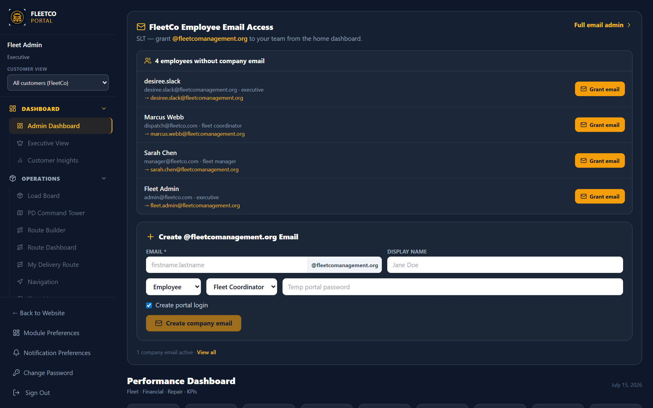
PART 5 · GEOFENCING
Portal map — where managers will review alerts
Existing Fleet Map already shows driver markers and shapes
Proposed: Geofence layer toggle + alert history panel
Click alert → fly to map location + link to live dashcam if session active
Customer-scoped: only their units and fences
Operations dashboard context
Smartphone Telematics Demo · https://fleetcomanagement.org · Slide 42

Slide 43
PART 6 · AI SAFETY
How AI reviews video for distracted driving
Not one monolithic “video AI” — FleetCo sends still frames (or short bursts) to Gemini with road vs cabin prompts (drivingSafetyAi.js).
Driver-facing camera → distraction, phone_use, drowsiness, no_seatbelt, impaired (review-only).
Road-facing camera → lane issues, tailgating, harsh_braking — corroborates inattention.
Each hit creates DrivingSafetyEvent with severity, confidence ≥0.55, GPS, speed, optional snapshot.
See Part 3B tables for full event type definitions.
Smartphone Telematics Demo · https://fleetcomanagement.org · Slide 43

Slide 44
PART 6 · AI SAFETY
Sampling strategy for cost control
When to analyze
When to skip
Only while live dashcam active AND speed > 10 mph
Road frame every 10s; cabin every 15s if dual camera
Burst mode: 1 fps for 30s after harsh deceleration (IMU trigger)
Parked / idling > 5 min
Customer driver_safety_ai_enabled = false
Missing GEMINI_API_KEY — log once, no user error spam
Smartphone Telematics Demo · https://fleetcomanagement.org · Slide 44

Slide 45
PART 6 · AI SAFETY
Illustrative Gemini cost model (planning only)
Scenario | Assumption | Rough monthly vision cost
Small pilot | 5 drivers, 4 hr/day, 1 frame/15s | $15–$80 depending on model
Mid fleet | 20 drivers, 8 hr/day, 1 frame/10s | $80–$400
Aggressive sampling | Same fleet, 1 frame/3s | 3–5× higher — avoid unless enterprise pays
Mitigation | Speed gates + dual-rate road/cabin | Keeps margin inside SaaS fee or add-on
Smartphone Telematics Demo · https://fleetcomanagement.org · Slide 45

Slide 46
PART 6 · AI SAFETY
Demo scenario — phone use (driver camera)
Use Android with dualSupported true OR iPhone with native DualCam plugin once shipped
Driver starts Live Dashcam; confirm front camera preview active (driver face visible)
Safe staged test: parked, hold phone to ear — cabin frame sampled → cabin Gemini prompt
Within 1–2 sample intervals, DrivingSafetyEvent type phone_use in portal Safety inbox
Manager sees cabin snapshot thumbnail, map pin, confidence, acknowledge / false positive
Smartphone Telematics Demo · https://fleetcomanagement.org · Slide 46

Slide 47
PART 6 · AI SAFETY
Demo scenario — distraction / drowsiness (driver camera)
Front camera captures glance away from windshield or head nod (staged while parked for demo)
AI returns distraction or drowsiness with description text from cabin prompt
Cross-check timestamp with road camera event (lane_split) if both streams active
Fleet manager filters by driver, date, severity; export weekly summary (proposed report)
Smartphone Telematics Demo · https://fleetcomanagement.org · Slide 47

Slide 48
PART 6 · AI SAFETY
Dual camera + AI — demo platform matrix
Platform | Road + driver together | Distraction AI quality | Demo note
Android + native dual (target) | Yes when concurrent API OK | High — continuous cabin frames | Primary PhonePulse demo kit
Android WebView only | Sometimes | Medium — test dualSupported flag | Phase A before native plugin
iPhone + native MultiCam (target) | Yes A12+ | High — continuous cabin frames | Required for parity with Android
iPhone WebView only | Usually road only | Low for in-cab — road AI only | Do not sell as full distraction suite
Mobile Safari | Gesture / single cam | Not for production telematics | Driver should install Capacitor app
Smartphone Telematics Demo · https://fleetcomanagement.org · Slide 48

Slide 49
PART 6 · AI SAFETY
Human review & false positives
Never auto-terminate drivers on AI alone — use review queue
Confidence threshold default 0.55 (already in code); raise to 0.7 for stricter fleets
Allow fleet_manager to mark “false positive” to improve future tuning prompts
Retain frames per retention policy — align with privacy policy & state law
Smartphone Telematics Demo · https://fleetcomanagement.org · Slide 49

Slide 50
PART 7 · DIAGNOSTICS
Why phones cannot read the ECU alone
Engine control units speak OBD-II (light duty) or SAE J1939/J1708 (many trucks)
Phone has no physical connection to the diagnostic port without an adapter
Bluetooth LE OBD dongles bridge phone ↔ OBD port (ELM327 family)
Heavy-duty 9-pin requires J1939-capable adapter — consumer OBD often insufficient
Smartphone Telematics Demo · https://fleetcomanagement.org · Slide 50

Slide 51
PART 7 · DIAGNOSTICS
Optional hardware SKUs (per vehicle, one-time)
Tier | Hardware | Typical price | Gets you
Light duty BLE | OBD-II ELM327 BLE | $25–$80 | Stored DTCs, some live PIDs
Heavy duty | J1939 Bluetooth adapter | $120–$400 | Truck DTCs on supported models
OEM telematics | Factory modem | Included in truck | API integration — separate project
Phone only | None | $0 | Manual codes + AI explain (current)
Smartphone Telematics Demo · https://fleetcomanagement.org · Slide 51

Slide 52
PART 7 · DIAGNOSTICS
Proposed BLE integration flow
Capacitor BLE plugin in Driver app — pair once per vehicle profile
On shift start: connect to dongle, poll DTCs every 15 min or on MIL change
POST new codes to DiagnosticCode entity with scan_type auto
Portal Diagnostics list updates; AI explain runs on new codes
Shop notification when critical severity code appears on active load
Smartphone Telematics Demo · https://fleetcomanagement.org · Slide 52

Slide 53
PART 7 · DIAGNOSTICS
Demo scenario — auto DTC pull
Shop plugs BLE dongle into test pickup; driver pairs in Driver Settings
Inject or clear test code P0301 on bench (safe environment)
Verify code appears in portal within one poll cycle
Create draft RO from diagnostic row (proposed one-click)
Smartphone Telematics Demo · https://fleetcomanagement.org · Slide 53

Slide 54
PART 7 · DIAGNOSTICS
Heavy-duty honesty slide for sales
Mixed fleets: offer phone-first GPS/AI for all units; OBD dongle SKU for units that support it
For brand-new Class 8 with OEM telematics, sell API import instead of dongle
Website copy: “Automatic fault capture available with optional adapter”
Avoid claiming universal J1939 live PGN streaming without certification/testing
Smartphone Telematics Demo · https://fleetcomanagement.org · Slide 54

Slide 55
PART 8 · ARCHITECTURE
Capacitor app configuration today
appId: org.fleetcomanagement.driver — webDir: dist
Plugins: Camera, Geolocation permissions declared in capacitor.config.json
Custom Android DashcamService plugin for foreground recording
driver-sw.js — background sync for offline API queue (Android Chrome)
Smartphone Telematics Demo · https://fleetcomanagement.org · Slide 55

Slide 56
PART 8 · ARCHITECTURE
Key server entities
Location & safety
Maintenance
DriverLocation — GPS pings
DrivingSafetyEvent — AI alerts
LiveStreamSession / Recording — dashcam
DashcamFrame — snapshot store (when enabled)
DiagnosticCode — DTC records
Vehicle — unit linkage
PortalActivity — audit feed (geofence events)
Customer — feature flags per fleet
Smartphone Telematics Demo · https://fleetcomanagement.org · Slide 56

Slide 57
PART 8 · ARCHITECTURE
Optional LiveKit layer
When LIVEKIT_* env vars set, startLiveVideoStream returns livekitUrl + token
Sub-second office viewing; higher infra cost than chunked mode
Safety AI still samples JPEGs from driver upload path regardless of mode
Production readiness card in portal documents configuration source
Smartphone Telematics Demo · https://fleetcomanagement.org · Slide 57

Slide 58
PART 8 · ARCHITECTURE
Security & multi-tenant isolation
DriverLocation and safety events scoped by customer_id / entityScope rules
Drivers only POST for their own user_id; managers see customer fleet only
Media stored via mediaStorage — signed URLs, not public buckets
Geofence admin limited to fleet_manager / customer admin roles
Smartphone Telematics Demo · https://fleetcomanagement.org · Slide 58

Slide 59
PART 8 · ARCHITECTURE
Offline & poor connectivity
offlineSync coalesces DriverLocation writes in IndexedDB
Dashcam chunks queue until cell returns — driver sees pending count
Geofence evaluation uses server time of ping arrival (note delay in UI)
Safety AI can backlog analyze when uploads resume — stamp original captured_at
Smartphone Telematics Demo · https://fleetcomanagement.org · Slide 59

Slide 60
PART 8 · ARCHITECTURE
Environment variables checklist
GEMINI_API_KEY — required for Safety AI vision
LIVEKIT_URL, LIVEKIT_API_KEY, LIVEKIT_API_SECRET — optional live WebRTC
FCM / push credentials — geofence and safety push alerts
SITE_URL — marketing screenshot scripts only
Smartphone Telematics Demo · https://fleetcomanagement.org · Slide 60

Slide 61
PART 9 · PLATFORMS
iPhone 15/16 vs flagship Android (2024–2026)
Topic | iPhone | Android
Background GPS | Always permission + App Store justification | Foreground service + permissions
Dual camera | Typically one active stream | Many models support dual
Dashcam while navigating | User must keep app foreground often | Foreground service helps
BLE OBD | CoreBluetooth via Capacitor plugin | Standard BLE scanning
App distribution | TestFlight + App Store | Play internal testing (live today)
Smartphone Telematics Demo · https://fleetcomanagement.org · Slide 61

Slide 62
PART 9 · PLATFORMS
Recommended demo device kit
Primary: Samsung or Pixel on latest Android — dual camera + foreground service demo
Secondary: iPhone on Capacitor build — road AI + geofence + live view
Mount: vent mount + charging cable (not “telematics hardware” but required for quality)
Test account: clocked-in driver linked to FC101 / demo customer fleet
Smartphone Telematics Demo · https://fleetcomanagement.org · Slide 62

Slide 63
PART 9 · PLATFORMS
Permissions UX copy (drivers)
Location: “FleetCo needs your location while you’re clocked in so dispatch can see the unit and geofence alerts work.”
Camera: “Road camera is used for live dashcam and safety monitoring when your fleet enables it.”
iOS Always: link to Settings screenshot in driver FAQ (proposed help article)
Opt-out: limited mode without camera — GPS-only telematics tier (policy decision)
Smartphone Telematics Demo · https://fleetcomanagement.org · Slide 63

Slide 64
PART 10 · COSTS
One-time costs
Item | Cost | Notes
Company phone (existing) | $0 marginal | Already budgeted ops expense
Phone mount + charger | $15–$40/unit | Strongly recommended for dashcam angle
BLE OBD optional | $25–$400/unit | Only if auto diagnostics sold
Apple Developer Program | $99/year | iOS distribution
Google Play | $25 one-time | Already used for driver app
Smartphone Telematics Demo · https://fleetcomanagement.org · Slide 64

Slide 65
PART 10 · COSTS
Recurring costs (beyond base SaaS)
Item | Driver scale | Order of magnitude
Gemini Safety AI | 20 drivers, moderate sampling | $80–$400/mo — model dependent
LiveKit Cloud | 5 concurrent viewers | $50–$200/mo or self-host
Extra GPS storage | 30s pings | Usually negligible on Postgres
Push notifications | FCM/APNs | Free at fleet scale
Pass-through pricing | Enterprise | Bill AI usage as add-on line item
Smartphone Telematics Demo · https://fleetcomanagement.org · Slide 65

Slide 66
PART 10 · COSTS
Engineering effort estimate
Geofence CRUD + server engine + notifications: ~1.5–2 weeks
Wire Safety AI to live snapshot pipeline + portal inbox: ~1 week
Background location hardening iOS/Android: ~1.5–2 weeks
BLE OBD MVP (light duty): ~2–3 weeks; heavy-duty J1939: +2–4 weeks
QA field pilot + privacy review: ~1 week parallel
Smartphone Telematics Demo · https://fleetcomanagement.org · Slide 66

Slide 67
PART 10 · COSTS
ROI narrative for website / sales
Avoid $200+ hardware × 40 units = $8,000 upfront vs app enablement
Single portal login — no separate telematics vendor training
Upsell: “Safety AI add-on” + “Auto diagnostics adapter kit”
Enterprise custom: LiveKit dedicated + SLA
Smartphone Telematics Demo · https://fleetcomanagement.org · Slide 67

Slide 68
PART 11 · LEGAL & PRIVACY
Driver consent & notice
Update Privacy policy — camera, location, AI analysis purposes
Employee handbook addendum for in-cab monitoring where required by state
California / Illinois / other two-party consent states — legal review for audio (mute audio if unsure)
Customer agreement: fleet owns policy; FleetCo is processor
Smartphone Telematics Demo · https://fleetcomanagement.org · Slide 68

Slide 69
PART 11 · LEGAL & PRIVACY
Data retention
Define retention for DrivingSafetyEvent snapshots (e.g. 90 days default)
DriverLocation history — align with IFTA/reporting needs
Right-to-delete requests — map to user_id and media blobs
Export for litigation hold — admin-only function (proposed)
Smartphone Telematics Demo · https://fleetcomanagement.org · Slide 69

Slide 70
PART 11 · LEGAL & PRIVACY
FMCSA / ELD clarification
This telematics package is not a certified ELD replacement unless you explicitly build and certify ELD mode
GPS + dashcam + geofence complements hours-of-service tools
Marketing: “fleet visibility and safety” not “DOT certified logging” unless certified
Smartphone Telematics Demo · https://fleetcomanagement.org · Slide 70

Slide 71
PART 12 · ROADMAP
Phase plan (suggested)
P0 (4–6 weeks): Geofence alerts + background GPS + Safety AI on live frames + portal inbox
P1 (6–10 weeks): Geofence admin UI on map, reports, customer notifications tuning
P2 (10–16 weeks): BLE OBD light duty, RO auto-create from DTC, IMU harsh event hints
P3 (enterprise): OEM telematics API feeds, custom SLAs, dedicated LiveKit
Smartphone Telematics Demo · https://fleetcomanagement.org · Slide 71

Slide 72
PART 12 · ROADMAP
Field pilot — 1 week with a customer
Day 1: Enable test customer, 2–3 drivers, permissions training
Day 2–4: Run loads with live dashcam + geofence test zones
Day 5: Review Safety inbox false positive rate; tune intervals
Day 6–7: Manager feedback session; prioritize P1 items
Smartphone Telematics Demo · https://fleetcomanagement.org · Slide 72

Slide 73
PART 12 · ROADMAP
Success metrics
Technical
Business
≥95% GPS pings received while clocked in
<60s geofence alert latency (p95)
Safety AI events reviewable within 5 min of occurrence
Zero cross-customer data leaks in QA audit
Customer willing to expand from pilot to paid add-on
Support tickets per driver < 0.5 during pilot week
Clear website copy approved by leadership
Cost per driver per month documented
Smartphone Telematics Demo · https://fleetcomanagement.org · Slide 73

Slide 74
PART 13 · LIVE DEMO SCRIPT
Pre-flight (15 minutes before)
Confirm API deployed with GEMINI_API_KEY and test customer driver_safety_ai_enabled true
Driver phone: logged in, clocked in on FC101, Live Dashcam tested once on Wi-Fi
Office: Fleet Map open; second screen for Safety inbox (when shipped)
Printed yard geofence coordinates or admin UI ready
Smartphone Telematics Demo · https://fleetcomanagement.org · Slide 74

Slide 75
PART 13 · LIVE DEMO SCRIPT
Step 1 — Show live map ping
Open portal Fleet Map — locate test driver marker
Point out speed, heading, unit label, trail
Explain 30s ping (or 10s if tuned for demo)
Toggle customer view-as to prove tenant isolation
Smartphone Telematics Demo · https://fleetcomanagement.org · Slide 75

Slide 76
PART 13 · LIVE DEMO SCRIPT
Step 2 — Enable dual camera + live dashcam
Customer portal Driver Media: confirm dual camera enabled for test fleet
Driver phone: verify dualSupported (Android) or native DualCam (iOS when available)
Dashcam tab → Start Live Dashcam — road live to office; driver cam feeding AI samples
Office: live viewer (road) + Safety inbox (driver cam events)
Smartphone Telematics Demo · https://fleetcomanagement.org · Slide 76

Slide 77
PART 13 · LIVE DEMO SCRIPT
Step 3 — Trigger geofence (after build)
Drive or simulate route crossing yard boundary (or replay GPX in staging)
Show dispatch notification and PortalActivity row
Open map fly-to on alert coordinates
Optional: customer email template preview
Smartphone Telematics Demo · https://fleetcomanagement.org · Slide 77

Slide 78
PART 13 · LIVE DEMO SCRIPT
Step 4 — Safety AI event
With sampling enabled, perform safe staged distraction test or use staging fixture
Refresh Safety inbox — show event_type, severity, confidence
Open linked snapshot and map pin
Demonstrate acknowledge / false positive workflow
Smartphone Telematics Demo · https://fleetcomanagement.org · Slide 78

Slide 79
PART 13 · LIVE DEMO SCRIPT
Step 5 — Diagnostics path
Today: show manual DiagnosticModal + AI code explain
Future: show BLE paired driver app pulling P0301
Link diagnostic to vehicle FC101 history tab
Close with optional dongle SKU pricing slide
Smartphone Telematics Demo · https://fleetcomanagement.org · Slide 79

Slide 80
PART 14 · WEBSITE COPY
Hero message (draft)
Headline: “Telematics built into the driver app you already use.”
Sub: Live GPS, geofence alerts, AI safety monitoring, and live dashcam — no extra black box required.
Footnote: Optional OBD adapter for automatic fault codes on supported vehicles.
CTA: Book demo · Enterprise telematics quote
Smartphone Telematics Demo · https://fleetcomanagement.org · Slide 80

Slide 81
PART 14 · WEBSITE COPY
Feature bullets for marketing page
Include
Exclude / qualify
Real-time fleet map with driver app GPS
Configurable geofence notifications
AI-assisted driver safety events
Live video to dispatch (optional low-latency LiveKit)
“Full J1939 telematics” without adapter
“Certified ELD” unless certified
Identical iOS/Android dual-camera claims
Unlimited AI with no usage note for enterprise
Smartphone Telematics Demo · https://fleetcomanagement.org · Slide 81

Slide 82
PART 14 · WEBSITE COPY
Comparison table for site vs hardware telematics
 | Traditional | FleetCo
Hardware install | Required | Optional (OBD only)
Time to live | Days–weeks | Hours (app update)
Video AI | Vendor lock-in | Gemini-powered, your portal
Shop diagnostics | Sometimes included | Portal + optional BLE
Single sign-on | Separate portal | Same FleetCo login
Smartphone Telematics Demo · https://fleetcomanagement.org · Slide 82

Slide 83
APPENDIX
Related FleetCo decks & downloads
FleetCo-Smartphone-Telematics-Demo.pptx — this deck (80+ slides, dual-camera + AI focus)
FleetCo-System-Deep-Dive-Review.pptx — UI screenshots + gap analysis
FleetCo-System-Capabilities-Review.pptx — module catalog
Regenerate telematics deck: npm run marketing:telematics
Download URL: https://fleetcomanagement.org/marketing/FleetCo-Smartphone-Telematics-Demo.pptx
Smartphone Telematics Demo · https://fleetcomanagement.org · Slide 83

Slide 84
APPENDIX
Source code references (for engineering review)
src/hooks/useDriverLocation.js — GPS ping interval
src/components/mobile/DriverDeviceProvider.jsx — dual camera
server/drivingSafetyAi.js — Gemini Safety AI
server/liveStream.js — live dashcam sessions
src/pages/Diagnostics.jsx — DTC tracking UI
capacitor.config.json — org.fleetcomanagement.driver
Smartphone Telematics Demo · https://fleetcomanagement.org · Slide 84

Slide 85
APPENDIX
QA audit command
After generating: node scripts/audit-pptx-content.mjs marketing/FleetCo-Smartphone-Telematics-Demo.pptx --min-slides=50
Fails if any slide has fewer than 48 characters of visible text
Screenshot frames live in marketing/manual-frames/*.png
Refresh UI shots: npm run marketing:deep-dive -- --refresh
Smartphone Telematics Demo · https://fleetcomanagement.org · Slide 85

Slide 86
Questions & next steps
Approve P0 roadmap · Run field pilot · Update fleetcomanagement.org telematics page
support@fleetcomanagement.org · (360) 952-1249
Smartphone Telematics Demo · https://fleetcomanagement.org · Slide 86

