Slide 1
System Deep Dive Review
FleetCo operations · Customer portal · Gaps & improvements
Screenshots from https://fleetcomanagement.org · 10/8/2026
FleetCo Management Deep Dive · https://fleetcomanagement.org · Slide 1

Slide 2
INTRODUCTION
How to use this deck
Part A walks through the platform as FleetCo staff (owner, fleet manager, coordinator, shop tech).
Part B walks through the same capabilities from a paying customer’s portal login.
Part C covers the driver mobile experience.
Part D lists what works today vs what still needs product, integration, or operational work — use this for prioritization.
Each workflow slide pairs narrative bullets with a real UI capture (right side).
FleetCo Management Deep Dive · https://fleetcomanagement.org · Slide 2

Slide 3
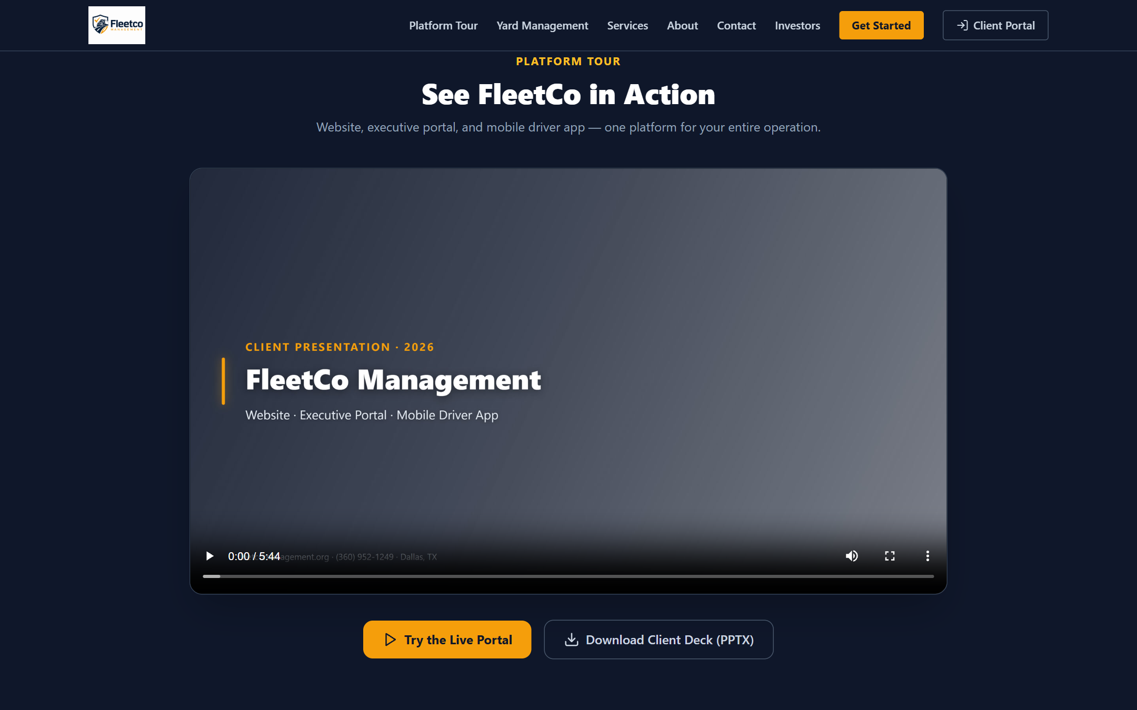
PART A · FLEETCO STAFF
Public site & portal entry
Prospects land on fleetcomanagement.org — pricing, platform tour, contact.
FleetCo staff use /login with @fleetcomanagement.org (or executive) accounts.
Brokers use separate signup; customers are provisioned by FleetCo (not self-serve SaaS checkout alone).
After login, sidebar shows all modules allowed for role (owner > executive > fleet manager > coordinator).
Marketing site — entry to client portal
FleetCo Management Deep Dive · https://fleetcomanagement.org · Slide 3

Slide 4
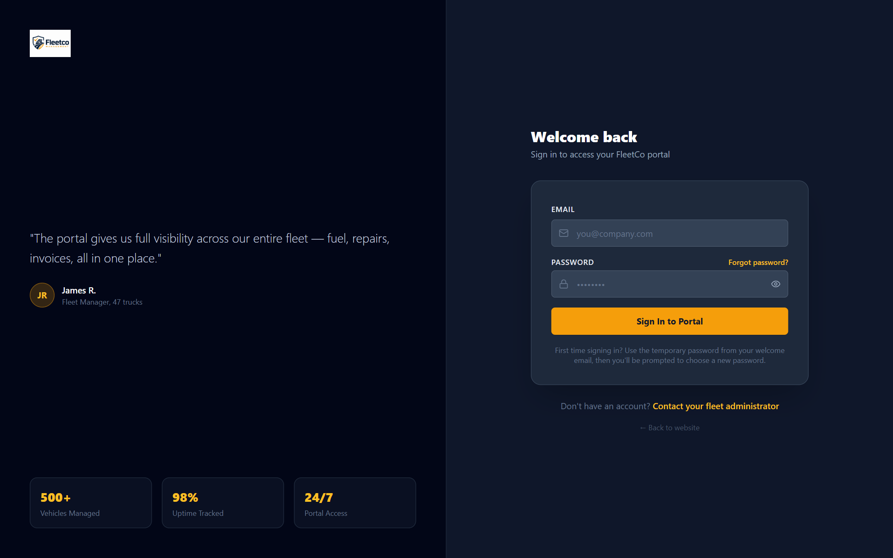
PART A · FLEETCO STAFF
Staff login & dashboard
Email + password authentication; JWT session stored client-side.
First login may force password change (temp password from welcome email).
Dashboard KPIs summarize fleet health — drill into modules from cards/feed.
Executives additionally use Executive View for cross-customer metrics.
Portal login screen
FleetCo Management Deep Dive · https://fleetcomanagement.org · Slide 4

Slide 5
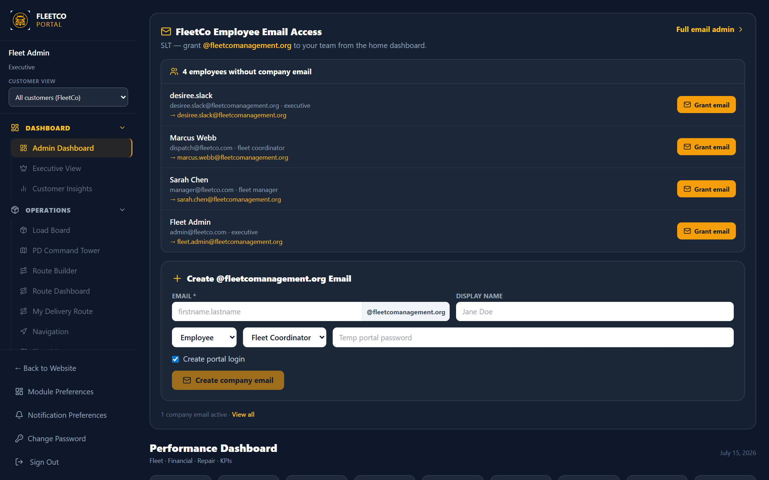
PART A · FLEETCO STAFF
Dashboard (internal home)
At-a-glance: active units, loads in motion, fuel spend, maintenance due, inspections, HOS flags.
FleetCo users with no customer_id see aggregate or select Customer view in sidebar dropdown.
Customer view sets X-Customer-Context — edits save to that customer’s data (amber banner).
Payment-due / paused overlays appear when subscription billing is past due.
Admin dashboard after login
FleetCo Management Deep Dive · https://fleetcomanagement.org · Slide 5

Slide 6
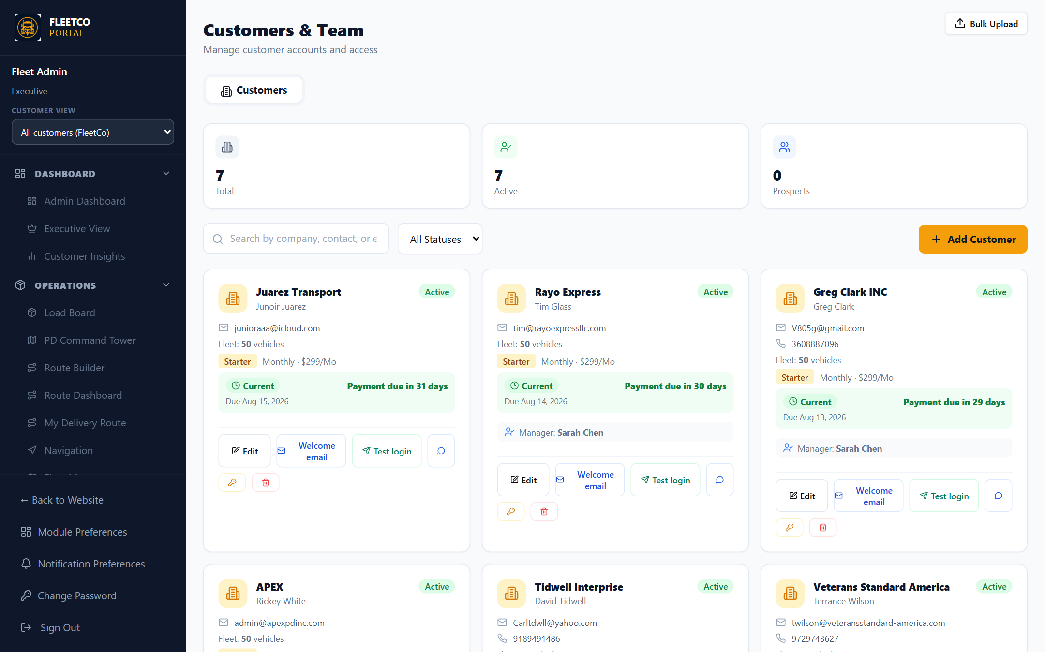
PART A · FLEETCO STAFF
Customers & provisioning
Add customer company — contact, fleet size, MC/DOT, subscription plan (Per Unit default).
Payment collected flag required before activation (business rule in provisionCustomer).
Create portal login — temp password, welcome email, PendingAccount until first login.
Assign FleetCo fleet manager / coordinator to account; message customer in-app.
Team tab: create internal users (executive, fleet manager, coordinator, tech).
Customers & Team hub
FleetCo Management Deep Dive · https://fleetcomanagement.org · Slide 6

Slide 7
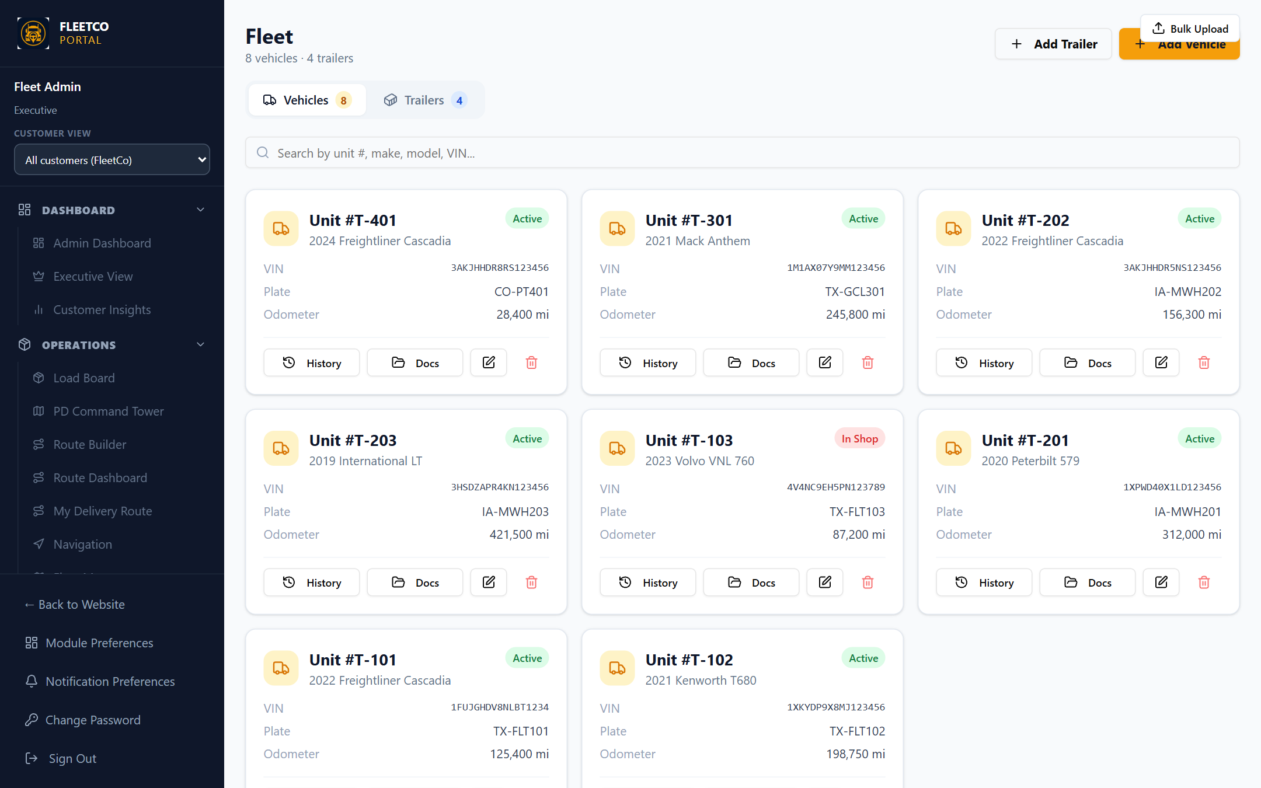
PART A · FLEETCO STAFF
Fleet units (all customers or view-as)
FleetCo admin: Add Vehicle / Add Trailer with full modal (assign customer, driver, VIN decode).
Coordinator: can edit status & use customer wizard when not admin.
Specs & Parts, History, Docs, Manuals per unit; bulk CSV import top-right on many pages.
Fleet Map (Operations) shows live GPS for clocked-in drivers company-wide.
Fleet Units list
FleetCo Management Deep Dive · https://fleetcomanagement.org · Slide 7

Slide 8
PART A · FLEETCO STAFF
Work orders — shop & manager flow
FleetCo manager creates RO or assigns to shop queue; tech uses Mechanic modal.
Lifecycle: intake → estimate → awaiting_approval → customer authorization → open → complete.
Manager approves estimates; can reject back to mechanic with notes.
Internal staff bypass customer-only intake UI — full Work Order modal when needed.
Bulk upload CSV available on this page for mass RO import.
Screenshot missing: portal-workorders
Run: npm run marketing:deep-dive -- --refresh
FleetCo Management Deep Dive · https://fleetcomanagement.org · Slide 8

Slide 9
PART A · FLEETCO STAFF
Repairs dashboard (downtime)
Executive view of active repair cost and units down (in-shop statuses).
Priority filters on active RO list; links to manage all work orders.
Used internally to monitor shop throughput and customer SLA conversations.
Screenshot missing: portal-repairs
Run: npm run marketing:deep-dive -- --refresh
FleetCo Management Deep Dive · https://fleetcomanagement.org · Slide 9

Slide 10
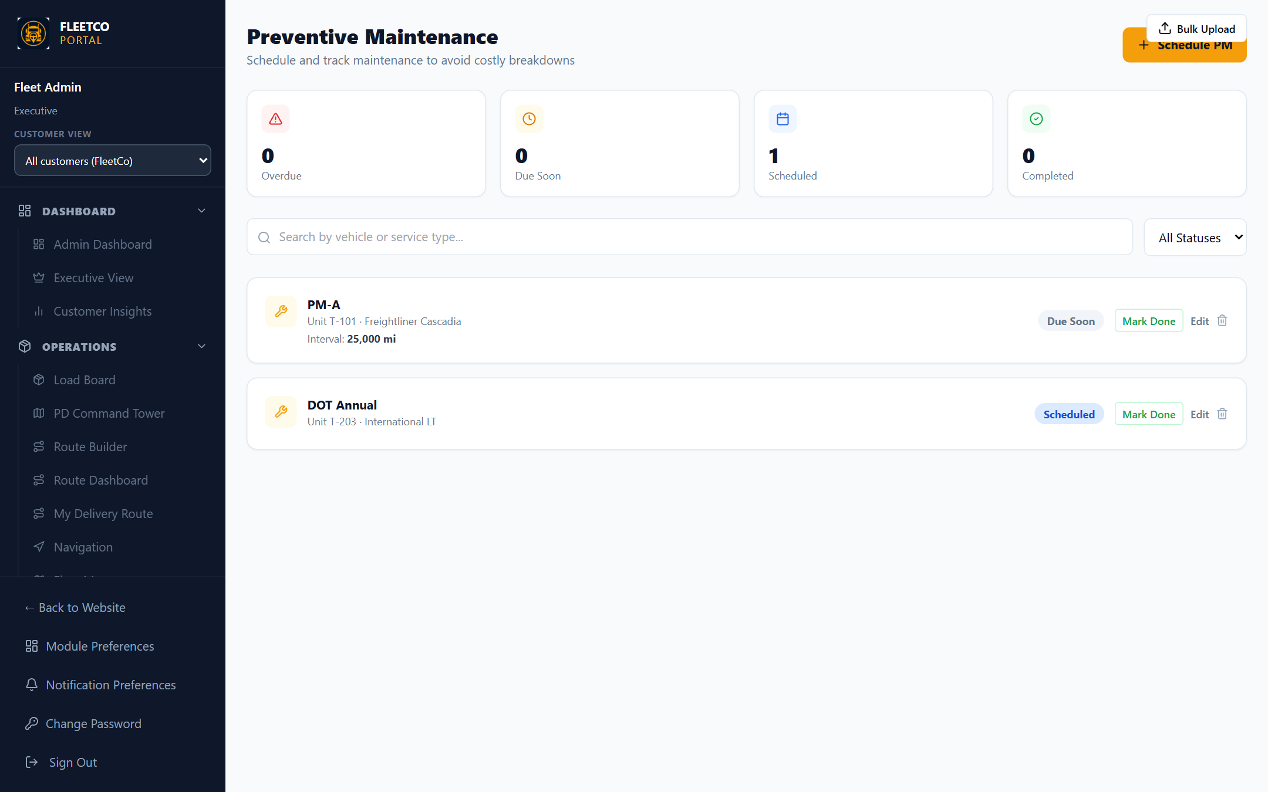
PART A · FLEETCO STAFF
Maintenance & parts
Preventive schedules — mileage/date triggers, overdue highlighting.
Calendar view for scheduled work across fleet.
Parts inventory ties into WO parts lines for job costing.
Service templates standardize brake jobs, PMs, etc.
Preventive maintenance
FleetCo Management Deep Dive · https://fleetcomanagement.org · Slide 10

Slide 11
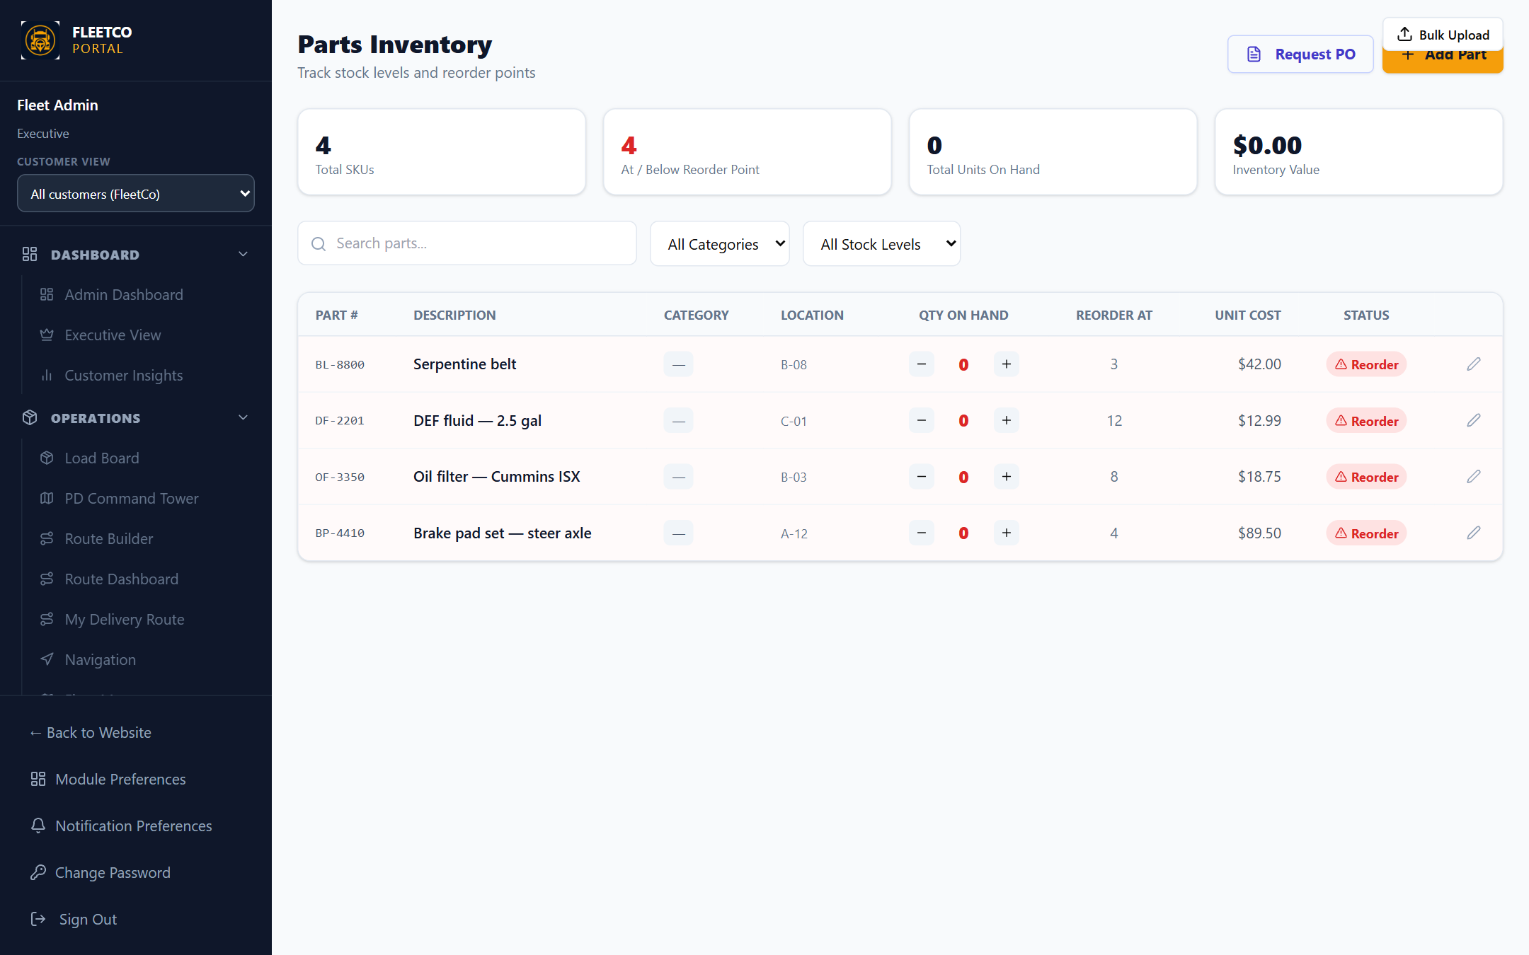
PART A · FLEETCO STAFF
Parts & VIN research
Stock levels, part numbers, unit costs; request POs from accounting flow.
Vehicle Parts Research — VIN context, accessories, recall awareness.
Vendors & Contracts module for shop rates and discounts (separate nav item).
Parts inventory
FleetCo Management Deep Dive · https://fleetcomanagement.org · Slide 11

Slide 12
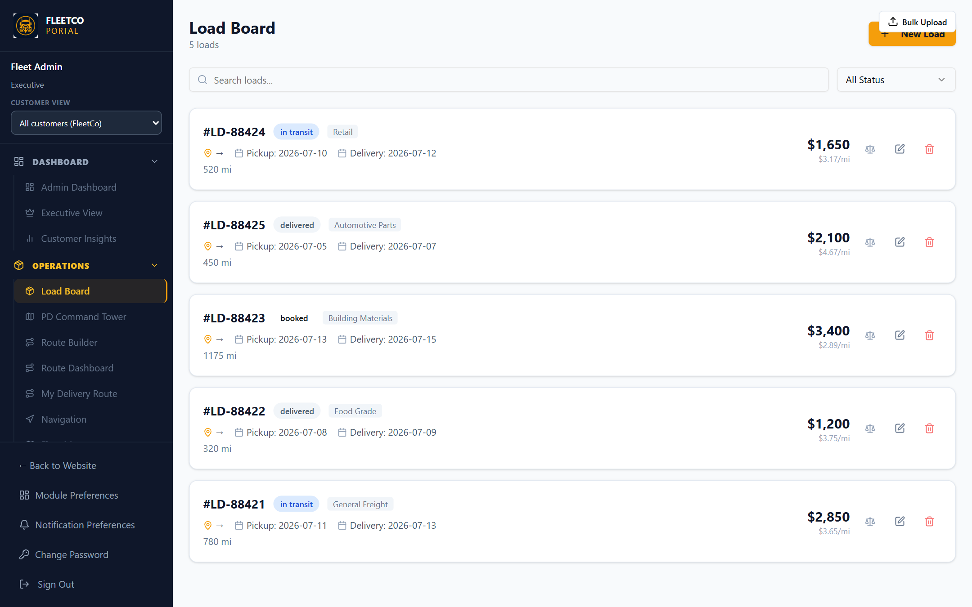
PART A · FLEETCO STAFF
Load board & dispatch
Create freight records, assign driver/truck/trailer, track status to delivered.
Load marketplace / broker flows for executive marketplace module.
Weigh scale fields; open Google Maps from load.
Customer view: only that customer’s loads visible.
Load Board
FleetCo Management Deep Dive · https://fleetcomanagement.org · Slide 12

Slide 13
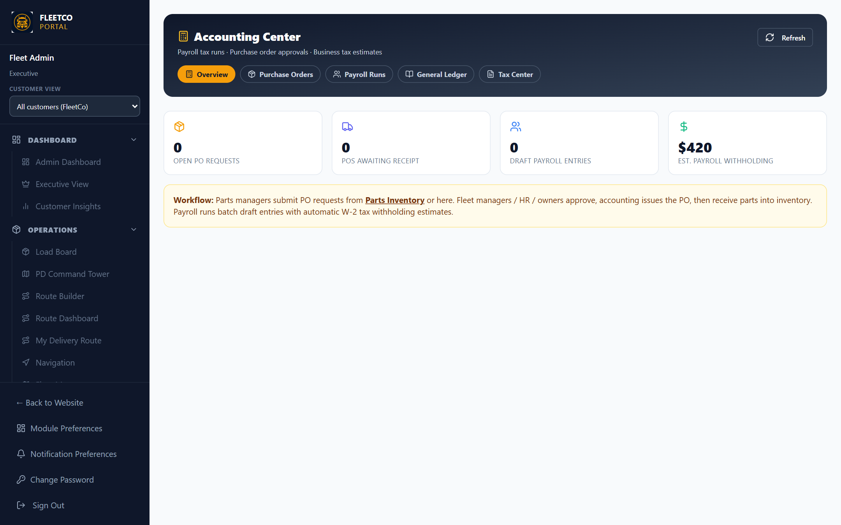
PART A · FLEETCO STAFF
Accounting & reports
Chart of accounts, journal entries, POs, payroll runs, 1099 tracking.
Reports Center — export Excel by category (fuel, maintenance, compliance).
SLT Billing — per-customer subscription status and Stripe portal session (if configured).
Accounting center
FleetCo Management Deep Dive · https://fleetcomanagement.org · Slide 13

Slide 14
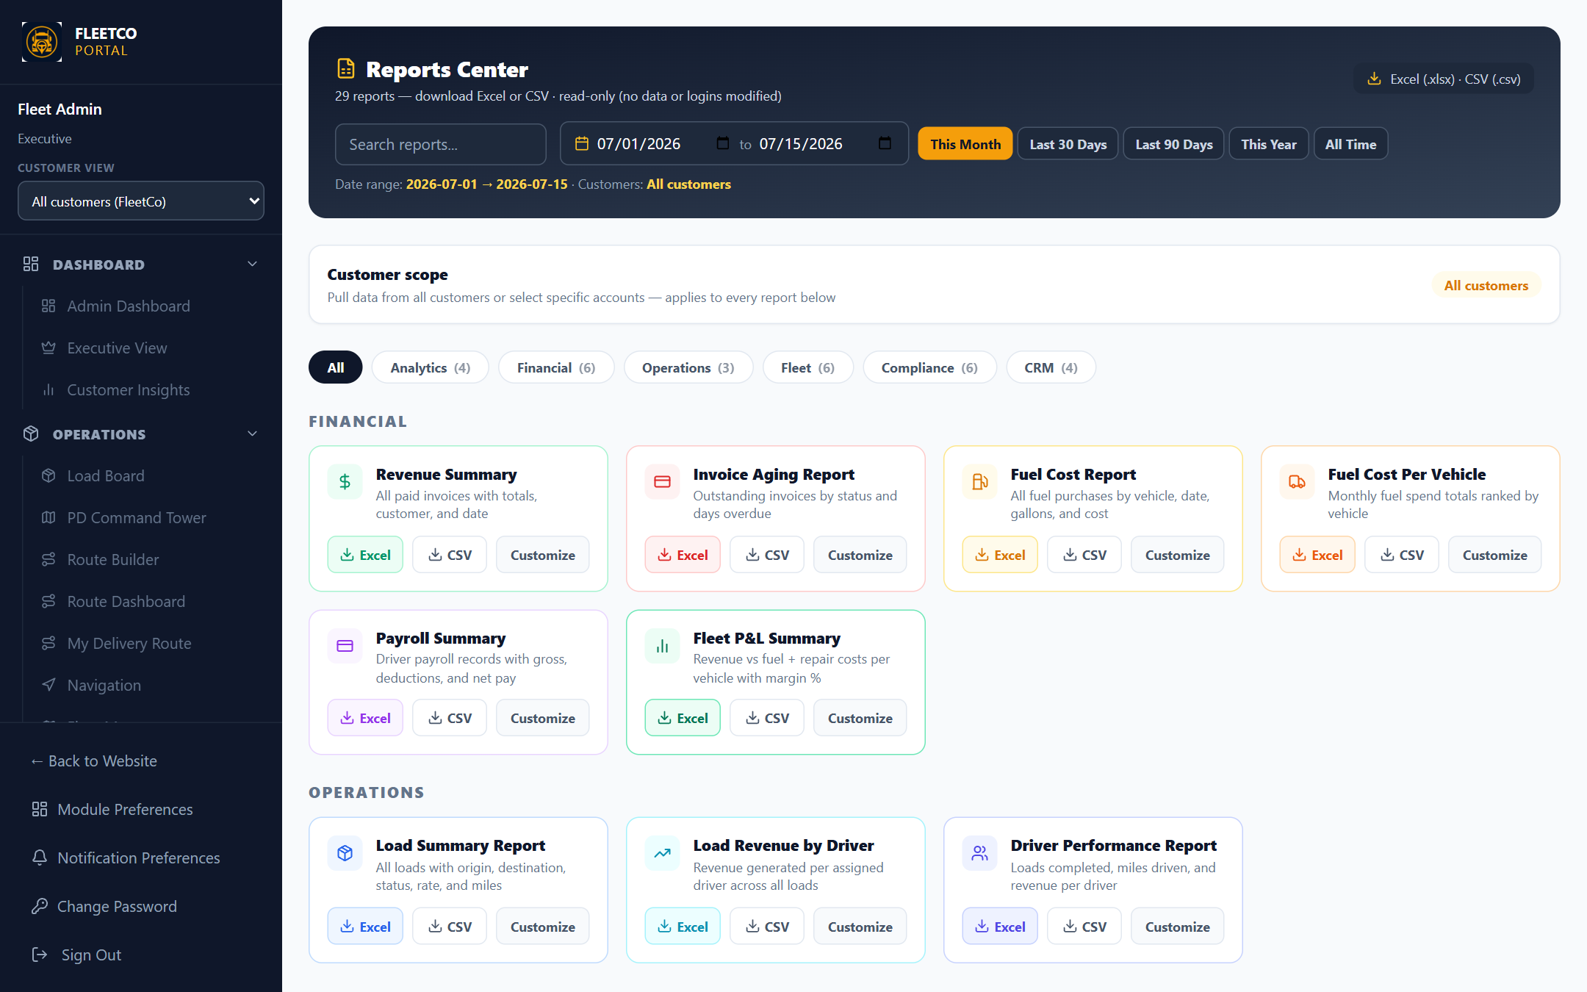
PART A · FLEETCO STAFF
Reports export hub
Centralized exports for audits and management meetings.
Date ranges and column selection on supported reports.
Complements Executive dashboard for board-ready data pulls.
Reports Center
FleetCo Management Deep Dive · https://fleetcomanagement.org · Slide 14

Slide 15
PART A · FLEETCO STAFF
Staff-only tools (no screenshot)
Senior leadership (SLT)
Load Marketplace executive view, Customer Insights analytics, SLT Billing, domain email admin.
Data Backup / datastore tools, FleetCo Marketing AI hub, autopilot & outbox (local-first without API keys).
Company email provisioning via functions; competitive analysis & dev feedback pages.
How staff should operate day-to-day
Provision customer → assign manager → customer view to verify sidebar → seed units/ROs as needed.
Shop: work awaiting_estimate queue first; managers clear awaiting_approval daily.
After each deploy: restart API process so new routes (e.g. WO comments) are live.
FleetCo Management Deep Dive · https://fleetcomanagement.org · Slide 15

Slide 16
PART B · CUSTOMER PORTAL
Customer login experience
Customers use email from welcome letter (e.g. customer owner at their company domain or Gmail).
Same /login URL as staff — role determines sidebar after auth (customer_id on user record).
Forced password change on first login; Module Preferences trim sidebar sections.
Shared login — role decides experience
FleetCo Management Deep Dive · https://fleetcomanagement.org · Slide 16

Slide 17
PART B · CUSTOMER PORTAL
Customer dashboard
Getting Started checklist — add unit, invite driver, log fuel, create load.
Tiles: My Vehicles, Active Loads, Amount Owed, Total Paid.
Outstanding invoices & fleet list with status chips.
Label shows “Customer Portal” / Dashboard (not Admin Dashboard).
Customer owner dashboard (same route, scoped data)
FleetCo Management Deep Dive · https://fleetcomanagement.org · Slide 17

Slide 18
PART B · CUSTOMER PORTAL
My fleet — edit status
Customer owner / fleet manager / coordinator / parts manager: Edit on unit card.
Change status Active ↔ In Shop ↔ Waiting for Parts etc.; update odometer & notes.
Add Vehicle Info wizard (not full admin assign-customer modal).
Cannot see other companies’ units — API filters by customer_id.
Fleet Units — customer scoped
FleetCo Management Deep Dive · https://fleetcomanagement.org · Slide 18

Slide 19
PART B · CUSTOMER PORTAL
Fleet repairs (customer ROs)
Header: “Fleet repairs” — New repair order opens intake modal (complaint, odometer, unit).
Customer edits own ROs in awaiting_estimate / awaiting_authorization.
Approves estimate when status awaiting_approval (owner/fleet manager roles).
Authorization signature panel before shop starts when required.
HR/Driver roles: view + comments only (server returns 403 on PATCH).
Screenshot missing: portal-workorders
Run: npm run marketing:deep-dive -- --refresh
FleetCo Management Deep Dive · https://fleetcomanagement.org · Slide 19

Slide 20
PART B · CUSTOMER PORTAL
Repairs dashboard (customer)
Sees only their fleet’s active ROs and downtime costs.
Validates that scoping works — same page as staff but filtered entities.
Screenshot missing: portal-repairs
Run: npm run marketing:deep-dive -- --refresh
FleetCo Management Deep Dive · https://fleetcomanagement.org · Slide 20

Slide 21
PART B · CUSTOMER PORTAL
Loads & operations
Customer fleet manager/coordinator: create and track loads for their fleet.
Drivers assigned from their driver roster.
My Delivery Route for last-mile if enabled in modules.
Customer load board
FleetCo Management Deep Dive · https://fleetcomanagement.org · Slide 21

Slide 22
PART B · CUSTOMER PORTAL
Maintenance visibility
Parts manager & fleet roles: PM schedules for their units.
Inspections & pre-trip visible if Compliance/Maintenance modules enabled.
Cannot access FleetCo Customers page or SLT tools.
Customer maintenance view
FleetCo Management Deep Dive · https://fleetcomanagement.org · Slide 22

Slide 23
PART B · CUSTOMER PORTAL
Finance & subscription
Invoices scoped to customer_id; subscription page for payment method (Stripe when live).
Reports exports for their data only — fuel, maintenance, etc.
Accounting depth depends on role — owner sees Finance module if enabled.
Customer finance modules
FleetCo Management Deep Dive · https://fleetcomanagement.org · Slide 23

Slide 24
PART B · CUSTOMER PORTAL
Customer team & roles
My Team (customer_owner / HR / fleet manager)
Invite: HR, fleet manager, coordinator, parts manager, driver.
Each role gets default sidebar modules (owner can tune via Module Preferences).
HR & drivers: repair orders comment-only — good for “driver reported noise” notes.
Support path
Messages module — chat with FleetCo account rep.
Customer Manual in app / PDF user manual on website.
Email support@fleetcomanagement.org · (360) 952-1249.
FleetCo Management Deep Dive · https://fleetcomanagement.org · Slide 24

Slide 25
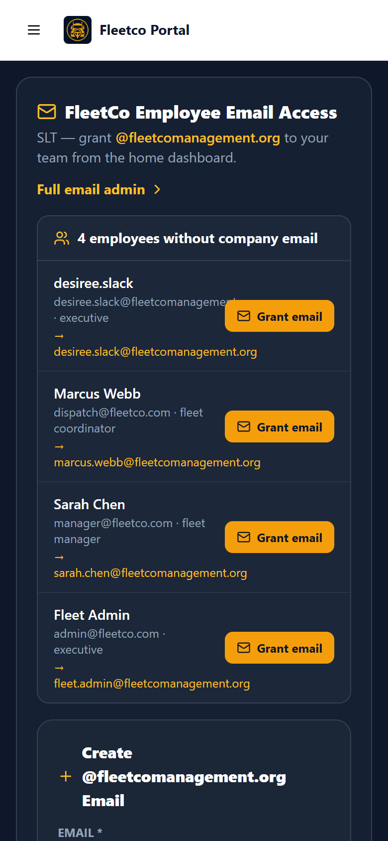
PART C · DRIVER APP
Driver home (mobile)
Drivers use /driver/login — mobile web or Android app.
Tiles: clock, route, loads, HOS, inspections, fuel, dashcam, messages.
Capabilities depend on customer toggles (dual camera, safety AI, etc.).
Driver app home
FleetCo Management Deep Dive · https://fleetcomanagement.org · Slide 25

Slide 26

PART C · DRIVER APP
Time clock & GPS
Must pick truck (and optional trailer) before clock-in — prevents double booking.
GPS position ~every 30s while clocked in → Fleet Map & Route Dashboard.
Clock-out stops location sharing.
Time clock & vehicle selection
FleetCo Management Deep Dive · https://fleetcomanagement.org · Slide 26

Slide 27
PART D · IMPROVEMENTS
Infrastructure & reliability (needs work)
Data & deploy
Primary store is file/SQLite-style JSON — requires persistent volume on Render/Railway or data resets on deploy.
Uploads/dashcam media warn on redeploy without persistent disk or object storage (S3-compatible).
API must be restarted after releases — stale process caused missing WO comment route in past.
DEPLOYMENT docs mention SQLite volume; confirm production matches (backup schedule, restore drill).
Testing & QA
No automated E2E suite in CI — rely on scripts/customer-portal-audit.mjs and manual QA.
Add Playwright/Cypress for login, RO lifecycle, customer scoping regression.
Production seed/demo accounts (e.g. Roby) should be scripted after each major release.
FleetCo Management Deep Dive · https://fleetcomanagement.org · Slide 27

Slide 28
PART D · IMPROVEMENTS
Integrations (optional / incomplete)
Requires configuration
LLM / Site Commander AI — stub responses until AI provider env vars set; marketing has local outbox fallback.
Stripe — subscription portal & checkout need keys for fully automated billing.
LiveKit — live office dashcam view; recording works locally without it.
SMTP/Resend — welcome & password emails; otherwise manual temp password delivery.
Google OAuth — redirects to email registration in standalone mode (not full SSO).
Industry integrations (roadmap)
ELD portal UI exists; deep integration with major ELD vendors (Samsara, Motive, etc.) not one-click.
True telematics ingest (automatic odometer, engine faults) vs manual entry.
Accounting export to QuickBooks/Xero — manual Excel today.
FleetCo Management Deep Dive · https://fleetcomanagement.org · Slide 28

Slide 29
PART D · IMPROVEMENTS
Product & UX gaps
Repair orders
Customer email notifications on status change (estimate ready, approval needed) — verify automated emails end-to-end.
PDF RO / invoice packet for customer authorization records.
Clearer difference between Work Orders vs Repairs Dashboard for new customers (onboarding copy).
Policy: Bulk CSV WO import for customers — enable or hide by role.
Portal polish
Some slides in text-only capabilities deck were blank — this deck embeds PNGs; refresh screenshots regularly.
Customer view banner — train staff to always verify customer context before edits.
Module sprawl — consider simplified “Starter sidebar” preset for small fleets (≤5 units).
Accessibility (WCAG) and mobile tablet layout for portal not formally audited.
FleetCo Management Deep Dive · https://fleetcomanagement.org · Slide 29

Slide 30
PART D · IMPROVEMENTS
Security & compliance (hardening)
Done / in progress
JWT auth, customer entity scoping, HR/driver WO PATCH blocks, vehicle reassignment blocks.
Immutable marketplace records; customer view delete guards on User/Customer.
Recommended next
Pen test before large customer pilots; rate limiting on auth endpoints.
Audit log for executive actions (provision, delete user, datastore restore).
SOC2-style backup encryption documentation for enterprise sales.
Secrets rotation playbook (JWT_SECRET, Stripe, SMTP).
FleetCo Management Deep Dive · https://fleetcomanagement.org · Slide 30

Slide 31
PART D · IMPROVEMENTS
Suggested priority roadmap
P0 — Before wide customer pilot
Persistent production datastore + uploads; deploy restart checklist.
Automated customer-portal-audit in CI against staging.
Email notifications for RO approval chain.
Demo tenant + seed script on production.
P1 — Revenue & retention
Stripe billing fully wired; dunning emails for past_due.
Customer onboarding wizard (first 7 days) in-app.
Mobile portal responsive pass for fleet managers on phone.
P2 — Scale & differentiation
ELD/telematics partner API; AI provider for predictive maintenance hints.
White-label/custom domain per customer; multi-language if needed.
FleetCo Management Deep Dive · https://fleetcomanagement.org · Slide 31

Slide 32
APPENDIX
Regenerate & assets
Screenshots folder: C:\Users\jarel\Projects\fleet-pulse-command\marketing\manual-frames
Refresh all captures: npm run marketing:deep-dive -- --refresh
Full PDF manual with same shots: npm run marketing:manual
Text capabilities deck: npm run marketing:capabilities
Download: https://fleetcomanagement.org/marketing/FleetCo-System-Deep-Dive-Review.pptx
FleetCo Management Deep Dive · https://fleetcomanagement.org · Slide 32

Slide 33
Review complete
Use Part D to prioritize sprints · Schedule live walkthrough with engineering
support@fleetcomanagement.org
FleetCo Management Deep Dive · https://fleetcomanagement.org · Slide 33

