Slide 1
Computational Phylogenetics
Building the Tree of Life
Computer Science
  Machine Learning
  Soft Computing
Biology
  Phylogenetics
    Morphological
    Molecular

Slide 2
Sequence Alignment
Alignment of residues (DNA, RNA, protein)
Longest common sub sequence
  Allows for insertions and deletions
  Substitution of amino acids and bases
Substitution matrix
  BLOSUM / PAM

Slide 3
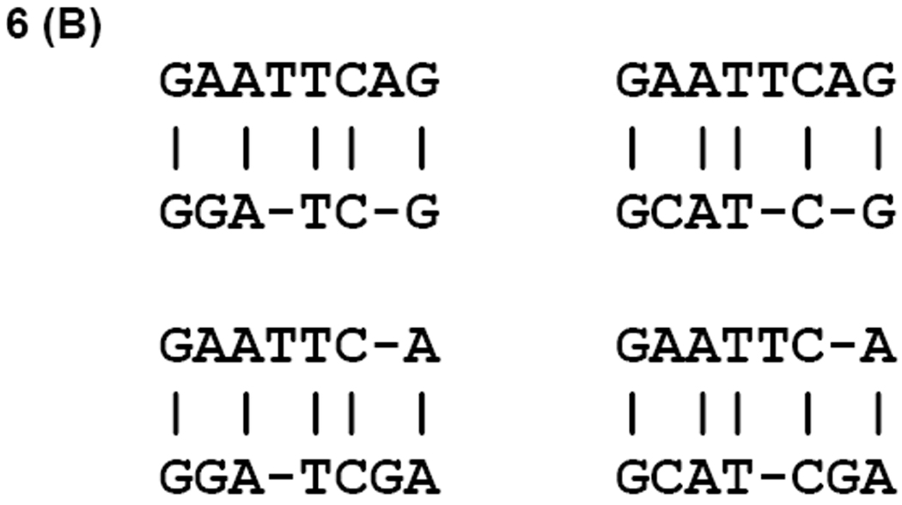
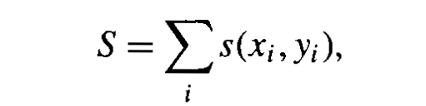
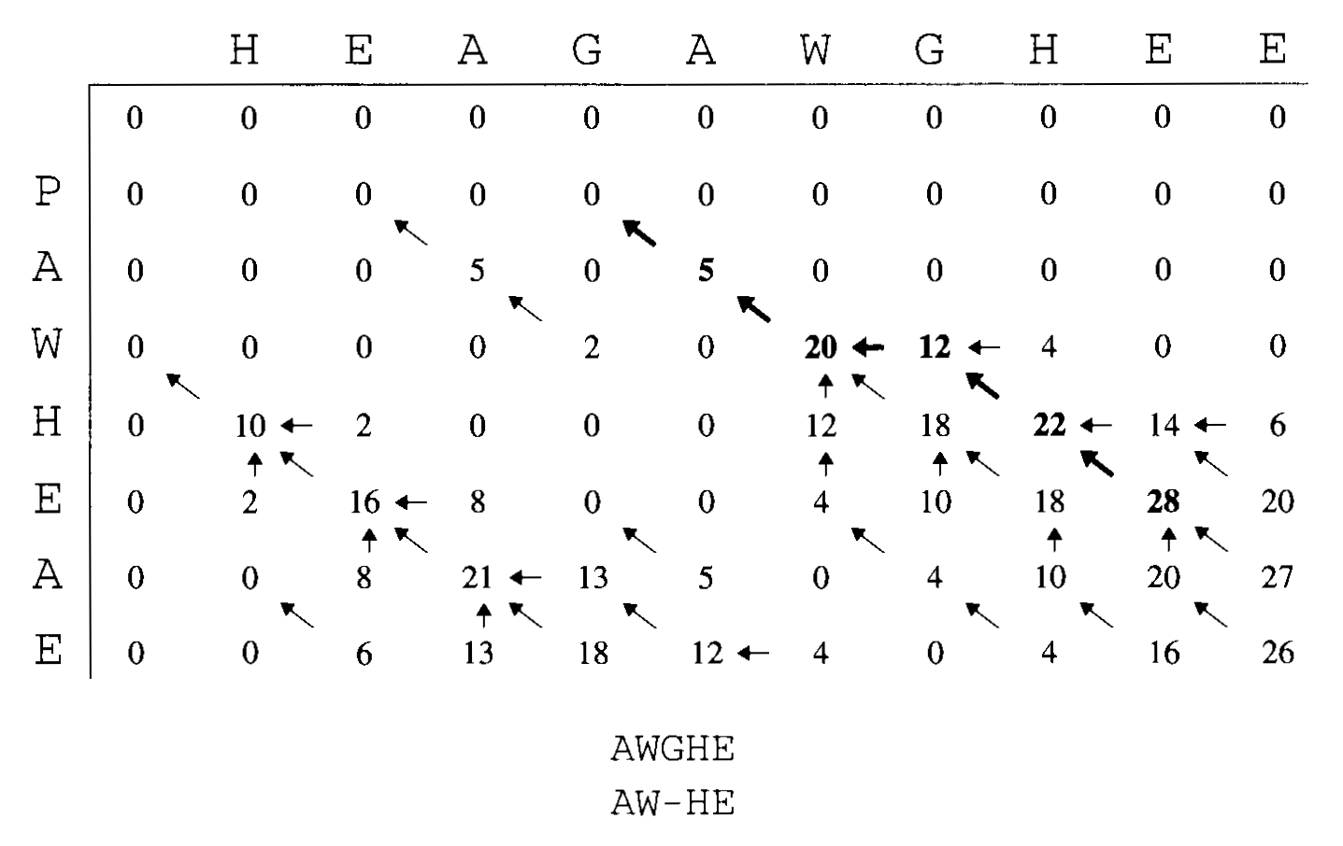
Sequence Alignment cont...
Scoring a sequence
  From the matrix
  Gap penalty
  eg: s(G,W) = 2
f

Slide 4
Pairwise Alignment
Finding the highest scoring alignment
  Needleman-Wunsch (global)
  Smith-Waterman (local)

Slide 5
N-M Algorithm
Problem: build an optimal global alignment between two sequences allowing gaps
Idea: use previous solutions for optimal alignments of smaller subsequences
Construct: a matrix F(i,j)
    F(i,j) score of ‘best’ alignment between initial segment x1,…xi and segment y1,...yj
    Build F(i,j) recursively (initialize at F(0,0))
    The following is applied repeatedly to fill in the matrix:
    F(i,j) = max F(i-1,j-1)+s(xi,yj)
    F(i-1,j)-d
    F(i,j-1)-d
    A pointer is kept in each cell back to the value from which its F(i,j) was derived
    F(n,m) is the best score for the alignment x1...xn and y1..yn
    The alignment itself is the path of (x,y) choices that led to this final value
    Perform a traceback to build the alignment in reverse
This is pairwise alignment. One of the next problems is to consider algorithms for multiple alignment.
Notes:
6

Slide 6
S-W Algorithm
Local alignment algorithm
Take away assumption that we are aligning two sequences from beginning to end
Looking for alignments between subsequences
For example: Do these protein sequences share a common domain?
Usually the most sensitive way to detect similarity when comparing two highly diverged sequences.
Often only part of the sequence has been under strong enough selection to preserve detectable similarity.
Notes:
6

Slide 7
S-W Algorithm Cont..
Differences from Global Alignment:
In each F(i,j) an extra possibility added allowing F(i,j)=0 if all other options <0
This corresponds to a new alignment and makes sure you are not extending an alignment that has proven unfruitful.
Secondly the alignment can end anywhere in the matrix.
So look at highest value F(i,j) and start the traceback from there.
Traceback ends when we hit a cell =0 which corresponds to a new alignment.
Next: sequences where there are many copies of a repeated domain or protein; expand this alg for repeated matches

Slide 8
Multiple Sequence Alignment
Generally for longer sequences these methods are intractable
  With longer sequences and multiple sequence alignments, dynamic programming and other algorithmic methods are to computationally expensive
  Global alignment using dynamic programming is NP complete!!!

Slide 9
Hidden Markov Models
Probabilistic method for generating sequences of states
  Markov Chain
  HMM
  Monte Carlo HMM

Slide 10
HMMs Cont...
Sequence alignment factors
  Profiles, families
  Conservation
Deriving an alignment vs deriving a profile
  Alignment gives state and string relationships at a high computational cost
    Not appropriate for global or multiple sequences
  Profiles can be used to score sequences or entire genomes

Slide 11
Genetic Algorithms
Genetic Algorithm / Genetic Programming
  NOT a biological process
  Theory and name only
Generating a Population
  Building potential alignments
Fitness function
Builds a set of alignments efficiently, though has some issues with local vs global optima

