Slide 1
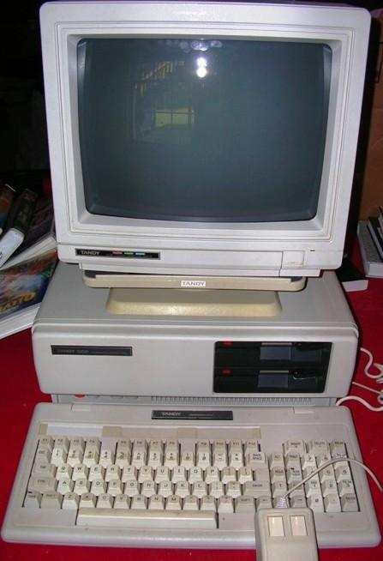
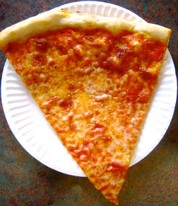
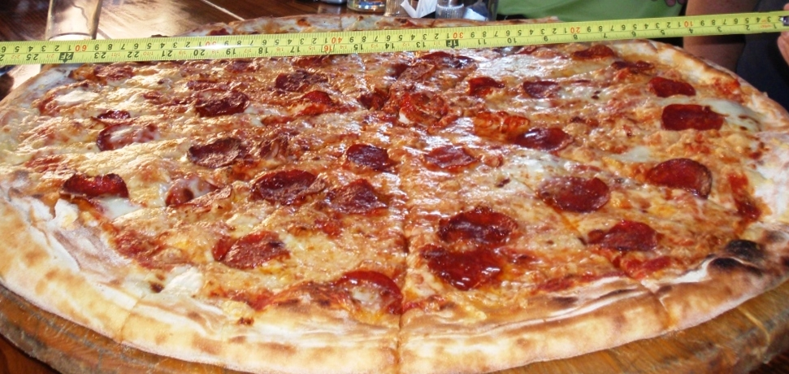
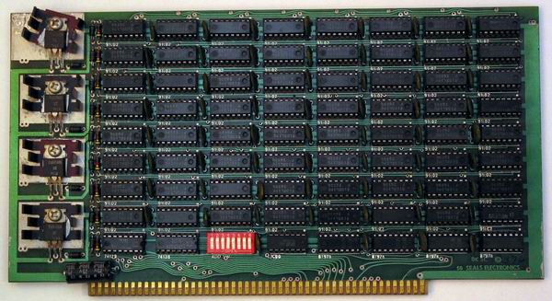
Ideas for a Future
Tomorrow Today

Slide 2
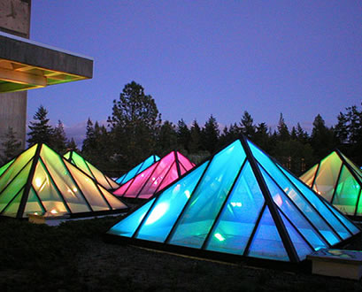
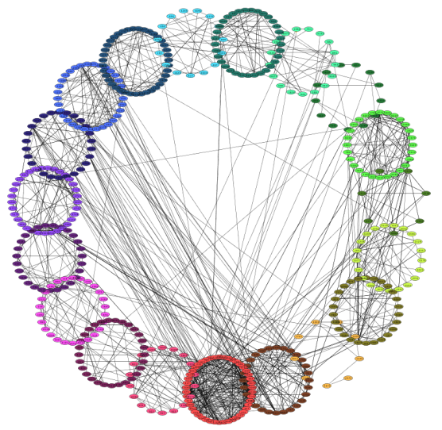
What the eff is Going On?!
SLACR Labs for ACRL Computing Labs (SLACRL)

Slide 3


Slide 4
WTF is an Algorithm?!
A set of instructions that solves a problem in a finite number of steps.
Example: alphabetically sort the sentence
“The fox jumped over a boat.”
Three Steps:
1. Find the word with the first letter 'closest' to 'a'.
2. Put that word at the front.
3. Repeat steps 1 and 2 on the rest of the sentence until there are no more words left.

Slide 5
WTF is an Algorithm?!
1. Find the word with the first letter 'closest' to 'a'.
2. Put that word at the front.
3. Repeat steps 1 and 2 on the rest of the sentence
until there are no more words left.
The fox jumped over a boat
a The fox jumped over boat
a boat The fox jumped over
a boat fox The jumped over
a boat fox jumped The over
a boat fox jumped over The
a boat fox jumped over The

Slide 6
Analyze This
The fox jumped over a boat 5 comparisons
a The fox jumped over boat 4 comparisons
a boat The fox jumped over 3 comparisons
a boat fox The jumped over 2 comparisons
a boat fox jumped The over 1 comparison

Slide 7

Analyze This
The fox jumped over a boat 5 comparisons
a The fox jumped over boat 4 comparisons
a boat The fox jumped over 3 comparisons
a boat fox The jumped over 2 comparisons
a boat fox jumped The over 1 comparison
a boat fox jumped over The
5 + 4 + 3 + 2 + 1 = 15 total comparisons

Slide 8
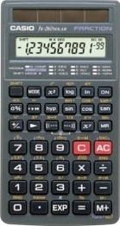
Mathemagics
6 words
6(5)/2 = 15 comparisons
1000 words
1000(999)/2 = 499,500 comparisons

Slide 9
Merge Sort
The fox jumped over a boat

Slide 10
Merge Sort
The fox jumped over a boat
fox The jumped over a boat
3 comparisons

Slide 11
Merge Sort
The fox jumped over a boat
fox The jumped over a boat
fox jumped over The
6 comparisons

Slide 12
Merge Sort
The fox jumped over a boat
fox The jumped over a boat
fox jumped over The
a boat fox jumped over the
8 comparisons

Slide 13
Analyze That
Merge sort for 6 words min 7, max 11 comparisons
Merge sort for 1000 words 9,900 comparisons (average case)
“Bad” sort for 1000 words 499,500 comparisons

Slide 14
It's that Simple
Merge
Algorithm
Computer

Slide 15
It's that Simple
Merge
Algorithm
Words to be
sorted from
the file system
Computer
Memory

Slide 16
It's that Simple
Merge
Algorithm
Words to be
sorted from
the file system
Computer
Memory

Slide 17
R-E-S-O-U-R-C...es
Merge Process
Memory
A
List
of
instructions
Data
Needed
by the
Merge process

Slide 18
Resource Allocation
Merge Process
Memory
...
Get “fox”
Get “jumped”
Get “over”
Get “a”
...
The
fox
jumped
over

Slide 19
Resource Allocation
Merge Process
Memory
...
Get “fox”
Get “jumped”
Get “over”
Get “a”
...
The
fox
jumped
over
(The Arrow represents the kernel)

Slide 20
Resource Allocation
Merge Process
Memory
...
Get “fox”
Get “jumped”
Get “over”
Get “a”
...
The
fox
jumped
over
(The Arrow represents the kernel)

Slide 21
Resource Allocation
Merge Process
Memory
...
Get “fox”
Get “jumped”
Get “over”
Get “a”
...
The
fox
jumped
over
(The Arrow represents the kernel)

Slide 22
Resource Allocation
Merge Process
Memory
...
Get “fox”
Get “jumped”
Get “over”
Get “a”
...
The
fox
jumped
over
WHA?!
(The Arrow represents the kernel)

Slide 23
Sort of Wikipedia

Slide 24
Sort of Wikipedia
Sorting of Wikipedia took 23 Hours! Why?

Slide 25
Sort of Wikipedia
Sorting of Wikipedia took 23 Hours! Why?
Wikipedia

Slide 26
Sort of Wikipedia
Sorting of Wikipedia took 23 Hours! Why?
Wikipedia
Memory
* not to scale

Slide 27
Sort of Wikipedia
Sorting of Wikipedia took 23 Hours! Why?
Wikipedia
Memory
'IT DON'T FIT!!!
* not to scale

Slide 28
DFS
Meta
Server
Storage
Server
1
Storage
Server
2
Storage
Server
3
Storage
Server
n
...
Client
1
Client
2
Client
3
Client
n
...
Storage Servers – Each hold a block/piece/slice of the filesystem.
No one Storage server holds the entire file system

Slide 29
Still Wont Fit

Slide 30
W/ DFS
Storage Servers

Slide 31
DFS
Meta
Server
Storage
Server
1
Storage
Server
2
Storage
Server
3
Storage
Server
n
...
Client
1
Client
2
Client
3
Client
n
...
Storage Servers – Each hold a block/piece/slice of the filesystem.
No one Storage server holds the entire file system
Meta Server – Holds information on what data is in which storage server
Clients – Work on assigned tasks, utilizing the meta and storage servers

Slide 32
DFS Resource Allocation
Storage
Server
1
Storage
Server
n
...
Meta
Server
Client
1
Client
n
...
Process on client 1 needs “word”

Slide 33
DFS Resource Allocation
Storage
Server
1
Storage
Server
n
...
Meta
Server
where?
Client
1
Client
n
blah!
...
Process on client 1 needs “word”
-Asks the Meta Server where “word” is
-Meta Server is like “It's over there in storage server blah”

Slide 34
DFS Resource Allocation
Storage
Server
1
Storage
Server
n
...
Meta
Server
therrr ya go
gimme!
Client
1
Client
n
...
Process on client 1 needs “word”
and knows where to find it.
-It now asks the appropriate storage server for “word”
-“word” is returned by the storage server.

Slide 35
Program
Merge
Algorithm
Computer

Slide 36
Distributed Program
Distributed
Merge
Algorithm
Merge
Merge
Merge
...
Merge
Computer
Computer
Computer
Computer
...
...

Slide 37
It's wooooorkingg
Results?
We were able to sort all the english words on wikipedia
in 90 minutes on an eight node subset of the SLACRL!
(That is less than 23 hours)

Slide 38
Rik is one CRAZY dude.

Slide 39
Computational Phylogenetics
Building the Tree of Life
Computer Science
  Machine Learning
  Soft Computing
Biology
  Phylogenetics
    Morphological
    Molecular

Slide 40
Sequence Alignment
Alignment of residues (DNA, RNA, protein)
Longest common sub sequence
  Allows for insertions and deletions
  Substitution of amino acids and bases
Substitution matrix
  BLOSUM / PAM

Slide 41
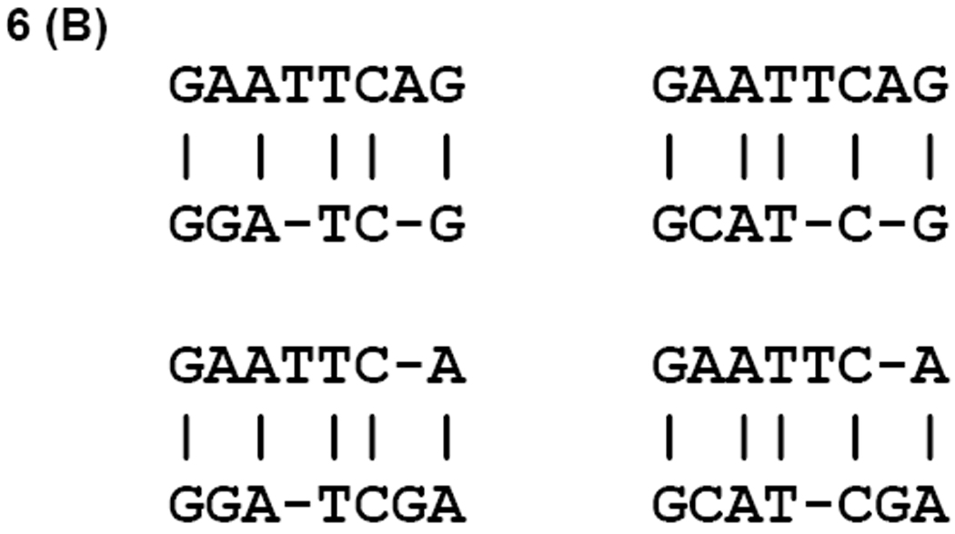
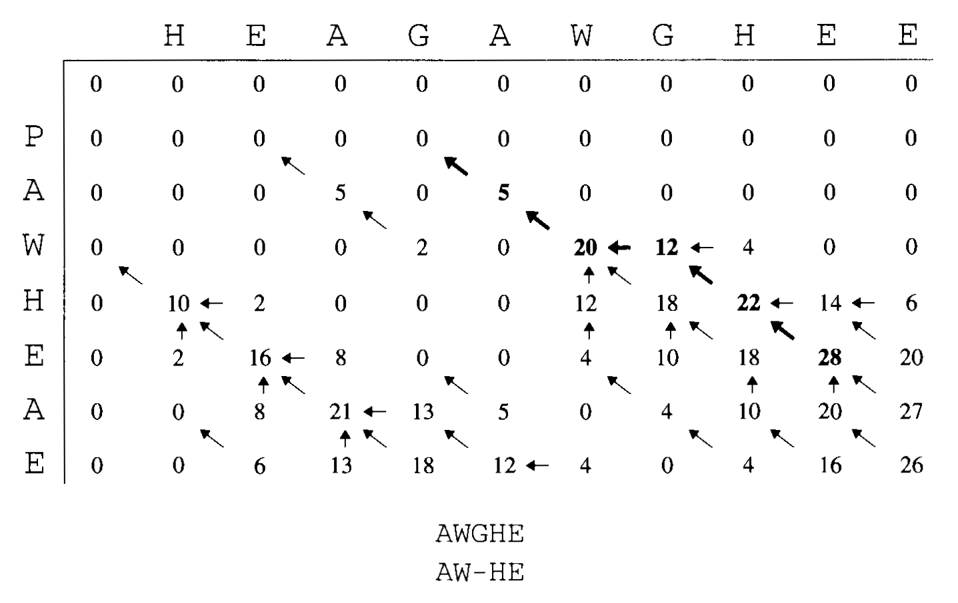
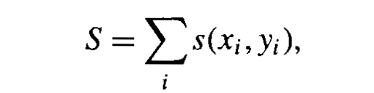
Sequence Alignment
Scoring a sequence
  From the matrix
  Gap penalty
  eg: s(G,W) = 2
f

Slide 42
Pairwise Alignment
Finding the highest scoring alignment
  Needleman-Wunsch (global)
  Smith-Waterman (local)

Slide 43
N-M Algorithm
Problem: build an optimal global alignment between two sequences allowing gaps
Idea: use previous solutions for optimal alignments of smaller subsequences
Construct: a matrix F(i,j)
    F(i,j) score of ‘best’ alignment between initial segment x1,…xi and segment y1,...yj
    Build F(i,j) recursively (initialize at F(0,0))
    The following is applied repeatedly to fill in the matrix:
    F(i,j) = max F(i-1,j-1)+s(xi,yj)
    F(i-1,j)-d
    F(i,j-1)-d
    A pointer is kept in each cell back to the value from which its F(i,j) was derived
    F(n,m) is the best score for the alignment x1...xn and y1..yn
    The alignment itself is the path of (x,y) choices that led to this final value
    Perform a traceback to build the alignment in reverse
This is pairwise alignment. One of the next problems is to consider algorithms for multiple alignment.

Slide 44
S-W Algorithm
Local alignment algorithm
Take away assumption that we are aligning two sequences from beginning to end
Looking for alignments between subsequences
For example: Do these protein sequences share a common domain?
Usually the most sensitive way to detect similarity when comparing two highly diverged sequences.
Often only part of the sequence has been under strong enough selection to preserve detectable similarity.

Slide 45
S-W Algorithm Cont..
Differences from Global Alignment:
In each F(i,j) an extra possibility added allowing F(i,j)=0 if all other options <0
This corresponds to a new alignment and makes sure you are not extending an alignment that has proven unfruitful.
Secondly the alignment can end anywhere in the matrix.
So look at highest value F(i,j) and start the traceback from there.
Traceback ends when we hit a cell =0 which corresponds to a new alignment.
Next: sequences where there are many copies of a repeated domain or protein; expand this alg for repeated matches

Slide 46
Multiple Sequence Alignment
Generally for longer sequences these methods are intractable
  With longer sequences and multiple sequence alignments, dynamic programming and other algorithmic methods are to computationally expensive
  Global alignment using dynamic programming is NP complete!!!

Slide 47
Hidden Markov Model
Probabilistic method for generating sequences of states
  Markov Chain
  HMM
  Monte Carlo HMM

Slide 48
HMMs Cont...
Sequence alignment factors
  Profiles, families
  Conservation
Deriving an alignment vs deriving a profile
  Alignment gives state and string relationships at a high computational cost
    Not appropriate for global or multiple sequences
  Profiles can be used to score sequences or entire genomes

Slide 49
Genetic Algorithms
Genetic Algorithm / Genetic Programming
  NOT a biological process
  Theory and name only
Generating a Population
  Building potential alignments
Fitness function
Builds a set of alignments efficiently, though has some issues with local vs global optima

