Slide 1
UGUI源码深度剖析

Slide 2
1.前言
方法论
2.图形绘制
绘制基础
绘制过程
3.事件系统
4.控件源码剖析
5.布局系统
6.UGUI扩展
源码简介
输入模块
射线检测
事件触发
Graphic家族
Selectable家族
布局概述
布局实现
百叶窗实现

Slide 3
方法论
What->Why->How
1.UGUI是什么？
Unity官方推出的开源GUI系统
2.为什么要阅读源码？
程序员理解世界的终极方式——Read the fucking source code
3.怎样阅读源码？
工具(Visual Studio)+调试

Slide 4
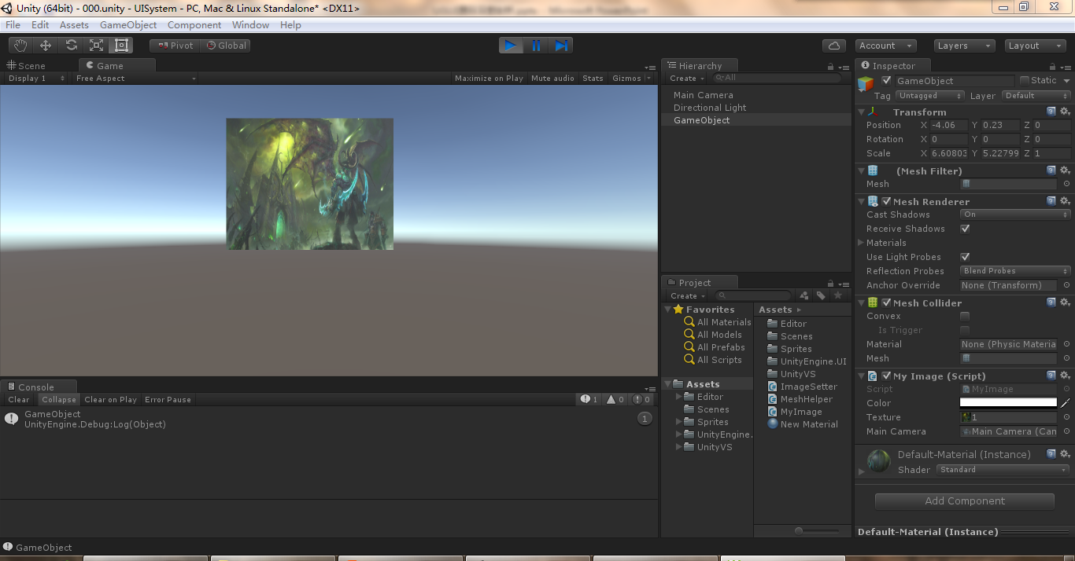
自制UI
在一个空白的场景中显示一副图片，当鼠标点击该图片时，执行一段代码

Slide 5
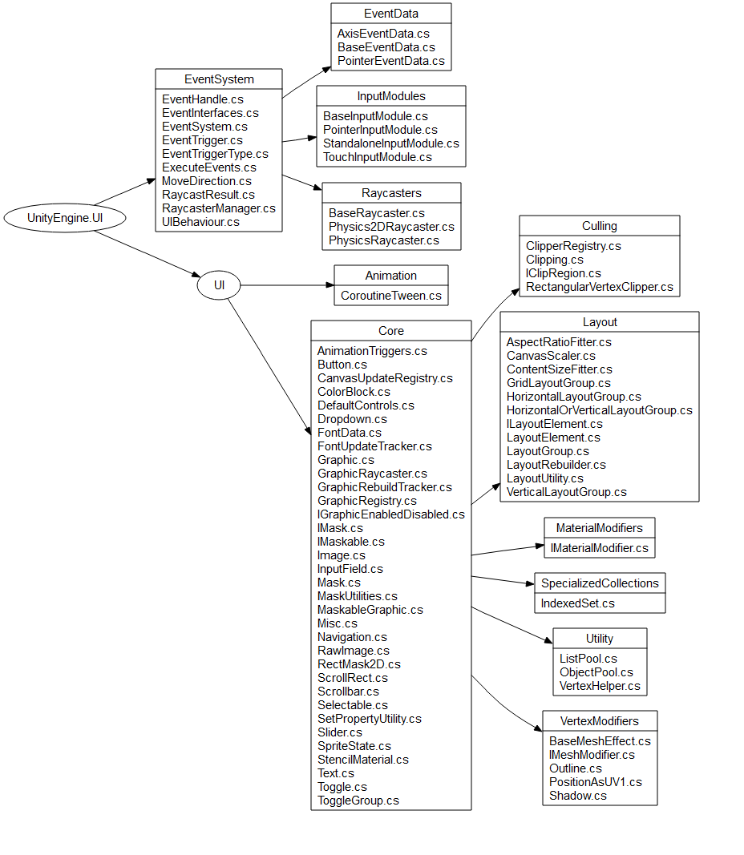
源码简介

Slide 6
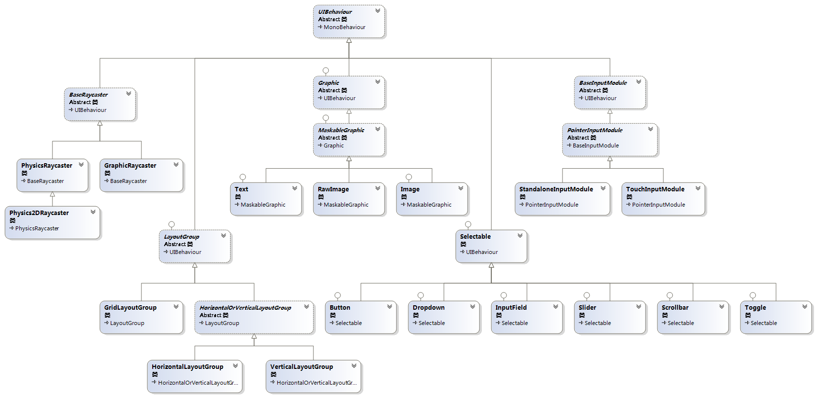
UML全家福

Slide 7
图形绘制-绘制基础
核心概念：Mesh、Vertex、Triangle、UV
Mesh：网格，决定物体的形状
Vertex ：顶点，组成Mesh的元素
Triangle ：三角形，决定顶点顺序
UV：纹理贴图坐标

Slide 8
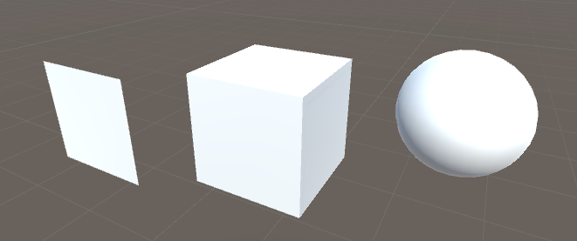
图形绘制-绘制基础

Slide 9
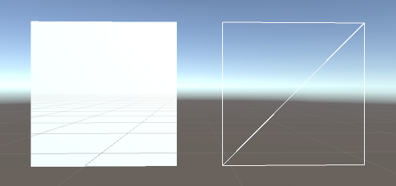
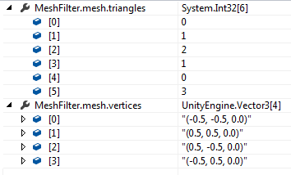
图形绘制-绘制基础

Slide 10
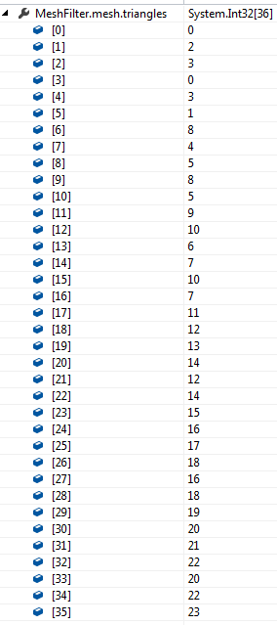
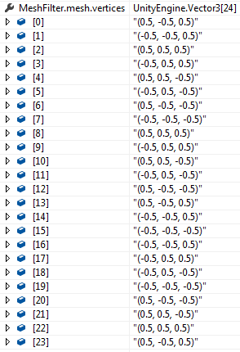
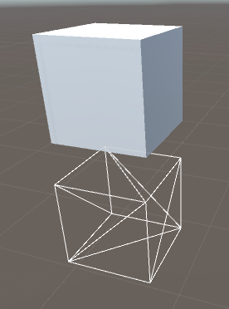
图形绘制-绘制基础

Slide 11
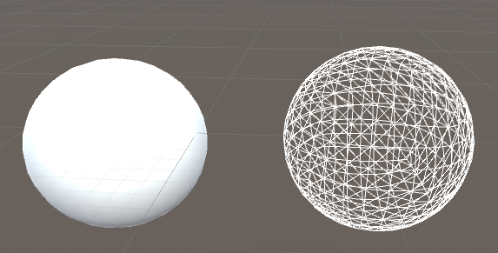

图形绘制-绘制基础

Slide 12
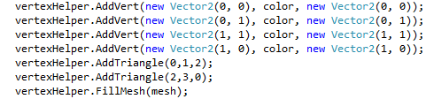
图形绘制-绘制基础
B(0,1)
C(1,1)
这是一个矩形
这个矩形由M和N两个三角形组成
M
构成三角形M和N的顶点顺序为顺时针
N
构成M和N的顶点顺序分别为A,B,C和C,D,A
A(0,0)
D(1,0)

Slide 13
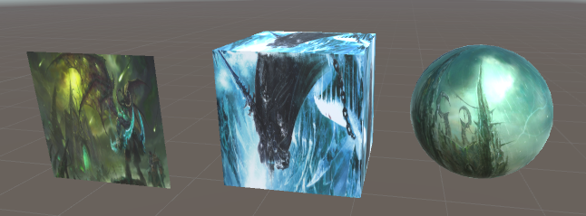
图形绘制-绘制基础
UV：纹理坐标，定义模型中的位置与贴图之间的位置关系
通俗理解，即如何将一张图片贴在模型表面

Slide 14

图形绘制-绘制基础
(0,1)
(1,1)
B(0,1)
C(1,1)
(0,0)
(1,0)
A(0,0)
D(1,0)

Slide 15

图形绘制-绘制基础
(0,1)
(0.5,1)
(1,1)
B(0,1)
C(0.5,1)
(0,0.5)
(0.5,0.5)
(1,0.5)
(0,0)
(0.5,0)
(1,0)
A(0,0.5)
D(0.5,0.5)

Slide 16
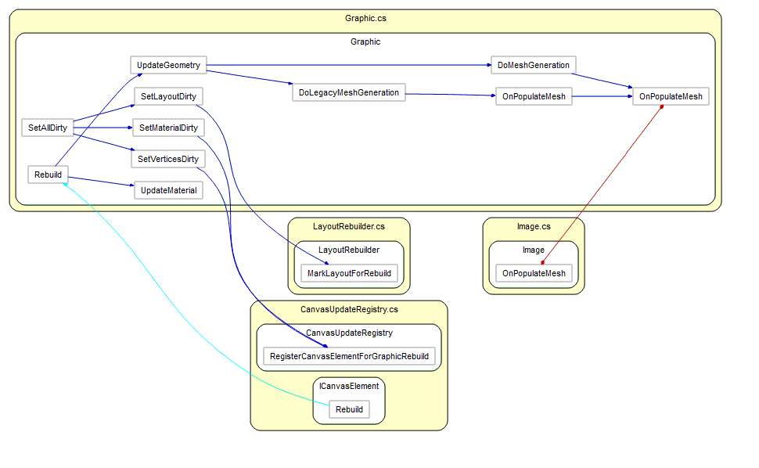
图形绘制-绘制过程

Slide 17
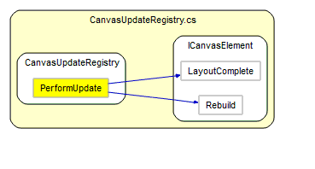
图形绘制-绘制过程

Slide 18
图形绘制-绘制过程

Slide 19
图形绘制-绘制过程
注册Canvas.willRenderCanvases事件，UI发生变动，该事件触发
该事件从渲染队列中获取元素，分别调用ReBuild方法
Rebuild方法中完成网格、材质等更新
UI发生变动时，会将发生变动的元素加入渲染队列，实现UI更新

Slide 20
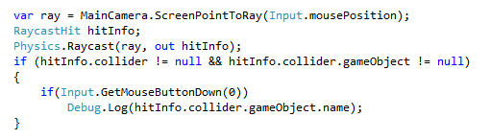
事件系统-输入模块
为什么UI中的元素可以交互？
1.生成射线
2.射线碰撞检测
3.引发事件

Slide 21
事件系统-输入模块
Button Click触发过程

Slide 22
事件系统-输入模块

Slide 23
事件系统-事件触发

Slide 24
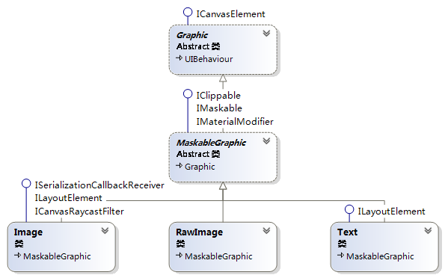
源码剖析-Graphic家族

Slide 25
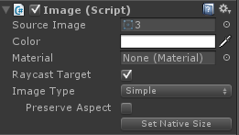
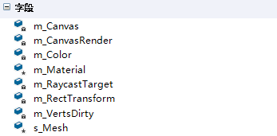
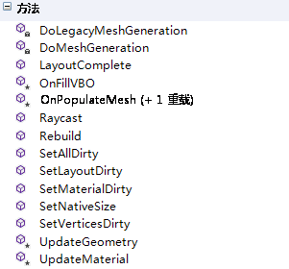
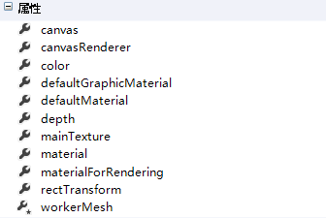
源码剖析-Graphic

Slide 26
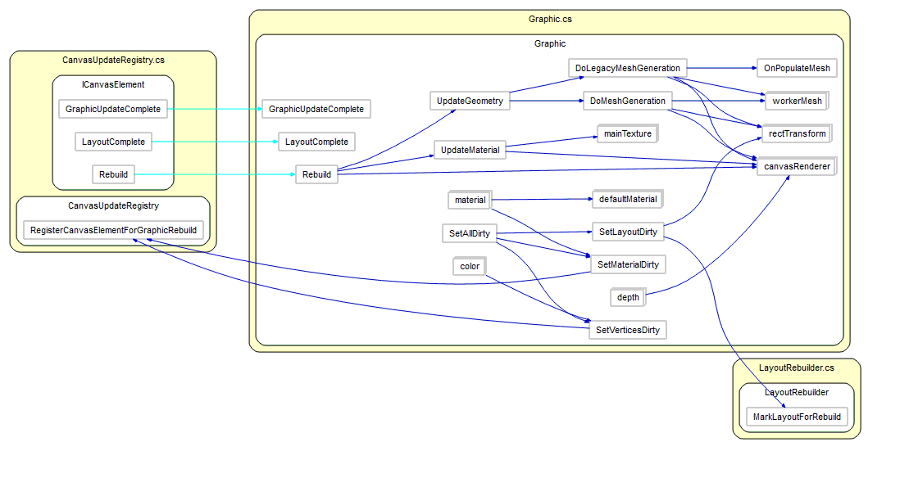
源码剖析-Graphic

Slide 27
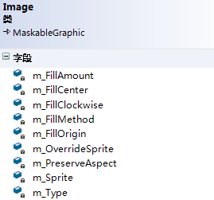
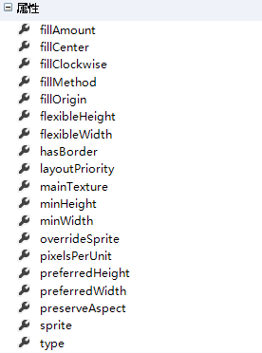
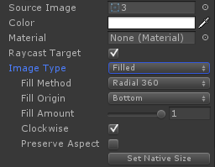
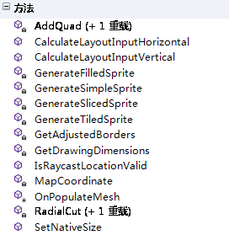
源码剖析-Image

Slide 28
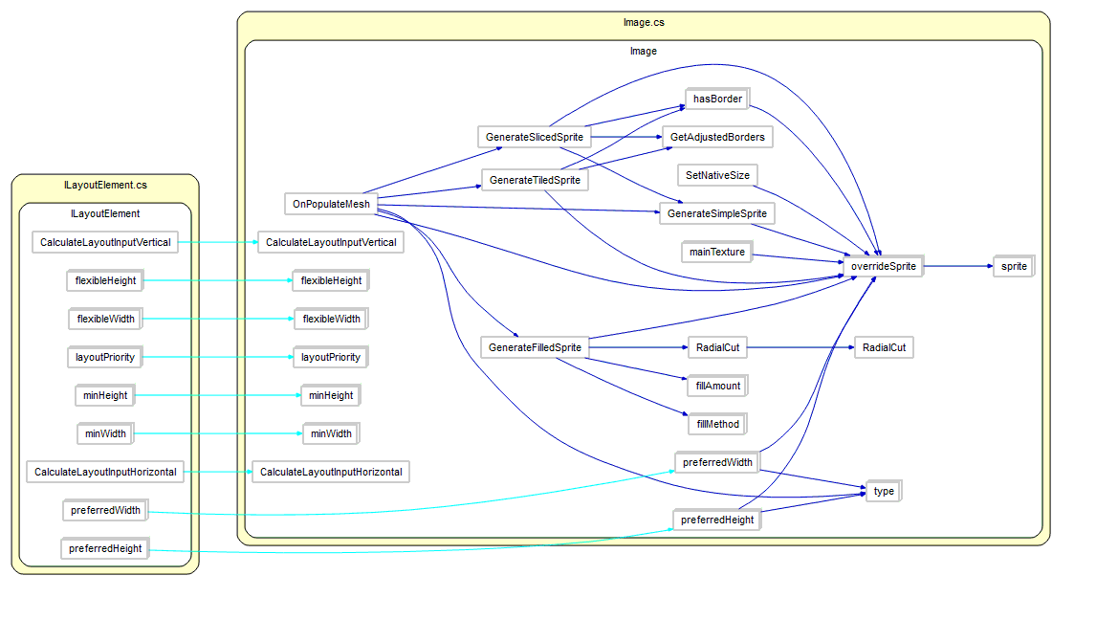
源码剖析-Image

Slide 29
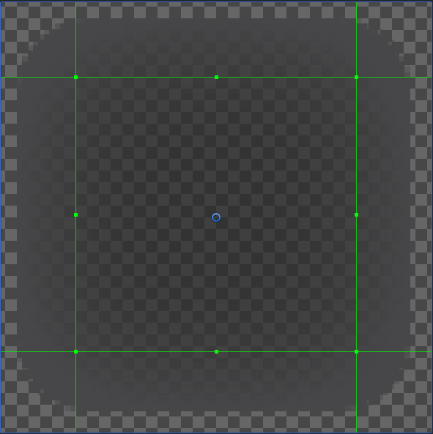
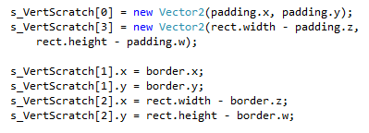
s_VertScratch[3]
源码剖析-Image
Image.Type = Sliced
border.w
s_VertScratch[2]
s_VertScratch[1]
border.x
border.z
s_VertScratch[0]
border.y

Slide 30
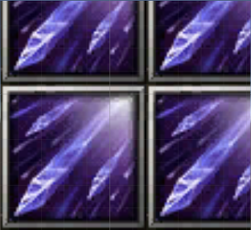
源码剖析-Image
rec.width
G
H
I
Image.Type = Tiled
右图中
tilewidth<rec.width<2*tilewidth
tileheight<rec.height<2*tileheight
D
E
F
rec.height
A=(0,0)
B=(tilewidth,0)
C=(rec.width,0)
D=(0,tileheight)
E=(tilewidth,tileheight)
F=(rec.width,tileheight)
G=(0,rec.height)
H=(tilewidth,rec.height)
I=(rec.width,rec.height)
tileheight
A
tilewidth
B
C

Slide 31
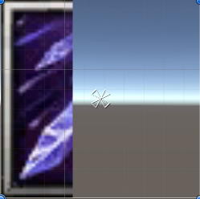
源码剖析-Image
C
D
rec.width
Image.Type = Filled
FillMethod = Horizontal
A=(0,0)
B=(FillAmount*rec.width,0)
C=(x,rec.height)
D=(FillAmount*rec.width,rec.height)
rec.height
FillAmount
A
B

Slide 32
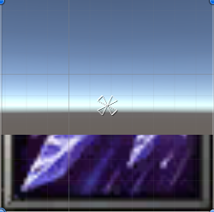
源码剖析-Image
rec.width
Image.Type = Filled
FillMethod = Vertical
A=(0,0)
B=(rec.width,0)
C=(0,rec.height*FillAmount)
D=(rec.width, 0,rec.height*FillAmount)
rec.height
C
D
FillAmount
A
B

Slide 33
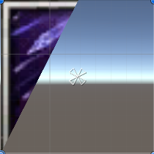
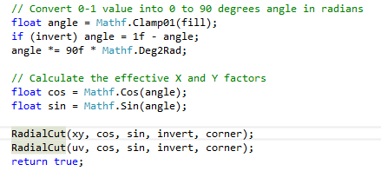
源码剖析-Image
C
Image.Type = Filled
FillMethod = Radial90
FillAmount = 0.3
B
rec.height
angle = 0.3
angle = 1 – 0.3 = 0.7
angle = 0.7 * 90 * 0.0174533 = 1.099
cos = cos(1.099) = 0.454
sin = sin(1.099) = 0.891
rec.width
A

Slide 34
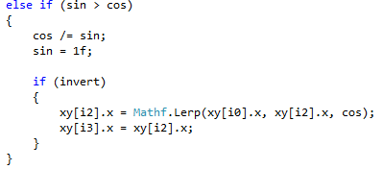
源码剖析-Image
C
Image.Type = Filled
FillMethod = Radial90
FillAmount = 0.3
B
同时缩放1/sin
rec.height
A=(0,0)
B=(0,rec.height)
C=(Mathf.Lerp(0,rec.width,cos),rec.height)
=(rec.width * 0.509,rec,height)
rec.width
A

Slide 35
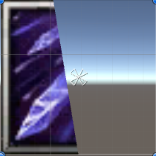
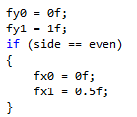
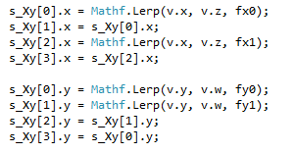
源码剖析-Image
C
Image.Type = Filled
FillMethod = Radial180
FillOrigin=Bottom
FillAmount = 0.4
B
rec.height
rec.width
A
D

Slide 36
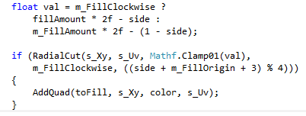
源码剖析-Image
C
Image.Type = Filled
FillMethod = Radial180
FillOrigin=Bottom
FillAmount = 0.4
B
val=0.8
rec.height
同Radial90一样
rec.width
A
D

Slide 37


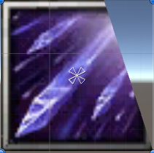

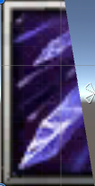
源码剖析-Image
VS

Slide 38


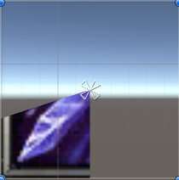
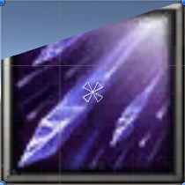
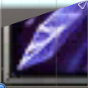
源码剖析-Image
VS

Slide 39
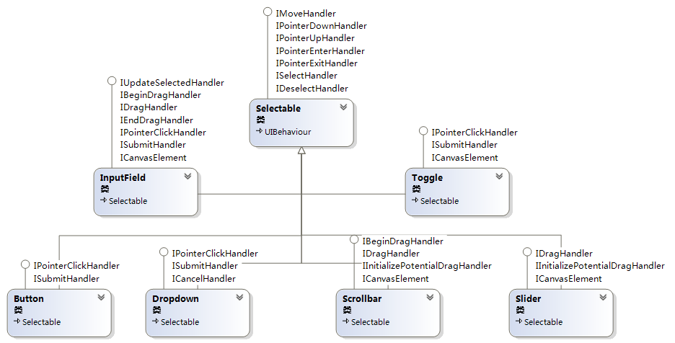
源码剖析-Selectable家族

Slide 40
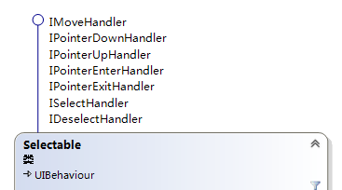
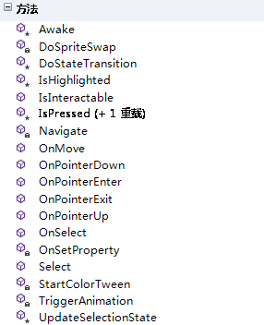
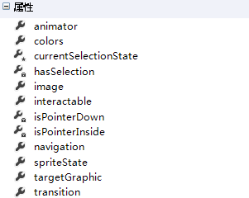
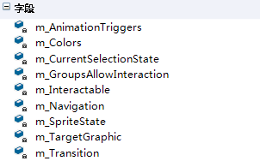
源码剖析-Selectable

Slide 41
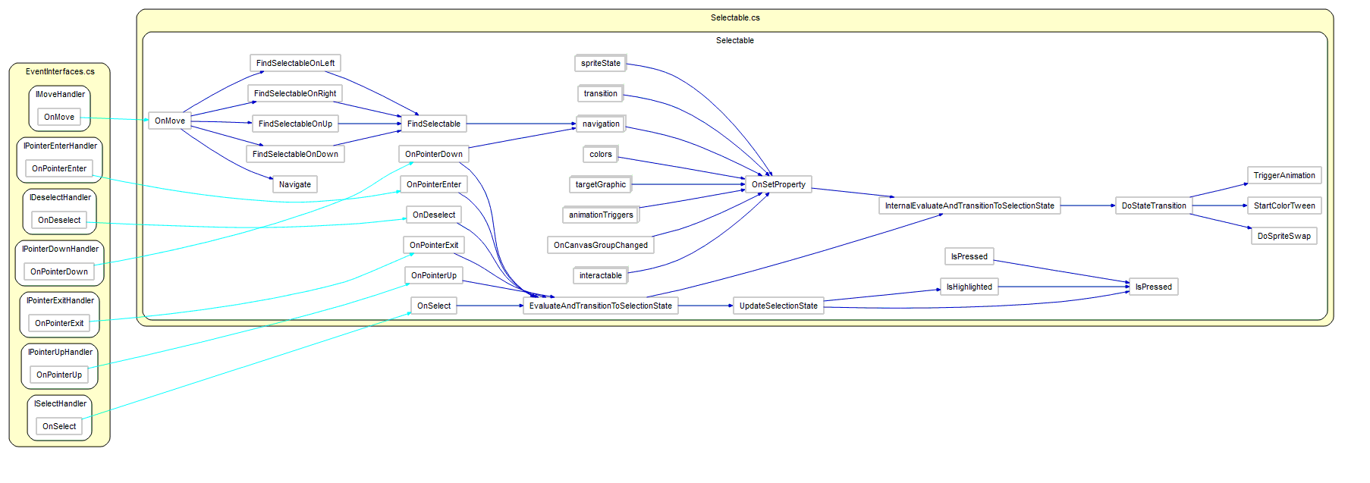
源码剖析-Selectable

Slide 42
布局系统-概述
The auto layout system provides ways to place elements in nested layout groups such as horizontal groups, vertical groups, or grids. It also allows elements to automatically be sized according to the contained content.

Slide 43

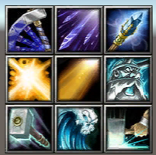
布局系统-概述

Slide 44



布局系统-概述
200
200
200
200

Slide 45



布局系统-概述
500
100
100
100

Slide 46

布局系统-概述
567.5
77.5
77.5
77.5

Slide 47
布局系统-布局过程

Slide 48

布局系统-布局过程

Slide 49
布局系统-布局计算
The properties are used in the following manner when a layout controller allocates width or height to a layout element:
First minimum sizes are allocated.
If there is sufficient available space, preferred sizes are allocated.
If there is additional available space, flexible size is allocated.

Slide 50

布局系统
已知如下条件：
GameObject.Width=800
 | A | B | C | D
Min | 500 | 0 | 0 | 0
Preferred | 0 | 0 | 0 | 0
Flexible | 0 | 0 | 0 | 0

Slide 51

布局系统
 | A | B | C | D
Min | 500 | 0 | 0 | 0
Preferred | 10 | 10 | 10 | 10
Flexible | 0 | 0 | 0 | 0
 | A | B | C | D
Min | 500 | 0 | 0 | 0
Preferred | 500 | 10 | 10 | 10
Flexible | 0 | 0 | 0 | 0

Slide 52

布局系统
 | A | B | C | D
Min | 500 | 0 | 0 | 0
Preferred | 10 | 10 | 10 | 10
Flexible | 0 | 0 | 0 | 0
 | A | B | C | D
Min | 500 | 0 | 0 | 0
Preferred | 500 | 10 | 10 | 10
Flexible | 1 | 1 | 1 | 1

Slide 53
布局系统
 | A | B | C | D
Min | 500 | 0 | 0 | 0
Preferred | 500 | 10 | 10 | 10
Flexible | 1 | 1 | 1 | 1
totalMinSize = 500 totalPreferredSize = 530 totalFlexibleSize = 4
minMaxLerp
= Mathf.Clamp01((size - totalMinSize) / (totalPreferredSize - totalMinSize))
= Mathf.Clamp01((800 - 500) / (530-500))=1
itemFlexibleMultiplier
= (size - totalPreferredSize) /totalFlexibleSize
= (800 -530) /4=67.5

Slide 54


布局系统
 | A | B | C | D
Min | 500 | 0 | 0 | 0
Preferred | 500 | 10 | 10 | 10
Flexible | 1 | 1 | 1 | 1
totalMinSize = 500 totalPreferredSize = 530 totalFlexibleSize = 4
minMaxLerp = 1 itemFlexibleMultiplier = 67.5
childSize = Mathf.Lerp(min, preferred, minMaxLerp)
childSize += flexible * itemFlexibleMultiplier
A.Width = Mathf.Lerp(500, 500,1) = 500
A.Width += 1 *67.5 = 500 + 67.5 = 567.5
B.Width = Mathf.Lerp(0, 10,1) = 10
B.Width += 1 *67.5 = 10 + 67.5 =77.5

Slide 55
布局系统
练习
 | A | B | C | D
Min | 150 | 120 | 10 | 50
Preferred | 200 | 150 | 20 | 50
Flexible | 0 | 0 | 0 | 0
 | A | B | C | D
Min | 150 | 120 | 10 | 50
Preferred | 200 | 150 | 20 | 50
Flexible | 1 | 1 | 1 | 1
totalMinSize = 330 totalPreferredSize = 420 totalFlexibleSize = 4
minMaxLerp = 1 itemFlexibleMultiplier = 95

Slide 56




布局系统
 | A | B | C | D
Min | 150 | 120 | 10 | 50
Preferred | 200 | 150 | 20 | 50
Flexible | 1 | 1 | 1 | 1
totalMinSize = 330 totalPreferredSize = 420 totalFlexibleSize = 4
minMaxLerp = 1 itemFlexibleMultiplier = 95
A.Width = Mathf.Lerp(150, 200,1) = 200
A.Width += 1 *95 = 200 + 95 = 295
B.Width = Mathf.Lerp(120, 150,1) = 150
B.Width += 1 *95 = 150 + 95 = 245
C.Width = Mathf.Lerp(10, 20,1) = 20
C.Width += 1 *95 = 20 + 95 = 115
D.Width = Mathf.Lerp(50, 50,1) = 50
D.Width += 1 *95 = 50 + 95 = 145

Slide 57

UGUI扩展
任务：给Image添加百叶窗效果

Slide 58


UGUI扩展
width
height
80%

Slide 59

UGUI扩展
width
height
80%

Slide 60

结束？
一切刚刚开始，加油，好运

