Slide 1
Sales Projection
Sam Lagana

Slide 2
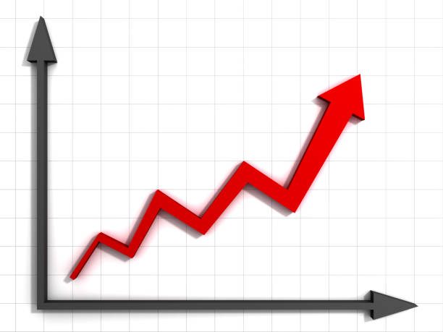
Overview
How does our data affect our future Item Outlet sales?

Slide 3
Understanding the data
Item_MRP
Outlet Location Type
Item_MRP has the highest correlation out of all the different features
Separated in different Tier sizes and different Tier sizes result in an increase or decrease in Item Outlet Sales
Tier 1
Tier 2
Tier 3

Slide 4
Project objective:
Does Item MRP and Outlet location type affect Item Outlet Sales?

Slide 5
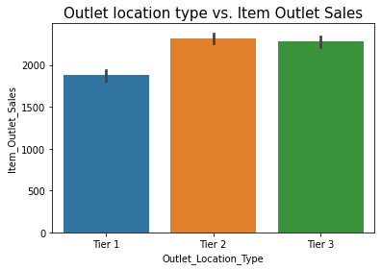
Outlet Location Type
Separated into three tiers
  Tier 1
  Tier 2
  Tier 3
Tier 2 and 3 are very similar but much higher than tier 1

Slide 6
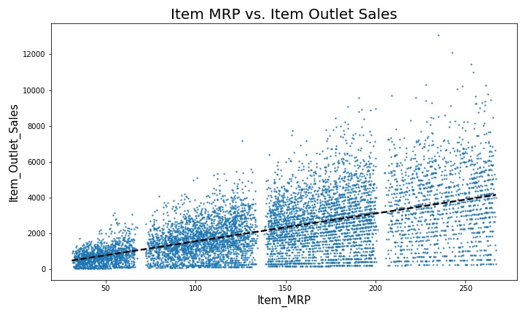
Item MRP
This shows higher Item MRP results in higher item outlet sales
25
22
15

Slide 7
Insights
Outlet location type
There isn’t a significant difference in outlet location type
Item MRP
Higher Item MRP predicts higher item outlet sales

Slide 8
Recommendation:
Focus on items with higher Item MRP to result in higher item outlet sales

