Slide 1
Result Generator App
Programming language: JAVA
IDE : Eclipse

Slide 2
App: WorkFlow
Start
FileOperations: readFile()
Check Input
Student Result Generator
FileOperations: writeResult()
End

Slide 3
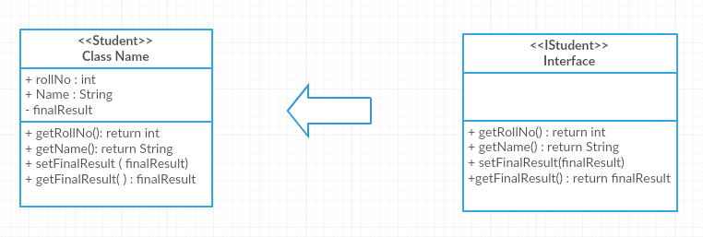
Class: Student

Slide 4
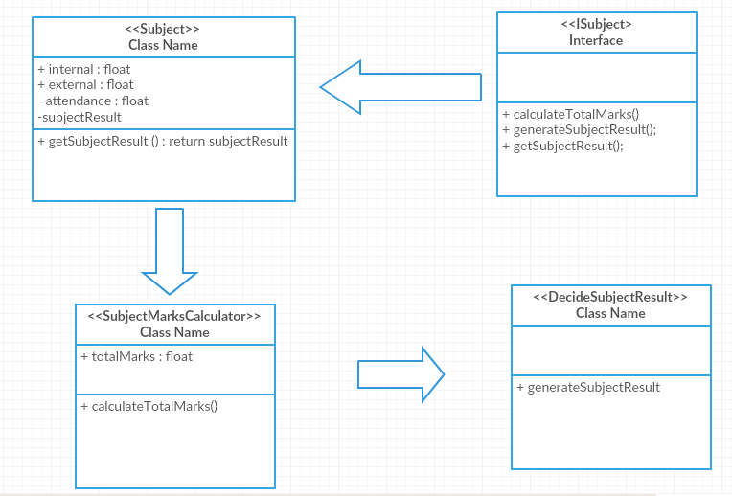
Class: Subject

