Slide 1

CYPHER · FOR THE TWENTY-FIVE
Ignorance is bliss.
Twenty-one specialists and the mind that runs them. Point it at anything on SitecoreAI and it ships, pixel perfect, for a rounding error of what you pay now.
It doesn’t replace you. It promotes you.
Selection closes Friday, November 13 · ignoranceisbliss.ai
Notes:
Cypher. Twenty-one specialists and the mind that runs them. We are not selling it. We are choosing twenty-five companies who get it. This deck is the case for why you want to be one of them.

Slide 2




Every booth in the expo hall sells hours
THE WAY IT WORKS NOW
And hours are the problem. The bigger the project, the more of them you buy, and the less anyone wants it finished.
The same question, every project.
Change orders. Plural.
QA after you find the bug.
Your agency asks it again. And bills you for asking.
The quote was the opening bid. The invoice is the real number.
You test their work. Then you pay them to fix it.
Somewhere, an agency is billing for this slide.
Notes:
The problem is not talent. It is the model. Hours, re-asked questions, change orders, and QA that happens after the client finds the bug.

Slide 3
We broke what a build costs. Permanently.
THE RECEIPT
$512
THE AGENCY QUOTE
$400,000+
THE RUN
What it cost to run a SitecoreAI build an agency quoted at $400,000+. We have the receipts.
$512
Drawn to scale. That sliver is the whole bar.
The cost of the run, not the price of Cypher. Every step metered to the cent, against a hard budget per specialist.
0.13% of the quote.
Notes:
Five hundred and twelve dollars. That is what the meter read at the end of a SitecoreAI build an agency quoted at four hundred thousand plus. It is the cost of the run, not the price of Cypher. The bars are drawn to scale.

Slide 4

Twenty-one specialists. One mind runs them all.
MEET THE TEAM
DISCOVERY
ENGINEERING
DB
Danielle Brooks
Discovery Lead
MR
Marcus Reyes
Engineering Lead
AJ
Aisha Johnson
Solution Architect
PP
Priya Patel
Repo Analyst
EC
Emily Chen
Component Engineer
CR
Carlos Ramirez
Sitecore Modeler
MG
Maria Gonzalez
Content Analyst
TM
Tyler Morgan
Research
DK
David Kim
Head Integrator
RM
Ryan Mitchell
Deployment
CONTENT
QUALITY
RG
Rachel Goldstein
Content Lead
Cypher
Chief of Staff. Your one point of contact.
KN
Kevin Nguyen
Quality Lead
LH
Leila Hassan
Content Migrator
BL
Brandon Lee
Media Migrator
AJ
Andre Jackson
Structural Validator
SW
Samantha Wright
Parity Auditor
LF Lauren Fitzgerald, Handover Writer
ST
Sarah Thompson
Experience Enabler
It plans it, builds it, checks it, and fixes what it finds before you find it.
JM
Jessica Martinez
Editor Experience QA
MR
Michael Robinson
Perf & Accessibility
Notes:
Every specialist has a name, a lead and a job. Four workstreams: Discovery, Engineering, Content and Quality. Cypher runs all of them and is the only one you talk to. No invoice you would recognize.

Slide 5
You make three decisions. That’s the job now.
HOW A BUILD RUNS
0
1
2
3
4
5
6
7
8
9
Intake
Discovery
Blueprint
Foundation
Components
Templates
Content
Experience
Deploy
Acceptance
GATE 1
PILOT
GATE 2
Approve the Blueprint.
Approve the pattern.
Accept the site.
Every source component mapped to what your marketers will edit in SitecoreAI. One read, one yes.
The first slice of components, built end to end. Say yes and the rest follow it.
Built, checked, published. You sign it off in the live systems, not in a slide.
Everything else? It asks, it recommends, and if you’re busy, it proceeds with its own pick when the clock runs out. Never on a gate.
Notes:
Ten phases, two gates and one pilot review. Those three are yours. Everything else is decided by the team, with Cypher recommending and a deadline after which it proceeds with its pick. Gates never default: they wait for you.

Slide 6
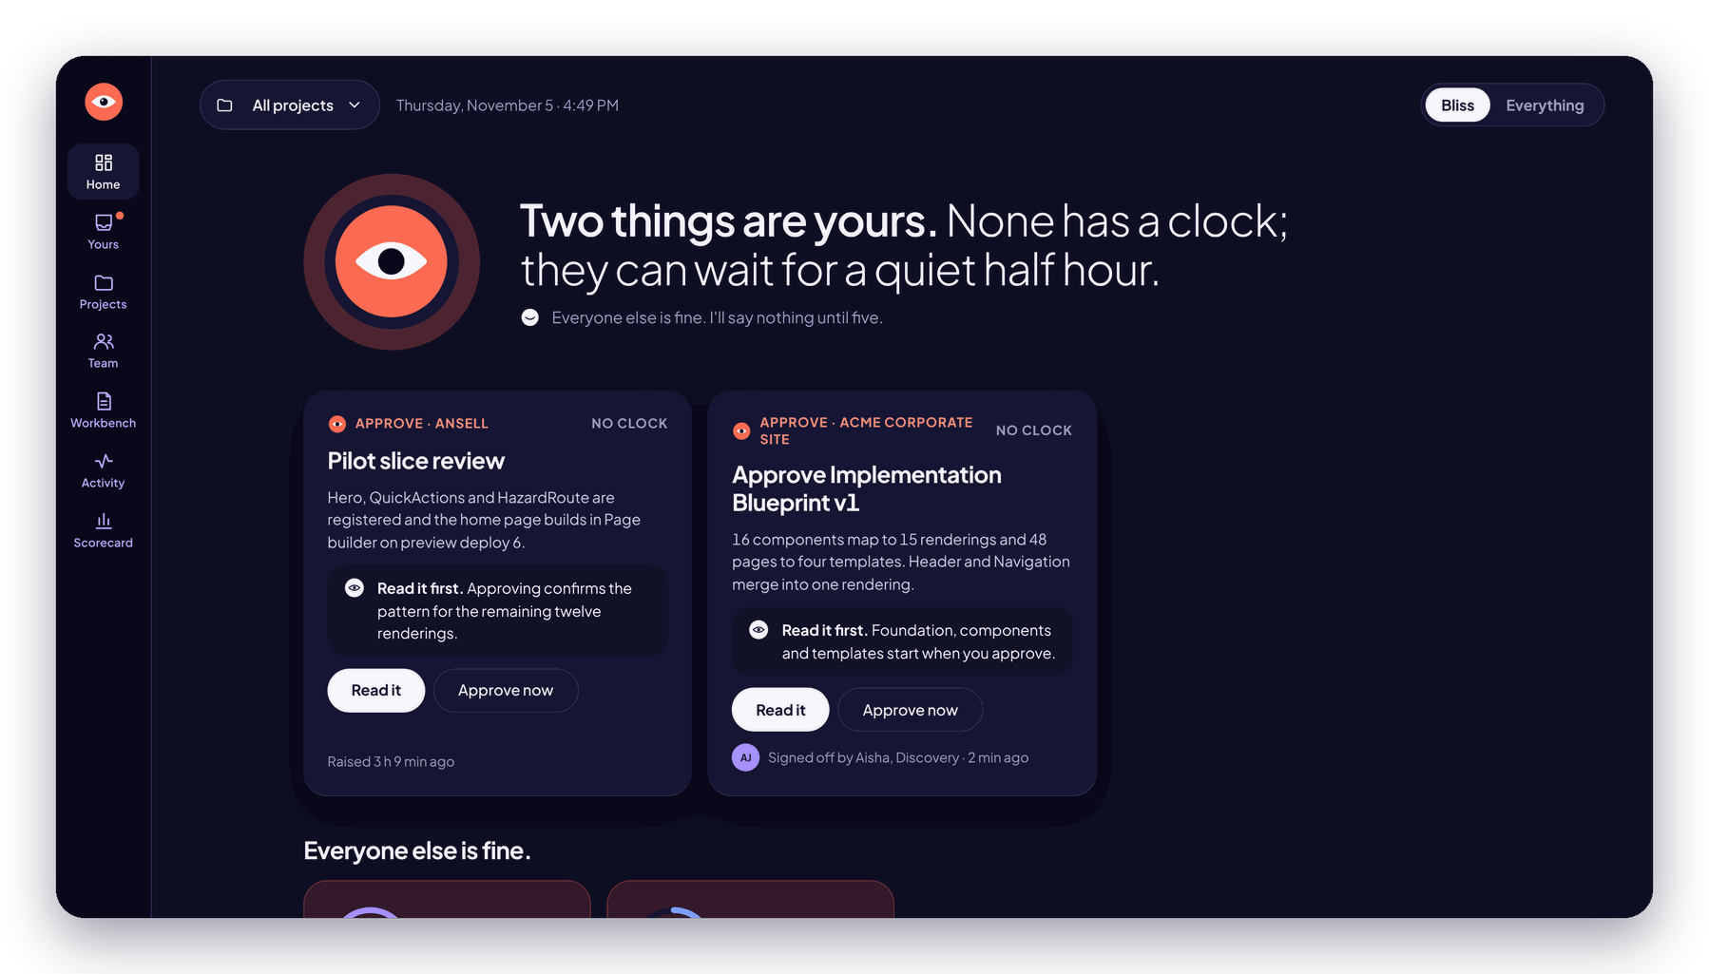
THE PRODUCT
Already built. Already running.
Everything that follows is a screenshot of the working product, taken today. Not a mock-up. Not a roadmap.
Notes:
Every screen in the next section is the real product, running, with live projects in it.

Slide 7
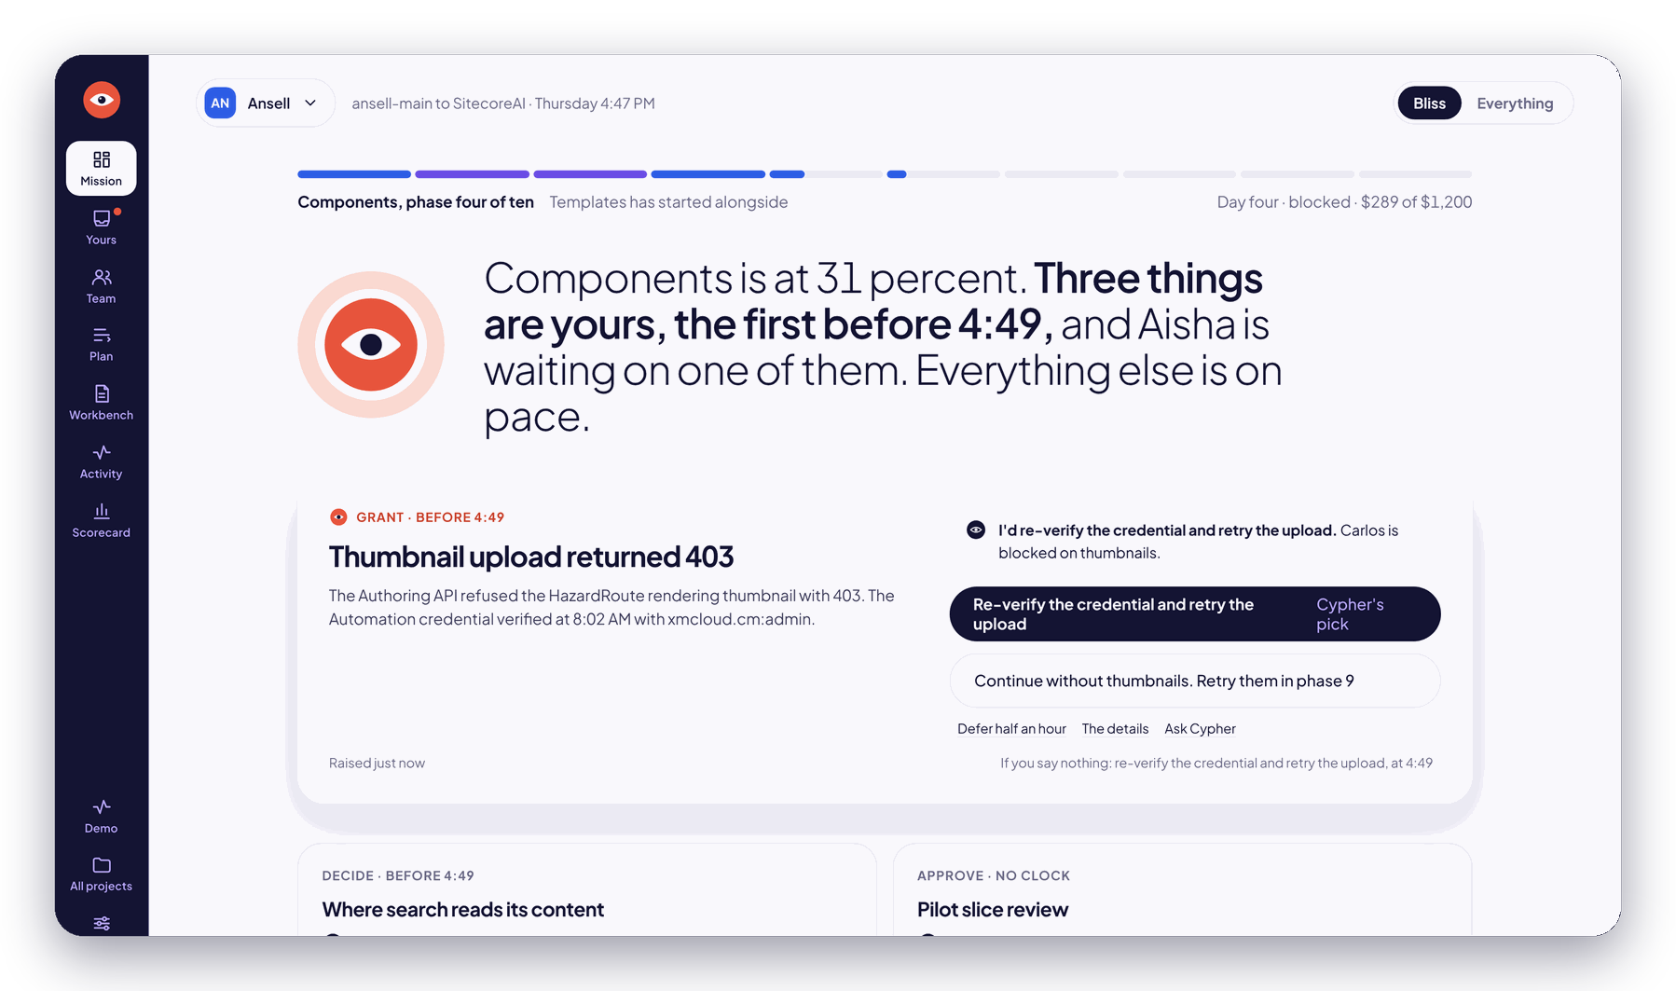
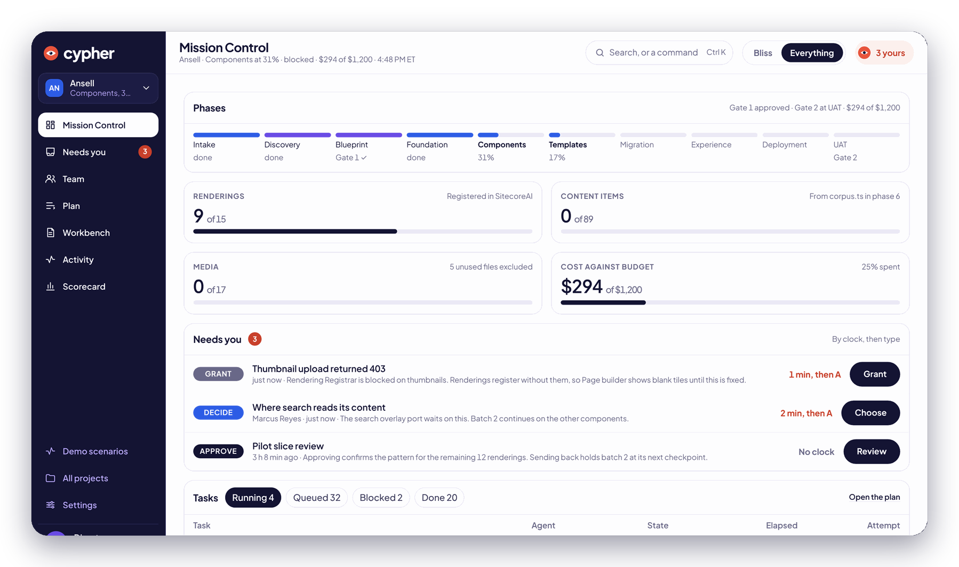
Bliss, or Everything. Same screen, two faces.
ONE DIAL
Bliss
Everything
Bliss. Cypher says what matters in one sentence, makes its pick, and leaves you alone.
Everything. Every phase, task, dollar and log line, for when you want to see the gears.
Notes:
Every screen has two faces. Bliss is for the executive: one sentence, the decisions that are yours, and the pick already made. Everything is the full instrument panel. One dial switches between them.

Slide 8
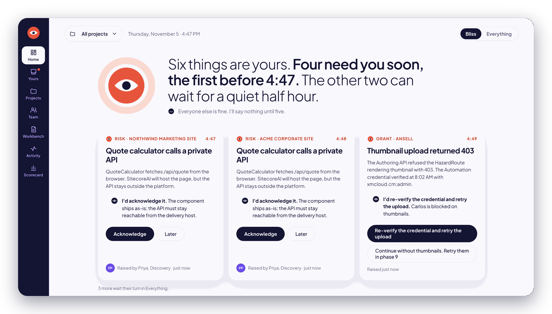
It tells you what matters. Then it shuts up.
BLISS
1
One sentence.
“Six things are yours. Four need you soon, the first before 4:47.”
1
3
2
Its pick, already made.
“I’d re-verify the credential and retry the upload.” One click and it’s done.
2
3
Everyone else is fine.
“I’ll say nothing until five.” And it means it.
Notes:
This is the portfolio dashboard in Bliss. Three projects running. The sentence at the top is generated from the live state. Each card already carries Cypher's recommendation as the primary button.

Slide 9
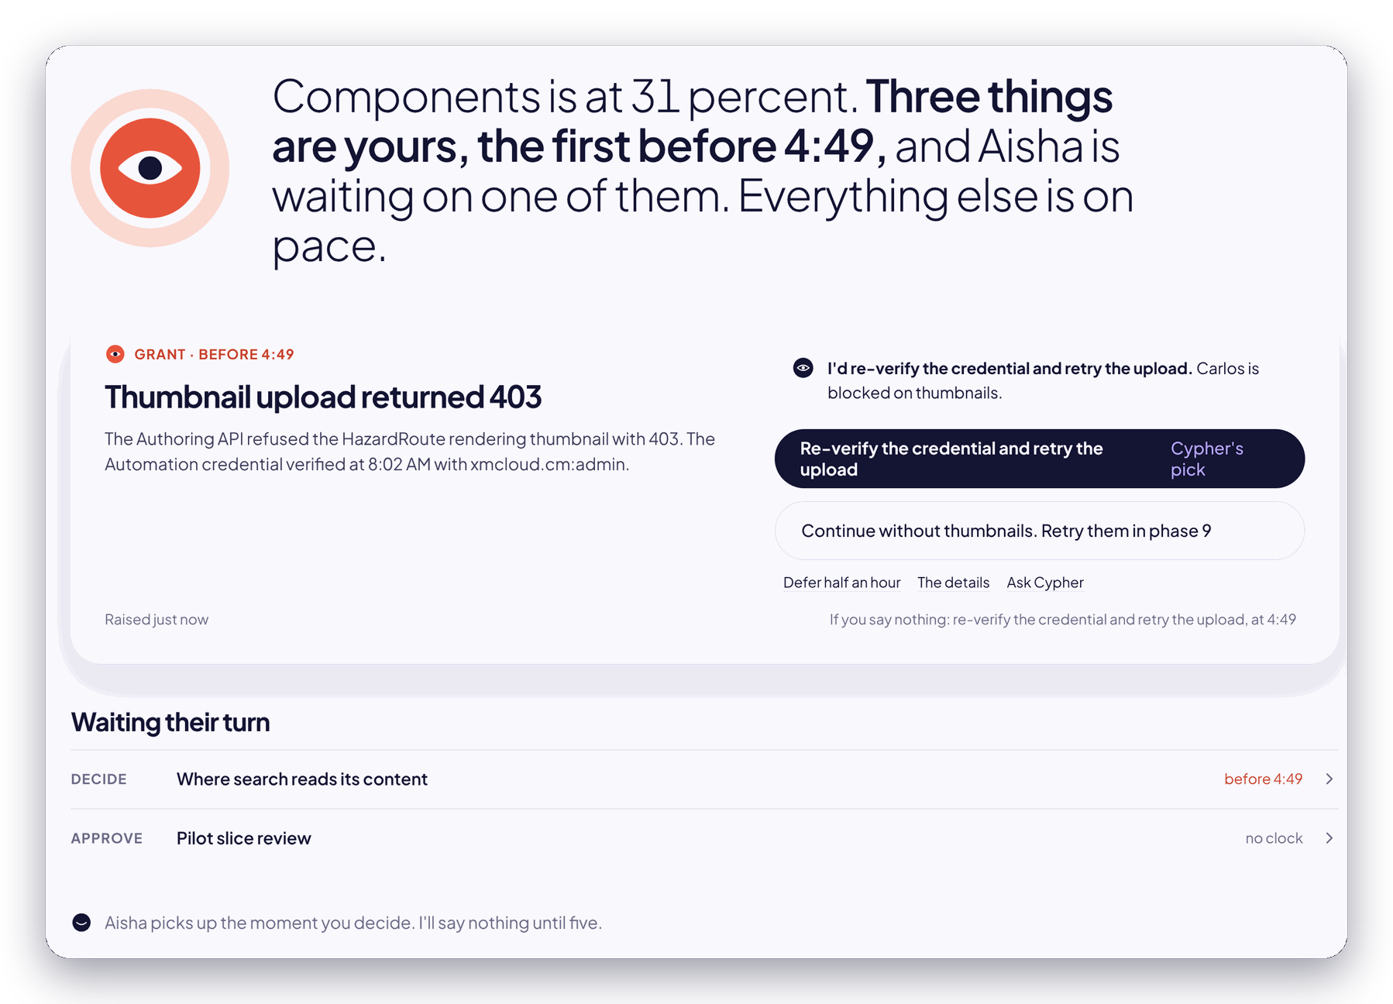
It asks for a signature, not for help.
NEEDS YOU
1
The problem, in a sentence.
A 403 on a thumbnail upload. What happened, who’s blocked, what it costs to wait.
2
Cypher’s pick.
Already reasoned, already the primary button. The alternative sits right below it.
1
2
3
A clock, not a nag.
“If you say nothing: retry at 4:49.” Deadlines are rules in code. It can never decide to skip your gate.
3
Notes:
Every escalation is a card: Decision, Blocker, Access, Budget, Risk or Review. The policy for what escalates and when it defaults is deterministic code. The model only writes the card and the recommendation.

Slide 10
For when you want to see the gears.
EVERYTHING
1
Ten phases, live.
Components at 31%. Templates already started alongside.
1
2
Every dollar.
$294 of a $1,200 budget. Warns at 80%, stops at 100%.
2
3
Yours, by the clock.
Grant, Decide, Approve. Each with the default it takes, and when.
3
4
Every task.
Running, queued, blocked, done. Who has it, how long, which attempt.
4
Notes:
Mission Control in Everything mode for the Ansell project: the phase strip, the metrics that matter for this playbook, the cost against budget, the decisions waiting, and the task table.

Slide 11
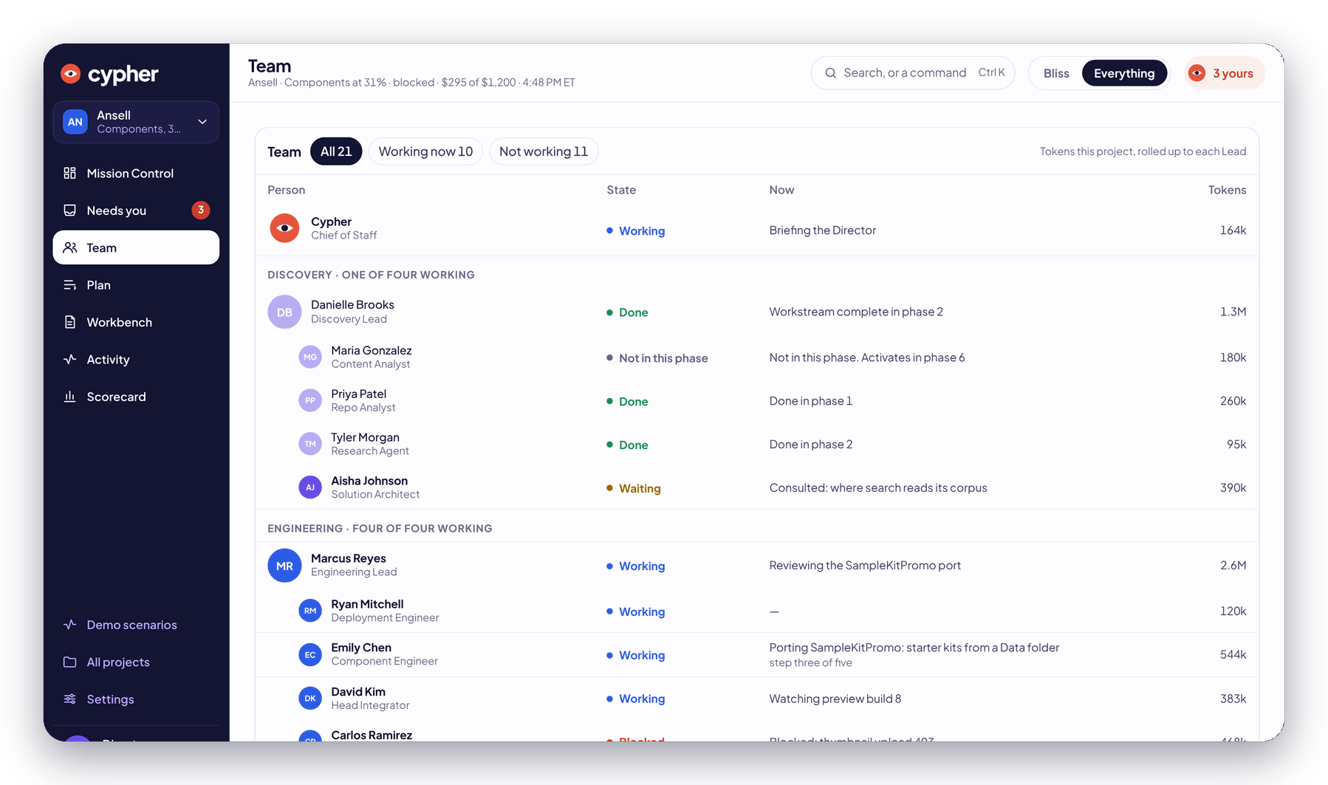



A team with names. Not a ticket queue.
TEAM
Every specialist has a name, a lead, a job and a meter. You see who is working, on what, and what it cost, down to the token.
Four leads, one Chief of Staff.
Leads settle what they can. Cypher brings you the rest.
Live state.
Working, waiting, blocked, done. Never “in progress” for a week.
Metered.
Usage rolls up to each lead and each project.
Notes:
The Team page shows all twenty-one roles on the project, grouped by workstream under their lead, with live state and token usage rolled up.

Slide 12
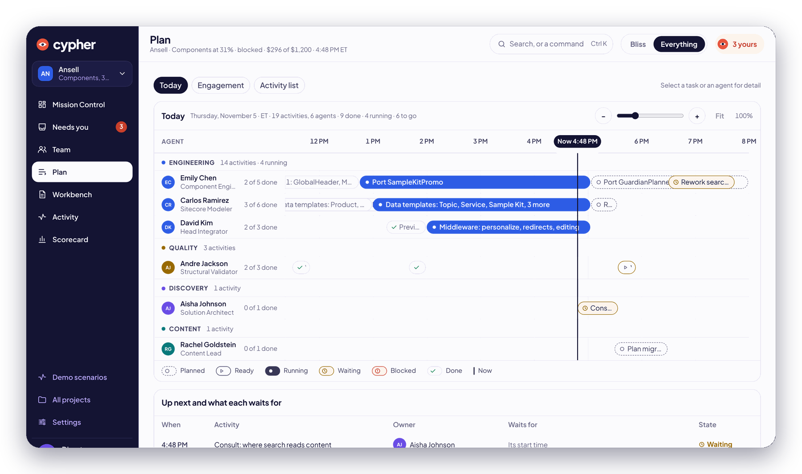
It schedules itself. In your time zone.
PLAN
1
A now line.
Today, by specialist, in working hours.
2
Real bars.
Every task forecast, then the actual window it ran in.
2
1
3
What waits on what.
Up next, who owns it, and what it’s waiting for.
Change your mind mid-build (“Skip the blog”) and it re-plans, shows the impact, then applies it.
3
Notes:
The plan is compiled from the playbook and the approved Blueprint into a task graph, then scheduled. Directives re-plan with an impact preview and a stop window.

Slide 13
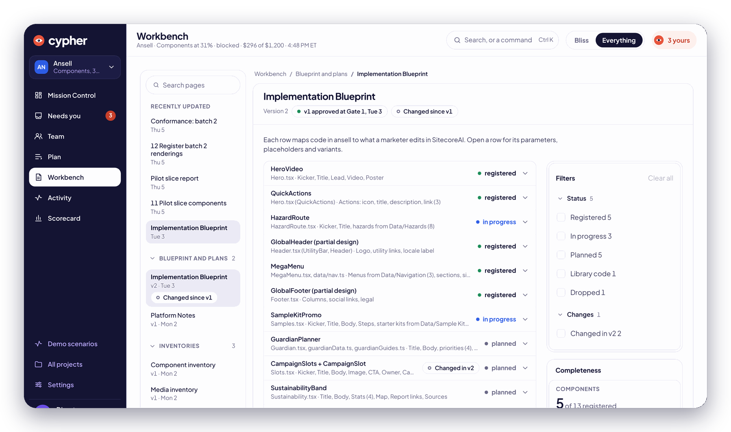
Every component mapped. Every change recorded.
WORKBENCH
1
The Blueprint.
Each source component mapped to what a marketer edits in SitecoreAI.
3
2
Status from the work.
Registered, in progress, planned. Not a status meeting.
1
2
3
Versioned.
v1 approved at Gate 1. Every change since, flagged.
Notes:
The Workbench holds every document the team writes: inventories, the Blueprint, reports, the Decision Log, pull requests. Every one versioned, with the approved version marked.

Slide 14
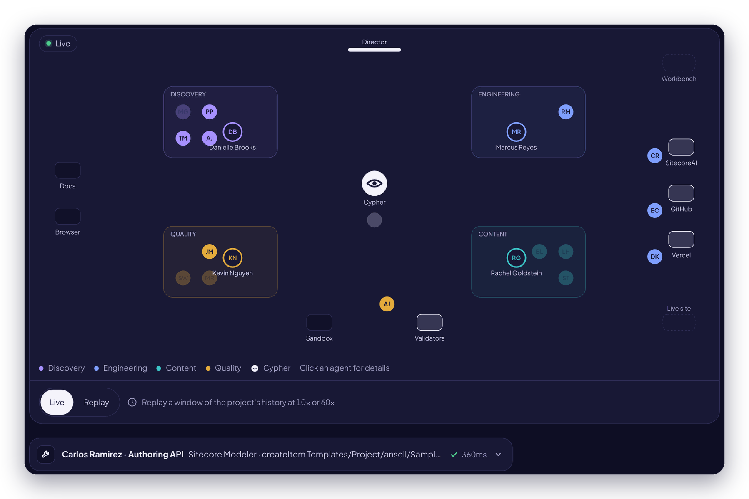
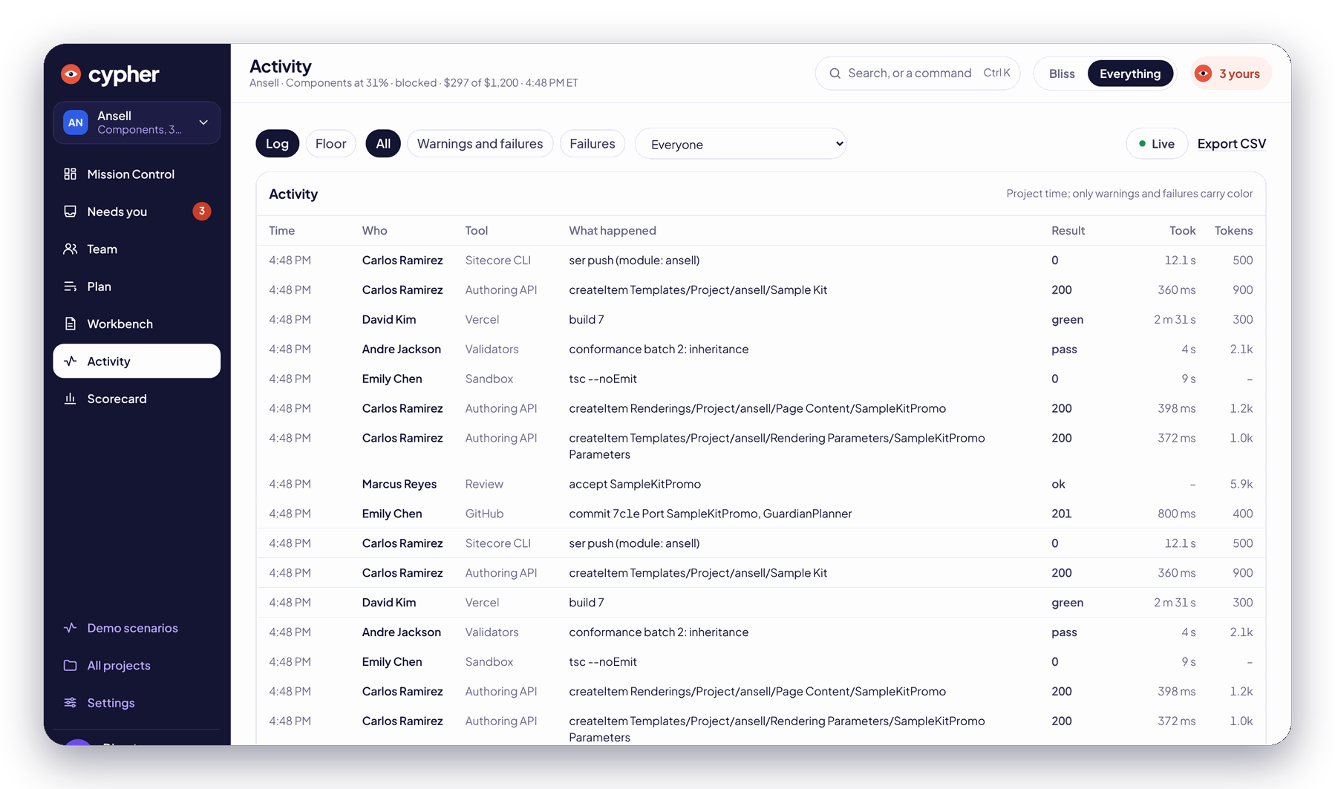
Watch it work. Or don’t. It’s all recorded.
ACTIVITY
The Floor. Every specialist, every tool, live. Replay any window of a build at 10× or 60×.
The log: every action, who did it, which tool, the result, the time and the tokens.
Notes:
Every tool call is recorded as an event in an append-only log. The Floor animates it. The log filters it. Nothing happens off the record.

Slide 15
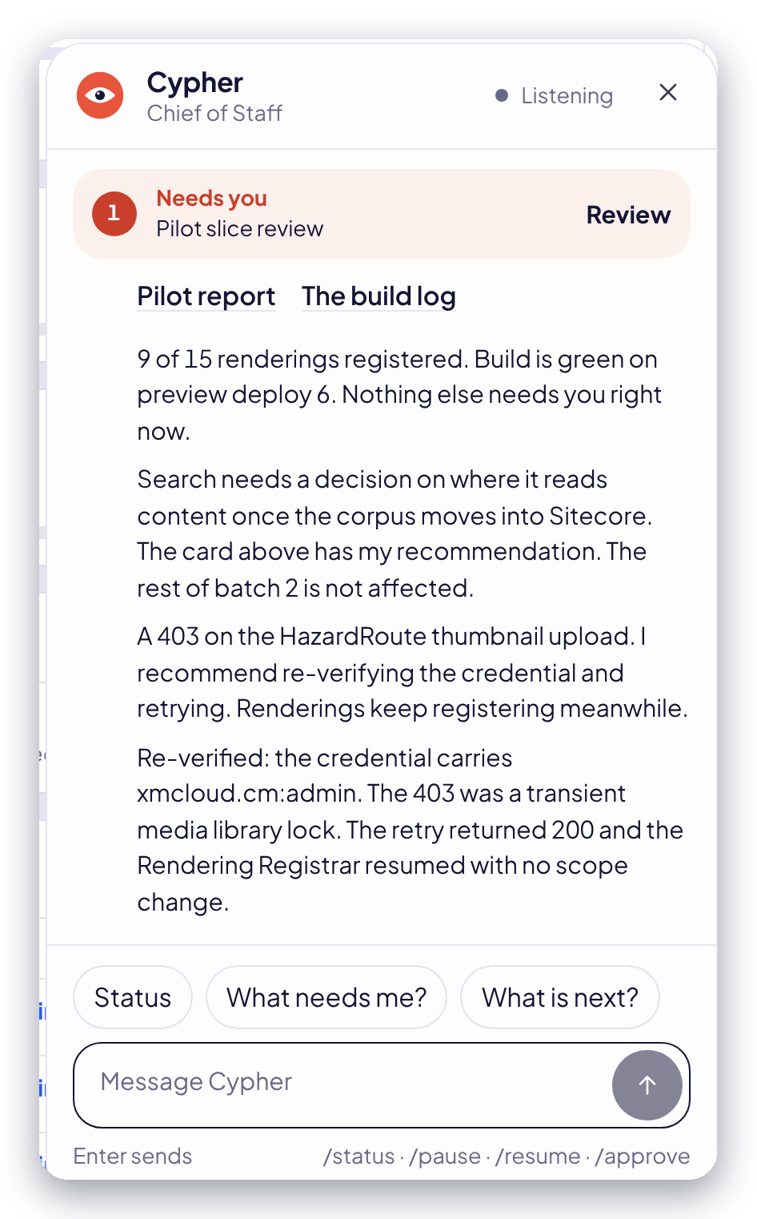
A chief of staff, not a chatbot.
TALK TO IT
“
A 403 on the HazardRoute thumbnail upload. I recommend re-verifying the credential and retrying. Renderings keep registering meanwhile.
Cypher, unprompted, while you were in a meeting
Status
Where it is, what’s blocked, what it cost.
What needs me?
The short list. Nothing else.
“Skip the blog.”
A directive. It re-plans, shows the impact, then applies it.
Notes:
Cypher is the only interface you need. It briefs you on phase entry, posts a daily digest, answers status questions, and takes directives in plain English with a stop window before they apply.

Slide 16

UNDER THE HOOD
The technology, simplified.
Because you have a job. Four ideas explain why this works when everything else bills by the hour.
Notes:
Four ideas: one mind, one gateway, one record, and an engine that cannot lose its place.

Slide 17





One mind. One gateway. One record.
HOW IT WORKS
You
Cypher
21 specialists
The gateway
Your systems
Three decisions and anything you want to say. In plain English.
The mind. Plans the build, runs the team, brings you only what’s yours.
Each with one job, its own tools and a hard budget.
Every action checked against what that specialist may touch. Then logged.
SitecoreAI, GitHub, Vercel, a browser, the validators.
The record. 225,000+ events
Append-only. Every action, by everyone, forever. Replay any build, step by step.
The engine. It can’t lose its place
Durable workflows. Pull the plug mid-build and it resumes exactly where it stopped.
Notes:
Technically: a Temporal-based durable orchestrator runs the plan; a model-driven runtime runs each role; a single policy-enforcing tool gateway sits between every role and every external system; and every action is appended to a Postgres event log that drives the UI live and can be replayed.

Slide 18





Specialists never see a password.
BUILT LIKE IT HANDLES YOUR KEYS. BECAUSE IT DOES.
One gateway, every action
Credentials by reference
Short-lived GitHub access
Each specialist gets an allow-list and a scope. Anything outside it is refused, and recorded.
Injected at the gateway. Never in a prompt, never in a log, never seen.
An app installed on your org. Tokens that expire. Revocable in one click.
A browser on a leash
Your data, your key
A hard budget, per specialist
Every crawl goes through an egress proxy that refuses private addresses.
Per-client encryption keys. Sign-in limited to named accounts with 2FA.
Warns at 80%. Stops at 100%. Nobody runs up a tab.
Notes:
Security is enforced in one place, the tool gateway: role allow-lists, resource scoping, credential injection, rate limits and audit. GitHub access is through a GitHub App with short-lived installation tokens. Browser traffic goes through an egress proxy that blocks private addresses.

Slide 19
It checks its own work. Harder than you would.
QUALITY
98%+
content parity, or it doesn’t ship
axe-core
accessibility, audited on every representative page
Lighthouse
performance budgets, with the report as evidence
Desktop
Tablet
Phone
Every page screenshotted at three breakpoints and diffed pixel by pixel against the original. The dashed box is what it catches before you do.
Page builder
tested the way your marketers will use it
Notes:
Visual QA screenshots each page at three breakpoints and pixel-diffs against the source. Accessibility runs axe-core, performance runs Lighthouse. Parity auditing compares text, links and media. Editor Experience QA works in Page builder the way a marketer would.

Slide 20
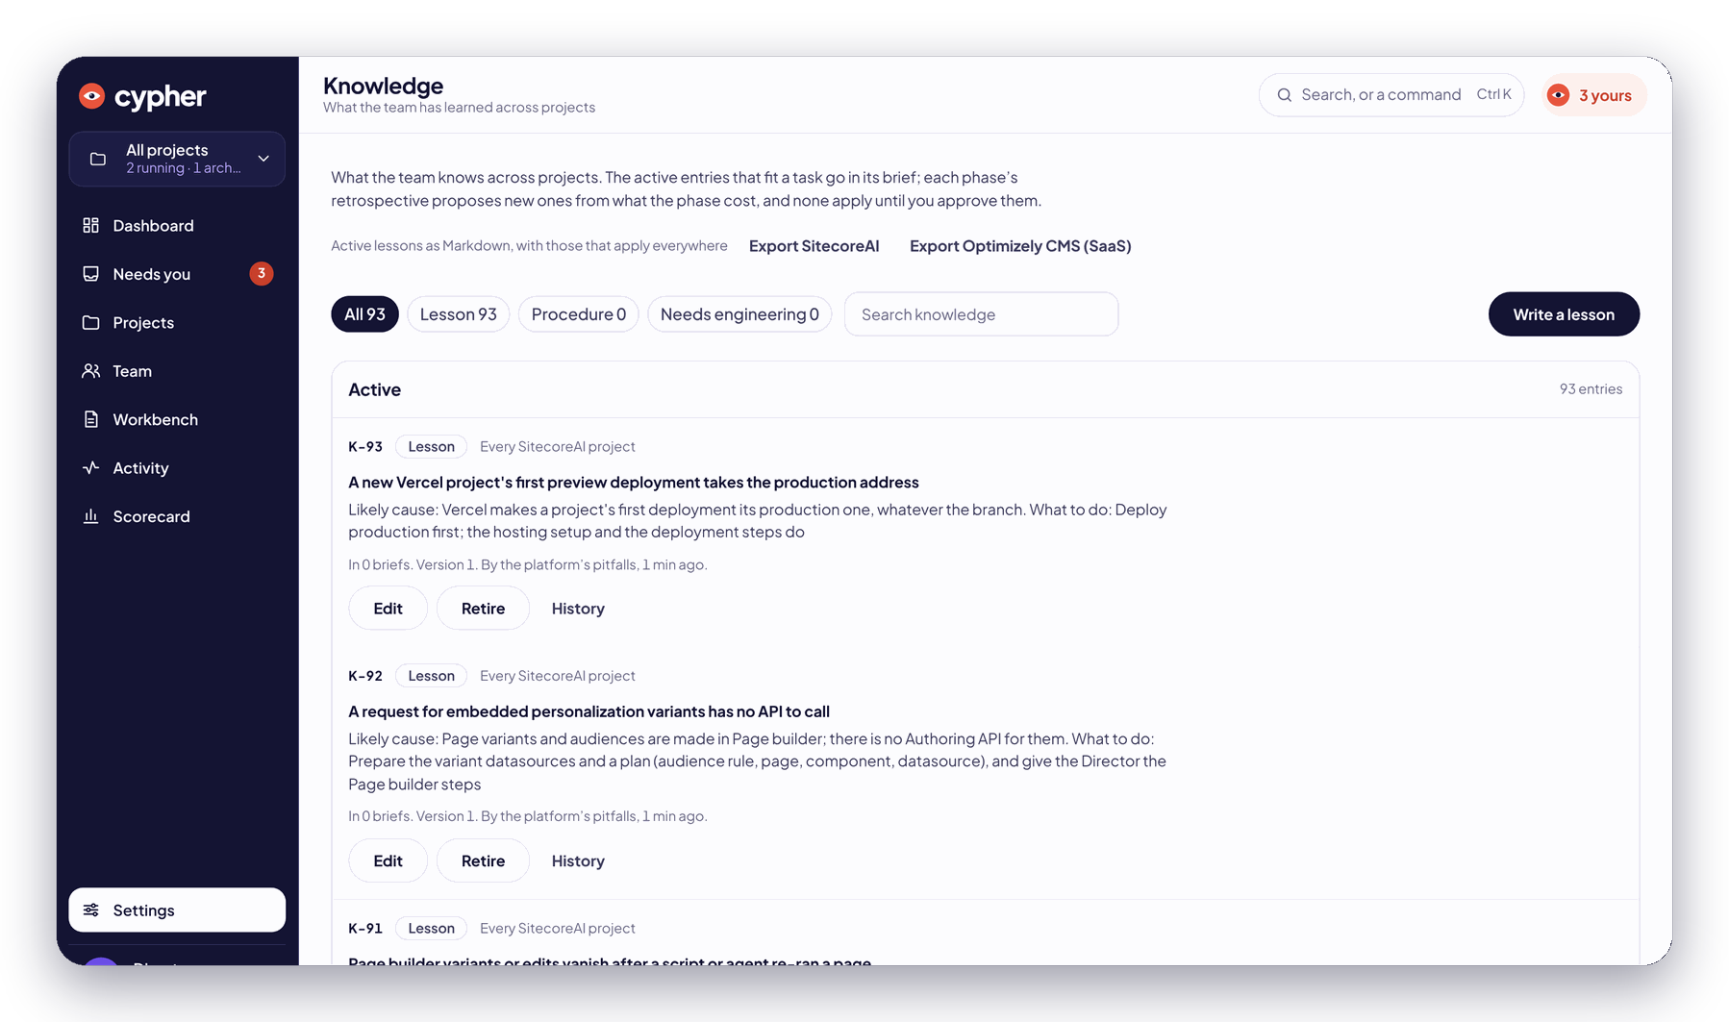



It gets smarter every build. Your agency doesn’t.
WHY IT GETS CHEAPER
Self-learning.
Every question becomes a rule. It never asks twice. Agencies ask the same question every project, and bill you for it.
Self-healing.
Things break. It finds why, fixes it and carries on, before anyone thinks to file a ticket.
Self-enhancing.
Every build rewrites its own playbook. Four new versions in a single night, mid-build.
Knowledge: every lesson versioned, reviewable, and applied to every build after.
Notes:
Every answer the Director gives can become a rule the Leads apply next time. Every phase retrospective proposes lessons; approved lessons go into the briefs of every future task. Playbooks are versioned and each project is pinned to the version it started on.

Slide 21

We don’t need you to believe us.
PROOF
225,000+
$512
36 of 36
518
events conducted. Every one on the record.
to run a build quoted at $400,000+.
calls its Leads settled on the latest build, matching the Director every time.
past decisions replayed against it, for $12.08.
Twenty-five companies are about to watch. We don’t need you to tell us it works. We need you to see it.
Notes:
Two hundred twenty-five thousand events conducted. Before letting its Leads settle cards unattended, we replayed 518 decisions the Director had made across five live projects. On the latest build, the Lead matched the Director on all 36 it chose to answer, and forwarded the rest.

Slide 22
Your annual roadmap. In a week.
PLAYBOOKS, NOT PROJECTS
Same crew every day, on SitecoreAI, and not one change order.
MON
TUE
WED
THU
FRI
The website.
The customer portal.
Thirty brand sites.
The acquisition.
Yours.
Pixel for pixel. Marketers edit it on day one.
Log in, self-serve, done.
One design system. One afternoon each.
Six sites into one. Every redirect kept.
The idea nobody would fund. Bring it.
Also on the menu: storefronts, intranets, member portals, design systems, personalization, accessibility. Weekends are for the one that starts with O. Ask us in the hallway.
Notes:
Each kind of build is a playbook: versioned phases, gates, roles and checks. Today: a SitecoreAI website build, a SitecoreAI customer portal, and one more for a platform that starts with O.

Slide 23
We’ve made every mistake. Once.
WHO BUILT IT
25
10
MVPs
years of engineering, written down so it never has to be relearned.
years of Sitecore. Every pitfall, every workaround, every 2 AM fix.
Sitecore MVPs built this. Yes, really.
Notes:
The playbooks encode twenty-five years of engineering and ten years of Sitecore practice. It was built by Sitecore MVPs.

Slide 24

Twenty-five companies. Not twenty-six.
WE’RE NOT SELLING IT. WE’RE CHOOSING WHO GETS IT.
After Symposium, Cypher sits down with twenty-five companies. You bring the website, the portal, the idea you couldn’t fund. You leave with it built, on SitecoreAI. Guaranteed, which is exactly why we can’t do it for everyone.
1
Put your company forward.
A work email, and how badly you want it.
2
We choose twenty-five.
Selected, not sold to.
3
Cypher sits down with you.
Right after Symposium.
4
You leave with it built.
On SitecoreAI. Guaranteed.
ignoranceisbliss.ai
Put us forward →
Selection closes Friday, November 13.
Notes:
One page, one form: a work email and how badly you want it. The company is read from the email domain. Twenty-five get selected. Selection closes Friday, November 13.

Slide 25

Ignorance is bliss.
Twenty-five companies are about to watch. Be one of them.
ignoranceisbliss.ai · Not affiliated with the conference. Obviously.
Notes:
Thank you. ignoranceisbliss.ai. Selection closes Friday, November 13.

