Slide 1



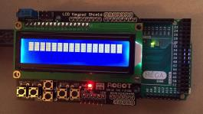


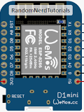
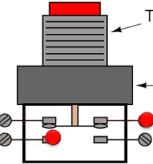
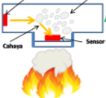
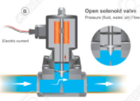

Broker - Server
Local Panel
HTTP - Protocol
Serial
MQTT - Protocol
EoN
EoN
EoN
I-Dev’s
ZONA 1
ZONA 2
ZONA 3
Hard Wire
Hard Wire
Hard Wire
Sensor
Solenoid
Valve
Sensor
Solenoid
Valve
Sensor
Solenoid
Valve
Push
Button
LED
Push
Button
LED
Push
Button
LED
Notes:
This is another option for an Overview slides using transitions.

Slide 2
Local Panel - HW
Server
Serial
Hard-wire
Arduino Mega c/w
Lcd Keypad
ESP-01

Slide 3
Server - HW
Arduino Mega c/w
Lcd Keypad
Server
ESP -01
Serial
Hard-wire
HTTP - Protocol
MQTT – Protocol
EoN

Slide 4
EoN - HW
Server
ESP -01
MQTT - Protocol
EoN – Wemos D1
EoN – Wemos D1
EoN – Wemos D1
ZONA 1
ZONA 2
ZONA 3
Hard Wire
Hard Wire
Hard Wire
Sensor
Solenoid
Valve
Sensor
Solenoid
Valve
Sensor
Solenoid
Valve
Push
Button
LED
Push
Button
LED
Push
Button
LED
Notes:
This is another option for an Overview slides using transitions.

