Slide 1



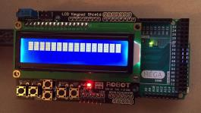


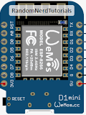
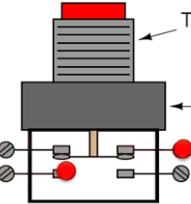
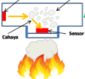
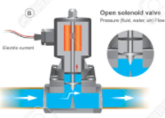

Broker - Server
Local Panel
HTTP - Protocol
Serial
MQTT - Protocol
EoN
EoN
EoN
I-Dev’s
ZONA 1
ZONA 2
ZONA 3
Hard Wire
Hard Wire
Hard Wire
Sensor
Solenoid
Valve
Sensor
Solenoid
Valve
Sensor
Solenoid
Valve
Push
Button
LED
Push
Button
LED
Push
Button
LED
Notes:
This is another option for an Overview slides using transitions.

