Slide 1
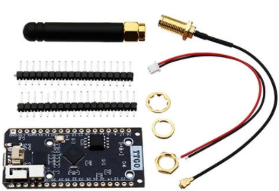


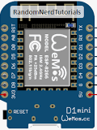

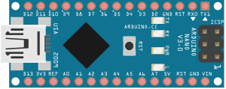
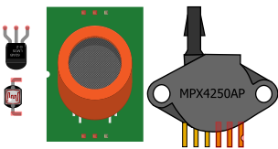
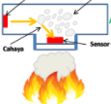
WlDA – Wireless Data Acquisition
Broker
Server
HTTP - Protocol
MQTT - Protocol
EoN
EoN
EoN
I-Dev’s
Hard Wire
Serial
Hard Wire
Serial
Hard Wire
Serial
Hard Wire
Hard Wire
Hard Wire
Sensors
Sensors
Sensors
Notes:
This is another option for an Overview slides using transitions.

