Slide 1

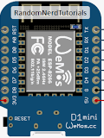
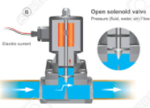

WIS – Wireless Irrigation System
Hard Wire
Hard Wire
Hard Wire
ID-04
ID-06
ID-05
Sol-Valve
Sol-Valve
Sol-Valve
ID-01
ID-02
I-Dev’s
ID-03
Hard Wire
Hard Wire
Hard Wire
Sol-Valve
Sol-Valve
Sol-Valve
Notes:
This is another option for an Overview slides using transitions.

