Slide 1
Lecture 12 Clustering Methods
Hierarchical and Non-Hierarchical Approaches
STP533 Multivariate Analysis

Slide 2
Hierarchical Clustering
Builds a hierarchy of clusters
Visualized as a dendrogram
Agglomerative (bottom-up) and Divisive (top-down)

Slide 3
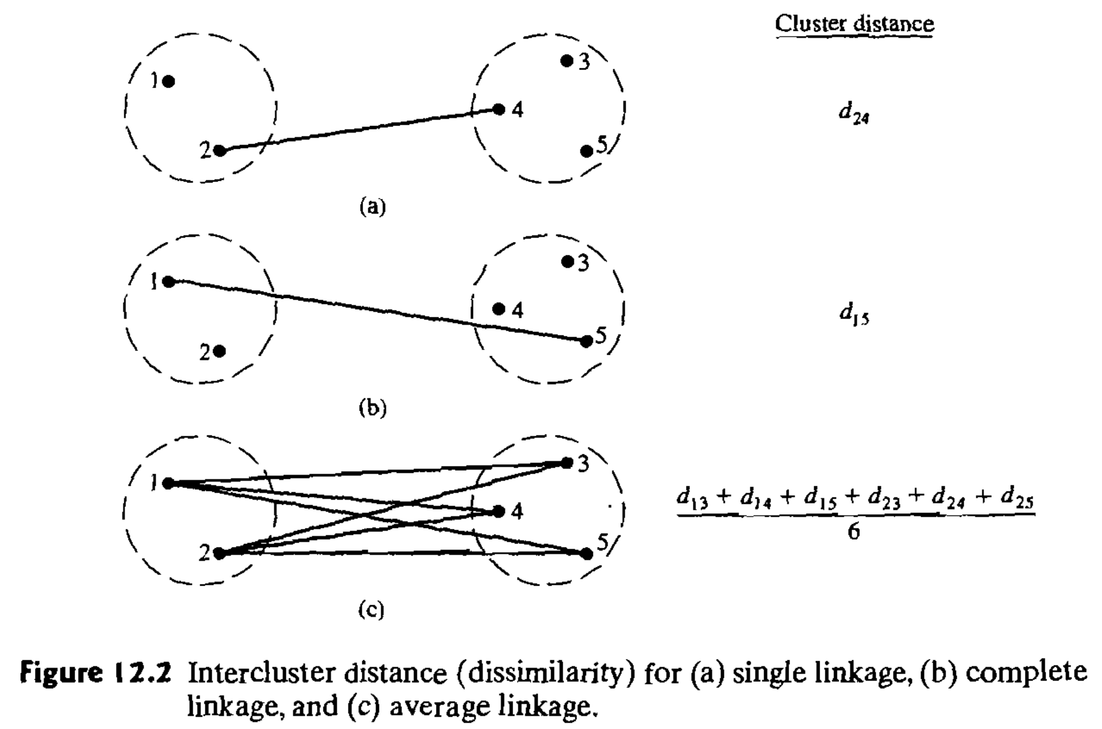

Linkage Methods Overview
Single linkage: Minimum distance $d_{\left(UV\right)W}=\min_{}{\{d_{UW},d_{VW}\}}$
Complete linkage: Maximum distance $d_{\left(UV\right)W}=\max_{}{\{d_{UW},d_{VW}\}}$
Average linkage: Average distance $d_{\left(UV\right)W}=\frac{\sum_{i}{\sum_{k}{d_{ik}}}}{N_{(UV)}N_{W}}$

Slide 4
Steps for Hierarchical Clustering
Compute
Compute the distance matrix
Choose
Choose a linkage method
Merge
Merge closest clusters step-by-step
Visualize
Visualize using a dendrogram

Slide 5
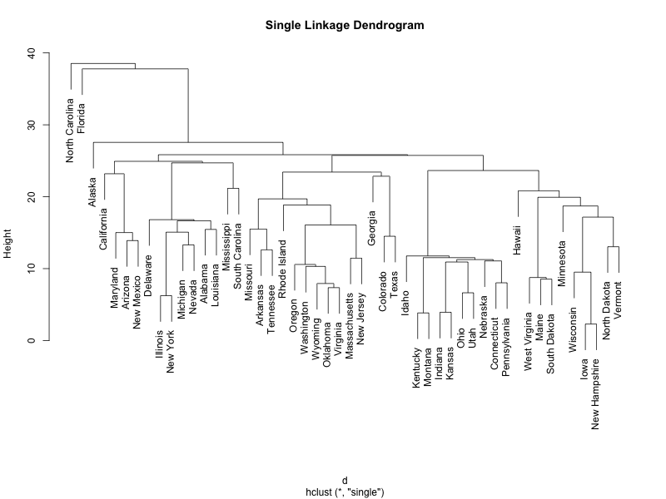
Single Linkage Example
library(datasets) data <- USArrests d <- dist(data) hc_single <- hclust(d, method = "single") plot(hc_single)

Slide 6
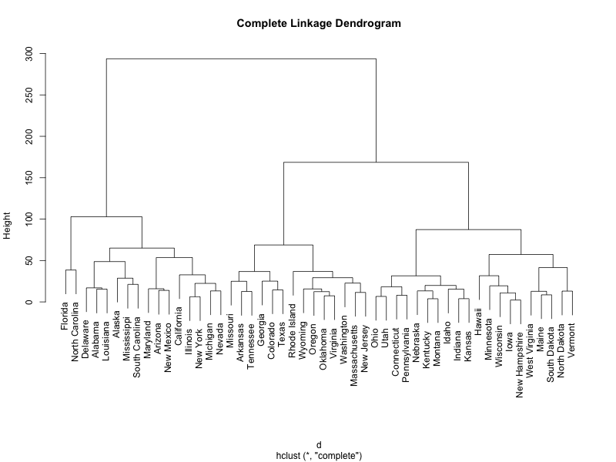
Complete Linkage Example
hc_complete <- hclust(d, method = "complete") plot(hc_complete)

Slide 7
Ward's Hierarchical Clustering
Minimizes within-cluster variance
Forms compact clusters
Sensitive to outliers

Slide 8

Steps for Ward's Method
1. Calculate error sum of the square deviations ${ESS}_{k}=\sum_{j=1}^{N_{k}}{{(x_{kj}−\overline{x_{k}})}^{T}(x_{kj}−\overline{x_{k}})}$.
2. Calculate ESS for the union of every possible pair of clusters.
3. Merge clusters with minimal increase in ESS.
4. Cut the dendrogram

Slide 9
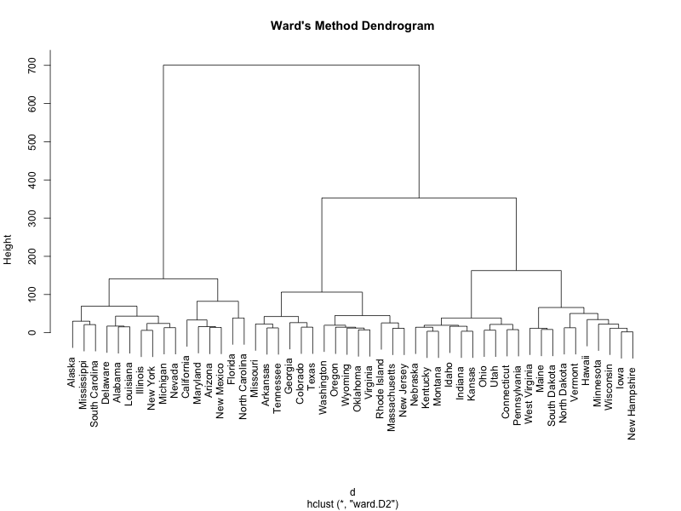
Ward's Method Example
hc_ward <- hclust(d, method = "ward.D2") plot(hc_ward)

Slide 10
Non-Hierarchical Clustering: K-means
Partitions data into k initial clusters
Minimizes within-cluster sum of squares
Pre-specify number of clusters (k)

Slide 11
Steps for K-means Clustering
1. Scale the dataset
2. Initialize k centroids
3. Assign points to the nearest centroids
4. Update centroids and repeat
5. Convergence reached

Slide 12
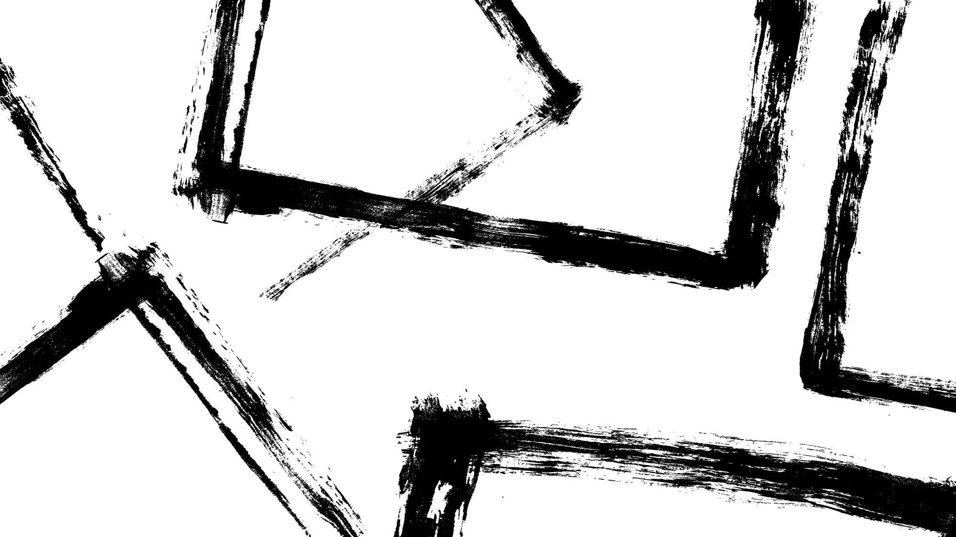
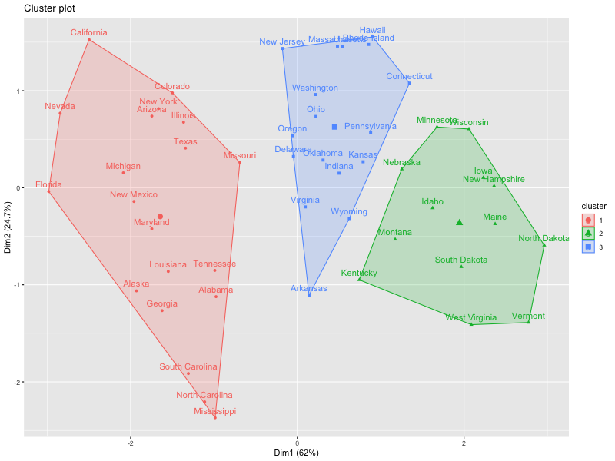
K-means Clustering Example
set.seed(123) data_scaled <- scale(data) kmeans_result <- kmeans(data_scaled, centers = 3) library(factoextra) fviz_cluster(kmeans_result, data = data_scaled)

Slide 13
Summary
Hierarchical Clustering: Good for exploration
Ward's Method: Minimizes variance
K-means: Efficient for large datasets
Tip: Always scale your data!

Slide 14
R codes
# Install packages if not already installed
if (!require(factoextra)) install.packages("factoextra")
# Load data
data <- USArrests
d <- dist(data)
# Single linkage dendrogram
hc_single <- hclust(d, method = "single")
png("single_linkage_dendrogram.png", width = 800, height = 600)
plot(hc_single, main = "Single Linkage Dendrogram")
dev.off()
# Complete linkage dendrogram
hc_complete <- hclust(d, method = "complete")
png("complete_linkage_dendrogram.png", width = 800, height = 600)
plot(hc_complete, main = "Complete Linkage Dendrogram")
dev.off()
# Ward's method dendrogram
hc_ward <- hclust(d, method = "ward.D2")
png("wards_method_dendrogram.png", width = 800, height = 600)
plot(hc_ward, main = "Ward's Method Dendrogram")
dev.off()
# K-means clustering
set.seed(123)
kmeans_result <- kmeans(scale(data), centers = 3)
library(factoextra)
png("kmeans_clusters.png", width = 800, height = 600)
fviz_cluster(kmeans_result, data = scale(data))
dev.off()

Slide 15
More Demos
https://uc-r.github.io/hc_clustering
https://www.datacamp.com/tutorial/hierarchical-clustering-R
https://www.r-bloggers.com/2016/01/hierarchical-clustering-in-r-2/

