Slide 1
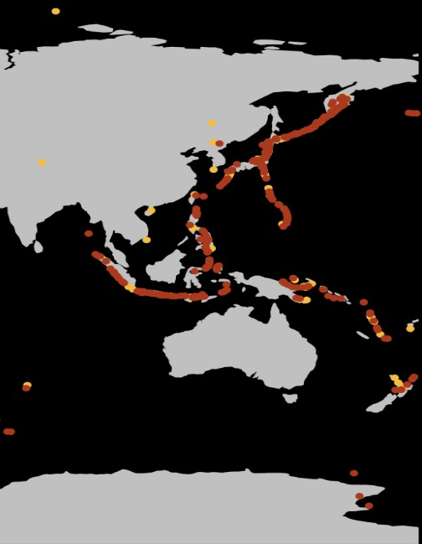
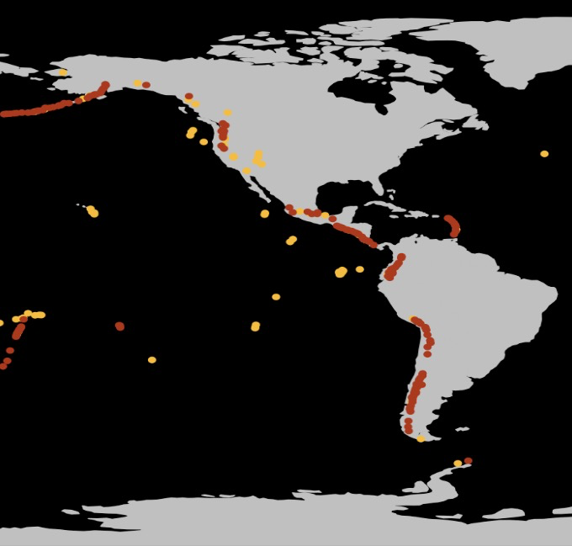
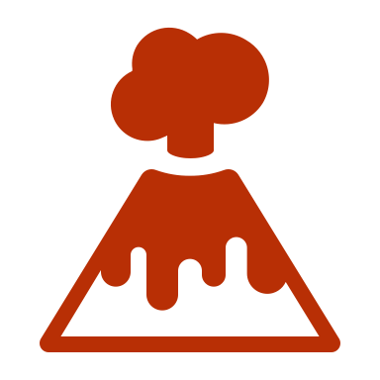

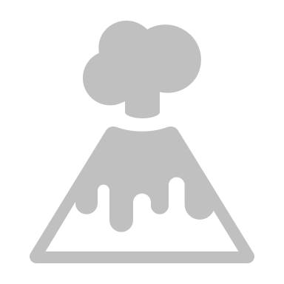
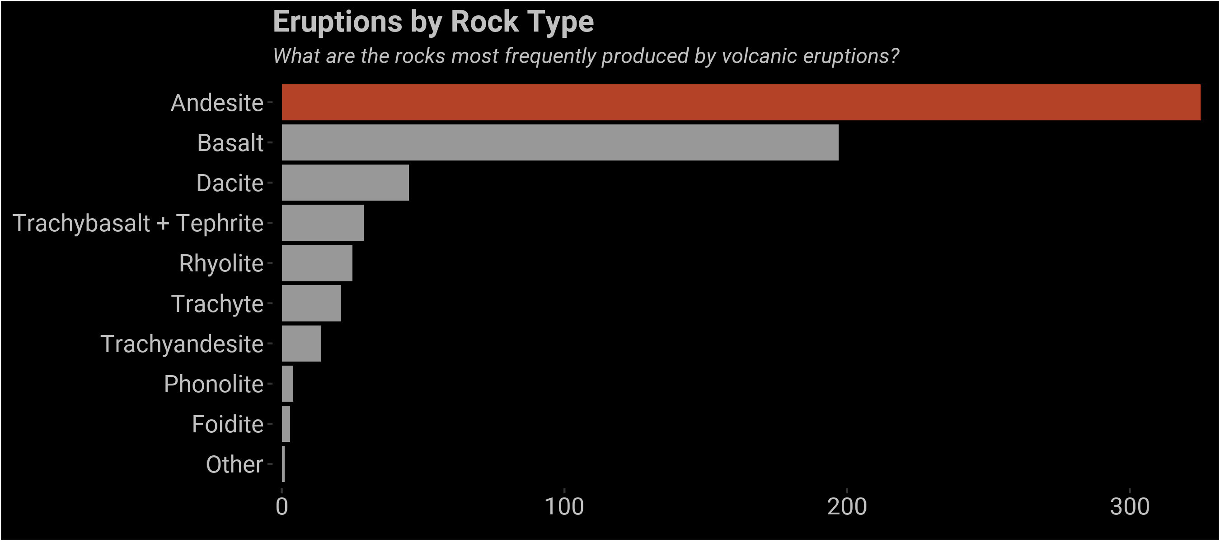
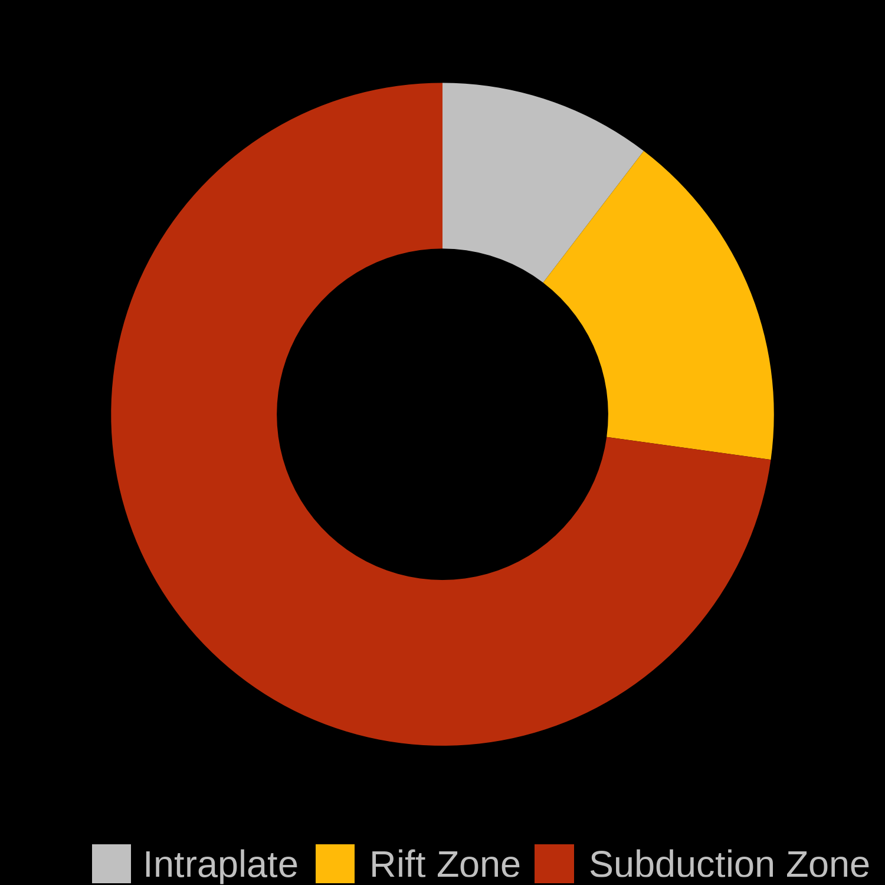
Understanding the Ring of Fire
Volcanoes form across the globe but are primarily clustered around the Pacific Ocean. What is so special about this region, and what do these volcanoes have in common?
A specific type of volcano, a composite or stratovolcano dominates the Ring of Fire
Composite Volcano
Other Volcano Type
Examples of famous composite volcanoes include Mount Ranier in Washington and Mount Fuji in Japan. But what do these volcanoes have in common?
Most rocks formed by volcanoes are andesites. Andesites are formed when hot magma formed by the mixing of melted oceanic + continental crust explode from a volcano.
These conditions occur at a specific type of tectonic plate boundary called a subduction zone. Here the oceanic plate subducts under the continent, causing melting and forming volcanoes like the Ring of Fire.

Slide 2
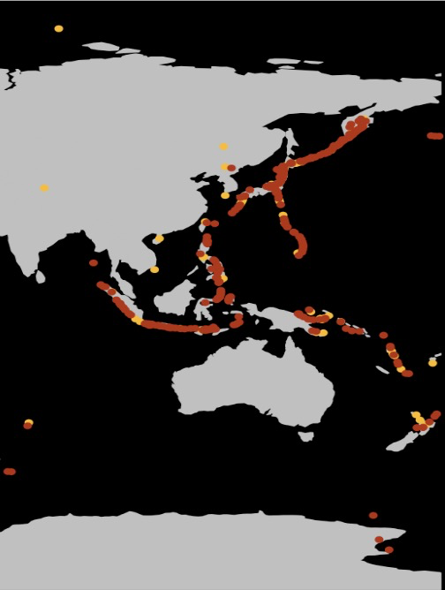
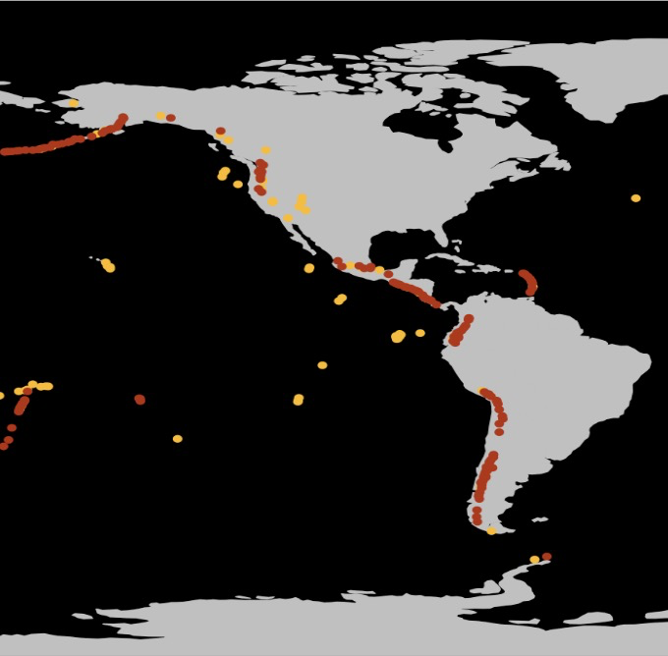
UNDERSTANDING THE RING OF FIRE

