Slide 1
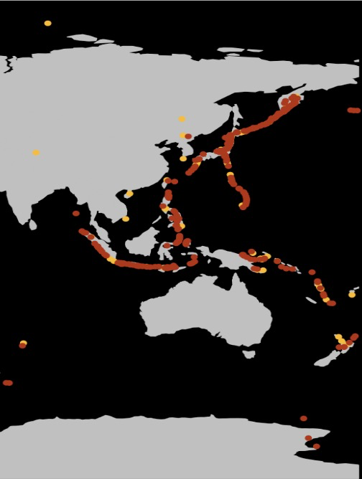
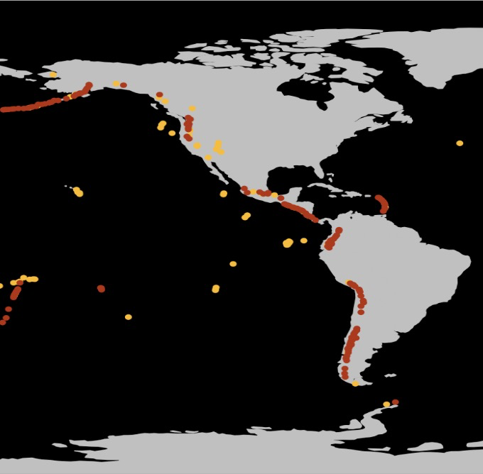
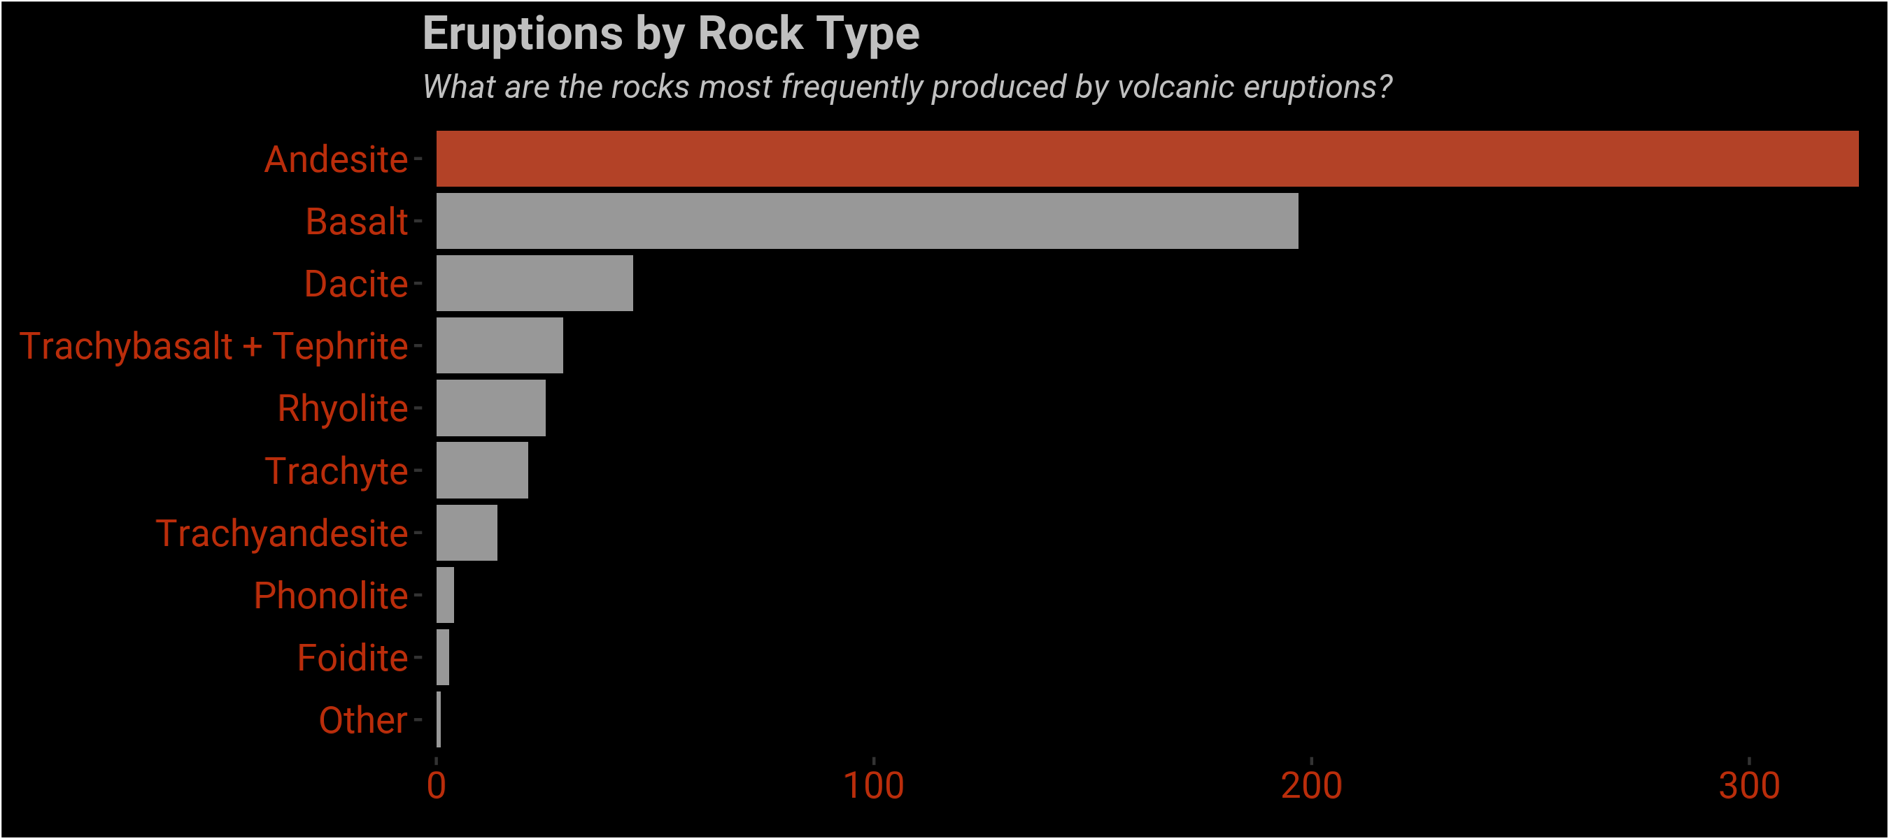
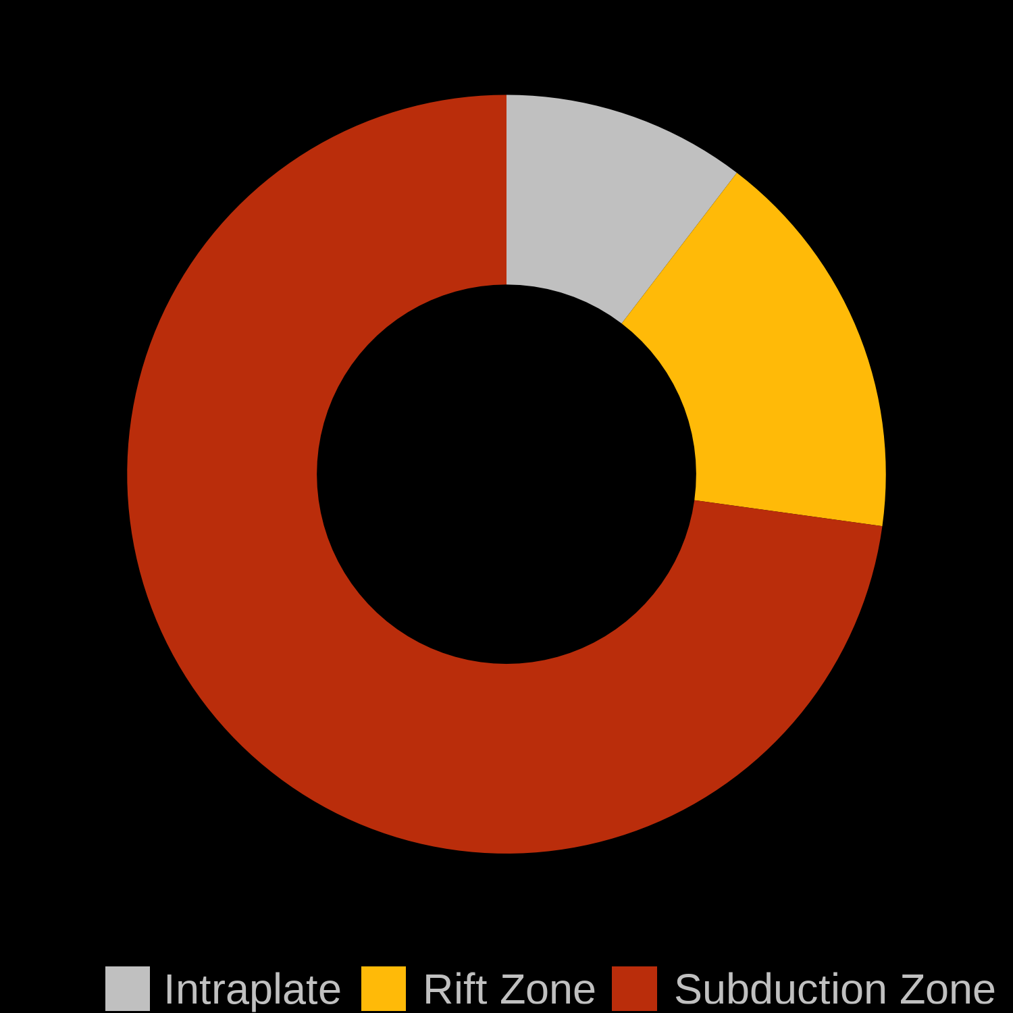
Understanding the Ring of Fire
The ring of fire is a chain of composite volcanos that bounds the Pacific Ocean. But why are there so many, and what do they have in common?
Composite volcanoes, or stratovolcanoes, form around the Pacific Ocean in a region called the Ring of Fire. When you picture a volcano, triangular and large, you are thinking of composite volcanoes.
But what makes this region so special? And why do volcanoes form along this coastline and not in the center of continents, or the ocean?
Most rocks in the Ring of Fire are andesites. These rocks form formed when oceanic crust is pushed under the continental crust, creating a subduction zone.
The movement at a subduction zone causes rock to melt and float below the surface, creating volcanoes. It is this process that creates the Ring of Fire along the subduction zones that line the Pacific Ocean

Slide 2
UNDERSTANDING THE RING OF FIRE

