Slide 1
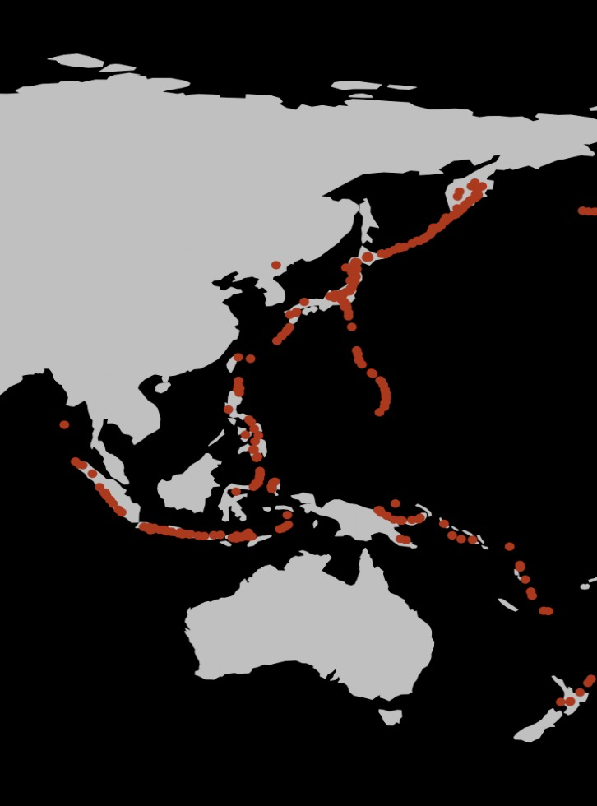
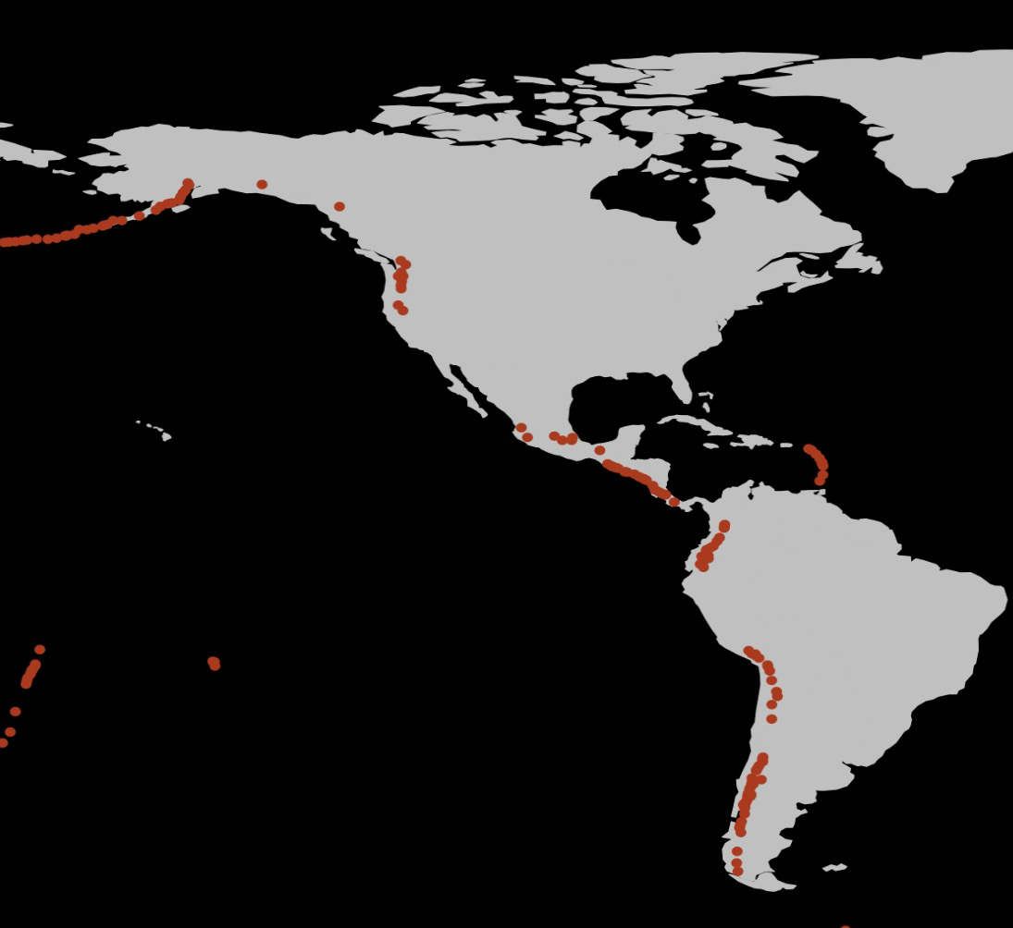
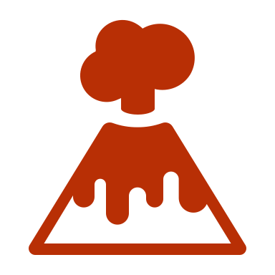
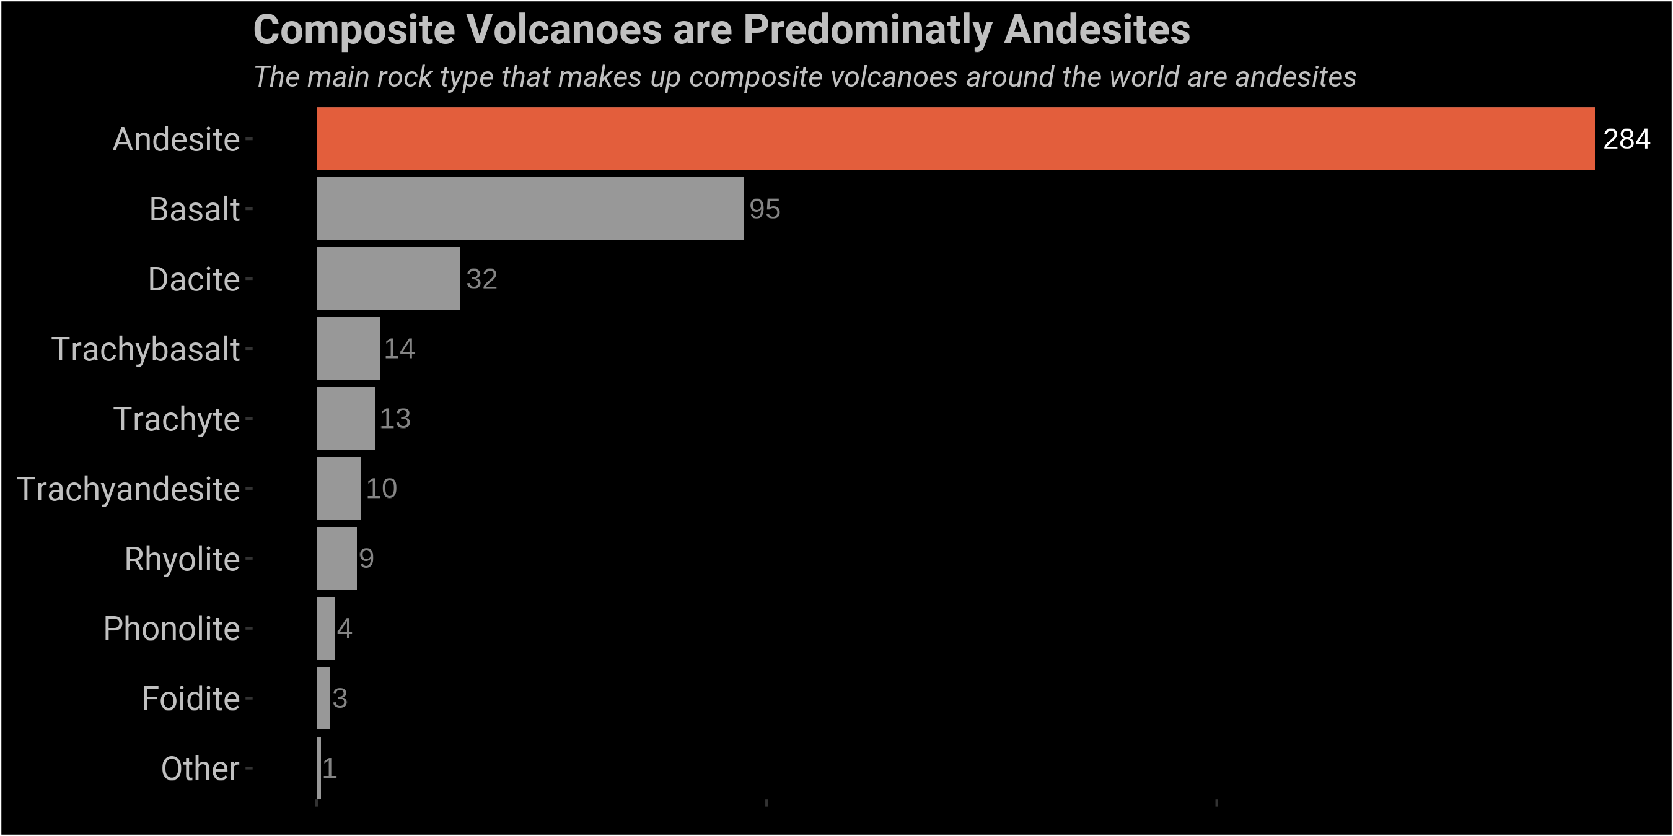

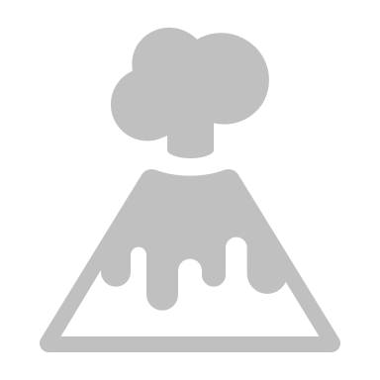
What is a Composite Volcano?
Composite volcanoes are large volcanoes present around the Ring of Fire, a highly volcanic region bordering the Pacific Ocean. What causes these volcanoes to arise here, and how can we see this in the rock record?
A specific type of volcano, a composite or stratovolcano dominates the Ring of Fire
Composite Volcano
Examples of famous composite volcanoes include Mount Ranier in Washington and Mount Fuji in Japan. But what do these volcanoes have in common?
Composite Volcanoes Primarily Form in Subduction Zones
Most composite volcanoes are andesites, which form in a specific type of tectonic setting called a subduction zone
Intraplate 7%
Rift Zone
4%
Subduction zones occur around the Pacific Ocean, where the dense Pacific Oceanic Plate slides under the lighter continental plates that surround it
This process melts both plates, creating an andesitic magma that rises to the surface, forming the volcanoes known as the Ring of Fire
Subduction Zone 89%

