Slide 1

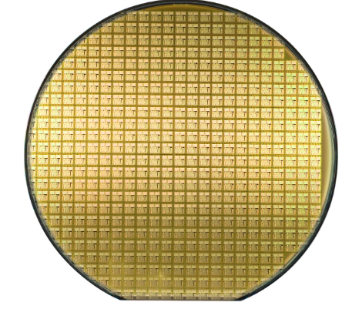
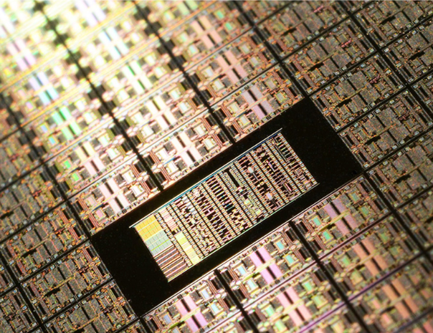

Photolithography Semiconductor Process Troubleshooting
Technical Presentation
Sherly Lande

Slide 2
Agenda
Introduction
Case Study 1: Overlay Misalignment
Case Study 2: AI-Driven Defect Reduction
Key Takeaways
Q&A

Slide 3
Introduction

Slide 4
Expertise & Passions
AI-Driven Innovation – Process optimization & material science
Bridging AI & Chemical Engineering – Driving next-gen advancements
Predictive Analytics & Smart Manufacturing – Data-driven decision-making
Beyond my professional pursuits, I love to sing in French, Latin, and Spanish, and I also cherish wisdom literature.

Slide 5
Photolithography Process Troubleshooting: Case Studies & Solutions

Slide 6
Case Study 1:Overlay Misalignment Impact on Yield and Pattern Fidelity

Slide 7
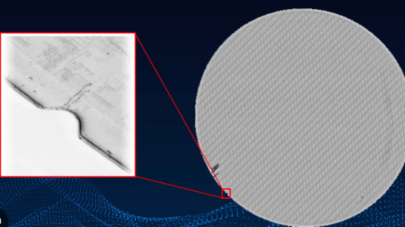
Problem Identification
Yield loss due to overlay misalignment, leading to pattern fidelity issues in critical layers.
Impact on production:
20% reduction in overlay accuracy.
Increased defect density, requiring costly rework.
Yield loss in high-density interconnect layers, causing 8% production yield drop.
Figure 1: Overlay misalignment defect (Adapted from WaferPro, n.d.)

Slide 8
Case Study 1:Overlay Misalignment — Root Cause Analysis

Slide 9
5 Whys Analysis
Why is there overlay misalignment?
➡ Due to progressive drift in overlay accuracy.
Why is there progressive drift?
➡ Reticle thermal expansion was detected.
Why does the reticle expand?
➡ Inconsistent heating during exposure.
Why is heating inconsistent?
➡ The temperature control system is not well-calibrated.
Why is calibration not effective?
➡ Lack of periodic recalibration and process monitoring.

Slide 10
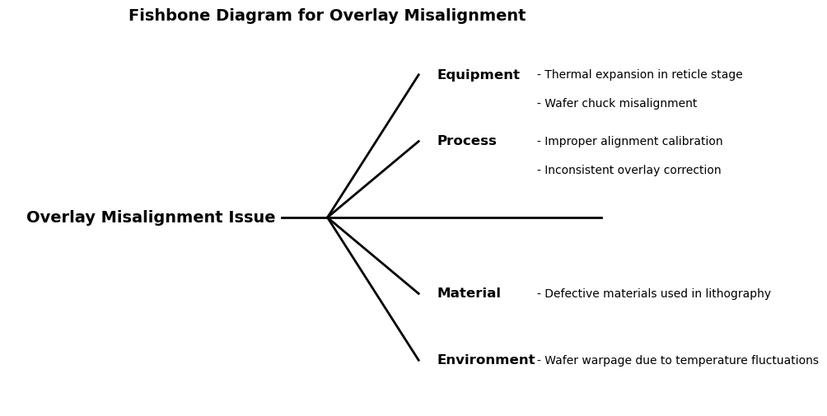

Slide 11
Data & Tools Used (1/2)
🔧 Equipment
Reticle Inspection: Identified thermal expansion
Equipment Logs: Found wafer chuck vacuum degradation
Sensor Calibration Data: Verified overlay tool accuracy
⚙️ Process
SPC Data Analysis: Detected progressive overlay drift
SPC Techniques: Applied for process monitoring and control
Alignment Logs: Investigated overlay calibration inconsistencies

Slide 12
Data & Tools Used (2/2)
🧪 Material
Incoming Material Checks: Validated lithography materials
Supplier Data Review: Detected batch variability
🌡️ Environment
Temperature & Humidity Logs: Analyzed for fluctuation-driven drift
ESD Event Logs: Identified potential electrostatic interference
📊 Cross-Category Tools
JMP Visualization: Uncovered statistical trends and correlations
Data-Driven Analysis: Integrated metrology, SEM, and process logs for confirmation

Slide 13
Executing the Fix: Implementation & Collaboration

Slide 14
Collaboration and Solutions
Cross-Functional Teamwork:
Collaborated with metrology, equipment, and yield enhancement teams to investigate and implement solutions.
Solutions:
- Introduced real-time stage compensation.
- Calibrated temperature control systems.
- Implemented routine reticle recalibration protocols.

Slide 15
Results
- 20% improvement in overlay accuracy.
- ~$200,000 quarterly rework cost reduction.
- 40% faster troubleshooting turnaround.

Slide 16
Troubleshooting Summary
Troubleshooting Breakdown | Details
Problem | Yield loss due to overlay misalignment affecting pattern fidelity
Root Cause Identified | Thermal expansion of the reticle due to uncalibrated temperature control system and inconsistent heating
Fix Implemented | Added real-time stage compensation, leading to 40% faster troubleshooting turnaround.
Results | Achieved 20% improvement in overlay accuracy, reducing rework costs by approximately $200,000 per quarter.
Validation | Validated corrective actions with integration and metrology teams across all toolsets over three production cycles.

Slide 17
Case Study 2: AI-Driven Defect Reduction — Impact on Yield and Quality

Slide 18
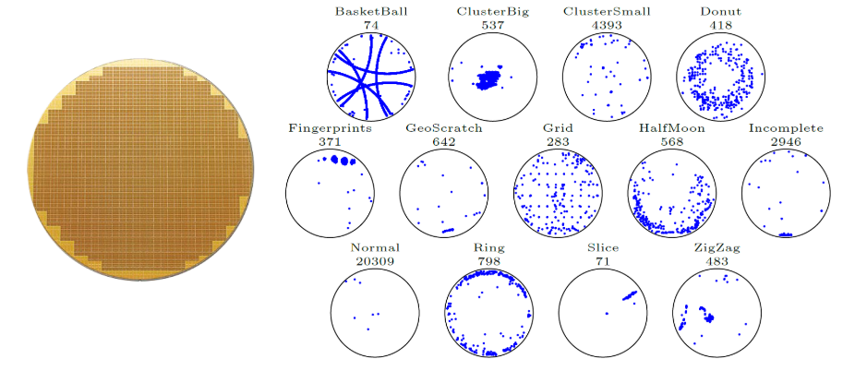
Problem Identification
High defect rates in semiconductor manufacturing were causing yield loss and increasing production costs. Traditional inspection methods were reactive and missed early signs of defects.
Impact on Production:
Defects went undetected until final inspection
Rework and scrap rates surged, increasing operational costs
Estimated rework losses approached ~$250,000 per quarter
Yield suffered due to late-stage interventions and missed process deviations
Figure 2: AI-driven defect classification and early detection (Adapted from Boracchi et al. n.d.)

Slide 19
Case Study 2: AI-Driven Defect Reduction— Root Cause Analysis

Slide 20
5 Whys Analysis
Why are defect rates high? ➜ Defects remain undetected until final inspection.
Why are defects not detected earlier? ➜ Traditional inspection methods are slow and reactive.
Why are traditional methods ineffective? ➜ They rely on manual reviews and rule-based detection.
Why is manual inspection unreliable? ➜ It lacks real-time monitoring and predictive capabilities.
Why is real-time monitoring not implemented? ➜No AI-based classification system was in place to detect defects early.

Slide 21
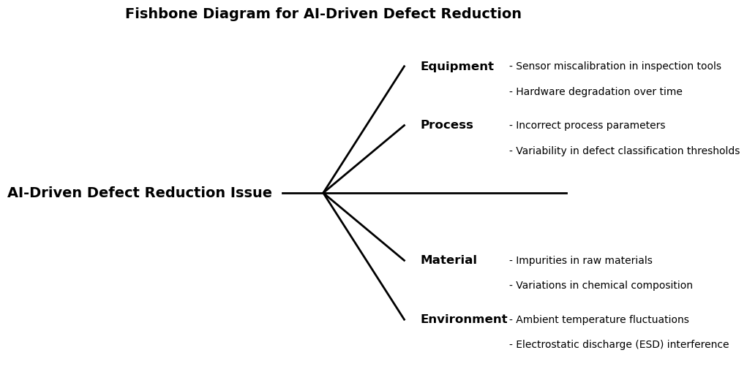

Slide 22
Data & Tools Used (1/3)
🔧 Equipment
Sensor Calibration Logs: Detected miscalibration in inspection tools
Tool Maintenance Records: Identified hardware degradation patterns
⚙️ Process
SPC Data Analysis: Revealed variations in defect thresholds
Defect Classification Rules: Highlighted inconsistencies in application
Inspection Recipes: Verified setup of defect detection parameters

Slide 23
Data & Tools Used (2/3)
🧪 Material
Raw Material Inspection: Flagged impurities in incoming lots
Chemical Composition Reports: Tracked variations between suppliers
🌡️ Environment
Ambient Temp & Humidity Logs: Identified instability in conditions
ESD Monitoring Data: Logged electrostatic discharge events

Slide 24
Data & Tools Used (3/3)
📊 Cross-Category Tools
JMP Visualization: Surfaced patterns across multiple datasets
CNN-Based Deep Learning Models: Used Convolutional Neural Networks for automated image-based defect classification—enabled detection of subtle and previously missed defects
Data Integration Platform: Combined inputs from SPC, inspection tools, and AI models to enable real-time analytics and corrective

Slide 25
From Root Cause to Resolution

Slide 26
Collaboration and Solutions
Cross-Functional Teamwork: Collaborated with AI engineers, process integration specialists, metrology experts, and yield enhancement teams to design and deploy AI-powered defect detection.
Solutions: – Deployed CNN-based classification models for real-time defect detection on wafer maps. – Integrated automated correction mechanisms to reduce manual intervention. – Refined classification thresholds and detection rules based on CNN model insights. – Enabled predictive monitoring, replacing manual inspection delays with proactive response.

Slide 27
Results
25% reduction in defect rates through CNN-powered detection.
~$250,000 in quarterly savings from reduced rework and scrap.
35% improvement in defect detection speed.
Enhanced process reliability and yield through earlier anomaly interception.

Slide 28
Troubleshooting Summary
Troubleshooting Breakdown | Details
Problem | High defect rates impacting semiconductor yield and reliability.
Root Cause Identified | Absence of real-time monitoring and predictive classification due to limited AI integration and overreliance on manual, rule-based inspection.
Fix Implemented | Implemented CNN-based image classification models for early defect detection. Integrated real-time corrections, improving detection speed by 35%.
Results | Achieved 25% reduction in defect rates, saving approximately $250,000 per quarter in scrap and rework costs.
Validation | Validated results with AI, metrology, and integration teams over three production cycles.

Slide 29
Lessons Learned

Slide 30
Key Takeaways
Overlay Defect Reduction: +20% accuracy, +10% yield, ~$200K/quarter saved
Process Optimization: 40% faster troubleshooting, improved interconnect stability
AI-Driven Defect Classification (CNN-based): –25% defects, +35% detection speed, ~$250K/quarter saved
Cross-Functional Teamwork: Aligned AI, process, and metrology teams across 3 cycles
Overlay defect reduction: 20% improvement in overlay accuracy, increasing production yield by 10%, reducing rework costs by ~$200,000 per quarter.

Slide 31
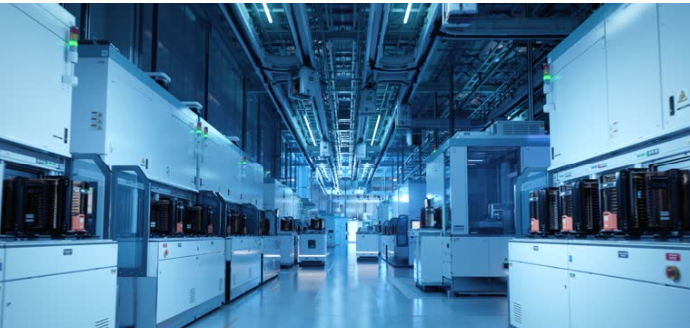
Q&A
Thank you for your time! I'm happy to answer any questions.

Slide 32
Bibliography

Slide 33
Beaudry, Richard, Md Iftekharul Islam, Amrid Amnache, Maurice Delafosse, and Luc Fréchette. 2023. “Programmable Photomask for Photolithography Systems.” In Photomask Technology 2023, vol. 12751, 298–301. SPIE.
Boracchi, Giacomo, et al. n.d. AI-Driven Defect Classification and Early Detection in Semiconductor Wafers. Accessed March 14, 2025. https://boracchi.faculty.polimi.it/Projects/Wafers.html.
Fan, Shu-Kai S., Ming-Shen Chen, Chia-Yu Hsu, and You-Jin Park. 2024. “An Artificial Intelligence Transformation Model–Pod Redesign of Photomasks in Semiconductor Manufacturing.” Journal of Industrial and Production Engineering 41 (3): 201–16.
GeeksforGeeks. 2023. “What Is Photolithography?” GeeksforGeeks, October 6, 2023. https://www.geeksforgeeks.org/what-is-photolithography/.
Jain, Rupal. 2024. Advancements in AI and IoT for Chip Manufacturing and Defect Prevention. CRC Press.
Lian, Yaguang. 2022. Semiconductor Microchips and Fabrication: A Practical Guide to Theory and Manufacturing. John Wiley & Sons.
Long, Yin, Cai Kun, Hunglin Chen, and Wang Kai. 2021. “The Inline Detection of Tiny Bubble Defect and Solution for 14NM Photolithography Process.” In 2021 China Semiconductor Technology International Conference (CSTIC), 1–3. IEEE.
Ohri, Amit, Steve Snyder, Vineet Vijayakrishnan Nair, Brian Watson, Kwangho Ahn, Efe Sinan Ege, Yashvi Singh, et al. 2024. “Enhanced EUV Photolithography Control for Overcoming Defectivity Challenges.” In International Conference on Extreme Ultraviolet Lithography 2024, vol. 13215, 164–68. SPIE.
Park, Seung, Sehoon Kim, and Jun-Geol Baek. 2018. “Kernel-Density-Based Particle Defect Management for Semiconductor Manufacturing Facilities.” Applied Sciences 8 (2): 224. https://doi.org/10.3390/app8020224.
University of California, Santa Cruz. n.d. “Lithography Process Flow.” Accessed March 14, 2025. https://cleanroom.soe.ucsc.edu/lithography.
WaferPro. n.d. “How Silicon Wafer Defects Impact Device Performance.” Accessed March 14, 2025. https://waferpro.com/how-silicon-wafer-defects-impact-device-performance/.

Slide 34
Appendices

Slide 35
Additional Case Studies & Solutions

Slide 36
Case Study 3: Photoresist Coating Defects – Non-Uniformity & Contamination (1/2)
Troubleshooting Breakdown | Details
Problem | Yield loss due to non-uniform resist thickness and contamination spots, causing CD variation in critical layers.
Root Cause Analysis | SPC Data Analysis: Detected variation in coat thickness. CDSEM & Metrology: Identified micro-bubble defects. Process Logs: Found inconsistent resist dispense pressure.

Slide 37
Case Study 3: Process Optimization & Yield Improvement (2/2)
Fix Implemented | Results
Resist Viscosity Optimization | Adjusted dispense pressure & flow rate.
Coat Track Tuning | Optimized spin profile & dispense timing.
Filtration Upgrade | Added a 0.1-micron resist filter.
Resist Uniformity | Improved by 25%.
Yield | Increased by 8% in critical patterned layers.
SPC Control Limits | Stabilized, reducing process excursions.

Slide 38
Case Study 4: Stepper Overlay Misalignment – Registration Drift Issue (1/2)
Troubleshooting Breakdown | Details
Problem | Overlay misalignment was detected in DUV stepper process, leading to pattern shift between layers. Affected high-density interconnect layers, causing 20% of wafers to fail electrical test.
Root Cause Analysis | SPC Data Trend Analysis: Identified progressive overlay drift in stepper tool. Reticle Inspection: Found thermal expansion effects on reticle stage, shifting alignment over time. Tool Performance Logs: Detected wafer chuck vacuum degradation, impacting wafer positioning repeatability.

Slide 39
Case Study 4: Stepper Overlay Misalignment (2/2)
Fix Implemented | Stepper Calibration Update: Implemented real-time overlay correction model based on wafer stage feedback. Wafer Chuck Maintenance: Replaced vacuum system components to improve wafer hold stability. Reticle Stage Compensation Algorithm: Introduced a thermal drift compensation model to adjust alignment dynamically.
Results | Overlay accuracy improved by 18%, reducing pattern shift defects. Electrical test pass rate increased by 12%. Reduced rework & scrap costs by $200K per quarter.
Team Involvement | Collaborated with stepper tool engineers to update calibration settings. Worked with metrology team to implement overlay correction strategies. Coordinated with yield enhancement engineers to track electrical test improvements.

Slide 40
Literature Review

Slide 41
Common Defects & Process Troubleshooting
Process variations – Overlay misalignment, photoresist defects (Lian 2022).
CD Uniformity Issues – Bubble defects in 14nm lithography require real-time detection (Long et al. 2021).
Inline Metrology for Defect Mitigation – Detects sub-nanometer defects, improving troubleshooting efficiency (Ohri et al. 2024).

Slide 42
AI for Lithography Defect Prevention
AI-driven defect correction – Prevents photomask defect propagation (Fan et al. 2024).
ML-optimized process parameters – Predicts & mitigates overlay misalignment (Jain 2024).
IoT-integrated monitoring – Automates defect classification & process control (Jain 2024).

Slide 43
Troubleshooting EUV Lithography Defectivity
Challenge:
Stochastic effects impact pattern accuracy (Ohri et al. 2024).
Advanced control techniques are required for defect reduction (Ohri et al. 2024).
Solution:
Programmable photomasks enable real-time defect correction (Beaudry et al. 2023).
Enhances lithography troubleshooting with dynamic pattern adjustments (Beaudry et al. 2023).

Slide 44
Photoresist & Developer Chemistry’s Role in Troubleshooting
Key Issues:
Resist adhesion failure → Leads to Line Edge Roughness (LER) & pattern collapse (Lian 2022).
Developer inconsistencies → Cause pattern fidelity defects in lithography (Long et al. 2021).
Solution:
Optimize developer chemistry to expand the process window and improve defect control (Long et al. 2021).

Slide 45
Identifying & Understanding Photolithography Defects and Solutions

Slide 46
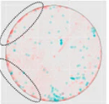
Major Defects in Photolithography & Their Impact
Photolithography defects impact yield, alignment, and device performance. Understanding these failure modes is crucial for effective troubleshooting.
Common Photolithography Defects Identified via Defect Mapping
CD Uniformity Variations → Caused by resist thickness variation or exposure issues.
Alignment & Overlay Errors → Indicating stepper misalignment or stage drift.
Photoresist Contamination or Microbubble Formation → Linked to developer issues or dispense instability.
Figure.3: The defect map highlights contamination patterns in the lithography process, adapted from Park, Kim, and Baek (2018).

Slide 47
Defect Type Breakdown & Process Solutions
Defect Type | Root Cause | Fix Implemented | Impact on Yield
CD Variation | Resist thickness variation | Optimized spin speed & bake temp | Yield improved by 10%
Alignment Drift | Stepper calibration issues | Overlay correction & periodic reticle calibration | 15% overlay accuracy increase
Particle Contamination | Developer instability | Improved filtration & dispense control | Defect density reduced by 30%

Slide 48
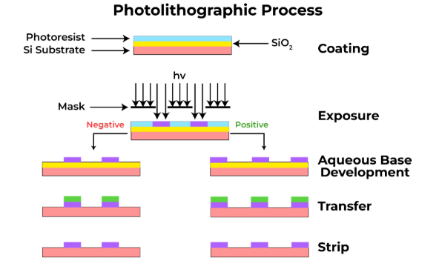
Photolithography Process Flow
Figure 4: Photolithographic Process Overview (Adapted from GeeksforGeeks 2023)
Notes:
Coating: Deposition of photoresist on Si substrate. Exposure: Light exposure through a mask to define patterns. Development: Selective removal of photoresist (positive/negative). Transfer: Pattern transfer via etching or deposition. Strip: Removal of remaining photoresist after processing.

Slide 49
Lithography Principles
Lithography: Process used in semiconductor manufacturing to transfer patterns onto a substrate using light-sensitive materials.
Key Steps:
Exposure: A light source (I-Line, DUV, or EUV) projects patterns onto a photoresist-coated wafer.
Development: Chemical reactions define structures by dissolving exposed or unexposed areas.
Etching & Deposition: Transfers the pattern onto the wafer via etching or material deposition.
Application: Enables microchip production by creating circuit patterns with high precision.

Slide 50
I-Line Lithography
Uses 365 nm ultraviolet light (Mercury I-Line source).
Best for legacy node semiconductor processes (≥350 nm).
Advantages: Lower cost, mature technology, good for MEMS fabrication.

Slide 51
DUV Lithography
Uses 248 nm (KrF) or 193 nm (ArF) light sources.
Advantages: Enables finer patterning (~130 nm and below).
Requires chemical amplification resists for higher sensitivity.

Slide 52
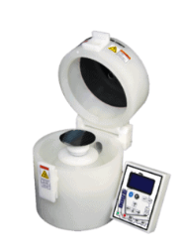
Spin Coating System
Ensures uniform photoresist application by spreading liquid resist via centrifugal force.
Process Control:
Spin speed, resist viscosity, and temperature impact thickness and uniformity.
Coat defect resolution critical for yield improvement.

Slide 53
Developer Chemistry
TMAH (Tetramethylammonium Hydroxide): A widely used developer that selectively dissolves photoresists.
Solvent-Based Developers: Used for specific resists that require non-aqueous processing.

Slide 54
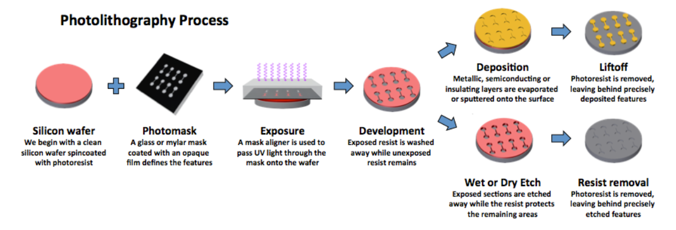
Photolithography Process Overview
Figure 5. Lithography Process Flow (Adapted from UCSC Cleanroom n.d.)

Slide 55
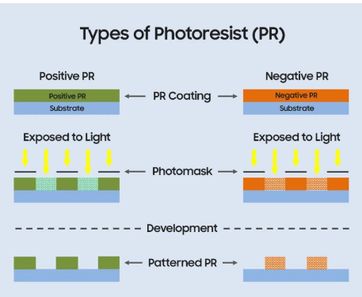
Lithography Chemistry & Photoresist Types
Positive vs. Negative Photoresist:
Positive PR: Exposed regions dissolve in developer.
Negative PR: Exposed regions remain after development.
Impact of PR selection on defect formation & patterning precision
Figure 5: Types of Photoresist (PR) in Photolithography(Adapted from GeeksforGeeks 2023)

Slide 56
Importance of Photo-Resin Chemistry & Developer Chemistry
Influences pattern resolution, adhesion, and defect reduction.
Impacts sensitivity and uniformity in semiconductor fabrication.

Slide 57
Foundational Knowledge

Slide 58
Anti-Reflective Coatings (ARC)
Purpose: Reduces light reflection during exposure, preventing pattern distortion.
Types:
Bottom Anti-Reflective Coatings (BARC): Applied below the resist to absorb light.
Top Anti-Reflective Coatings (TARC): Applied on top of the resist to control reflectivity.

Slide 59
Benefits of ARC
Enhances pattern fidelity by minimizing standing wave effects.
Reduces swing curve variations in photoresist thickness.
Improves critical dimension (CD) uniformity for high-resolution lithography.

Slide 60
Liftoff Process
Used in metal deposition for fine-line patterning.
Involves photoresist undercutting, allowing deposited material to be selectively removed.
Challenges:
Requires bilayer resist systems or controlled sidewall angles.
Poor liftoff leads to edge roughness and metal peeling.

Slide 61
Image Reversal
Converts positive resist patterns into negative ones.
Process:
Exposure → Softbake → Reverse Bake → Flood Exposure → Development.
Application: Improves feature resolution, enhances adhesion for etching/deposition.

Slide 62
Thin-Film Strip
Photoresist Stripping Methods:
Wet Stripping:
Solvents (NMP, Acetone) dissolve the resist chemically.
Used for delicate structures where plasma damage must be avoided.
Dry Stripping (Plasma Ashing):
Oxygen plasma removes resist without liquid waste.
Faster and more environmentally friendly than wet stripping.

Slide 63
Rework Procedures
Used to fix defective photoresist layers without damaging the wafer.
Common Rework Strategies:
Adjusting exposure dose or bake parameters.
Stripping and recoating for improved uniformity.
Process tuning based on SPC analysis.

Slide 64
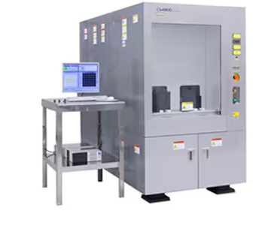
Metrology Tool: CDSEM
CDSEM (Critical Dimension Scanning Electron Microscopy):
Measures lithographic feature sizes down to the nanometer scale.
Used for line-edge roughness (LER) analysis, pattern fidelity checks.

Slide 65
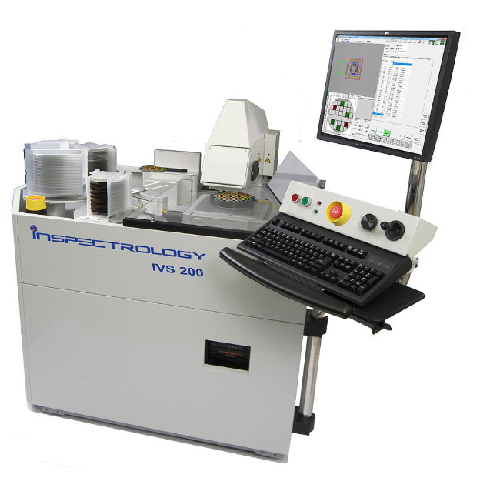
Metrology Tools: Overlay Measurement
Ensures accurate alignment between different lithographic layers.
Uses optical interferometry and scatterometry for nanometer-level accuracy.

Slide 66
Importance of Metrology Tools
Ensures consistent process control, reduces defect formation.
Critical for multi-layer patterning in advanced nodes (≤7nm).

Slide 67
Equipment Knowledge

Slide 68
DUV & I-Line Scanners/Steppers
DUV (Deep Ultraviolet):
193 nm/248 nm lithography for sub-100 nm feature sizes.
Used in high-volume chip manufacturing (EUV being next-gen).
I-Line Steppers:
365 nm exposure for larger nodes (≥350 nm).
Preferred for MEMS, sensors, and legacy nodes.

Slide 69
Coat/Develop Tracks
Common Systems:
TEL Mark V, TEL ACT8: Industry standard for automated photoresist processing.
SVG 86xx/88xx, SVG 90S: Older but reliable coat/develop tools.
C&D P8000: Used in specialty applications.
Importance:
Uniformity in coating/developing impacts lithography precision.
Advanced process control enhances yield and device reliability.

