Slide 1
Last Time: Gradient Descent in SLR
In-class Assignment:
Gradient Descent Implementation in SLR (Fill in Code Blanks)
Lecture:
Cost Function
Visualizing the Cost Function
Gradient Descent
Learning Rate in GD
Gradient Descent for SLR
Implementing Gradient Descent for SLR
Running Gradient Descent

Slide 2
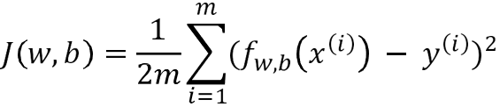

Review of last lecture: Cost Function
Cost function (MSE):

Slide 3
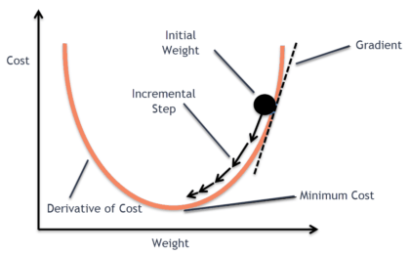
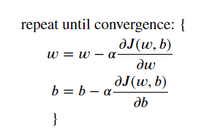
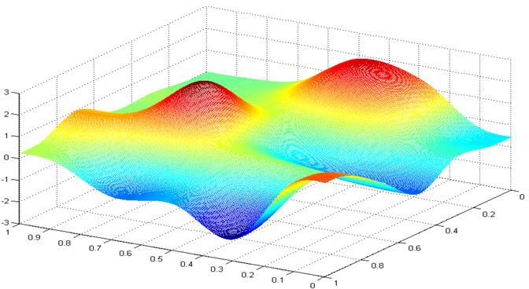
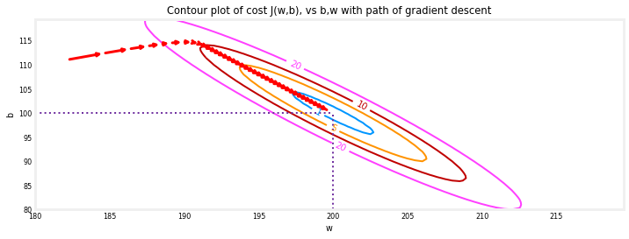




Review of last lecture: Gradient Descent
Gradient Descent Algorithm is used to minimize the cost function:
J(w, b)
b
w

Slide 4
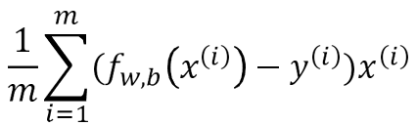
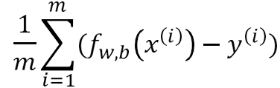
Review of last lecture: Gradient Descent for SLR
Cost function:
The goal is to teach you gradient descent to set you up for ML algorithms. The mathematical derivation of the derivative is beyond the scope of this course. Please fill in this gap outside the classroom.
Gradient Descent for SLR:

Slide 5
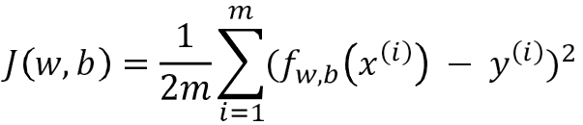

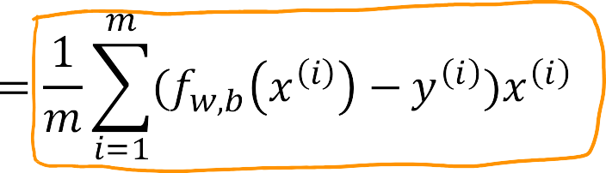

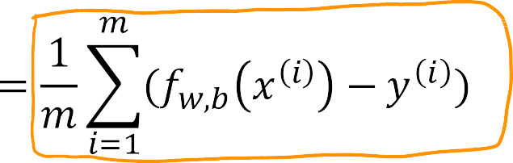
Last Quiz: Implement GD using for loop for SLR
Step functions:
compute_cost: in each step, computing the cost J (w, b) as (w, b) gets updated
compute_gradient: Return the total gradient update from all the examples
gradient_descent: update (w, b)repeat until convergence

Slide 6
Agenda for Today
After-class Assignment:
Gradient Descent Implementation in MLR (Fill in Code Blanks, 6 tasks in total)
Lecture:
Review MLR
Vectorization in NumPy
Gradient Descent for MLR
Feature Scaling in Gradient Descent
Checking Gradient Descent for Convergence
Choosing the Learning Rate
Linear Regression in Sklearn
Regularization to Prevent Overfitting

Slide 7
MLR
Linear Regression with Multiple Variables

Slide 8
Last time: Single feature (variable)
Size in feet² (𝑥) Price ($) in 1000’s (𝑦)
2104 | 400
1416 | 232
1534 | 315
852 | 178
… | …
^{𝑓}𝑤,𝑏
𝑥 = 𝑤𝑥 + 𝑏

Slide 9


General case: Multiple features (variables)
Size in Number of Number of
Age of home
in years
Price ($) in
$1000’s
feet² bedrooms floors
2104
5
1
45
460
232
315
178
…
1416
3
2
40
1534
852
…
3
2
…
2
1
…
30
36
…
x_{𝑗} = 𝑗^{𝑡ℎ} feature
𝑛 = number of features
_{x} 𝑖
= features of 𝑖^{𝑡ℎ} training example
= value of feature 𝑗 in 𝑖^{𝑡ℎ} training example
_{x} 𝑖
𝑗

Slide 10
Model:
SLR: 𝑓_{𝑤,𝑏}
𝑥 = 𝑤𝑥 + 𝑏
MLR:
^{𝑓}𝑤,𝑏
x = 𝑤₁𝑥₁ + 𝑤₂𝑥₂ + ⋯ + 𝑤_{𝑛}𝑥_{𝑛} + 𝑏
multiple linear regression

Slide 11





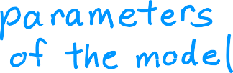







(𝑥) = 𝑤₁𝑥₁ + 𝑤₂𝑥₂ + ⋯ + 𝑤_{𝑛}𝑥_{𝑛} + 𝑏
multiple linear regression
^{𝑓}𝑤,𝑏
𝑏 is a number

Slide 12




Parameters and features
w =
𝑤₁ 𝑤₂ 𝑤₃
𝑏 is a number
x =
𝑥₁ 𝑥₂ 𝑥₃
linear algebra: count from 1
Using loops
w = np.array([1.0,2.5,-3.3]) b = 4
x = np.array([10,20,30])
f = 0
for j in range(0,n):
f = f + w[j] * x[j]
f = f + b
code: count from 0
Using Loops
^{𝑓}w,𝑏
x = 𝑤₁𝑥₁ + 𝑤₂𝑥₂ + 𝑤₃ 𝑥₃ + 𝑏
f = w[0] | * x[0] | +
w[1] | * x[1] | +
w[2] | * x[2] | + b

Slide 13
NumPy Vectorization
Dot Product in NumPy

Slide 14


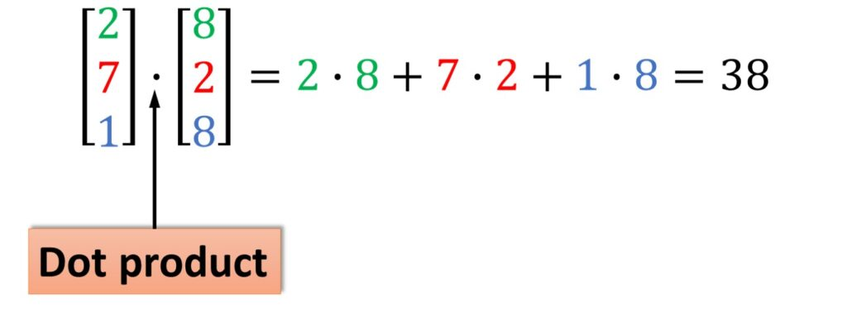
Vectors
w[0] w[1]
* *
…
w[15]
…
*
x[0] | x[1] | … | x[15]
Using NumPy
^{𝑓}w,𝑏
x = w ∙ x + 𝑏
Speed
Code simplicity
f = np.dot(w,x) + b

Slide 15
Without vectorization
Vectorization
for j in range(0,16):
f = f + w[j] * x[j]
np.dot(w,x)
𝑡₀
w[0] w[1]
* *
𝑡₀
…
w[15]
f | + | w[0] | * x[0]
f | + | w[1] | * x[1]
…
*
𝑡₁
x[0] | x[1] | … | x[15]
𝑡₁
…
w[0]*x[0]
+
w[1]*x[1]
+…+
w[15]*x[15]
^{𝑡}15
f + w[15] * x[15]

Slide 16
MLR
Gradient Descent for Multiple Regression

Slide 17
Vector notation
Previous notation
𝑤₁ , ⋯ , 𝑤_{𝑛}
𝑏
Parameters
w =
𝑏
^{𝑓}w,𝑏
[ 𝑤₁ ⋯ 𝑤_{𝑛}
x = w ∙ x + 𝑏
Model ^{𝑓}w,𝑏
Cost function
x = 𝑤₁ 𝑥₁ + ⋯ + 𝑤_{𝑛}𝑥_{𝑛} + 𝑏
𝐽 (𝑤₁, ⋯ , 𝑤_{𝑛}, 𝑏 )
𝐽 w, 𝑏
Gradient descent
repeat {
repeat {
𝑤_{𝑗} = 𝑤_{𝑗} − 𝛼 𝜕 𝐽(𝑤₁, ⋯ , 𝑤_{𝑛}, 𝑏)
𝑤 = 𝑤 − 𝛼 𝜕 𝐽 w, 𝑏
𝜕𝑤_{𝑗}
𝑗 𝑗
𝜕𝑤_{𝑗}
𝑏 = 𝑏 − 𝛼 𝜕 𝐽 𝑤₁, ⋯ , 𝑤_{𝑛}, 𝑏
𝑏 = 𝑏 − 𝛼 𝜕 𝐽 w, 𝑏
𝜕𝑏
𝜕𝑏
}
}
For j =1…n

Slide 18
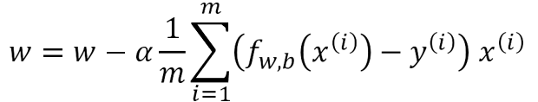
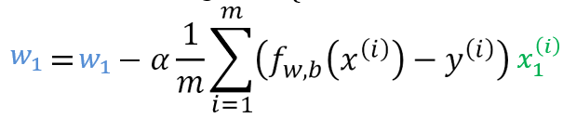
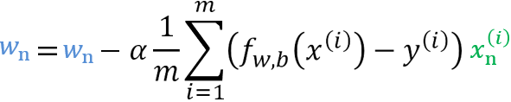
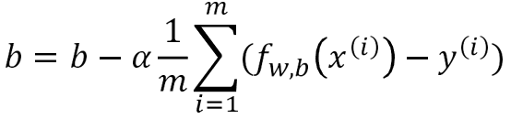
Gradient descent in MLR
One feature
𝑛 features
𝑛 ≥ 2
repeat {
repeat {
⋮
𝜕 𝐽 w, 𝑏
𝜕
𝜕𝑤₁
_{𝜕𝑤} 𝐽 𝑤, 𝑏
simultaneously update
𝑤_{𝑗} (for 𝑗 = 1, ⋯ , 𝑛) and 𝑏
simultaneously update 𝑤, 𝑏
}
}

Slide 19
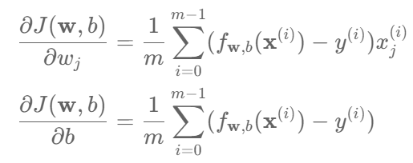
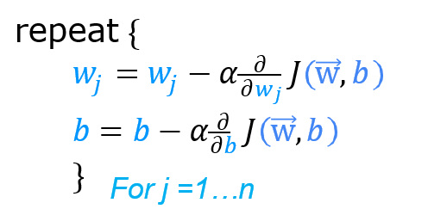
Gradient Descent in MLR
𝜕 𝐽 (w, 𝑏) not depend on each other
𝜕𝑤_{j}

Slide 20



Gradient descent in MLR
w = 𝑤₁ 𝑤₂ ⋯
d = 𝑑₁ 𝑑₂ ⋯
^{𝑤}16
^{𝑑}16
w = np.array([0.5, 1.3, … 3.4])
d = np.array([0.3, 0.2, … 0.4])
compute
𝑤_{𝑗} = 𝑤_{𝑗} − 0.1𝑑_{𝑗} for 𝑗 = 1 … 16
With vectorization
w = w − 0.1d
Without vectorization
for j in range(0,16):
w[j] = w[j] - 0.1 * d[j]
w = w – 0.1 * d
𝑤₁ = 𝑤₁ − 0.1𝑑₁
𝑤₂ = 𝑤₂ − 0.1𝑑₂
⋮
𝑤₁₆ = 𝑤₁₆ − 0.1𝑑₁₆
w[0] w[1]
- -
w[15]
…
-
0.1 *
d[0] | d[1] | … | d[15]
w[0] | w[1] | … | w[15]

Slide 21
Crucial to the performance of the GD algorithm
Feature Scaling

Slide 22





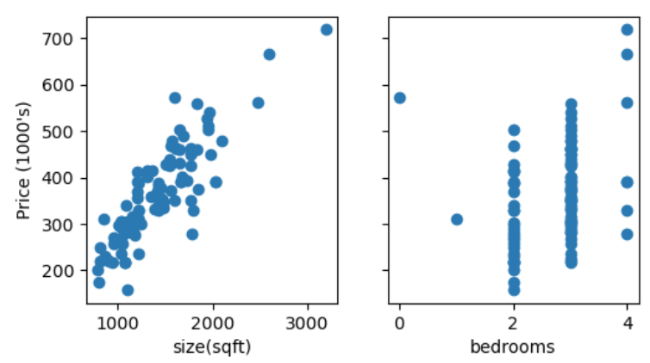
Feature and parameter values
𝑥₁: size (feet²)
range: 300 − 2,000
𝑥₂: # bedrooms
range: 0 − 5
𝑝𝑟𝑖𝑐𝑒 = 𝑤₁ 𝑥₁ + 𝑤₂𝑥₂ + 𝑏
House: 𝑥₁ = 2000, 𝑥₂ = 5, 𝑝𝑟𝑖𝑐𝑒 = $500k
size of the parameters 𝑤₁ , 𝑤₂? Is the 1 feet square as significant as a 1 bedroom difference?

Slide 23


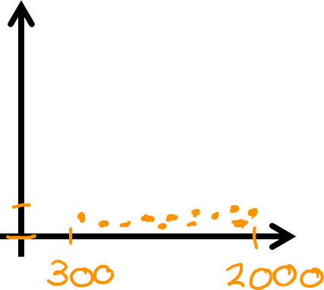
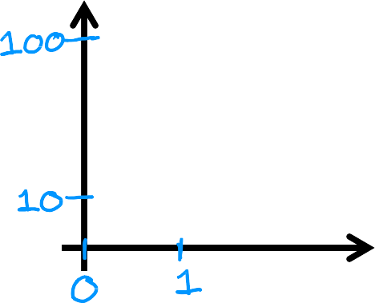
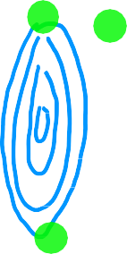


Feature size and parameter size
 | size of feature 𝑥_{𝑗} | size of parameter 𝑤_{𝑗}
size in feet²
#bedrooms
Features
Parameters
𝐽 w, 𝑏
𝑥₂
# bedrooms
𝑤₂
# bedrooms
𝑥₁ size in feet²
𝑤₁ size in feet²

Slide 24
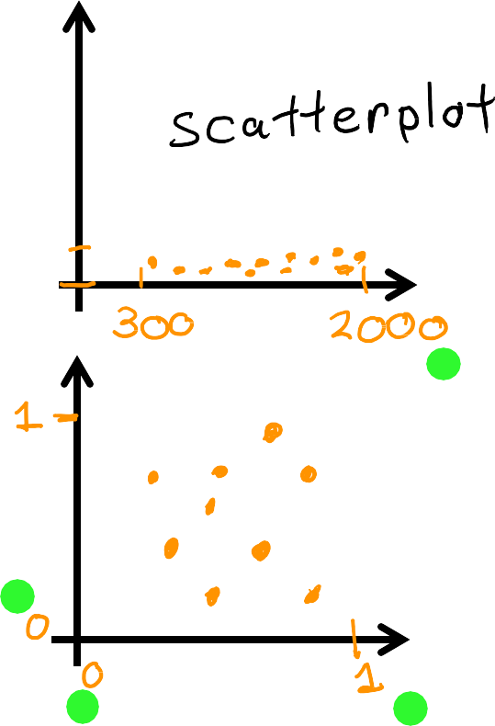
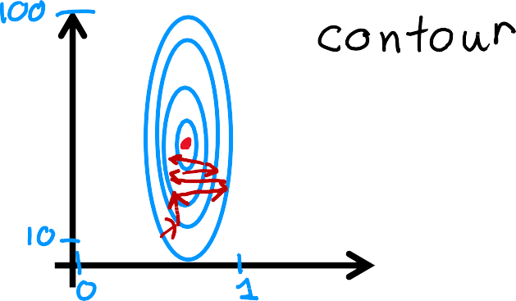


Feature size and gradient descent
Features Parameters
𝐽 w, 𝑏
𝑥₂
# bedrooms
𝑤₂
# bedrooms
𝑤₁ size in feet²
𝑥₁ size in feet²
Without feature scaling, the gradient descent algorithm would oscillate a lot back and forth, taking a long time before finding its way to the minimum point due to elongated contour plots, which cause the algorithm to zigzag across the gradient rather than moving directly toward the minimum!

Slide 25


Feature scaling
Feature scaling is crucial for gradient descent optimization algorithms when features have different orders of magnitude
Two commonly used ways for feature scaling in sklearn
Standard Scaling:
MinMax Scaling:
$$X_{j_scaled}=\frac{X_{j}−mean(X_{j})}{{st.dev.(X}_{j})}$$
$$X_{j_scaled}=\frac{X_{j}−min(X_{j})}{{max(X}_{j}) −min⁡(X_{j})}$$
maps to a Standard Normal distribution.
maps to [0,1].

Slide 26
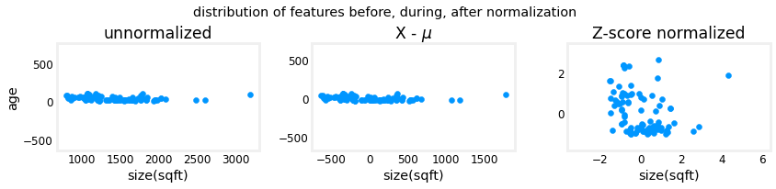
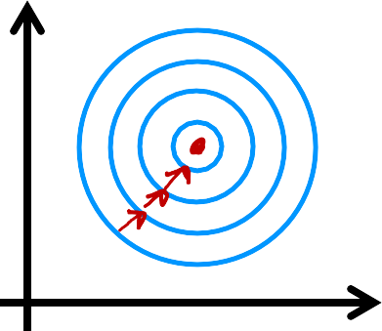

Standard Scaling: Z-score normalization
Standard Scaling:
$$X_{j_scaled}=\frac{X_{j}−mean(X_{j})}{{st.dev.(X}_{j})}$$
𝑤₂
# bedrooms rescaled
Standard Normal Distribution
𝐽 w, 𝑏
𝑤₁ size in feet²
rescaled

Slide 27
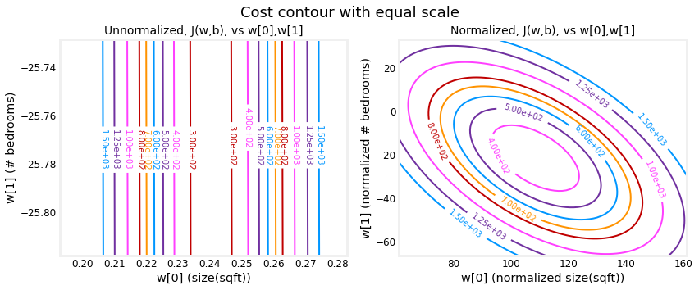
Standard Scaling: Z-score normalization

Slide 28
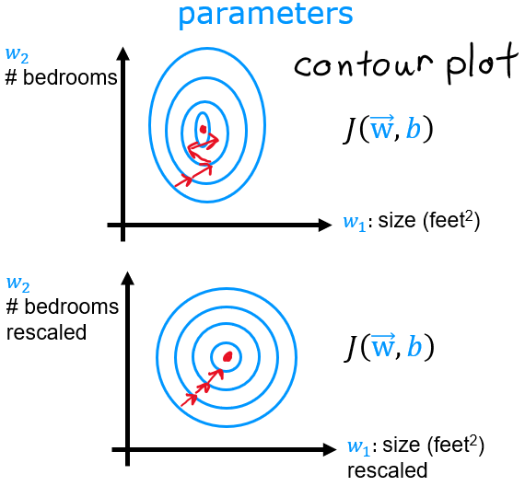
Notes:
The left plot is the cost contour plot of w[0], the square feet versus w[1], the number of bedrooms before normalizing the features. The plot is so asymmetric, the curves completing the contours are not visible. In contrast, when the features are normalized, the cost contour is much more symmetric. The result is that updates to parameters during gradient descent can make equal progress for each parameter.

Slide 29
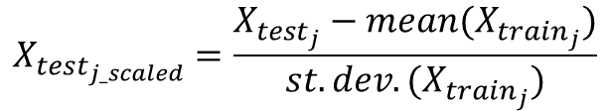
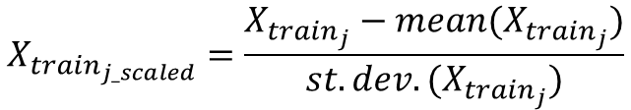
The Need for Scaling the Features
Note: Scaling is a transformation. In order to have meaningful prediction results, training and test data should undergo the exact same transformation.
For Standard Scaling:
Training Data:
Test Data:
$$X_{train_{j_scaled}}=\frac{X_{train_{j}}−mean(X_{train_{j}})}{st.dev.(X_{train_{j}})}$$
$$X_{test_{j_scaled}}=\frac{X_{test_{j}}−mean(X_{train_{j}})}{st.dev.(X_{train_{j}})}$$
Transform each training instance using the mean and st.dev. of each training column before training.
Transform each test instance using the mean and st.dev. of each training column before prediction.
Same idea with MinMax scaling (using min and max instead of mean and st.dev.)
In sklearn,
.fit to train the scaler (with the training data)
.transform to scale the datasets (training and test)
Do not refit the scaler with the test data
This is just following the general principle: any thing you learn, must be learned from the model's training data.

Slide 30
Practical Tips for Linear Regression
Checking Gradient Descent for Convergence and Choosing the Learning Rate

Slide 31

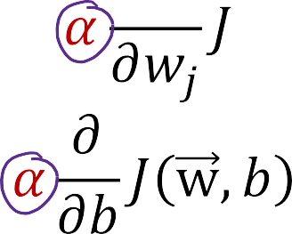

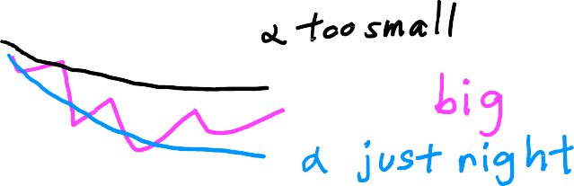

Gradient descent
For Gradient Descent:
Learning rates typically fall in the range of 0.1 to 0.0001.
For Adaptive Methods (e.g., Adam, RMSprop):
J w, b
# iterations

Slide 32









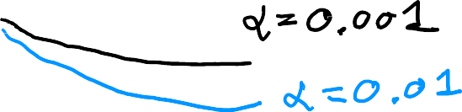
Values of 𝛼 to try:
… 0.001
0.01
0.1
1 …
J w, b
J w, b
# iterations
# iterations

Slide 33

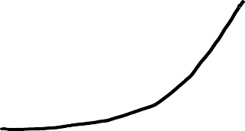

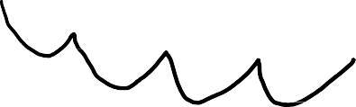
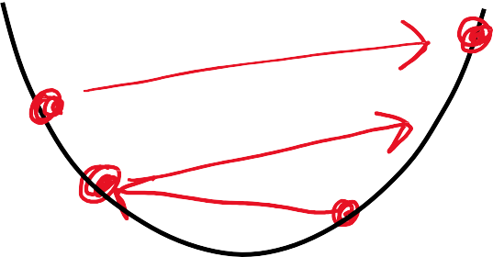
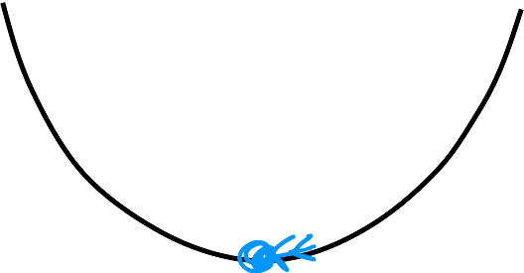
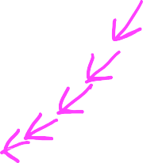




Identify problem with gradient descent
learning rate is too large
or
𝛼 is too large
𝐽 𝑤, 𝑏
𝐽 𝑤, 𝑏
# iterations
# iterations
Adjust learning rate
𝛼 is too big
Use smaller 𝛼
With a small enough 𝛼,
𝐽 w, 𝑏 should decrease on every iteration
𝐽 𝑤, 𝑏
𝐽 𝑤, 𝑏
If 𝛼 is too small, gradient descent takes a lot more iterations to converge
parameter 𝑤₁
parameter 𝑤₁

Slide 34
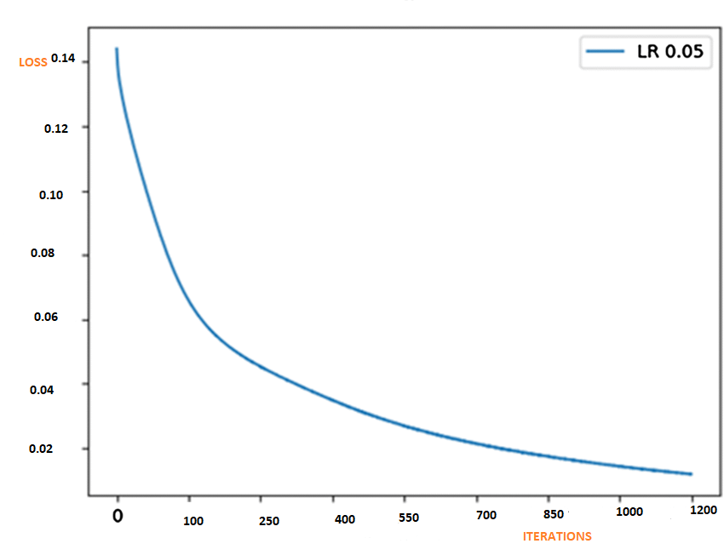

Make sure gradient descent is working correctly
𝐽 w, 𝑏 should decrease
objective: min 𝐽 w, 𝑏
w,𝑏
after every iteration
Automatic convergence test Let 𝜀 “epsilon” be 10⁻³.
If 𝐽 w, 𝑏 decreases by ≤ 𝜀
in one iteration,
declare convergence. (found parameters w, 𝑏
to get close to
global minimum)

Slide 35
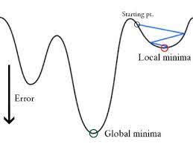
Tolerance (tol) in Logistic Regression (hw1)
tol stands for tolerance and controls the stopping criterion for the optimization algorithm (like gradient descent or other solvers).
The optimization process (such as gradient descent) iterates to minimize the cost function. However, after a certain number of iterations, the updates to the weights (or loss) become very small.
tol (epsilon-like) is the threshold below which the updates are considered insignificant, and the algorithm is allowed to stop. In other words, when the change in the cost function or the coefficients between iterations is smaller than this value, the solver concludes that convergence has been reached and terminates.
Non-convex function

Slide 36
Linear Regression in Scikit-Learn
Gradient Descent in Scikit-Learn

Slide 37
Linear Regression in Sklearn
from sklearn.linear_model import LinearRegression
from sklearn.linear_model import SGDRegressor
from sklearn.linear_model import Ridge, Lasso, and ElasticNet (regularized version)

Slide 38
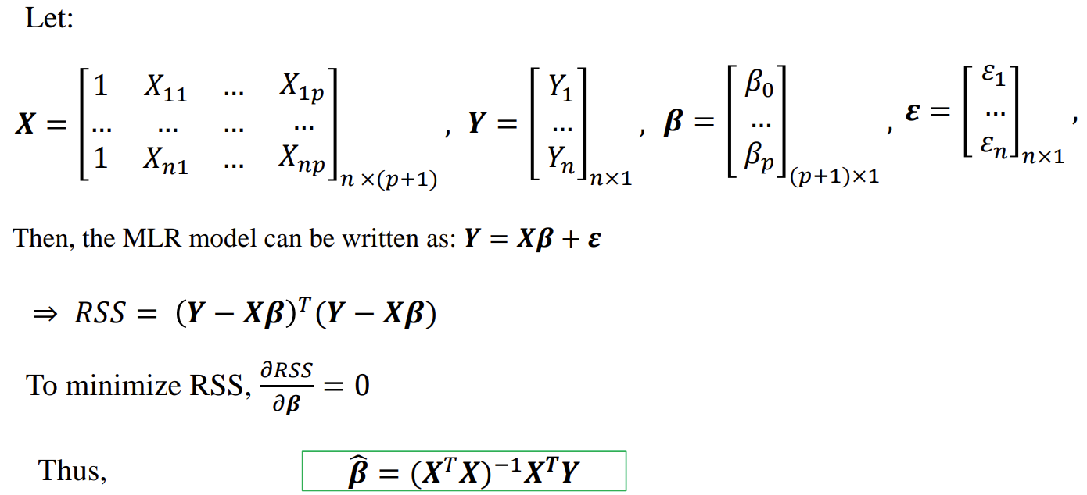
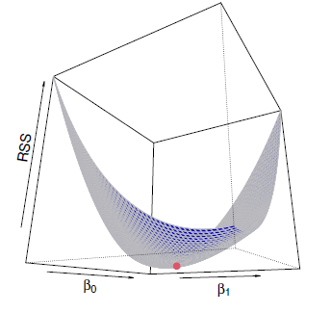
From 303-2: Estimating the Regression Coefficients (Mathematically)

Slide 39

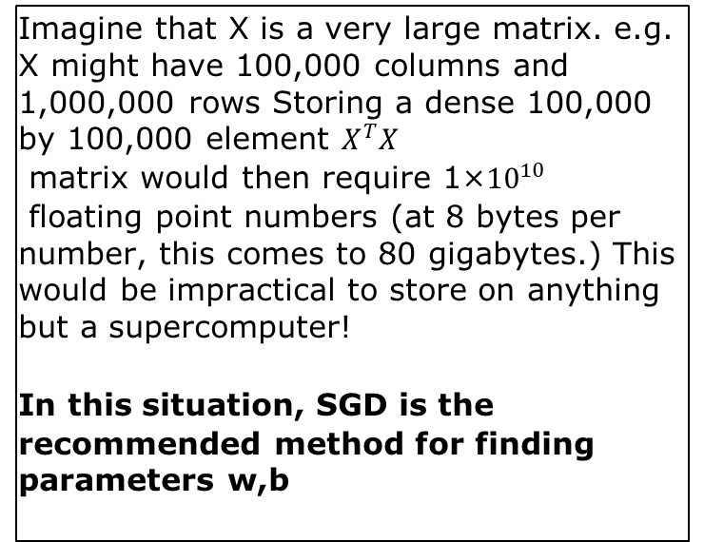
Linear Regression in Sklearn, Statsmodels
Used the close-form solution to calculate the parameters.
Imagine that X is a very large matrix. e.g. X might have 100,000 columns and 1,000,000 rows Storing a dense 100,000 by 100,000 element $X^{T}X$
matrix would then require 1×${10}^{10}$
floating point numbers (at 8 bytes per number, this comes to 80 gigabytes.) This would be impractical to store on anything but a supercomputer!
In this situation, SGD is the
recommended method for finding parameters w,b
Feature scaling is not needed in the closed-form solution
Disadvantages
For most nonlinear regression problems there is no closed form solution.
Even in linear regression (one of the few cases where a closed form solution is available), it may be impractical to use the closed-form solution when the data set is large.

Slide 40

LinearRegression vs. SGDRegressor
LinearRegression is a straightforward and deterministic algorithm suitable for smaller datasets that can fit into memory,
while SGDRegressor is more flexible and scalable, making it suitable for large-scale datasets and online learning scenarios but requiring more parameter tuning and potentially exhibiting more variability in results.
What is Stochastic Gradient Descent Regressor?

Slide 41


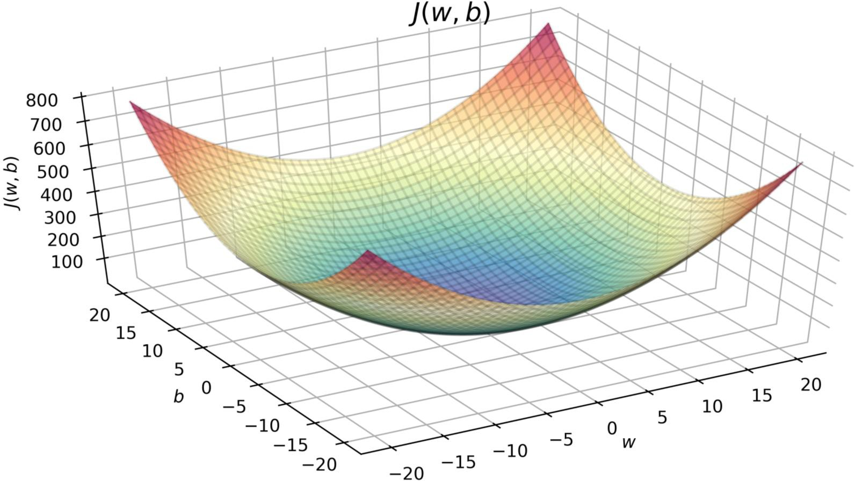
"Batch" gradient descent
"Batch": Each step of gradient descent
uses all the training examples.
 | x size in feet² | y price in $1000'5
(1) | 2104 | 400
(2) | 1416 | 232
(3) | 1534 | 315
(4) | 852 | 178
. | . | .
(47) | 3210 | 870

Slide 42

"Stochastic" gradient descent
"Stochastic": Each Step of gradient descent
uses single training example.
 | x size in feet² | y price in $1000'5
(1) | 2104 | 400
(2) | 1416 | 232
(3) | 1534 | 315
(4) | 852 | 178
. | . | .
(47) | 3210 | 870

Slide 43
"mini-batch" gradient descent
"mini-batch": Each Step of gradient descent
uses one batch of training example.
Batch size
 | x size in feet² | y price in $1000'5
(1) | 2104 | 400
(2) | 1416 | 232
(3) | 1534 | 315
(4) | 852 | 178
. | . | .
(47) | 3210 | 870
Batch Size
Epoch
Iteration
Mini-batch gradient descent will be covered in Deep Learning

Slide 44
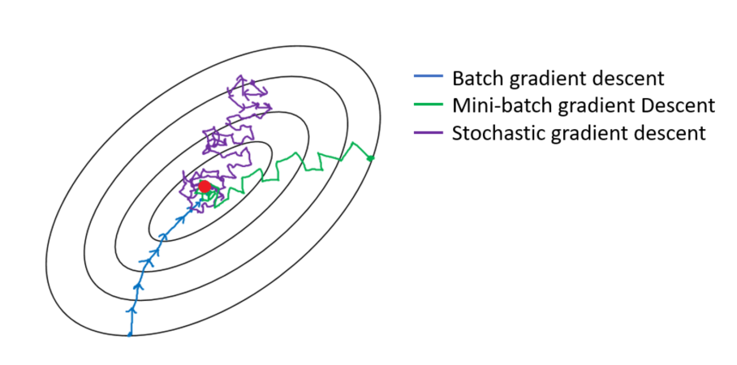

Slide 45
Advantages of SGD
It is easier to fit into memory due to a single training sample being processed by the whole iteration
It is computationally fast as only one sample is processed at a time
For larger datasets it can converge faster as it causes updates to the parameters more frequently
Due to frequent updates the steps taken towards the minima of the loss function have oscillations which can help getting out of local minimums of the loss function (in case the computed position turns out to be the local minimum)

Slide 46
Disadvantages of SGD
Due to frequent updates the steps taken towards the minima are very noisy. This can often lead the gradient descent into other directions
Due to noisy steps it may take longer to achieve convergence to the minima of the loss function
Frequent updates are computationally expensive due to using all resources for processing one training sample at a time
It loses the advantages of vectorized operations as it deals with only a single example at a time

Slide 47
Regularization to Reduce Overfitting
Cost Function with Regularization

Slide 48


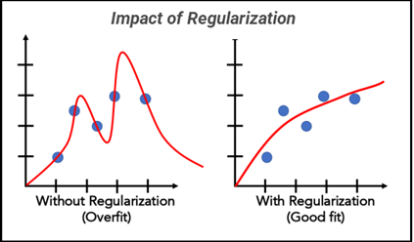
Cost Function with Regularization
Where:
𝜆: Regularization term
choose 𝜆 = 10¹⁰

Slide 49








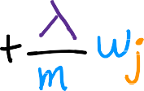

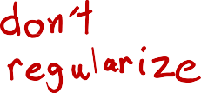


Regularized linear regression
Gradient descent
repeat {
𝜕
$$χ_{j}^{\left(i\right)}$$
𝑤_{𝑗} = 𝑤_{𝑗} − 𝛼
𝐽 w, 𝑏
𝜕𝑤
𝑗
𝜕
𝑏 = 𝑏 − 𝛼
𝐽 w, 𝑏
𝜕𝑏
} simultaneous update

Slide 50
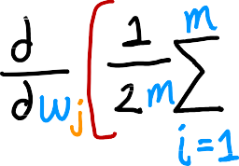

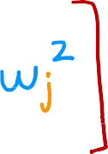


















How we get the derivative term (optional)
𝜕
𝐽 w, 𝑏 =
𝜕𝑤_{𝑗}

Slide 51






Implementing gradient descent
repeat {
} simultaneous update

Slide 52
Reference:
https://www.deeplearning.ai/

Slide 53










(𝑥) = 𝑤₁𝑥₁ + 𝑤₂𝑥₂ + ⋯ + 𝑤_{𝑛}𝑥_{𝑛} + 𝑏
multiple linear regression
^{𝑓}𝑤,𝑏
𝑏 is a number
^{𝑓}w,𝑏
x = w ∙ x + 𝑏 =

