Slide 1
Automated Extraction of Non-functional Requirements in Available Documentation
John Slankas and Laurie Williams
1st Workshop on Natural Language Analysis in Software Engineering
May 25th, 2013
Notes:
Script:
Good afternoon. I am John Slankas

Slide 2

Motivation Research Solution Method Evaluation Future Relevant Documentation for Healthcare Systems
HIPAA
HITECH ACT
Meaningful Use Stage 1 Criteria
Meaningful Use Stage 2 Criteria
Certified EHR (45 CFR Part 170)
ASTM
HL7
NIST FIPS PUB 140-2
HIPAA Omnibus
NIST Testing Guidelines
DEA Electronic Prescriptions for Controlled Substances (EPCS)
Industry Guidelines: CCHIT, EHRA, HL7
State-specific requirements
North Carolina General Statute § 130A-480 – Emergency Departments
Organizational policies and procedures
Project requirements, use cases, design, test scripts, …
Payment Card Industry: Data Security Standard

Slide 3
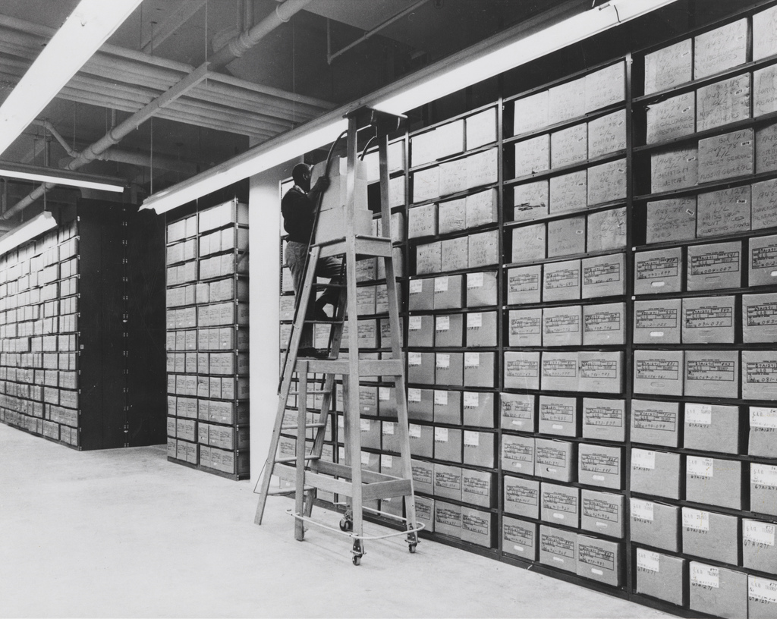
Motivation Research Solution Method Evaluation Future Research Goal Research Questions
Aid analysts in more effectively extracting relevant non-functional requirements (NFRs) in available unconstrained natural language documents through automated natural language processing.

Slide 4
Motivation Research Solution Method Evaluation Future Research Goal Research Questions
What document types contain NFRs in each of the different categories of NFRs?
What characteristics, such as keywords or entities (time period, percentages, etc.), do sentences assigned to each NFR category have in common?
What machine learning classification algorithm has the best performance to identify NFRs?
What sentence characteristics affect classifier performance?

Slide 5
Motivation Research Solution Method Evaluation Future NFR Locator
Parse Natural Language Text
Classify Sentences
“The system shall terminate a remote session after 30 minutes of inactivity.”

Slide 6
Motivation Research Solution Method Evaluation Future Context Categories Procedure
Electronic Health Record (EHR) Domain
Why?
# of open and closed-source systems
Government regulations
Industry Standards
Included PROMISE NFR Data Set

Slide 7
Motivation Research Solution Method Evaluation Future Context Categories Procedure Non-functional Requirement Categories
Started with 9 categories from Cleland-Huang, et al.
Availability
Look and Feel
Legal
Maintainability
Operational
Performance
Scalability
Security
Usability
J. Cleland-Huang, R. Settimi, X. Zou, and P. Solc, “Automated Classification of Non-functional Requirements,”
Requirements Engineering, vol. 12, no. 2, pp. 103–120, Mar. 2007.

Slide 8
Motivation Research Solution Method Evaluation Future Context Categories Procedure Non-functional Requirement Categories
Combined performance and scalability
Separated access control and audit from security
Added privacy, recoverability, reliability, and other
Access Control | Privacy
Audit | Recoverability
Availability | Performance & Scalability
Legal | Reliability
Look & Feel | Security
Maintenance | Usability
Operational | Other
J. Cleland-Huang, R. Settimi, X. Zou, and P. Solc, “Automated Classification of Non-functional Requirements,”
Requirements Engineering, vol. 12, no. 2, pp. 103–120, Mar. 2007.

Slide 9
Motivation Research Solution Method Evaluation Future Context Categories Procedure
Collected 11 EHR related documents
https://github.com/RealsearchGroup/NFRLocator
Types: requirements, use cases, DUAs, RFPs, manuals
Converted to text via “save as”
Manually labeled sentences
Validated labels
Clustering
Iterative classifying using previous results
Representative sample of 30 sentences classified by others
Executed various machine learning algorithms and factors

Slide 10
Motivation Research Solution Method Evaluation Future RQ1: What document types contain what categories of NFRs?
All evaluated document contained NFRs
RFPs had a wide variety of NFRs except look and feel
DUAs contained high frequencies of legal and privacy
Access control and/or security NFRs appeared in all of the documents.
Low frequency of functional and NFRs with CFRs exemplifies why tool support is critical to efficiently extract requirements from those documents.

Slide 11

Motivation Research Solution Method Evaluation Future RQ2: What characteristics to the requirements have in common?
$$P_{k}= \frac{N_{K,C}}{N_{C}}×log⁡(\frac{N}{N_{K}})×\frac{{tf−idf}_{C}}{\sum_{i∈C}{{tf−idf}_{i}}}$$
Performance & Scalability | fast, simultaneous, 0, second, scale, capable, increase, peak, longer, average, acceptable, lead, handle, flow, response, capacity, 10, maximum, cycle, distribution
Reliability (RL) | reliable, dependent, validate, validation, input, query, accept, loss, failure, operate, alert, laboratory, prevent, database, product, appropriate, event, application, capability, ability
Security (SC) | cookie, encrypted, ephi, http, predetermined, strong, vulnerability, username, inactivity, portal, ssl, deficiency, uc3, authenticate, certificate, session, path, string, password, incentive
Usability (US) | easy, enterer, wrong, learn, word, community, drop, realtor, help, symbol, voice, collision, training, conference, easily, successfully, let, map, estimator, intuitive

Slide 12
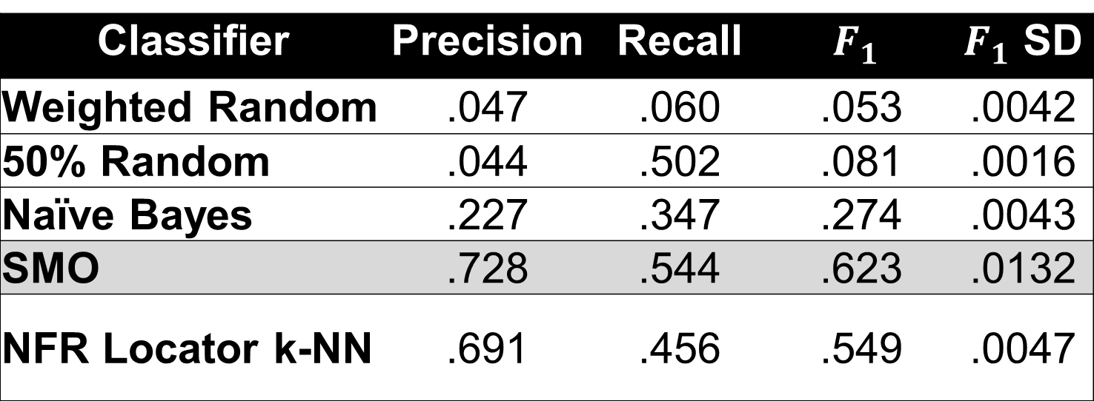
Motivation Research Solution Method Evaluation Future RQ3: What ML Algorithm Should I Use?
Classifier | Precision | Recall | $$F_{1}$$ | $F_{1}$ SD
Weighted Random | .047 | .060 | .053 | .0042
50% Random | .044 | .502 | .081 | .0016
Naïve Bayes | .227 | .347 | .274 | .0043
SMO | .728 | .544 | .623 | .0132
NFR Locator k-NN | .691 | .456 | .549 | .0047

Slide 13
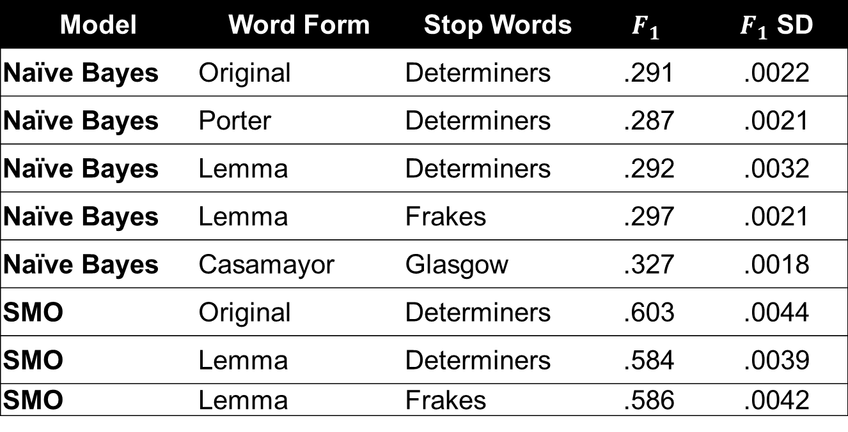
Motivation Research Solution Method Evaluation Future RQ4: What sentence characteristics affect classifier performance?
Model | Word Form | Stop Words | $$F_{1}$$ | $F_{1}$ SD
Naïve Bayes | Original | Determiners | .291 | .0022
Naïve Bayes | Porter | Determiners | .287 | .0021
Naïve Bayes | Lemma | Determiners | .292 | .0032
Naïve Bayes | Lemma | Frakes | .297 | .0021
Naïve Bayes | Casamayor | Glasgow | .327 | .0018
SMO | Original | Determiners | .603 | .0044
SMO | Lemma | Determiners | .584 | .0039
SMO | Lemma | Frakes | .586 | .0042

Slide 14
Motivation Research Solution Method Evaluation Future So, What’s Next?
Improve classification performance
Other domains
Finance
Conference Management Systems
Getting the text is a start, but …
Semantic relation extraction
Access control

