Slide 1
Access Control Policy Extraction from Unconstrained Natural Language Text
John Slankas and Laurie Williams
5th ASE/IEEE International Conference on
Information Privacy, Security, Risk and Trust
September 9th, 2013
Notes:
Script:
Good afternoon. I am John Slankas

Slide 2

Motivation Research Prior Solution Method Evaluation Future Relevant Documentation for Healthcare Systems
HIPAA
HITECH ACT
Meaningful Use Stage 1 Criteria
Meaningful Use Stage 2 Criteria
Certified EHR (45 CFR Part 170)
ASTM
HL7
NIST FIPS PUB 140-2
HIPAA Omnibus
NIST Testing Guidelines
DEA Electronic Prescriptions for Controlled Substances (EPCS)
Industry Guidelines: CCHIT, EHRA, HL7
State-specific requirements
North Carolina General Statute § 130A-480 – Emergency Departments
Organizational policies and procedures
Project requirements, use cases, design, test scripts, …
Payment Card Industry: Data Security Standard

Slide 3
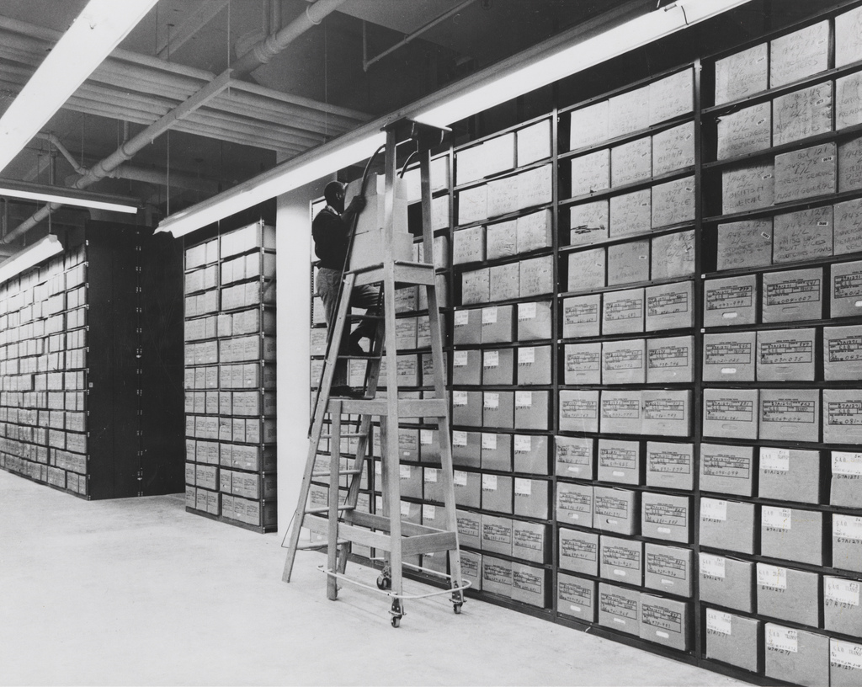
Motivation Research Solution Method Evaluation Future Research Goal Research Questions
Help developers improve security by extracting the access control policies implicitly and explicitly defined in natural language project artifacts.

Slide 4
Motivation Research Solution Method Evaluation Future Research Goal Research Questions
How effectively can we identify access control policies in natural language text in terms of precision and recall?
What common patterns exist in sentences expressing access control policies?
What is an appropriate set of seeded graphs to effectively bootstrap the process to extract the access control elements?

Slide 5
Motivation Research Prior Solution Method Evaluation Future Prior Work
Controlled natural languages
Heuristics and established patterns
Information Extraction
Templates
Relations
Semantic role labelling

Slide 6
Motivation Research Solution Method Evaluation Future Approach Representation Process Access Control Relation Extraction (ACRE)
Natural language documents contain explicit and implicit access control statements:
A nurse can order a lab procedure for a patient.
The doctor may add or remove patients from the monitoring list.
Only doctors can write prescriptions.

Slide 7
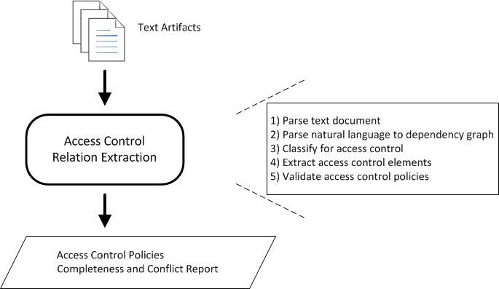
Motivation Research Prior Solution Method Evaluation Future Approach Representation Process Access Control Relation Extraction (ACRE)

Slide 8
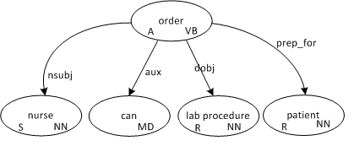
Motivation Research Prior Solution Method Evaluation Future Approach Representation Process ACRE: Sentence Representation
“The nurse can order a lab procedure for a patient.”

Slide 9
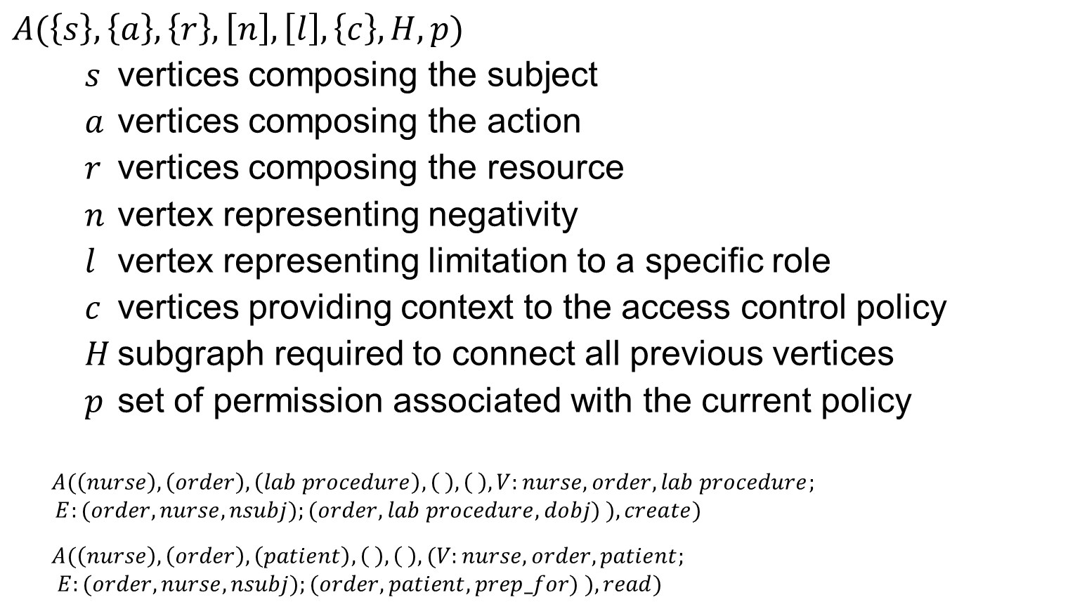
Motivation Research Prior Solution Method Evaluation Future Approach Representation Process ACRE: Policy Representation
$$A(\left\{s\right\},\left\{a\right\},\left\{r\right\},\left[n\right],\left[l\right],\left\{c\right\},H,p)$$
$s$ vertices composing the subject
$a$ vertices composing the action
$r$ vertices composing the resource
$n$ vertex representing negativity
$l$ vertex representing limitation to a specific role
$c$ vertices providing context to the access control policy
$H$ subgraph required to connect all previous vertices
$p$ set of permission associated with the current policy
$$A(\left(nurse\right), \left(order\right),\left(lab procedure\right), \left( \right), \left( \right), V:nurse,order,lab procedure;$$
$E:(order,nurse,nsubj);(order,lab procedure,dobj) ), create)$
$$A(\left(nurse\right), \left(order\right),\left(patient\right), \left( \right), \left( \right), (V:nurse,order,patient;$$
$E:(order,nurse,nsubj);(order,patient,prep_for) ), read)$

Slide 10
Motivation Research Solution Method Evaluation Future Approach Representation Process ACRE: Step 1 - Parse Text Document
Read input from a text file to identify major “types” of lines
Titles
Lists
Sentences / Sentence Fragments
document → line
line → listID title line | title line | sentence line | λ
sentence → normalSentence | listStart (“:” | “-”) listElement
listElement → listID sentence listElement | λ
listID → listParanID | listDotID | number
listParanID → “(” id “)” listParanID | id “)” listParanID | λ
listDotID → id “.” listDotID | λ
id → letter | romanNumeral | number

Slide 11
Motivation Research Solution Method Evaluation Future Approach Representation Process ACRE: Step 2 - Parse Natural Language
Parse text utilizing Stanford Natural Language Parser
Apply transformations to minimize graph.
“ A nurse can order a lab procedure for a patient.”

Slide 12
Motivation Research Solution Method Evaluation Future Approach Representation Process ACRE: Step 2 - Parse Natural Language
Parse text utilizing Stanford Natural Language Parser
Apply transformations to minimize graph.
“ A nurse can order a lab procedure for a patient.”

Slide 13
Motivation Research Solution Method Evaluation Future Approach Representation Process Bootstrap ACRE: Step 3 - Classify
Does the current sentence contain access control elements?
Utilizes a k-NN Classifier as the primary classifier
Ability to find closely matched sentences
Performs well on similar document types
If the k-NN Classifier doesn’t find a close match(es), then a majority vote is taken in conjunction with naïve Bayes, and SVM classifiers

Slide 14
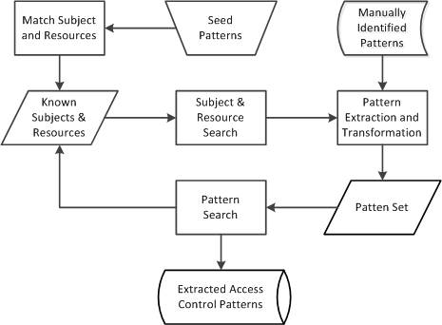
Motivation Research Solution Method Evaluation Future Approach Representation Process ACRE: Step 4 - Extraction

Slide 15
Motivation Research Solution Method Evaluation Future Approach Representation Process ACRE: Step 4 – Extraction / Seed Patterns
Determine verb frequency
Generate “base” wildcard patterns
Determine initial subject and resource lists
Iterate
From subject and resources, determine graph patterns existing between combinations
Apply transformations and wildcards to generate new patterns
Examine document for matching patterns
Extract access control policies
Extract newly found subject and resources

Slide 16
Motivation Research Solution Method Evaluation Future Context Study Oracle Procedure
Electronic Health Record (EHR) Domain
Specifically – iTrust
http://agile.csc.ncsu.edu/iTrust
Why Healthcare?
# of open and closed-source systems
Government regulations
Industry Standards

Slide 17
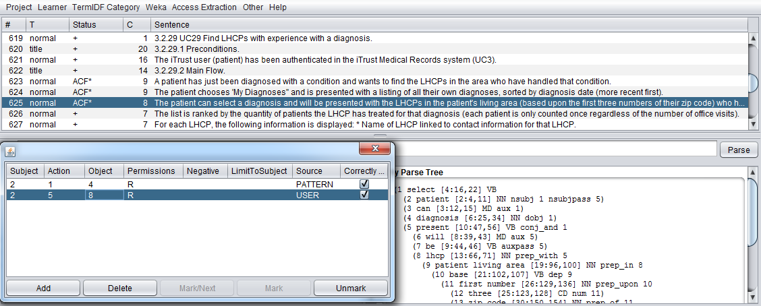
Motivation Research Solution Method Evaluation Future Context Study Oracle Procedure

Slide 18
Motivation Research Solution Method Evaluation Future Context Study Oracle Procedure
Evaluate ability to identify access control statements
What machine learning algorithms perform best?
What features affect performance?
Examine identified patterns for commonality
Examine different seed words and patterns

Slide 19
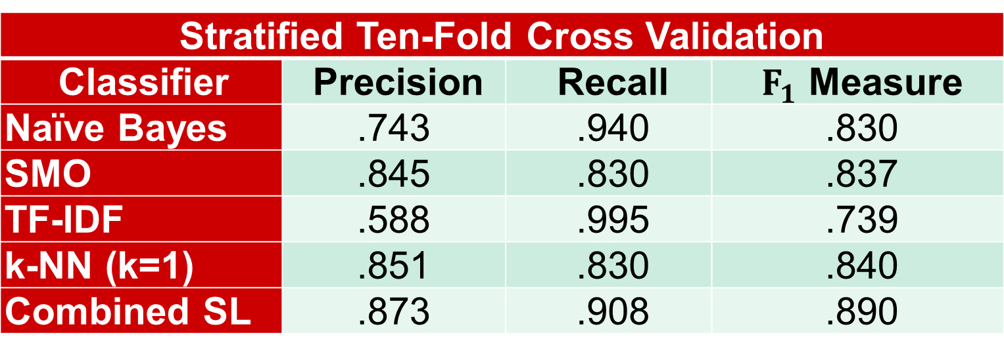
Motivation Research Solution Method Evaluation Future RQ1: How effectively can we identify access control policies in natural language text in terms of precision and recall?
Stratified Ten-Fold Cross Validation
Classifier | Precision | Recall | $F_{1}$ Measure
Naïve Bayes | .743 | .940 | .830
SMO | .845 | .830 | .837
TF-IDF | .588 | .995 | .739
k-NN (k=1) | .851 | .830 | .840
Combined SL | .873 | .908 | .890

Slide 20
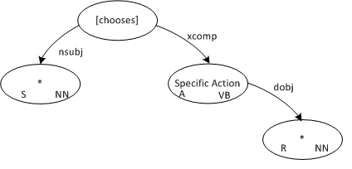
Motivation Research Solution Method Evaluation Future RQ2: What common patterns exist in sentences expressing access control policies?
From the iTrust Requirements –

Slide 21
Motivation Research Solution Method Evaluation Future RQ3: What is an appropriate set of seeded graphs to effectively bootstrap the process to extract the access control elements?
Looking at just a basic pattern:
Utilizing 10 action verbs as the initial seed to find subjects and resources, we found the existing access control with a precision of .46 and a recall of .536
create, retrieve, update, delete, edit, view, modify, enter, choose, select

Slide 22
Research Prior Solution Method Evaluation Limitations Future Limitations and Threats to Validity
Limitations
Text-based process
Conditional access
Reification
Resolution
Threats to Validity:
Only examined one system in one domain
One individual performed the labeling
(validated labels through random samples and inter-rater agreement)

Slide 23
Motivation Research Prior Solution Method Evaluation Future So, What’s Next?
Data Modeling
Resolution
Reification
Additional documents, systems, and domains
Use process to inform analysts of ambiguity

