Slide 1
DIGS – A Framework for Discovering Goals for Security Requirements Engineering
Maria Riaz, Jonathan Stallings, Munindar P. Singh, John Slankas, Laurie Williams
September 9th, 2016
Notes:
Script:
Welcome everyone and thank you for joining me today. I am John Slankas ….

Slide 2
Agenda
Motivation
Research Objective
DIGS Framework
Evaluation Methodology
Results
On-going: Security Goals to Requirements
Conclusion
Notes:
For today’s talk, I will start with the motivation for this research and the objectives. I will talk about some background and related work and then present the DIGS framework, evaluation methodology and results.
I will also discuss some ongoing work related to going from goals to security requirements.
I will conclude the talk with a discuss of consideration for future studies and research directions.

Slide 3
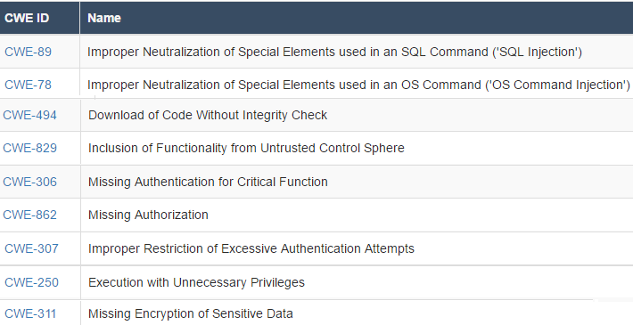
Motivation
Integrating Security Requirements with System Functionality
92% of the vulnerabilities are in the system implementation [NVD]
Limited Security Expertise and Resources [RePa12]
[CWE-SANS Top 25 Vulnerabilities]
Missing Security-Related Functionality
https://www.sans.org/top25-software-errors/
Notes:
The motivation for this research is to support early integration of security requirements with system functionality.
A majority of the vulnerabilities are in the system implementation, and not due to insecure networks or configurations.
Looking at the top 25 CWE-SANS vulnerabilities (2011), we see a number of vulnerabilities related to missing security functionality. For instance, lack of input neutralization. Or using insecure or untrusted code. We also have missing authentication and authorization where needed.
Errors of omission, like these examples, are among the most common errors in requirements engineering and one of the prevailing reason is the lack of domain knowledge. Given that security expertise is usually limited, security requirements are even more likely to be left out / not identified.

Slide 4
Research Objective
To support analysts in security requirements engineering by providing a framework that supports a systematic and comprehensive discovery of security goals for a software system.
Notes:
The objective of this research is to support [above statement]
We are focusing on identifying security goals as they capture the rationale behind the security requirements and also provide a frame of reference for requirements completeness.

Slide 5
Related Work: Identifying Security Requirements
Conceptual Frameworks
Multi-step process for identifying security requirements [Square05]
Security Requirements Models
Misuse and abuse cases to model attack scenarios [Alexander03, Sindre05]
Argumentation based on actions that violate security goals [Haley08]
Secure Tropos, i* and extensions [Asnar07, Ali09, Massacci10]
Notes:
In the existing literature, methods for identifying security requirements include both frameworks and requirements models.
- The frameworks outline various steps involved in the process of identifying security requirements.
- Identifying security goals is among the first steps of the security requirements engineering process and most of the modeling efforts have focused on security goal modeling and refinement.
These approaches are inherently based on the expertise of the analysts. Moreover, identifying security requirements and goals from scratch requires time and resources that may not be readily available.
We propose a framework for systematically discovering and modeling security goals for a software system. Our framework can be incorporated with existing goals modeling techniques.
I present the elements of the framework in the next slide.

Slide 6
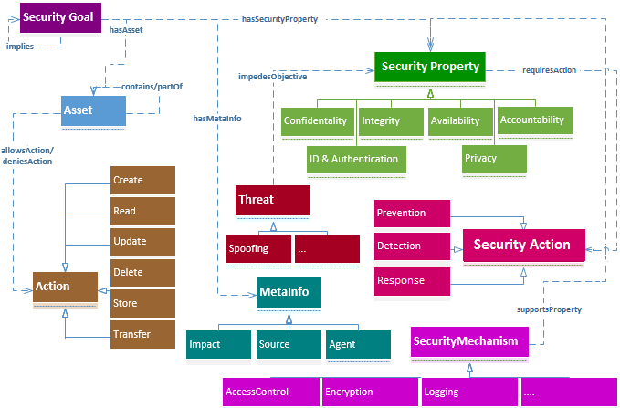
DIGS Framework
Notes:
DIGS framework models security goals related to the assets in a system as a combination of 1-of-6 security properties (e.g., CIA) and 1-of-3 security actions (prevent, detect or respond).
The list of security properties and actions have been identified from existing literature and taxonomies of security requirements.
We also define 6 action types for assets which help in determining the applicable security properties. For instance, read-type actions imply a need for confidentiality during read. Whereas write-type actions (update / delete) imply a need for integrity.
Various security mechanisms can be used to support the goals. We have mapped the identified security goals to NIST controls (SP-800-53) that support in operationalizing the goals.

Slide 7
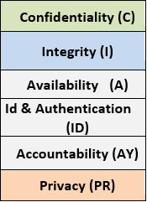
Security Goal Patterns: DIGS Framework
Security Actions
Security Properties
Prevent
of <asset>
[when <actor>
<performs action>]
Detect
a breach of
Respond to
Security Goal Pattern:
<prevent | detect | respond to> a breach of <Security Property> of <asset>
[when <actor> <performs action>]
Notes:
To model security goals in our framework, we have identified 18 security goal patterns (all combinations of 1-of-3 security actions and 1-of-6 security properties).

Slide 8
Initial and Implied Goals: DIGS Framework
Initial Goal(s)
Implied Goal(s)
prevent a breach of Confidentiality of discharge instructions
ID & Authentication of actors
→
Availability of access enforcement mechanisms
detect a breach of Integrity of discharge instructions
→
Accountability of actions
Integrity of audit records
Notes:
Each of the 18 initial goal patterns imply additional security goals. For example, for detecting a breach of integrity of an asset (E.g., discharge instructions), an implied goal is ‘integrity of audit records’. We have captured these relations among goals as well in our framework.
As part of DIGS, we also outline a step-by-step process for applying the framework, starting from assets to identifying initial and implied goals. The objective is that an analyst can consider all these goals for each asset and make a conscious decision whether a goal is applicable or not, potentially minimizing errors of omissions. [DIGS steps given in backup slides - Slide # 23 ----- More example goals in Slide # 24 & 25]
Table 2 in the paper lists the ones we have identified

Slide 9
Security Goals Identification: Experiment Design
Pre-Task Quiz
Main Task
Post-Task Survey
Assess relevant knowledge
Create balanced groups
Identify security goals
Demographics
Feedback about task
28 participants [Networks Security Course]
Two real-world systems: iHRIS / Cyclos [High level features, assets in the system]
Split-plot design: Treatment [Analyze Both Systems] + Control [Analyze Both Systems]
18 Security Goal Patterns
+ Implied Goals, Systematic Process
iHRIS
Cyclos
iHRIS
Cyclos
iHRIS
Cyclos
…
…
Cyclos
iHRIS
Cyclos
iHRIS
Cyclos
iHRIS
Control
Treatment
Notes:
We conducted the experiment in the Networks security course at NCSU with 28 enrolled participants.
Before the study, participants received reference material about different security properties and security actions (18 goal patterns) and listened to a short presentation describing the related concepts.
The study consisted of three parts as follows:
1) We performed a pre-task quiz to assess the relevant background knowledge of participants. Based on the quiz scores, we randomly placed participants having the top one-third, middle one-third, and bottom one-third scores (terciles) into treatment and control groups. Consequently, groups are balanced in terms of relevant background knowledge and no group is inherently better at identifying security goals.
2) As part of the main task, participants evaluated two systems to identify their security goals. We provided a high-level description of system features and assets in the system as input.
We used a split-plot design in which each participant was assigned to either treatment or control group (whole-plot factor) and each participant analyzed both systems in random order (split-plot factor).
Participants in the control group had knowledge about the 18 goal patterns to identify the initial goals.
Participants in the treatment group additionally had knowledge about implied goals and a systematic process for identifying the initial and implied goals.
3) At the end, we conducted a post-task survey to get demographic information and feedback.
For Discussion
----------------
Random assignment: divide into three groups based on performance (lower, mid and higher tercile) and then randomly assign to treatment and control from each tercile.
Using a split-plot design we can have more data points with the same number of participants.
We couldn’t test how the availability of 18 goal patterns impacts the discovery of different types of goals as both groups had that knowledge available as part of the reference material.

Slide 10
Security Goals Identification: Empirical Evaluation: Hypothesis and Metrics
Research Question: Can analysts identify the implied security goals without explicit knowledge?
H₀₂: Explicit knowledge about implied security goals does not impact their identification
Metrics:
Precision of overall goals w.r.t oracle
Recall of overall goals w.r.t oracle
Recall of implied goals w.r.t oracle
Notes:
We conducted a controlled experiment to evaluate whether an analyst can identify the implied security goals without the explicit knowledge of these implied goals.
We use the metrics of precision and recall based on overall goals that are identified, as well as recall in terms of initial and implied goals.
We created an oracle of security goals before the experiment. Two researchers independently identified goals for the oracle and resolved the disagreements with discussion. [Kappa score = 0.81 –---- 22 disagreements out of 252 possible votes].
For Discussion:
----------------
Metrics: Slide #21
All participants in our study were aware of the 18 security goal patterns so we could not meaningfully compare the control and treatment group in terms of the discovery of overall goals.

Slide 11
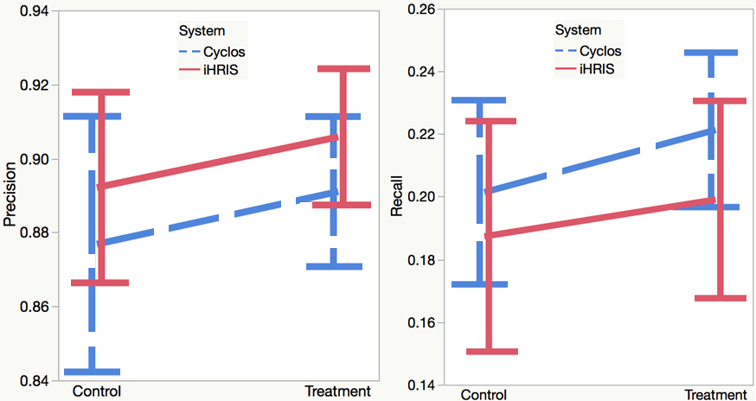
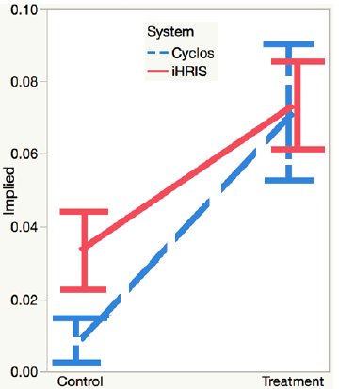
Security Goals Identification: Results
Recall based on
Implied Goals
Precision and Recall
Notes:
Based on the results, we did not find any significant differences in terms of the overall precision and recall between the two groups or the systems. However, the recall of implied goals is significantly higher for the treatment group as compared to the control group.
For Discussion
----------------
A number of reasons for low recall overall
Participants spent 15-19 minutes per system and is not enough time to identify a large number of goals.
One individual may not identify all applicable goals due to limited knowledge or different security perceptions about different types of assets.
Participants may not be as familiar with the system as an actual analyst would be.
Low recall of implied goals
implied goals are identified after the initial goals, so participants may have needed more time to get to the point where they start identifying more of the implied goals.

Slide 12
Security Goals Identification: Results – Combined Goals Identified by Group
 | iHRIS |  |  | Cyclos
Goals | O (#) | C (%) | T (%) | O (#) | C (%) | T (%)
Initial | 71 | 82% | 92% | 36 | 94% | 97%
Implied | 37 | 24% | 54% | 25 | 12% | 40%
Total | 108 | 62% | 79% | 61 | 61% | 74%
O: Oracle; C: Control ; T: Treatment;
Notes:
Since the overall recall was low, we looked at the combined set of goals identified by participants in both groups (considering each group as a team of analysts identifying goals for the system).
We see that the treatment group performed better than the control group for both initial and implied goals for both the systems.
For instance, for iHRIS, of the 108 goals in the oracle, control group identified 62% of the goals, whereas treatment group identified 79% of the goals. The difference is more pronounced in terms of the implied goals. For iHRIS, the control group identified only 24% of the implied goals whereas treatment group identified 54% of the implied goals. We see similar results for the Cyclos system.
Participants in treatment group identified significantly more implied goals, and also a much larger pool of initial and implied goals as a group with the explicit knowledge of implied goals and availability of a step-by-step process for identifying security goals (DIGS).
For Discussion
----------------
Of the 131 (101 initial; 30 implied) distinct security goals correctly identified by participants overall, the treatment group identified 27 goals (9 initial; 18 implied) that control did not. Whereas the control group identified only one goal that the treatment group did not.
Some of the implied goals, that were identified by both groups include protecting the login credentials and log files.

Slide 13
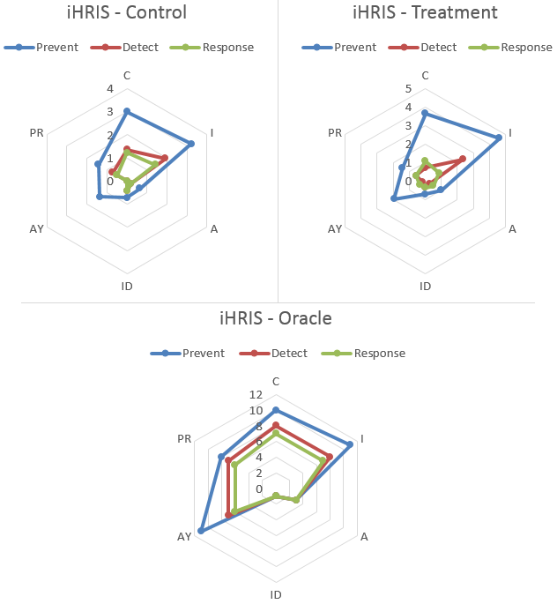
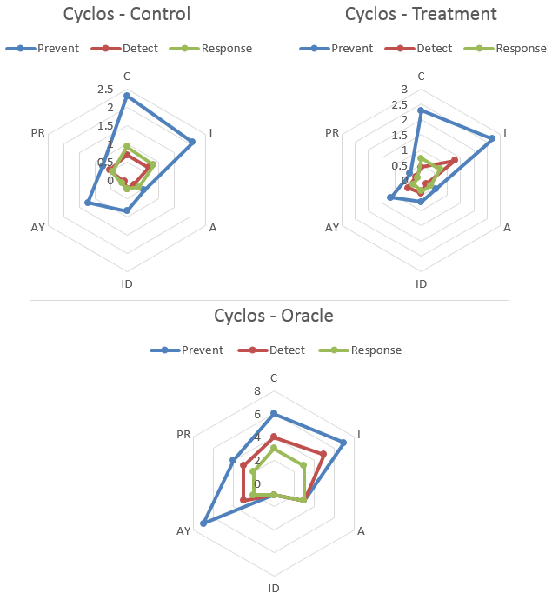
Identifying Security Goals: Types of Goals Identified by Participants
C
C
PR
I
PR
I
AY
A
AY
A
ID
ID
Notes:
This is a breakdown of different types of goals identified by participants for the two systems.
Participants mostly identified goals related to confidentiality and integrity of assets, which were also more prevalent in the oracle. However, participants did not identify as many goals related to accountability.
[May be keep it as a backup slide if you think presentation is long]

Slide 14
From Security Goals to Requirements : Security Requirements Patterns from NIST Controls
Pattern Name: R-AY-1: Respond to failures in accountability.
Problem (Security Goal):
<respond to> a breach of <Accountability> of user actions.
Context: An attacker may compromise the mechanisms for accountability to covertly perform malicious activity in the system OR the mechanism may fail arbitrarily.
...
Solution (Security Requirements Templates): The system shall:
respond to audit processing failures by alerting <authorized user>.
have provision for alternate audit capability to record <designated actions> if the primary audit capability fails.
Source (NIST Controls): AU-5, AU-15.
See Also: P-ALL-1: Enable continuous monitoring, D-ALL-1: Monitoring for security incidents, …
35 security requirements patterns [20 prevention, 7 detection, 8 response]
Notes:
[May be a backup slide if presentation seems long]
As part of on-going work, we are developing security requirements patterns for specification of security requirements that support different types of security goals in the DIGS framework.
The ‘problem’ section of the pattern is the security goal(s) that this pattern supports.
The pattern ‘name’ contains a unique identifier and descriptive text.
The ‘Solution’ section of the pattern is a set of security requirements templates that we have identified from NIST controls (the ‘source’).
We also have ‘context’ and ‘see also’ sections.
The ‘context’ section contains additional detail about applicability of the pattern.
The ‘see also’ contains list of related patterns. Patterns related to implied goals are listed here as well.
We have identified a total of 35 patterns that group together 131 different security requirements templates.
For Discussion
-----------------
We developed the patterns to support a comprehensive set of the security goals that we have identified. Existing security patterns are mostly related to later stages (architecture and security mechanisms).
Existing security requirements patterns cover some aspects of access control, intrusion detection, audit and non-repudiation.
Representation in some cases is not text-based (i* or problem frames).
Prevention: 20 patterns, 76 templates
Detection: 7 patterns, 32 templates
Response: 8 patterns, 23 templates

Slide 15
Conclusion
Considerations for Future Studies
Control group without knowledge of 18 goal patterns.
Individuals may prioritize security goals differently.
Systematic process may lead to positive task experience.
Research Directions
Automatically construct goals from functional requirements through natural language processing
Map the goals to later software development phases
(design / testing)
Notes:
Some lessons learned that are interesting to explore in future studies:
- The control group had knowledge of the 18 goal patterns. Without that knowledge, we may have seen more pronounced differences between the groups in terms of the types of identified goals as well as the precision / recall metrics.
Different individuals may prioritize security goals differently, even if they have same knowledge and background. We did not factor in individual security preferences but might be useful to consider in future studies.
Participants using DIGS reported a more positive experience performing the task as compared to the control group and seemed robust to the effects of fatigue in the current experimental setup. The availability of a systematic process might have lessened the cognitive load on participants thus leading to a more positive experience. This is worth exploring in the future.
In terms of research directions,
We can introduce automation using information retrieval techniques.
We can map the security goals to later phases (e.g., for developing test plans).

Slide 16
References
[Alexander03] Alexander, Ian. “Misuse Cases: Use Cases with Hostile Intent.” IEEE Software 20 (1): 58–66. 2003
[Ali09] Ali, Raian, Fabiano Dalpiaz, and Paolo Giorgini. “A Goal Modeling Framework for Self-Contextualizable Software.” Lecture Notes in Business Information Processing 29 LNBIP: 326–38. 2009
[Asnar07] Asnar, Yudistira, Paolo Giorgini, Fabio Massacci, and Nicola Zannone. “From Trust to Dependability through Risk Analysis.” Proceedings - Second International Conference on Availability, Reliability and Security, ARES 2007, 19–26.
[Daramalo12] Daramola, Olawande, Guttorm Sindre, and Tor Stalhane. “Pattern-Based Security Requirements Specification Using Ontologies and Boilerplates.” 2nd IEEE International Workshop on Requirements Patterns, RePa 2012 - Proceedings, 54–59. 2012
[Haley08] Haley, Charles B, Robin Laney, Jonathan D Moffett, and Bashar Nuseibeh. 2008. “Security Requirements Engineering: A Framework for Representation and Analysis.” IEEE Transactions on Software Engineering 34 (1): 133–53
[Massacci10] Massacci, Fabio, John Mylopoulos, and Nicola Zannone. “Security Requirements Engineering: The SI* Modeling Language and the Secure Tropos Methodology.” Advances in Intelligent Information Systems 265: 147–74. 2010
[McGraw06] G. McGraw. “Software Security: Building Security In”, Addison Wesley Professional, 2006.
[NVD] Alshazly, A.A., Elfatatry, A.M. and Abougabal, M.S. 2014. Detecting defects in software requirements specification. Alexandria Engineering Journal. 53, 3 (2014), 513–527.
[Schneider12] Kurt Schneider, Eric Knauss, Siv Houmb, Shareeful Islam, and J. Jürjens, "Enhancing security requirements engineering by organizational learning," Requirements Engineering, vol. 17, pp. 35-56, 2012.
[Schumacher06] M. Schumacher, E. Fernandez-Buglioni, D. Hyberston, F. Buschmann, and P. Sommerlad, Security Patterns: Integrating Security and Systems Engineering. West Sussex: John Wiley & Sons, Ltd, 2006.
[Sindre05] Sindre, G, and A L Opdahl. “Eliciting Security Requirements with Misuse Cases.” Requirements Engineering 10 (1) . 2005
[Slankas13] J. Slankas and L. Williams, "Access Control Policy Extraction from Unconstrained Natural Language Text", 2013 ASE/IEEE International Conference on Privacy, Security, Risk, and Trust (PASSAT), Washington D.C., USA, September 8-14, 2013.
[Slankas14] Slankas, J, X Xiao, L Williams, and T Xie. “Relation Extraction for Inferring Access Control Rules from Natural Language Artifacts.” Annual Computer Security Applications Conference (ACSAC 2014). New Orleans, LA. 2014
[Souag15] Souag, Amina, Raúl Mazo, Camille Salinesi, and Isabelle Comyn-Wattiau. “Reusable Knowledge in Security Requirements Engineering: A Systematic Mapping Study.” Requirements Engineering, 251–83. 2015
[Square05] N. R. Mead, E. D. Houg, and T. R. Stehney, "Security Quality Requirements Engineering (SQUARE) Methodology," Software Engineering Inst., Carnegie Mellon University2005.

Slide 17
References
[CyberSec 2016] Hibshi, Hanan, Travis Breaux, Maria Riaz, and Laurie Williams. “A Grounded Analysis of Experts’ Decision-Making During Security Assessments.” Submitted to: Journal of CyberSecurity, Feb 2016.
[ESEM 2014] Riaz, Maria, John Slankas, Jason King, and Laurie Williams. 2014. “Using Templates to Elicit Implied Security Requirements from Functional Requirements - A Controlled Experiment.” In 8th ACM/IEEE International Symposium on Empirical Software Engineering and Measurement (ESEM), 1–10. Torino
[ESEM 2016] Riaz, Maria, Jonathan Stallings, Munindar P. Singh, John Slankas, and Laurie Williams. 2016. “DIGS – A Framework for Discovering Goals for Security Requirements Engineering.” In Empirical Software Engineering and Measurement (ESEM) (to Appear). Ciudad Real
[ESE Journal 2016] Riaz, Maria, Jason King, John Slankas, Laurie Williams, Fabio Massacci, Christian Quesada Lopez, and Marcelo Jenkins. “Identifying the implied: Findings from Three Differeniated Replications on the Use of Security Requirements Templates”. Empirical Software Engineering Journal, 1st Submission: Nov. 2015. Revision: May 2016.
[ESE Journal 2016] King, Jason, John Stallings, Maria Riaz, and Laurie Williams. “To Log, or Not To Log: Using Heuristics to Identify Mandatory Log Events – A Controlled Experiment”. Empirical Software Engineering Journal, 1st Submission: Oct. 2015. Revision: April 2016.
[ICSE 2016] Industrial case study with Cisco – To Submit
[IST Journal 2015] Riaz, Maria, Travis Breaux, and Laurie Williams. 2015. “How Have We Evaluated Software Pattern Application? A Systematic Mapping Study of Research Design Practices.” Information and Software Technology 65: 14–38. doi:10.1016/j.infsof.2015.04.002
[RE 2014] Riaz, Maria, Jason King, John Slankas, and Laurie Williams. 2014. “Hidden in Plain Sight: Automatically Identifying Security Requirements from Natural Language Artifacts.” In 22nd International Requirements Engineering Conference (RE), 183–92. Karlskrona: IEEE
[RE-ESPRE 2014] Hibshi, Hanan, Travis Breaux, Maria Riaz, and Laurie Williams. 2014. “Towards a Framework to Measure Security Expertise in Requirements Analysis.” In 1st International Workshop on Evolving Security and Privacy Requirements Engineering (ESPRE), 13–18. Sweden
[RE-ESPRE 2016] Riaz, Maria, Sarah Elder, and Laurie Williams. 2016. “Systematically Developing Prevention, Detection and Response Patterns for Security Requirements”. Submitted to: 3rd International Workshop on Evolving Security and Privacy Requirements Engineering (ESPRE). Beijing.
[RE Journal 2012] Jeremy C. Maxwell, Annie I. Anton, Peter Swire, Maria Riaz, Christopher M. McCraw. "A Legal Cross-References Taxonomy for Reasoning About Compliance," Requirements Engineering Journal, 17(2), pp 99-115, Springer-Verlag, 2012
[RePa 2012] Riaz, Maria, and Laurie Williams. 2012. “Security Requirements Patterns: Understanding the Science behind the Art of Pattern Writing.” In Proceedings of the 2nd IEEE International Workshop on Requirements Patterns (RePa), 29–34. Chicago

Slide 18
Backup Slides
BACKUP

Slide 19
Security Properties Definitions
Confidentiality (C)
The degree to which the "data is disclosed only as intended“ [SECPAT]
Integrity (I)
“The degree to which a system or component prevents unauthorized access to, or modification of, computer programs or data.” [IEEE]
Availability (A)
"The degree to which a system or component is operational and accessible when required for use." [IEEE]
Identification & Authentication (IA)
Accountability (AY)
Privacy (PR)
The need to establish that "a claimed identity is valid" for a user, process or device. [NIST-SP800-33]
Degree to which actions affecting software assets "can be traced to the actor responsible for the action“ [SECPAT]
The degree to which “an actor can understand and control how their information is used.” [RE14]
Notes:
Put references
verbatim definitions of a good source ... put source on slide

Slide 20
Security Properties Classifying Security Goals and Requirements
classifying sentences in requirements artifacts
cataloging security requirements patterns
Spoofing
Tampering
Repudiation
Information Disclosure
Denial of Service
Elevation of Privileges
Notes:
To identify security properties, we analyzed taxonomies and standards related to security requirements in the existing literature. In addition to the commonly used CIA, we identified three additional properties namely: ID, AY, and PR
Each of these properties counters one or more threats in the Microsoft STRIDE model.

Slide 21

Additional Information Precision, Recall, F₁ Measure
Precision (P) is the proportion of correctly predicted classifications for security properties in the input sentences: $P = TP/(TP+FP)$.
Recall (R) is the proportion of sentences found for a security property: $R = TP/(TP+FN)$
F₁ Measure is the harmonic mean between P and R:
$\text{F}\text{1}=2 ×\left(P ×R\right) /(P+R)$
True Positive (TP): identified by participant -- in the oracle
False Positive (FP): identified by participant -- not in the oracle
True Negative (TN): not identified by participant -- not in the oracle
False Negative (FN): not identified by the participant -- in the oracle
 |  | Expected Classification
 |  | Yes | No
Predicted Classification | Yes | True Positive | False Negative
 | No | False Negative | True Negative

Slide 22

Additional Information Inter-rater Agreement (Fleiss’ Kappa)
How well do multiple raters agree beyond what’s possible by chance?
$$κ = \frac{\overline{P} −\overline{P_{e}}}{1−\overline{P_{e}}}$$
Degree of agreement attained above chance divided by the degree of agreement possible above chance
Fleiss’ Kappa | Agreement Interpretation
<= 0 | Less than chance
0.01 – 0.20 | Slight
0.21 – 0.40 | Fair
0.41 – 0.60 | Moderate
0.61 – 0.80 | Substantial
0.81 – 0.99 | Almost perfect

Slide 23
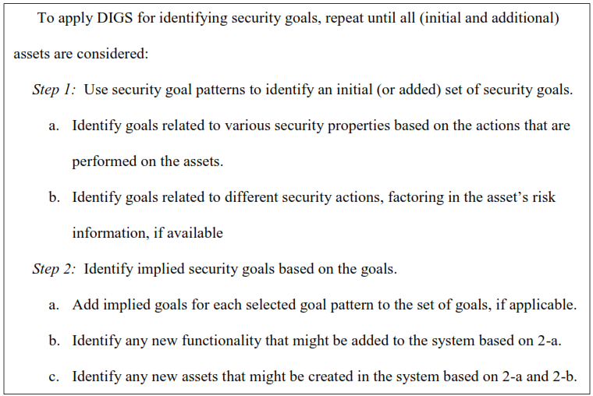
Steps for applying DIGS

Slide 24
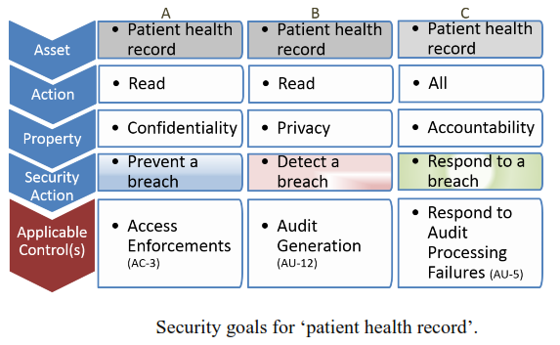
Example: Initial Security Goals

Slide 25
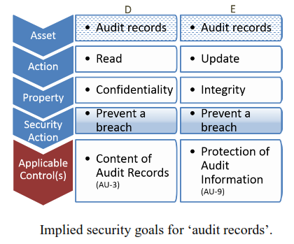
Example: Implied Security Goals

Slide 26



Security Goals & Requirements
Security Goals: security-related outcomes a system must ensure or prevent [Firesmith03]
Security requirements: security-related functionality/behavior or properties/quality attributes or constraints [MARTIN07, SOAR07, CIGITAL]
Security Goals
Why?
have
operationalize
context
What?
Software Systems
Security Requirements
[Lamsweerde03]
Notes:
Goals: objectives to be achieved by the system (A. van Lamsweerde) / prescriptive statements of intent
http://www.computer.org/portal/web/swebok/html/contents

Slide 27
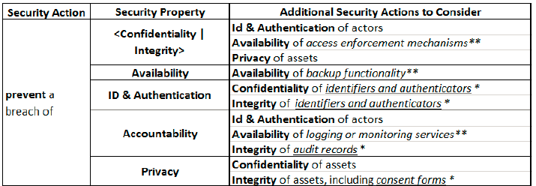
Implied Security Goals

