Slide 1
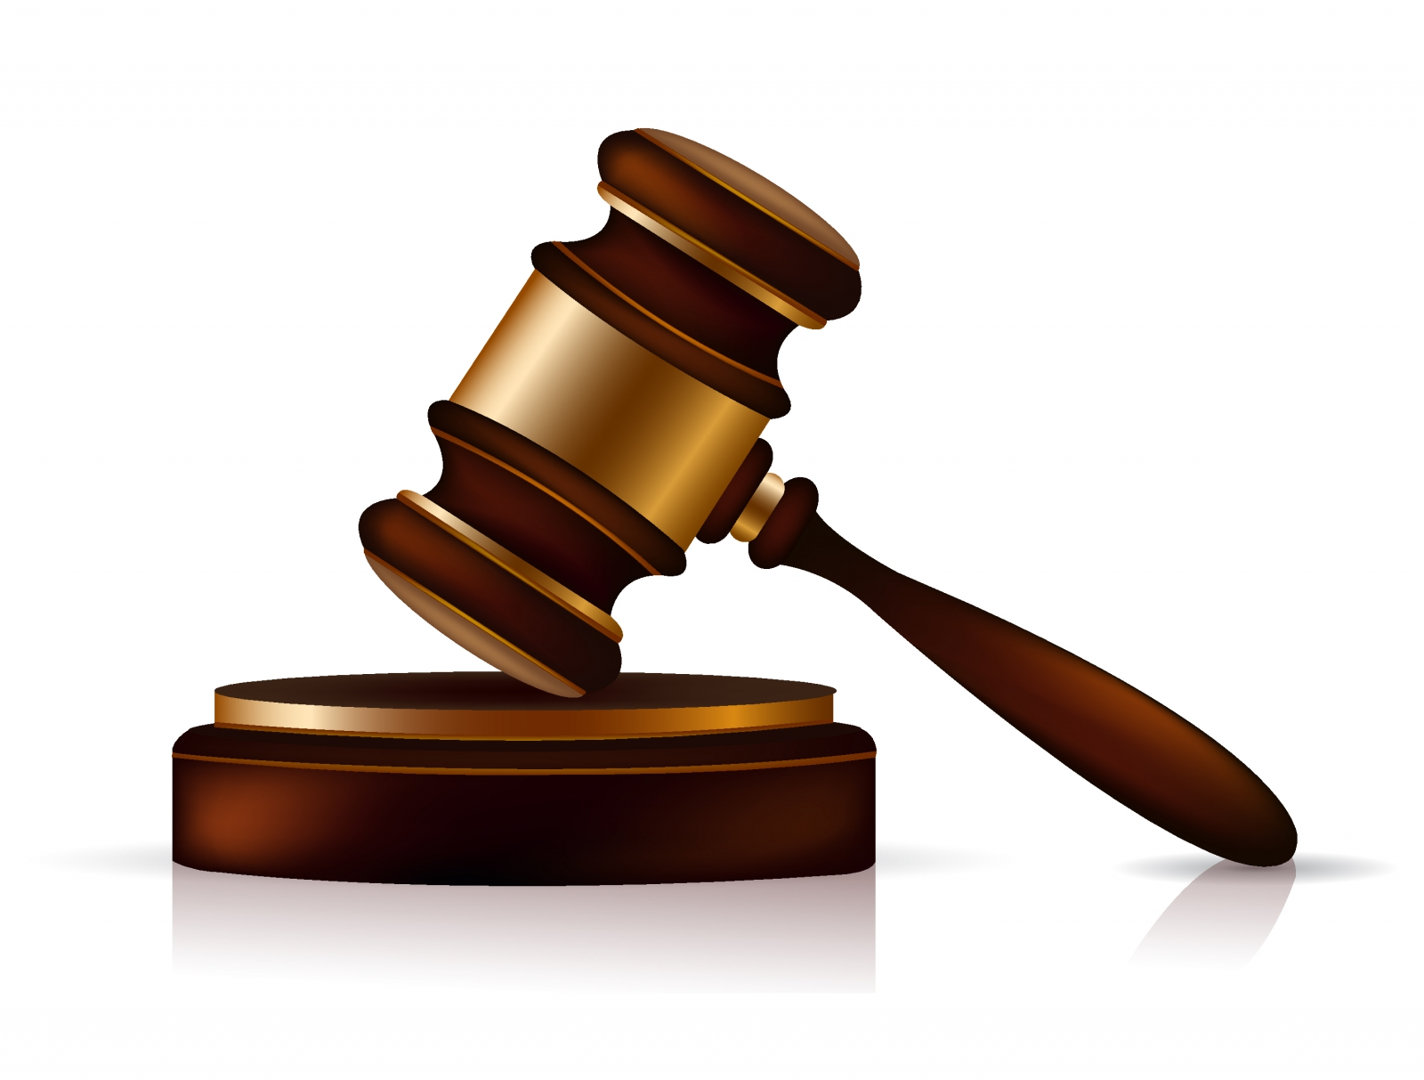
Predicting the vote of a supreme court justice
Natnaell Mammo & Santiago Larrain

Slide 2
Recap
Predict the votes of 9 US Supreme Court Justices
Use two data sources
  General case facts
  More detailed text data
Build a model for each justice that uses only the case facts
Evaluate specific cases that are difficult to classify
Include text data and measure improved accuracy
Predict pending cases of 2016

Slide 3
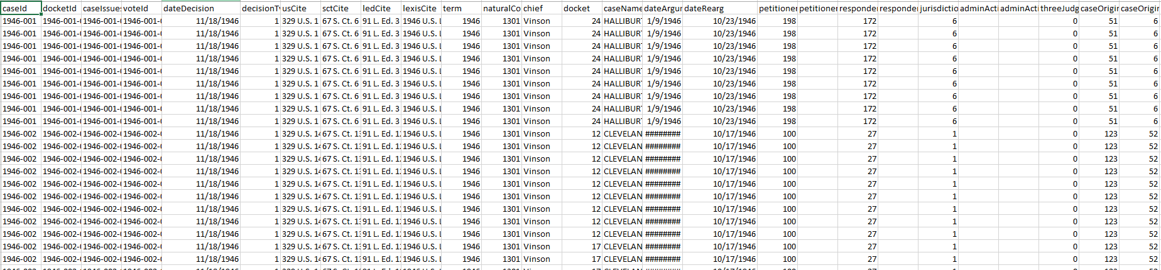
The Data: General Case Facts
3147 cases for the last 9 justices
3082 of which had a normal vote
32 possible features
Many had missing values
  1230 cases had the majority of features filled

Slide 4
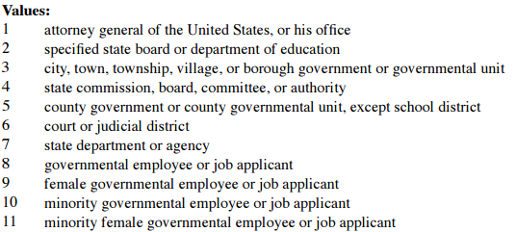
Model Building
First Ammendment
attorney or gov officials compensation
civil rights
criminal procedure
due process
economic activity
federal taxation
federalism
judicial power
misc
privacy
unions
Features
  Issue
  Issue Area
  Lower Court Disposition Direction
  Petitioner
  Respondent
  Length of Justice’s Service
  Case origin
Model
  Random Forest
  Logistic Regression
  Nearest Neighbor
  Linear SVC

Slide 5
Accuracy by Model and Justice
 | Random Forest | Logistic | Nearest Neighbor | Baseline
Scalia | .718 | .712 | .636 | .668
Kennedy | .691 | .667 | .600 | .589
Thomas | .713 | .714 | .645 | .682
Ginsburg | .693 | .666 | .596 | .630
Breyer | .676 | .652 | .590 | .590
Roberts | .631 | .651 | .596 | .589
Alito | .680 | .692 | .620 | .635
Sotomayor | .656 | .660 | .600 | .630
Kagan | .626 | .623 | .525 | .618

Slide 6
Accuracy by Issue

Slide 7
Consistently Misclassified
Mislabeled Liberal Block
37
Mislabeled Conservative Block
89
5 of the 13 were related to “economic activity”
ALL
13

Slide 8
Consistently Misclassified
Wrong for everyone
  Dockets:
  ’11-1274’,'10-1150', '11-139', '12-1281', '11-1118', '13-854', '10-875', '12-729', '12-1497', '09-737', '10-1042', '11-246', '14-116‘
Wrong for conservative block
  Dockets:
  '10-1150', '10-1042', '09-1403', '06-1509', '08-911', '06-11612', '05-9222', '07-773', '12-1497', '08-604', '12-873', '12-872', '08-10537', '04-1506', '09-737', '12-236', '08-1198', '11-1285', '13-1412', '06-8120', '10-1259', '06-571', '08-1119', '14-593', '09-837', '11-184', '06-969', '08-1569', '05-259', '10-1320', '09-559', '08-1107', '06-134', '08-1214', '09-1159', '13-894', '10-507', '04-1527', '04-1327', '11-1118', '05-1074', '10-779', '09-520', '06-562', '14-116', '08-1438', '05-260', '05-465', '08-1134', '06-1413', '08-861', '14-103', '11-208', '05-1589', '12-52', '05-555', '08-678', '12-1281', '12-574', '11-1274', '11-1179', '06-11429', '07-636', '11-1175', '09-1163', '10-875', '07-6053', '11-139', '08-1529', '10-879', '09-868', '08-1555', '13-1041', '13-301', '10-1293', '08-1151', '05-1126', '07-6984', '10-1195', '08-322', '12-1200', '10-9995', '07-610', '11-982', '08-1394', '07-11191', '09-1498', '08-453', '09-115', '08-192', '11-246', '10-1062', '12-820', '06-1456', '08-5274', '07-210', '13-483', '07-110'
Wrong for liberal block
  Dockets:
  '10-1150', '12-1497', '10-5258', '11-9953', '14-46', '11-713', '13-854', '12-9012', '13-1074', '13-1333', '12-135', '12-138', '10-1265', '10-1261', '14-939', '12-417', '11-246', '12-62', '11-982', '10-444', '13-354', '13-433', '09-993', '13-271', '10-875', '12-992', '09-737', '11-139', '14-116', '10-179', '11-796', '13-483', '12-729', '11-8976', '10-1542', '13-9026', '10-1042', '09-1298', '11-1447', '13-461', '12-142', '10-895', '13-1041', '11-166', '10-930', '10-1491', '13-113', '14-144', '13-720', '09-1088', '09-907', '12-1281'

Slide 9
Consistently Misclassified
 | Gradient Boosting | AdaBoost | Baseline
Scalia | .727 | .695 | .668
Kennedy | .677 | .647 | .589
Thomas | .721 | .707 | .682
Ginsburg | .657 | .637 | .630
Breyer | .689 | .632 | .590
Roberts | .636 | .639 | .589
Alito | .654 | .665 | .635
Sotomayor | .629 | .637 | .630
Kagan | .614 | .595 | .618

Slide 10
Next Steps
Tokenize the text data
Create unigram/bigram features
Search for additional features that may help with mislabeled cases
Measure improved accuracy with inclusion of text data

Slide 11
The End

