Slide 1
Rock & Roll Ride

Slide 2
Our solution
Single purpose application - fast, reliable and comfort transport
We have control over all transport risk
Competitive advantage on market

Slide 3
Core value
Connected and intelligent transform platform
Collecting all relevant data
Creation of optimal routes

Slide 4
Traffic informations input of Nitra
Public transport data
Real time data
We can visualise capacity and limitations of traffic situation

Slide 5
Visualisation of traffic in Nitra

Slide 6
Route optimization model

Slide 7
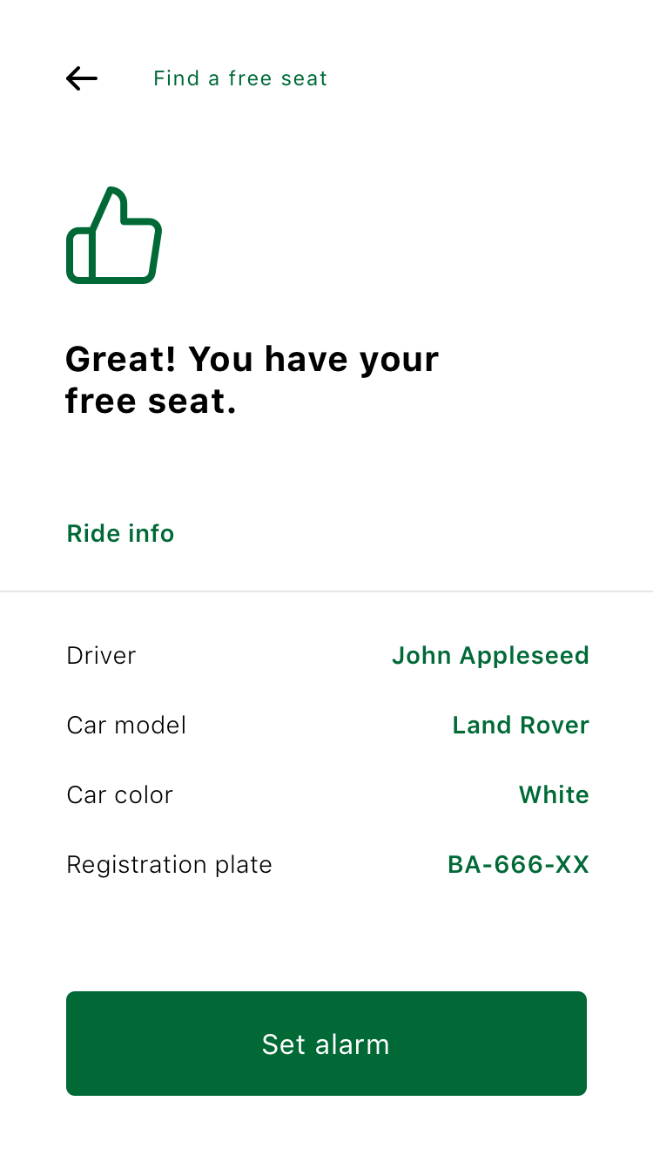
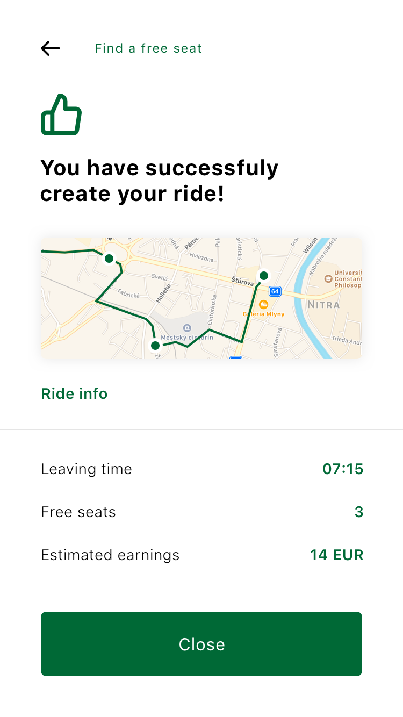
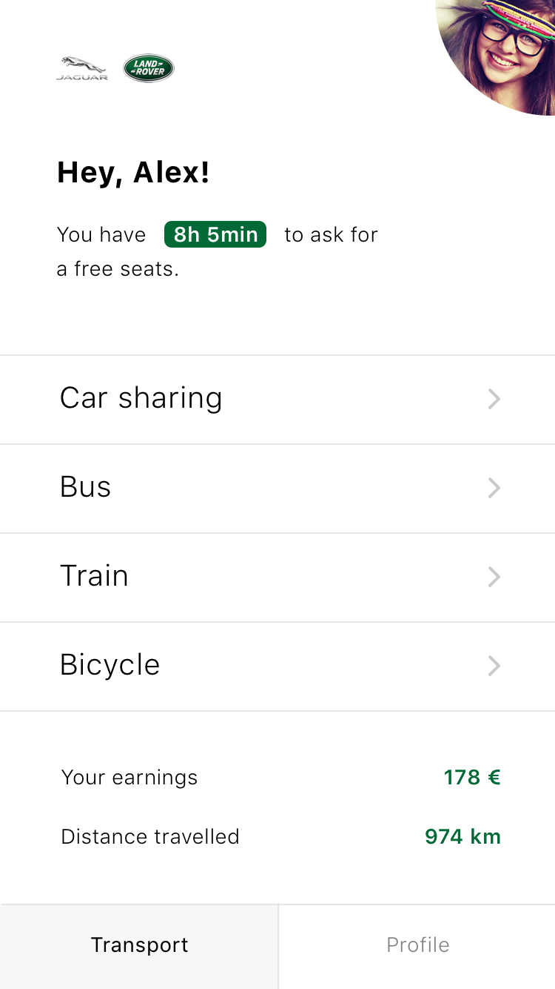
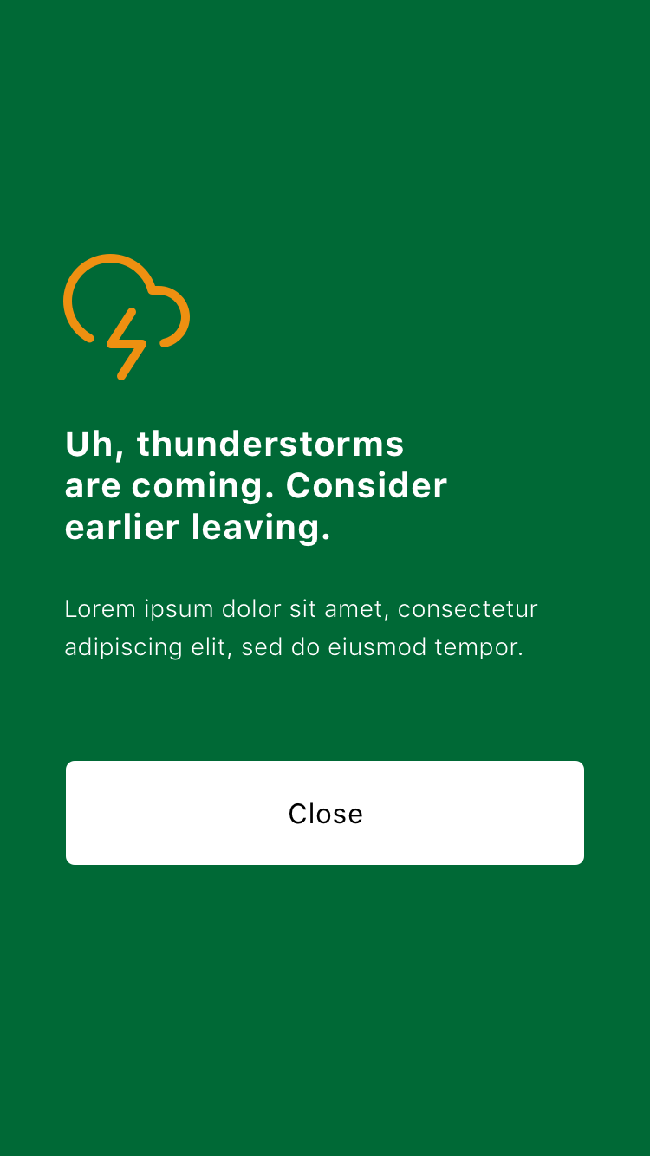
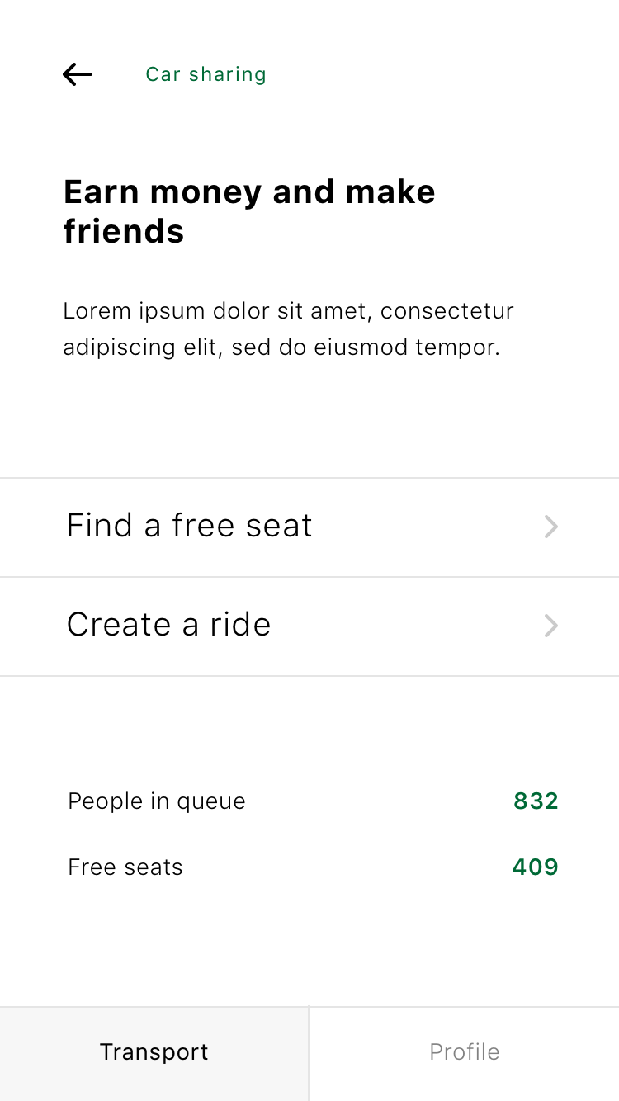
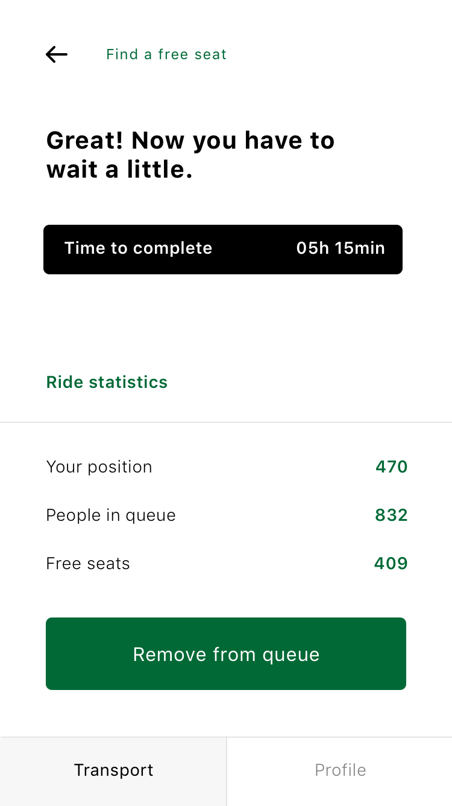
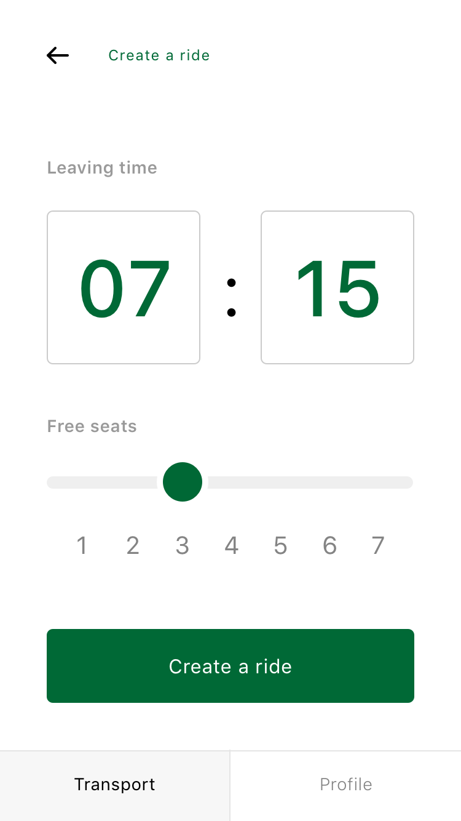
Demo - applications
passenger
driver

Slide 8
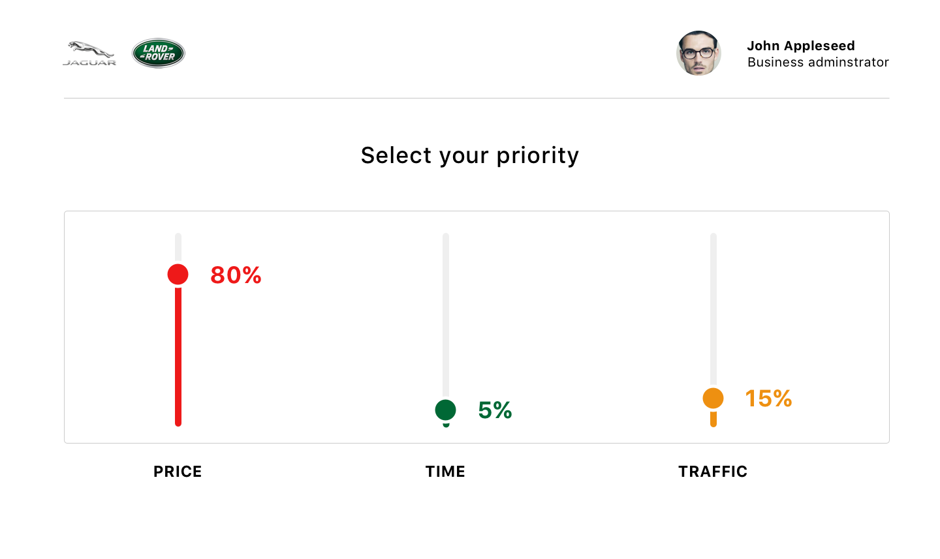
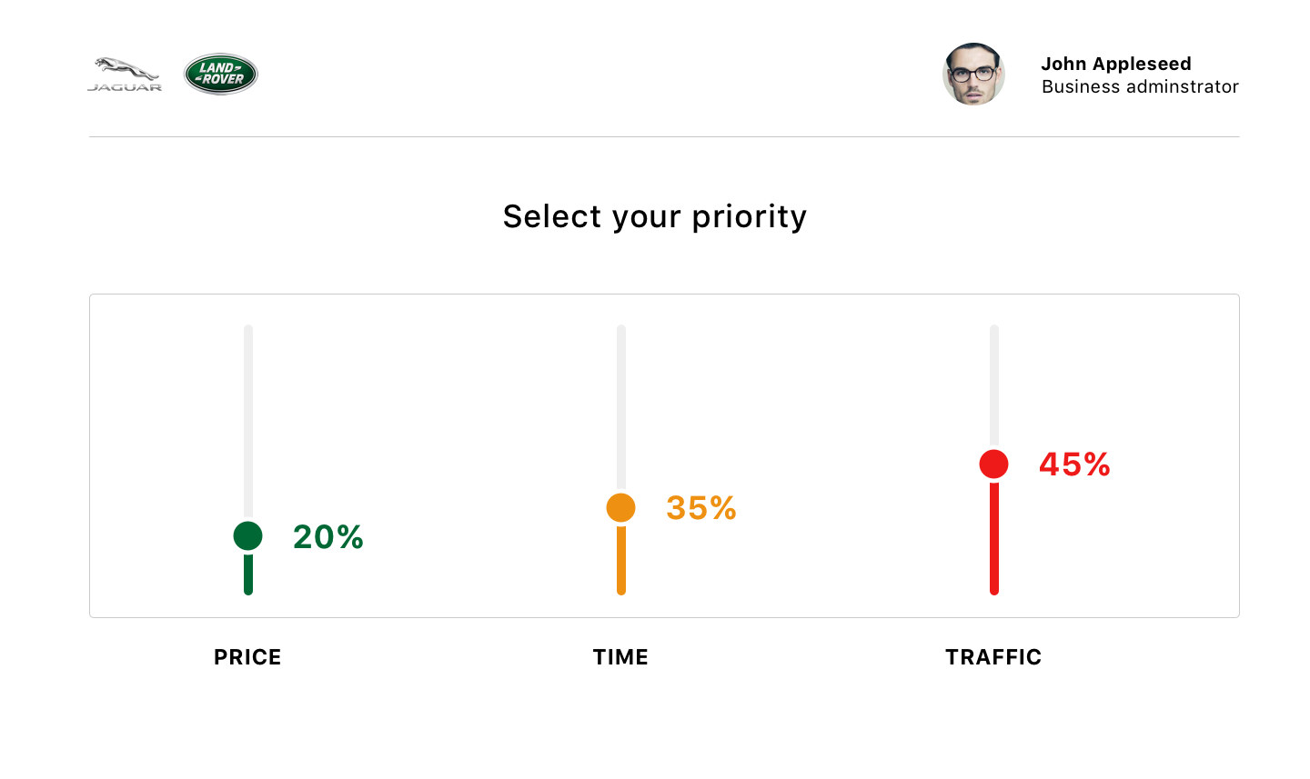
Business administrator

Slide 9
Shift manager

Slide 10
Next ideas
Digital communication between Jaguar, Land Rover and employee
Gamification
Open platform for other services and partners

