Slide 1
EEG Biometrics:
Rapid Identification across Varied Electrode Configurations and Limited Recording Times
Supervisor: Prof. Anupam
Members:
Akash Biswas (IIT2020001) Ritej Dhamala (IIT2020006) Aashish Agarwal (IIT2020009)

Slide 2
Introduction
User identification methods have rapidly advanced, and they are essential in many information-security fields. Biometrics has gradually emerged to enhance the security of the user’s identification method. These biometric characteristics include the face, iris, voice, gait, finger or footprint, and signature technologies However, there is still a risk of forgery and theft of the biometric characteristics from users. A mental passphrase is difficult to steal because brain activity is unique for each individual and stable over time. Some studies have shown that a user’s mental passphrase is well-defended against attackers.

Slide 3
Types of Biometric System
Physiological
Behavioral
Considered to be more reliable as individual features of a person, do not change by influence of psycho emotional state. Physiological systems of identification deal with statistical characteristics of a person
Face
Fingerprints
Iris Recognition
EEG
Develop over time and become consistent characteristics. Also known as soft biometrics relay on the psychological features[1].
Handwriting
Voice
Gait Recognition
Typing Rhythm

Slide 4
EEG
EEG records brain's electrical signals via electrodes on the scalp, offering insights into brain activity patterns.
Clinical use includes diagnosing epilepsy, sleep disorders, and brain tumors by analyzing abnormal brain wave patterns.
In research, EEG helps study cognitive functions like attention, memory, and language processing by monitoring brain responses to stimuli.

Slide 5
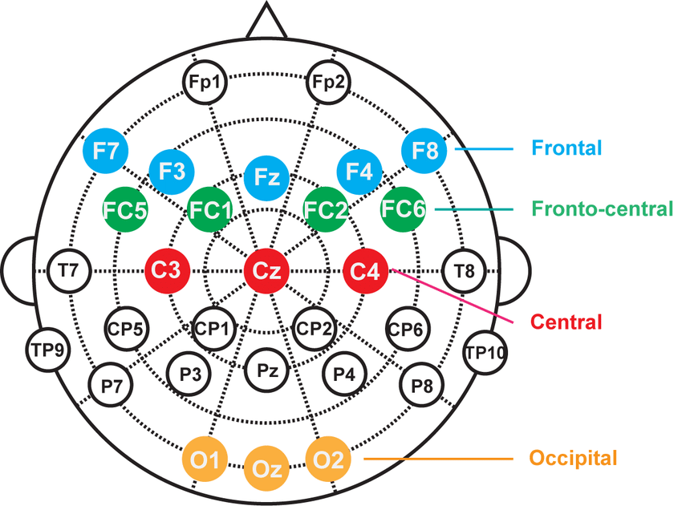
Fig.1: electrode placement for EEG [14]

Slide 6
Datasets:
Auditory evoked potential EEG-Biometric dataset
BED Dataset

Slide 7
Auditory evoked potential EEG-Biometric dataset
This data set consists of over 240 two-minute EEG recordings obtained from 20 volunteers. Resting-state and auditory stimuli experiments are included in the data.[2]
The 10/10 worldwide EEG system implanted electrodes on T7, F8, Cz, and P4, which were chosen from these articles [3][4][5].
In addition, reference and ground electrodes were inserted in the left and right ears.
Skin impedance was measured to verify electrode connection during calibration.

Slide 8
The stimuli include:
Three minutes of resting-state, eyes open for three sessions.
Three minutes of resting-state, eyes closed for three sessions.
Three minutes of listing to a song in their native language using in-ear headphones. Three minutes of listing to a song in a non-native language using in-ear headphones. Three minutes of listing to neutral music using in-ear headphones.
Three minutes of listing to a song in their native language using bone-conducting headphones.
Three minutes of listing to a song in a non-native language using bone-conducting headphones.
Three minutes of listing to neutral music using bone-conducting headphones.

Slide 9
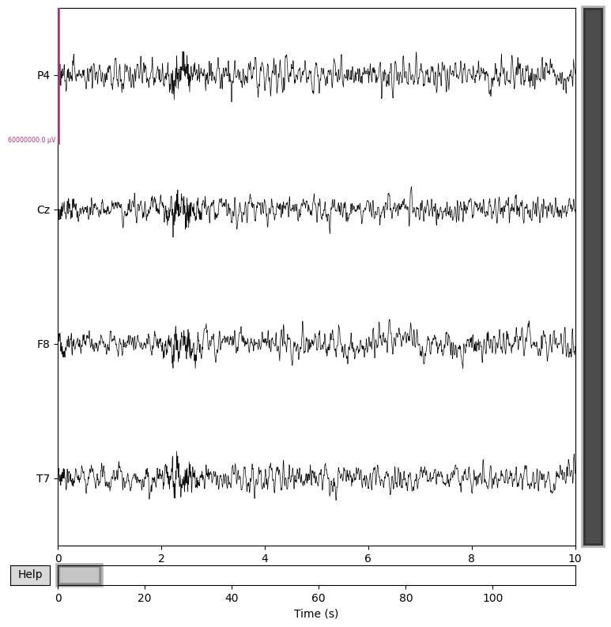
Fig.1 : Filtered eeg data of a subject in Auditory evoked potential EEG-Biometric dataset

Slide 10
BED Dataset
Dataset includes EEG responses from 21 subjects to 12 different stimuli, across 3 different chronologically disjointed sessions[6].
The stimuli include:
- Images selected to elicit specific emotions
- Mathematical computations (2-digit additions)
- Resting-state with eyes closed
- Visual Evoked Potentials at 2, 5, 7, 10 Hz - Standard checkerboard pattern with pattern reversal
- Visual Evoked Potentials at 2, 5, 7, 10 Hz - Flashing with a plain colour, set as black

Slide 11
The BED dataset includes:
- The raw EEG recordings with no pre-processing and the log files of the experimental procedure, in text format
- The EEG recordings with no pre-processing, segmented, structured and annotated according to the presented stimuli, in Matlab format
- The features extracted from each EEG segment, as described in the associated publication

Slide 12
Difference in Dataset
 | BED Dataset | Auditory evoked potential Dataset
Channel | 14-Channel | 4-channel
Subjects | 21 | 20
Experiment | 12 Experiment | 6 Experiment
University | The University of the West of Scotland, Durham University, and Universitat de València | Marche Polytechnic University (UNIVPM)

Slide 13
Literature Survey

Slide 14
BED Dataset Papers
Title | Date | Methodology | Result | Conclusion | Future Scope
Multi Channel EEG Based Biometric System with a Custom Designed Convolutional Neural Network [7] | 11 May, 2022 | CNN was custom designed to offer the best performance. With the sliding window approach, the signals were separated into overlapping 5 s windows for training CNN better. | Proposed CNN gave a correct classification rate (CCR) of 72.71%,. The CCR reached the level of average 83.51% by using 4 channels. Also, reduced the training time from 626 to 306 s | A custom CNN is designed with three convolution layers, two Max Pooling layers, one fully connected layer and a Softmax layer which increases the classification accuracy and reduces the time required for training. | The effects of combining CNN with other deep learning techniques like RNN can be also explored.

Slide 15
Title | Date | Methodology | Result | Conclusion | Future Scope
A Short-Length Single Channel EEG Based Personal Identification System [8] | 2023 | This study uses PREP to remove noise, detect faulty channels, and interpolate signals. Uses a sliding window technique s to improve the dataset and study segment length and classification accuracy. Created two deep learning models based on EEG channel count. | Multi-channel Result 95% Single-Channel Result Training set 98.27%, Testing set 97.13%. | The suggested technology requires only a single-channel EEG signal and a short signal length, making data collecting easier. EEG-based personal identification is effective with the suggested system's high accuracy, comparable to prior investigations. | Future research could explore the use of lightweight CNN architectures or other deep learning techniques to further simplify the proposed system and reduce the number of trainable parameters.

Slide 16
Title | Date | Methodology | Result | Conclusion | Future Scope
Investigation of EEG-Based Biometric Identification Using State-of-the-Art Neural Architectures on a Real-Time Raspberry Pi-Based System [9] | 2022 | Three state-of-the-art DL models were employed: ResNet, Inception, and EEGNet. | ResNet achieved 63.21% inception achieved 70.18% EEGNet achieved 86.74% | The exploration of state-of-the-art DL models (ResNet, Inception, EEGNet) for EEG-based subject identification tasks yielded promising results. EEGNet, designed specifically for EEG signals, showed the highest accuracy. | Validate these deep learning models on more training datasets

Slide 17
Auditory evoked potential Dataset
Title | Date | Methodology | Result | Conclusion | Future Scope
Effect of Auditory Stimuli on Electroencephalography-based Authentication[10] | 2022 | Auditory Stimuli Analysis: Addresses key questions regarding the effect of AS on EEG-based authentication, considering eight EEG-based biometric authentication systems. Utilizes EEG epochs and features extracted from cluster maps, employing three classifiers: Multilayer Perceptron (MLP), K-Nearest Neighbors (KNN), and eXtreme Gradient Boosting (XGBoost), detailing their architectures, parameters, and evaluation processes. | Effect of Auditory Stimuli significantly improves authentication performance, with a 9.27% increase in accuracy compared to resting states. AS via bone-conducting headphones slightly outperforms in-ear AS. Language variation in AS does not significantly affect performance. | The achieved results show that AEPs carry discriminative features allowing the possibility of employing AEP signal as a biometric trait. | The performance needs to be evaluated over larger population database and over multiple session recordings

Slide 18
Problem Description:
Conventional EEG-based biometric identification systems encounter difficulties when applied in real-world situations. Their reliance on specific electrode setups and lengthy recording periods poses challenges.
Hard to make a reliable and effective system for quick biometric identification because the number of electrodes and recording times vary.
Furthermore, the extended recording times inconvenience users, restricting the practicality of EEG-based identification systems in time-critical applications.

Slide 19
Objectives and Scope
Project Objective: Create a robust EEG-based biometric identification system that addresses existing limitations.
The high level goals are:
Develop a solution independent of electrode count.
Achieve accurate identification results within a 2-second recording window.
Prioritize seamless user experience.
Explore Ensemble Learning methods.
High accuracy across various electrode setups and limited recording durations.

Slide 20
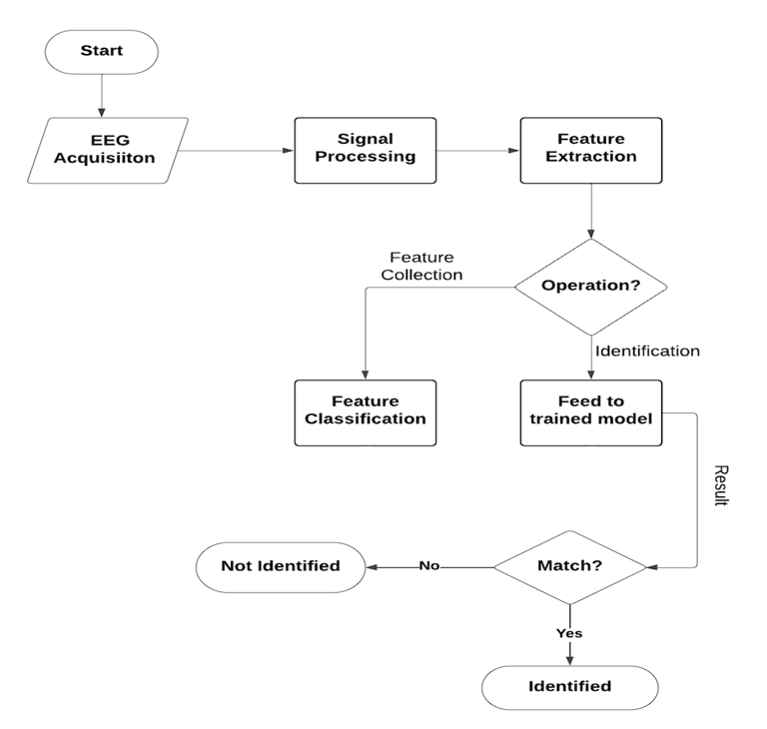
Block Diagram
Fig.2: Block diagram representing complete workflow of a biometric architecture

Slide 21
Methodology

Slide 22
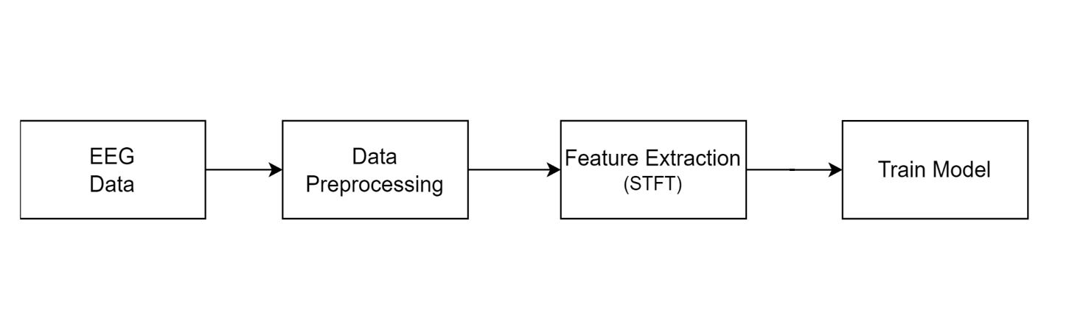
Training Dataset
Fig.3: Workflow of the training phase of the proposed model

Slide 23
Testing Dataset
Fig.4: Workflow of the testing phase of the proposed model

Slide 24
Channel Selection
For EEG (Electroencephalography) with a large number of channels, managing and processing the data can become cumbersome and computationally intensive.
To address this challenge, we will be selecting a subset of channels based on specific criteria such as electrode placement, signal quality, or relevance to the research question.

Slide 25
Data Pre-processing
Apply a 1st order 1-40 Hz Butterworth filter: this allows frequencies between 1 Hz and 40 Hz to pass through.
Apply 50 Hz notch filter: it presses power at that frequency 50 Hz to remove electrical interference (such as mains power noise).
Segmenting data at 2 second time window.

Slide 26
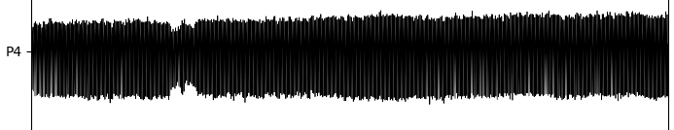
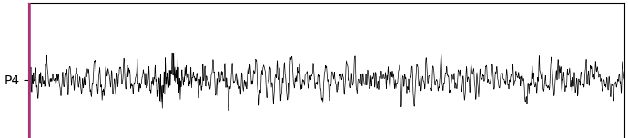
Fig.5: Unfiltered eeg signal depicting one channel of a subject in Auditory evoked potential EEG Biometric dataset
Fig.6: Filtered eeg signal depicting one channel of a subject in Auditory evoked potential EEG Biometric dataset

Slide 27

Feature extraction - STFT (Short-time Fourier transform)
STFT divides the signal into short overlapping segments (windowing section) and performs Fourier Transform separately on each segment.
It provides insight into how the spectral characteristics of the signal evolve over time, this allows for a more detailed examination of the signal's frequency characteristics over time.
The resulting magnitude of STFT representation is squared resulting in a spectrogram, which displays time on one axis, frequency on another.
Here, K is the frequency index with respect to Nyquist frequency. N is the duration of the section. hop size (H), which is the step size of the window to be shifted. ω be a sampling window function which is ω: [0, N-1] → R, m ϵ [0,M] and M is the maximum frame index mathematically M = (L−N)/ H .
Equation 1.[12]

Slide 28
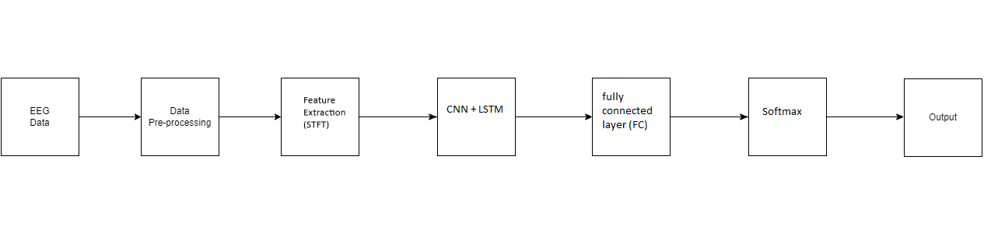
Fig.7: Complete training workflow diagram for model processing all channels at once

Slide 29
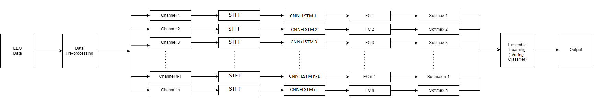
Fig.8: Complete training workflow diagram for model processing individual channels (one at a time)

Slide 30
Individual Channel Processing
For each channel:
Pass the segmented EEG data through an CNN+LSTM (Long Short-Term Memory) network.
CNN layers will capture spatial features while LSTM layers will help capture temporal dependencies and patterns in the EEG signals over time.
Follow the LSTM layers with two fully connected layers (dense layers) for feature extraction and representation.
Apply an activation function (e.g., ReLU) after each fully connected layer to introduce non-linearity.
End with a softmax layer to generate class probabilities for each segment.

Slide 31
CNN
CNNs are deep neural networks designed for processing structured grid-like data, such as images.
They apply learnable filters to small patches of input data, sliding them across the entire input image or signal. Each filter detects specific features by performing element-wise multiplications and aggregations.
The resulting feature maps contain information about the presence and location of these features in the input data.
Pooling layers are used to downsample the feature maps generated by convolutional layers, reducing their spatial dimensions while retaining the most important information.
CNNs are well-suited for capturing both spatial and temporal features simultaneously, making them ideal for analyzing EEG signals without the need for handcrafted feature extraction.
Fig.8: Diagram of a LSTM cell[13]

Slide 32
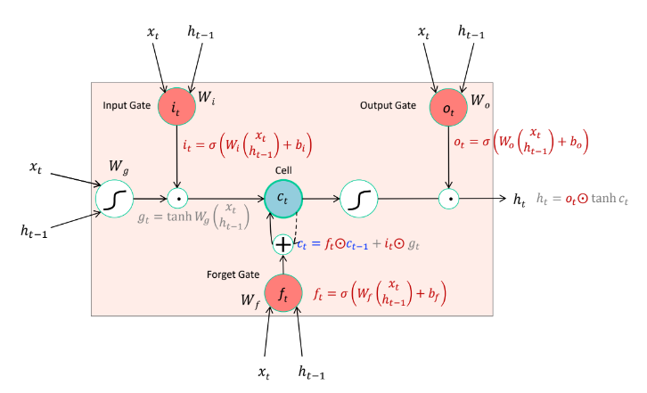
LSTM
Unlike traditional RNNs, which suffer from the vanishing gradient problem, LSTMs are designed to capture long-term dependencies in sequential data.
They excel at handling sequences with varying time intervals and maintaining context over extended periods.
EEG signals exhibit complex temporal patterns. LSTMs can model these dependencies effectively.
Fig.8: Diagram of a LSTM cell[13]

Slide 33
Attention model
Attention models are a type of neural network architecture inspired by human attention mechanisms.
They focus on different parts of input data, assigning varying degrees of importance to each part during processing.
Attention mechanism involves computing a set of attention weights for each input. These weights determine how much focus the model should give to each input during processing.
Attention mechanisms allow the model to focus on relevant EEG signals at different time points, emphasizing important features while suppressing noise or irrelevant information.

Slide 34
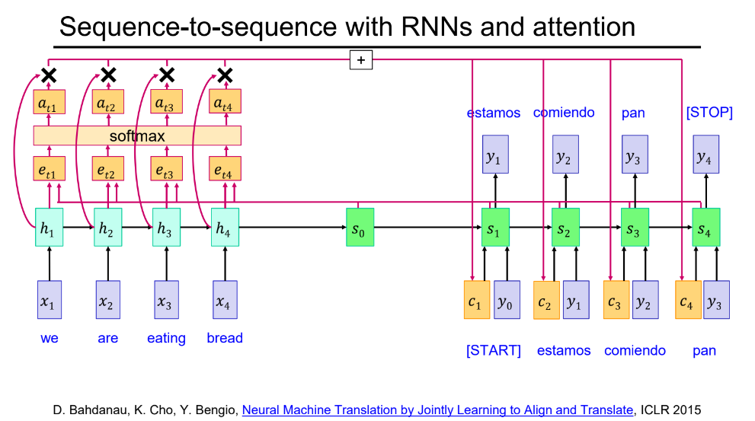
Fig.9 Architecture of attention model [13]

Slide 35
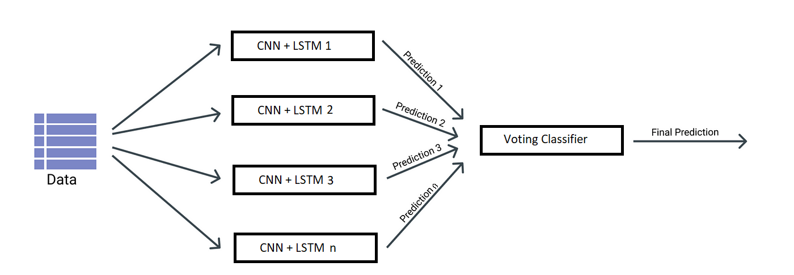
Voting Classifier
A voting classifier is an ensemble technique that generates a final prediction by aggregating the predictions of several separate classifiers.
A voting classifier can be implemented in a variety of ways:
Hard Voting: In a hard vote, the majority prediction is selected as the final prediction, with each classifier in the ensemble receiving a vote.
Soft Voting: In soft voting, the average probabilities across all classifiers are computed, and each class receives a probability score from each classifier individually. The final prediction is then made for the class with the highest average probability
Fig.10: Architecture of a stacking classifier

Slide 36
Ensemble Learning with Voting Classifier
Collect the outputs from all individual channel processing steps.
Concatenate or combine the outputs to form a feature matrix for each segment.
Implement a Voting Classifier, a type of ensemble learning method:
Train a set of base classifiers on the training set. Each base classifier corresponds to one of the individual channels' processed data.
Build a voting-classifier that takes the predictions of the base classifiers as input features and votes among them to generate the final decision.

Slide 37
Novelty
We process EEG data by treating each channel separately, capturing unique channel-specific information.
Instead of relying on a single classifier, we use ensemble learning techniques to combine multiple classifiers for improved performance.
Our innovation lies in seamlessly integrating individual channel processing with ensemble learning, enhancing both discriminative power and robustness.

Slide 38
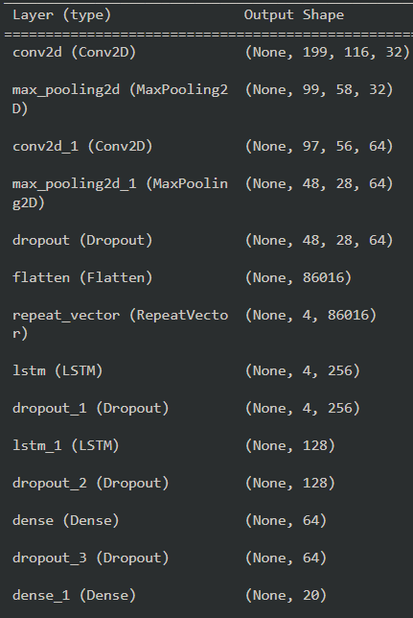
Experimental Setup
Fig.11. Complete architecture of the proposed CNN+LSTM model

Slide 39
Tools
Python 3
Tensorflow
Keras
Scikit-learn
Numpy
Pandas
Google Colab

Slide 40
Results

Slide 41
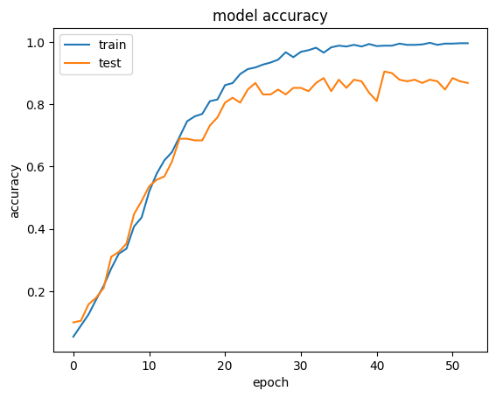
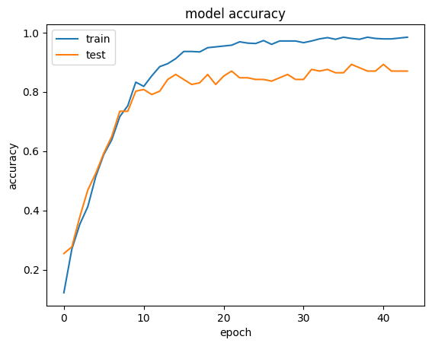
Fig.11. Accuracy curve for CNN+LSTM training with all 4 channel on AEP dataset
Fig.12. Accuracy curve for CNN+LSTM training with all 14 channel on BED dataset

Slide 42
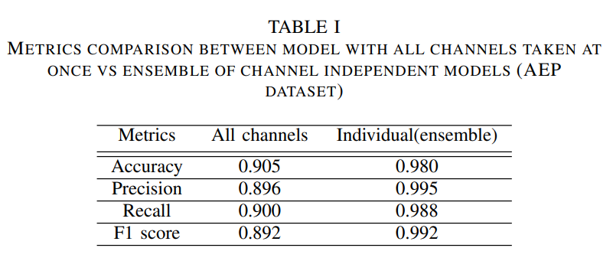
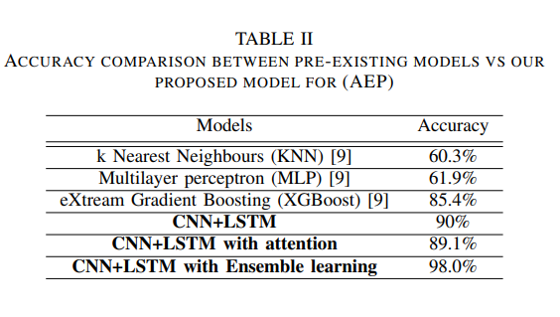

Slide 43
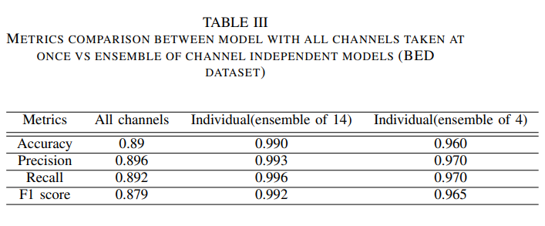
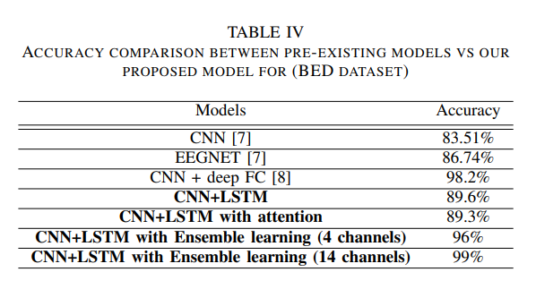

Slide 44
Conclusion
In conclusion, this research presents a novel methodology for EEG-based biometric identification, leveraging both the Auditory Evoked Potential EEG-Biometric dataset (AEP dataset) and the Biometric EEG dataset (BED).Through the proposed approach, we have demonstrated significant advancements in the field we achieved an impressive accuracy of 98% using the AEP dataset and 95% using the BED dataset. These results signify the robustness and reliability of our proposed methodology in accurately identifying individuals based on EEG signals.

Slide 45
References
[1] Alsaadi, Israa. (2021). Study On Most Popular Behavioral Biometrics, Advantages, Disadvantages And Recent Applications : A Review. International Journal of Scientific & Technology Research. 10. 15-21.
[2] Abo Alzahab, N., Di Iorio, A., Apollonio, L., Alshalak, M., Gravina, A., Antognoli, L., Baldi, M., Scalise, L., & Alchalabi, B. (2021). Auditory evoked potential EEG-Biometric dataset (version 1.0.0).
[3]Altahat SH. Robust EEG Channel Set for Biometric Application (Doctoral dissertation, University of Canberra).
[4] Ravi KV, Palaniappan R. A minimal channel set for individual identification with EEG biometric using genetic algorithm. InInternational Conference on Computational Intelligence and Multimedia Applications (ICCIMA 2007) 2007 Dec 13 (Vol. 2, pp. 328-332). IEEE.
[5] Marcel S, Millán JD. Person authentication using brainwaves (EEG) and maximum a posteriori model adaptation. IEEE transactions on pattern analysis and machine intelligence. 2007 Feb 20;29(4):743-52.
[6] P. Arnau-González, S. Katsigiannis, M. Arevalillo-Herráez and N. Ramzan, "BED: A New Data Set for EEG-Based Biometrics," in IEEE Internet of Things Journal, vol. 8, no. 15, pp. 12219-12230, 1 Aug.1, 2021
[7] Bakırcıoglu, K., Tanimu, M.B., Özkurt, N., Seçmen, M., Güzeliş, C., Yıldız, O. (2022). Multi Channel EEG Based Biometric System with a Custom Designed Convolutional Neural Network. In: Seyman, M.N. (eds) Electrical and Computer Engineering.

Slide 46
[8] Hendrawan, Muhammad Afif & Ratsanjani, M & Noprianto, Noprianto & Ed Dien, Habibie. (2024). A Short-Length Single Channel EEG Based Personal Identification System. 10.1109/COMNETSAT59769.2023.10420768.
[9] Benomar M, Cao S, Vishwanath M, Vo K, Cao H. Investigation of EEG-Based Biometric Identification Using State-of-the-Art Neural Architectures on a Real-Time Raspberry Pi-Based System. Sensors (Basel). 2022 Dec 6;22(23):9547.
[10] Seha, Sherif Nagib & Hatzinakos, Dimitrios. (2018). Human Recognition Using Transient Auditory Evoked Potentials: A Preliminary Study.
[11] C.M. Jijomon, A.P. Vinod,Person-identification using familiar-name auditory evoked potentials from frontal EEG electrodes, Biomedical Signal Processing and Control, Volume 68, 2021,
[12] M. Asif, S. Mishra, M. T. Vinodbhai and U. S. Tiwary, "Emotion Recognition Using Temporally Localized Emotional Events in EEG With Naturalistic Context: DENS# Dataset," in IEEE Access, vol. 11, pp. 39913-39925, 2023, doi: 10.1109/ACCESS.2023.3266804.
[13] Lecture on RNN, Deep Learning course 2023, CVBL Labs, IIITA
[14] JOUR Yang, Weiping Yang, Jingjing AU - Gao, Yulin Tang, Xiaoyu Yanna, Ren Takahashi, Satoshi Wu, Jinglong Effects of Sound Frequency on Audiovisual Integration: An Event-Related Potential Study journal.pone.0138296 PLOS ONE ER -

Slide 47
Thank You

