Slide 1
Unsupervised Image Retrieval
Group 13
IIT2020224 - Jitesh Kumar IIT2020244 - Rahul
IIT2020005 - Pushkal Madan
IIT2020006 - Ritej Dhamala

Slide 2
Problem Statement
Educational, industrial, medical, social, and other life institutions have produced vast image collections. A robust picture search system is needed for all of these image libraries. There are two typical search strategies.
The ﬁrst technique, referred to as text-based image retrieval, is based on the keywords used to annotate photos.
This approach has a number of drawbacks:
Manually annotating huge databases is impractical since it takes a lot of time, effort, and money.
This strategy is sensitive to human perception because the end user must annotate.
These annotations may only apply to one language.
In this project, we aim to build an image retrieval system that utilizes deep CNNs to extract features from images and retrieves the most relevant images based on a given query image.

Slide 3
Introduction
The proposed system will be designed and evaluated on lfw dataset.
This project aims to contribute to the development of efficient and effective image retrieval systems, which can have a significant impact on various applications such as content-based image search, medical diagnosis, and surveillance systems.
In image retrieval, images are found and retrieved based on how closely their visual contents match those of a query image utilising the image's features.
The collection of photos is processed to extract low-level visual features using a feature extraction module.
Color, texture, and shape are often retrieved image attributes.
The similarity between two photos is then assessed by comparing their feature similarities.

Slide 4
Experimental Dataset
Labelled Faces in the Wild (LFW) Dataset
A database of face images called Labeled Faces in the Wild (LFW) was created to examine the issue of unrestricted face identiﬁcation.
University of Massachusetts, Amherst scholars built and maintain this database (speciﬁc references are in Acknowledgments section). The Viola Jones face detector was used to locate 5,749 people in 13,233 photos that were acquired from the internet.
This dataset consists of 11 ﬁles. The remaining 10 ﬁles all contain essential metadata that we will use to create the training and test sets for our model.
We can ﬁnd all the information and metadata at http://vis-www.cs.umass.edu/lfw/.

Slide 5
Literature Review - 1
Title | An unsupervised learning approach to content-based image retrieval
Methodology | This work offers a unique image retrieval method called CLUster-based retrieval of pictures by unsupervised learning (CLUE) to address the semantic gap issue. The foundation of CLUE is the idea that images with similar semantic properties tend to cluster together. By returning picture clusters based on both the similarities between individual photos and the query's features, it aims to close the semantic gap between them.

Slide 6
Result | The experimental CBICR system uses the same feature extraction scheme and the UFM similarity measure. A general-purpose image database (from COREL) with roughly 60,000 images is used to create the system. Using pairwise distances, CLUE divides the images into clusters where within-cluster similarity is high and between-cluster similarity is low. The outcomes seem to suggest that unsupervised learning can group together photos with comparable semantic properties to some extent.
Drawbacks | The relevance of image semantics is subjective and hence the relevance criteria, may be quite different from those used by a user of the system.Also, space limitations, only 11 matches are represented in the paper.
Dataset Used | general-purpose images
Source: https://ieeexplore.ieee.org/document/1224674

Slide 7
Literature Review - 2
Title | CLUE: cluster-based retrieval of images by unsupervised learning
Methodology | In order to enhance user involvement with image retrieval systems by fully utilising similarity information, this work introduces a novel technique called cluster-based retrieval of pictures by unsupervised learning (CLUE). By using a graph-theoretic clustering algorithm on a set of photographs close to the query, CLUE is able to retrieve image clusters. CLUE can be combined with any real-valued symmetric similarity measure (metric or nonmetric). As a result, it might be included into a number of current CBIR systems, such as relevance feedback systems.

Slide 8
Result | A 1000-image database's numerical tests reveal enhanced retrieval accuracy and good cluster quality. Additionally, Google's Image Search results for photos point to the possibility of using CLUE to analyse real-world image data and incorporating CLUE into the user interface for keyword-based image retrieval systems.
Drawbacks | The current method of ﬁnding a representative image for a cluster does not always give a semantically representative image. If the number of neighboring target images is large (more than several thousand), sparsity of the afﬁnity matrix becomes crucial to retrieval speed. The current weighting scheme given in the ﬁrst collection of images does not lead to a sparse afﬁnity matrix. As a result, different weighting schemes should be studied to improve the scalability of CLUE.
Dataset Used | COREL
Source: https://ieeexplore.ieee.org/document/1468202/

Slide 9
Literature Review - 3
Title | Classiﬁcation Using K Nearest Neighbor for Brain Image Retrieval
Methodology | In this paper, the authors propose the algorithm for the retrieval of the most visually similar images to a given query image from a database of medical images by content. In this algorithm, they take shape feature extraction by canny Edge detection and texture feature extraction by using Gabor ﬁlter. Gabor ﬁlter is best feature extraction method for texture. And on the basis of these feature, medical images are classiﬁed using KNN method. The medical image retrieval system was implemented using MATLAB

Slide 10
Result | Results of experimentation show that the texture features mentioned in this paper can fully describe the content of image, and improve the recall and precision rate and classiﬁcation accuracy on medical image retrieval. From observing the table depicting retrieval performance of Canny Edge Detection, Gabor Filter and Combining both Method, it can be seen that Average precision gradually decreases as the number of retrieved images are increased.
Drawbacks | The dataset used was quite small, containing only 500 images. Also, extracting Texture as a feature is quite difﬁcult and ends up being computationally expensive when doing so with the help of Gabor ﬁlters.
Dataset Used | Unpaired MR-CT brain dataset

Slide 11
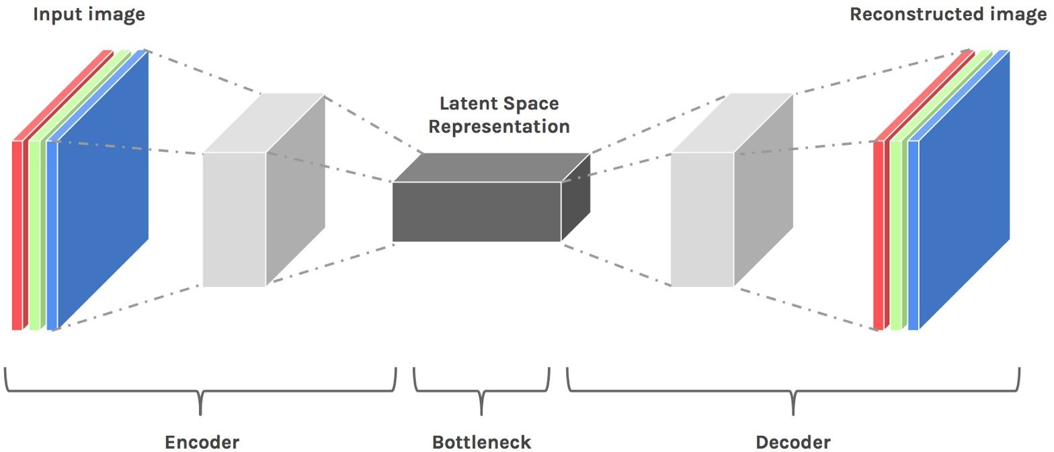
Methodology
Autoencoder
The autoencoder is made up of two function, the encoder function, which transforms input data into a new representation, and the decoder function, which returns the representation to the original domain.
Source: Towards Representation Learning for Image Retrieval

Slide 12
Training
Using an image dataset, train the convolutional autoencoder.
Create feature vectors for every dataset image (output of the encoder, or the latent-space representation, will serve as our feature vector for a particular image)
Calculate the distance between two vectors to compare them. Pictures closer together will resemble one another more than images farther apart.
Use the autoencoder for picture retrieval to analyse the results.

Slide 13
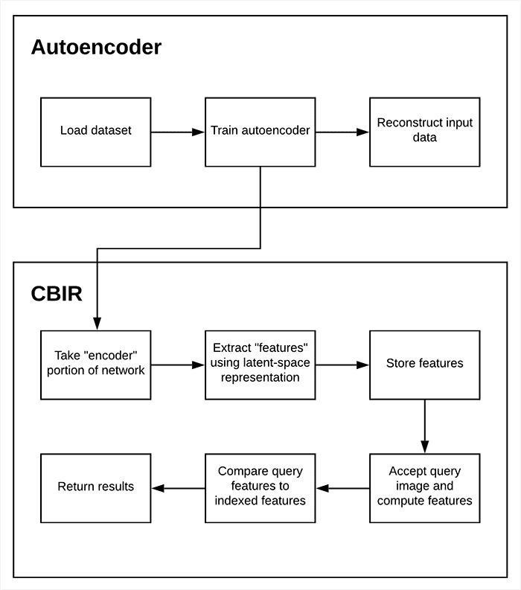
Source: Autoencoders for Content-based Image Retrieval

Slide 14
References
[1] Yixin Chen, J.Z. Wang and R. Krovetz. CLUE: cluster-based retrieval of images by unsupervised learning. 2005
[2] Y. Chen, J.Z. Wang and R. Krovetz . An unsupervised learning approach to content-based image retrieval. 2003
[3] K Venkataravana Nayak, J Arunalatha and K Venugopal. IR-FF-kNN: Image Retrieval Using Feature Fusion with k-Nearest Neighbour Classifier
[4] P.A.Charde and S.D.Lokhande. Classification Using K Nearest Neighbor for Brain Image Retrieval. 2011
[5] Xinyi Wang, Yajing Xu, Haitao Yang, Si Li. Unsupervised Image Retrieval with Mask-based Prominent Feature Accumulation. 2019
,

