Slide 1
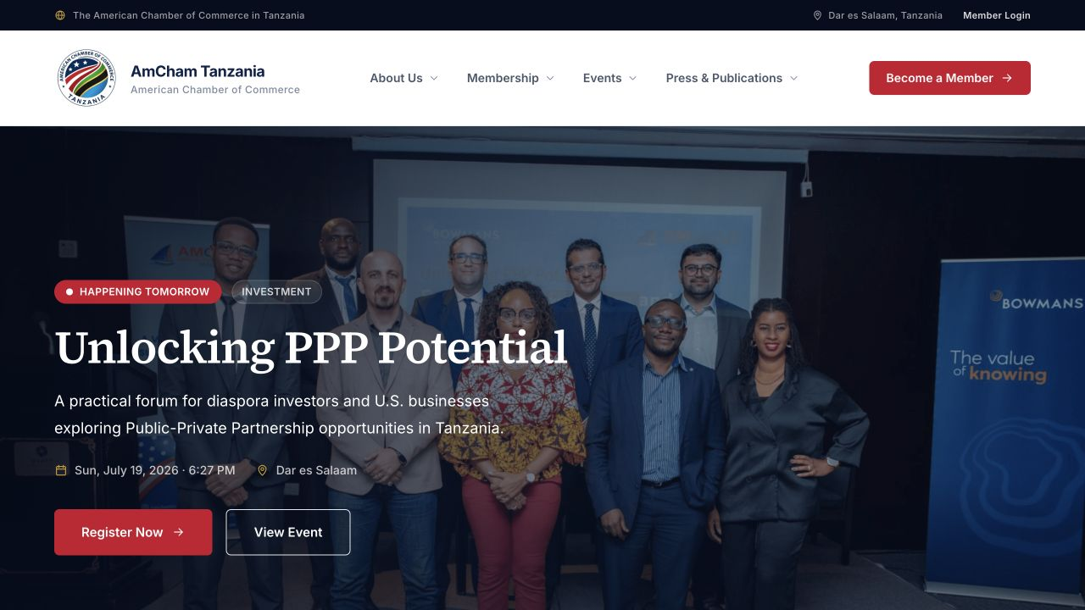

IMPLEMENTED • AWAITING APPROVAL
AMCHAM Tanzania
Digital Platform
Website proposal and implementation proof
A modern public website, member workspace and Secretariat command centre—built as one connected platform and ready to be hosted after approval.
Prepared for AMCHAM Tanzania • July 2026

Slide 2
AMCHAM TANZANIA
02
THE PROPOSITION
Not a concept. A working implementation.
01
Public experience
Responsive pages for membership, events, news, resources, galleries and company discovery.
02
Member self-service
A secure company workspace for profiles, submissions and documents.
03
Secretariat control
Publishing, approvals, uploads and member operations from one administration hub.
Every screen shown was captured from the completed working build, currently awaiting approval and hosting.

Slide 3
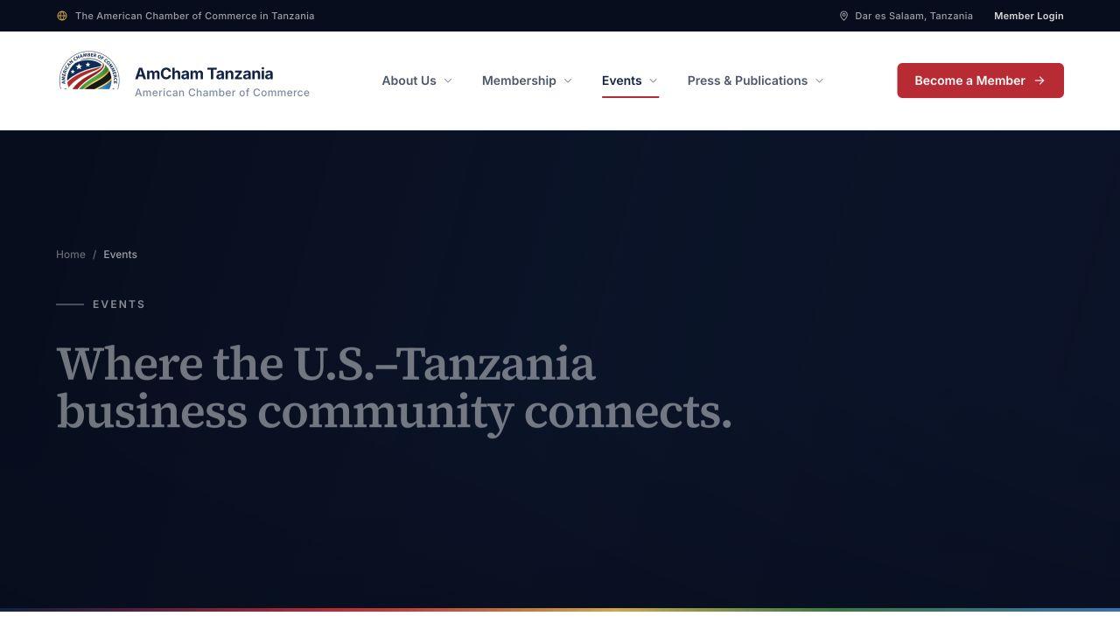
AMCHAM TANZANIA
03
PUBLIC EXPERIENCE
A confident front door for trade and membership.
Clear navigation turns AMCHAM’s value into visible pathways: discover, participate, join and return.
EVENTS
HOMEPAGE
Responsive layouts • Strong calls to action • Editorial storytelling • Clear member access

Slide 4
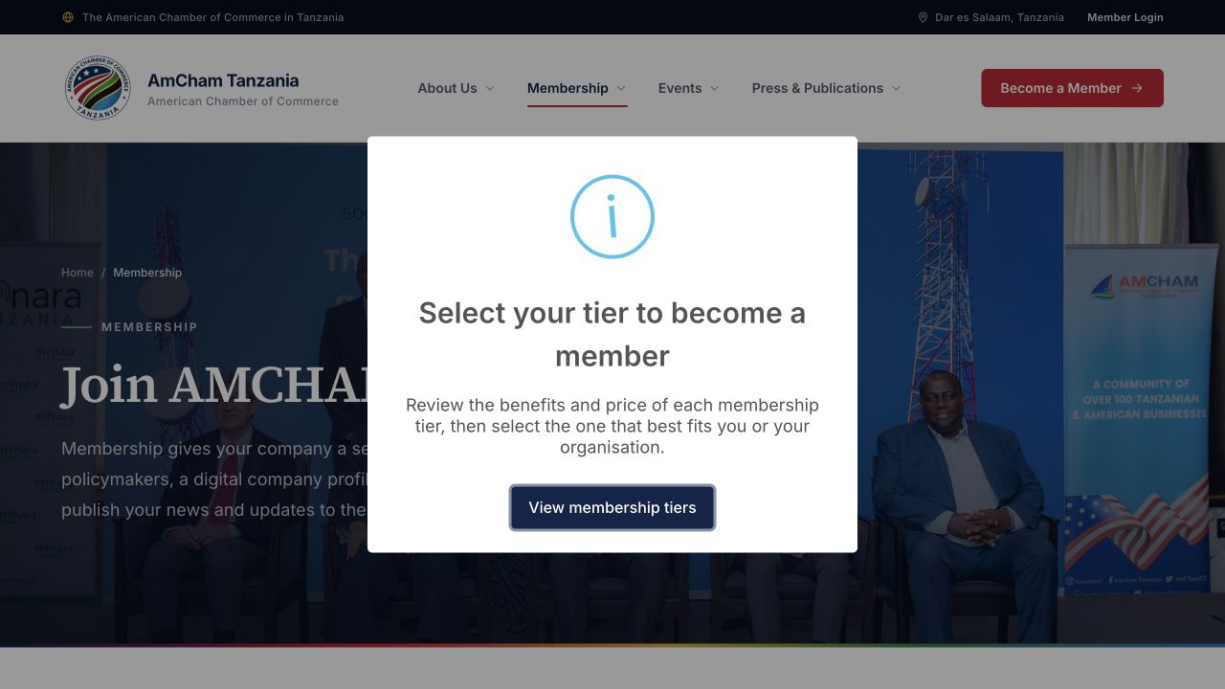
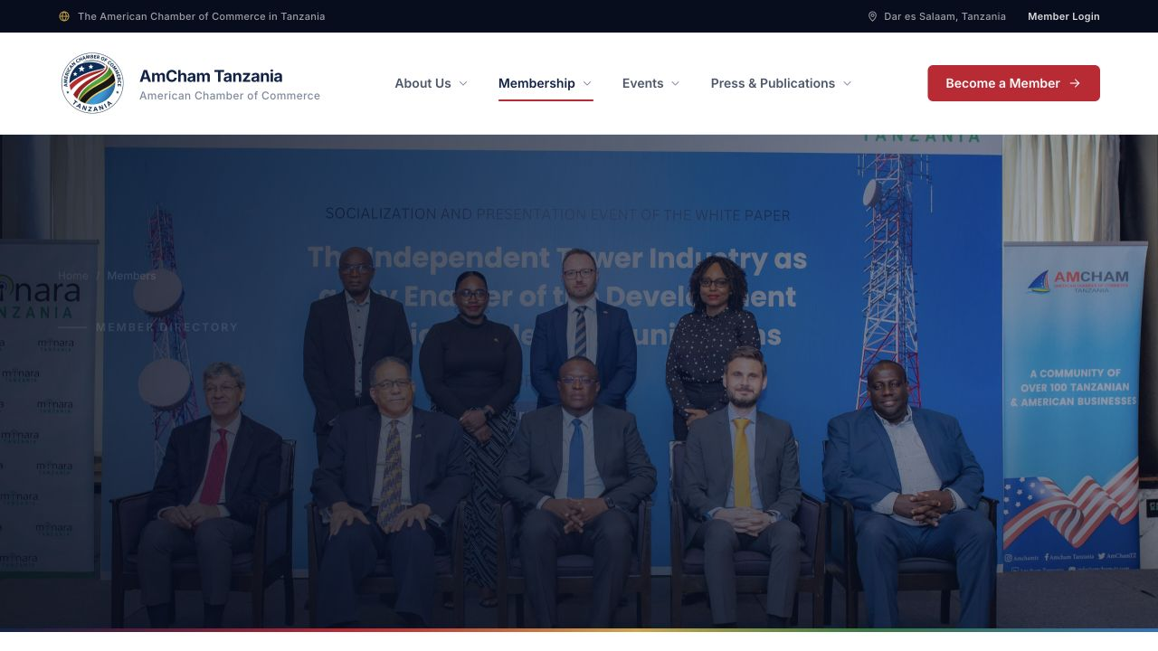
AMCHAM TANZANIA
04
MEMBERSHIP GROWTH
Membership becomes a guided digital journey.
Prospects can understand the proposition, explore the network and move directly toward application.
JOIN AMCHAM
MEMBER DIRECTORY
A clearer value story supports recruitment while the directory demonstrates the strength of the network.

Slide 5
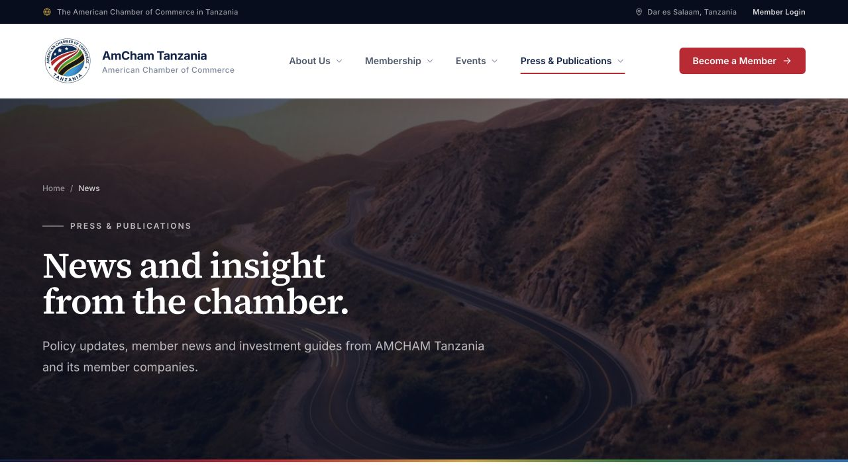
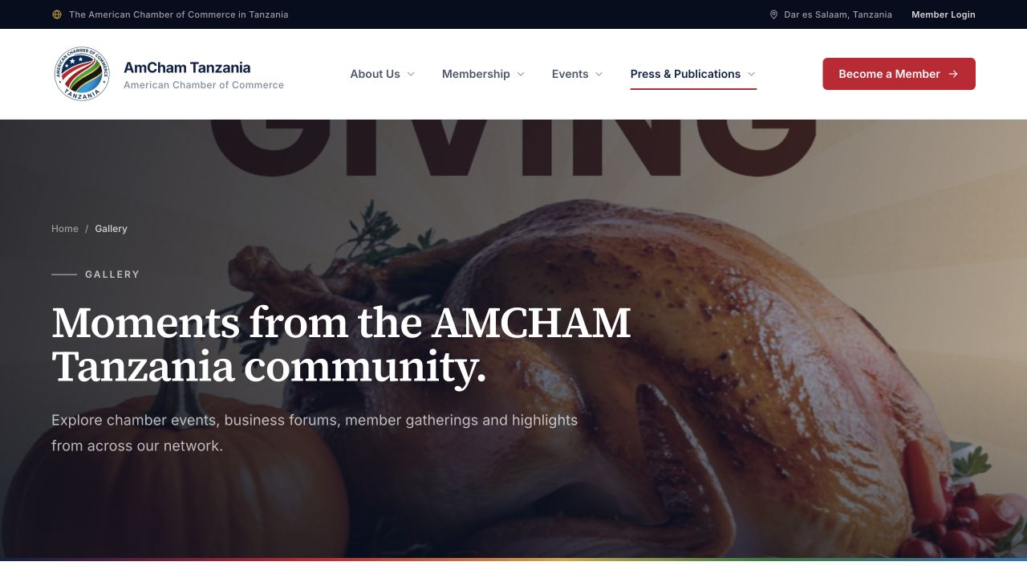
AMCHAM TANZANIA
05
CONTENT AND ENGAGEMENT
Events and publications stay visible—and current.
NEWS & INSIGHTS
EVENTS
GALLERY
Publish analysis, updates and member stories.
Promote participation and manage what is live.
Turn chamber activity into visual proof.
Newsletters and resources are uploaded by administrators and presented through the same trusted experience.

Slide 6
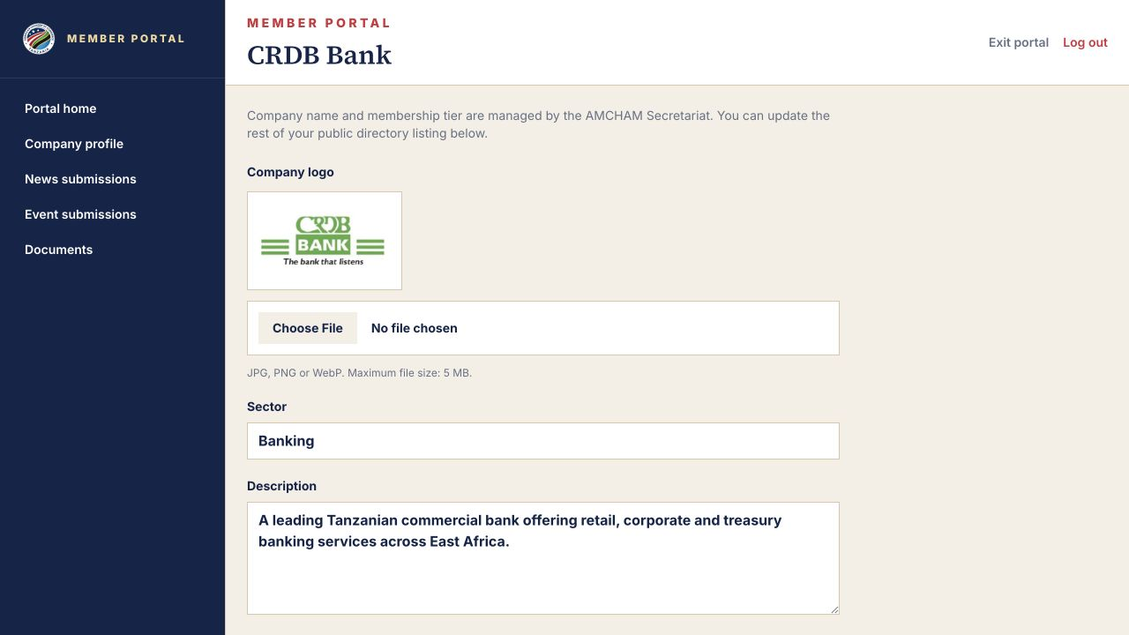
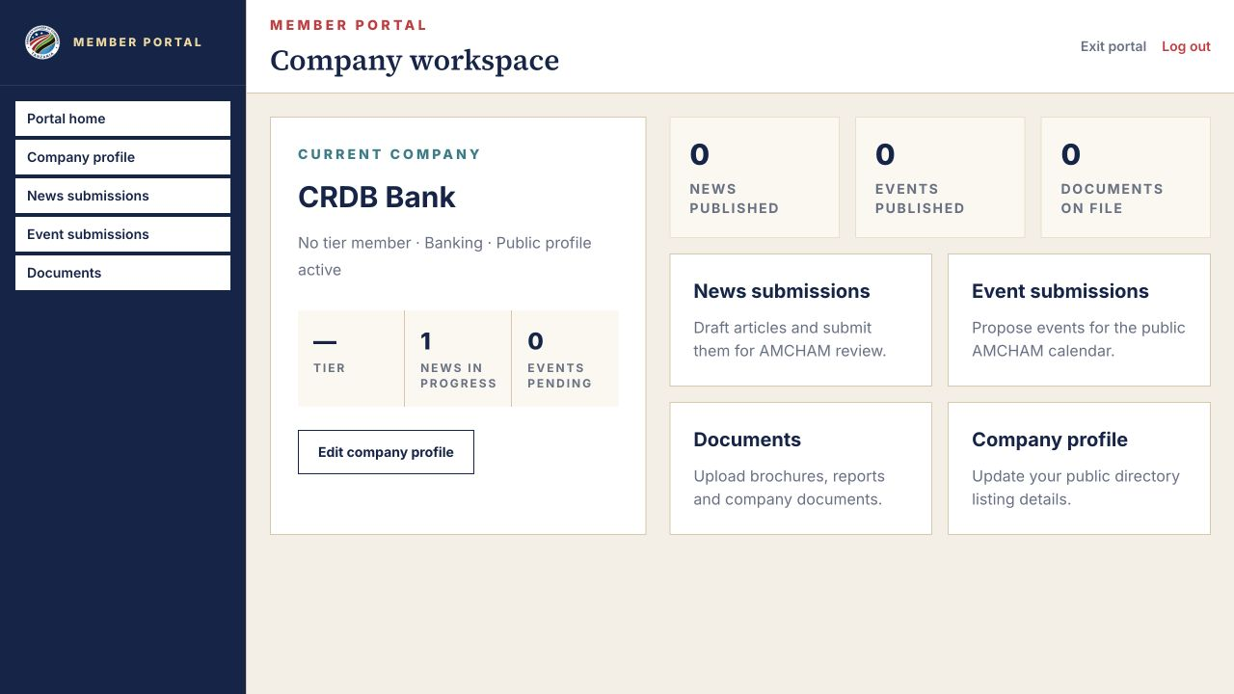
AMCHAM TANZANIA
06
MEMBER WORKSPACE
Members have a workspace of their own.
Each company can keep its presence accurate and contribute content through a controlled review process.
COMPANY PROFILE • NEWS SUBMISSIONS • EVENT SUBMISSIONS • DOCUMENTS
Member-created items remain governed: draft → submit → Secretariat review → publish.

Slide 7
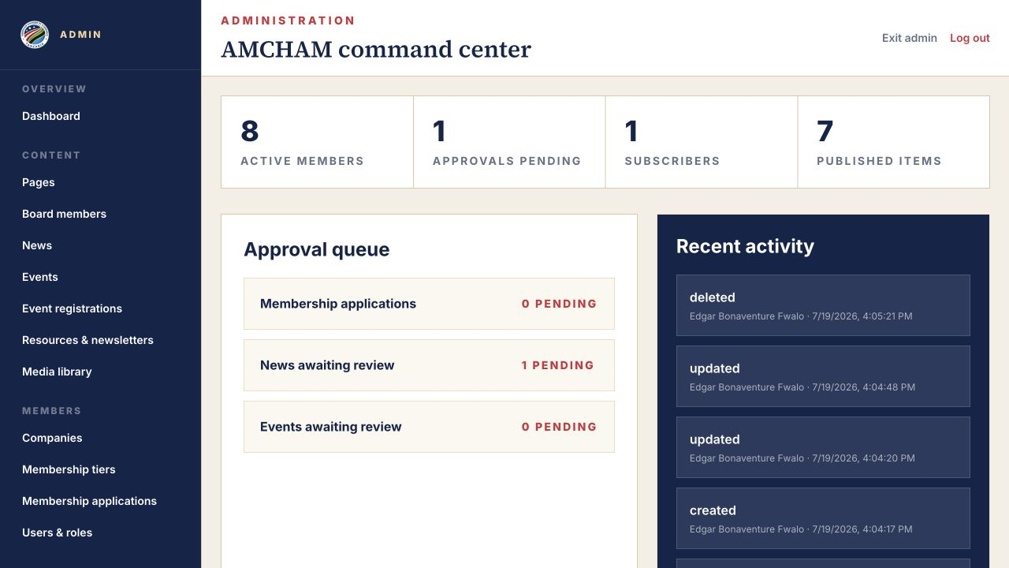
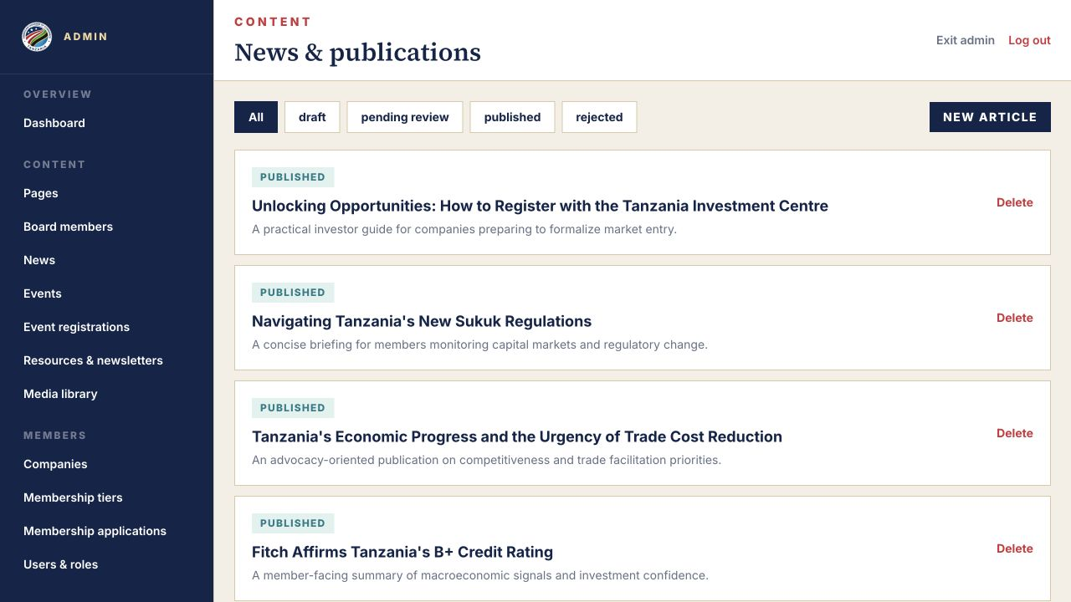
AMCHAM TANZANIA
07
SECRETARIAT COMMAND CENTRE
One place to operate the entire platform.
The administration area brings approvals, publishing, uploads and member oversight into a single workflow.
OVERVIEW & APPROVALS
CONTENT OPERATIONS
Designed for day-to-day Secretariat ownership—without depending on a developer for routine publishing.

Slide 8
AMCHAM TANZANIA
08
CONNECTED COMMUNICATIONS
One publishing action activates the network.
Approved content can move from the platform to the right audiences by email—consistently and once.
01
Publish or approve
02
Build the audience
03
Deliver by email
→
→
News, events and newsletters enter the live content stream.
Approved member-company addresses plus active subscribers are deduplicated.
A single queued notification links recipients back to the website.
EMAIL ONLY
Clear preferences, safe unsubscribe handling and no SMS claims in the dashboard.
The platform keeps the website as the source of truth while email brings audiences back to it.

Slide 9
AMCHAM TANZANIA
09
TRUST, VISIBILITY AND RESILIENCE
Built to be discoverable—and safe to operate.
SECURE IDENTIFIERS
SAFER SUBMISSIONS
CONTROLLED UPLOADS
UUID-backed records protect internal identity; public content uses readable slugs.
Validation, throttling and anti-spam controls protect forms and review queues.
Images and documents are validated, normalized and served from the public media structure.
ACCOUNT RECOVERY
SEARCH & SHARING
PUBLISHING HYGIENE
Forgot-password responses preserve privacy while serving legitimate users properly.
Canonical metadata, page descriptions, Open Graph images, favicon, sitemap and structured data.
Sanitized rich text, authorization checks and approval gates reduce content and access risk.
Security is treated as an operating discipline—not a one-time feature.

Slide 10
AMCHAM TANZANIA
10
COMMERCIAL INVESTMENT
A complete platform for TZS 4,000,000.
The investment covers the website implementation demonstrated throughout this proposal.
WEBSITE DEVELOPMENT
ONGOING MAINTENANCE
TZS
4,000,000
TZS 50,000
per month
One-time implementation fee
Continued technical maintenance after hosting.
APPROVAL UNLOCKS HOSTING AND GO-LIVE PREPARATION
Commercial proposal: TZS 4,000,000 implementation + TZS 50,000 monthly maintenance.

Slide 11
READY FOR APPROVAL
The build is ready. Approval brings it online.
The public experience, member workspace and Secretariat tools are complete in working form. Hosting begins once the proposal is approved.
NEXT
Approval • Hosting configuration • Content sign-off • Go-live
Developed by NextByte iCT Solutions • nextbyte.co.tz

