Slide 1

Introduction to Version Control
Mehmet Yiğit Avcı

Slide 2
Content
Version Control
Git Basics
Git Branching

Slide 3

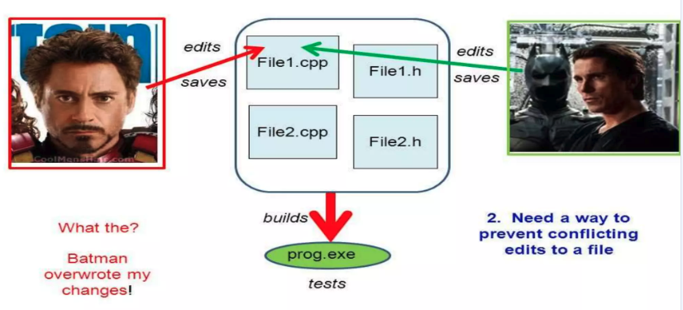
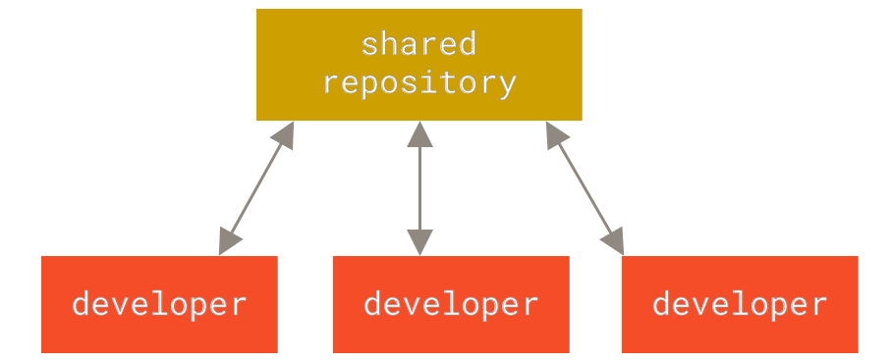
Version Control
Version control is a system that records changes to a file or set of files over time so that you can recall specific versions later.
It allows you to collaborate with other developers on same project without distortion.

Slide 4
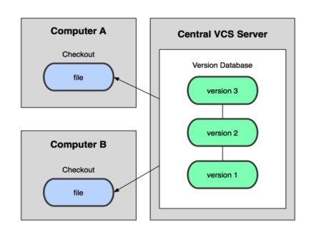
Centralized VS
In Subversion, CVS, Perforce, etc. A central server repository (repo) holds the "official copy" of the code – the server maintains the sole version history of the repo
• You make "checkouts" of it to your local copy – you make local modifications – your changes are not versioned
• When you're done, you "check in" back to the server – your checkin increments the repo's version

Slide 5
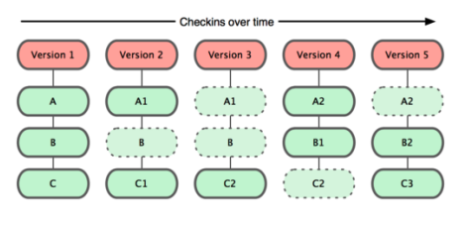
What is Git?
Git is a free, open-source, and distributed version control system (DVCS) that tracks changes in files.
With Git, every time you commit, or save the state of your project, Git basically takes a picture of what all your files look like at that moment and stores a reference to that snapshot
Notes:
When you do actions in Git, nearly all of them only add data to the Git database. It is hard to get the system to do anything that is not undoable or to make it erase data in any way. As with any VCS, you can lose or mess up changes you haven’t committed yet, but after you commit a snapshot into Git, it is very difficult to lose, especially if you regularly push your database to another repository.
This makes using Git a joy because we know we can experiment without the danger of severely screwing things up.

Slide 6
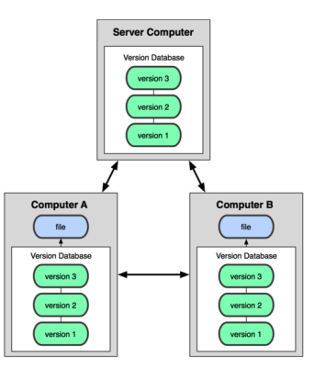
What is Git?
In git, mercurial, etc., you don't "checkout" from a central repo – you "clone" it and "pull" changes from it
Your local repo is a complete copy of everything on the remote server – yours is "just as good" as theirs
Many operations are local: – check in/out from local repo – commit changes to local repo – local repo keeps version history
When you're ready, you can "push" changes back to server
Notes:
When you do actions in Git, nearly all of them only add data to the Git database. It is hard to get the system to do anything that is not undoable or to make it erase data in any way. As with any VCS, you can lose or mess up changes you haven’t committed yet, but after you commit a snapshot into Git, it is very difficult to lose, especially if you regularly push your database to another repository.
This makes using Git a joy because we know we can experiment without the danger of severely screwing things up.

Slide 7
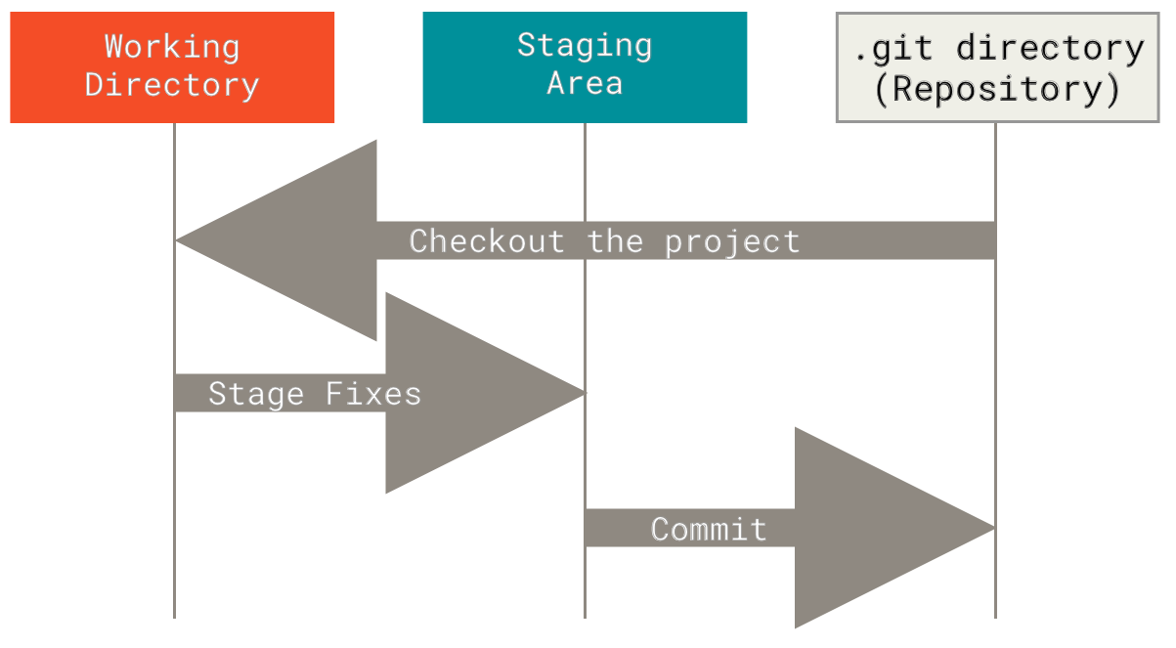
Git has three main stages
Git has three main states that your files can reside in: modified, staged, and committed:
Modified means that you have changed the file but have not committed it to your database yet.
Staged means that you have marked a modified file in its current version to go into your next commit snapshot.
Committed means that the data is safely stored in your local database.
Notes:
The working tree is a single checkout of one version of the project. These files are pulled out of the compressed database in the Git directory and placed on disk for you to use or modify.
The staging area is a file, generally contained in your Git directory, that stores information about what will go into your next commit. Its technical name in Git parlance is the “index”, but the phrase “staging area” works just as well.
The Git directory is where Git stores the metadata and object database for your project. This is the most important part of Git, and it is what is copied when you clone a repository from another computer.

Slide 8
Basic Git Workflow
1. You modify files in your working tree.
2. You selectively stage just those changes you want to be part of your next commit, which adds only those changes to the staging area.
3. You do a commit, which takes the files as they are in the staging area and stores that snapshot permanently to your Git directory.
Notes:
If a particular version of a file is in the Git directory, it’s considered committed. If it has been modified and was added to the staging area, it is staged. And if it was changed since it was checked out but has not been staged, it is modified.

Slide 9
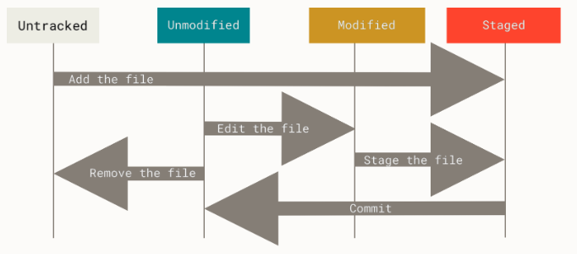
Basic Git Workflow
Notes:
If a particular version of a file is in the Git directory, it’s considered committed. If it has been modified and was added to the staging area, it is staged. And if it was changed since it was checked out but has not been staged, it is modified.

Slide 10
Hands ON: Install Git
Installing on Linux
$ sudo dnf install git-all
If you’re on a Debian-based distribution, such as Ubuntu, try apt:
$ sudo apt install git-all
Installing on macOS
$ git –version
https://git-scm.com/download/mac.
Installing on Windows
https://git-scm.com/download/win
$ git config --global user.name ”Yigit Avci"
$ git config --global user.email yigitavci@example.com
Notes:
If a particular version of a file is in the Git directory, it’s considered committed. If it has been modified and was added to the staging area, it is staged. And if it was changed since it was checked out but has not been staged, it is modified.

Slide 11
Creating a Repository
$ mkdir version_control
$ cd version_control
$ Create a file named as init.py
$ git init: This creates a new subdirectory named .git that contains all of your necessary repository files — a Git repository skeleton.
$ git add init.py This basically stages your changes
$ git commit -m 'Initial project version'
Notes:
If a particular version of a file is in the Git directory, it’s considered committed. If it has been modified and was added to the staging area, it is staged. And if it was changed since it was checked out but has not been staged, it is modified.

Slide 12

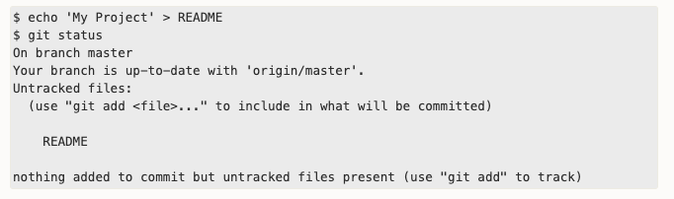
Cloning a Repository
$ git clone github.com/slatifi/drive-coding
$ cd drive-coding/lesson02-versioncontrol/playground
Notes:
You can see that your new README file is untracked, because it’s under the “Untracked files” heading in your status output. Untracked basically means that Git sees a file you didn’t have in the previous snapshot (commit), and which hasn’t yet been staged; Git won’t start including it in your commit snapshots until you explicitly tell it to do so. It does this so you don’t accidentally begin including generated binary files or other files that you did not mean to include. You do want to start including README, so let’s start tracking the file.

Slide 13
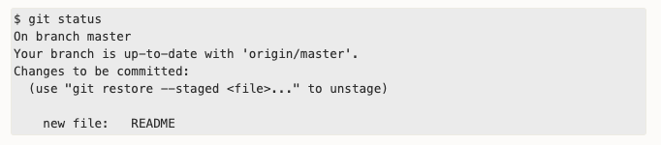
Touch README $ git add README
Notes:
You can tell that it’s staged because it’s under the “Changes to be committed” heading. If you commit at this point, the version of the file at the time you ran git add is what will be in the subsequent historical snapshot. You may recall that when you ran git init earlier, you then ran git add <files> — that was to begin tracking files in your directory. The git add command takes a path name for either a file or a directory; if it’s a directory, the command adds all the files in that directory recursively.

Slide 14
Ignore Files
Often, you’ll have a class of files that you don’t want Git to automatically add or even show you as being untracked. These are generally automatically generated files such as log files or files produced by your build system. In such cases, you can create a file listing patterns to match them named .gitignore.
$ touch .gitignore
$ echo *.nii > .gitignore
Notes:
You can see that your new README file is untracked, because it’s under the “Untracked files” heading in your status output. Untracked basically means that Git sees a file you didn’t have in the previous snapshot (commit), and which hasn’t yet been staged; Git won’t start including it in your commit snapshots until you explicitly tell it to do so. It does this so you don’t accidentally begin including generated binary files or other files that you did not mean to include. You do want to start including README, so let’s start tracking the file.

Slide 15

Comitting
Now that you are happy with your changes and staged everyting with git add. Now it is time to be starting to be careful.
First check the status of your staged changes with git status
Check your changes are correct.
Now ready to commit your changes!
Notes:
You can see that your new README file is untracked, because it’s under the “Untracked files” heading in your status output. Untracked basically means that Git sees a file you didn’t have in the previous snapshot (commit), and which hasn’t yet been staged; Git won’t start including it in your commit snapshots until you explicitly tell it to do so. It does this so you don’t accidentally begin including generated binary files or other files that you did not mean to include. You do want to start including README, so let’s start tracking the file.

Slide 16
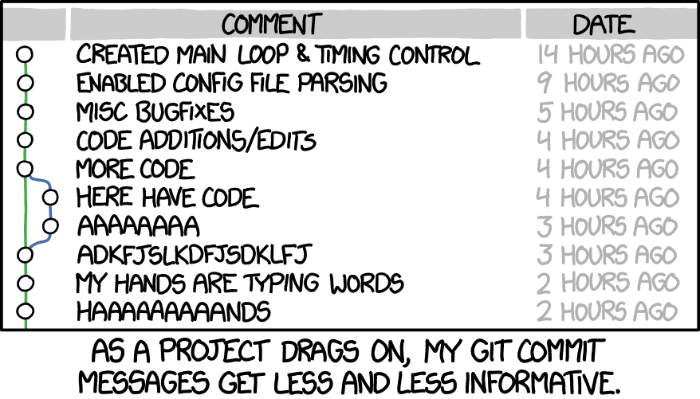
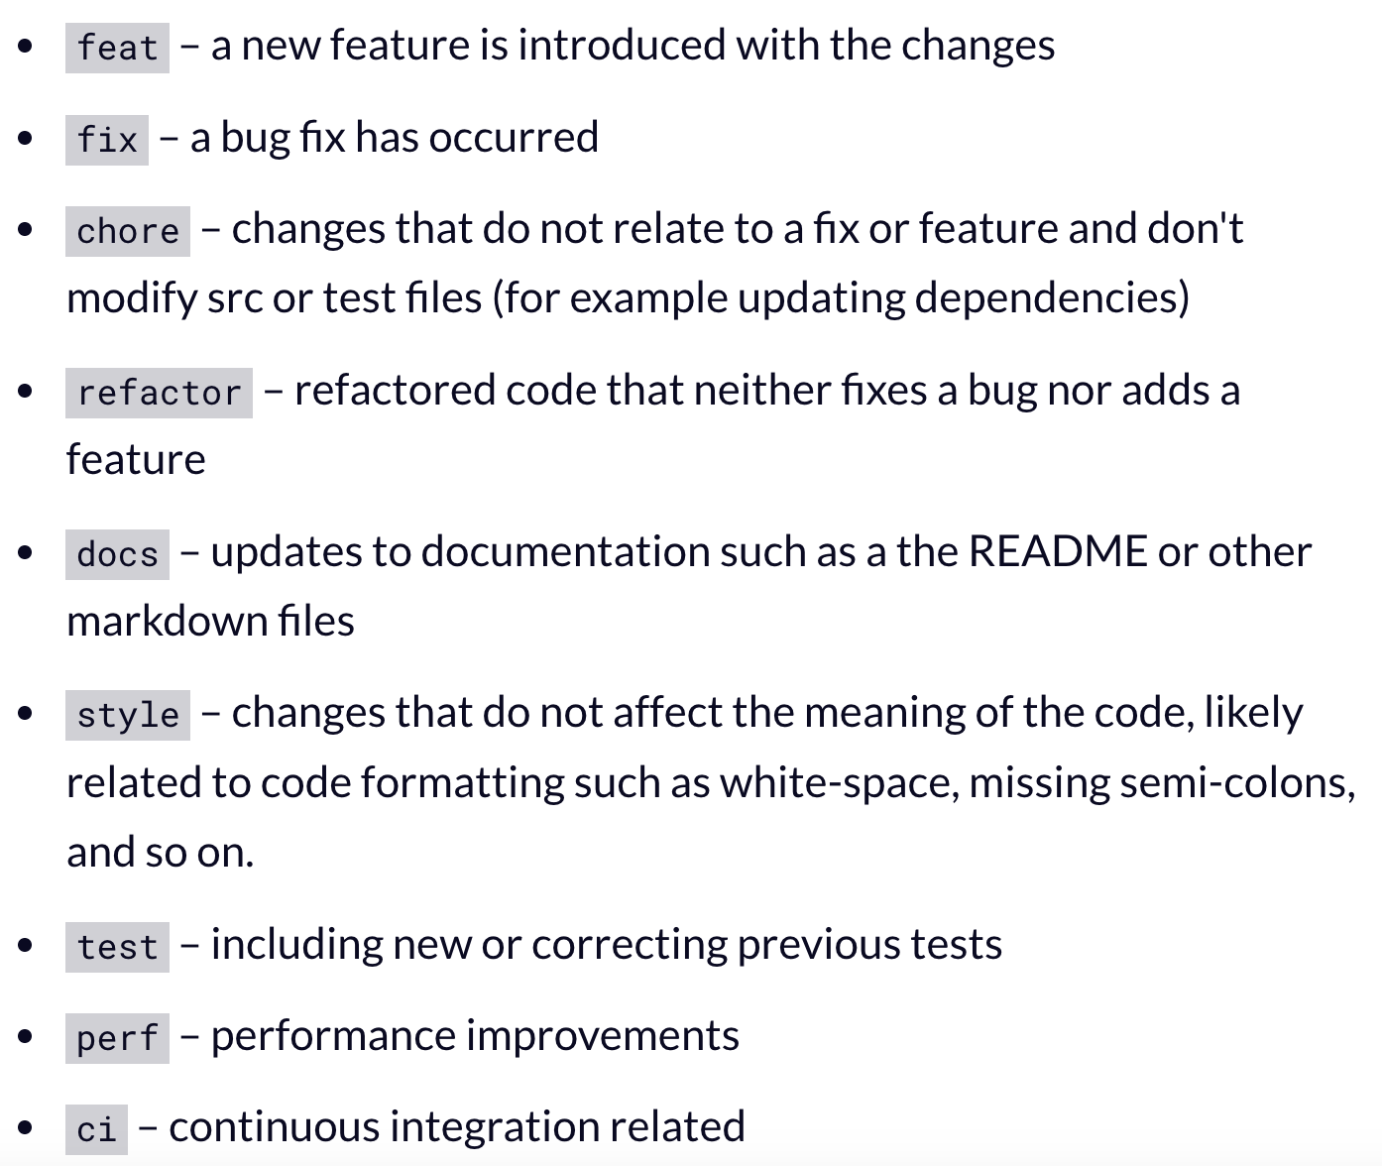
Comitting: Messages
Set meaningful commit messages.
Especially working with another people!
Examples:
- Git commit –m ”fix: fixed bug on nii conversion
Git commit –m ”feat: added skull stripping”
Git commit –m “chore: did daily task x”
Notes:
You can see that your new README file is untracked, because it’s under the “Untracked files” heading in your status output. Untracked basically means that Git sees a file you didn’t have in the previous snapshot (commit), and which hasn’t yet been staged; Git won’t start including it in your commit snapshots until you explicitly tell it to do so. It does this so you don’t accidentally begin including generated binary files or other files that you did not mean to include. You do want to start including README, so let’s start tracking the file.

Slide 17
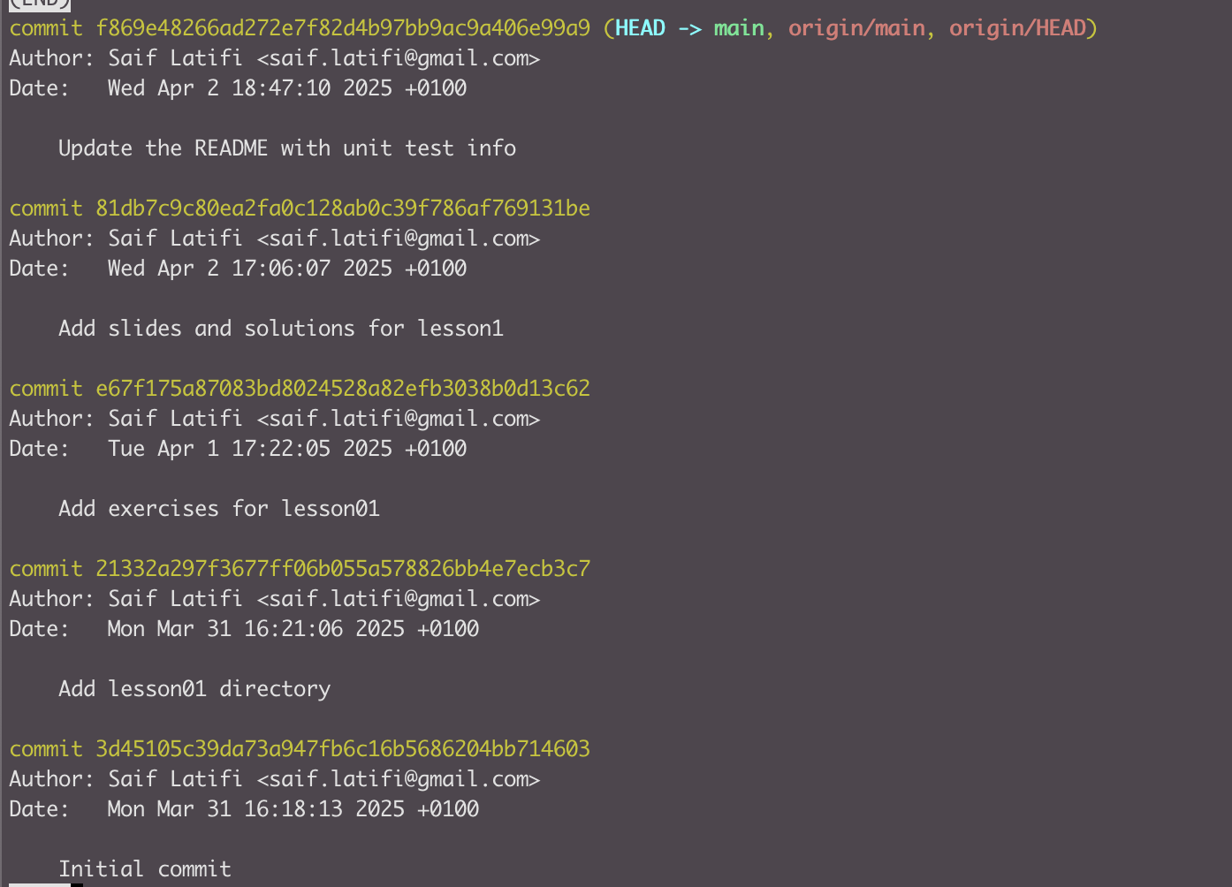
Commit History
To view the commit history: $ git log

Slide 18
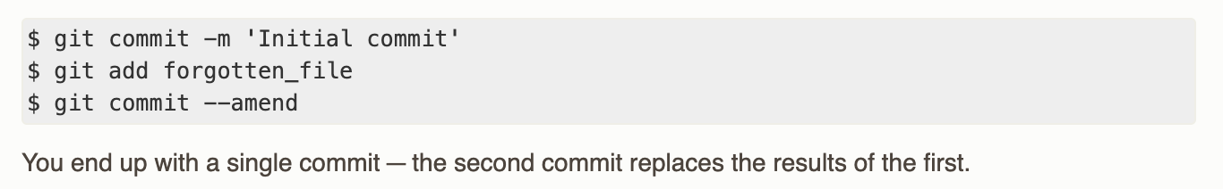
Undoing Things
!! Be careful with undoing things, you may lose your work!!
If you want to redo that commit, make the additional changes you forgot, stage them, and commit again using the --amend option:
$ git commit –amend
This command takes your staging area and uses it for the commit. If you’ve made no changes since your last commit (for instance, you run this command immediately after your previous commit), then your snapshot will look exactly the same, and all you’ll change is your commit message.

Slide 19
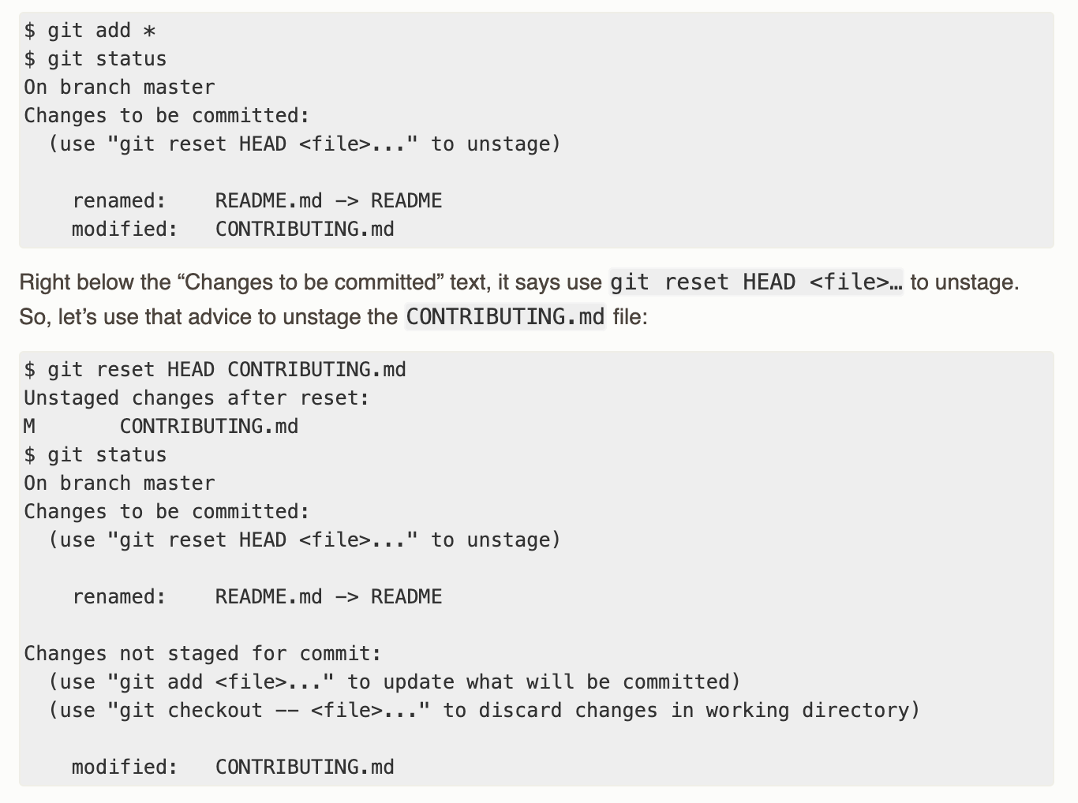
Undoing Things

Slide 20
Push your changes to your branch
When you are done with your changes and want to save them in your repository, just -carefully- do
$git push

Slide 21
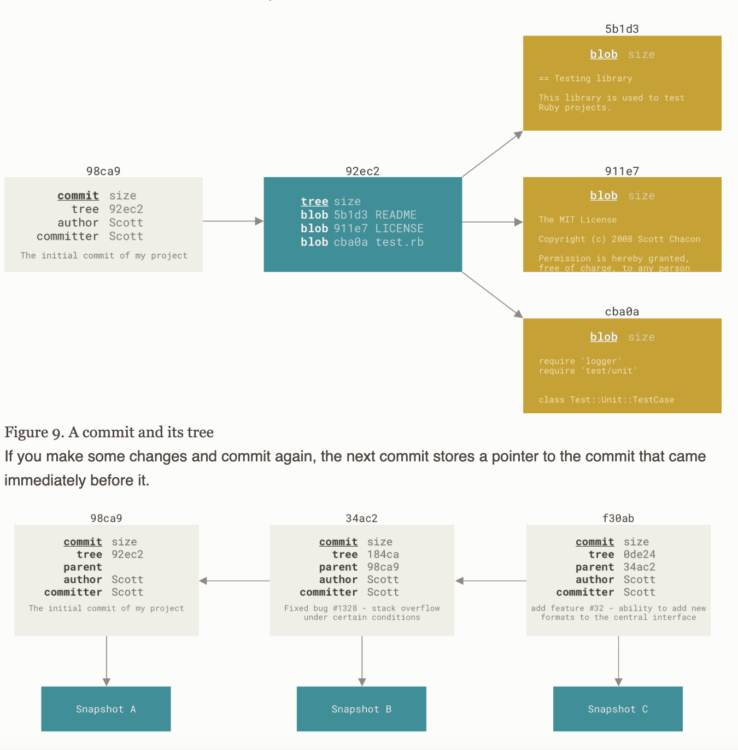
Git Branching
Nearly every VCS has some form of branching support. Branching means you diverge from the main line of development and continue to do work without messing with that main line.
A branch in Git is simply a lightweight movable pointer to one of these commits. The default branch name in Git is master. As you start making commits, you’re given a master branch that points to the last commit you made. Every time you commit, the master branch pointer moves forward automatically.
Notes:
When you create the commit by running git commit, Git checksums each subdirectory (in this case, just the root project directory) and stores them as a tree object in the Git repository. Git then creates a commit object that has the metadata and a pointer to the root project tree so it can re-create that snapshot when needed.
Your Git repository now contains five objects: three blobs (each representing the contents of one of the three files), one tree that lists the contents of the directory and specifies which file names are stored as which blobs, and one commit with the pointer to that root tree and all the commit metadata.

Slide 22
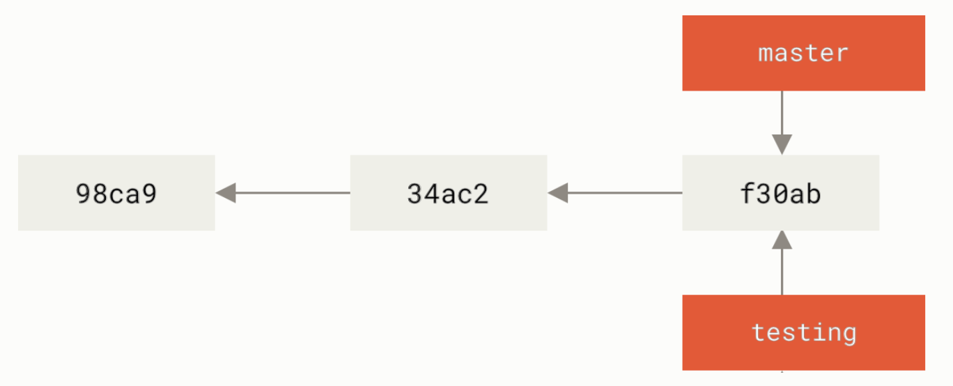
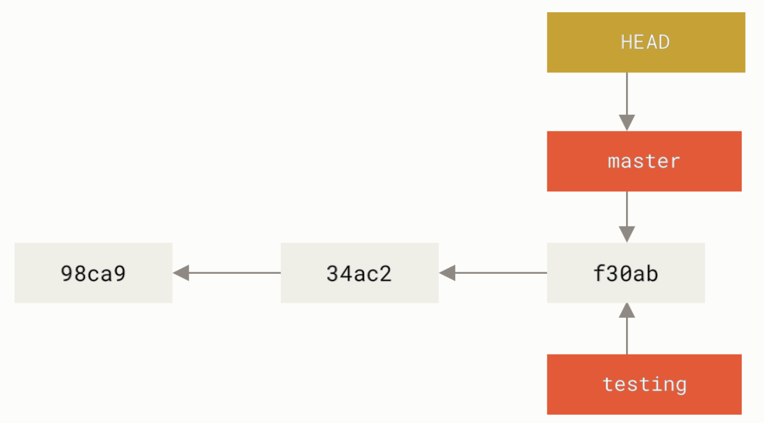
Git Branching
What happens when you create a new branch? Well, doing so creates a new pointer for you to move around.
$ git branch testing
How does Git know what branch you’re currently on? It keeps a special pointer called HEAD. In Git, this is a pointer to the local branch you’re currently on. In this case, you’re still on master. The git branch command only created a new branch — it didn’t switch to that branch.
Notes:
When you create the commit by running git commit, Git checksums each subdirectory (in this case, just the root project directory) and stores them as a tree object in the Git repository. Git then creates a commit object that has the metadata and a pointer to the root project tree so it can re-create that snapshot when needed.
Your Git repository now contains five objects: three blobs (each representing the contents of one of the three files), one tree that lists the contents of the directory and specifies which file names are stored as which blobs, and one commit with the pointer to that root tree and all the commit metadata.

Slide 23
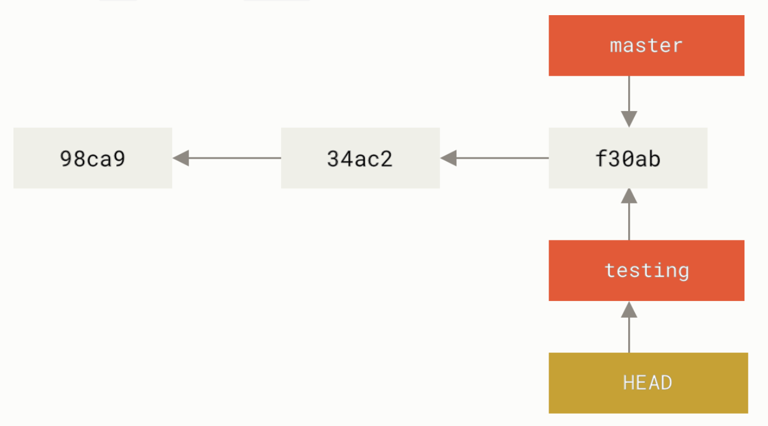
Switching Branches
$ git checkout testing: This moves HEAD to point to the testing branch.
Notes:
When you create the commit by running git commit, Git checksums each subdirectory (in this case, just the root project directory) and stores them as a tree object in the Git repository. Git then creates a commit object that has the metadata and a pointer to the root project tree so it can re-create that snapshot when needed.
Your Git repository now contains five objects: three blobs (each representing the contents of one of the three files), one tree that lists the contents of the directory and specifies which file names are stored as which blobs, and one commit with the pointer to that root tree and all the commit metadata.

Slide 24
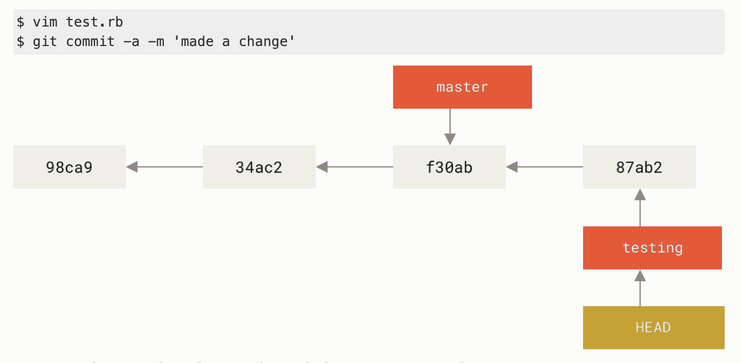
Notes:
When you create the commit by running git commit, Git checksums each subdirectory (in this case, just the root project directory) and stores them as a tree object in the Git repository. Git then creates a commit object that has the metadata and a pointer to the root project tree so it can re-create that snapshot when needed.
Your Git repository now contains five objects: three blobs (each representing the contents of one of the three files), one tree that lists the contents of the directory and specifies which file names are stored as which blobs, and one commit with the pointer to that root tree and all the commit metadata.

Slide 25
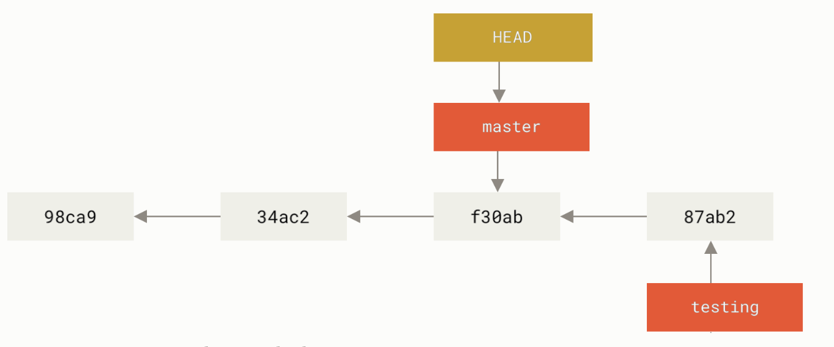
$ git checkout master
Notes:
When you create the commit by running git commit, Git checksums each subdirectory (in this case, just the root project directory) and stores them as a tree object in the Git repository. Git then creates a commit object that has the metadata and a pointer to the root project tree so it can re-create that snapshot when needed.
Your Git repository now contains five objects: three blobs (each representing the contents of one of the three files), one tree that lists the contents of the directory and specifies which file names are stored as which blobs, and one commit with the pointer to that root tree and all the commit metadata.

Slide 26
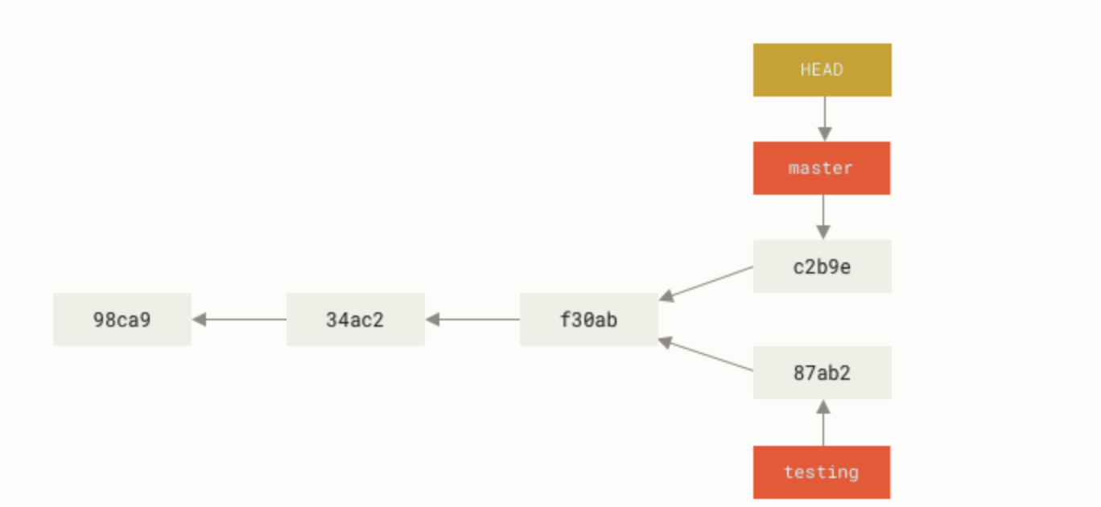
Notes:
When you create the commit by running git commit, Git checksums each subdirectory (in this case, just the root project directory) and stores them as a tree object in the Git repository. Git then creates a commit object that has the metadata and a pointer to the root project tree so it can re-create that snapshot when needed.
Your Git repository now contains five objects: three blobs (each representing the contents of one of the three files), one tree that lists the contents of the directory and specifies which file names are stored as which blobs, and one commit with the pointer to that root tree and all the commit metadata.

Slide 27
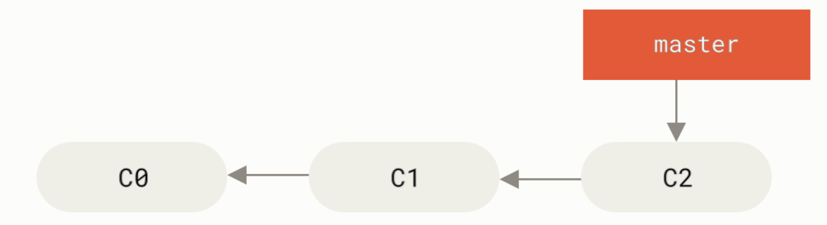
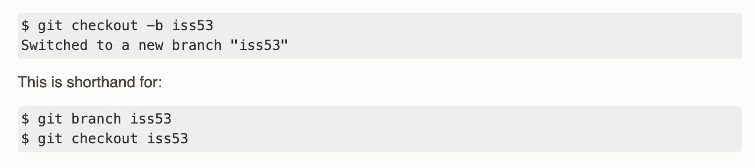
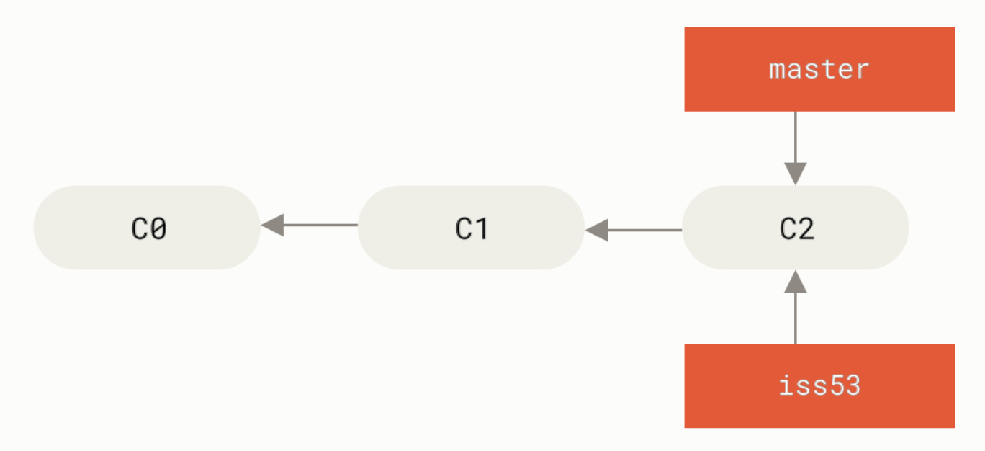
Branching and merging example
Notes:
When you create the commit by running git commit, Git checksums each subdirectory (in this case, just the root project directory) and stores them as a tree object in the Git repository. Git then creates a commit object that has the metadata and a pointer to the root project tree so it can re-create that snapshot when needed.
Your Git repository now contains five objects: three blobs (each representing the contents of one of the three files), one tree that lists the contents of the directory and specifies which file names are stored as which blobs, and one commit with the pointer to that root tree and all the commit metadata.

Slide 28
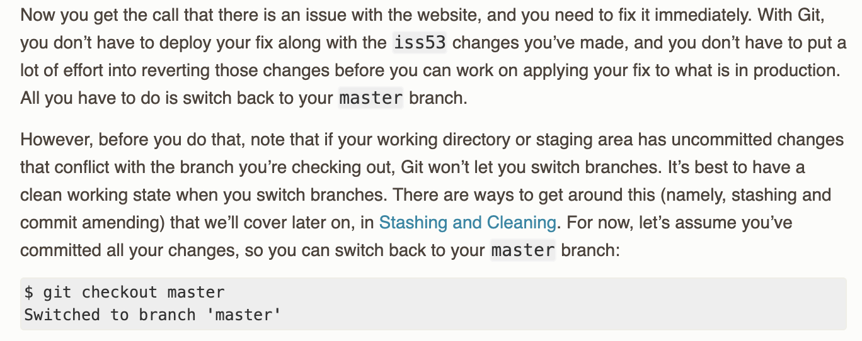
Notes:
When you create the commit by running git commit, Git checksums each subdirectory (in this case, just the root project directory) and stores them as a tree object in the Git repository. Git then creates a commit object that has the metadata and a pointer to the root project tree so it can re-create that snapshot when needed.
Your Git repository now contains five objects: three blobs (each representing the contents of one of the three files), one tree that lists the contents of the directory and specifies which file names are stored as which blobs, and one commit with the pointer to that root tree and all the commit metadata.

Slide 29
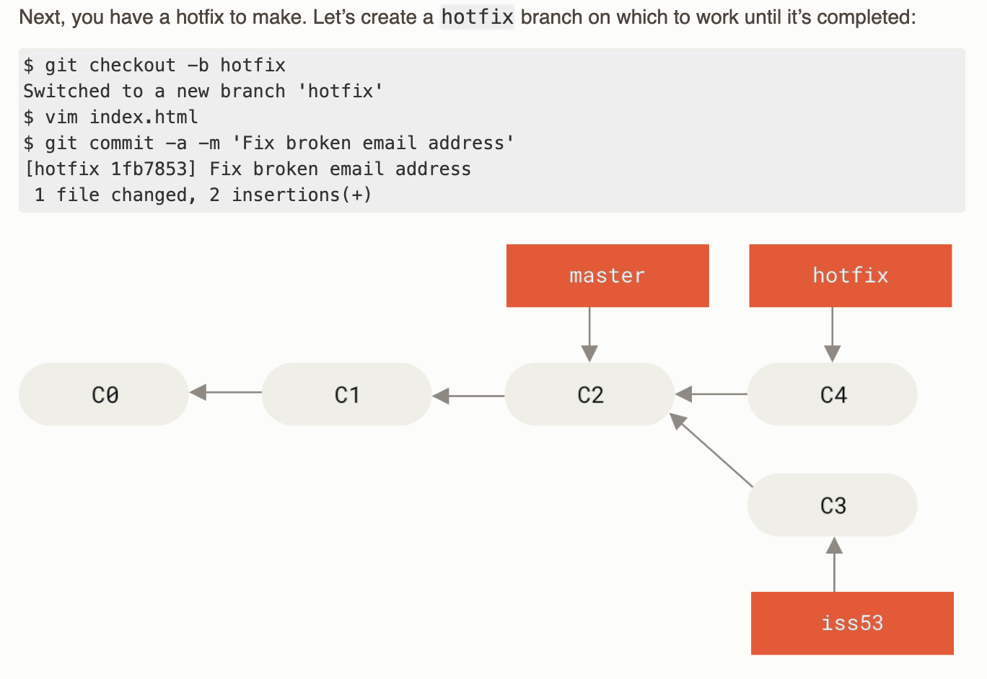
Notes:
When you create the commit by running git commit, Git checksums each subdirectory (in this case, just the root project directory) and stores them as a tree object in the Git repository. Git then creates a commit object that has the metadata and a pointer to the root project tree so it can re-create that snapshot when needed.
Your Git repository now contains five objects: three blobs (each representing the contents of one of the three files), one tree that lists the contents of the directory and specifies which file names are stored as which blobs, and one commit with the pointer to that root tree and all the commit metadata.

Slide 30
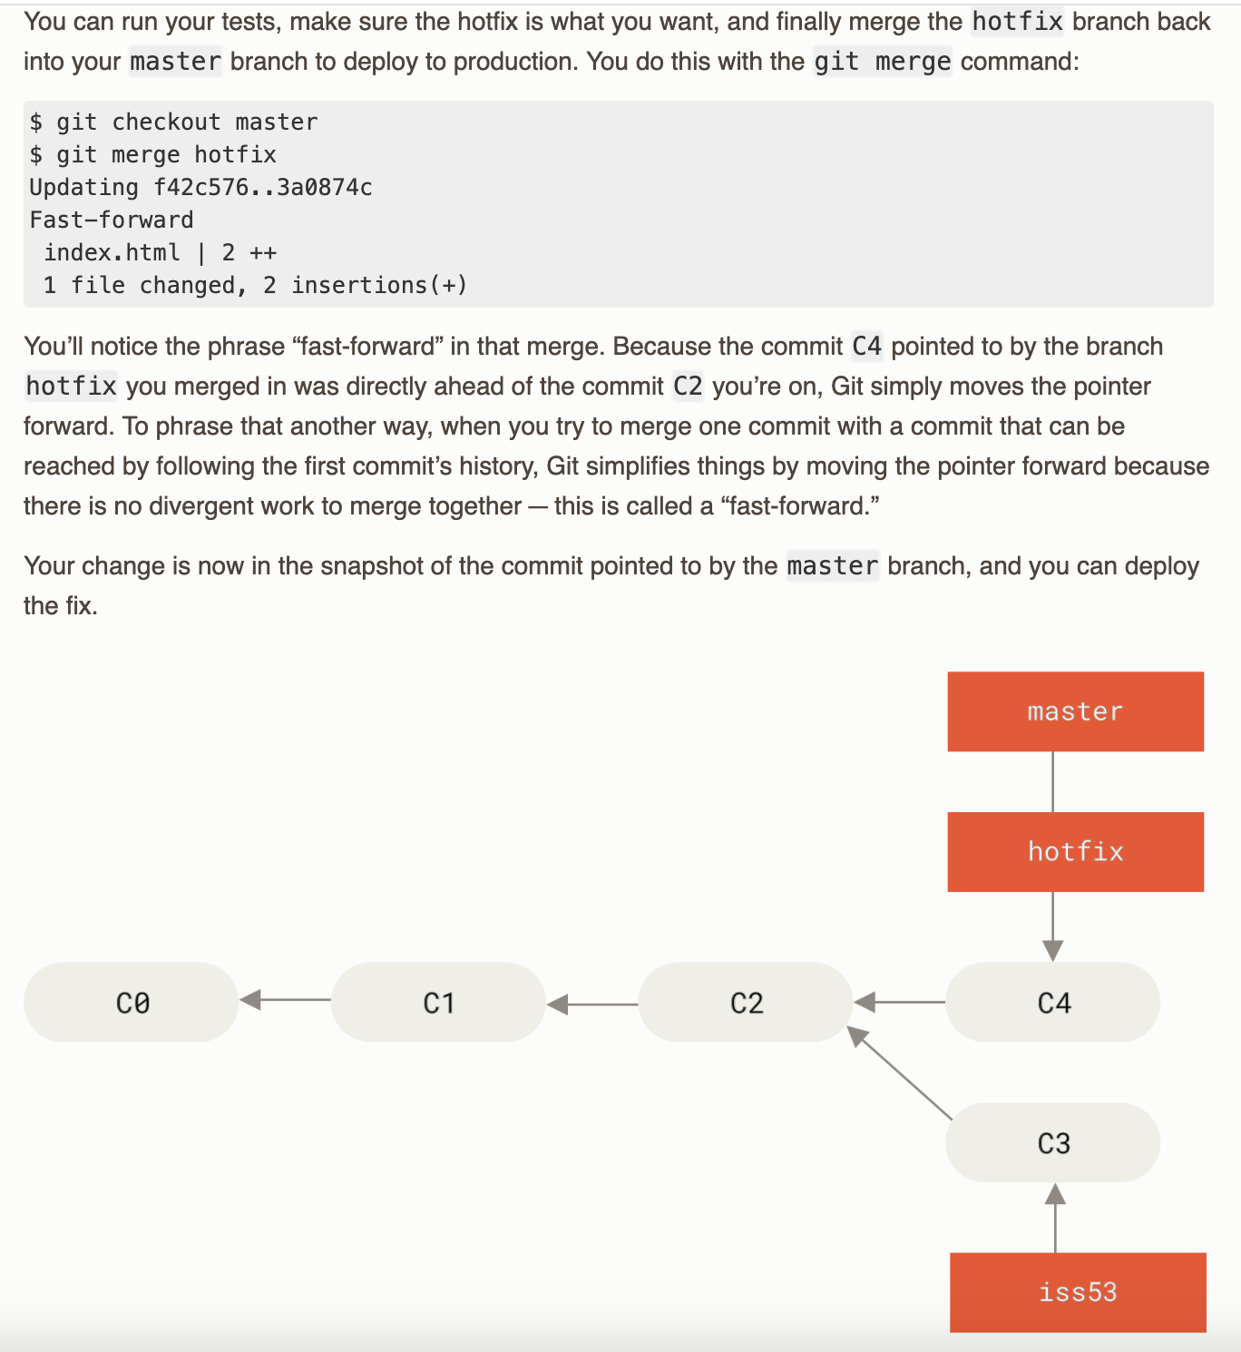
Notes:
When you create the commit by running git commit, Git checksums each subdirectory (in this case, just the root project directory) and stores them as a tree object in the Git repository. Git then creates a commit object that has the metadata and a pointer to the root project tree so it can re-create that snapshot when needed.
Your Git repository now contains five objects: three blobs (each representing the contents of one of the three files), one tree that lists the contents of the directory and specifies which file names are stored as which blobs, and one commit with the pointer to that root tree and all the commit metadata.

Slide 31
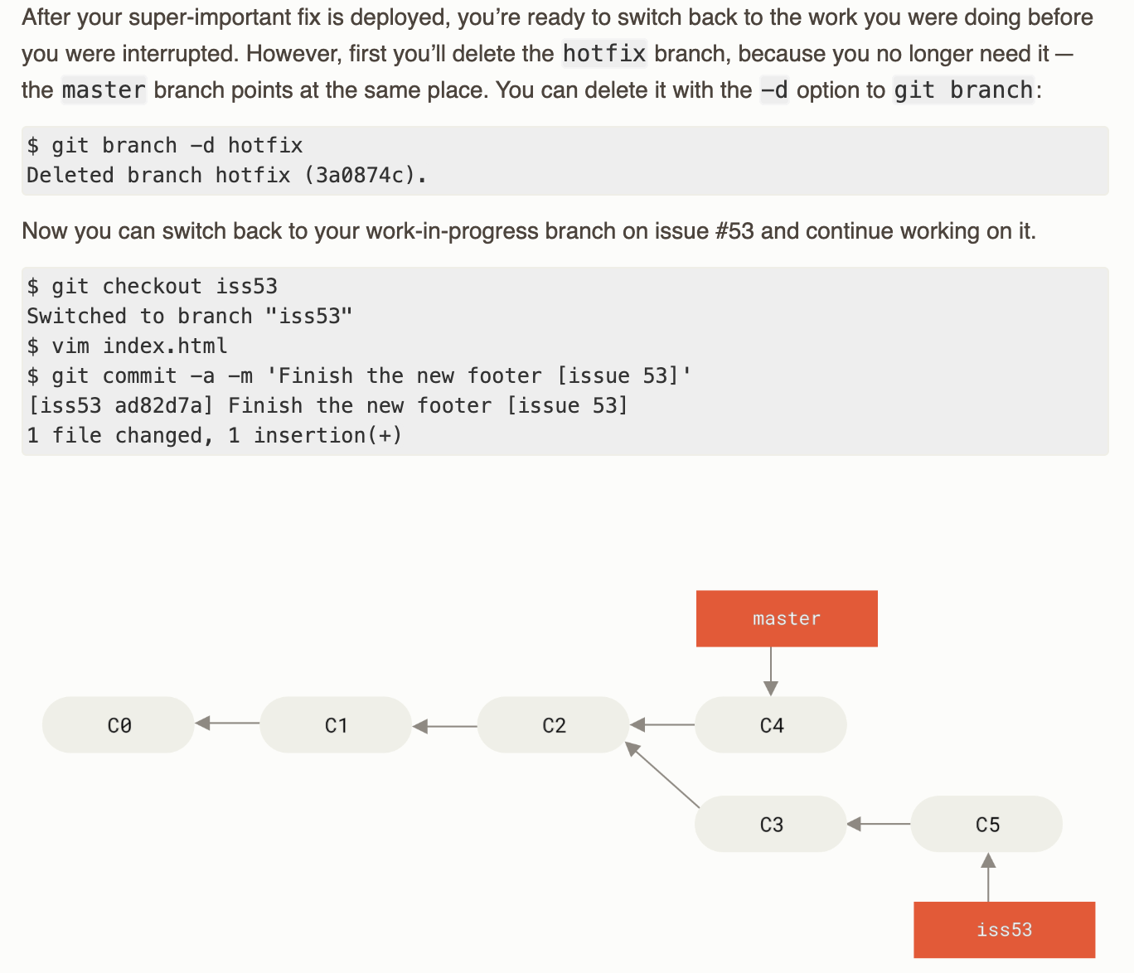
Notes:
When you create the commit by running git commit, Git checksums each subdirectory (in this case, just the root project directory) and stores them as a tree object in the Git repository. Git then creates a commit object that has the metadata and a pointer to the root project tree so it can re-create that snapshot when needed.
Your Git repository now contains five objects: three blobs (each representing the contents of one of the three files), one tree that lists the contents of the directory and specifies which file names are stored as which blobs, and one commit with the pointer to that root tree and all the commit metadata.

Slide 32
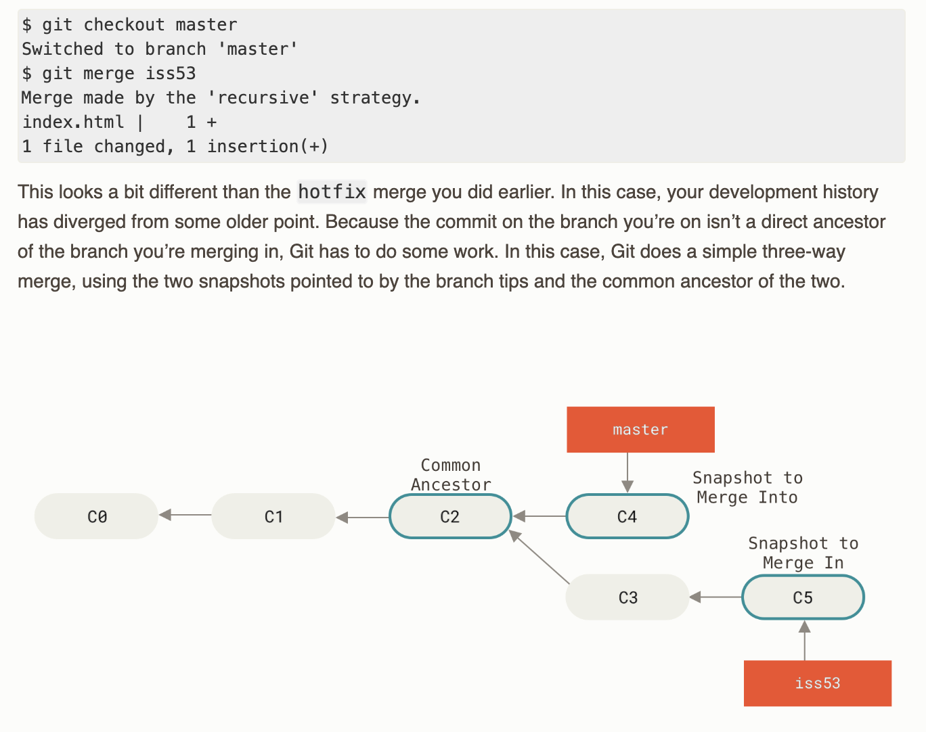
Notes:
When you create the commit by running git commit, Git checksums each subdirectory (in this case, just the root project directory) and stores them as a tree object in the Git repository. Git then creates a commit object that has the metadata and a pointer to the root project tree so it can re-create that snapshot when needed.
Your Git repository now contains five objects: three blobs (each representing the contents of one of the three files), one tree that lists the contents of the directory and specifies which file names are stored as which blobs, and one commit with the pointer to that root tree and all the commit metadata.

Slide 33
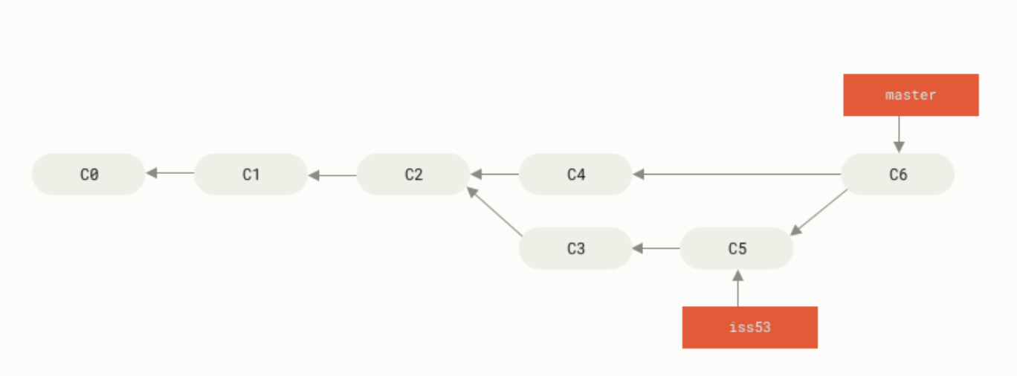
Notes:
When you create the commit by running git commit, Git checksums each subdirectory (in this case, just the root project directory) and stores them as a tree object in the Git repository. Git then creates a commit object that has the metadata and a pointer to the root project tree so it can re-create that snapshot when needed.
Your Git repository now contains five objects: three blobs (each representing the contents of one of the three files), one tree that lists the contents of the directory and specifies which file names are stored as which blobs, and one commit with the pointer to that root tree and all the commit metadata.

Slide 34
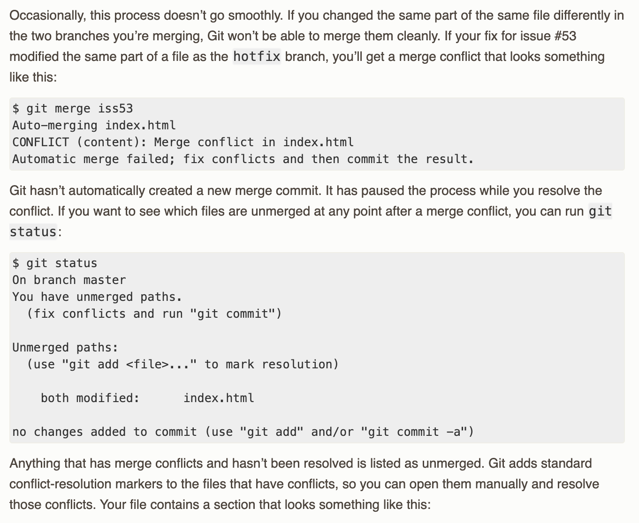
Merge Conflicts
Notes:
When you create the commit by running git commit, Git checksums each subdirectory (in this case, just the root project directory) and stores them as a tree object in the Git repository. Git then creates a commit object that has the metadata and a pointer to the root project tree so it can re-create that snapshot when needed.
Your Git repository now contains five objects: three blobs (each representing the contents of one of the three files), one tree that lists the contents of the directory and specifies which file names are stored as which blobs, and one commit with the pointer to that root tree and all the commit metadata.

Slide 35
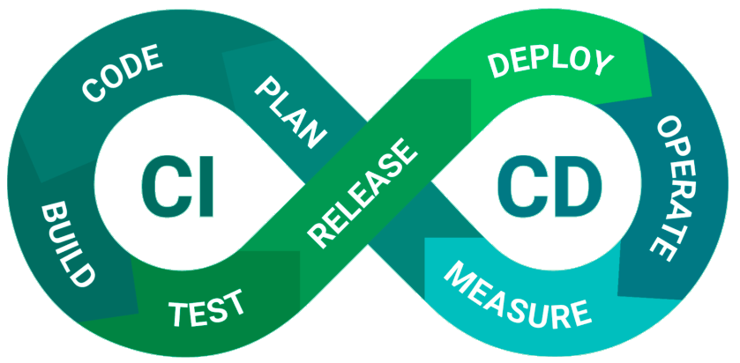
Continuous Integration/ Continous Development (CI/CD)
CI: What it is: The process of automatically integrating code changes from multiple contributors into a shared repository several times a day.
Why it matters:
Detects bugs early via automated testing
Ensures that new code doesn't break the main project
Speeds up collaboration and code review
Continuous Delivery: Automatically prepares your code to be deployed (e.g., packaging, staging) after it passes CI.
Continuous Deployment: Goes one step further—automatically deploys every passing change to production.
Why it matters:
Reduces manual work and human error
Makes releases faster and more frequent
Encourages small, incremental updates (safer and easier to debug)
Notes:
When you create the commit by running git commit, Git checksums each subdirectory (in this case, just the root project directory) and stores them as a tree object in the Git repository. Git then creates a commit object that has the metadata and a pointer to the root project tree so it can re-create that snapshot when needed.
Your Git repository now contains five objects: three blobs (each representing the contents of one of the three files), one tree that lists the contents of the directory and specifies which file names are stored as which blobs, and one commit with the pointer to that root tree and all the commit metadata.

Slide 36
Further Topics
CI/CD
Unit testing
GitLab
Semantic Versioning
DevOps: Docker
Notes:
When you create the commit by running git commit, Git checksums each subdirectory (in this case, just the root project directory) and stores them as a tree object in the Git repository. Git then creates a commit object that has the metadata and a pointer to the root project tree so it can re-create that snapshot when needed.
Your Git repository now contains five objects: three blobs (each representing the contents of one of the three files), one tree that lists the contents of the directory and specifies which file names are stored as which blobs, and one commit with the pointer to that root tree and all the commit metadata.

Slide 37
References
https://git-scm.com/book/en/v2

