Slide 2
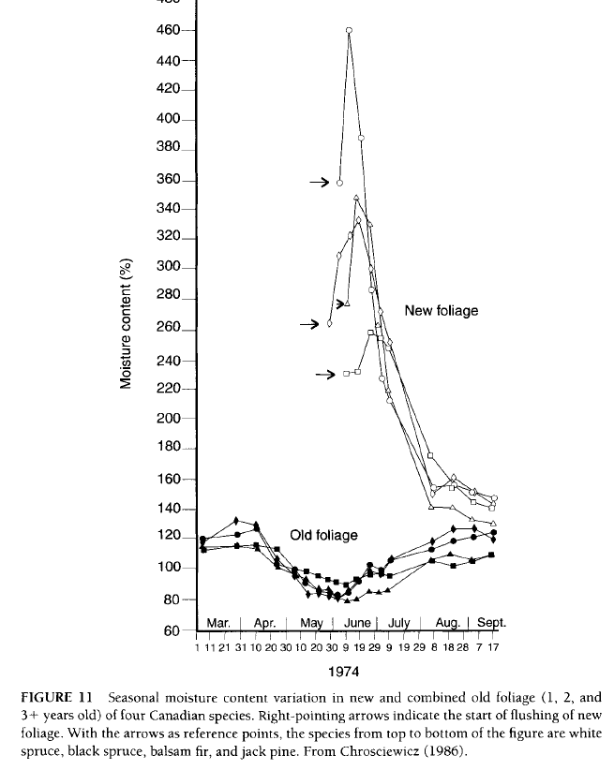
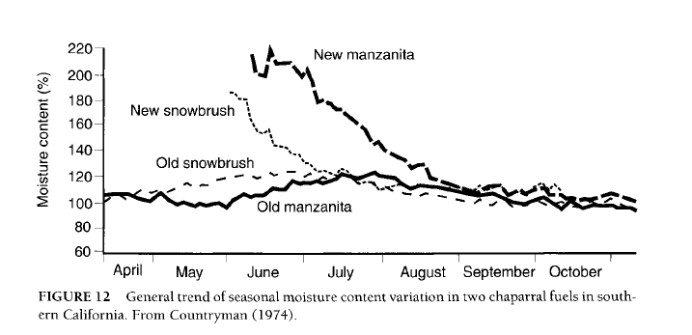
Live fuel moisture; Nelson 2001. Water Relations in Forest Fuels

Slide 3
