Slide 1
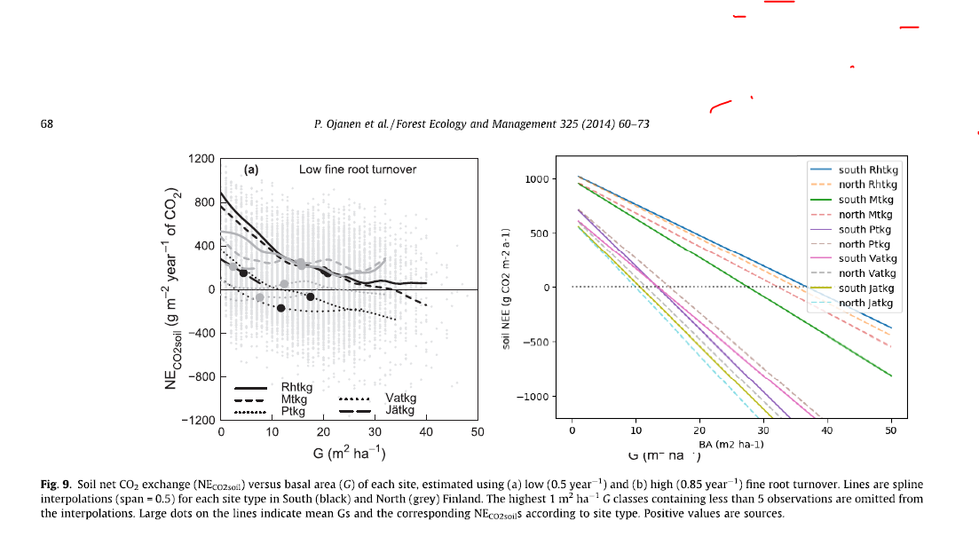
Ojanen et al. 2014 soil NEE: BA-dependency from site-level estimates
Soil NEE using our draft eq. 9 at T=10degC and litterfall/BA
-ratio according to last NFI (using Fig. 3 right panels last 5 years)

Slide 2
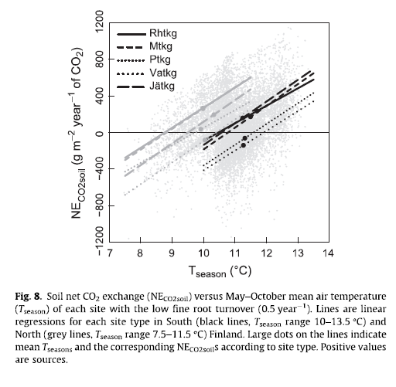
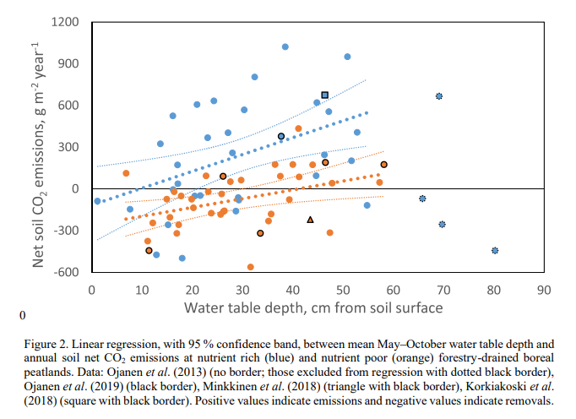
Ojanen et al. 2014 soil NEE as function of temperature. This model is basis for Alm et al. 2014 And what the heck are the points in the figure. There are at maximum (68+3)*2 =142 datapoints according to Methods
Ojanen et al. 2019: same dataset but now temperature effect is not included at all…

