Slide 1
Initial quality control and adapter trimming Initial quality control with FastQC Adapter trimming with Trim Galore! and Trimmomatic

Slide 2
Software to install
Install fastQC
$ conda install -c bioconda fastqc
Install Trim galore!
$ conda install -c bioconda trim-galore
Install Trimmomatic
$ conda install -c bioconda trimmomatic

Slide 3
Quality control
After receiving the reads, we need to conduct initial assessment of their quality
Typical questions to ask at this stage:
What are the sizes of the sequencing libraries and are they enough to achieve the experimental objective?
What are the base qualities?
Is there anything wrong with key attributes of the library: sequence composition, GC content, length distribution, duplicated sequences, over-represented sequences?
Are the sequences contaminated with adapters?
Can we do anything to improve the quality of the sequencing libraries?
NOTE: Do not try to “save” failed libraries, it’s a waste of time.

Slide 4
Quality control
Quality control helps us to diagnose problems and improve the data at the early stages of the workflow
Any steps we undertake to improve the data will alter it, so we must be careful with this process
Diagnostic software: FastQC
https://www.bioinformatics.babraham.ac.uk/projects/fastqc/
Take a look at FastQC documentation:
https://www.bioinformatics.babraham.ac.uk/projects/fastqc/Help/
FastQC examples
Good data: https://www.bioinformatics.babraham.ac.uk/projects/fastqc/good_sequence_short_fastqc.html
Bad data:
https://www.bioinformatics.babraham.ac.uk/projects/fastqc/good_sequence_short_fastqc.html

Slide 5
Quality control
FastQC examples
Adapter dimer contamination:
https://www.bioinformatics.babraham.ac.uk/projects/fastqc/RNA-Seq_fastqc.html
Small RNA sequencing adapter read-through
https://www.bioinformatics.babraham.ac.uk/projects/fastqc/small_rna_fastqc.html
PacBio
https://www.bioinformatics.babraham.ac.uk/projects/fastqc/pacbio_srr075104_fastqc.html#M1
Useful website to examine failed libraries and sketchy situations that arise during sequencing
https://sequencing.qcfail.com/

Slide 6
QC practice
Small RNA mouse example
Create a folder QC/ in sandbox/ directory
QC folder will be our working directory for this practice
Download sample_mm_srna.fastq from github repository
$ wget https://raw.githubusercontent.com/slavailn/bioinf_training/main/sample_mm_srna.fastq
View fastqc help files; what options are available
$ fastqc -h # examine the help file
$ fastqc sample_mm_srna.fastq # Generated .html report and .zip file with the data used for report generation
We can unzip the data and take a look at the files it has
$ unzip sample_mm_srna_fastqc.zip
$ ls -l sample_mm_srna_fastqc/
$ less sample_mm_srna_fastqc/fastqc_data.txt # this file will contain report data as text

Slide 7
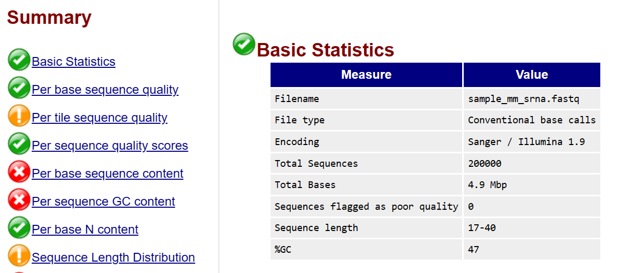
QC practice
Small RNA mouse example
View the html report
$ firefox sample_mm_srna_fastqc.html

Slide 8
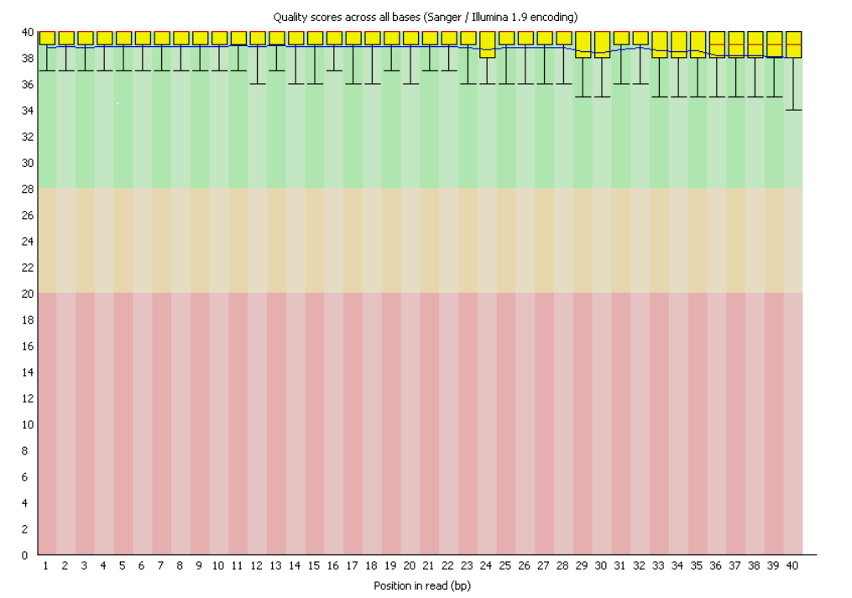
QC practice
Small RNA mouse example : Per base sequence quality
X-axis – base position
Y-axis - qualities on Phred scale
Quality distribution at each base are shown as box plots
Green Q >= 30 : Good
Orange 20 =< Q < 30 : OK
Red Q < 20: Poor

Slide 9
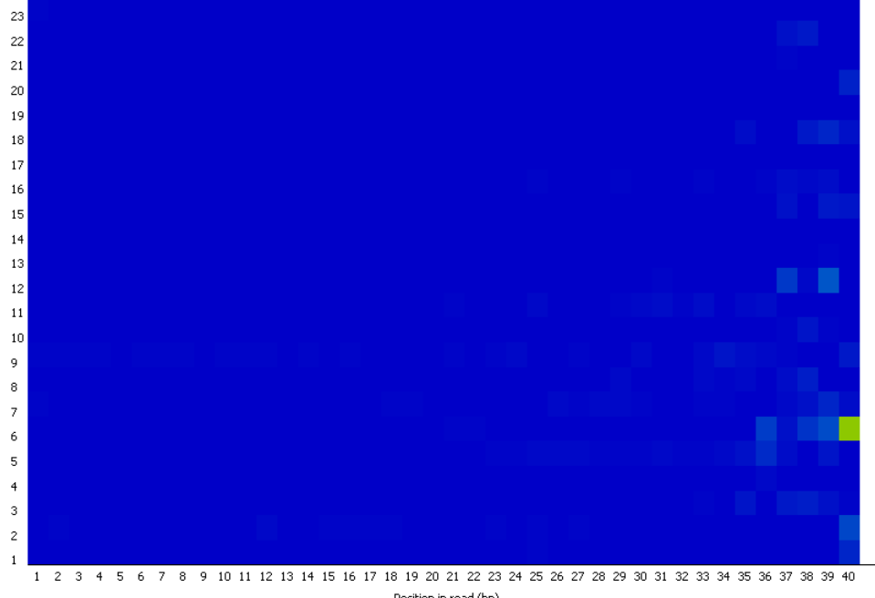
QC practice
Per tile sequence quality
Average quality score per tile across all bases

Slide 10
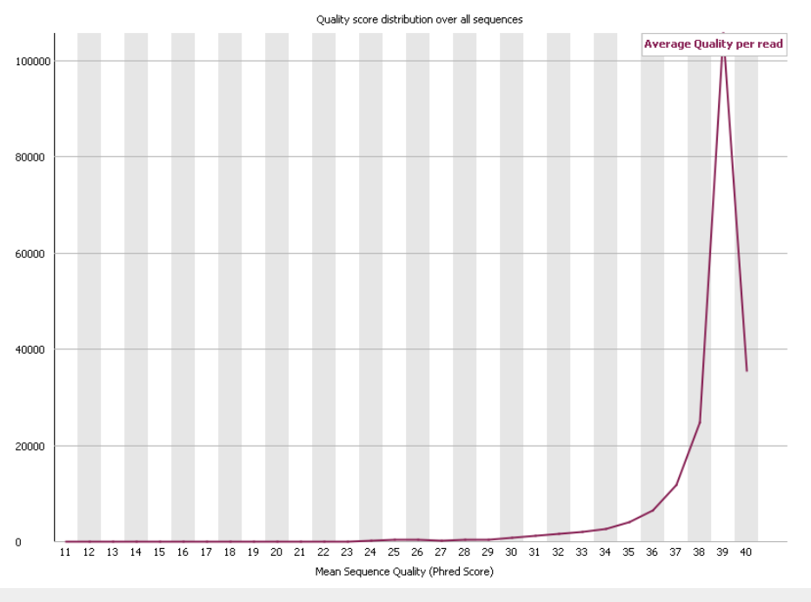
QC practice
Distribution of average quality scores over all sequences

Slide 11
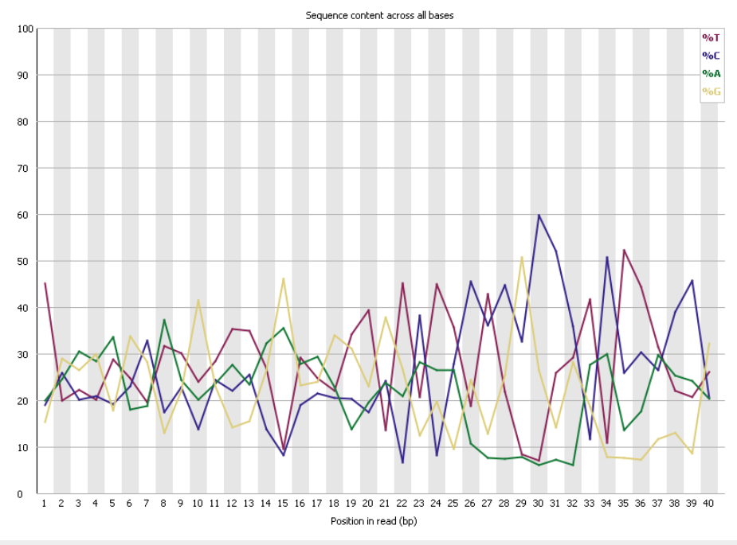
QC practice
Base composition across the sequence
Normally we would expect a more even distribution where each of 4 bases is observed about 0.25 times
However small RNA libraries are naturally heavily imbalanced

Slide 12
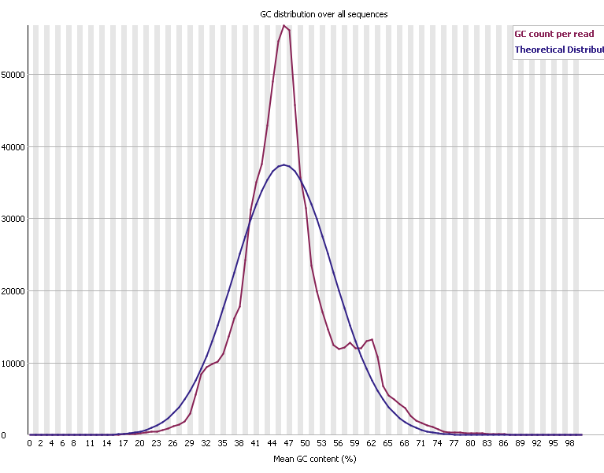
QC practice
Distribution of mean GC content across sequences
Normally we would expect observed distribution much closer to theoretical
However, small RNA libraries are a clear exception due large part of sequencing space occupied by highly expressed small RNAs and the presence of adapters in raw reads

Slide 13
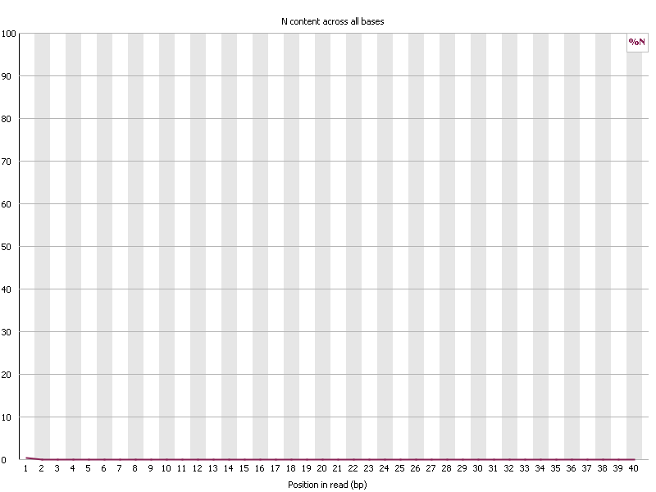
QC practice
Percentage of N bases along the read

Slide 14
QC practice
Read length distribution
Raw reads have a single point, in this case, the sequences were already trimmed of adapters

Slide 15
QC practice
In the properly diverse libraries most sequences will fall to the far left of the plot
To estimate duplication the reads are trimmed to the first 50 bp and matched against each other
Only 100,000 reads are assessed
We should not rely on sequence matches to identify duplicates. They are detected as reads mapping to the same coordinates. Duplicate sequences must be removed from the analysis in variant calling
Sequence duplication levels

Slide 16
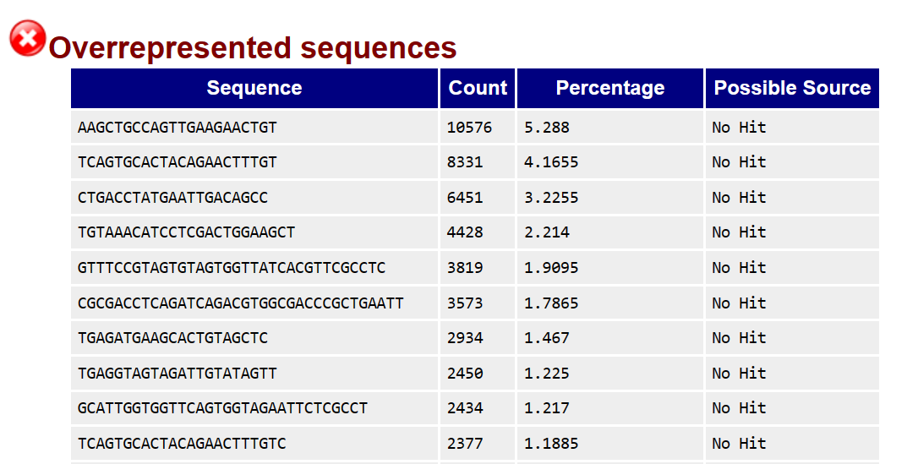
QC practice
A sequence is considered over-represented when it occupies over 0.5% of the library

Slide 17
QC practice
Percentage of sequences attributed to adapters
FastQC can automatically detect a number of adapters
We can also add more adapter or other contaminant sequences to adapter.list file in FastQC configuration directory

Slide 18
Adapter trimming
Our reads may contain partial adapter sequences if the number of sequencing cycles exceeds the length of the fragment
Fragment
Adapter
Read through into the adapter
Fragment
Adapter
Resulting read with partial adapter sequence

Slide 19
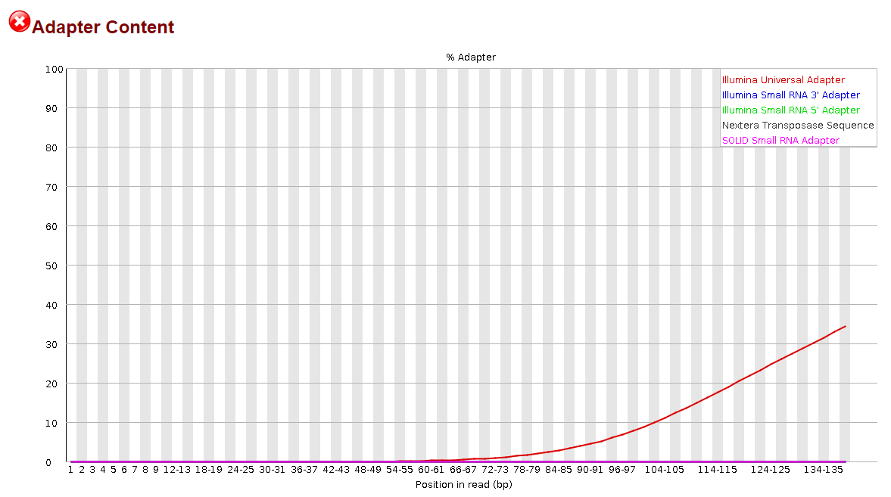
Adapter trimming
Adapter contamination

Slide 20
Adapter trimming
Adapter trimmers
Trim Galore! https://www.bioinformatics.babraham.ac.uk/projects/trim_galore/
Trimmomatic https://github.com/usadellab/Trimmomatic
Cutadapt https://cutadapt.readthedocs.io/en/stable/
Bbduk.sh https://manpages.ubuntu.com/manpages/focal/man1/bbduk.sh.1.html
and a few others
I use Trim Galore! And Trimmomatic in my projects, both have nice interface and can handle paired-end reads without breaking the order of the reads in read1 and read2 files

Slide 21
Adapter trimming
Download human small RNA fastq contaminated with adapters
$ wget https://raw.githubusercontent.com/slavailn/bioinf_training/main/smallrna_adapt_cont.fastq
Run fastqc
$ fastqc smallrna_adapt_cont.fastq
$ firefox sample_mm_srna_fastqc.html
Take a look at the options available with Trim Galore!
$ trim_galore --help
Run trim galore analysis, compress the output and use fastQC on the trimmed file
$ trim_galore --small_rna -Q 30 --gzip --fastqc smallrna_adapt_cont.fastq # this will produce trimmed reads file, trimming report and fastqc report, trimmed files will have the extension trimmed
Check the results
$ firefox smallrna_adapt_cont_trimmed_fastqc.html

Slide 22
Adapter trimming
Install Trimmomatic
Take a look at Trimmomatic help file
$ trimmomatic -h
Read the docs
https://github.com/usadellab/Trimmomatic
Download adapter sequences from Trimmomatic github page
$ wget https://raw.githubusercontent.com/usadellab/Trimmomatic/main/adapters/TruSeq3-SE.fa
Trim the reads with Trimmomatic
$ trimmomatic SE -phred33 smallrna_adapt_cont.fastq smallrna_trimmomatic.fastq ILLUMINACLIP:TruSeq3-SE.fa:2:30:10 LEADING:3 TRAILING:3 SLIDINGWINDOW:4:20 MINLEN:40
See next page for options explanation

Slide 23
Adapter trimming
Remove adapters (ILLUMINACLIP:TruSeq3-SE.fa:2:30:10)
Remove leading low quality or N bases (below quality 3) (LEADING:3)
Remove trailing low quality or N bases (below quality 3) (TRAILING:3)
Scan the read with a 4-base wide sliding window, cutting when the average quality per base drops below 20 (SLIDINGWINDOW:4:20)
Drop reads below the 20 bases long (MINLEN:36)
Check the results with fastQC
Were the adapters removed?

