Slide 1
Read alignment
Introduction to alignments, scoring matrices, alignment practice

Slide 2
Required software
Install EMBOSS bioinformatics suite:
$ conda install -c bioconda emboss
Install BLAST
$ conda install -c bioconda blast
Install entrez-direct
$ conda install -c bioconda entrez-direct
Install seqtk
$ conda install -c bioconda seqtk

Slide 3
Introduction to alignments
Sequence alignment is fundamental bioinformatics task
Practically, any bioinformatics works involves DNA, RNA, or protein sequence alignment
Alignment means arranging two or more sequences in a way that the regions of similarity line up
Example of an alignment
GATTACA
||| |
GATCA- -
This is not the only possible arrangement
GATTACA
||| ||
GAT- - CA
Examples from Bioinformatics Handbook, 2022

Slide 4
Introduction to alignments
Humans mind is notoriously bad in evaluating alignments!
We tend to get fixated on certain pattern while ignoring many other possible alternatives
The problem of sequence alignment is best suited for computational solution
Let’s examine this 3 alternative alignments:
1 | 2 | 3
GATTACA ||| | GATCA- - | GATTACA ||| || GAT- - CA | GATTACA ||| | | GAT -C -A
Which of them is better? Which of them we should rely on when answering biological questions.

Slide 5
Introduction to alignments
Why do we use alignments?
Finding similar regions between sequences (similarity may indicate evolutionary relatedness)
Finding which sequences from many alternatives in the most similar query (input) sequence
What determines a sequence alignment
Type of the alignment algorithm: 1) global; 2. local; 3. semi-global
Scoring matrix: numerical values assigned to matches, mismatches, and gaps
Different algorithms may produce different alignments for the same sequences
Different scoring matrices may generate different alignments with the same sequences even with the same algorithm
Algorithm * Scoring matrix → Alignment

Slide 6
Introduction to alignments
Scoring alignments
1 | 2 | 3
GATTACA ||| | GATCA- - | GATTACA ||| || GAT- - CA | GATTACA ||| | | GAT -C -A
We have 3 alternative alignments; how do we determine the best one?
We can devise a way to assign numeric scores that will reward an alignments for match and punish it for mismatches or gaps
Mismatch → substitution of one nucleotide or amino-acid by another, for example A/C
Gap → a nucleotide or an amino-acid is missing from a query sequence caused by insertion or deletion of a part of a sequence (indels)

Slide 7
Introduction to alignments
Scoring alignments
1 | 2 | 3
GATTACA ||| | GATCA- - | GATTACA ||| || GAT- - CA | GATTACA ||| | | GAT -C -A
Example scoring matrix
Value | Alignment
1 | Match
-1 | Mismatch
-2 | Opening a gap
-1 | Extending a gap
Let’s score GATTACA alignments in a table above:
M → Match; X → Mismatch; D → gap open; E → gap extension
M + M + M +X + M + D + E = 3 – 1 + 1 - 2 – 1 = 0
Score 2 – This is the best alignment according to our scheme
Score 1

Slide 8
Introduction to alignments
What is the best alignment?
There is no universally best alignment
The aligner generates a set of alternative alignments and calculates scores based on a scoring matrix
The alignment with a maximum score is selected as a “best”, therefore the objective of the aligner is a score maximization
Value | Alignment
1 | Match
-1 | Mismatch
-2 | Opening a gap
-1 | Extending a gap
0 | Opening or extending a gap at the end of either sequence
The choice of the scoring matrix is critical to answering biologically meaningful questions
For example, we would like to detect the longest marching run in the shorter sequence
To achieve this, we will remove penalty for opening or extending a gap at either end of the sequence
Alignment 1 scores 4; 2 → 2; 3 → 1

Slide 9
Introduction to alignments
What are scoring matrices
Scoring matrices can apply to nucleotides, amino-acids, and codons
Scoring matrices reflect the likelihoods of substitution rates along the evolutionary history
Scoring matrices are calculated based on the alignment of many homologous sequences
Two large families of scoring matrixes: BLOSUM and PAM
BLOSUM | PAM
https://www.ncbi.nlm.nih.gov/pmc/articles/PMC50453/ | https://doi.org/10.1093/molbev/msi005
BLOcks SUbstitution Matrix | Point Accepted Mutation
Based on very conserved regions in protein families with no gaps in alignments | Replacement of a single AA accepted by natural selection. Silent and lethal mutations are ignored
Based on relative frequencies of amino-acids (AA) and their substitution probabilities | Entry in a PAM matrix indicate the likelihood of the AA of that row being replaced with the AA of that column through a series PAM during a specified evolutionary
log-odds scores for each of the 210 possible substitution pairs of the 20 standard amino acids.

Slide 10
Introduction to alignments
EDNAFULL nucleotide scoring matrix
Where to find scoring matrices:
ftp://ftp.ncbi.nlm.nih.gov/blast/matrices
Download and view EDNAFULL matrix:
$ curl -O ftp://ftp.ncbi.nlm.nih.gov/blast/matrices/NUC.4.4
$ cat NUC.4.4
A T G C
A 5 -4 -4 -4
T -4 5 -4 -4
G -4 -4 5 -4
C -4 -4 -4 5
The actual matrix contains also contains ambiguous bases

Slide 11
Introduction to alignments
EDNAFULL nucleotide scoring matrix
This matrix tends to produce mismatches, for example:
Alignment of ACT to AGT will produce:
A C T
| |
A G T
M : A – A → 5
X : A – T → -4
A T G C
A 5 -4 -4 -4
T -4 5 -4 -4
G -4 -4 5 -4
C -4 -4 -4 5
https://pubmed.ncbi.nlm.nih.gov/24509512/
Selecting the Right Similarity-Scoring Matrix
William R Pearson
If we change penalties of a match to 4 and mismatch to -5 this alignment with look as follows
A
|
A
The alignment will not extend to the left, since the penalty of mismatch outweighs the reward of a match
How to select a scoring matrix:

Slide 12
Introduction to alignments
Other properties of the scoring matrixes
Scoring matrixes do not contain gap opening and gap extension penalties
Gap opening and extension penalties are typically different; gap extension penalty is typically smaller than gap opening. Additional reading: https://en.wikipedia.org/wiki/Gap_penalty
Choosing right scoring is critical as gap penalties decide the “willingness” of the aligner to open gaps
The scores are typically on the logarithmic scale
The choice of scoring matters less when the sequences are very similar
The more different are sequences, the more sensitive the alignment is to scoring choices
The longer the sequence

Slide 13
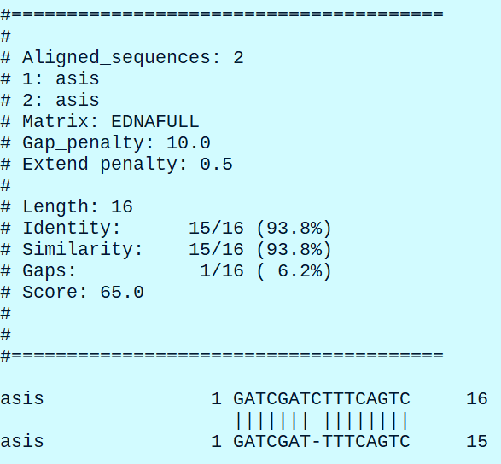
Practice alignments
We will use needle from EMBOSS suite to practice alignments.
needle uses Needleman-Wunsch global alignment algorithm
Let’s try an alignment
$ needle -asequence asis:GATCGATCTTTCAGTC -bsequence asis:GATCGATTTTCAGTC -auto -stdout # -asequence and -bsequence specify query and reference sequences; asis allows to enter a sequence on the command line; -auto – use default gap-open [10] and gap-extend [0.5] penalty; -stdout prints output to screen

Slide 14
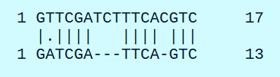
Practice alignments
We will use needle from EMBOSS suite to practice alignments.
There are different ways to visualize the alignments, but the following symbols are commonly used:
| - match
- - gap
. - mismatch
In the alignment above we have 12 matches, 2 gaps, and 1 mismatch
Usually, a query sequence is on the bottom and subject sequence is on the top
Query – sequence we need to compare; Subject - sequence we are comparing the query to

Slide 15

Practice alignments
We will use needle from EMBOSS suite to practice alignments.
How to describe alignments?
In this case we will say that the alignment has 2 deletions (part of the sequence is missing) and 1 mismatch
Let’s flip the sequences and make query sequence a subject
$ needle -asequence asis:GATCGATTCAGTC -bsequence asis:GTTCGATCTTTCACGTC -auto -stdout
Now we will describe the alignment as having 2 insertions and 1 mismatch

Slide 16
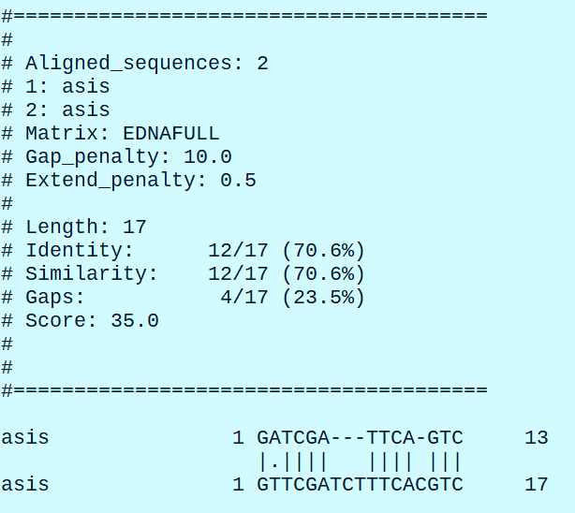
Practice alignments
Other characteristics of the alignment (apart of the score)
Let’s run this command again
$ needle -asequence asis:GATCGATTCAGTC -bsequence asis:GTTCGATCTTTCACGTC -auto -stdout
Score – 35
Percent identity – 70.6% # what percent of the sequence is the same
Percent similarity – 70.6% # what percent of the sequence with similar bases/amino-acids

Slide 17
Practice alignments
Confusion of terminology
Terms in bioinformatics are frequently poorly defined or calculated differently depending on the tool
On the definition of sequence identity (lh3.github.io)
Gap excluded identity: pident = matches / (matches + mismatches)
BLAST identity: pident = matches / (matches + mismatches + deletions)
Gap compressed identity: pident = matches / (matches + mismatches + gapopen)

Slide 18
Practice alignments
Compact record of the alignment: CIGAR string
How can we record this alignment?
1 match – 1M
1 mismatch – 1X
4 matches – 4M
3 deletions – 3D
4 matches – 4M
1 deletion – 1D
3 matches – 3M
Put it all together: 1M1X4M3D4M1D3M
This format type is called Extended CIGAR format
Sequence Alignment Map (SAM) files use different CIGAR format, where both matches in mismatches are shown as M
6M3D4M1D3M
Yet another CIGAR format goes one step further and skips a preceding digit for single-base changes
6M3D4MD3M

Slide 19
Global and local alignments
Three types of alignment algorithms:
Global – Needleman-Wunsch
Local – Smith-Waterman
Semi-global

Slide 20
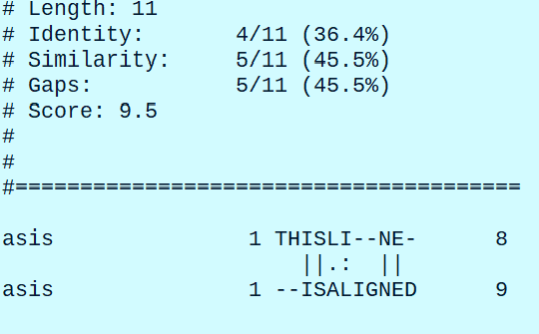
Global and local alignments
Global alignment
Global alignment is designed to find and alignment of sequences over their full length while allowing gaps
Let’s try the following example from the book Understanding Bioinformatics by Marketa Zvelebil and Jeremy Baum:
$ needle -asequence asis:THISLINE -bsequence asis:ISALIGNED -auto -stdout

Slide 21
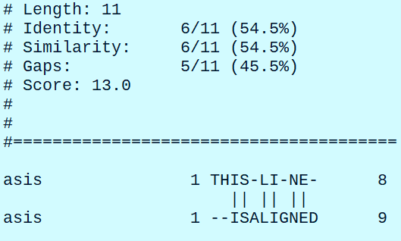
Global and local alignments
Global alignment
By default, needle has a gapopen penalty of 10.
Let’s decrease gapopen penalty and observe the results:
$ needle -asequence asis:THISLINE -bsequence asis:ISALIGNED -auto -stdout -gapopen 7
Gapopen: 10
Gapopen: 7
We created an alignment that favors gaps over the mismatches!

Slide 22
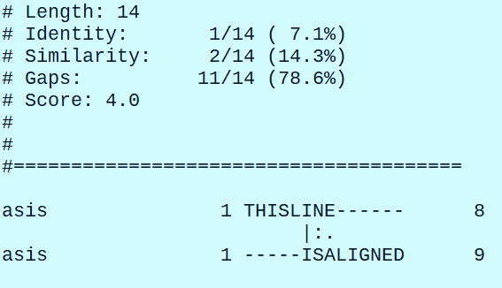
Global and local alignments
Global alignment
By default, needle has a gapopen penalty of 10.
Let’s increase gapopen penalty to 20 and observe the results:
$ needle -asequence asis:THISLINE -bsequence asis:ISALIGNED -auto -stdout -gapopen 20
High penalty for opening the gaps prevented any gaps in the alignment, the highest score could be achieved with mismatches only.

Slide 23
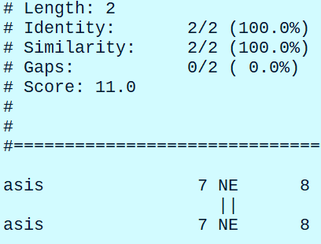
Global and local alignments
Local alignment
Local alignment is designed to find the region of highest similarity between the sequences
In other words, we are looking for the partial interval of the query sequence that produces the highest scoring alignment with the subject
Local alignment is implemented in Smith-Waterman algorithm
EMBOSS utility for local alignment is called water
Let’s try local alignment with the same sample sequences as in global alignment
$ water -asequence asis:THISLINE -bsequence asis:ISALIGNED -auto -stdout

Slide 24
Global and local alignments
Local alignment
Local alignment generated here is very short
We tried all possible alternatives and NE=NE matches gave us the maximum score
By default, water uses BLOSUM62 protein matrix.
Let’s change the scoring matrix and see the effect on the results
Download BLOSUM90 from NCBI site:
$ wget -nc ftp://ftp.ncbi.nlm.nih.gov/blast/matrices/BLOSUM90
$ cat BLOSUM90

Slide 25
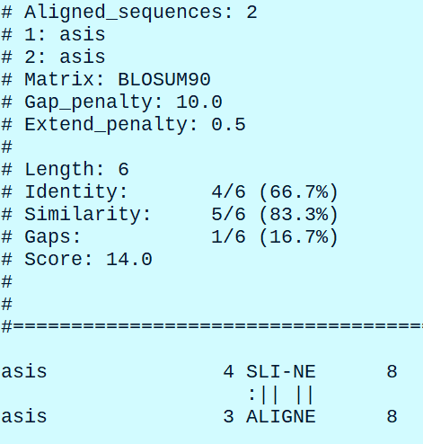
Global and local alignments
Local alignment
Map the same 2 sequences with BLOSUM90 matrix
$ water -asequence asis:THISLINE -bsequence asis:ISALIGNED -auto -stdout -datafile BLOSUM90

Slide 26
Global and local alignments
Selecting the right similarity matrix
Paper by FASTA author Pearson: https://www.ncbi.nlm.nih.gov/pmc/articles/PMC3848038/
A paper about evolutionary distances: https://pubmed.ncbi.nlm.nih.gov/11752185/
Scoring (similarity) matrixes reflect evolutionary relationships
Different similarity matrixes are effective at different evolutionary distances
“Deep” scoring matrixes (BLOSUM50, BLOSUM62) allow more AA substitutions and gaps
“Shallow” matrixes (VT10, VT20, VT40) give higher scores to matches, more negative scores to mismatches and higher gap penalties
“Deep” matrixes should be used to target alignments with 20-30% identities
“Shallow” matrixes are ideal for finding alignments in the sequences with 50-90% similarities, protein domains, exons, DNA reads, closely related orthologs

Slide 27
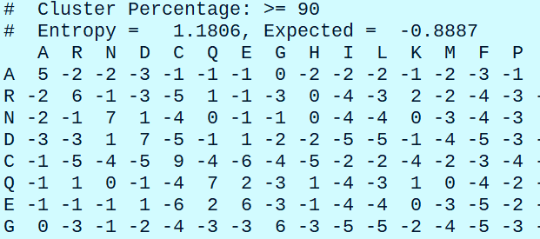
Global and local alignments
Similarity scores and probabilities
Take a look at a scoring matrix:
$ cat BLOSUM90
Note that all scores are integers
The scores reflect probabilities represented log 2 odds
The substitution score of -5 means 2^(-5) = 1/32, and the score of 3 means 2^(-3) = 1/8
The substitution with the score of -5 is 4 times (32/8 = 4) less likely than that subst. with a score of -3
AA pairs with lower negative scores have less divergent properties that those with higher negative scores
For simplicity log 2 odds were rounded to the nearest integers

Slide 28
Global and local alignments
Semi-global alignment
Semi-global alignments combine the properties of global and local alignments
The objective of semi-global alignment is to find a maximum scoring full length alignment between a shorter query and longer subject sequence
This type of alignment is achieved by setting the end gap penalty (gaps at the end and the beginning) to zero
Most of the alignments in NGS data analysis are semi-global
Semi-global algorithm – modification of Smith-Waterman
Question: does a shorter sequence originate from a longer one?

Slide 29
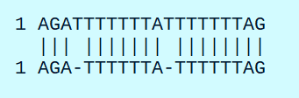
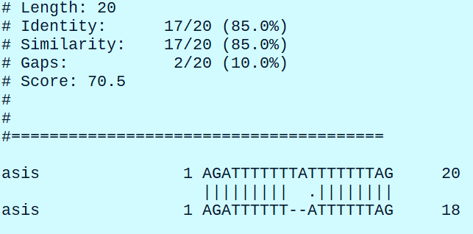
Global and local alignments
Misleading alignment
There are limitations in using mathematical concepts to biological phenomena
Let’s create a sequence with homo-polymer stretches
Subject: AGATTTTTTTATTTTTTTAG
Remove nucleotides marked in red
Query: AGATTTTTTATTTTTTAG
Try matching these sequences
$ needle -asequence asis:AGATTTTTTTATTTTTTTAG -bsequence asis:AGATTTTTTATTTTTTAG -auto -stdout
Expected alignment

Slide 30


Global and local alignments
Misleading alignment
1. False, higher score
2. True, lower score
Alignment 1 is mathematically correct, although it does not reflect biological reality
Assuming scores of 1 for match, -1 for mismatch, -10 – gap open and -0.5 gap extend
For alignment 1 (9M2D1X8M) : 17 – 10 – 0.5 – 1 = 5.5
For alignment 2 (3M1D7M1D8M): 18 – 10 - 10 = -2
The algorithm is thrown off by TTTTTTTT homopolymer – a region with low information content
When shifted by one base we are still getting the same base lined up that receives a reward by a matching base

Slide 31
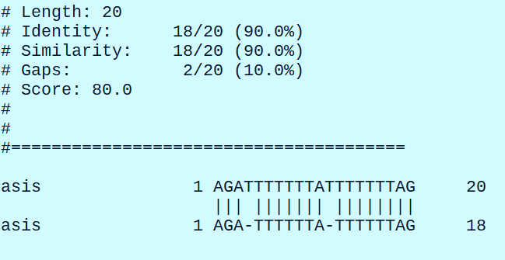
Global and local alignments
Misleading alignment
We can “fix” this alignment by deacreasing gap open penalty
$ needle -asequence asis:AGATTTTTTTATTTTTTTAG -bsequence asis:AGATTTTTTATTTTTTAG -auto -stdout -gapopen 5

Slide 32
Global and local alignments
Misleading alignment
If decreasing the gap penalty “fixed” the alignment, should we use this setting all the time?
Lowering the gap penalty will lead to profound effect, the algorithm will be opening gaps at will
In some cases, lowering the gapopen penalty, will improve the alignments, but normally it will produce erroneous results
This remains a problem in variant calling, some aligners have procedures that help to recognize and correct “misalignments”
In generally, alignments in the repetitive (low information) regions produce less reliable variant calls

Slide 33
Global and local alignments
Using BLAST
Basic Local Alignment Search Tool – algorithm and a suite of tools
Primary goal – search a large collection of sequences to find similarities with a query sequence
BLAST performs local alignments, and the results are mostly partial matches to the query sequence
BLAST has web interface (https://blast.ncbi.nlm.nih.gov/Blast.cgi) and a command line tool
Further information: BLAST handbook: https://www.ncbi.nlm.nih.gov/books/NBK279690/

Slide 34
Global and local alignments
Using BLAST
BLAST is not an optimal aligner, it may not find all the hits, and there are limits how short or how long the sequence is
A search may occur in nucleotide, protein or translated space
BLAST is designed to search a huge database of sequences for “hits”
The more sequences we search the higher is the probability to get a “hit” purely by chance, it is important to know where to draw the line
Let’s try pair-wise BLAST alignment Swine hepatitis gene (AF082843.1) and Orthoherpevirus A (AP003430.1)
$ esearch -db nucleotide -query "AF082843.1" | efetch -format fasta > swine_hepE.fasta
$ esearch -db nucleotide -query "AP003430.1" | efetch -format fasta > OrthohepevirusA.fasta
$ blastn -query swine_hepE.fasta -subject OrthohepevirusA.fasta

Slide 35
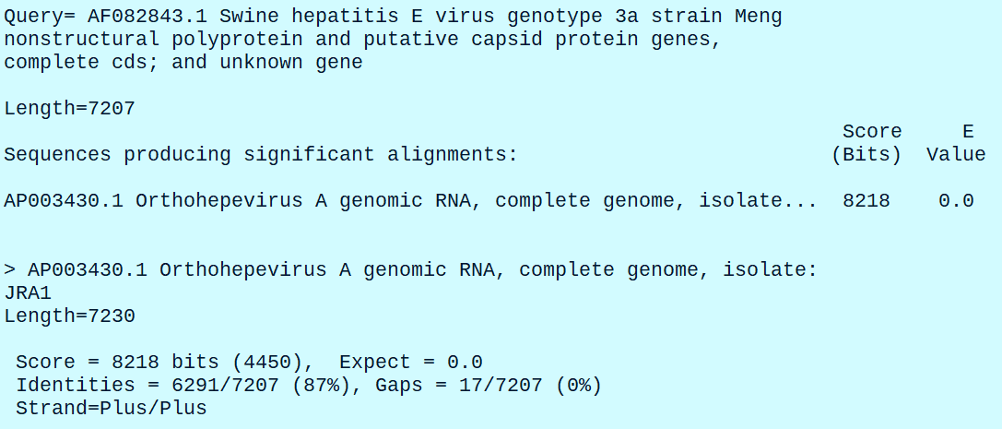
Global and local alignments
Using BLAST
We can learn quite a bit from the report:
Length of the query sequence – 7207
Bit-score (8218) – describes overall quality of the alignment, higher score indicates better alignment
E-value – measures a probability to observe this alignment purely by chance
Percent identity report a fraction of matching bases between the query and a subject sequences

Slide 36
Global and local alignments
Using BLAST
We can reformat the default output from the command line
$ blastn -query swine_hepE.fasta -subject OrthohepevirusA.fasta -outfmt '6 pident’ # this will produce only percent identities
Tabular format
$ blastn -query swine_hepE.fasta -subject OrthohepevirusA.fasta -outfmt 6
Tabular with comment lines
$ blastn -query swine_hepE.fasta -subject OrthohepevirusA.fasta -outfmt 7
Pairwise
$ blastn -query swine_hepE.fasta -subject OrthohepevirusA.fasta -outfmt 0
This info can be found out from blast help file
$ blastn -help # Check the formatting section

Slide 37
Global and local alignments
Using BLAST
Steps to run BLAST on the command line:
Download a collection of subject sequences and create a BLAST database using makeblastdb command
Select appropriate BLAST tool (blastp, blastn, blastx, etc.) and tune other parameters if necessary
Run the tool and format the output as necessary

Slide 38
Global and local alignments
Using BLAST
BLAST tasks
Nucleotide (blastn) and protein (blastp) BLAST have a task option that sets a combination of word size and gap penalties required for a specific search type
Program | Task name | Description
blastn | blastn | Traditional nucleotide BLAST requiring exact match of 11
blastn | blastn-short | BLAST optimized for short sequences less than 50 bp
blastn | megablast | BLAST optimized to find very similar sequences (intraspecies, closely related species)
blastn | dc-megablast | Discontiguous megablast used to find more distant sequences (interspecies)
blastp | blastp | Traditional BLASTP to compare protein query to protein database
blastp | blastp-short | Optimized for sequences less than 30 residues

Slide 39
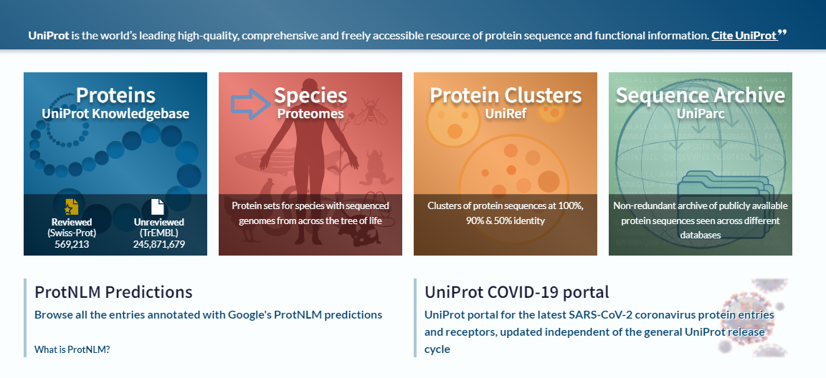
Global and local alignments
Using BLAST
Let’s practice searching for similar sequences with protein BLAST. We will compare M. tuberculosis and M. avium proteomes
First download all protein sequences for Mycobacterium tuberculosis (strain ATCC 25618 / H37Rv) (ATCC 25618 / H37Rv) from Uniprot
Go to uniport.org and click on Species (Proteomes)

Slide 40
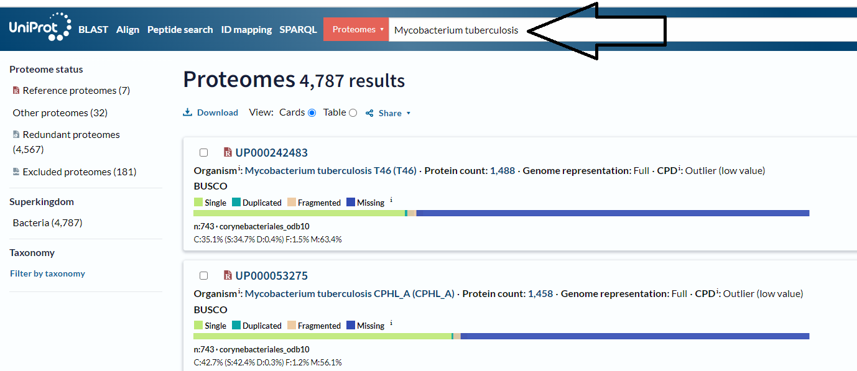
Global and local alignments
Using BLAST
Search for Mycobacterium tuberculosis

Slide 41
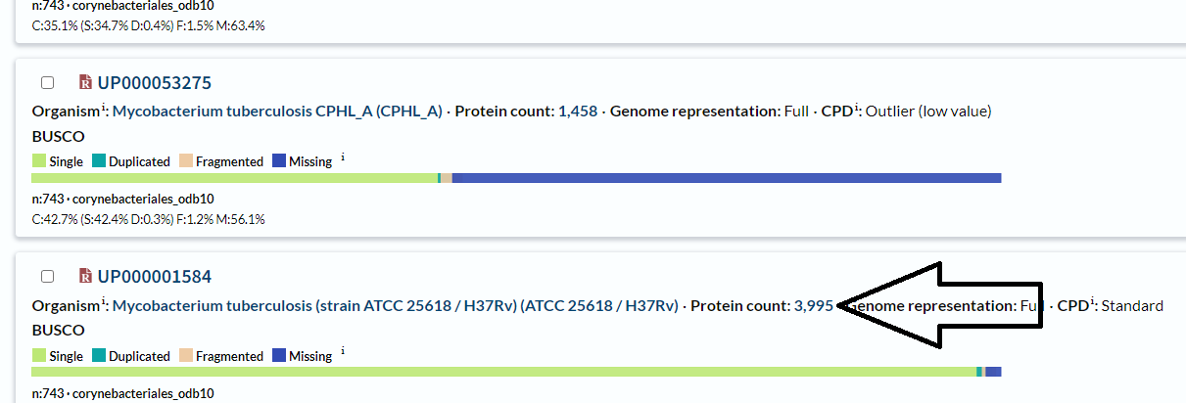
Global and local alignments
Using BLAST
Scroll down to Mycobacterium tuberculosis (strain ATCC 25618 / H37Rv) (ATCC 25618 / H37Rv) and press protein counts

Slide 42
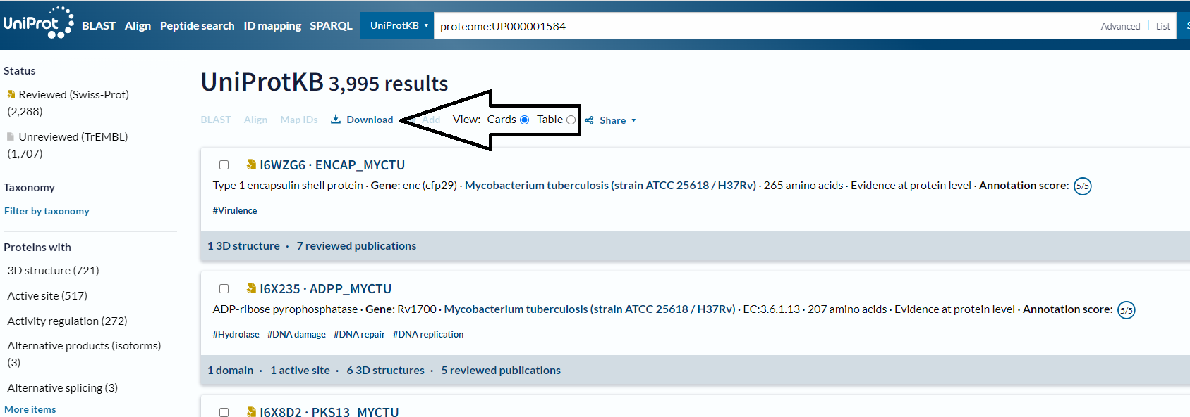
Global and local alignments
Using BLAST
We will get a list of all 3995 protein sequences from this strain
Now click on download to retrieve all of these proteins in FASTA format

Slide 43
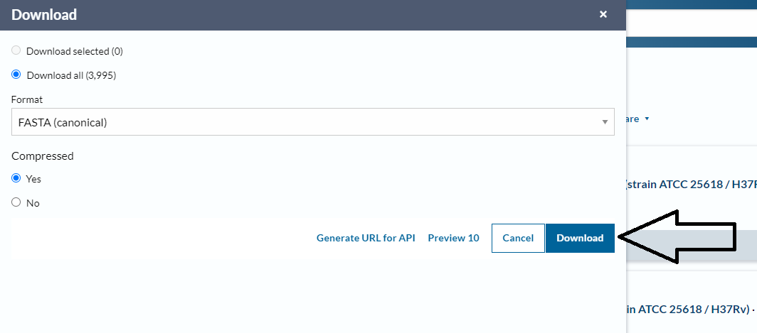
Global and local alignments
Using BLAST
Download proteins in FASTA format
Repeat this step for Mycobacterium avium subsp. avium (DSM 44156)

Slide 44
Global and local alignments
Using BLAST
Unzip downloaded sequences using gunzip command
$ gunzip <uniprot>.fasta.gz # Unzip both M. tuberculosis and M. avium files
Give both protein fasta files less bulky name
$ mv <uniport>.fasta m_tuber.fasta
$ mv <uniprot>.fasta m_avium.fasta
$ grep '>' m_tuber.fasta | wc -l # verify number of sequences
$ grep '>' m_avium.fasta | wc -l
We will use M. tuberculosis as target data base.
Use makeblastdb to create a database for targets
makeblastdb has a following syntax
makeblastdb -in <fasta_file> -out <database_name> -dbtype <type> -title <title> -parse_seqids
-dbtype - prot OR nucl
-parse_seqids – include target fasta ids into the output

Slide 45
Global and local alignments
Using BLAST
Create BLAST database from M. tuberculosis protein fasta file
$ mkdir ref
$ cd ref
$ makeblastdb -in ../m_tuber.fasta -out m_tuber -dbtype prot -parse_seqids
$ ls -lh # Take a look at database files
$ cd ../
Run protein BLAST
$ blastp -help # Go through the help file, try to understand options and arguments
Common options and arguments
-query – query sequence in fasta format
-task – task to execute
-db – path to database
-out – output file
-outfmt – output format (many variations and options)

Slide 46
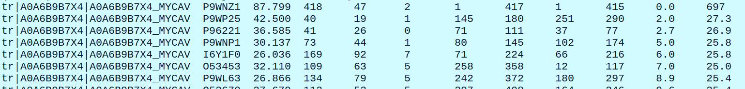
Global and local alignments
Using BLAST
Align M. avium to M. tuberculosis proteomes
$ blastp -task blastp -query m_avium.fasta -db ref/m_tuber -out blast6.txt -outfmt 6 -num_threads 4
This alignment task is very large and will take a long, press Ctrl-C to kill the process and examine the output file
$ head blast6.txt

Slide 47
Global and local alignments
Using BLAST
How to interpret tabular output
There are 12 columns:
Column ID | Meaning
qseqid | query ID
seseqid | subject ID
pident | percent identity
length | alignment length
mismatch | Number of mismatches
gapopen | Number of gap openings
qstart | The start of the alignment relative to query sequence
qend | The end of the alignment relative to query sequence
sstart | The start of the alignment relative to subject sequence
send | The end of the alignment relative to subject sequence
evalue | Probability of the observed alignment by chance (adjusted for the size of the database)
bitscore | Sequence similarity independent of the sequence length and database size

Slide 48
Global and local alignments
Using BLAST
We can instruct BLAST to include specific columns in the output
$ blastp -task blastp -query m_avium.fasta -db ref/m_tuber -outfmt "6 qseqid sseqid pident evalue bitscore" | head # We will get only the 5 columns specified
Sort the output to get matches with the highest bitscore at the top
$ blastp -task blastp -query m_avium.fasta -db ref/m_tuber -outfmt "6 qseqid sseqid pident evalue bitscore" | head | sort -k 5 -n -r
Frequently it is useful to set thresholds based on statistical parameters of alignments, for example e-value
$ blastp -task blastp -query m_avium.fasta -db ref/m_tuber -outfmt "6 qseqid sseqid pident evalue bitscore" -evalue 0.01 | head # this will output the alignments
Limit the number of alignments shown per database sequence (limit 250)
$ blastp -task blastp -query m_avium.fasta -db ref/m_tuber -outfmt "6 qseqid sseqid pident evalue bitscore" -num_alignments 10 | head

Slide 49
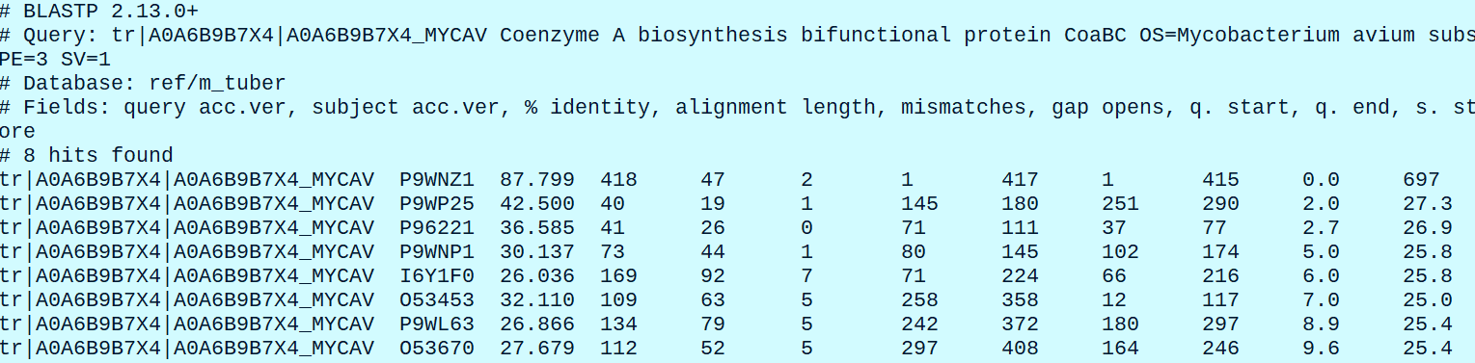
Global and local alignments
Using BLAST
Using BLAST
Let’s check other useful formats
$ blastp -task blastp -query m_avium.fasta -db ref/m_tuber -outfmt 7 -num_threads 4 | head -n 50 # Output format 7 adds some useful information
Note that the highest scoring gene has score of 697 and evalue of 0.0, which gene is this?
$ grep "P9WNZ1" m_tuber.fasta

Slide 50
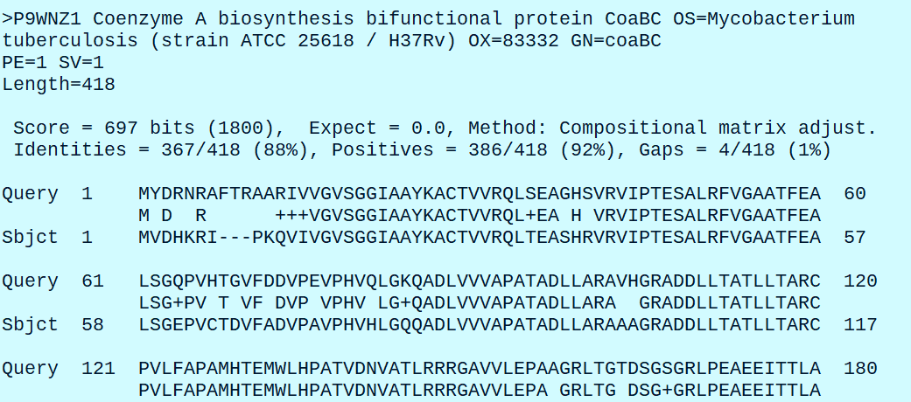
Global and local alignments
Using BLAST
Let’s examine the high scoring alignment between tr|A0A6B9B7X4|A0A6B9B7X4_MYCAV and P9WNZ1 in more detail
$ echo "P9WNZ1" > id_list.txt
$ blastp -task blastp -query m_avium.fasta -db ref/m_tuber -outfmt 0 -seqidlist id_list.txt -evalue 0.0001 -sorthits 1 | head -n 100 # option -seqidlist allows us to limit the search to a list of specific ids, we can also sort output using -sorthits option

Slide 51
Global and local alignments
Using BLAST
Compare Ebola virus proteins from Zaire obtained in 1976 to Zaire Ebola virus isolate from 2014 (example inspired by Biostars handbook)
Take a look at Ebola virus genome
https://www.ncbi.nlm.nih.gov/nuccore/AF086833.2/
Take a look at 2014 Ebola isolate
https://www.ncbi.nlm.nih.gov/nuccore/KM233118.1/
Let’s fetch this sequences using Enrez Programming Utilities https://www.ncbi.nlm.nih.gov/books/NBK25501/
Fetch protein sequences using Entrez E-Utilities, break this command into stages to view intermediate results
$ esearch -db nuccore -query AF086833.2 | elink -target protein | efetch -format fasta > ebola1976.fasta
$ esearch -db nuccore -query KM233118.1 | elink -target protein | efetch -format fasta > ebola2014.fasta

Slide 52
Global and local alignments
Using BLAST
Compare Ebola virus proteins from Zaire obtained in 1976 to Zaire Ebola virus isolate from 2014 (example inspired by Biostars handbook)
Take a look at Ebola virus genome
https://www.ncbi.nlm.nih.gov/nuccore/AF086833.2/
Take a look at 2014 Ebola isolate
https://www.ncbi.nlm.nih.gov/nuccore/KM233118.1/
Let’s fetch this sequences using Enrez Programming Utilities https://www.ncbi.nlm.nih.gov/books/NBK25501/
Fetch protein sequences using Entrez E-Utilities, break this command into stages to view intermediate results
$ esearch -db nuccore -query AF086833.2 | elink -target protein | efetch -format fasta > ebola1976.fasta
$ esearch -db nuccore -query KM233118.1 | elink -target protein | efetch -format fasta > ebola2014.fasta

Slide 53
Global and local alignments
Using BLAST
Compare Ebola virus proteins from Zaire obtained in 1976 to Zaire Ebola virus isolate from 2014 (example inspired by Biostars handbook)
Let’s create a BLAST database from Ebola 1976 proteins
$ mkdir ebola1976_ref
$ cd ebola1976_ref
$ ls -lh
$ cd ../
Compare both proteomes and examine the output
$ blastp -task blastp -query ebola2014.fasta -db ebola1976_ref/ebola1976 -outfmt 0 # This will match every protein of the query to every protein in the target database, try to limit the search to high similarity hits with -evalue option
$ blastp -task blastp -query ebola2014.fasta -db ebola1976_ref/ebola1976 -outfmt 0 -evalue 0.01

Slide 54
Global and local alignments
Using BLAST
Default behavior of BLAST with repeats and how to overcome it (example from Biostars handbook)
Let’s fetch yeast chromosome 1
$ efetch -db nuccore -id NC_001133 -format fasta > NC_001133.fasta
$ head NC_001133.fasta
Let’s extract first 60 bases and save than in a separate fasta file
$ echo -e "NC_001133.9\t0\t59" > subseq.bed # First we will create a BED file with coordinates
$ echo -e "NC_001133.9\t0\t59" # check this part of the command above
$ echo "NC_001133.9\t0\t59" # what will happen if you skip -e (evaluate option)
Now, extract the first 60 bp using seqtk. Note, that the coordinates in this case are 0-based, so we will need to specify the interval as 0 – 59 bp
$ seqtk subseq NC_001133.fasta subseq.bed > subseq.fasta
$ cat subseq.fasta
$ grep 'CCA' subseq.fasta | wc -c # Let’s verify the length of the sequence

Slide 55
Global and local alignments
Using BLAST
Default behavior of BLAST with repeats and how to overcome it (example from Biostars handbook)
Let’s create BLAST database for yeast chromosome I
$ mkdir yeast_ref
$ makeblastdb -dbtype nucl -in NC_001133.fasta -out yeast_ref/NC_001133
$ ls -lh yeast_ref
Try to map first 60 bases to chromosome I
$ blastn -db yeast_ref/NC_001133 -query subseq.fasta # No hits found!
But grep finds this match with no problem
$ grep --color="auto" -A 1 -B 1 'CCACACCACACCCACACACCCACACACCACACCACACACCACACCACACCCACACACAC' NC_001133.fasta
By default, BLAST silently and automatically filters out hits on the repetitive regions
$ blastn -db yeast_ref/NC_001133 -query subseq.fasta -dust no # No we get the expected hit! It is important to be avare of this behaviour when mapping sequences with repeats

Slide 56
Global and local alignments
Using BLAST
Extracting data from BLAST databases and using pre-built databases
We can manipulate BLAST databases with blastdbcmd command
Syntax
blastdbcmd -db <database> -entry <pattern> -out <file>
-db – database name
-entry – pattern to search
-out – file name for output, otherwise print to StdIn
Before using blastdbcmd, take a look at BLAST ftp site that contains lots of useful resources including documentation, code, and pre-built databases
Open https://ftp.ncbi.nlm.nih.gov/blast/
Examine blastftp.txt file, files in documents folder, db folder and others

Slide 57
Global and local alignments
Using BLAST
Extracting data from BLAST databases and using pre-built databases
Let’s go to db/ folder at https://ftp.ncbi.nlm.nih.gov/blast/ and download a pre-built database for 18S fungal ribosomal sequences
You can right-click on the desired file and press Copy link address; use this link to download the file with wget
$ wget https://ftp.ncbi.nlm.nih.gov/blast/db/18S_fungal_sequences.tar.gz
$ mkdir ribo_db # create a directory to store the database
$ cd ribo_db
$ tar -xzvf ../18S_fungal_sequences.tar.gz # untar and uncompress the files
$ ls -lh # check the results
We can recover all sequences from the database
$ cd ../
$ blastdbcmd -db ribo_db/18S_fungal_sequences -entry all -out 18S_fungal_seq.fa
$ head 18S_fungal_seq.fa # check the output
$ grep '>' 18S_fungal_seq.fa | wc -l # how many sequences do we have?

Slide 58
Global and local alignments
Using BLAST
Extracting data from BLAST databases and using pre-built databases
We can extract specific sequences
$ blastdbcmd -db ribo_db/18S_fungal_sequences -entry 'NG_063391.1’ # extract a single sequence
$ blastdbcmd -db ribo_db/18S_fungal_sequences -entry 'NG_070171.1,NG_070172.1’ # extract multiple sequences with comma separated entries
Which taxa are present among the sequences
$ blastdbcmd -db ribo_db/18S_fungal_sequences -tax_info # Print taxonomic information
$ blastdbcmd -db ribo_db/18S_fungal_sequences -taxids '3003221,3003220’ # Print 18S sequences for 2 species of Polyporus
Extract range of bases
$ blastdbcmd -db ribo_db/18S_fungal_sequences -taxids '3003221,3003220' -range 1-50 # Extract first 50 bases from 2 species of Polyporus
Examine the wealth of options in blastdbcmd
$ blastdbcmd -help | less

Slide 59
Global and local alignments
Using BLAST
A guide to BLAST utilities
Tool name | Alignment (Query → Subjct) | Alignment level
blastn | Nucleotide → Nucleotide | Nucleotide
blastp | Protein → Protein | Peptide
blastx | Nucleotide → Peptide | Peptide
tblastn | Peptide → Nucleotide | Peptide
tblastx | Nucleotide → Nucleotide | Peptide

