Slide 1
Short read alignment Introduction to short read alignment, mapping with bowtie, bowtie2, and BWA, visualizing alignments

Slide 2
Required software
Install bowtie aligner
$ conda install -c bioconda bowtie
Install samtools
$ conda install -c bioconda samtools
Install seqkit
$ conda install -c bioconda seqkit
Download sra-toolkit binaries, Bioconda version is too old
Sra-toolkit binaries are located at https://github.com/ncbi/sra-tools/wiki/02.-Installing-SRA-Toolkit
$ mkdir ~/programs
$ cd ~/programs
$ wget https://ftp-trace.ncbi.nlm.nih.gov/sra/sdk/current/sratoolkit.current-ubuntu64.tar.gz
$ tar -xzvf sratoolkit.current-ubuntu64.tar.gz
$ rm sratoolkit.current-ubuntu64.tar.gz
$ ls -lh ~/programs/sratoolkit.3.0.1-ubuntu64/bin # take a look at the binaries
Check if the binaries work
$ ~/programs/sratoolkit.3.0.1-ubuntu64/bin/prefetch -h

Slide 3
Required software
Install bowtie2 aligner
$ conda install -c bioconda bowtie2
Install BWA aligner
$ conda install -c bioconda bwa
Install Integrated Genomic Viewer (IGV)
$ conda install -c bioconda igv

Slide 4
Introduction to short read alignments
What are the properties of short read alignments?
The query sequences are short in range of 50 – 300 bp
The reference sequences are much longer than the query, i.e. a set of short sequencing reads are matched to a genome or to a set of transcripts
Normally there is a large number of short sequence queries (millions) originating from high throughput sequencing platforms
Short read aligners solve the problem of locating the best match to reference as fast as possible, as opposed to trying every possible alternative to find an optimal alignment
Short reads aligners are not guaranteed to determine a best match or to locate all possible matches

Slide 5
Introduction to short read alignments
Short read alignment software
The tools used for this task are called short read aligners or short read mappers
Short read aligners are much faster than BLAST, and can match thousands of sequences per second against Human genome
They’re behavior can be tuned with numerous options
Different aligners may produce different results
NGS analysis may include looking for exact matches, partial matches, multiple alignments, detecting gaps and mismatches
Different aligners and different option combinations of the same aligner allow to gain efficiency in some NGS analysis domains while loosing them in others

Slide 6
Introduction to short read alignments
Software limitations to keep in mind
The query sequences must be quite similar to a target, short read algorithm typically quit searching after a certain similarity threshold
They will not work with the query sequences that are too short or too long, the size limitation should be described in the software manual
Repetitive regions cause problems for short read aligners, for example if the reference contains lots of AAAAAAAAAAAAA repeats and a short sequence is AAAAAA, we would not be able to tell where this read had originated from
Repeat problem – we cannot really tell where the repetitive sequence is located

Slide 7
Introduction to short read alignments
A difference between mapping and alignment
Mapping solves a problem of locating the genomic origin of the read
The alignment tries to find the optimal arrangement of bases between sequences
Mapping oriented methods forgo search for optimal arrangement for efficient read placement
ChIP-seq, RNA-seq, ATAC-seq rely on mapping, while variant calling also requires alignment

Slide 8
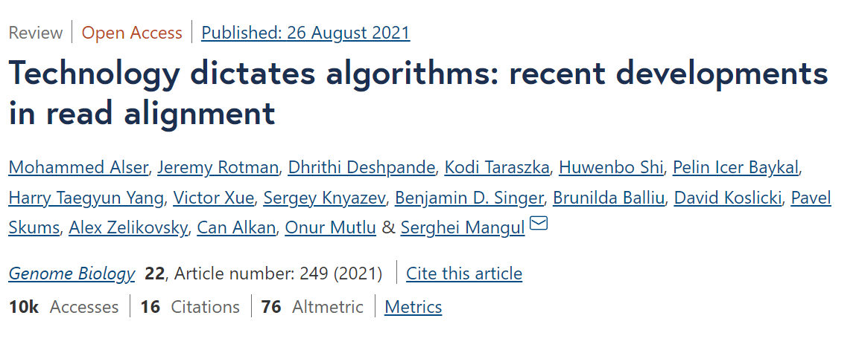
Introduction to short read alignments
What alignment tools (short read and others) are available
Take a look at a comprehensive table of 107 alignment tools published since 1988 to 2020
https://genomebiology.biomedcentral.com/articles/10.1186/s13059-021-02443-7/tables/1

Slide 9
Introduction to short read alignments
Popular and established short read aligners
Name | Link | Domain | Comment | Cited
HISAT2 | http://daehwankimlab.github.io/hisat2/ | RNA-seq | Splice-aware aligner popular, my primary choice for RNA-seq | 4212
STAR | https://github.com/alexdobin/STAR | RNA-seq | Splice-aware aligner, used by both researchers and genome centers | 29749
BWA | https://github.com/lh3/bwa | DNA-seq | Probably most popular in variant calling and other domains of DNA-seq (WGS, exome seq, ChIP-seq, etc) | 38636
bowtie2 | https://github.com/BenLangmead/bowtie2 | DNA-seq | Another good and well cited DNA-seq alignment | 38517
minimap2 | https://github.com/lh3/minimap2 | DNA-seq | Recommended for long reads from PacBio and Oxford nanopore | 5475
BBMap | https://sourceforge.net/projects/bbmap/ | DNA- and RNA-seq | Versatile aligner written in Java | 1037

Slide 10
Introduction to short read alignments
Picking the right aligner
Can the aligner handle your input data (paired- or single-end, long vs short, sequencing platform, etc.)?
What is the output, for example, does it produce the alignments in SAM format?
How does it handle gaps?
Will it work on your system?
Is it well cited, supported by developers and mature?
Is it recommended by the developers and academic community for your use case?
Is it recommended in “best practice” guides (for example, Best Practice Workflows GATK)?
Additional information provided: splicing, soft-clipping, chimeric alignments, etc?

Slide 11
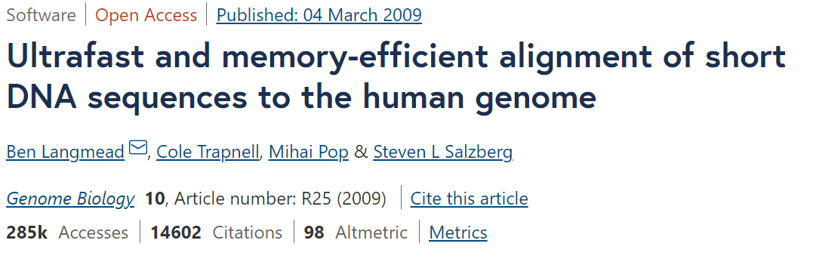
Mapping with Bowtie
Practice short read alignments with bowtie
Disclaimer: we use bowtie as introductory software for training, use bowtie2 or BWA for actual genomic analysis!
Bowtie is a fast un-gapped (does not detect gaps) aligner that was popular once, but now is superseded by bowtie2 that allows gaps
Link to bowtie manual
https://bowtie-bio.sourceforge.net/manual.shtml
Let’s open and read bowtie manual, it’s well written and concise!

Slide 12
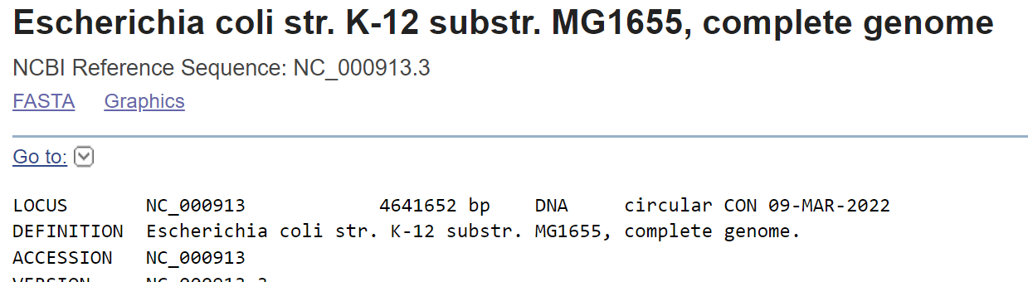
Mapping with Bowtie
Short read alignment process
Typically, short read alignment includes 2 steps
Creating a reference index
Mapping the reads to the reference
Let’s download a reference and create an index
We will use E. coli reference genome shown the screenshot:

Slide 13
Mapping with Bowtie
Short read alignment process
Download and index genome
Make sure you are in sandbox/ directory
$ mkdir -p GENOMES/E_coli # -p option will allow to create subdirectories
$ ls -lh GENOMES
$ cd GENOMES/E_coli
$ esearch -db nucleotide -query "NC_000913.3" | efetch -format fasta > Ecoli_K12.fasta
$ ls -lh # Check the result
Create E.coli genome index
Link to indexing section of the bowtie manual:
https://bowtie-bio.sourceforge.net/manual.shtml#the-bowtie-build-indexer
Bowtie index command syntax:
bowtie-build [options] <reference_in> <ebwt_base>

Slide 14
Mapping with Bowtie
Short read alignment process
Build bowtie index
$ mkdir bowtie_index # Create index directory
$ cd bowtie_index
$ bowtie-build ../Ecoli_K12.fasta Ecoli_K12
$ ls -lh # Check the files created
$ cd ../../
$ echo "GENOMES directory content" > README_GENOMES.txt # Let’s create documentation for our GENOMES directory
$ echo "E_coli/ : Escherichia coli str. K-12 substr. MG1655, complete genome. NCBI Reference Sequence: NC_000913.3" >> README_GENOMES.txt
$ cat README_GENOMES.txt # view resulting document
$ cd ../ # Return to sandbox/ directory

Slide 15
Mapping with Bowtie
Short read alignment process
Mapping the reads
First, let’s take a look at some of bowtie mapping options
Options:
-v, -n, -e, -l : this options decide which alignments are considered valid
-k, -a, -m, -M, --best, --strata : decide which alignments will be reported
-q, -f, -c, --phred64-quals : some input options
--al, --un, --suppress, -t : some output options
-S, --no-unal, --mapq : some SAM options
-p : performance options, parallelization

Slide 16
Mapping with Bowtie
Short read alignment process
Most useful options (in my opinion):
-v <INT> – number of mismatches allowed in the entire read
-n <INT> – number of mismatches allowed in l left-most reads set by -l option
-l <INT> – seed length of l (number of left-most bases to be matched exactly)
-v and -n modes are mutually exclusive
-k <INT> - report up to <INT> valid alignments
-m <INT> – suppress all reads with number of hits exceeding a number specified by -m option
--best – guarantees to find best alignment at the expense of speed (I recommend to always use this option)
--tryhard – try hard to find valid alignments, if they exist (very slow!)

Slide 17
Mapping with Bowtie
Short read alignment process
Most useful options (in my opinion):
-v <INT> – number of mismatches allowed in the entire read
-n <INT> – number of mismatches allowed in l left-most reads set by -l option
-l <INT> – seed length of l (number of left-most bases to be matched exactly)
-v and -n modes are mutually exclusive
-k <INT> - report up to <INT> valid alignments
-m <INT> – suppress all reads with number of hits exceeding a number specified by -m option
--best – guarantees to find best alignment at the expense of speed (I recommend to always use this option)
--tryhard – try hard to find valid alignments, if they exist (very slow!)

Slide 18
Mapping with Bowtie
Short read alignment process
Let’s practice bowtie alignments with some examples.
The examples are from bowtie manual with some modifications
Map a single sequence to E_coli genome with 2 mismatches allowed across full length of the sequence
$ bowtie -a -v 2 GENOMES/E_coli/bowtie_index/Ecoli_K12 -c ATGCATCATGCGCCAT # -a – output all valid alignments, -v 2 – allow up to 2 mismatches across a full length of the sequence, -c – get the sequence from the command line
Output format:
Col 1. Query id
Col 2. Reference strand the read was mapped to – sense/antisense
Col 3. Reference sequence id
Col 4. 0-based start of the match
Col 5. Query sequence (reverse complemented if reference is ‘-’)
Col 6. Read qualities
Col 7. Contains prescribed ceiling if –M option was set and the ceiling was exceeded
Col 8. Comma separated mismatch descriptors

Slide 19
Mapping with Bowtie
Short read alignment process
More examples:
We can change the format of default output with --suppress option
$ bowtie -a -v 2 GENOMES/E_coli/bowtie_index/Ecoli_K12 --suppress 1,2,3,6,7 -c ATGCATCATGCGCCA # We suppressed the columns that do not carry any additional information when mapping a single sequence
Let’s limit the number of valid alignments reported to 3
$ bowtie -k 3 -v 2 GENOMES/E_coli/bowtie_index/Ecoli_K12 --suppress 1,2,3,6,7 -c ATGCATCATGCGCCA # Repeat this command a couple of times, do the reported alignments change?
Combine -k, --best and --strata to report only a specified number of best alignments within a “stratum”
$ bowtie -k 3 -v 2 --best --strata GENOMES/E_coli/bowtie_index/Ecoli_K12 --suppress 1,2,3,6,7 -c ATGCATCATGCGCCA # in this case, the “stratum” is defined by the number of mismatches, notice that only the reads in the best stratum (1 mismatch) are reported

Slide 20
Mapping with Bowtie
Short read alignment process
More examples:
Do not report the alignments for the reads with the number of valid matches that exceed the limit specified in -m
$ bowtie -a -m 20 -v 2 GENOMES/E_coli/bowtie_index/Ecoli_K12 --suppress 1,2,3,6,7 -c ATGCATCATGCGCCA # this read has 21 valid alignment with up to 2 mismatches
$ bowtie -a -m 22 -v 2 GENOMES/E_coli/bowtie_index/Ecoli_K12 --suppress 1,2,3,6,7 -c ATGCATCATGCGCCA # This will report all 21 valid alignments since it is below the -m limit of 22. Typically, this option is used to exclude the reads mapping to repeats, for example -m 1 will result in reporting the alignments with a single valid match
Let’s map a couple of reads and get the output in SAM format
$ bowtie -a -v 2 --best --strata GENOMES/E_coli/bowtie_index/Ecoli_K12 -c GTTGGATCTGCCAAAAGAGCTGGCA,CAACATTATGAATGGCGAGGCAATCGCTGG,CCGAAAATGAAAGCCAGTAAAGAAG -S Ecoli_test.sam # output only the best matches for the “stratum” allowing for 2 mismatches

Slide 21
SAM format
Let’s take a look at the resulting SAM file
$ less Ecoli_test.sam
SAM stands for Sequence Alignment/Map format
SAM stores data as human readable tab delimited file. Tab delimited meaning that [TAB] was used to separate columns. In Linux tab is coded as \t
SAM stores read sequences, qualities, alignment coordinates, number of mismatches, number of times the read was mapped, was it mapped at all, etc.
SAM file consists out of 2 sections: Header section that describes the reference sequences, source of data, method of alignments Alignment section describes each individual alignment
BAM is a binary (machine code) version of sam. I would always recommed converting sam to bam and indexing resulting bam for speed and storage space considerations

Slide 22
SAM format
SAM header describes source of the data, reference sequence, method of the alignment etc. Each line starts with @ followed by 2 letter code, followed by tags and values
@HD header line VN:format version SO:sorting order
@SQ reference info SN:reference sequence LN:sequence length SP:species
@RG Read group ID:group id CN:sequencing centre SM:sample name
@PG program ID:program name VN:program version CL:command

Slide 23
SAM format
Let’s take a look at the body of a SAM containing alignments
SAM alignment format has 11 mandatory fields and any number of optional fields that may vary across different aligners
This format was designed to contain all the information about each individual alignment and make it available for visualization

Slide 24
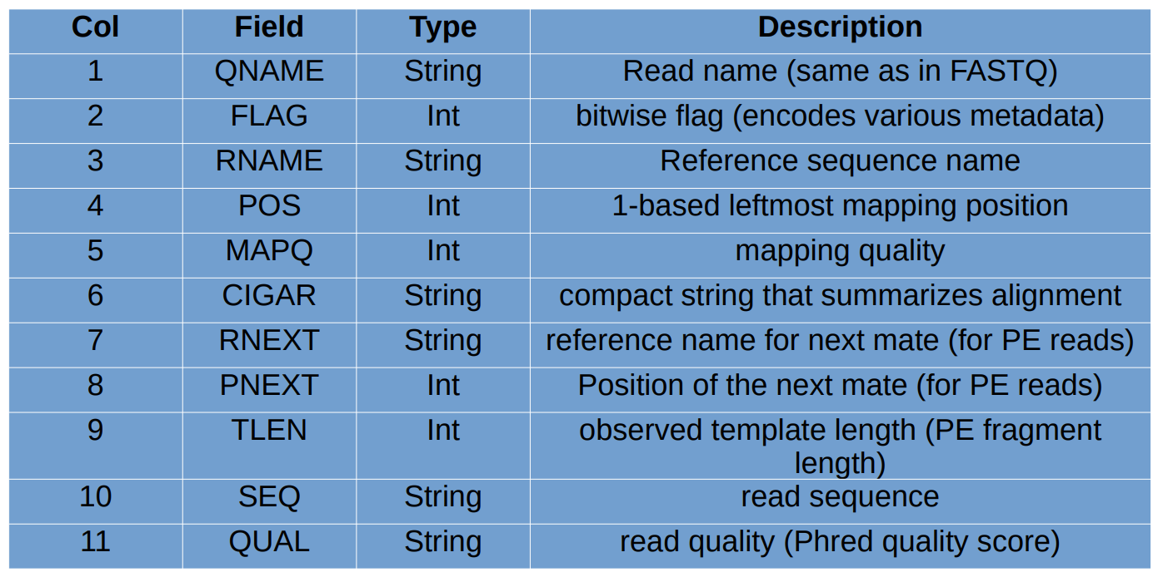
SAM format
Let’s take a look at the body of a SAM containing alignments

Slide 25
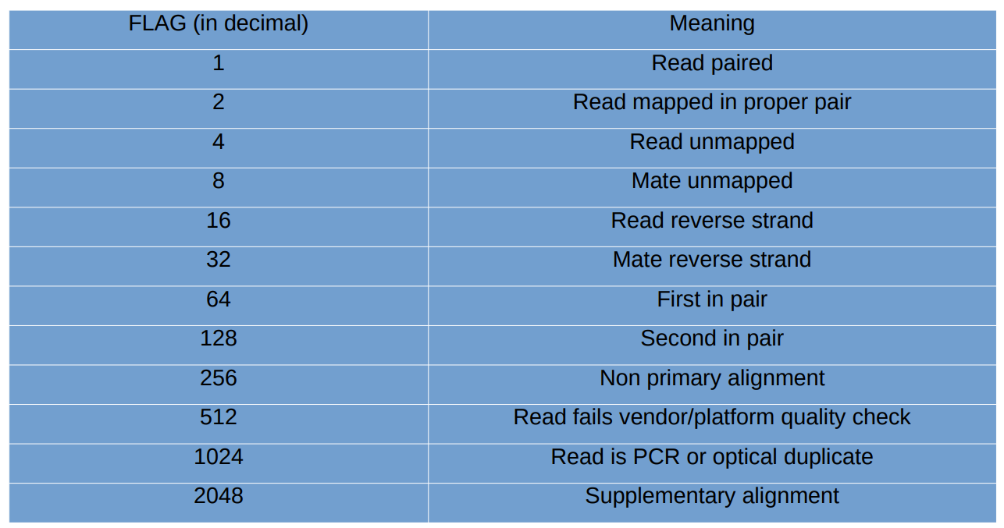
SAM format
Bitwise flags

Slide 26
SAM format
Bitwise flags
Bitwise flags are counter-intuitive and not easy to understand
It was a way for the developers to include as much information into a single number as possible
It is difficult to use flags correctly
Individual flags are combined to form the value of the second column of a SAM file
For example, IF:
Read paired : 1
Read mapped in proper pair : 2
Mate reverse strand : 32
THEN the value of the second column will be 1 + 2 + 32 = 35 or 0X23 in hexadecimal, the software needs to decompose every value of the second column to select alignments with a certain attribute

Slide 27
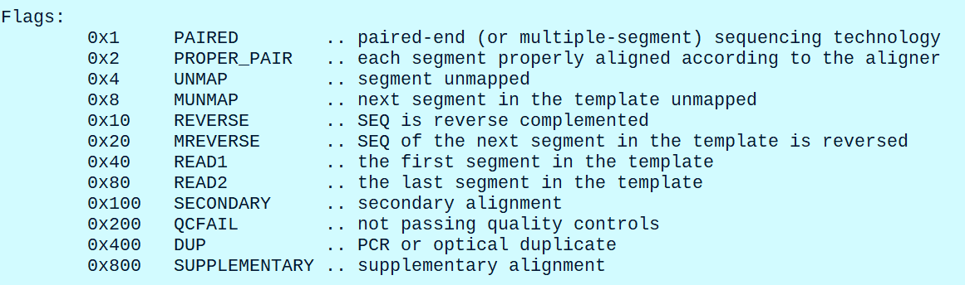
SAM format
We can use samtools to take a look at bitwise flags
$ samtools flags
Explain SAM flags service: Explain SAM Flags (broadinstitute.github.io)

Slide 28
SAM format
Manipulating SAM files with samtools
Let’s check our theory that flag 35 means read paired ,properly paired, and mate in reverse
$ samtools flags 35
Samtools functions: viewing, filtering, sorting, indexing alignments, calling small nucleotide variants, data extraction, format conversion, duplicate read removal
Samtools allows creation of Unix-style pipes, i.e. streaming the output of one command as input to another
Manual: http://www.htslib.org/doc/samtools.html
Let’s create a more realistic SAM file to use for practice with samtools
Download a sample of M.tuberculosis sequencing file from GEO. Link to the file: https://trace.ncbi.nlm.nih.gov/Traces/sra/?run=SRR17227596

Slide 29
SAM format
Manipulating SAM files with samtools
Download the sequencing reads from SRA archive
$ ~/programs/sratoolkit.3.0.1-ubuntu64/bin/prefetch -v -p SRR17227596
Check the contents of the newly creates directory, it should contain an .sra file
$ ls -lh SRR17227596
Dump the reads into fastq file
$ ~/programs/sratoolkit.3.0.1-ubuntu64/bin/fasterq-dump SRR17227596
Take a look at the file
$ head -n 20 SRR17227596.fastq
Print basic stats with seqkit
$ seqkit stats SRR17227596.fastq

Slide 30
SAM format
Manipulating SAM files with samtools
Subsample 200,000 random reads with seqtk
$ seqtk sample SRR17227596.fastq 200000 > Mtub_sub.fastq
Verify the results
$ seqkit stats Mtub_sub.fastq
Download M. tuberculosis H37Rv genome using efetch, the accession number is NC_000962.3
Name the resulting fasta file M_tuber_H37Rv.fasta
Move M. tuberculosis fasta file to M_tuber/ directory in GENOMES/
Create a bowtie index for M. tuberculosis and place it in bowtie_index/ folder inside in M_tuber/ directory
Update README_GENOMES file accordingly

Slide 31
SAM format
Manipulating SAM files with samtools
Map the sub-sample to M. tuberculosis genome
$ bowtie --threads 2 -q --phred33-quals -n 1 -k 10 -l 28 --best GENOMES/M_tuber/bowtie_index/M_tuber_H37Rv Mtub_sub.fastq -S Mtub.sam # --threads 2 – use 2 processor cores in parallel; -k 10 – allow up to 10 alignments per reads; -q – reads file is fastq; --phred33-quals – Phred 33 quality scores; -n 1 – allow up to 1 mismatches in the seed; -l 28 – lengths of the seed is 28 nt at leftmost end of the read; --best – guarantees to find the matches
Let’s take a look at the resulting SAM file
$ head Mtub.sam
$ wc -l Mtub.sam # What is the number of lines in the file, is it higher than the number of the reads?
Let’s take a look a samtools manual and get familiar with the syntax and the options
http://www.htslib.org/doc/samtools.html
There is a lot we can do with samtools!

Slide 32
SAM format
Manipulating SAM files with samtools
A typical task in NGS analysis is to convert SAM files to BAM, sort, and index
BAM files are much smaller and faster to work with, while they contain the same data
$ samtools view -b Mtub.sam > Mtub.bam
$ head Mtub.bam # This produces gibberish, since bam files are not human readable
$ samtools sort Mtub.bam -o Mtub.sorted.bam # sort the alignments by chromosomal position
$ samtools index Mtub.sorted.bam # index the file for fast random access, lots of bioinformatics tools require bam files to be sorted and indexed
Compare the size of SAM and BAM files
$ ls -lh Mtub.sam | cut -d ' ' -f 5
$ ls -lh Mtub.bam | cut -d ' ' -f 5

Slide 33
SAM format
Manipulating SAM files with samtools
A typical task in NGS analysis is to convert SAM files to BAM, sort, and index
BAM files are much smaller and faster to work with, while they contain the same data
$ samtools view -b Mtub.sam > Mtub.bam
$ head Mtub.bam # This produces gibberish, since bam files are not human readable
$ samtools sort Mtub.bam -o Mtub.sorted.bam # sort the alignments by chromosomal position
$ samtools index Mtub.sorted.bam # index the file for fast random access, lots of bioinformatics tools require bam files to be sorted and indexed
Compare the size of SAM and BAM files
$ ls -lh Mtub.sam | cut -d ' ' -f 5
$ ls -lh Mtub.bam | cut -d ' ' -f 5

Slide 34
SAM format
Manipulating SAM files with samtools
Extract matches restricted to a genomic interval and write them into a new bam file
$ samtools view -b Mtub.sorted.bam "NC_000962.3:1000-10000" > region.bam # -b option ensures that extracted alignments are saved as bam, otherwise they are output as sam by default
Count all alignments (including unmapped) with samtools view and -c option
$ samtools view -c Mtub.sorted.bam
$ samtools view -c Mtub.sorted.bam "NC_000962.3:1000-10000“ # -c can be combined with other options, like regions and filters
Filter alignments based in flags
Go to http://broadinstitute.github.io/picard/explain-flags.html and find a flag for unmapped reads (spoiler alert it is 4)
$ samtools view -b -F 4 Mtub.sorted.bam > Mtub.mapped.bam # -F 4 – print all alignments excluding unmapped (flag 4), output as bam (-b option)
$ samtools view -F 4 -c Mtub.sorted.bam # count all alignments (not reads!) for mapped reads

Slide 35
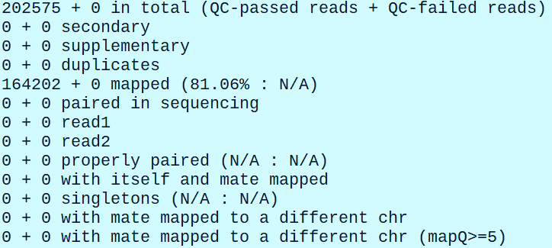
SAM format
Manipulating SAM files with samtools
Count all unmapped alignments (will be the same as unmapped reads)
$ samtools view -f 4 -c Mtub.sorted.bam
Count PCR/optical duplicates
$ samtools view -f 1024 -c Mtub.sorted.bam
Output SAM file statistics
$ samtools flagstat Mtub.sorted.bam

Slide 36
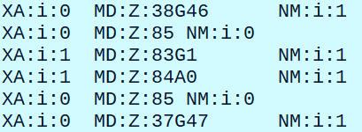
SAM format
Manipulating SAM files with samtools
Task: Use https://broadinstitute.github.io/picard/explain-flags.html site to figure out how to output forward and reverse alignments using samtools filtering based on flags
Hint: forward → check unmapped and reverse
Optional bowtie flags:
Take a look at the last 3 columns
$ samtools view Mtub.sorted.bam | cut -f 12-14 | head

Slide 37
SAM format
Manipulating SAM files with samtools
Bowtie optional fields
XA:i:<N> - aligned read belongs to stratum N, the stratum is defined by the number of mismatches in the seed regions
MD:Z:<S> - <S> is a string representation of mismatches in the reference, for example MD:Z:38G46 means that 38 leftmost bases match, then base 39 is mismatch with G in the reference, and 46 next bases match
NM:i:<INT> - Contains edit distance to reference stored as integer value <INT>. Edit distance is measure of similarity between sequences, it tells as how many edits we need to make to
Optional field specifications: https://samtools.github.io/hts-specs/SAMtags.pdf

Slide 38
SAM format
Manipulating SAM files with samtools
We can filter the alignments based on the optional fields
Example, count the number of alignments with 0 mismatches
$ samtools view Mtub.sorted.bam | grep 'XA:i:0' | wc –l
How to get detailed help for samtools
$ samtools view -?
$ samtools sort -?
Using multiple processor cores with -@ option
$ time samtools sort Mtub.sam -o Mtub.sorted.bam # time the sorting time with time
$ time samtools -@ 2 sort Mtub.sam -o Mtub.sorted.bam # -@ 2 tells to use 2 processor cores

Slide 39
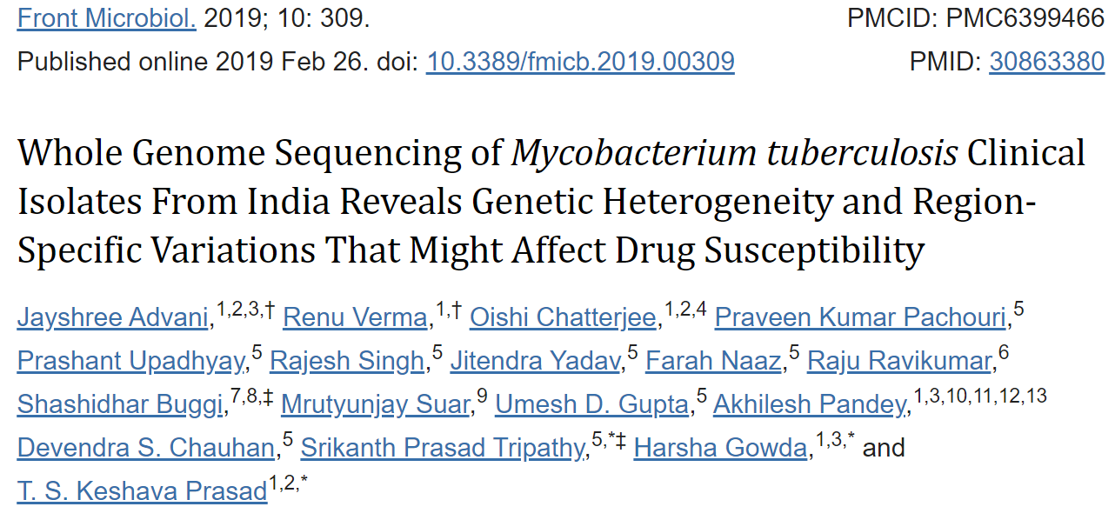
Mapping paired-end reads with Bowtie
Download practice paired-end sample
To practice, we will download one sequencing samples from the following paper
Link to the paper: https://www.ncbi.nlm.nih.gov/pmc/articles/PMC6399466/

Slide 40
Mapping paired-end reads with Bowtie
Download practice paired-end sample
Scan the methods section of the paper to understand what was done
Locate data availability section with BioProject accession number
Use the accession number to search NCBI SRA database
Locate and download one of the paired-end sequencing samples we will practice with. You can use Entrez utilities or wget
Hints:
How to search for SRA accession number with BioProject accession
$ esearch -db sra -query <PRJNAxxxxxx> | efetch -format runinfo # this will print RunInfo file
How to fetch SRA file
$ ~/programs/sratoolkit.3.0.1-ubuntu64/bin/prefetch -v -p <SRRxxxxxxx>

Slide 41
Mapping paired-end reads with Bowtie
Download practice paired-end sample
Hints:
We can also download SRA files with wget, URLs can be found in RunInfo file
$ esearch -db sra -query PRJNA379070 | efetch -format runinfo | cut -d ',' -f 1,10 # This command will grab the SRA accession numbers and their URLs from RunInfo file
We can use SRA file URL to download a file directly with wget.
$ wget https://sra-downloadb.be-md.ncbi.nlm.nih.gov/sos5/sra-pub-zq-14/SRR005/341/SRR5341272.sralite.1 # there is a possibility that SRA will block your IP if you are downloading too many files
Resulting file can be dumped to FASTQ using fasterq-dump from sra-tools
$ ~/programs/sratoolkit.3.0.1-ubuntu64/bin/fasterq-dump --split-3 SRR5341272.sralite.1 # --split-3 – option will split paired-end SRA into 2 properly formatted fastq files from Read1 and Read2
Now, use these commands to retrieve one of the sequencing samples from Advani et al, 2019, rename fastq files to india.R1.fastq and india.R2.fastq

Slide 42
Mapping paired-end reads with Bowtie
Let’s view the basic stats for these fastq files and map the reads
$ seqkit -j 2 stats india.R* -a # -j 2 will use 2 processor cores, -a will print additional columns in summary stats
To reduce mapping types, let’s subsample 10,000 random reads
$ seqtk sample -s100 india.R1.fastq 10000 > sub1.fq
$ seqtk sample -s100 india.R2.fastq 10000 > sub2.fq # when sub-sampling paired-end reds we need to set the same seed for random number algorithm for both commands
Map paired-end reads to M.tuberculosis genome
$ bowtie --threads 2 --fr GENOMES/M_tuber/bowtie_index/M_tuber_H37Rv -1 sub1.fq -2 sub2.fq -S india.sam # --fr – is a paired-end specific option that tells the aligners that mate 1 is in forward direction and mate 2 is mapped in reverse. Note, the low number of mapped reads, bowtie is not a suitable aligner in this case!
What happens if we specify the strandness of the library as --rf?
bowtie --threads 2 --rf GENOMES/M_tuber/bowtie_index/M_tuber_H37Rv -1 sub1.fq -2 sub2.fq test.aln # Almost no reads are mapped, specifying strandness is important

Slide 43
Mapping paired-end reads with Bowtie
Typed of sequencing library strandness
Illumina paired-end
Illumina mate-pair
FR
RF
R1
R2
R1
R2
Fragment length
Solid paired-end
FF
RR
R1
R2
R1
R2

Slide 44
Mapping paired-end reads with Bowtie
Let’s take a look a the sam file format after paired-end alignments
View basic stats with samtools
$ samtools flagstat india.sam
Let’s take a look at some lines of the SAM file
$ samtools view -h india.sam | head # -h – option will skip the header lines; most of the lines in this case are not aligned hence fields storing coordinates are 0
Let’s retain mapped reads only and take a look at paired-end specific columns 7, 8, 9
$ samtools view -F 4 india.sam | head # take a look at mapped reads
$ samtools view -F 4 india.sam | head | cut -f 7-9 # select columns specific to paired-end reads
Column | SAM Description | Meaning
7 | RNEXT | Reference name for the second mate alignment
8 | PNEXT | Coordinate for the start for second mate alignment
9 | TLEN | Fragment length

Slide 45
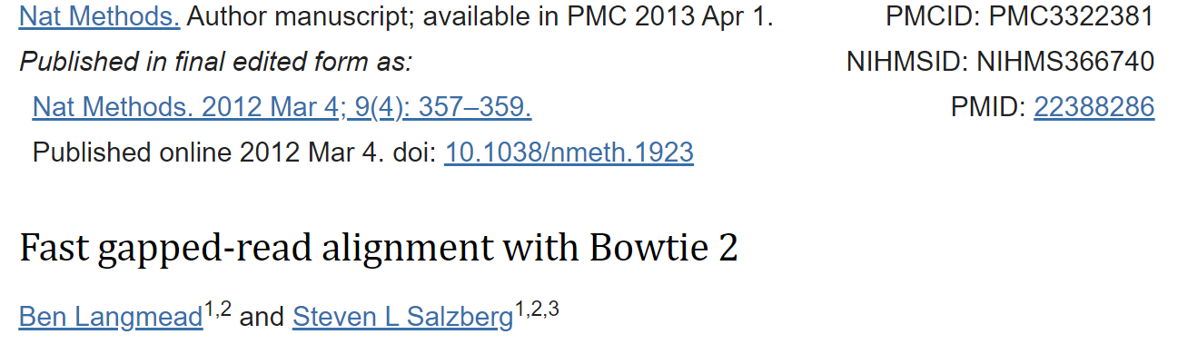
Mapping with Bowtie2
Install bowtie2, take a look at bowtie2 documentation
Bowtie2 paper: https://www.ncbi.nlm.nih.gov/pmc/articles/PMC3322381/
Scan through bowtie2 alignments and try to understand software capabilities and options:
https://bowtie-bio.sourceforge.net/bowtie2/manual.shtml

Slide 46
Mapping with Bowtie2
Key properties of bowtie2
Bowtie2 allows gaps
Bowtie2 is faster and more sensitive than bowtie for reads < 50 bp
Supports both end-to-end and local alignments, bowtie only had end-to-end alignments
Can map long reads, over 1000 bp
Bowtie2 does have “strata”, the alignments have continuous mapping quality scores. Bowtie had only 2 values: 0 and 255 as mapping quality scores
In case of paired-end alignments, bowtie2 tries to find valid matches for individual pairs

Slide 47
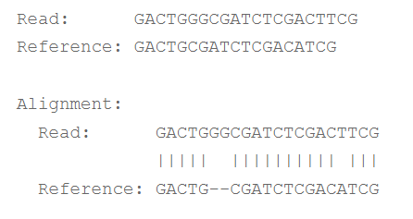
Mapping with Bowtie2
Difference between end-to-end and local alignments
End-to-end alignment searches for matches that include all characters of a sequence.
By default, bowtie2 preforms end-to-end alignment
End-to-end alignment example:

Slide 48
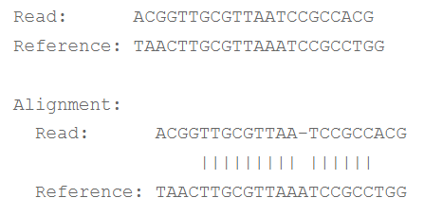
Mapping with Bowtie2
Difference between end-to-end and local alignments
In “local” alignment, some characters at the end of the read may not participate, bases at the start or end of a read that are omitted are called “soft-clipped”
Local alignments are invoked with --local option
Example of a local alignment

Slide 49
Mapping with Bowtie2
Bowtie2 alignment scoring
Alignment score measures the similarity between aligned sequences
Higher score means higher similarity
In end-to-end mode the scores are calculated by subtracting penalties for gaps and mismatches, and in local alignments by adding “bonuses” for matches
End-to-end scoring scheme: mismatch at high quality base is -6; gap open -5, gap extend -3 and second gap extend -3. The best possible match quality is 0.
In local alignments we have the same mismatch and gap penalties as in end-to-end mode, however, every match receives +2 bonus. The score a perfectly matching reads will 2 * read_length
The scoring schemes can be changes with corresponding options, however default schemes work the best in most cases

Slide 50
Mapping with Bowtie2
Bowtie2 mapping quality
Higher mapping quality corresponds to higher uniqueness
A read can have equally good matches to multiple regions, and we have no basis to prefer one match to another
A preferred alignment can be selected based on mapping quality which is a measure of probability that a read may have a different point of origin than the one determined by a given match
Mapping quality is a non-negative integer Q = -10 log p, where p is an estimate of probability that the read can have a true origin in a different location
Mapping quality depends on the difference between the best and a second-best alignment, the bigger is this difference, the higher is the mapping quality and a “uniqueness” of this match
For example, a quality of 10 or less means that there is 1 in 10 probability that the read originated some other locus than a given location of a match. Mapping qualities are recorded in MAPQ column of a SAM file (column 5).

Slide 51
Mapping with Bowtie2
Assumptions in paired-end mapping
In case of paired-end libraries we sequence a DNA fragment from both ends resulting in mate 1 and mate 2 reads.
There are certain expectations as tow how both mate reads are supposed to match the reference based on the library preparation protocol.
For example, in first-stranded (FR) libraries mate 1 originates from the forward strand of the reference and mate 2, from the reverse.
In most of library construction protocols, we expect 200 – 500 interval between mates
Concordant alignments match these expectations, while discordant do not
An example of discordant pair would be mate 1 mapping 2000 bp away from mate 2

Slide 52
Mapping with Bowtie2
Practicing bowtie2 alignments
Start with creating a bowtie2 index using M. tuberculosis genome
Create bowtie2 index and place it in /GENOMES/M_tuber/bowtie2 directory
$ bowtie2-build ../M_tuber_H37Rv.fasta M_tuber_H37Rv
Bowtie2 syntax
bowtie2 [options] -x <bt2-idx> {-1 <m1> -2 <m2> | -U <r>} -S <sam>
Run a single-end alignment with bowtie2
$ bowtie2 -p 2 --sensitive -x GENOMES/M_tuber/bowtie2_index/M_tuber_H37Rv -U sub1.fq -S test_SE.sam # Take a look at the summary of alignments printed to screen
Now, let’s try to map paired-end reads
$ bowtie2 -p 2 --fr --sensitive -x GENOMES/M_tuber/bowtie2_index/M_tuber_H37Rv -1 sub1.fq -2 sub2.fq -S test_PE.sam 2> align_stats.txt # We can re-direct alignment statistics to file from StdErr

Slide 53
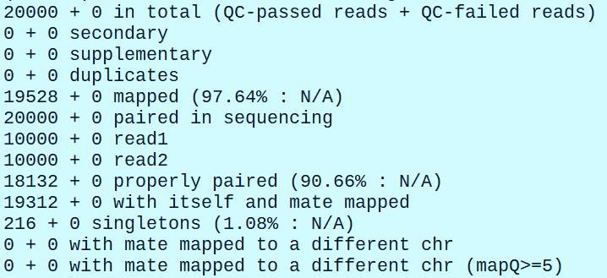
Mapping paired-end reads with Bowtie2
Flagstat output for paired alignments
Let’s take a look at the output of samtools flagstat
$ samtools flagstat test_PE.sam
samtools flagstat manual: http://www.htslib.org/doc/samtools-flagstat.html
Explain SAM flags: https://broadinstitute.github.io/picard/explain-flags.html

Slide 54
Mapping paired-end reads with Bowtie2
Flagstat output for paired alignments
Some cryptic terms in flagstat output:
Secondary alignments – refers to multimapping reads, one of the mutimappers is considered “primary”, and the rest are secondary alignments
Primary
Secondary
Secondary
Secondary

Slide 55
Mapping paired-end reads with Bowtie2
Flagstat output for paired alignments
Some cryptic terms in flagstat output:
Supplementary alignments – are related to non-linear/fusion/chimeric alignments, where the sequence is broken into segments to align. One of the segment will be considered “primary” and another “supplementary”. This choice can be arbitrary
chr1
Primary
Secondary
chr2

Slide 56
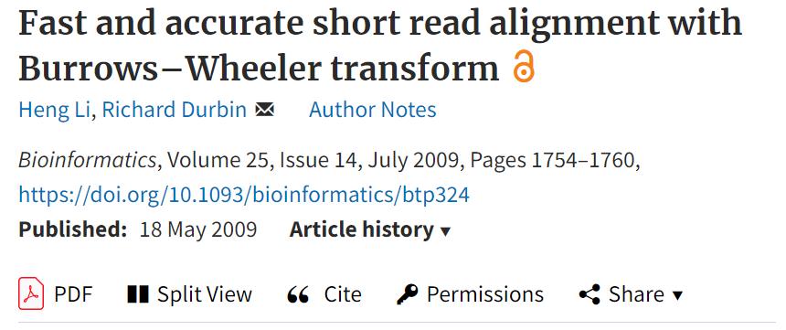
Mapping with BWA
Install BWA (Burrows-Wheelers Aligner) and take a look at the manual
Original paper - https://academic.oup.com/bioinformatics/article/25/14/1754/225615
BWA mem paper - https://arxiv.org/pdf/1303.3997v2.pdf
Manual: https://bio-bwa.sourceforge.net/bwa.shtml

Slide 57
Mapping with BWA
Different algorithms within BWA
BWA employes 3 different algorithms: BWA-backtrack, BWA-MEM, and BWA-SW
The syntax of alignments for all 3 algorithms
bwa aln ref.fa short_read.fq > aln_sa.sai # BWA-backtrack, best for short reads below 100 bp
bwa mem ref.fa reads.fq > aln-se.sam # BWA-MEM single-end
bwa mem ref.fa read1.fq read2.fq > aln-pe.sam # BWA-MEM paired-end
bwa samse ref.fa aln_sa.sai short_read.fq > aln-se.sam # converts sai file to sam for single-end reads

Slide 58
Mapping with BWA
Different algorithms within BWA
bwa sampe ref.fa aln_sa1.sai aln_sa2.sai read1.fq read2.fq > aln-pe.sam # converts sai file to sam for paired-end reads
bwa bwasw ref.fa long_read.fq > aln.sam # BWA SW algorithm for reads longer than 100 bp, now superseded by BWA MEM

Slide 59
Mapping with BWA
Different algorithms within BWA
BWA-backtrack invoked with bwa aln command is recommended for short reads below 100 bp
BWA SW (bwa samse and bwa sampe) commands are now deprecated, the author of BWA recommends using BWA-MEM instead
BWA MEM is current version of the algorithm that should be used for the reads longer than 100 bp
Backtrack algorithm searches for exact end-to-end matches. If an exact match is not found, the program tries all single edits, all possible 2-character edits, etc.
This is problematic since the time of execution grows exponentially with increasing number of errors and, I expect, increasing read length. To avoid this the program is instructed to stop and throw out a read once the divergence between the query and reference increases over a certain threshold set in -maxDiff option
BWA-MEM detects long exact matches between the read and the reference, and chains them into local or global alignments, based on what is more appropriate in that specific case

Slide 60
Mapping with BWA
Practice mapping with BWA
First, create an index of M. tuberculosis genome in GENOMES/M_tuber/bwa_index
$ bwa index ../M_tuber_H37Rv.fasta
Let’s map the reads with BWA-backtrack algorithm
$ bwa aln GENOMES/M_tuber/bwa_index/M_tuber_H37Rv.fasta sub1.fq > sub1_sa.sai
Now we need to convert an intermediate .sai file to .sam
$ bwa samse GENOMES/M_tuber/bwa_index/M_tuber_H37Rv.fasta sub1_sa.sai sub1.fq > sub1.sam
$ samtools flagstat sub1.sam # take a look at mapping stats
Let’s map paired-end reads with bwa aln
$ bwa aln GENOMES/M_tuber/bwa_index/M_tuber_H37Rv.fasta sub1.fq > sub1_sa.sai
$ bwa aln GENOMES/M_tuber/bwa_index/M_tuber_H37Rv.fasta sub2.fq > sub2_sa.sai
$ bwa sampe GENOMES/M_tuber/bwa_index/M_tuber_H37Rv.fasta sub1_sa.sai sub2_sa.sai sub1.fq sub2.fq > sub_pe.sam
$ samtools flagstat sub_pe.sam

Slide 61
Mapping with BWA
Practice mapping with BWA
Map single end reads with bwa mem
$ bwa mem GENOMES/M_tuber/bwa_index/M_tuber_H37Rv.fasta sub1.fq > mem_se.sam
$ samtools flagstat mem_se.sam
Map paired end reads with bwa mem
$ bwa mem GENOMES/M_tuber/bwa_index/M_tuber_H37Rv.fasta sub1.fq sub2.fq > mem_pe.sam
$ samtools flagstat mem_pe.sam
Take a look at the alignments
$ samtools view -h mem_pe.sam
$ samtools view mem_pe.sam | head | cut -f 5 # BWA produces proper MAPQ scores (mapping quality) recorded in column 5 of the SAM file

Slide 62
Visualizing alignments
Let’s create a larger subsample from india.Rx.fastq files, this time will sample 200,000 files
$ seqtk sample -s100 india.R1.fastq 200000 > sub1.fq
$ seqtk sample -s100 india.R2.fastq 100000 > sub2.fq
Verify that the number of sequences is the same
$ grep '@SRR' sub1.fq | wc -l
$ grep '@SRR' sub1.fq | wc –l
Map the reads to M. tuberculosis genome with BWA
$ bwa mem GENOMES/M_tuber/bwa_index/M_tuber_H37Rv.fasta sub1.fq sub2.fq > mem_pe.sam
Convert resulting file to bam, sort and index
$ samtools view -b mem_pe.sam > mem_pe.bam
$ samtools sort mem_pe.bam -o mem_pe.sorted.bam
$ samtools index mem_pe.sorted.bam

Slide 63
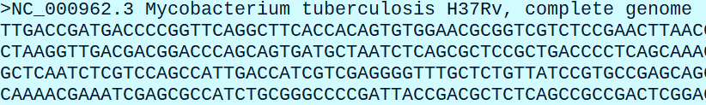
Visualizing alignments
View the alignments with samtools tview
Manual: http://www.htslib.org/doc/samtools-tview.html
samtools tview is a fast text-based interactive browser, that allows to view the alignments in Linux terminal
Command syntax
samtools tview -p <chr:start-end> -d display -s STR <sorted.bam> <reference.fasta>
We need to know the name of the chromosomes (or a single chromosome in our case), to navigate across the genome
$ head GENOMES/M_tuber/M_tuber_H37Rv.fasta

Slide 64
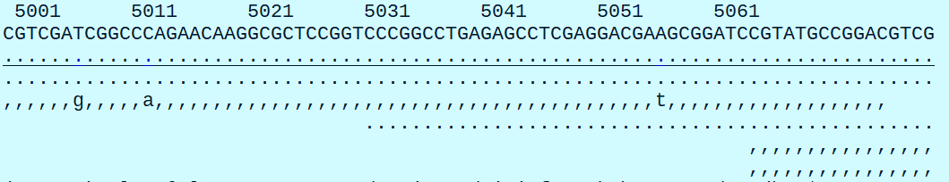
Visualizing alignments
View the alignments with samtools tview
Let’s view the alignments 5000 bp
$ samtools tview -p NC_000962.3:5000 mem_pe.sorted.bam GENOMES/M_tuber/M_tuber_H37Rv.fasta
Top line is a reference sequence
Below the reference sequence we see a consensus sequence in dot notation. In dot notation, ‘.’ are characters matching the reference, ‘,’ matching the reference in reverse, only mismatches are shown as characters

Slide 65
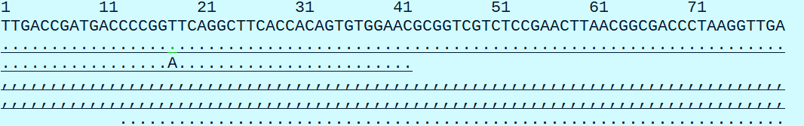
Visualizing alignments
View the alignments with samtools tview
Let’s view the alignments 5000 bp
$ samtools tview -p NC_000962.3:5000 mem_pe.sorted.bam GENOMES/M_tuber/M_tuber_H37Rv.fasta
Here we observe a T/A mismatch highlighted in green
Sequence of dots under the reference is a consensus sequence – theoretical representation of sequence of where each character is the most frequent character observed in aligned reads

Slide 66
Visualizing alignments
View the alignments with Integrative Genomic Viewer (IGV)
Home page: https://software.broadinstitute.org/software/igv/
User guide: https://software.broadinstitute.org/software/igv/UserGuide
IGV is a powerful genomic viewer designed in Broad Institute
IGV has a graphical user integrate
It can show alignments, coverage data, genomic intervals, genomic variants and other forms of genomic data
In addition, IGV’s functionality permits data transformation and export

Slide 67
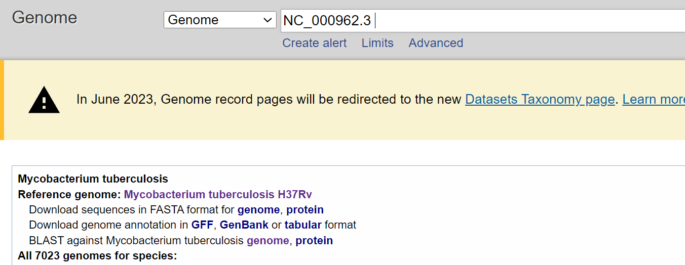
Visualizing alignments
View the alignments with Integrative Genomic Viewer (IGV)
Let’s obtain gene annotation for M. tuberculosis H37Rv with the accession number NC_000962.3
We need GFF file containing annotation data for NC_000962.3 genome

Slide 68
Visualizing alignments
View the alignments with Integrative Genomic Viewer (IGV)
Create annotation/ directory in GENOMES/M_tuber folder
$ mkdir -p GENOMES/M_tuber/annotation
Download GFF file using wget
$ wget https://ftp.ncbi.nlm.nih.gov/genomes/all/GCF/000/195/955/GCF_000195955.2_ASM19595v2/GCF_000195955.2_ASM19595v2_genomic.gff.gz
Unzip GFF file and move it to GENOMES/M_tuber/annotation
$ gunzip GCF_000195955.2_ASM19595v2_genomic.gff.gz && mv GCF_000195955.2_ASM19595v2_genomic.gff GENOMES/M_tuber/annotation/

Slide 69
Visualizing alignments
Create reference fasta index
Reference index is created using samtools faidx command
Read the manual: http://www.htslib.org/doc/samtools-faidx.html
Command syntax
samtools faidx <ref.fasta>
Create index
$ cd GENOMES/M_tuber
$ samtools faidx M_tuber_H37Rv.fasta
$ ls -lh
We will see a newly created M_tuber_H37Rv.fasta.fai
$ cat M_tuber_H37Rv.fasta.fai # the output is a 5 column text file, like below
NC_000962.3 4411532 63 70 71

Slide 70
Visualizing alignments
Create reference fasta index
Format of the .fai file
Column 1: The contig name. In your FASTA file, this is preceeded by '>’
Column 2: The number of bases in the contig
Column 3: The byte index of the file where the contig sequence begins. (Notice how it constantly increases by roughly the amount in column 2?)
Column 4: bases per line in the FASTA file
Column 5: bytes per line in the FASTA file
We can also use samtools faidx to extract subsequences from a fasta file:
$ samtools faidx M_tuber_H37Rv.fasta NC_000962.3:2000-3000 # this will extract a sequence between 2000 and 3000 bp

Slide 71
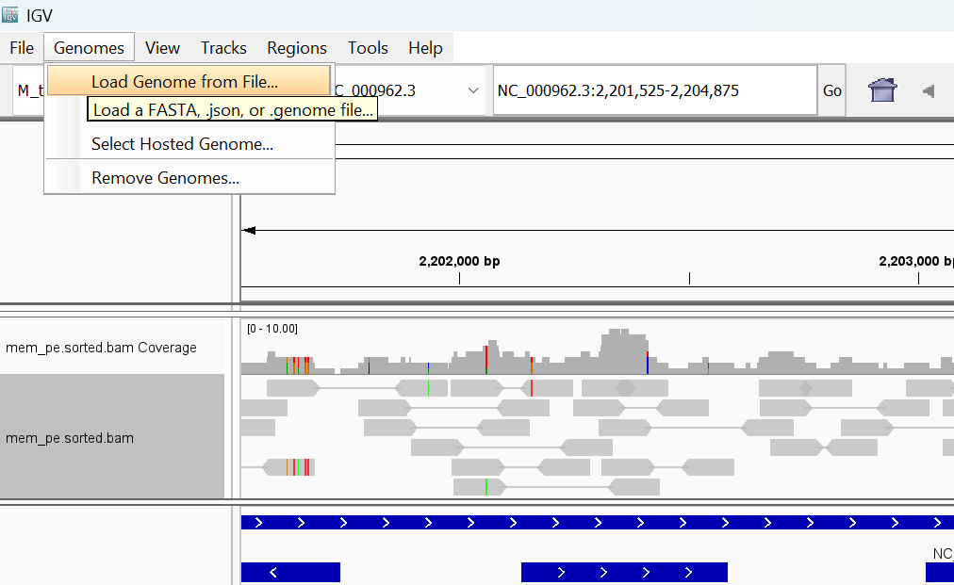
Visualizing alignments
Launch IGV and load the genome reference from file

Slide 72
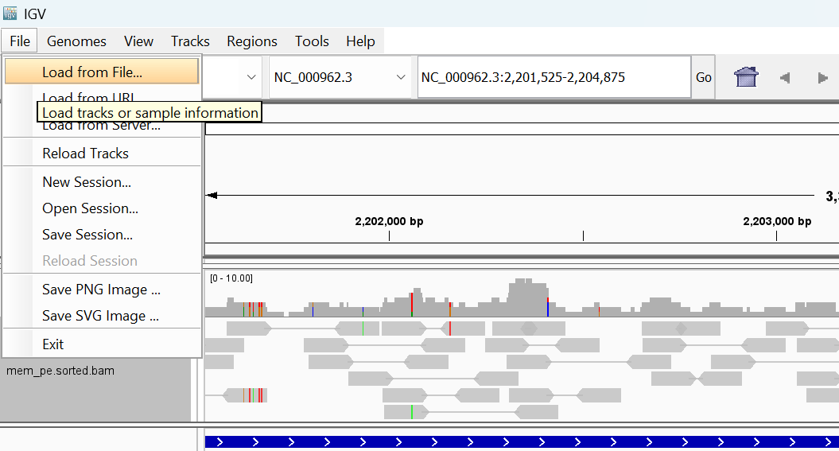
Visualizing alignments
Load GFF and bam file using “Load from File” tab, bam file needs to be sorted and indexed

Slide 73
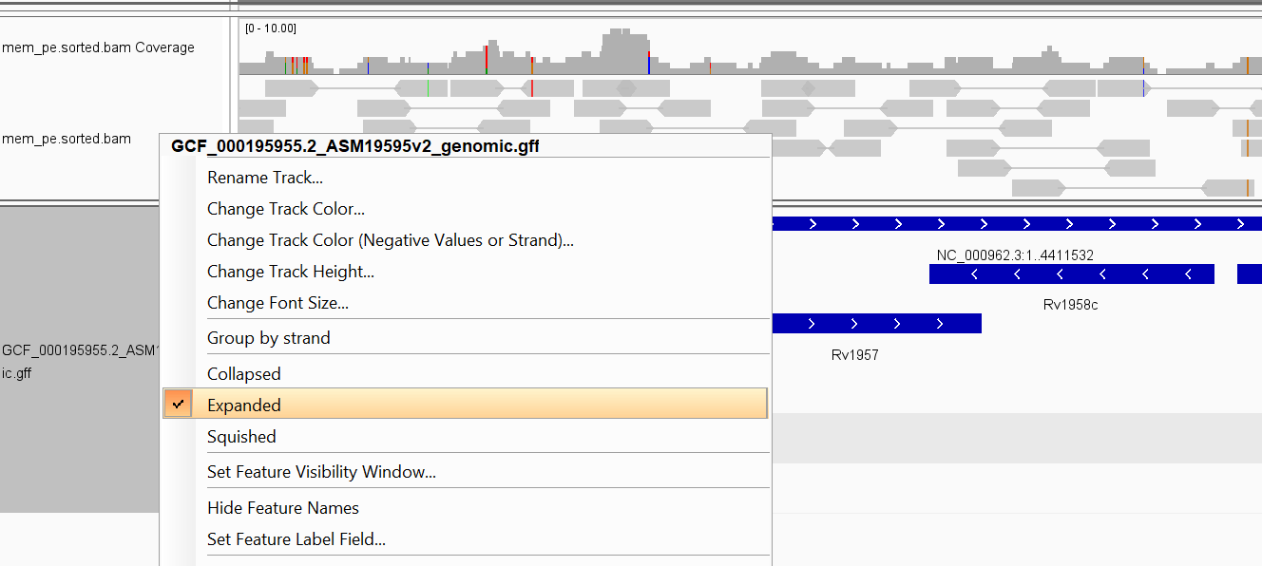
Visualizing alignments
Now we can expand the tracks for better view, play around with IGV to explore it’s interface and capabilities

