Slide 1
Linux part III
Working with commands;
shell expansion and quoting;
permissions

Slide 2
How to capitalize the first letter of each word in the sentence
$ echo how to capitalize each word | sed -e "s/\b./\u\0/g“
\b – word boundary
. – match any character
\u – turn the next character to uppercase
\0 – everything that was matched, in this case everything that was matched is only ‘.’, as the word anchor is not included into the match

Slide 3
Working with commands
type displays what kind of command we are dealing with
$ type cp
$ type whoami
$ type ls
$ type type
which - where is the executable for a command located?
$ which sed
$ which which
$ which bash
$ which cd
whatis – what is this command?
$ whatis which
$ whatis cp

Slide 4
Working with commands
Get help for the command:
help <command> - works only for built-ins, like cd
$ help cd
<command> --help – print help for the command
$ grep -help
$ ls -help
man <command> - view the manual for the command in less
$ man sed
apropos <topic> – display appropriate commands that deal with certain topic
$ apropos schedule task
alias - create aliases for command
$ type c # check if command exists
$ alias c='clear’

Slide 5
Shell expansion and quoting
Shell expansion
$ echo *
$ echo *.txt
$ echo /usr/*/share
$ echo [[:upper:]]
Hidden files start with ., for example .bashrc
$ ls -l ~/.* # expand all hidden files and directories in the home folder
Arithmetic expansion
$ echo $((2 + 2))
$ echo $((10 * 4))
echo $(( (4 * 2) / 4 ))

Slide 6
Shell expansion and quoting
Arithmetic expansion (continued)
$ echo $((5/2))
$ echo $(( 0.5 * 2 )) # bash can handle only integers, use bc for non-integer calculation
Brace expansion (create text of a pattern between braces)
$ echo sample_{1..10}
$ echo sample_{A,B,C}
$ echo {1,2,3}_{_,@}
$ echo {A{1,2},B{1,2}}
$ mkdir {2022..2023}_{01..12}
Command substitution (use an output of the command in brace expansion)
$ ls -l $(which cp)
$ ls -l `which cp`

Slide 7
Shell expansion and quoting
Quoting
$ echo a b c
$ echo “a b c”
Command expansion works in double quotes
$ echo $(date)
$ echo “$(date)”
Use single quotes to suppress expansions and treat the argument as simple text
$ echo '$(date)’
Escape special characters with back slashes
$ echo \$\(date\)

Slide 8
Permissions
id – display user identity
chmod – change mode of the file
umask – sets default permissions
su – run a shell as another user
sudo – run a command as another user
chown – change file’s owner
chgrp – change file’s group ownership
passwd – change users password

Slide 9
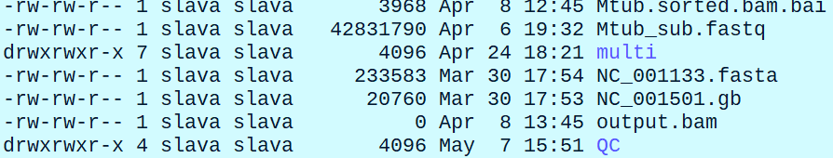
Permissions
Show user identity
$ id
View file permissions
$ ls -l
Permissions
The first character in permission line can be: - - file; d – directory; l – symbolic link; c – terminal or dev/null; b – block special file, like hard drive device, DVD, etc

Slide 10
Permissions
Permission example: -rw-rw-r--
r – the file is open for reading
w – the file can be written to
x – the file can be executed
(1)rwx (2)rwx (3)rwx
(1)Owner (2)Group (3)World

Slide 11
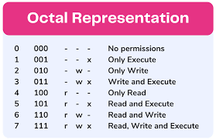
Permissions
-rwx------ - the file is readable, writable, executable by the owner, but not by anyone else
-rw-r--r-- - the file can red and written to by the owner and read by everyone else
drwxrwx – directory that can be opened and written to by everyone
chmod – change mode of the file
Modes in octal notation

Slide 12
Permissions
chmod 600 <some_file>
6 – Owner – read and write
0 – Group – no permissions
0 – World – no permissions
Result: -rw-------

Slide 13
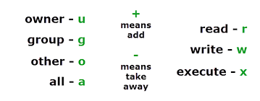
Permissions
Symbolic notation
Give an owner permission to execute the file
chmod u+x <some_file>
Take away permission to read, write and execute from the user group
chmod g-rwx <some_file>

Slide 14
Permissions
Create a test directory
$ mkdir test_dir
$ chmod u-rwx test_dir # take away all permissions from the user
$ ls test_dir
Give back the permissions
$ chmod u+rwx test_dir
$ ls -l test_dir
Set default permissions with umask
$ umask # show default permissions
$ umask 0000 # set default permissions
su – run shell as a different use
$ su -l steve # run shell as user steve
$ su - # run shell as root

Slide 15
Permissions
sudo – run command as a different use
$ sudo apt get install bowtie
chown – change file owner
$ touch test_file
$ sudo chown steve test_file # overturn file ownership to steve
$ sudo chown steve:workshop test_file # make steve and user-group “workshop” owners of the file
$ sudo chown :workshop test_file # give the file ownership to the “workshop” user group
passwd – change password
$ passwd # change your password
$ sudo passwd steve # change a password for steve

