Slide 1
Software installation
Installing from source
Installing with apt package manager
Installing with Conda

Slide 2
Packaging systems
Linux software is distributed through packaging systems
Different Linux distributions have different packaging systems that are not compatible with each other
Debian-style: Debian, Ubuntu, Mint
Red-hat style: Fedora, CentOS, Red Hat, openSUSE
Debian style packages have the extension .deb and Red-hat - .rpm
All software for Linux is found on Internet as package files (.deb, .rpm files) or as source code for manual installation
Linux software is usually available through repositories or repos that contain thousands of packages
Linux can interact with repos through a package manager to download and install software

Slide 3
Installing software from source
Linux software is open source, meaning that we can view, download, edit the source code
We can install the software from the source
Source code is a set of instructions written in human readable programming language
This code can be interpreted directly in the case of interpreted languages (perl, python, bash, R) or compiled as machine code (C++, C, java)
Linux system must contain appropriate interpreters or compilers to interpret or compile source code
Software required to install from source are called development tools, for example GNU coreutils, gcc, GNU tar, gunzip, bunzip2, make
Usually, your system will come with development tools, but they can also be downloaded and installed

Slide 4
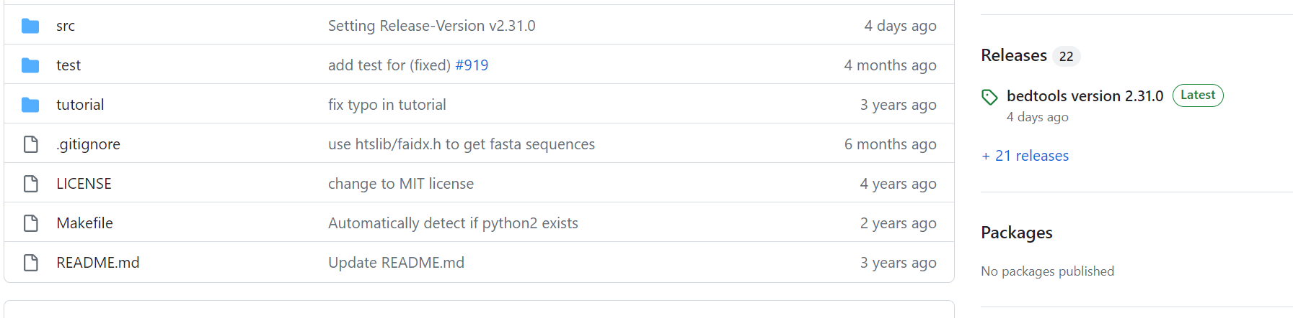

Installing software from source
Practice installing software from source
We will install bedtools2 https://github.com/arq5x/bedtools2
Bedtools2 is a versatile toolset for operations in genomic intervals, scan through their github to know more
Search for bedtools2 github and find releases:

Slide 5
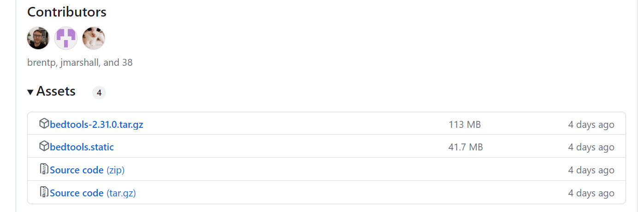
Installing software from source
Practice installing software from source
Click on releases and locate compressed source code for the latest stable release
Right click on .tar.gz file and copy link address

Slide 6
Installing software from source
Practice installing software from source
Create programs/ directory in your home folder and cd there
$ cd ~
$ mkdir programs
$ cd programs
Download bedtools2 tarball
$ wget https://github.com/arq5x/bedtools2/releases/download/v2.31.0/bedtools-2.31.0.tar.gz
Read installation instructions https://bedtools.readthedocs.io/en/latest/content/installation.html
Untar and unzip bedtools2.tar.gz
$ tar -xzvf bedtools-2.31.0.tar.gz
$ cd bedtools2/
$ make # compile binaries

Slide 7
Installing software from source
Practice installing software from source
Create programs/ directory in your home folder and cd there
$ cd ~
$ mkdir programs
$ cd programs
Download bedtools2 tarball
$ wget https://github.com/arq5x/bedtools2/releases/download/v2.31.0/bedtools-2.31.0.tar.gz
Read installation instructions https://bedtools.readthedocs.io/en/latest/content/installation.html
Untar and unzip bedtools2.tar.gz
$ tar -xzvf bedtools-2.31.0.tar.gz
$ cd bedtools2/
$ make # compile binaries
$ ls -lh bin/ # take a look at compiled binaries
$ ./bin/bamToBed -h # test if it works

Slide 8
Installing software from source
Practice installing software from source
Now we can copy bedtools2/ binaries to /usr/local/bin (you will require) or you can simply add bedtools2/bin directory to your PATH
Most of software tools require dependencies
Dependencies are other software tools or code libraries that our software tools requires to work
The presence of dependencies, for example I/O libraries, or other shared libraries is checked during the installation process
Missing dependencies need to be installed, otherwise you will encounter installation errors
Some software will need you to run 3 step installation process that includes running configure script that detects installed dependencies, followed by make that compiled binaries and make install that makes the binaries available in your path

Slide 9
Installing with package tools
Package files for Debian flavor of Linux, like Ubuntu, have .deb extension or .rpm on Red Hat systems (Fedora, CentOS)
Packages can be handled by low-level and high-level package tools
Low-level tools are dpkg on Debian and rpm on Red Hat
Low-level tools handle tasks of installing and removing packages
High-level tools are apt, apt-get and aptitude on Debian or yum and dnf on Red Hat
High level tools conduct searches for metadata and dependency resolution
Use apt to search repositories
$ sudo apt-get update
$ apt-cache search gedit | less # search for a software package gedit – a lightweight text editor

Slide 10
Installing with package tools
Practice installation with a package manager
$ sudo apt-get install gedit # install the package
Search and install fastx-toolkit http://hannonlab.cshl.edu/fastx_toolkit/
$ apt-cache search fastx
$ sudo apt-get install fastx-toolkit # install fastx toolkit
What tools are there?
http://hannonlab.cshl.edu/fastx_toolkit/commandline.html
Test if the installation worked
$ fastq_to_fasta -h

Slide 11
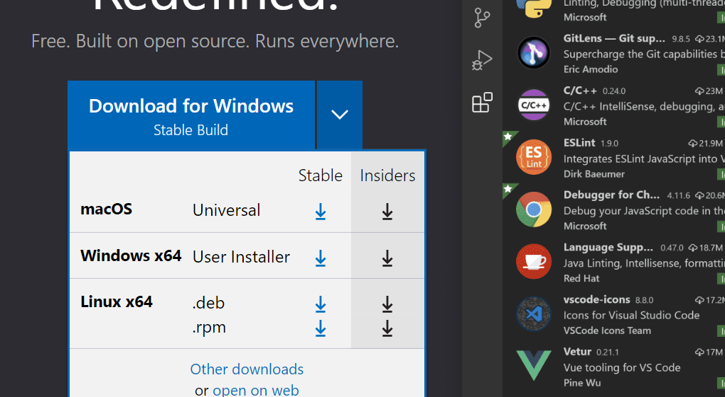
Installing with package tools
We can also use low-level package tools to install directly from package files downloaded to your system
In some cases, the software is available for download as a package file like .deb or .rpm
Let’s download and install Visual Studio Code for Linux https://code.visualstudio.com/
Visual Studio Code is a popular code editor we can later use to edit our code

Slide 12
Installing with package tools
Download Visual Studio Code .deb file to your system and install it using dpkg
$ sudo dpkg --install code_1.77.3-1681292746_amd64.deb
$ rm code_1.77.3-1681292746_amd64.deb # remove the .deb file, we don’t need anymore
Updating packages
$ sudo apt-get update
$ sudo apt-get upgrade
We can also update specific package from .deb file that contains a more up-to-date version
dpkg -i <package_name>
List installed packages
$ dpkg -l
$ dpkg -l | grep fastx
Is package installed
$ dpkg -s fastx-toolkit

Slide 13
Installing with package tools
Show information about a package
$ apt-cache show fastx-toolkit
Find which packages owning files
$ dpkg -S fastq_to_fasta
Uninstall packages
$ sudo apt purge fastx-toolkit

Slide 14
Environment management with Conda
Conda is a better way to install and manage bioinformatics software
In this course we will try to use conda install all of the required software
Why conda? It is the best way to deal with conflicting dependencies
Almost every software we are installing requires other software (dependency) to work, that other software also requires its own and so on.
Imagine that we have program A that requires a library shared with a program B, however program B need an older version of the library that A cannot work with. Now we have dependency conflict, and we will need to jump lots of hoops to get both programs to work
Conda is an environment manager that makes sure we don’t need to deal with conflicting dependencies

Slide 15
Environment management with Conda
Conda handles dependency-related problems by setting up isolated package installations called environments
I tend to create separate environments for the projects in different domains of NGS, such as RNA-seq, metagenomics, variant calling etc. It maybe worthwhile to create a separate environments for separate NGS analysis projects. Sometimes it may be necessary to create separate environment for old problematic software
Conda is both a package manager that performs the same functions as apt, and an environment manager at the same time
Let’s set up conda on our system
We will install a light-weight variation of conda called miniconda
Download miniconda installation script
wget https://repo.anaconda.com/miniconda/Miniconda3-latest-Linux-x86_64.sh

Slide 16
Environment management with Conda
Run the installation script
$ bash Miniconda3-latest-Linux-x86_64.sh
The installation script will create miniconda/ directory in your home directory, all of the packages installed through conda will be located there
Activate conda
$ conda activate # this will launch a base environment
We will create a dedicated environment for this course
$ conda create -n course
List environments
$ conda info --envs
Activate course environment
$ conda activate course

Slide 17
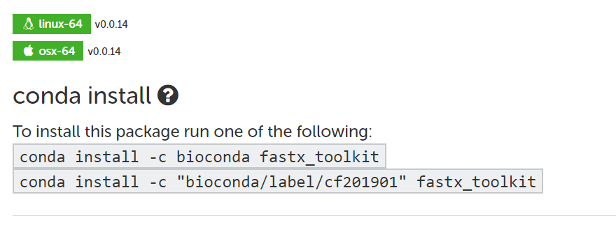

Environment management with Conda
Install bioinformatics software with conda
Simply google “conda package_name” and it will lead you to bioconda page with the instructions
bioconda is a repository of thousands of bioinformatics packages
Let’s install fastx-toolkit with conda
Search conda + fastx toolkit

Slide 18
Environment management with Conda
Install the package
$ conda install -c fastx_toolkit
Deactivate environment
$ conda deactivate
Remove the environment
$ conda env remove --name rnaseq

