Slide 1
Capstone project II
Redo a published paper

Slide 2
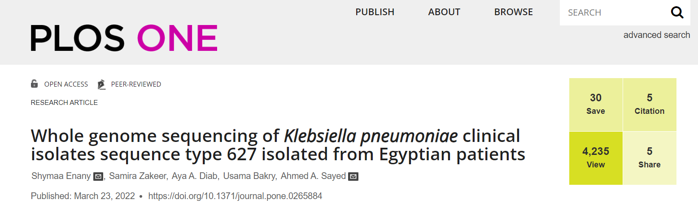
A paper to redo

Slide 3
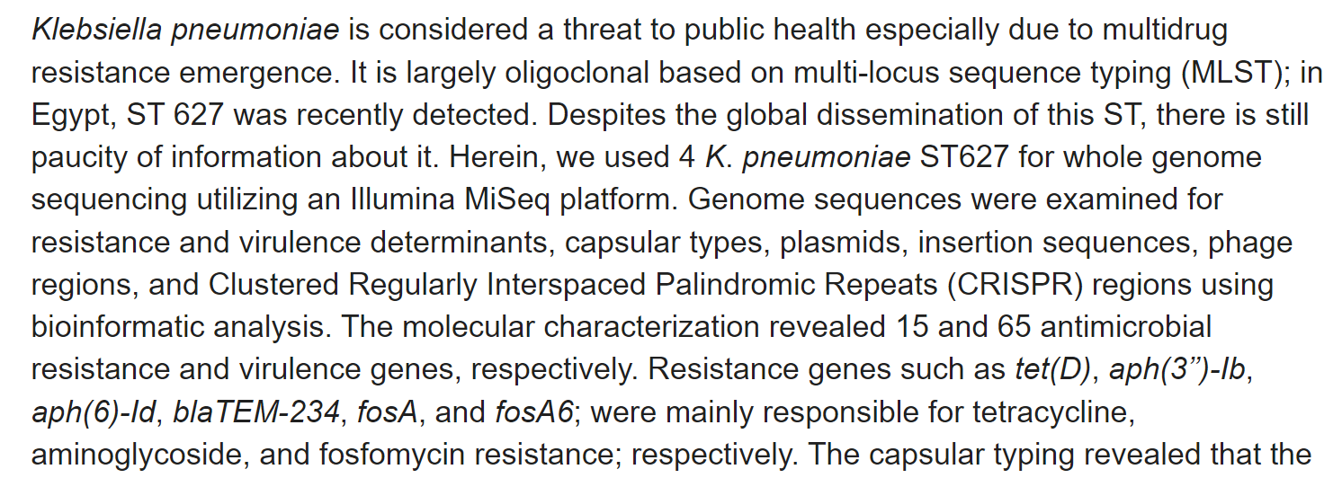
A paper to redo
Familiarize yourself with the paper: https://journals.plos.org/plosone/article?id=10.1371/journal.pone.0265884#sec003

Slide 4
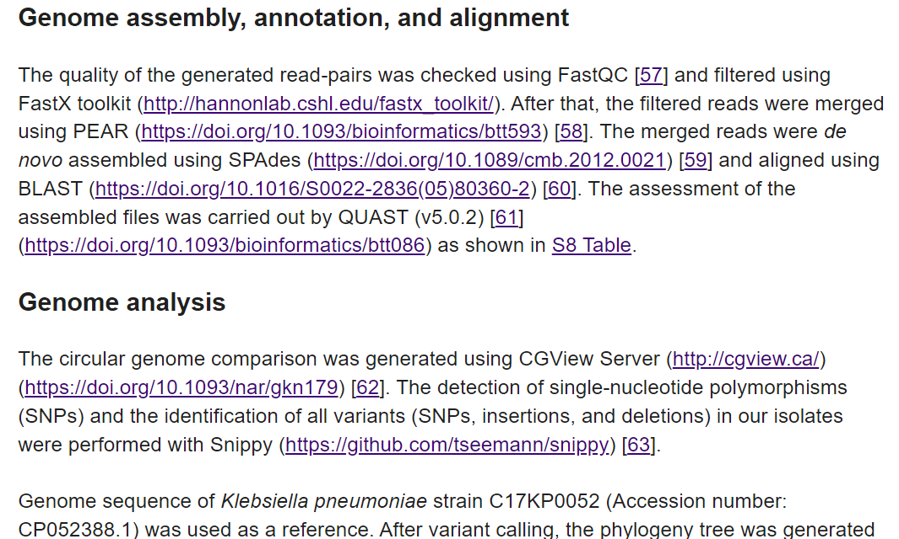
A paper to redo

Slide 5
A paper to redo
Suggested workflow
NOTE: Document your workflow on github, make sure the code is well commented!
Treat as a real project, create a project directory, organize files across appropriate folders, maintain workflow documentation
Download 3 random samples from PRJNA639351 bioproject
Convert the reads to fastq
Download the reference as fasta and as a genbank file. Reference accession number is CP052388.1
Use fastQC or similar software to run initial quality control

Slide 6
A paper to redo
5. Create a simulated dataset with the parameters mirroring those of our dataset:
Paired-end
Read-length 150 bp
Error rates are changing in range of 0.0001-0.002 from the beginning to the end of the read
Total number of reads must be similar to the size of the read sets in the paper
Run quality control on simulated reads to verify the results of the simulation
Run all the steps below on simulated reads as well
6. Map the reads to the reference genome with BWA
7. Prepare the alignment files for variant calling: convert to BAM, sort, deduplicate and index
8. Check alignment qualities with qualimap bamqc or similar
9. Call the variants with bcftools
10. Collect VCF stats with bcftools stats
11. Explore the calls and alignments in IGV, compare simulated data to the “ground truth” dataset

Slide 7
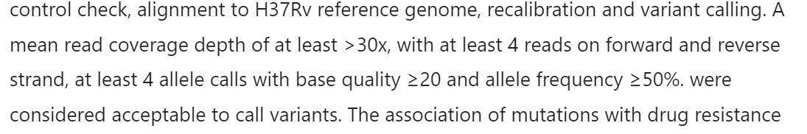
A paper to redo
12. Compare simulated data variant calls to the ground truth data set, are the result any good?
13. Try to call the simulated variants with Freebayes and see if the results improve.
14. Try to filter Freebayes results using the filtering method from Tagliani et al, 2017 paper: Read depth >= 30; Allele Freq >= 0.5; supporting forwar reads > 4 and supporting reverese reads > 4. Should we use this filtering method for our data set.
VCF filtering parameters from Tagliani et al, 2017
Bonus task: call the simulated variants using Snippy ( https://github.com/tseemann/snippy ) and compare Snippy calls to ground truth. Does Snippy improves the calls compared to Freebayes?

