Slide 1
Variant calling
Variant calling process and terminology,
challenges,
statistical approaches,
read simulation, VCF format,
variant calling with Bcftools and Freebayes, variant filtering and annotation
Capstone project I
Capstone project II

Slide 2
Required software
Install dwgsim
$ conda install -c bioconda dwgsim
Install bcftools
$ conda install -c bioconda bcftools
Install vcftools
$ conda install -c bioconda vcftools
Install bedtools
$ conda install -c bioconda bedtools
Install freebayes
$ conda install -c bioconda freebayes
Install bamaddrg
$ conda install -c bioconda bamaddrg

Slide 3
Required software
Install sambamba
$ conda install -c bioconda sambamba
Install SnpEff
$ conda install -c "bioconda/label/cf201901" snpeff
Install SnpSift
$ conda install -c "bioconda/label/cf201901" snpsift

Slide 4
Introduction to variant calling
Variant calling is a process of identification of differences between the reference and the sequencing reads
Variant calling process
Clean and trim the reads
Align the reads to the reference
Correct and refine alignments (optional)
Call the variants
Filter the variant based on user-defined properties
Annotate the variants

Slide 5
Introduction to variant calling
Variant calling terminology
Ploidy: number of complete sets of chromosomes in a cell, corresponds to number of possible individual genetic variants per cell. The ploidy of procaryotes is 1.
If we consider a collection of cells as a studied population (somatic mutations, prokaryotes), than the number of possible alleles is equal to N X ploidy, where N is a number of cells
Haplotype is a group of alleles inherited together from the same parent, these alleles are located close together and rarely undergo recombination. These alleles are also called “phased variants”
Genotype is a collection of all known alleles
Single nucleotide polymorphisms (SNPs) are single nucleotide substitutions, that occur with the frequency of over 1% in the population
Single nucleotide variant (SNVs) are the same as SNPs, but with frequency below 1%

Slide 6
Introduction to variant calling
Variant calling terminology
There is no clarity in SNP vs SNV definition and they are frequently used interchangeably
Short insertions and deletions (Indels) are insertions or deletions of relatively small stretches of nucleotides. One of the length threshold used is less than 1000 bp to call the insertion or deletion an indel
Gross chromosomal rearrangements (GCRs) – large deletions, insertions, amplifications or translocations (over 1000 bp)

Slide 7
Introduction to variant calling
Classification of single nucleotide substitutions
SNP
Non-coding
Coding
Synonymous
Non-synonymous
Missense
Non-sense

Slide 8
Introduction to variant calling
Challenges in variant calling
Library preparation bias: Success of a variant detection depends on coverage, i.e. a genomic position must be covered by a certain number of reads to consider a call reliable. Different library preparation protocols are prone to region biases, leading to insufficient coverage of certain regions
Artifact mutations introduced during the library preparation process, for example endonuclease-mediated DNA fragmentation introduces more artifactual SNV/Indels compared to ultrasonication (PMID: 31899787)
PCR/Optical duplicates can falsely increase allele frequencies or even introduce mutations
Errors introduced during sequencing and base calling (platform-dependent)
Read alignment issues, such as mapping repeat regions, alignment around indels

Slide 9
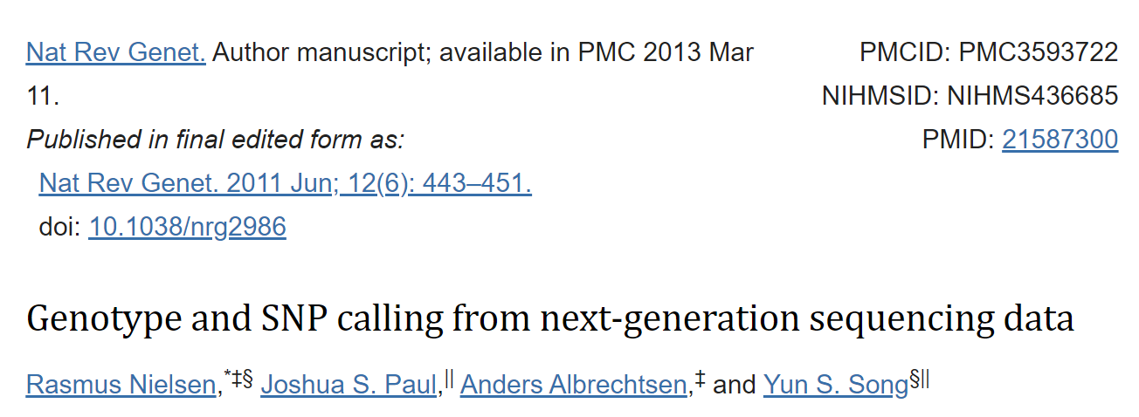
Introduction to variant calling
Statistical approaches in variant calling
The software that detects the variants are called variant callers
The purpose of a variant caller is to detect variants and separate true variants (signal) from various artifacts and errors introduced by laboratory procedures and sequencing (noise)
Detection of SNPs and Indels is relatively straightforward, however sophisticated statistics is required to separate signal from noise

Slide 10
Introduction to variant calling
Statistical approaches in variant calling
We should differentiate between variant and genotype calling
Variant calling aims at identifying bases in the query sequence that are different from the reference; genotype calling is a determination of genotype (heterozygous or homozygous)
In prokaryotes variant calling and genotyping are the same
Early methods in variant and genotype calling were based on simple cutoffs, and did not allow for uncertainty in the determination of variants and genotypes
Current methods use probabilistic models that quantify the uncertainty of the calls

Slide 11
Introduction to variant calling
Early methods in variant calling
Based on simple threshold, for example:
We include all variant with a quality Q >= 20 (1/100 probability of variant called wrong)
Calculate allele frequencies for variant sites
If the allele frequency is 20 – 80% call heterozygous genotype (for diploid organism), otherwise call homozygous genotype
This method works quite well for sequencing depth over x20

Slide 12
Introduction to variant calling
Probabilistic methods in variant calling
For moderate and low sequencing depths (< 20), simple threshold methods result in under-calling of heterozygous phenotypes
Probabilistic methods provide quality scores that reflect the posterior probability of genotypes
Genotype likelihood are based on quality scores for each read
Let Xi → data in read i for a particular individual at a particular site with genotype G
The probability p(X_{i}|G) is then given by a simple rescaling of the quality score of X_{i}, and the genotype likelihood, p(X|G), can be calculated directly from the data by taking the product of p(X_{i}|G) over all i.
P(G | Xi) = (P(Xi | G) * P(G)) / P(Xi)

Slide 13
Introduction to variant calling
Probabilistic methods in variant calling
Basic probabilistic model assumes independence of errors in the reads
This assumption can be violated by the presence of PCR duplicates and alignment errors
Some variant callers use a weighing scheme to account for correlated errors
Variant calling can be improved by recalibrating base quality scores using empirical data
A prior genotype probability can be assumed as equal probability for all possible genotypes or based on empirical data – genotypes observed in variant databases, like dbSNP

Slide 14
Introduction to variant calling
Commonly used, well established variant callers
bcftools created by Heng Li the author of samtools and many other tools http://www.htslib.org/doc/1.0/bcftools.html
FreeBayes, originated from MIT https://github.com/freebayes/freebayes
GATK, from Broad Institute https://gatk.broadinstitute.org/hc/en-us
Specifically, GATK for Microbes: https://gatk.broadinstitute.org/hc/en-us/articles/360060004292-Introducing-GATK-for-Microbes
VarScan2, a well documented versatile alignments https://varscan.sourceforge.net/

Slide 15
Introduction to variant calling
Practice variant calling using simulated data
We will use dwgsim software https://github.com/nh13/DWGSIM to simulate the reads data
Other read simulation software:
wgsim https://github.com/lh3/wgsim by author of samtools
readsim https://sourceforge.net/p/readsim/wiki/Home/ long read simulator for PacBio and Nanopore
Art https://www.niehs.nih.gov/research/resources/software/biostatistics/art/index.cfm a set of versatile and very sophisticated tools for read simulations

Slide 16
Introduction to variant calling
Simulate reads with dwgsim
dwgsim simulates reads from reference fasta to evaluate alignments and variant calling methods
SYNTAX: dwgsim [option] <reference> <output_prefix>
$ dwgsim -h # read the help and try to understand the options
$ mkdir sim_reads # we will work in the sirectory sim_reads/ for this task
$ cd sim_reads
$ dwgsim -H -N 10000 -1 100 -2 100 ../GENOMES/M_tuber/M_tuber_H37Rv.fasta output # -H – simulate the reads from a haploid genome; -N <INT> - simulate N number of reads; -1 <INT> -2 <INT> - simulate read 1 and read 2 reads, where INT is length of the reads

Slide 17
Introduction to variant calling
Simulate reads with dwgsim
dwgsim output files
output.bfast.fastq.gz – interleaved fastq file (read 1 is followed by read 2 in the same file )
output.bwa.read1.fastq.gz – Read1 fastq file
output.bwa.read2.fastq.gz – Read 2 fastq file
output.mutations.txt – simulated mutations in tab delimited file
output.mutations.vcf – simulated mutations in VCF file
Let’s create a larger more, more realistic data set while setting sequencing errors and mutation rates
$ dwgsim -H -C 30.0 -1 100 -2 100 -e 0.002 -E 0.004 -r 0.001 -r 0.1 ../GENOMES/M_tuber/M_tuber_H37Rv.fasta output # -C FLOAT – read coverage; -e – base error frequency in Read 1; -E - base error frequency in Read 2; -r – mutation frequency; -R – faction of indels among mutations

Slide 18
Introduction to variant calling
Simulate reads with dwgsim
dwgsim output files
output.bfast.fastq.gz – interleaved fastq file (read 1 is followed by read 2 in the same file )
output.bwa.read1.fastq.gz – Read1 fastq file
output.bwa.read2.fastq.gz – Read 2 fastq file
output.mutations.txt – simulated mutations in tab delimited file
output.mutations.vcf – simulated mutations in VCF file
Let’s create a larger more, more realistic data set while setting sequencing errors and mutation rates
$ dwgsim -H -C 30.0 -1 100 -2 100 -e 0.002 -E 0.004 -r 0.001 -r 0.1 ../GENOMES/M_tuber/M_tuber_H37Rv.fasta output # -C FLOAT – read coverage; -e – base error frequency in Read 1; -E - base error frequency in Read 2; -r – mutation frequency; -R – faction of indels among mutations

Slide 19
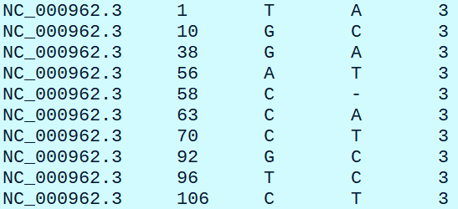
Introduction to variant calling
Let’s take a look at the reads
$ zcat output.bwa.read1.fastq.gz | head
Verify read numbers for both fastq files
$ zcat output.bwa.read1.fastq.gz | grep '@NC_000962' | wc -l
$ zcat output.bwa.read2.fastq.gz | grep '@NC_000962' | wc -l
$ wc -l output.mutations.txt # how many mutations
$ head output.mutations.txt # Take a look the the mutation file

Slide 20
Introduction to variant calling
Mutation txt file format:
the chromosome/contig name
the one-based position
the original reference base
the new reference base(s)
the variant strand(s)
Interpreting the mutation file, from the manual:
contig4 4 T K 1
A heterozygous mutation at position 4 of contig4 on the first strand, mutating the T base to a heterozygous K (G or T) SNP
contig6 22 A - 2
A heterozygous deletion of T at position 22 on the second strand

Slide 21
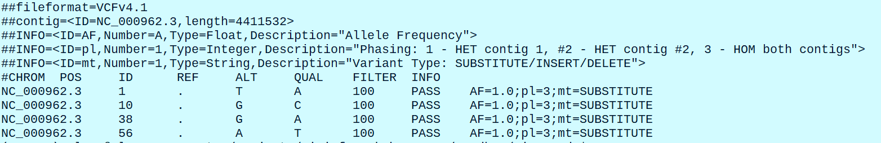
Introduction to variant calling
VCF file format
Let’s take a look at the VCF file in dwgsim
$ head output.mutations.vcf
VCF format is text, human readable format designed to describe genomic variation
VCF can contain information on any number of samples/individuals, serving as a single data base for a large variant calling project
VCF files can get incredibly complex; we need specialized software to access and manipulate VCF files

Slide 22
Introduction to variant calling
VCF file format (continuation)
VCF format consists out 2 section header and a body
Lines in a header section start with #, special keywords start with ##
Header contains data on the format version of VCF file, VCFv4.1 in our case
Contig data, ID and length, the is only 1 contig in our case since we are working with bacteria

Slide 23
Introduction to variant calling
VCF file format (continuation)
Data stored in INFO lines describe variations across all samples
VCF file can also contain FORMAT lines, data types shown in FORMAT descriptor applies to individual samples

Slide 24
Introduction to variant calling
VCF file format (continuation)
Body of the file: 9 mandatory columns, and additional columns for individual samples, see https://en.wikipedia.org/wiki/Variant_Call_Format
Name | Brief description (see the specification for details).
1 | CHROM | The name of the sequence (typically a chromosome) on which the variation is being called. This sequence is usually known as 'the reference sequence', i.e. the sequence against which the given sample varies.
2 | POS | The 1-based position of the variation on the given sequence.
3 | ID | The identifier of the variation, e.g. a dbSNP rs identifier, or if unknown a ".". Multiple identifiers should be separated by semi-colons without white-space.
4 | REF | The reference base (or bases in the case of an indel) at the given position on the given reference sequence.
5 | ALT | The list of alternative alleles at this position.
6 | QUAL | A quality score associated with the inference of the given alleles.
7 | FILTER | A flag indicating which of a given set of filters the variation has failed or PASS if all the filters were passed successfully.
8 | INFO | An extensible list of key-value pairs (fields) describing the variation. See below for some common fields. Multiple fields are separated by semicolons with optional values in the format: <key>=<data>[,data].
9 | FORMAT | An (optional) extensible list of fields for describing the samples. See below for some common fields.
+ | SAMPLEs | For each (optional) sample described in the file, values are given for the fields listed in FORMAT

Slide 25
Introduction to variant calling
VCF file format (continuation)
Common INFO fields (describe alleles). There are many more fields described in VCF docs.
Name | Brief description
AA | ancestral allele
AC | allele count in genotypes, for each ALT allele, in the same order as listed
AF | allele frequency for each ALT allele in the same order as listed (use this when estimated from primary data, not called genotypes)
AN | total number of alleles in called genotypes
BQ | RMS base quality at this position
CIGAR | cigar string describing how to align an alternate allele to the reference allele
DB | dbSNP membership

Slide 26
Introduction to variant calling
VCF file format (continuation)
Common FORMAT fields (describe genotypes). There are many more fields described in VCF docs.
Name | Brief description
AD | Read depth for each allele
ADF | Read depth for each allele on the forward strand
ADR | Read depth for each allele on the reverse strand
DP | Read depth
EC | Expected alternate allele counts
FT | Filter indicating if this genotype was “called”
GL | Genotype likelihoods
You don’t need to remember INFO and FORMAT fields, they are represented large number of identifiers, many of which are invented, by the authors of variant calling software.
Normally, only a few of those will be useful in your analysis.

Slide 27
Introduction to variant calling
VCF file format (continuation)
Closer look at VCF file variant entry
1 2 3 4 5 6 7
Field | ID | Meaning
1 | CHROM | Chromosome, contig
2 | POS | Position of the variant
3 | ID | Variant ID, like dbSNP id is available
4 | REF | Reference allele
5 | ALT | Alternative allele
6 | QUAL | Variant quality
7 | FILTER | This field is filled after applying a variant filter, before filtering this field is shown as ‘.’

Slide 28
Introduction to variant calling
VCF file format (continuation)
Closer look at VCF file variant entry
Red boxes select an INFO field
INFO field descriptions are located in the header of the vcf files, where lines start with ‘##’
We can search for the INFO tag of interest with great, like this:
$ grep ‘^##INFO=<ID=AF' output.mutations.vcf # This command will search for AF tag on a VCF header

Slide 29
Introduction to variant calling
VCF file format (continuation)
Closer look at VCF file variant entry
Red boxes select Genotype and Sample fields, there may be multiple sample fields, this example contains one sample
Genotype field tags match data in a sample field
GT → 1 : Genotype of this sample at this site
DP → 18 : Unfiltered reads depth at this site
RO → 0 : Reference allele observation count
QR → 0 : Sum of qualities for reference allele observation
AO → 18 : Alternative allele observation counts
QA → 479 : Sum of qualities for alternative allele observations
GL → -43.3724,0 : Genotype Likelihood, log10-scaled likelihoods of the data given the called genotype for each possible genotype generated from the reference and alternate alleles given the sample ploidy

Slide 30
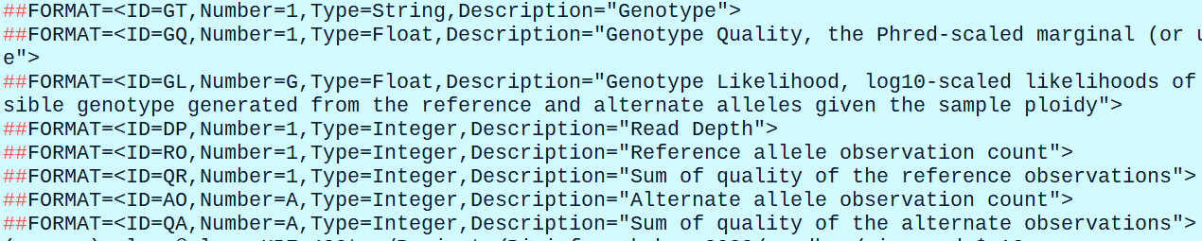
Introduction to variant calling
VCF file format (continuation)
Closer look at VCF file variant entry
We can find out the meaning of FORMAT tags from VCF header
Use grep to find a description of the FORMAT tag, for example to search for GT tag
$ grep '##FORMAT=<ID=GT' freebayes.bwa.vcf

Slide 31
Introduction to variant calling
VCF file format (continuation)
Where to get information about VCF format:
Official documentation: https://samtools.github.io/hts-specs/VCFv4.2.pdf
Wikipedia article (it is rather good): https://en.wikipedia.org/wiki/Variant_Call_Format
GATK explanation of VCF format: https://gatk.broadinstitute.org/hc/en-us/articles/360035531692-VCF-Variant-Call-Format
NEVER try to edit, filter or otherwise manipulate VCF files using general text processing tools! It will never end well.
Use only specialized software to work with VCF files!

Slide 32
Introduction to variant calling
VCF file format (continuation)
A list of VCF manipulation software:
Picard http://broadinstitute.github.io/picard/index.html - java-based command line tools to manipulate SAM, BAM, CRAM, and VCF files
VCF-kit https://github.com/AndersenLab/VCF-kit - command line set of utilities to manipulate VCF files
VCFtools https://vcftools.github.io/ - another command line set of tools to manipulate and analyze VCFs
BCFtools https://samtools.github.io/bcftools/bcftools.html - a set of tools written by Heng Li to manipulate and analyze VCFs and their binary representations – BCF files

Slide 33
Calling variants
Calling variants with simulated reads using BCFtools
Change to sim_reads/ directory
$ cd sim_reads
Map simulated reads with bwa
$ bwa mem -t 2 ../GENOMES/M_tuber/bwa_index/M_tuber_H37Rv.fasta output.bwa.read1.fastq.gz output.bwa.read2.fastq.gz > simulated.bwa.sam
Map simulated reads with bowtie 2
$ bowtie2 -p 2 --fr --very-sensitive -X 1000 -x ../GENOMES/M_tuber/bowtie2_index/M_tuber_H37Rv -1 output.bwa.read1.fastq.gz -2 output.bwa.read2.fastq.gz -S simulated.bowtie2.sam # -X – 1000 sets maximum insert size, works well for most of the libraries
Check basic statistics for both sam files
$ samtools flagstat simulated.bwa.sam
$ samtools flagstat simulated.bowtie2.sam

Slide 34
Calling variants
Calling variants with simulated reads using BCFtools
Convert sam files to bam, sort and index
$ samtools view -@ 2 -b simulated.bwa.sam > simulated.bwa.bam
$ samtools view -@ 2 -b simulated.bowtie2.sam > simulated.bowtie2.bam
Sort
$ samtools sort -@ 2 simulated.bwa.bam -o simulated.bwa.sorted.bam
$ samtools sort -@ 2 simulated.bowtie2.bam -o simulated.bowtie2.sorted.bam
Index
$ samtools index simulated.bwa.sorted.bam
$ samtools index simulated.bowtie2.sorted.bam
Remove intermediate files
$ rm *.sam *.bowtie2.bam *.bwa.bam

Slide 35
Calling variants
Calling variants with simulated reads using BCFtools
Convert sam files to bam, sort and index
$ samtools view -@ 2 -b simulated.bwa.sam > simulated.bwa.bam
$ samtools view -@ 2 -b simulated.bowtie2.sam > simulated.bowtie2.bam
Sort
$ samtools sort -@ 2 simulated.bwa.bam -o simulated.bwa.sorted.bam
$ samtools sort -@ 2 simulated.bowtie2.bam -o simulated.bowtie2.sorted.bam
Index
$ samtools index simulated.bwa.sorted.bam
$ samtools index simulated.bowtie2.sorted.bam
Remove intermediate files
$ rm *.sam *.bowtie2.bam *.bwa.bam

Slide 36
Calling variants
Calling variants with simulated reads using BCFtools
Generate genotype likelihoods in VCF or BCF format using bcftools mpileup
Get familiar with bcftools mpileup by reading the manual https://samtools.github.io/bcftools/bcftools.html#mpileup
bcftools variant calling how-to https://samtools.github.io/bcftools/howtos/variant-calling.html
Call variants in a two-stage process, first calculate genotype likelihoods with mpileup, then call variants with call
$ bcftools mpileup -Ovu -f ../GENOMES/M_tuber/M_tuber_H37Rv.fasta simulated.bwa.sorted.bam > genotypes.bwa.vcf # -O – specify output format v – VCF, u – uncompressed
$ bcftools mpileup -Ovu -f ../GENOMES/M_tuber/M_tuber_H37Rv.fasta simulated.bowtie2.sorted.bam > genotypes.bowtie2.vcf

Slide 37
Calling variants
Calling variants with simulated reads using BCFtools
Read BCFtools call manual and try to understand the options:
Call variants using bcftools call
$ bcftools call --ploidy 1 -vm -O v genotypes.bwa.vcf > variants.bwa.vcf # -O v – output vcf; --ploidy – set ploidy, 1 in our case; -v – output variant sites only; -m mutiallelic caller, alternative model for multiallelic and rare-variant calling designed to overcome known limitations in -c calling model (conflicts with -c)
$ bcftools call --ploidy 1 -vm -O v genotypes.bowtie2.vcf > variants.bowtie2.vcf
Put both commands on the same line to avoid creating an intermediate genotype.vcf file
$ bcftools mpileup --threads 2 -Ov -f ../GENOMES/M_tuber/M_tuber_H37Rv.fasta simulated.bwa.sorted.bam | bcftools call --threads 2 --ploidy 1 -vm -O v > test.vcf # bcftools commands can be connected into pipelines; used 2 processor cores with --threads command

Slide 38
Calling variants
Calling variants with simulated reads using BCFtools
Print detailed VCF statistics with bcftools stats
$ bcftools stats variants.bwa.vcf > variants.bwa.stats
$ less variants.bwa.stats # this file quite detailed, go through the stats command output and try to understand what it means
Run the same command on bowtie2 vcf file
$ bcftools stats variants.bowtie2.vcf > variants.bowtie2.stats
$ less variants.bowtie2.stats
Compare VCF files with stats
First, we will need to compress and index them
$ bgzip variants.bowtie2.vcf > variants.bowtie2.vcf.gz
$ bcftools index variants.bowtie2.vcf.gz # this will create an index with .csi format
$ bgzip variants.bwa.vcf > variants.bwa.vcf.gz
$ bcftools index variants.bwa.vcf.gz

Slide 39







Calling variants
Calling variants with simulated reads using BCFtools
Compare VCF files with stats
$ bcftools isec variants.bwa.vcf.gz variants.bowtie2.vcf.gz -p vcf_comparison # isec command will create intersects and complements of 2 files and print the output to vcf_compatison/ directory
Set 1
Set 2
Set 1
Set 2
I
I
I is an Intersect
Yelllow : complement of Set1
Green : complement of Set2

Slide 40
Calling variants
Calling variants with simulated reads using BCFtools
Compare VCF files with isec
bcftools isec command created a directory with 4 vcf files and a README files
$ ls -lh vcf_comparison
$ cat vcf_comparison/README.txt # print README file
How many variants are in common between BWA and bowtie2 vcf files?
$ bcftools stats vcf_comparison/0002.vcf | grep 'number of records’
$ bcftools stats vcf_comparison/0003.vcf | grep 'number of records’
How many variants are unique to BWA vcf file
bcftools stats vcf_comparison/0000.vcf | grep 'number of records’
How many variants are unique to bowtie2 vcf file
bcftools stats vcf_comparison/0001.vcf | grep 'number of records’

Slide 41
Calling variants
Calling variants with simulated reads using BCFtools
Determine concordance between “ground truth” data set and variants based in BWA and bowtie2 alignments
Ground truth data set is a collection of variants generated by read simulation software and saved in mutations.vcf file
Concordance is a state in which things agree and do not conflict with each other (Enc. Brittanica)
In our case concordance indicates similarity between variant call results
Let’s use vcf-compare from vcftools suite, which is a good alternative to bcftools
Scan through vcftools manual - https://vcftools.github.io/man_latest.html
Read vcf-compare help
$ vcf-compare -h

Slide 42
Calling variants
Calling variants with simulated reads using BCFtools
Determine concordance between “ground truth” data set and variants based in BWA and bowtie2 alignments
vcftools requires tabix index, tabix is a generic indexer for tab delimited files compressed with bgzip
$ tabix variants.bwa.vcf.gz
$ tabix variants.bowtie2.vcf.gz
$ bgzip output.mutations.vcf
$ tabix output.mutations.vcf.gz
$ mkdir vcf_comparison # Create vcf_comparison directory in sim_reads folder
$ cd vcf_comparison
$ vcf-compare ../variants.bwa.vcf.gz ../output.mutations.vcf.gz > bwa_vs_truth.txt # compare BWA derived variants with ground truth data set
$ cat bwa_vs_truth.txt
$ grep ^VN bwa_vs_truth.txt | cut -f 2- # grab data for Venn Diagram

Slide 43
Calling variants
Calling variants with simulated reads using BCFtools
Determine concordance between “ground truth” data set and variants based in BWA and bowtie2 alignments
$ vcf-compare ../variants.bowtie2.vcf.gz ../output.mutations.vcf.gz > bowtie2_vs_truth.txt # compare bowtie2 derived variants with ground truth data set
$ cat bowtie2_vs_truth.txt
Compare the results, which aligner worked better? What are the conclusions we can draw from this analysis?
Other ways to look at concordance between variants bedtools jaccard distance and SnpSift
bedtools is a software suite that operates in genomic intervals https://bedtools.readthedocs.io/en/latest/

Slide 44
Calling variants
Calling variants with simulated reads using BCFtools
Determine concordance between “ground truth” data set and variants based in BWA and bowtie2 alignments
Use bedtools to calculate Jaccard distance between vcf files
$ bedtools jaccard -a ../variants.bwa.vcf.gz -b ../output.mutations.vcf.gz # prints out Jaccard distance and some other data, higher Jaccard distance indicates higher similarity between interval sets
$ bedtools jaccard -a ../variants.bowtie2.vcf.gz -b ../output.mutations.vcf.gz
Explanation of Jaccard distance
Read the docs https://bedtools.readthedocs.io/en/latest/content/tools/jaccard.html
Command syntax
bedtools jaccard [options] –a <BED,VCF,GFF> -b < BED,VCF,GFF >

Slide 45
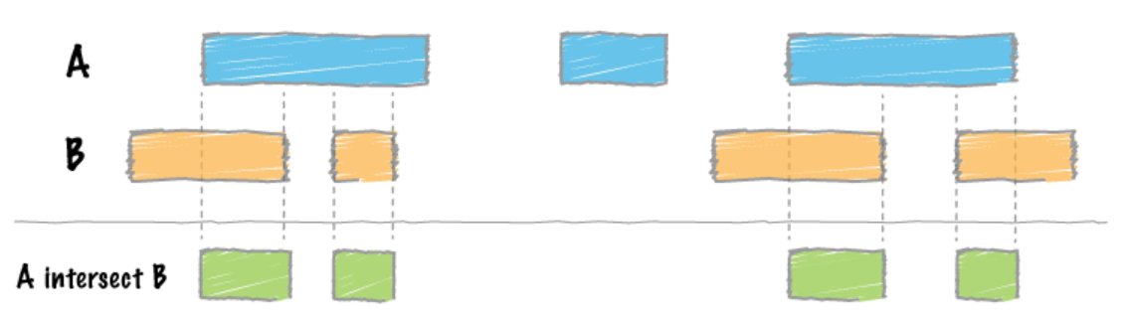
Calling variants
Calling variants with simulated reads using BCFtools
Determine concordance between “ground truth” data set and variants based in BWA and bowtie2 alignments
Explanation of Jaccard distance (continued)
Intersect
Example from bedtools manual: https://bedtools.readthedocs.io/en/latest/content/tools/intersect.html

Slide 46
Calling variants
Calling variants with simulated reads using BCFtools
Determine concordance between “ground truth” data set and variants based in BWA and bowtie2 alignments
Explanation of Jaccard distance (continued)
Union
Jaccard distance = Intersect / Union
Bedtools Jaccard distance = Intersect / Union - Intersect

Slide 47
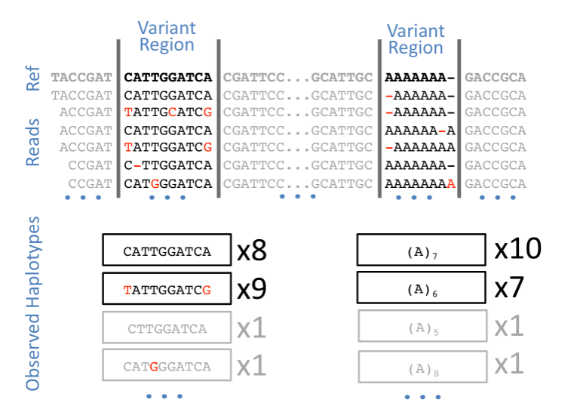
Calling variants
Calling variants with simulated reads using Freebayes
Freebayes link: https://github.com/freebayes/freebayes
$ freebayes --help # Get familiar with the options
Freebayes was designed to call SNPs, indels, multi-nucleotide polymorphisms, and composite insertion and substitution events that are shorter than the alignment length
Freebayes uses statistics that relies on frequently observed haplotypes to call variants, it is expected that that haplotypes that result from sequencing errors are rare

Slide 48
Calling variants
Calling variants with simulated reads using Freebayes
$ freebayes -f ../GENOMES/M_tuber/M_tuber_H37Rv.fasta -p 1 simulated.bwa.sorted.bam > freebayes.bwa.vcf # -p 1 – set ploidy to 1
Previous command may take a long time, let’s restrict variant calling to small region of the genome
$ freebayes -f ../GENOMES/M_tuber/M_tuber_H37Rv.fasta -p 1 -r NC_000962.3:20000-80000 simulated.bwa.sorted.bam > freebayes.bwa.vcf # -r chrQ:start-end will restrict variant calling to a specified region
NOTE: Freebayes requires bam file with alignment quality encoded on Phred33 scale
Print the summary of alignments
$ bcftools stats freebayes.bwa.vcf > freebayes.bwa.stats
How many variant sites are in common between freebayes call and “ground truth” data
$ bgzip freebayes.bwa.vcf # we need to bgzip files for bcftools isec to work
$ bgzip output.mutations.vcf

Slide 49
Calling variants
Calling variants with simulated reads using Freebayes
Index compressed VCF files
$ bcftools index freebayes.bwa.vcf.gz
$ bcftools index output.mutations.vcf.gz
$ bcftools isec -r NC_000962.3:20000-80000 -p freebayes_vs_truth freebayes.bwa.vcf.gz output.mutations.vcf.gz # we will restrict the comparison to the region of freebayes call
$ cd freebayes_vs_truth
$ ls -lh
$ cat README.txt
Check how many variants are in common between freebayes and simulated mutations data set
$ bcftools stats 0003.vcf | less # 2358 sites are in common – “true postive” calls
$ bcftools stats 0000.vcf | less # 1608 sites called by freebayes are not on “ground truth” data, they are “false positives”
$ bcftools stats 0001.vcf # 3628 of mutation sites were simulated, but not called by freebayes, these are “false negatives”

Slide 50
Calling variants
Calling variants with simulated reads using Freebayes
Calculate Jaccard distance between freebayes calls and simulated mutations
Let’s extract variants from a specific region and save it to a separate file
$ bcftools view -r NC_000962.3:20000-80000 freebayes.bwa.vcf.gz > freebayes.sub.vcf
Now we need to extract variants from the same regions in simulated data set
$ bcftools view -r NC_000962.3:20000-80000 output.mutations.vcf.gz > simulated.sub.vcf
Use bedtools to calculate Jaccard distance
$ bedtools jaccard -a freebayes.sub.vcf -b simulated.sub.vcf

Slide 51
Variant normalization
SNPs involve a single nucleotide and can be represented in a single way, i.e. A → T
Indels, multi-nucleotide polymorphisms, and other structural variants can be represented in different ways:
GAC → AC
TGAC → AC
GACC → ACC
Researchers realized that there is need to develop a unified representation of variants in order to facilitate comparison and integration of variant calls
The process of bringing the variants to unified representation is called “variant normalization”

Slide 52
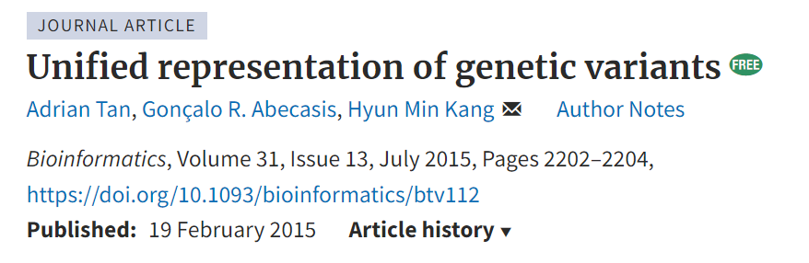
Variant normalization
Variant normalization was originally described in the following paper:
Variant normalization has two conditions – the variant must be parsimonious and left aligned
Parsimony means representing a variant with as few nucleotides as possible without reducing the length of any allele to 0
Left alignment means shifting the start position of that variant to the left until it is impossible to do so

Slide 53
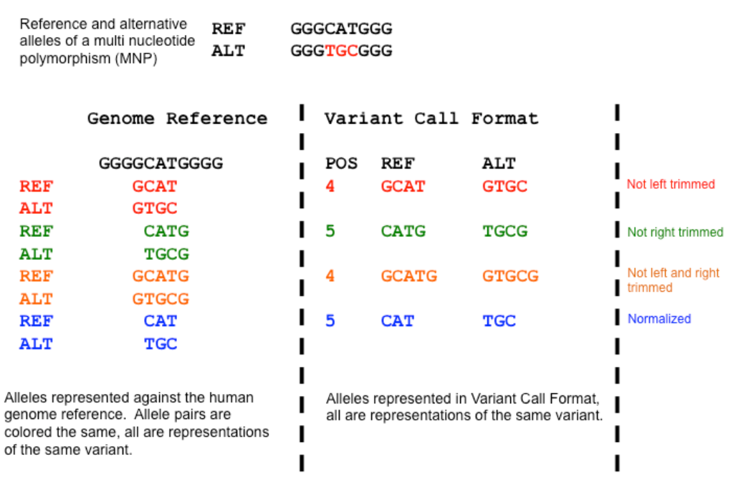
Variant normalization
Visual explanation of parsimonious representation in the context of multi-nucleotide variant
The example is found here: https://genome.sph.umich.edu/wiki/Variant_Normalization

Slide 54
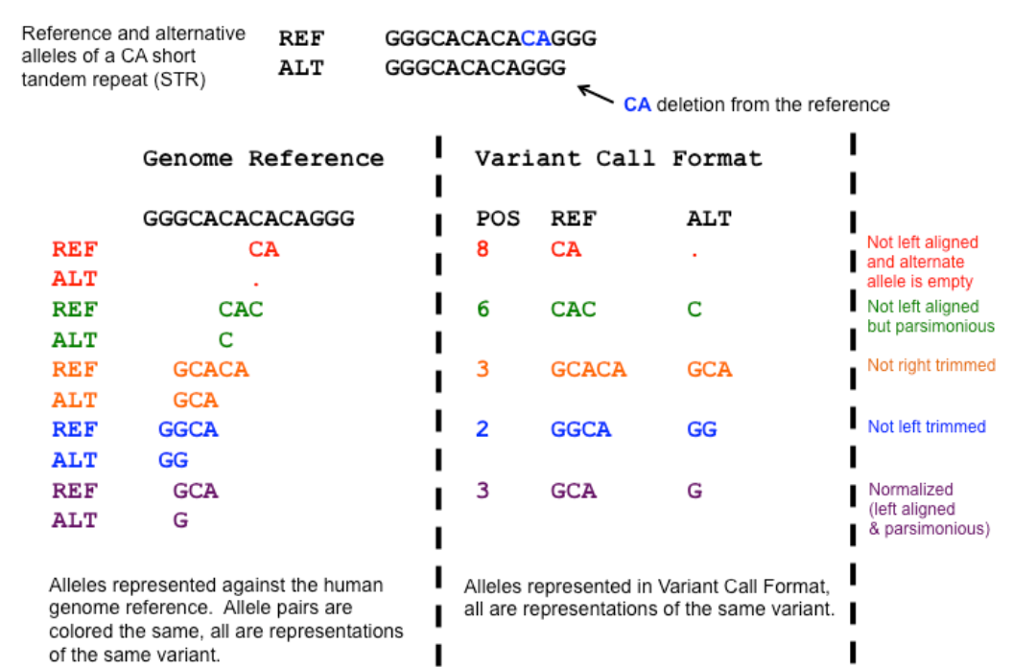
Variant normalization
Visual explanation of parsimonious representation and left alignment in the context of a deletion

Slide 55
Variant normalization
Normalization of variants with bcftools norm
Variant calls derived from different software must be normalized in order to compare and integrate them
Some variant callers, such as GATK already produces normalized variant calls
Consult a variant caller’s manual understand its behavior regarding variant normalization
Print bcftools norm help and try to understand the options
$ bcftools norm –h
Normalize freebayes calls
$ bcftools norm -O v -f ../GENOMES/M_tuber/M_tuber_H37Rv.fasta -d all freebayes.sub.vcf -o freebayes.norm.vcf # -O v – output is an uncompressed VCF file; -d – removed duplicate variants (SNPs and indels)
$ bcftools norm -O v -f ../GENOMES/M_tuber/M_tuber_H37Rv.fasta -d all simulated.sub.vcf -o simulated.norm.vcf

Slide 56
Variant normalization
Normalization of variants with bcftools norm
Now we can do a proper comparison using normalized file
$ bgzip freebayes.norm.vcf # bgzip both files
$ bgzip simulated.norm.vcf
$ bcftools index freebayes.norm.vcf.gz # index zipped files with bcftools
$ bcftools index simulated.norm.vcf.gz
$ bcftools isec -p comp_norm freebayes.norm.vcf.gz simulated.norm.vcf.gz # compare with isec
NOTE: I would recommend to always normalize VCF files making them comparable between projects
Additional reading about variant normalization: http://www.cureffi.org/2014/04/24/converting-genetic-variants-to-their-minimal-representation/

Slide 57
Variant normalization
Multi-sample variant calling
It is possible to call variants in multiple samples at the same time
There are two ways to call variants in more than one sample:
Use multiple BAM as input into the variant caller
Call variants on individual BAM and then merge resulting VCF files into a single file (tool: bcftools merge)
Likely it is better to create multi-sample files using method 1 if possible.
Merging VCF files may be problematic especially when different versions of the variant caller were used

Slide 58
Variant normalization
Multi-sample variant calling
Let’s create a multi-sample VCF file
First, we will generate 3 simulated read files with different coverage
Create a new directory multi/ in the sandbox/ folder and change into it
$ mkdir multi
$ cd multi
Simulate 3 samples with different coverages and error rates, all reads will be single-end
Sample | Coverage | Error rate
Sample_1 | 3 | 0.00001
Sample_2 | 10 | 0.0001
Sample_3 | 25 | 0.003

Slide 59
Multi-sample analysis
Multi-sample variant calling
Simulate 3 samples with dwgsim from M. tuberculosis genomes, the reads will be single-end, 100 bp
$ dwgsim -H -C 3 -1 100 -2 0 -e 0.00001 ../GENOMES/M_tuber/M_tuber_H37Rv.fasta sample_1 # -H – simulate in haploid mode; -C 3 – mean coverage is 3; -1 100 – length of read 1 is 100 bp; -2 0 – length of read 2 is 0, the reads are single-end; -e 0.00001 – set the error rate
Sample 2 reads – error rate 0.0001 and with a mean coverage of 10
$ dwgsim -H -C 10 -1 100 -2 0 -e 0.0001 ../GENOMES/M_tuber/M_tuber_H37Rv.fasta sample_2
Sample 3 – error rate 0.003; mean coverage - 25
$ dwgsim -H -C 25 -1 100 -2 0 -e 0.003 ../GENOMES/M_tuber/M_tuber_H37Rv.fasta sample_3
$ ls -lh
Remove interleaved fastq files and read 2 files we don’t need
$ rm *bfast* *read2.*
$ ls -lh

Slide 60
Multi-sample analysis
Multi-sample variant calling
Map the reads bwa
$ bwa mem -t 2 -R '@RG\tID:sample_1\tSM:sample_1' ../GENOMES/M_tuber/bwa_index/M_tuber_H37Rv.fasta sample_1.bwa.read1.fastq.gz > sample_1.sam
$ bwa mem -t 2 -R '@RG\tID:sample_2\tSM:sample_2' ../GENOMES/M_tuber/bwa_index/M_tuber_H37Rv.fasta sample_2.bwa.read1.fastq.gz > sample_2.sam
$ bwa mem -t 2 -R '@RG\tID:sample_3\tSM:sample_3' ../GENOMES/M_tuber/bwa_index/M_tuber_H37Rv.fasta sample_3.bwa.read1.fastq.gz > sample_3.sam
$ samtools view -H sample_1.sam | grep '@RG’ # check that read groups are present
Sort and index SAM files
$ samtools view -@ 2 -b sample_1.sam > sample_1.bam
$ samtools view -@ 2 -b sample_2.sam > sample_2.bam
$ samtools view -@ 2 -b sample_3.sam > sample_3.bam
$ samtools sort -@ 2 sample_1.bam -o sample_1.sorted.bam
$ samtools sort -@ 2 sample_2.bam -o sample_2.sorted.bam
$ samtools sort -@ 2 sample_3.bam -o sample_3.sorted.bam

Slide 61
Multi-sample analysis
Multi-sample variant calling
Sort and index SAM files [continued]
$ samtools index sample_1.sorted.bam
$ samtools index sample_2.sorted.bam
$ samtools index sample_3.sorted.bam
$ ls -lh # check the results
Remove SAM files, they take up space and contain the same information as BAM
$ rm *.sam
Remove unsorted BAM files
$ ls sample_[[:digit:]].bam # test regex pattern first
$ rm sample_[[:digit:]].bam # remove unsorted bam files according to the pattern match
Check the quality of the alignments using bamqc qualimap
$ bamqc qualimap bamqc -nt 2 -bam sample_1.sorted.bam -outdir sample_1_qualimap -outfile sample_1_qualimap.html -gff ../GENOMES/M_tuber/annotation/GCF_000195955.2_ASM19595v2_genomic.gff # -nt <NUM_THREADS>

Slide 62
Multi-sample analysis
Multi-sample variant calling
Check the quality of the alignments using qualimap bamqc
$ qualimap bamqc -nt 2 -bam sample_2.sorted.bam -outdir sample_2_qualimap -outfile sample_2_qualimap.html -gff ../GENOMES/M_tuber/annotation/GCF_000195955.2_ASM19595v2_genomic.gff # -nt <NUM_THREADS>
$ qualimap bamqc -nt 2 -bam sample_3.sorted.bam -outdir sample_3_qualimap -outfile sample_3_qualimap.html -gff ../GENOMES/M_tuber/annotation/GCF_000195955.2_ASM19595v2_genomic.gff
Integrate quality control data into a single report using mutiqc
$ multiqc .

Slide 63
Multi-sample analysis
Multi-sample variant calling
Call the variants according to the recommendations in freebayes manual
Add readgroups to bam files with bamaddrg (our alignments already have read groups added by bwa)
Mark duplicates with sambamba markdups
Run freebayes on alignment files and a multi-sample VCF, usually defaults should work, but you will need to adjust --ploidy and --min-alternate-fraction for your analysis case
Filter the outputs based on variant quality and/or read depth or observation count
Interpret the variants
Possibly, repeat filtering based on variant interpretation

Slide 64
Multi-sample analysis
Multi-sample variant calling
The read groups are already present in our bam file and we can skip directly to marking the duplicates
Mark duplicates using sambamba markdup
$ sambamba markdup -h # Check the help file
$ sambamba markdup -t 2 sample_1.sorted.bam sample_1.sorted.dedup.bam # -t 2 – use 2 threads
$ sambamba markdup -t 2 sample_2.sorted.bam sample_2.sorted.dedup.bam
$ sambamba markdup -t 2 sample_3.sorted.bam sample_3.sorted.dedup.bam
Call variants with freebayes using deduplicated files
$ freebayes -f ../GENOMES/M_tuber/M_tuber_H37Rv.fasta --ploidy 1 --min-alternate-fraction 0 sample_1.sorted.dedup.bam sample_2.sorted.dedup.bam sample_3.sorted.dedup.bam > multi.vcf # --ploidy 1 - set ploidy to 1; --min-alternate-fraction 0 – minimum frequency of the alternative allele is set to 0
Examine VCF statistics
$ bcftools stats multi.vcf | less

Slide 65
Multi-sample analysis
Multi-sample variant calling
Normalize the variants in the vcf files we had produced
$ bcftools norm -O v -f ../GENOMES/M_tuber/M_tuber_H37Rv.fasta -d all multi.vcf -o multi.norm.vcf
Normalize simulated variants
$ bcftools norm -O v -f ../GENOMES/M_tuber/M_tuber_H37Rv.fasta -d all sample_1.mutations.vcf -o sample_1.mutations.norm.vcf
$ bcftools norm -O v -f ../GENOMES/M_tuber/M_tuber_H37Rv.fasta -d all sample_2.mutations.vcf -o sample_2.mutations.norm.vcf
$ bcftools norm -O v -f ../GENOMES/M_tuber/M_tuber_H37Rv.fasta -d all sample_3.mutations.vcf -o sample_3.mutations.norm.vcf
Bgzip normalized files
$ bgzip multi.norm.vcf
$ bgzip sample_1.mutations.norm.vcf
$ bgzip sample_2.mutations.norm.vcf
$ bgzip sample_3.mutations.norm.vcf

Slide 66
Multi-sample analysis
Multi-sample variant calling
Index bgzipped files with tabix
$ tabix multi.norm.vcf.gz
$ tabix sample_1.mutations.norm.vcf.gz
$ tabix sample_2.mutations.norm.vcf.gz
$ tabix sample_3.mutations.norm.vcf.gz
Once VCF files are indexed with tabix we can compare them using vcf-compare from vcftools
$ vcf-compare -s sample_1 multi.norm.vcf.gz sample_1.mutations.norm.vcf.gz # -s <sample_name> will select variants from the sample
$ vcf-compare -s sample_2 multi.norm.vcf.gz sample_2.mutations.norm.vcf.gz
$ vcf-compare -s sample_3 multi.norm.vcf.gz sample_3.mutations.norm.vcf.gz
Record the numbers of True positives (TP), False positives (FP), and False negatives (FN) for these comparisons.
How much of an effect increasing coverage from 3 to 25 has on the results?

Slide 67
Multi-sample analysis
Multi-sample variant calling
Benchmarks to evaluate variant calling workflows
Precision – ratio of correctly called variants to all variants detected
Precision = TP / (TP + FP)
Sensitivity (Recall) – ratio of correctly called variants to all variants in “ground truth” dataset
Sensitivity = TP / (TP + FN)
F1 score (F1 measure)
F1 score – harmonious means of precision and sensitivity
F1 Score = 2 * (Sensitivity * Precision) / (Sensitivity + Precision)
F1 score ranges between 0 and 1 , with 0 being the worst possible score and 1 is the best meaning that the all events were predicted correctly.
Rules of thumb for F1 scores > 0.9 – excellent; 0.8 – 0.9 – good; 0.5 – 0.8 – OK; < 0.5 - poor

Slide 68
Filtering variants
After a caller software is used to detect variants, we always need to filter in order to exclude low quality calls
Filtering criteria differ depending on the properties of the dataset, but frequently it includes selecting the variant calls based on variant quality and reads depth
Please, do not try to filter variants using ad hoc scripts and commands, use specialized software
Popular and well-established filtering software includes:
bcftools - https://samtools.github.io/bcftools/bcftools.html
vcftools - https://vcftools.sourceforge.net/man_latest.html
SnpSift - https://pcingola.github.io/SnpEff/ss_introduction/
rtg tools - https://github.com/RealTimeGenomics/rtg-tools
vcflib - https://github.com/vcflib/vcflib

Slide 69
Filtering variants
Practice variant filtering using vcftools
Read vcftools manual to understand its options and capabilities:
https://vcftools.sourceforge.net/man_latest.html
We will extract and filter sample_3 from multi VCF file, this file has a mean coverage of 25
$ bcftools view -s sample_3 -O v multi.norm.vcf.gz > sample_3.norm.vcf
Did we extract a right sample? Sample_3 is supposed to have a mean coverage close to 25
vcftools --vcf sample_3.norm.vcf --depth && cat out.idepth # the first part of the command will create a file with .idepth extension, and the second part after ‘&&’ will open it
$ vcftools --vcf sample_3.norm.vcf --minQ 30 --recode --recode-INFO-all --out sample_3.Q30 # --gzvcf – the input file was compressed; --minQ 30 – keep variants with quality over 30; --recode – will create a new filtered VCF file and a log file with “recode” suffix; --recode-INFO-all – keep INFO fields from the original file, they are removed by default
$ bcftools stats sample_3.Q30.recode.vcf | less # check the resulting file

Slide 70
Filtering variants
Practice variant filtering using vcftools
Compare filtered file to the “ground truth” data set
vcf-compare -s sample_3 multi.norm.vcf.gz sample_3.mutations.norm.vcf.gz # Compare original VCF file first
$ bgzip sample_3.Q30.recode.vcf
$ tabix sample_3.Q30.recode.vcf.gz
$ vcf-compare sample_3.Q30.recode.vcf.gz sample_3.mutations.norm.vcf.gz
Filtering based on quality > 30 improved the results, now are detecting 98% of true variants, however we are still generating about 60% of false positives

Slide 71
Filtering variants
Practice variant filtering using vcftools
Let’s calculate an F-score:
Precision = TP / (TP + FP)
Sensitivity = TP / (TP + FN)
F1 Score = 2 * (Sensitivity * Precision) / (Sensitivity + Precision)
We should get F1 ~ 0.56, that’s not bad, but not good enough!
Let’s try to improve a filter by read depth to the filtering parameters
First let’s visualize true positives and false positives using IGV in attempt to understand what separates them
Use bcftools isec to create separate files for true and false positives

Slide 72
Visualize variants
Practice visualizing variants
Use bcftools isec to create separate files for true and false positives
$ mkdir igv_vis
$ cd igv_vis # for convenience create igv_vis/ directory and change into it
$ cp ../sample_3.Q30.recode.vcf.gz* ../sample_3.mutations.norm.* . # copy the files will be working with
$ bcftools index sample_3.Q30.recode.vcf.gz # we will need to index this file with bcftools to enable isec comparison
$ bcftools isec sample_3.Q30.recode.vcf.gz sample_3.mutations.norm.vcf.gz -p comparison # compare filtered file
$ ls -lh comparison
$ mv comparison/* .
$ mv comparison/* .
$ cat README.txt # which files do we need to use?
0000.vcf – false positives
0002.vcf or 0003.vcf – true positives

Slide 73
Visualize variants
Practice visualizing variants
Bgzip comparison files
$ bgzip 0000.vcf
$ bgzip 0002.vcf
$ tabix 0000.vcf.gz
$ tabix 0002.vcf.gz
Fire up IGV
Load M. tuberculosis genome
Load sorted, indexed and deduplicated files
Load 0000.vcf.gz – TRUE positives
Load 0002.vcf.gz – FALSE positives
There is something really odd about false positive variants!

Slide 74

Visualize variants
Practice visualizing variants
Let’s verify our observation about allele counts
$ zcat 0000.vcf.gz | grep -v '^#' | head -n 3 # Print some lines from the body of the VCF file
How many variants in “false positives” file have allele count of 0?
$ zcat 0000.vcf.gz | grep -v '^#' | grep ';AC=0;' | wc -l
How many variant in “false positives” file have allele count of 1?
$ zcat 0000.vcf.gz | grep -v '^#' | grep ';AC=1;' | wc -l
Now count variants with allele count 0 or 1 in “true positive” file
$ zcat 0002.vcf.gz | grep -v '^#' | grep ';AC=0;' | wc -l
$ zcat 0002.vcf.gz | grep -v '^#' | grep ';AC=1;' | wc -l

Slide 75
Visualize variants
Practice visualizing variants
Filter out the variants with AC=0 and re-calculate F1 score
$ cp ../sample_3.norm.vcf . # copy the original file to our working directory
Keep only the variants with allele count 1
$ bcftools view --min-ac 1 -O v sample_3.norm.vcf > sample_3.AC1.vcf
Compress and index with tabix
$ bgzip sample_3.AC1.vcf
$ tabix sample_3.AC1.vcf.gz
Compare AC filtered VCF and “ground truth” data set
$ vcf-compare sample_3.AC1.vcf.gz sample_3.mutations.norm.vcf.gz

Slide 76
Visualize variants
Practice visualizing variants
Precision = TP / (TP + FP)
Sensitivity = TP / (TP + FN)
F1 Score = 2 * (Sensitivity * Precision) / (Sensitivity + Precision)
F1 Score ~ 0.984

Slide 77
Variant annotation
Predict biological effects of detected variants
Variant annotation means predicting the consequences of genetic changes on the function of genes.
Changes in the sequence of the gene itself or regulatory regions may alter rate of transcription, change the structure of transcripts, change the stability of transcripts, and change the stability and structure of proteins. This list is not exhaustive.
Genetic changes may be silent.
The software that predicts variant effects is called a variant annotator
Variant annotators can rely both on mathematical models and on external data to predict variant effects
Normally, they take VCF file as an input and output an updated VCF files annotations together with more detailed html or pdf reports

Slide 78
Variant annotation
Predict biological effects of detected variants
What kind of variant annotations we can generate?
Relate variants to genomic regions (conding or non-coding regions, regulatory elements, transcription start or termination sites, etc.)
List which genes or transcripts are affected by the variant
Determine the effect of the variant on protein sequence: synonymous mutations, missense mutation, stop-gained, stop-lost, frameshift
Match detected variants with known variants from and external data set, like snpDB, Clinvar, ExAc or custom data sets

Slide 79
Variant annotation
Predict biological effects of detected variants
Variant annotation software
snpEff : https://pcingola.github.io/SnpEff/
Variant Effect Predictor : https://useast.ensembl.org/info/docs/tools/vep/script/index.html
AnnoVar : https://annovar.openbioinformatics.org/en/latest/
Vaast2 : https://www.yandell-lab.org/software/vaast.html
Here we will use SnpEff to annotate the final set of variants detected with the use of BWA – freebayes workflow

Slide 80
Variant annotation
Predict biological effects of detected variants
Annotate the filtered set of variants with snpEff
Familiarize yourself with snpEff manual : https://pcingola.github.io/SnpEff/se_introduction/
Create a new directory annotation/ in the sandbox/ folder
$ mkdir annotation
$ cd annotation
List prebuilt annotation data sets that come with snpEff
$ snpEff databases > snpeff_builds.txt
$ wc -l snpeff_builds.txt # how many organisms are available?
$ head snpeff_builds.txt
Search for Mycobacterium tuberculosis H37Rv
$ grep --color="auto" 'Mycobacterium_tuberculosis_h37' snpeff_builds.txt | head

Slide 81
Variant annotation
Predict biological effects of detected variants
Annotate the filtered set of variants with snpEff
Copy filtered VCF file to annotation/ directory
$ cp ../multi/igv_vis/sample_3.AC1.vcf.gz .
$ gunzip sample_3.AC1.vcf.gz
Annotate the VCF file
$ snpEff -t Mycobacterium_tuberculosis_h37rv sample_3.AC1.vcf > sample_3.AC1.annot.vcf # -t option instruct the command to run on multiple threads
Take a look at the body of the resulting VCF file
$ bcftools view -H sample_3.AC1.annot.vcf | head
SnpEff added an ANN tag to the INFO field on the VCF file, the entries in the ANN tag are separated with |
However, the ANN fields are empty since the chromosome names in the database in in the VCF file did not match!

Slide 82
Variant annotation
Predict biological effects of detected variants
Annotate the filtered set of variants with snpEff
Annotation data sets used by snpEff were build based on bacterial genomes from Ensembl https://bacteria.ensembl.org/index.html
We downloaded our reference sequence from NCBI genomes, as the result, the sequence id between snpEff database and our genome does not match
We must use the same genome build from the same source throughout the project
Luckily snpEff allows us to build custom databases from using the genomes sequence and gene annotation file

Slide 83
Variant annotation
Predict biological effects of detected variants
Annotate the filtered set of variants with snpEff
Build a custom database for the reference genome
Create a directory called data/ in the annotation/ folder
$ mkdir data
In data/ create a subfolder names after the accession number of our reference sequence
$ mkdir -p data/NC_000962.3
Copy the reference genome and gene annotation file to data/NC_000962.3/ directory
$ cp ../GENOMES/M_tuber/M_tuber_H37Rv.fasta data/NC_000962.3/
$ cp ../GENOMES/M_tuber/annotation/GCF_000195955.2_ASM19595v2_genomic.gff data/NC_000962.3/
Rename these files to sequences.fa and genes.gff correspondignly and build snpEff database
$ snpEff build -gff3 -v NC_000962.3

Slide 84
Variant annotation
Predict biological effects of detected variants
Annotate the filtered set of variants with snpEff
snpEff build command will create snpEffectPredictor.bin file in the database directory
$ ls -lh data/NC_000962.3/
Now we can annotate the filetered VCF file
$ snpEff -t -canon NC_000962.3 sample_3.AC1.vcf > sample_3.AC1.annot.vcf # -canon option forces the use of only canonical transcripts
snpEff will add an ANN tag to the INFO field that contains information about predicted variant effects
The ANN format specifications are described here:
https://pcingola.github.io/SnpEff/se_inputoutput/

Slide 85
Variant annotation
Predict biological effects of detected variants
Annotate the filtered set of variants with SnpEff
Filtered variants based on annotation using SnpSift
Install SnpSift and go through the manual: https://pcingola.github.io/SnpEff/ss_introduction/
Look through SnpSift help file to become familiar with the syntax and options
$ SnpSift -h
SnpSift is a universal variant filtering software with added ability to filter based on ANN fields
For example, we can filter VCF file by quality
$ cat sample_3.AC1.annot.vcf | SnpSift filter "( QUAL >= 400 )" | grep -v '^#' | head
Filter by multiple fields, for example QUAL and DP
$ cat sample_3.AC1.annot.vcf | SnpSift filter "( QUAL >= 400 && DP > 25 )" | grep -v '^#' | head

Slide 86
Variant annotation
Predict biological effects of detected variants
Annotate the filtered set of variants with SnpEff
Filtered variants based on annotation using SnpSift
Extract variants based on genomic intervals
$ cat sample_3.AC1.annot.vcf | SnpSift filter "( POS > 10000) & (POS < 20000 )" | grep -v '^#' | head
Filter by reference and alternative alleles
$ cat sample_3.AC1.annot.vcf | SnpSift filter "( REF = 'A' && ALT = 'C')" | grep -v '^#' | head # Get A/C variants
Keep deletions with quality over 500
$ cat sample_3.AC1.annot.vcf | SnpSift filter "(TYPE = 'del' && QUAL > '500')" | grep -v '^#' | head
Keep SNPs only
$ cat sample_3.AC1.annot.vcf | SnpSift filter "(TYPE = 'snp')" | grep -v '^#' | head

Slide 87
Variant annotation
Predict biological effects of detected variants
Annotate the filtered set of variants with SnpEff
Filtered variants based on annotation using SnpSift
Specification for ANN format: https://pcingola.github.io/SnpEff/adds/VCFannotationformat_v1.0.pdf
We can filter by ANN fields, but we must remember about some specific properties of this format
For example, we could try to select missense variants
$ SnpSift filter "ANN[0].EFFECT = 'missense_variant'" sample_3.AC1.annot.vcf
However, there can be more than one effect for the same variant separated by &, for example missense_variant&splice_region_variant. In this case specifying ’=’ would mean that we will select missense variants, but not missense variants combined with splice region variants.
It makes sense to use ’has’ instead of ’=’, the command below will find lines where any of the effects are missense variants
$ SnpSift filter "ANN[*].EFFECT has 'missense_variant'" sample_3.AC1.annot.vcf

Slide 88
Variant annotation
Predict biological effects of detected variants
Annotate the filtered set of variants with SnpEff
Filtered variants based on annotation using SnpSift
Extract missense variant from a specific gene
$ SnpSift filter "(ANN[*].EFFECT has 'missense_variant') && (ANN[*].GENE = 'pstP')" sample_3.AC1.annot.vcf
Extract high impact variants
$ SnpSift filter "(ANN[*].IMPACT = 'HIGH')" sample_3.AC1.annot.vcf

Slide 89
Complete workflow
Putting it all together
Let’s plan a complete variant calling workflow based on what we’ve learned so far!
Use FastQC to evaluate the quality of sequencing reads
Trim adapters if necessary (Trimmomatic, TrimGalore!); trimming low quality bases is probably unnecessary if you are using a variant caller that relies on haplotype data, like freebayes, see discussion here: https://www.biostars.org/p/85400/
Map the reads to the reference genome (BWA, bowtie2, mosaic, etc), if resulting file is in SAM format – convert to BAM. Sort and index BAM files.
Evaluate the quality of alignments (qualimap, bamQC)
Mark PCR duplicates with sambamba or picard tools, so they won’t be used in variant calling
Call variants using bcftools, freebayes, varscan2 or any other suitable variant caller

Slide 90
Complete workflow
Putting it all together (continued)
7. Filter the variants using bcftools, vcftools, rtg or other similar packages. Normally the variants are filtered based on variant quality (QUAL) and read depth (DP). Sometime filtering is fine-tuned by using allele balance (AB) and strand bias counts (SRF, SRR, SAF, SAR, SAP). In many cases, filtering strategies can become quite sophisticated.
9. Evaluate filtering against simulated data set, your experiment may call for higher precision or sensitivity depending on the application. Explore the variants together with alignments in genomic browser. Use visualizations, comparisons and analysis of VCF statistics to gain better understanding of the sources of false positives and false negatives.
10. Annotate the final set of variants (SnpEff, Variant Effect Predictor, AnnoVar)

