Slide 1
Towards a Typology of Micro-Syntactic Constructions
Tania Avgustinova & Leonid Iomdin

Slide 2
Rationale
Context: experiments in receptive multilingualism
closely related languages (Slavic)
mutually intelligible to various degrees
cross-linguistic perspective (aspects of shared grammar)
Focus: conventionalized multi-component units
at the borderline of lexicon and grammar
microsyntactic dictionary
enriched annotation of dependency structures
Material: relevant expressions (based on Russian)
lexically idiomatic (type A)
syntactically idiomatic (type B)
constructionally idiomatic (type C)

Slide 3
Central source and point of departure
Russian National Corpus (RNC)
main part (monolingual Russian)
parallel corpora (with further Slavic languages)
5 collections of Russian multi-component units
compiled from RNC frequency collocation database and supplemented with data from dictionaries
these inventories are used for finding translational equivalents in multilingual sub-corpora
dependency treebank SynTagRus
sentences with microsyntactic annotations: ~10,000
inventory of microsyntactic elements: ~1,100 items

Slide 4
The notion of catena (chain)
O'Grady 1998, Osborne et al. 2012
A, B, and C (order irrelevant) form a chain
if A immediately dominates B and C,
or if A immediately dominates B and B immediately dominates C
in dependency syntax
any combination of elements that are continuous in the vertical dimension of a dependency tree
underspecified catenae are stored in lexical entries

Slide 5
A. Lexically idiomatic correspondences
Type A1: multi-component prepositions
P₁ | N^{abstr} | (P₂) | N_{case} | English equivalent | Available alternatives | Examples of alternative implementations
в | связи | с | N_{instr} | with regard to | в DEM связи | в этой связи ‘in this regard’
в | отличие | от | N_{gen} | unlike, in contrast to
в | адрес |  | N_{gen} | in/to the address of | в INT/POSS адрес | в мой адрес ‘to my address, toward me’; в чей адрес ‘to whose address’
во | время |  | N_{gen} | at the time of | в DEM время | в то же время ‘at the same time’
по | причине |  | N_{gen} | because of, due to | по DEM/INT причине | по какой причине ‘for what reason’
в | соответствии | с | N_{inst} | in accordance with
на | тему |  | N_{gen} | on the topic of | на DEM/INT тему | на какую тему ‘on which subject’

Slide 6
A. Lexically idiomatic correspondences
Type A1: multi-component prepositions
--
P₁ | N^{abstr} | (P₂) | N_{case} | English equivalent | Available alternatives | Examples of alternative implementations
в | связи | с | N_{instr} | with regard to | в DEM связи | в этой связи ‘in this regard’
в | отличие | от | N_{gen} | unlike, in contrast to
в | адрес |  | N_{gen} | in/to the address of | в INT/POSS адрес | в мой адрес ‘to my address, toward me’; в чей адрес ‘to whose address’
во | время |  | N_{gen} | at the time of | в DEM время | в то же время ‘at the same time’
по | причине |  | N_{gen} | because of, due to | по DEM/INT причине | по какой причине ‘for what reason’
в | соответствии | с | N_{inst} | in accordance with
на | тему |  | N_{gen} | on the topic of | на DEM/INT тему | на какую тему ‘on which subject’
Russian | Bulgarian | Polish | Czech
в связи с | във връзка с | w związku z | v souvislosti s
в отличие от | за разлика от | w przeciwieństwie do | na rozdíl od
в адрес | на адреса на | na adres | na adresu
во время | по време на | w czasie | během
по причине | поради | z powodu | z důvodu
в соответствии с | в съответствие с | zgodnie z | v souladu s
на тему | на тема | na temat | na téma

Slide 7
A. Lexically idiomatic correspondences
Type A1: multi-component prepositions
--
P₁ | N^{abstr} | (P₂) | N_{case} | English equivalent | Available alternatives | Examples of alternative implementations
в | связи | с | N_{instr} | with regard to | в DEM связи | в этой связи ‘in this regard’
в | отличие | от | N_{gen} | unlike, in contrast to
в | адрес |  | N_{gen} | in/to the address of | в INT/POSS адрес | в мой адрес ‘to my address, toward me’; в чей адрес ‘to whose address’
во | время |  | N_{gen} | at the time of | в DEM время | в то же время ‘at the same time’
по | причине |  | N_{gen} | because of, due to | по DEM/INT причине | по какой причине ‘for what reason’
в | соответствии | с | N_{inst} | in accordance with
на | тему |  | N_{gen} | on the topic of | на DEM/INT тему | на какую тему ‘on which subject’

Slide 8
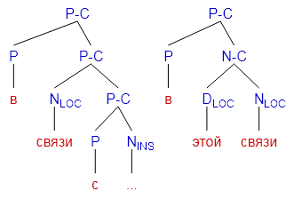
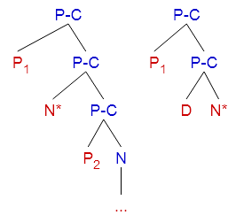
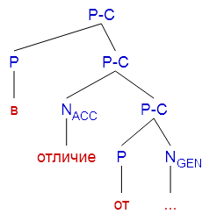
Pattern as catena & its realisation
Notes:
[P-C [P_1] [P-C [N*] [P-C [P_2][N ...]]]]
[P-C [P_1][P-C[D ][N*]]]
[P-C [P в] [P-C[N_LOC связи] [P-C [P с][N_INS ...]]]]
[P-C [P в][P-C[D_LOC этой][N_LOC связи]]]
[P-C [P в] [P-C[N_ACC отличие] [P-C [P от][N_GEN ...]]]]

Slide 9
A. Lexically idiomatic correspondences
Type A2: combinations of closed class pro-forms and function words
adv/prep/prt | aux₁ | pron/conj | prt | adv/A/N^{abstr} | aux₂ | English equivalents
 |  | как | бы 1 |  |  | ‘as if, like, sort of’ (particle):
 |  | как | бы 2 |  |  | ‘lest’ (conjunction
 |  | всё | же |  |  | ‘all the same’
только |  | что |  |  |  | ‘just now’
 |  | тем | не | менее |  | ‘however’, ‘yet’
между |  | тем |  |  |  | ‘meanwhile’
между |  |  |  | прочим |  | ‘by the way’
 |  | как | будто |  |  | ‘as though’
 |  | что | ли |  |  | ‘or something’
 |  | что | за |  |  | ‘what kindof a’
 |  | тот | же |  |  | ‘same as’
пока |  | что |  |  |  | 'as yet’
разве |  | что |  |  |  | ‘perhaps only’
 |  | тем |  | более |  | ‘especially’
 |  |  | не | прочь |  | ‘don't mind’
 |  | то | и | дело |  | ‘every now and then’
 |  | так | и |  | быть | ‘so be it’
 |  | всё |  | равно |  | ‘just the same’
 |  | как |  | раз |  | ‘just, exactly’
не |  | тут- | -то |  | было | ‘nothing of the kind’
 | будь | что |  |  | будет | ‘whatever happens’
E.g. как будто (‘as though’)
Ru: Он смерил Берлиоза взглядом, как будто собирался сшить ему костюм
Bg: Той измери Берлиоз с поглед, като че ли му взимаше мярка за костюм
Pl: On zmierzył Berlioza spojrzeniem, jakby zamierzał uszyć mu garnitur
Cz: Změřil si ho pátravým pohledem, jako by se mu chystal šít oblek
En: He looked Berlioz up and down as though he were measuring him for a suit.

Slide 10
A. Lexically idiomatic correspondences
Type A2: combinations of closed class pro-forms and function words
adv/prep/prt | aux₁ | pron/conj | prt | adv/A/N^{abstr} | aux₂ | English equivalents
 |  | как | бы 1 |  |  | ‘as if, like, sort of’ (particle):
 |  | как | бы 2 |  |  | ‘lest’ (conjunction
 |  | всё | же |  |  | ‘all the same’
только |  | что |  |  |  | ‘just now’
 |  | тем | не | менее |  | ‘however’, ‘yet’
между |  | тем |  |  |  | ‘meanwhile’
между |  |  |  | прочим |  | ‘by the way’
 |  | как | будто |  |  | ‘as though’
 |  | что | ли |  |  | ‘or something’
 |  | что | за |  |  | ‘what kindof a’
 |  | тот | же |  |  | ‘same as’
пока |  | что |  |  |  | 'as yet’
разве |  | что |  |  |  | ‘perhaps only’
 |  | тем |  | более |  | ‘especially’
 |  |  | не | прочь |  | ‘don't mind’
 |  | то | и | дело |  | ‘every now and then’
 |  | так | и |  | быть | ‘so be it’
 |  | всё |  | равно |  | ‘just the same’
 |  | как |  | раз |  | ‘just, exactly’
не |  | тут- | -то |  | было | ‘nothing of the kind’
 | будь | что |  |  | будет | ‘whatever happens’
Russian | Bulgarian | Polish | Czech
как бы 1 | като че ли | jakby | jakoby
всё же | все пак | jednak | přesto, stejně
только что | току-що | dopiero | zrovna, právě
тем не менее | въпреки това | tym niemniej, mimo wszystko | nicméně, presto
между тем | същевременно | tymczasem | mezitím
между прочим | между другото | nawiasem mówiąc, przy okazji | mimochodem

Slide 11
A. Lexically idiomatic correspondences
Type A2: combinations of closed class pro-forms and function words
adv/prep/prt | aux₁ | pron/conj | prt | adv/A/N^{abstr} | aux₂ | English equivalents
 |  | как | бы 1 |  |  | ‘as if, like, sort of’ (particle):
 |  | как | бы 2 |  |  | ‘lest’ (conjunction
 |  | всё | же |  |  | ‘all the same’
только |  | что |  |  |  | ‘just now’
 |  | тем | не | менее |  | ‘however’, ‘yet’
между |  | тем |  |  |  | ‘meanwhile’
между |  |  |  | прочим |  | ‘by the way’
 |  | как | будто |  |  | ‘as though’
 |  | что | ли |  |  | ‘or something’
 |  | что | за |  |  | ‘what kindof a’
 |  | тот | же |  |  | ‘same as’
пока |  | что |  |  |  | 'as yet’
разве |  | что |  |  |  | ‘perhaps only’
 |  | тем |  | более |  | ‘especially’
 |  |  | не | прочь |  | ‘don't mind’
 |  | то | и | дело |  | ‘every now and then’
 |  | так | и |  | быть | ‘so be it’
 |  | всё |  | равно |  | ‘just the same’
 |  | как |  | раз |  | ‘just, exactly’
не |  | тут- | -то |  | было | ‘nothing of the kind’
 | будь | что |  |  | будет | ‘whatever happens’

Slide 12
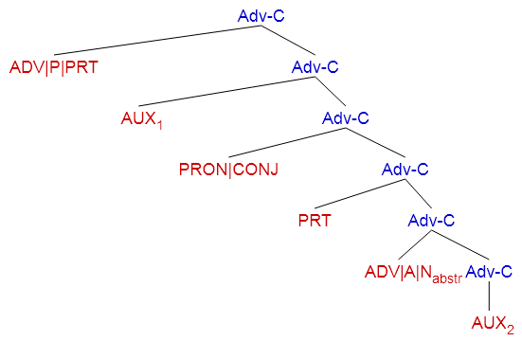
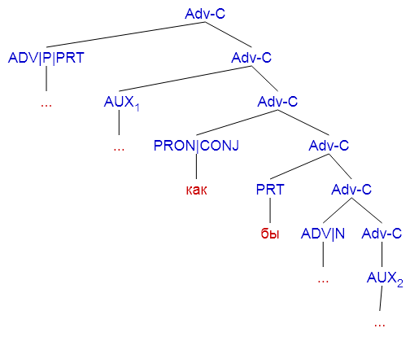
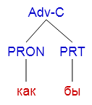
Pattern as catena & its realisation
Notes:
[Adv-C [ADV|P|PRT] [Adv-C [AUX_1] [Adv-C [PRON|CONJ] [Adv-C [PRT] [Adv-C [ADV|A|N_abstr] [Adv-C [AUX_2]]]]]]]
[Adv-C [ADV|P|PRT ...] [Adv-C [AUX_1 ...] [Adv-C [PRON|CONJ как] [Adv-C [PRT бы] [Adv-C [ADV|A|N_ ...] [Adv-C [AUX_2 ...]]]]]]]
[Adv-C [PRON как][PRT бы]]

Slide 13
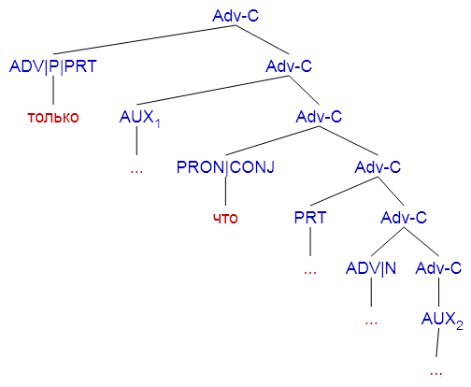
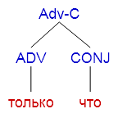
Pattern as catena & its realisation
Notes:
[Adv-C [ADV|P|PRT] [Adv-C [AUX_1] [Adv-C [PRON|CONJ] [Adv-C [PRT] [Adv-C [ADV|A|N_abstr] [Adv-C [AUX_2]]]]]]]
[Adv-C [ADV|P|PRT только] [Adv-C [AUX_1 ...] [Adv-C [PRON|CONJ что] [Adv-C [PRT ...] [Adv-C [ADV|A|N_ ...] [Adv-C [AUX_2 ...]]]]]]]
[Adv-C [ADV только] [CONJ что]]

Slide 14
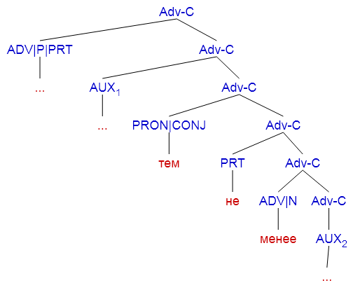
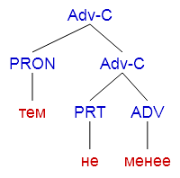
Pattern as catena & its realisation
Notes:
[Adv-C [ADV|P|PRT] [Adv-C [AUX_1] [Adv-C [PRON|CONJ] [Adv-C [PRT] [Adv-C [ADV|A|N_abstr] [Adv-C [AUX_2]]]]]]]
[Adv-C [ADV|P|PRT ...] [Adv-C [AUX_1 ...] [Adv-C [PRON|CONJ тем] [Adv-C [PRT не] [Adv-C [ADV|A|N_ менее] [Adv-C [AUX_2 ...]]]]]]]
[Adv-C [PRON тем] [Adv-C [PRT не][ADV менее]]]

Slide 15
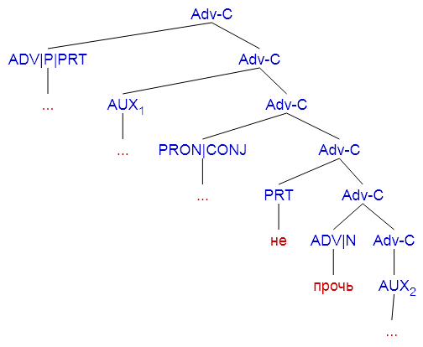
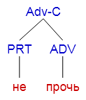
Pattern as catena & its realisation
Notes:
[Adv-C [ADV|P|PRT] [Adv-C [AUX_1] [Adv-C [PRON|CONJ] [Adv-C [PRT] [Adv-C [ADV|A|N_abstr] [Adv-C [AUX_2]]]]]]]
[Adv-C [ADV|P|PRT ...] [Adv-C [AUX_1 ...] [Adv-C [PRON|CONJ ...] [Adv-C [PRT не] [Adv-C [ADV|A|N_ прочь] [Adv-C [AUX_2 ...]]]]]]]
[Adv-C [PRT не][ADV прочь]]

Slide 16
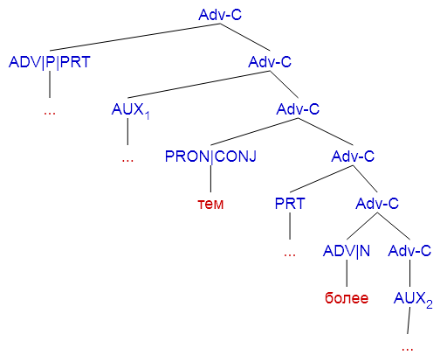
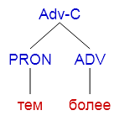
Pattern as catena & its realisation
Notes:
[Adv-C [ADV|P|PRT] [Adv-C [AUX_1] [Adv-C [PRON|CONJ] [Adv-C [PRT] [Adv-C [ADV|A|N_abstr] [Adv-C [AUX_2]]]]]]]
[Adv-C [ADV|P|PRT ...] [Adv-C [AUX_1 ...] [Adv-C [PRON|CONJ тем] [Adv-C [PRT ...] [Adv-C [ADV|A|N_ более] [Adv-C [AUX_2 ...]]]]]]]
[Adv-C [PRON тем] [ADV более]]

Slide 17
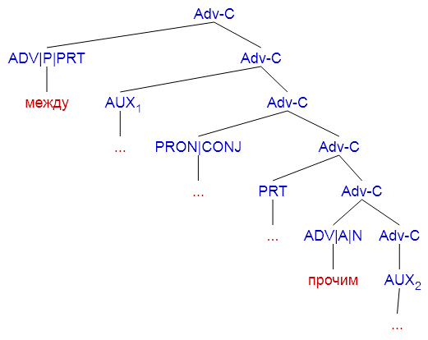
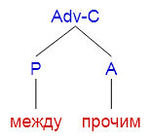
Pattern as catena & its realisation
Notes:
[Adv-C [ADV|P|PRT] [Adv-C [AUX_1] [Adv-C [PRON|CONJ] [Adv-C [PRT] [Adv-C [ADV|A|N_abstr] [Adv-C [AUX_2]]]]]]]
[Adv-C [ADV|P|PRT между] [Adv-C [AUX_1 ...] [Adv-C [PRON|CONJ ...] [Adv-C [PRT ...] [Adv-C [ADV|A|N_ прочим] [Adv-C [AUX_2 ...]]]]]]]
[Adv-C [P между][A прочим]]

Slide 18
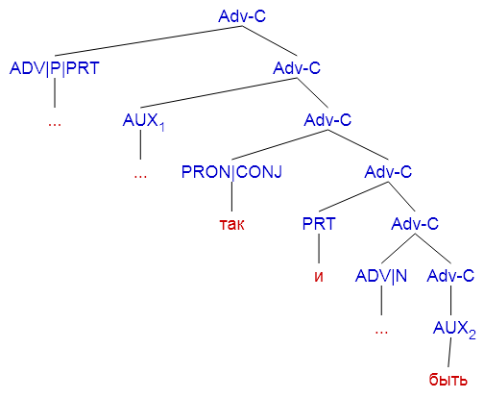
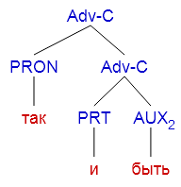
Pattern as catena & its realisation
Notes:
[Adv-C [ADV|P|PRT] [Adv-C [AUX_1] [Adv-C [PRON|CONJ] [Adv-C [PRT] [Adv-C [ADV|A|N_abstr] [Adv-C [AUX_2]]]]]]]
[Adv-C [ADV|P|PRT ...] [Adv-C [AUX_1 ...] [Adv-C [PRON|CONJ так] [Adv-C [PRT и] [Adv-C [ADV|A|N_ ...] [Adv-C [AUX_2 быть]]]]]]]
[Adv-C [PRON так] [Adv-C [PRT и] [AUX_2 быть]]]

Slide 19
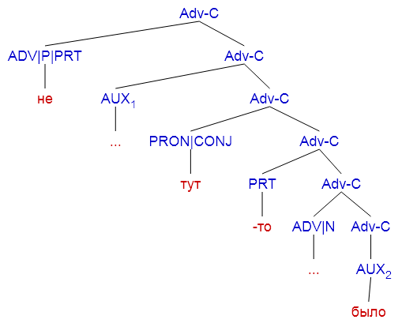
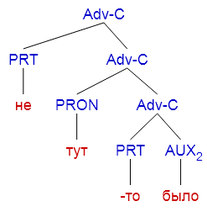
Pattern as catena & its realisation
Notes:
[Adv-C [ADV|P|PRT] [Adv-C [AUX_1] [Adv-C [PRON|CONJ] [Adv-C [PRT] [Adv-C [ADV|A|N_abstr] [Adv-C [AUX_2]]]]]]]
[Adv-C [ADV|P|PRT не] [Adv-C [AUX_1 ...] [Adv-C [PRON|CONJ тут] [Adv-C [PRT -то] [Adv-C [ADV|A|N_ ...] [Adv-C [AUX_2 было]]]]]]]
[Adv-C [PRT не] [Adv-C [PRON тут] [Adv-C [PRT -то] [AUX_2 было]]]]

Slide 20
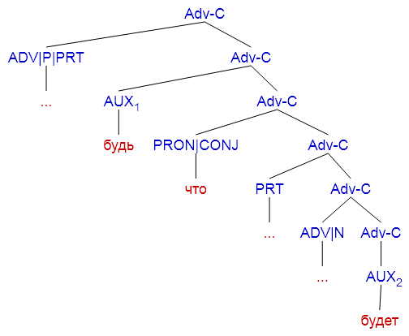
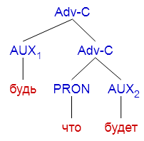
Pattern as catena & its realisation
Notes:
[Adv-C [ADV|P|PRT] [Adv-C [AUX_1] [Adv-C [PRON|CONJ] [Adv-C [PRT] [Adv-C [ADV|A|N_abstr] [Adv-C [AUX_2]]]]]]]
[Adv-C [ADV|P|PRT ...] [Adv-C [AUX_1 будь] [Adv-C [PRON|CONJ что] [Adv-C [PRT ...] [Adv-C [ADV|A|N_ ...] [Adv-C [AUX_2 будет]]]]]]]
[Adv-C [AUX_1 будь] [Adv-C [PRON что] [AUX_2 будет]]]

Slide 21
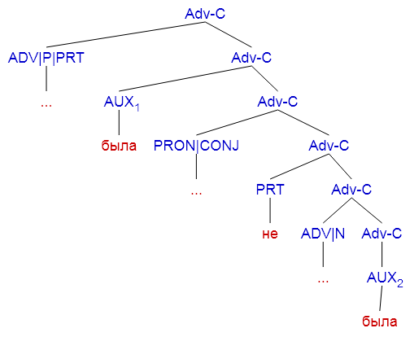
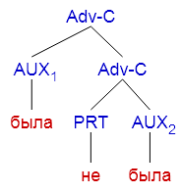
Pattern as catena & its realisation
Notes:
[Adv-C [ADV|P|PRT] [Adv-C [AUX_1] [Adv-C [PRON|CONJ] [Adv-C [PRT] [Adv-C [ADV|A|N_abstr] [Adv-C [AUX_2]]]]]]]
[Adv-C [ADV|P|PRT ...] [Adv-C [AUX_1 была] [Adv-C [PRON|CONJ ...] [Adv-C [PRT не] [Adv-C [ADV|A|N_ ...] [Adv-C [AUX_2 была]]]]]]]
[Adv-C [AUX_1 была][Adv-C [PRT не][AUX_2 была]]]

Slide 22
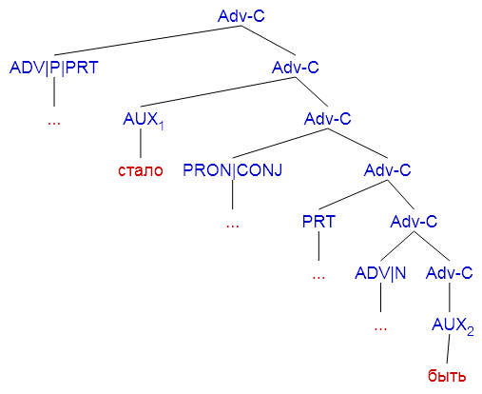
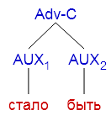
Pattern as catena & its realisation
Notes:
[Adv-C [ADV|P|PRT] [Adv-C [AUX_1] [Adv-C [PRON|CONJ] [Adv-C [PRT] [Adv-C [ADV|A|N_abstr] [Adv-C [AUX_2]]]]]]]
[Adv-C [ADV|P|PRT ...] [Adv-C [AUX_1 стало] [Adv-C [PRON|CONJ ...] [Adv-C [PRT ...] [Adv-C [ADV|A|N_ ...] [Adv-C [AUX_2 быть]]]]]]]
[Adv-C [AUX_1 стало][AUX_2 быть]]

Slide 23
A. Lexically idiomatic correspondences
Type A3: semi-lexicalized patterns with constant and variable parts
 | N^{variable} | V^{constant} | Interrogative pro-form | Adv^{constant} | English equivalent
(a) |  |  | кто/что/где/зачем/куда | угодно | 'wh-ever'
(b) | чёрт/бес/бог... | знает | кто/что/где/зачем/куда |  | 'God knows wh...'
Ru | Капельдинеры рассказывали Бог знает что, …
Pl | Bileterzy opowiadali niestworzone rzeczy.
Cz | Biletáři vykládali neuvěřitelně věci, …
Bg | Разпоредителите разправяха какво ли не, …
En | The commissionaires were saying unbelievable things, …
 | The ushers told of God knows what, …

Slide 24
A. Lexically idiomatic correspondences
Type A3: semi-lexicalized patterns with constant and variable parts
 | N^{variable} | V^{constant} | Interrogative pro-form | Adv^{constant} | English equivalent
(a) |  |  | кто/что/где/зачем/куда | угодно | 'wh-ever'
(b) | чёрт/бес/бог... | знает | кто/что/где/зачем/куда |  | 'God knows wh...'
^^

Slide 25
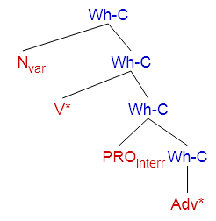
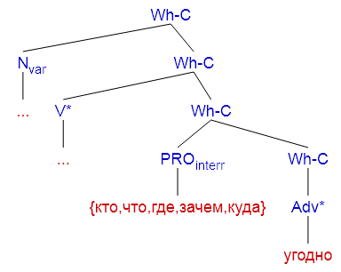
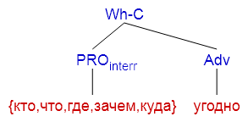
Pattern as catena & its realisation
Notes:
[Wh-C [N_var] [Wh-C [V*] [Wh-C [PRO_interr] [Wh-C [Adv*]]]]]
[Wh-C [N_var ...] [Wh-C [V* ...] [Wh-C [PRO_interr {кто,что,где,зачем,куда}] [Wh-C [Adv* угодно]]]]]
[Wh-C [PRO_interr {кто,что,где,зачем,куда}] [Adv угодно]]

Slide 26
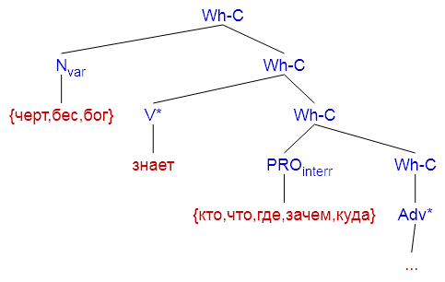
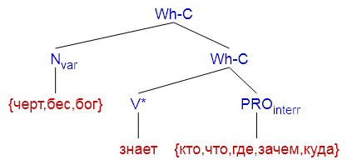
Pattern as catena & its realisation
Notes:
[Wh-C [N_var] [Wh-C [V*] [Wh-C [PRO_interr] [Wh-C [Adv*]]]]]
[Wh-C [N_var {черт,бес,бог}] [Wh-C [V* знает] [Wh-C [PRO_interr {кто,что,где,зачем,куда}] [Wh-C [Adv* ...]]]]]
[Wh-C [N_var {черт,бес,бог}] [Wh-C [V* знает] [PRO_interr {кто,что,где,зачем,куда}]]]

Slide 27
A. Lexically idiomatic correspondences
Outlook: feasibility of a straightforward treatment for
multi-component prepositions
combinations of closed class pro-forms and function words
semi-lexicalized patterns with constant and variable parts

Slide 28
Cross-linguistic challenges
syntactic & constructional idiomaticity
moderately transparent non-standard constructions

Slide 29
B. Syntactically idiomatic expressions
valence requirements and selectional restrictions
(a) | как быть | X_{dat} | Y_{[with]} | Z_{[situation]}
 | ‘what to do about‘ | профессору | со студентами | на экзамене
 |  | ‘professor’ | ‘with students’ | ‘at examination’
(b) | не V_{fin} …, | то ли дело | X
 | (negated proposition) |  | (non-negated proposition)
(c) | [situation: immediacy + service] BE-aux_{[future] [transitive]} | X_{[food/drink/tobacco]}
 | буду/будешь/будет/будем/будете/будут | чай
 | ‘will have’ | ‘tea’

Slide 30
B. Syntactically idiomatic expressions
(a) | как быть | X_{dat} | Y_{[with]} | Z_{[situation]}
 | ‘what to do about‘ | профессору | со студентами | на экзамене
 |  | ‘professor’ | ‘with students’ | ‘at examination’
(b) | не V_{fin} …, | то ли дело | X
 | (negated proposition) |  | (non-negated proposition)
(c) | [situation: immediacy + service] BE-aux_{[future] [transitive]} | X_{[food/drink/tobacco]}
 | буду/будешь/будет/будем/будете/будут | чай
 | ‘will have’ | ‘tea’

Slide 31
B. Syntactically idiomatic expressions
English | Alice had no idea what to do,
Russian | Алиса растерялась.
Russian_2 | Аня не знала, как ей быть.
Russian_3 | Бедная Алиса не знала, что ей делать;
Ukrainian | Аліса не знала, що робити;
Belarussian | Алеся ня мела ніякага ўяўленьня, што рабіць.
Polish | Alicja nie wiedziała, jak wybrnąć z tej sytuacji.
Polish_2 | Zupełnie nie wiedząc, co począć,
Czech | Alenka nevěděla, co počít,
Slovak | Alica raz nevedela, čo robiť;
Slovene | Alica sploh ni vedela, kaj naj stori;
Croatian | Jadna Alica! Šta će sad? Ne znajući kako da se izvuče iz neprilike
Serbian | Алиса није имала појма шта да ради.
Macedonian | Алиса воопшто не знаеше што да прави,
Bulgarian | Алиса не знаеше какво да стори

Slide 32
B. Syntactically idiomatic expressions
Outlook: search of equivalents
strong language specificity (Russian)
valence requirements and selectional restrictions as a unit
diverse paraphrases possible in different languages

Slide 33
C. Constructionally idiomatic expressions
Type C
infinitival existential (syntactic agglomerate)
modal infinitive X_{dat} (не) V_{inf} (ли)
experiencer predicative X_{dat} (не) до Y_{gen} (ли)
reduplicative V
V_{inf} не V_{fin}
V не V
V_{inf} так V_{inf}
V да / и V
reduplicative non-V
X_{nom} есть X_{nom}
X_{nom} X_{instr}
X_{nom} как X_{nom}
interr-neg, a X
tautological
V N_{instr}
X_{nom} Аdv_{[how]}
X_{nom} X_{dat} рознь

Slide 34
C. Constructionally idiomatic expressions
Type C
infinitival existential (syntactic agglomerate)
modal infinitive X_{dat} (не) V_{inf} (ли)
experiencer predicative X_{dat} (не) до Y_{gen} (ли)
reduplicative V
V_{inf} не V_{fin}
V не V
V_{inf} так V_{inf}
V да / и V
reduplicative non-V
X_{nom} есть X_{nom}
X_{nom} X_{instr}
X_{nom} как X_{nom}
interr-neg, a X
tautological
V N_{instr}
X_{nom} Аdv_{[how]}
X_{nom} X_{dat} рознь
dative realisation of the subject valence

Slide 35
C. Constructionally idiomatic expressions
Type C
infinitival existential (syntactic agglomerate)
modal infinitive X_{dat} (не) V_{inf} (ли)
experiencer predicative X_{dat} (не) до Y_{gen} (ли)
reduplicative V
V_{inf} не V_{fin}
V не V
V_{inf} так V_{inf}
V да / и V
reduplicative non-V
X_{nom} есть X_{nom}
X_{nom} X_{instr}
X_{nom} как X_{nom}
interr-neg, a X
tautological
V N_{instr}
X_{nom} Аdv_{[how]}
X_{nom} X_{dat} рознь
≈ ‘one X is different from another X’

Slide 36
C. Constructionally idiomatic expressions
Ru Bg | Агент агенту рознь. Има агенти и агенти. ‘There are different sorts of agents’
Ru Be | Грешки грешкам ― рознь (Гоголь) Грашкі на грашкі ня выходзяць. ‘Little sins can be different’
Ru Uk | Погода погоде рознь, да и день — дню! Верем’є верем’ю нерівне, та й днина днині! (Мартович) ‘Weather is different from weather, and one day is different from another day.’
Ru Pl | Оказывается, пуля пуле рознь. Kula, jak się okazywało, kuli nie była bynajmniej równą (Sapkowski) ‘It turns out one bullet is different from another’

Slide 37
C. Constructionally idiomatic expressions
Outlook: finding cross-linguisticc equivalents
classification based on Russian
various strategies in the other languages detectable
non-trivial (!)

Slide 38
Micro-syntactic phenomena
Language-specific idiomaticity
ideosyncracy due to grammaticalization and/or lexicalization of expressions
defying uniform interpretation
little freedom in formation, anomalous in structure
Detection & classification of equivalents
bilingually (with Russian as pivot) & multilingually
language-family oriented interpretation
Ensuring cross-linguistic comparability
lexical, grammatical, constructional information
to be captured in a modular way

Slide 39
Next steps
differentiation criteria for microsyntactic units
vs. collocations that can be captured by LFs,
vs. fragments interpretable in terms of ellipsis,
vs. “trivially” lexicalized MWE
in order to operationalize search for cross-lingual correspondences

Slide 40
Afterthoughts
‘idiom’ is a pre-theoretic term referring to various types of fixed expressions
conventionalized multilexemic expressions whose meaning is figurative (metaphoric) and unpredictable by semantic composition
idioms differ from one another in the level of their transparency (opacity)
the degree of opacity can be determined only once we know the meaning of the idioms
the meanings of idioms are unpredictable (even if a posteriori, more transparent)
proverbs have no precise linguistic definition

Slide 41
The notion of catena “chain”
O’Grady (1998: 284)
introduced as a mechanism for representing the syntactic structure of idioms
in response to the need for a definition of syntactic patterns not coinciding with constituents
Osborne (2006: 258)
“The words A, B, and C (order irrelevant) form a chain if and only if A immediately dominates B and C, or if and only if A immediately dominates B and B immediately dominates C.”
Quirk & Menezes (2006)
in translation research known as “treelets”

Slide 42
O’Grady (1998) and Gross (2010)’s definition:
a catena is a word or a combination of words directly connected with dominance relations
Applied to dependency representations
in the domain of dependency trees, this definition is equivalent to a subtree definition
the complete tree is also a catena
individual words are catenae, too

Slide 43
Czech light verb constructions (→ LFs)
predicative noun as a direct or indirect object of a light verb, e.g.,
dostat strach ‘to get fear’ ⇒ ‘to become afraid’,
vzdát úctu ‘to pay tribute’,
vyvolat pobouření ‘to provoke indignation’ ⇒ ‘to cause uproar’
predicative noun as adverbial of the light verb, e.g.,
dát do pořádku ‘to put in order’,
mít pod kontrolou ‘to have under control’,
mít na starosti ‘to have on care’ ⇒ ‘to be responsible’

Slide 44
Czech light verb constructions (→ LFs)
as single predicative units can be paraphrased by their single predicative counterparts, e.g.,
dát polibek ‘give a kiss’ → políbit ‘to kiss’
dát pusu ‘give a kiss’ → políbit ‘to kiss’
easier modification of LVCs is often considered a motivation for their use
dát vášnivý /něžný / letmý / manželský / májový /smrtící polibek ‘give a passionate / tender / fleeting / marriage / May / fatal kiss’
vášnivě / něžně / letmo / *manželsky / *májově / *smrtelně políbit ‘to kiss passionately / tenderly / fleetingly / *marriagely/ *Mayly /?fatally’

Slide 45
Czech light verb constructions (→ LFs)
different light verbs: perspectivization from the point of view of different participants
dát polibek ‘to give a kiss’ promotes a kisser in the subject position
dostat polibek ‘to get a kiss’ puts a kissee into this position
paraphrasable with different voice values
dát polibek ‘to give a kiss’ → active voice, e.g., Petr dal Janě polibek. ‘Peter gave a kiss to Jane.’ Petr Janu políbil. ‘Peter kissed Jane.’
dostat polibek ‘to get a kiss’ → passive voice, e.g., Jana dostala od Petra polibek. ‘Jane got a kiss from Peter.’ Jana byla políbena od Petra. ‘Jane was kissed by Peter’.

Slide 46
a paraphrasing model has been proposed within the Meaning↔Text Theory (Žolkovskij & Mel’čuk 1965);
its representation of LVCs by means of lexical functions and rules applied in the paraphrasing model are thoroughly described in Alonso-Ramos (2007)

Slide 47
Czech idiomatic verbal constructions
a verbal multiword unit that exhibits strong lexical co-occurrence restrictions so that at least one of its parts cannot be used with the same meaning outside the given multiword unit
highly conventionalized multiword units

Slide 48
IVC properties: markedness
vzít za své ‘take as one’s own’ ⇒ ‘to be no more’ (syntactically marked as the reflexive adjective své does not modify any noun),
nalít někomu čistého vína ‘to pour someone pure wine’ ⇒ ‘to tell someone the honest truth’ (morphologically marked due to the partitive genitive of the noun víno ‘wine’, which is highly restricted in contemporary Czech);

Slide 49
IVC properties: figuration
vstát z mrtvých, ‘raise the dead’ (as it involves a metaphor)
pověsit se někomu na krk ‘to hang around someone’s neck’ (as it involves a metonymy);

Slide 50
IVC properties: fixedness
postavit někoho na nohy ‘to put someone back on his feet’ (syntactically fixed as it cannot be transformed into the passive structure)
přijít na jiné myšlenky ‘to come to different ideas’ ⇒ ‘to find something else to think about’ (morphologically fixed as the noun myšlenka ‘idea’ can have only the plural form)

Slide 51
IVC properties: proverbiality
recurrent socially significant situations, implying their subjective evaluation, e.g.,
vidět někomu do duše ‘to see right through someone’;

Slide 52
IVC properties: informality
typically of informal register, e.g.,
strčit si něco za klobouk ‘to put something behind a hat’ ⇒ ‘to stick it up one’s jumper’).

Slide 53
Some IVCs can be paraphrased by a single word verb, e.g.,
podat někomu pomocnou ruku ‘to give someone helping hand’ → pomoci ‘to help’
However, many IVCs are paraphrasable rather by a whole syntactic structure, e.g.,
mít slovo ‘to have a word’ ⇒ ‘to be someone’s turn to speak’

Slide 54
LVCs
položit otázku ‘put a question’
dát do pořádku ‘put in order’
přejít ze smíchu do pláče ‘go from laughing to crying’

Slide 55
LVC → single verb
dávat přednost ‘to give a preference’ → upřednostňovat / preferovat ‘to prefer’
vypovídat pravdu ‘to tell the truth’ antonym lhát ‘to lie’ (Nevypovídá pravdu. ‘He is not telling the truth.’ → Lže. ‘He is lying.’)
IVC → single verb
prásknout do bot ‘to bang to the shoes’ ⇒ ‘to take to one’s heels’, → utéci ‘to run away’ / zdrhnout ‘to make off’

Slide 56
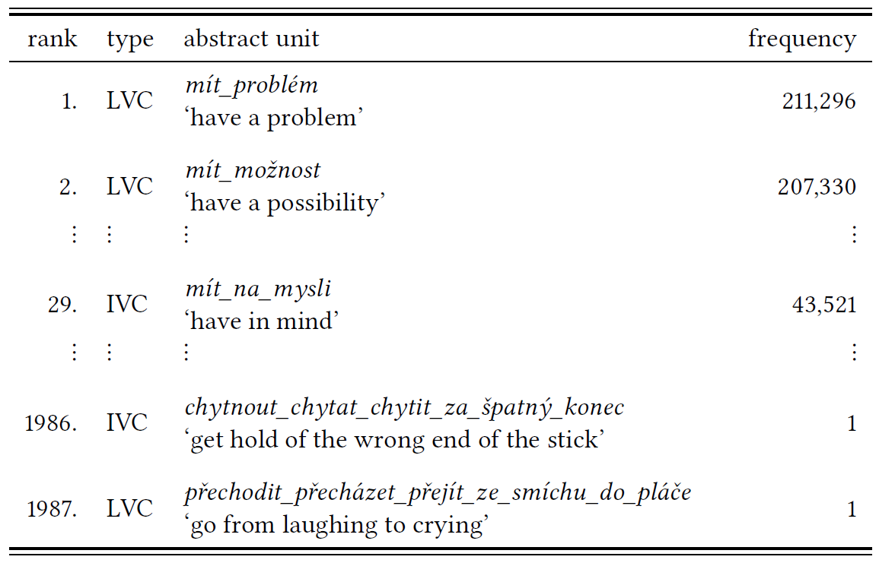

Slide 57
Paraphrase – How?
straightforeward, e.g.,
mít zájem ‘to be interested’ and chtít ‘to want’;
antonym (context), e.g.,
zaznamenat propad ‘to experience a drop’ and stoupnout ‘to rise’;
change in morphosyntactic expression of arguments, e.g.,
dostat nabídku ‘to get an offer’ and nabídnout ‘to offer’;
change in sentence structure required, e.g.,
dojít k poruše ‘to happen to the failure’ ⇒ ‘the failure happens’ and porouchat se ‘to breakdown’;
with reflexive morpheme se/si is, e.g.,
nést název ‘bear a name’ and nazývat se ‘to be called’;
only with adjectival modification of noun component
e.g., podat oznámení ‘to make an announcement’ can be paraphrased as žalovat ‘to sue’ only if the noun oznámení is modified with the adjective trestní ‘criminal’;

Slide 58
