Slide 1
A High-Performance Matrix Storage Format for Sparse Banded Matrices Derived from Structured Grids

Slide 2
I. Introduction

Slide 3
I. Introduction
Structured Grids
  - used in simulations (CFD et al.)
Sparse Banded Matrices Derived from Structured Grids
Notes:
- structured = nodes identified by tuple of coords.
- “logically rectangular”

Slide 4
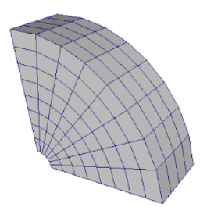
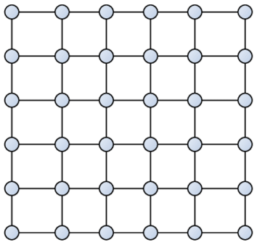
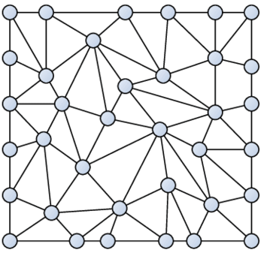
I. Introduction
Structured Grids
  - used in simulations (CFD et al.)
    - PDEs linearized, discretized → mesh generation
Sparse Banded Matrices Derived from Structured Grids
Notes:
- structured = nodes identified by tuple of coords.
- “logically rectangular”

Slide 5
I. Introduction
Structured Grids
  - used in simulations (CFD et al.)
    - PDEs linearized, discretized → mesh generation
    - Linear system Ax=b inherits structure from the mesh
    - iterative methods → many spMV with “A”
Sparse Banded Matrices Derived from Structured Grids
Notes:
- structured = nodes identified by tuple of coords.
- “logically rectangular”

Slide 6
I. Introduction
Structured Grids
  - used in simulations (CFD et al.)
    - PDEs linearized, discretized → mesh generation
    - Linear system Ax=b inherits structure from the mesh
    - iterative methods → many spMV with “A”
  - distinct structure: matrix is sparse and banded
Sparse Banded Matrices Derived from Structured Grids
Notes:
- structured = nodes identified by tuple of coords.
- “logically rectangular”

Slide 7
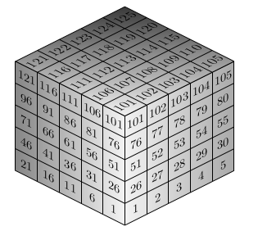
I. Introduction
Structured Grids
  - used in simulations (CFD et al.)
    - PDEs linearized, discretized → mesh generation
    - Linear system Ax=b inherits structure from the mesh
    - iterative methods → many spMV with “A”
  - distinct structure: matrix is sparse and banded
Sparse Banded Matrices Derived from Structured Grids
Notes:
- structured = nodes identified by tuple of coords.
- “logically rectangular”
- Laplace/Poisson Equation using finite diffs, on 5x5x5 grid ..

Slide 8
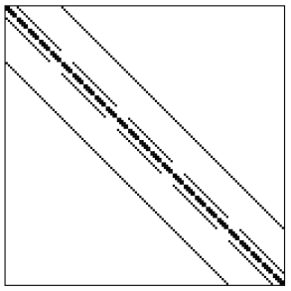
I. Introduction
Structured Grids
  - used in simulations (CFD et al.)
    - PDEs linearized, discretized → mesh generation
    - Linear system Ax=b inherits structure from the mesh
    - iterative methods → many spMV with “A”
  - distinct structure: matrix is sparse and banded
Sparse Banded Matrices Derived from Structured Grids
Notes:
- structured = nodes identified by tuple of coords.
- “logically rectangular”
- Laplace/Poisson Equation using finite diffs, on 5x5x5 grid ..
… this system matrix

Slide 9

I. Introduction
Structured Grids
  - used in simulations (CFD et al.)
    - PDEs linearized, discretized → mesh generation
    - Linear system Ax=b inherits structure from the mesh
    - iterative methods → many spMV with “A”
  - distinct structure: matrix is sparse and banded
Sparse Banded Matrices Derived from Structured Grids
Notes:
- structured = nodes identified by tuple of coords.
- “logically rectangular”
- Laplace/Poisson Equation using finite diffs, on 5x5x5 grid ..
… this system matrix
… solving linear system via Jacobi (D, L, U)

Slide 10
I. Introduction
Structured Grids
  - used in simulations (CFD et al.)
    - PDEs linearized, discretized → mesh generation
    - Linear system Ax=b inherits structure from the mesh
    - iterative methods → many spMV with “A”
  - distinct structure: matrix is sparse and banded
Sparse Banded Matrices Derived from Structured Grids
Notes:
- structured = nodes identified by tuple of coords.
- “logically rectangular”
- Laplace/Poisson Equation using finite diffs, on 5x5x5 grid ..
… this system matrix
… solving linear system via Jacobi (D, L, U)

Slide 11
I. Introduction
Efficient spMV on sparse banded matrices
Efficient SpMV on Sparse Banded Matrices
Notes:
- takeaway: many spMV .. how to do it efficiently?
= which spM format to use?
… leave matrix for preview

Slide 12
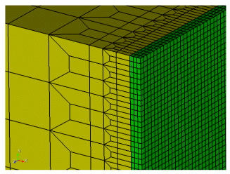
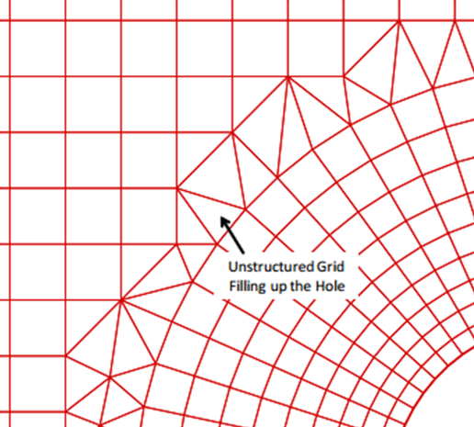
I. Introduction
Efficient spMV on sparse banded matrices
  - accounting for heterogeneous meshes
Efficient SpMV on Sparse Banded Matrices
Notes:
- takeaway: many spMV .. how to do it efficiently?
= which spM format to use?
… leave matrix for preview

Slide 13
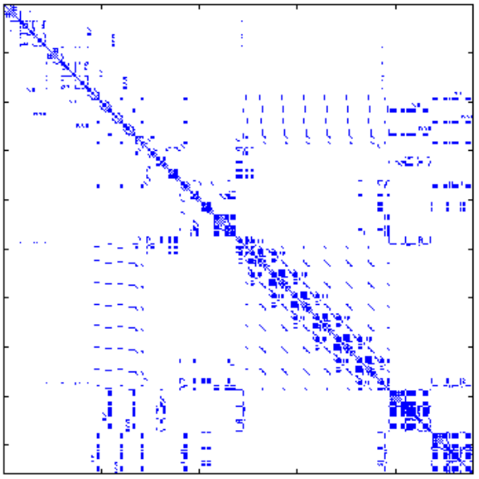
I. Introduction
Efficient spMV on sparse banded matrices
  - accounting for heterogeneous meshes
Efficient SpMV on Sparse Banded Matrices
Notes:
- takeaway: many spMV .. how to do it efficiently?
= which spM format to use?
… leave matrix for preview
- spM might look like mixture of

Slide 14
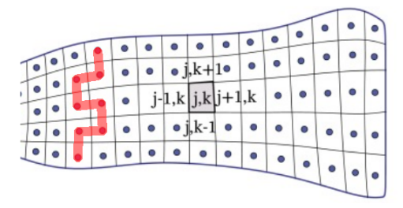
I. Introduction
Efficient spMV on sparse banded matrices
  - accounting for heterogeneous meshes,
  - … local perturbations
Efficient SpMV on Sparse Banded Matrices
Notes:
- takeaway: many spMV .. how to do it efficiently?
= which spM format to use?
… leave matrix for preview
- spM might look like mixture of
- line integral → additional connections

Slide 15
I. Introduction
Efficient spMV on sparse banded matrices
  - accounting for heterogeneous meshes,
  - … local perturbations,
  - … higher dim entities
Efficient SpMV on Sparse Banded Matrices
Notes:
- takeaway: many spMV .. how to do it efficiently?
= which spM format to use?
… leave matrix for preview
- spM might look like mixture of
- line integral → additional connections

Slide 16
I. Introduction
Efficient spMV on sparse banded matrices
  - accounting for heterogeneous meshes,
  - … local perturbations,
  - … higher dim entities,
  - … & constant/unique values
Efficient SpMV on Sparse Banded Matrices
Notes:
- takeaway: many spMV .. how to do it efficiently?
= which spM format to use?
… leave matrix for preview
- spM might look like mixture of
- line integral → additional connections
- rows might share nnz values, or not
- common CSR or flavors used → evidently not optimal for SBM

Slide 17
2. The 3-CSR Format

Slide 18
2. The 3-CSR Format
V
...
 | ■ | ■
■ |  |  | ■ | ■ | ■
 | ■ | ■ | ■ |  | ■
■ | ■ | ■
■ |  | ■ | ■ | ■
... | ... | ... | ... | ... | ...
RP
...
CI
...
Basic CSR Format

Slide 19
2. The 3-CSR Format
V
...
RP
...
Values’ Storage Scheme

Slide 20
2. The 3-CSR Format
V
6.1
4.4
3.3
2.5
6.1
4.4
3.3
2.5
6.1
4.4
3.3
2.5
...
RP
...
Values’ Storage Scheme

Slide 21
2. The 3-CSR Format
V
6.1
4.4
3.3
2.5
...
RP
...
Values’ Storage Scheme

Slide 22
2. The 3-CSR Format
V
6.1
4.4
3.3
2.5
...
V_{Start}
...
Values’ Storage Scheme

Slide 23
2. The 3-CSR Format
V
6.1
4.4
3.3
2.5
...
V_{Start}
...
#_{nnz}
2
4
4
3
4
...
Values’ Storage Scheme

Slide 24
2. The 3-CSR Format
V
6.1
4.4
3.3
2.5
...
V_{Start}
...
#_{nnz}
2
4
4
3
4
...
J
0
1
1
2
4
5
2
3
5
6
1
4
5
4
7
8
9
...
RP
...
Structure’s Storage Scheme

Slide 25
2. The 3-CSR Format
V
6.1
4.4
3.3
2.5
...
V_{Start}
...
#_{nnz}
2
4
4
3
4
...
J
0
1
1
2
4
5
2
3
5
6
1
4
5
4
7
8
9
...
RP
...
J_{Peg}
0
1
2
1
4
...
Structure’s Storage Scheme

Slide 26
2. The 3-CSR Format
V
6.1
4.4
3.3
2.5
...
V_{Start}
...
#_{nnz}
2
4
4
3
4
...
J
0
1
0
1
3
4
0
1
3
4
0
3
4
0
3
4
5
...
RP
...
J_{Peg}
0
1
2
1
4
...
Structure’s Storage Scheme

Slide 27
2. The 3-CSR Format
V
6.1
4.4
3.3
2.5
...
V_{Start}
...
#_{nnz}
2
4
4
3
4
...
J
0
1
0
1
3
4
0
3
4
0
3
4
5
...
RP
...
J_{Peg}
0
1
2
1
4
...
Structure’s Storage Scheme

Slide 28
2. The 3-CSR Format
V
6.1
4.4
3.3
2.5
...
V_{Start}
...
#_{nnz}
2
4
4
3
4
...
J
0
1
0
1
3
4
0
3
4
0
3
4
5
...
J_{Start}
...
J_{Peg}
0
1
2
1
4
...
Structure’s Storage Scheme

Slide 29
2. The 3-CSR Format
V
6.1
4.4
3.3
2.5
...
V_{Start}
...
#_{nnz}
2
4
4
3
4
...
J
0
1
0
1
3
4
0
3
4
0
3
4
5
...
J_{Start}
...
J_{Peg}
0
1
2
1
4
...
Structure’s Storage Scheme

Slide 30
2. The 3-CSR Format
V
6.1
4.4
3.3
2.5
...
V_{Start}
...
#_{nnz}
2
4
4
3
4
...
J
0
1
0
1
3
4
0
3
4
0
3
4
5
...
J_{Start}
...
J_{Peg}
0
1
2
1
4
...
Run-Lenth-Increment Encoding
Notes:
- one entry per matrix row
- inherit aspects of the matrix’s regularity

Slide 31
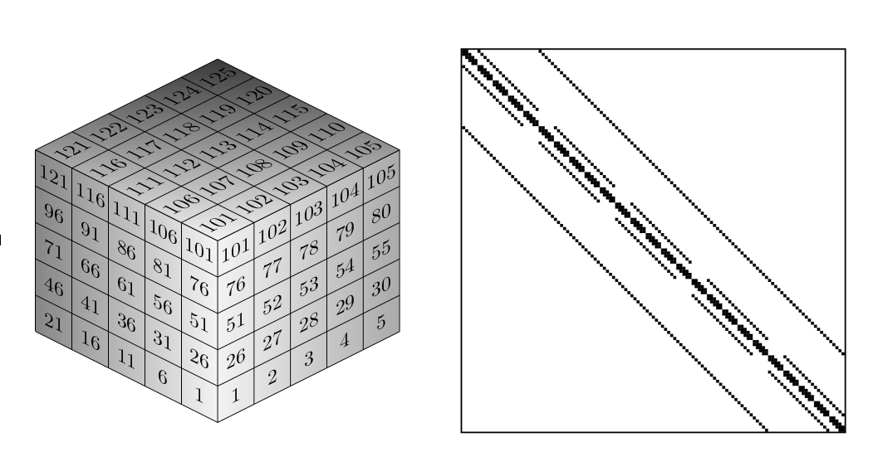
2. The 3-CSR Format
V_{Start}
...
#_{nnz}
...
J_{Start}
...
J_{Peg}
...
Run-Lenth-Increment Encoding

Slide 32
2. The 3-CSR Format
V_{Start}
...
15
15
15
15
15
15
15
15
...
#_{nnz}
...
# = x-dim
J_{Start}
...
J_{Peg}
...
Run-Lenth-Increment Encoding

Slide 33
2. The 3-CSR Format
V_{Start}
...
15
22
29
36
43
50
57
64
...
#_{nnz}
...
# = x-dim
J_{Start}
...
J_{Peg}
...
Run-Lenth-Increment Encoding

Slide 34
2. The 3-CSR Format
V_{Start}
...
15
22
29
36
43
50
57
64
...
#_{nnz}
...
7
7
7
7
7
7
7
7
7
7
7
7
7
7
7
7
...
J_{Start}
...
J_{Peg}
...
Run-Lenth-Increment Encoding

Slide 35
2. The 3-CSR Format
V_{Start}
...
15
22
29
36
43
50
57
64
...
#_{nnz}
...
7
7
7
7
7
7
7
7
7
7
7
7
7
7
7
7
...
J_{Start}
...
7
23
7
23
7
23
7
23
7
23
7
23
7
23
7
23
...
J_{Peg}
...
Run-Lenth-Increment Encoding

Slide 36
2. The 3-CSR Format
V_{Start}
...
15
22
29
36
43
50
57
64
...
#_{nnz}
...
7
7
7
7
7
7
7
7
7
7
7
7
7
7
7
7
...
J_{Start}
...
7
23
7
23
7
23
7
23
7
23
7
23
7
23
7
23
...
J_{Peg}
...
7
9
7
10
7
11
7
12
7
13
7
14
7
15
7
16
...
Run-Lenth-Increment Encoding

Slide 37
2. The 3-CSR Format
Row
13
14
15
16
17
18
19
20
V_{Start}
...
15
22
29
36
43
50
57
64
...
...
#_{nnz}
...
7
7
7
7
7
7
7
7
7
7
7
7
7
7
7
7
...
J_{Start}
...
7
23
7
23
7
23
7
23
7
23
7
23
7
23
7
23
...
J_{Peg}
...
7
9
7
10
7
11
7
12
7
13
7
14
7
15
7
16
...
Run-Lenth-Increment Encoding

Slide 38
2. The 3-CSR Format
Row
13
14
15
16
17
18
19
20
V_{Start}
...
15
22
29
36
43
50
57
64
...
...
→
...
...
(13, 15, 7)
...
...
#_{nnz}
...
7
7
7
7
7
7
7
7
7
7
7
7
7
7
7
7
...
J_{Start}
...
7
23
7
23
7
23
7
23
7
23
7
23
7
23
7
23
...
J_{Peg}
...
7
9
7
10
7
11
7
12
7
13
7
14
7
15
7
16
...
Run-Lenth-Increment Encoding

Slide 39
2. The 3-CSR Format
Row
13
14
15
16
17
18
19
20
V_{Start}
...
15
22
29
36
43
50
57
64
...
...
→
...
...
(13, 15, 7)
...
...
#_{nnz}
...
7
7
7
7
7
7
7
7
7
7
7
7
7
7
7
7
...
→
...
...
(13, 7, 0)
...
...
J_{Start}
...
7
23
7
23
7
23
7
23
7
23
7
23
7
23
7
23
...
J_{Peg}
...
7
9
7
10
7
11
7
12
7
13
7
14
7
15
7
16
...
Run-Lenth-Increment Encoding

Slide 40
2. The 3-CSR Format
Row
13
14
15
16
17
18
19
20
V_{Start}
...
15
22
29
36
43
50
57
64
...
...
→
...
...
(13, 15, 7)
...
...
#_{nnz}
...
7
7
7
7
7
7
7
7
7
7
7
7
7
7
7
7
...
→
...
...
(13, 7, 0)
...
...
J_{Start}
...
7
23
7
23
7
23
7
23
7
23
7
23
7
23
7
23
...
→
...
...
(13, 23, 0)
...
...
J_{Peg}
...
7
9
7
10
7
11
7
12
7
13
7
14
7
15
7
16
...
Run-Lenth-Increment Encoding

Slide 41
2. The 3-CSR Format
Row
13
14
15
16
17
18
19
20
V_{Start}
...
15
22
29
36
43
50
57
64
...
...
→
...
...
(13, 15, 7)
...
...
#_{nnz}
...
7
7
7
7
7
7
7
7
7
7
7
7
7
7
7
7
...
→
...
...
(13, 7, 0)
...
...
J_{Start}
...
7
23
7
23
7
23
7
23
7
23
7
23
7
23
7
23
...
→
...
...
...
...
(13, 23, 0)
(13, 23, 0)
...
...
...
...
J_{Peg}
...
7
9
7
10
7
11
7
12
7
13
7
14
7
15
7
16
...
→
...
...
...
...
(13, 23, 0)
(13, 9, 1)
...
...
...
...
Run-Lenth-Increment Encoding

Slide 42
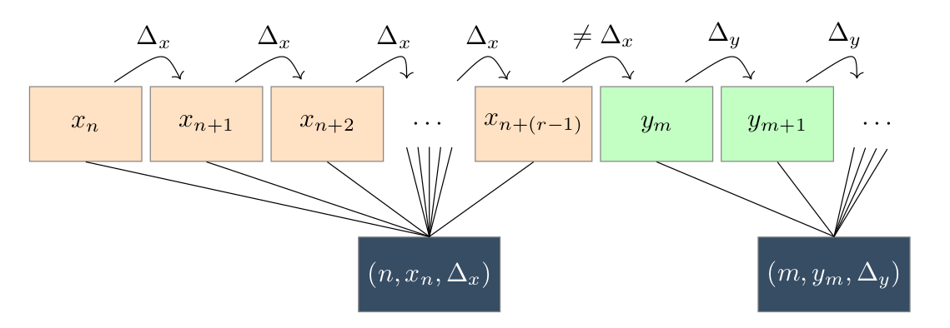
2. The 3-CSR Format
Row
13
14
15
16
17
18
19
20
V_{Start}
...
15
22
29
36
43
50
57
64
...
...
→
...
...
(13, 15, 7)
...
...
#_{nnz}
...
7
7
7
7
7
7
7
7
7
7
7
7
7
7
7
7
...
→
...
...
(13, 7, 0)
...
...
J_{Start}
...
7
23
7
23
7
23
7
23
7
23
7
23
7
23
7
23
...
→
...
...
...
...
(13, 23, 0)
(13, 23, 0)
...
...
...
...
J_{Peg}
...
7
9
7
10
7
11
7
12
7
13
7
14
7
15
7
16
...
→
...
...
...
...
(13, 23, 0)
(13, 9, 1)
...
...
...
...
Run-Lenth-Increment Encoding

Slide 43
2. The 3-CSR Format
V
6.1
4.4
3.3
2.5
...
V_{Start}
...
#_{nnz}
2
4
4
3
4
...
J
0
1
0
1
3
4
0
3
4
0
3
4
5
...
J_{Start}
...
J_{Peg}
0
1
2
1
4
...
Overview
Notes:
- Recap

Slide 44
2. The 3-CSR Format
V
6.1
4.4
3.3
2.5
...
V_{Start}
...
Numerical values
#_{nnz}
2
4
4
3
4
...
J
0
1
0
1
3
4
0
3
4
0
3
4
5
...
J_{Start}
...
J_{Peg}
0
1
2
1
4
...
Overview
Notes:
- Recap

Slide 45
2. The 3-CSR Format
V
6.1
4.4
3.3
2.5
...
V_{Start}
...
#_{nnz}
2
4
4
3
4
...
J
0
1
0
1
3
4
0
3
4
0
3
4
5
...
Structure
J_{Start}
...
J_{Peg}
0
1
2
1
4
...
Overview
Notes:
- Recap

Slide 46
2. The 3-CSR Format
V
6.1
4.4
3.3
2.5
...
V_{Start}
...
Numerical values
#_{nnz}
2
4
4
3
4
...
J
0
1
0
1
3
4
0
3
4
0
3
4
5
5
...
...
Structure
J_{Start}
...
J_{Peg}
0
1
2
1
4
...
Overview
Notes:
- Recap

Slide 47
2. The 3-CSR Format
V
6.1
4.4
3.3
2.5
...
V_{Start}
...
RLI-enc’d
Numerical values
#_{nnz}
2
4
4
3
4
...
RLI-enc’d
J
0
1
0
1
3
4
0
3
4
0
3
4
5
5
...
...
Structure
J_{Start}
...
RLI-enc’d
J_{Peg}
0
1
2
1
4
...
RLI-enc’d
Overview
Notes:
- Recap
- Namesgebung:
- Idee CSFR
- Aufteilen V/J + Kompression
- RLI

Slide 48
3. Storage Size Measurement

Slide 49
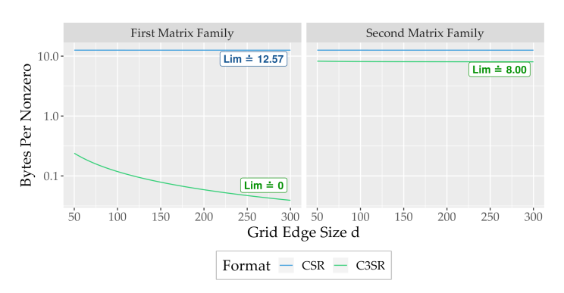
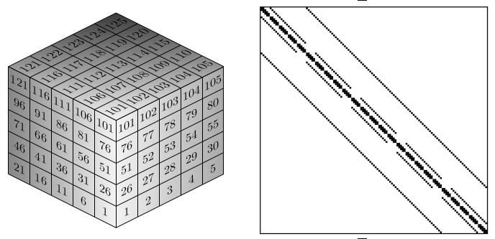
3. Storage Size Measurement
Relative Object Size of Fully Structured Matrices
Notes:
- Fully Structured Matrices as a realistic best case
.. establish baseline performance

Slide 50
3. Storage Size Measurement
All values equal
All values unique
Relative Object Size of Fully Structured Matrices
Notes:
- Recap

Slide 51
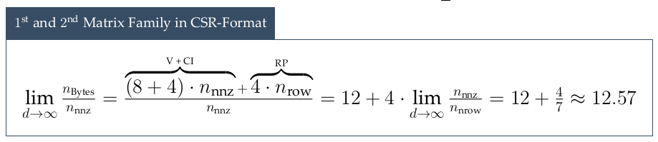
3. Storage Size Measurement
All values equal
All values unique
Relative Object Size of Fully Structured Matrices
Notes:
- Recap

Slide 52
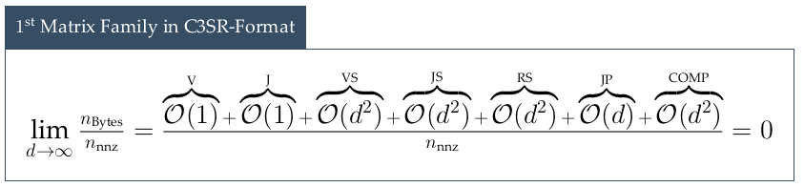
3. Storage Size Measurement
All values equal
All values unique
Relative Object Size of Fully Structured Matrices
Notes:
- Recap

Slide 53
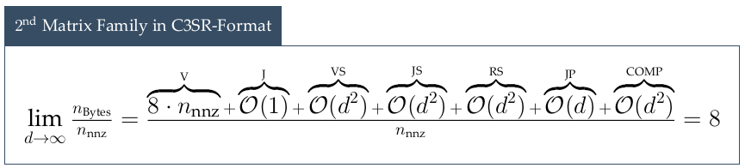
3. Storage Size Measurement
All values equal
All values unique
Relative Object Size of Fully Structured Matrices
Notes:
- Recap

Slide 54

3. Storage Size Measurement
All values equal
All values unique
Notes:
- Recap

Slide 55
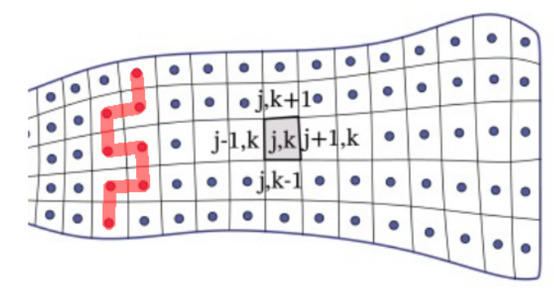
3. Storage Size Measurement
All values equal
All values unique
Relative Object Size of Fully Structured Matrices
Notes:
- Recap

Slide 56
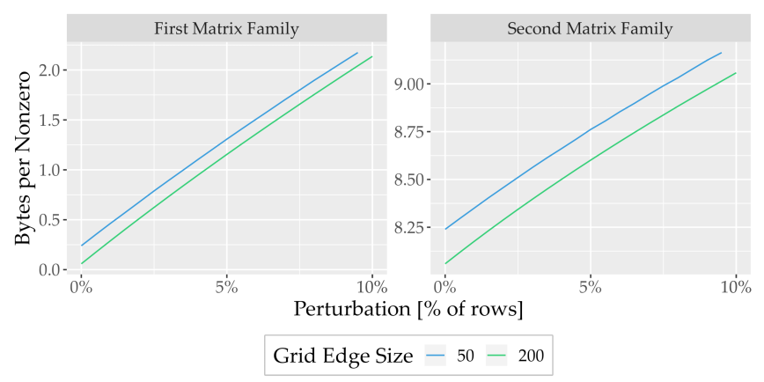
3. Storage Size Measurement
All values equal
All values unique
Relative Object Size of Perturbed Matrices
Notes:
- Recap

Slide 57
4. Arithmetic Performance

Slide 58
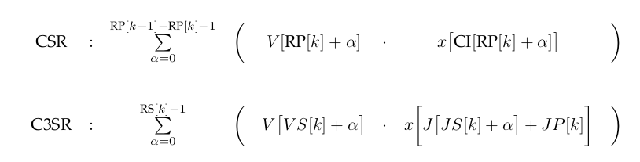
4. Arithmetic Performance
V
...
...
RP
...
...
CI
...
...

Slide 59
4. Arithmetic Performance
V
...
...
RP
...
...
CI
...
...

Slide 60
4. Arithmetic Performance
V
...
...
RP
...
...
CI
...
...

Slide 61
4. Arithmetic Performance
V
...
...
J
...
...
V_{Start}
...
...
J_{Start}
...
...
#_{nnz}
...
...
J_{Peg}
...
...
Notes:
- Access might look complex, but most arrays are trivially small as we’ve seen before

Slide 62
4. Arithmetic Performance
V
...
...
J
...
...
V_{Start}
...
...
J_{Start}
...
...
#_{nnz}
...
...
J_{Peg}
...
...
Notes:
- Access might look complex, but most arrays are trivially small as we’ve seen before

Slide 63
4. Arithmetic Performance
V
...
...
J
...
...
V_{Start}
...
...
J_{Start}
...
...
#_{nnz}
...
...
J_{Peg}
...
...
Notes:
- Access might look complex, but most arrays are trivially small as we’ve seen before

Slide 64
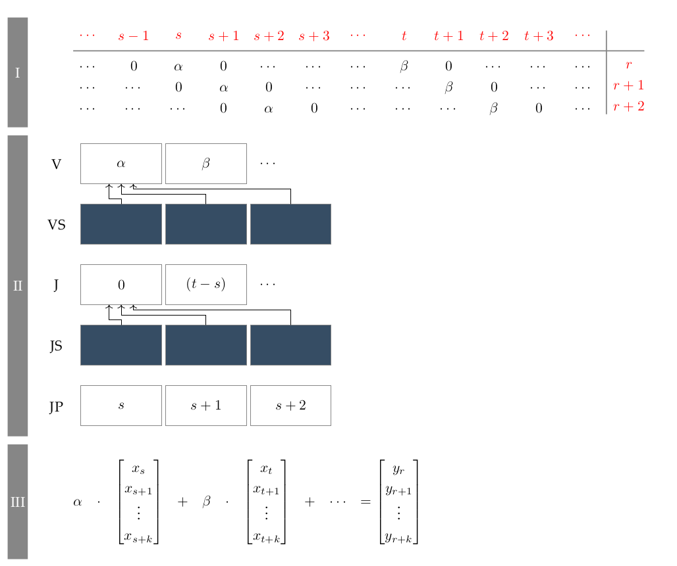
4. Arithmetic Performance
Diagonal Structure & Collated Values

Slide 65
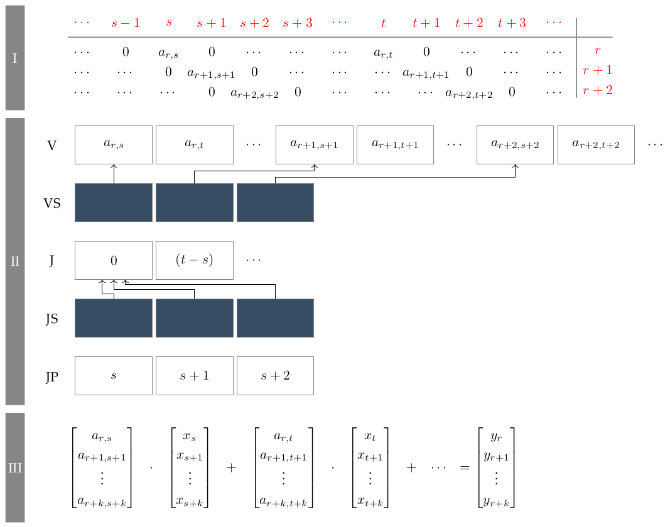
4. Arithmetic Performance
Diagonal Structure & Arbitrary Values

Slide 66
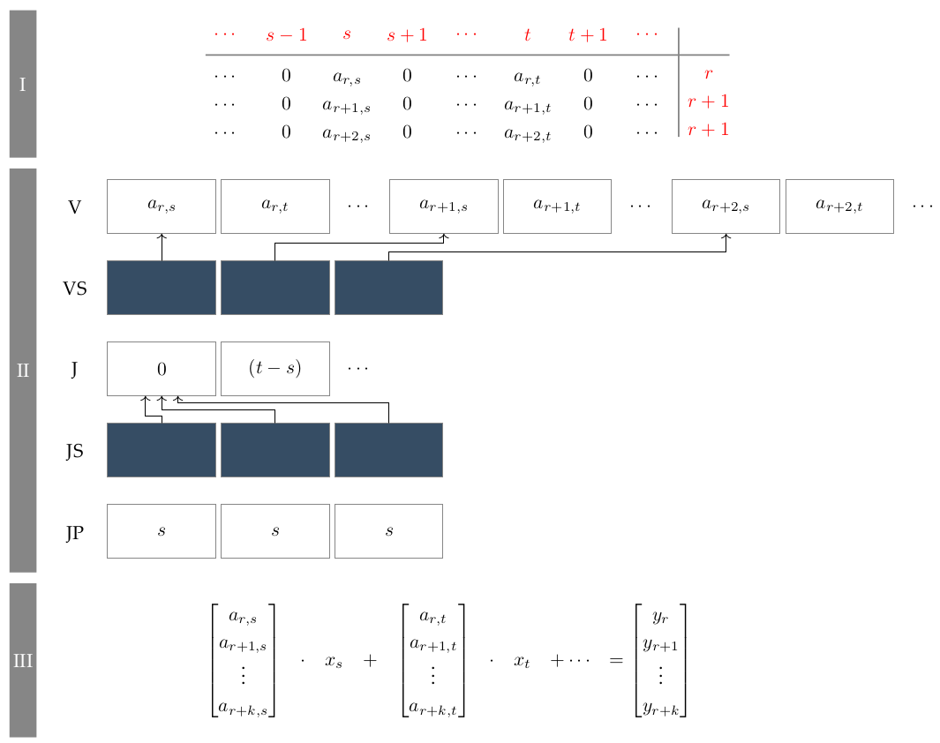
4. Arithmetic Performance
Uniform Structure & Arbitrary Values
Notes:
- Access might look complex, but most arrays are trivially small as we’ve seen before

Slide 67
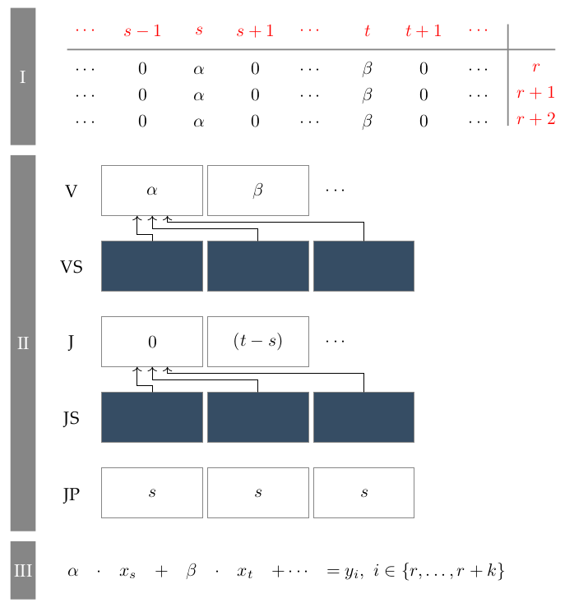
4. Arithmetic Performance
Uniform Structure & Collated Values

Slide 68
4. Arithmetic Performance
Values | Structure | Arithmetic Impl.
Arbitrary | Diagonal | SIMD 1
Collated | Diagonal | SIMD 2
Arbitrary | Uniform | SIMD 3
Collated | Uniform | SIMD 4
Arbitrary | Arbitrary | Scalar
Collated | Arbitrary | Scalar
Summary

Slide 69
4. Arithmetic Performance
Values | Structure | Arithmetic Impl.
Arbitrary | Diagonal | SIMD 1
Collated | Diagonal | SIMD 2
Arbitrary | Uniform | SIMD 3
Collated | Uniform | SIMD 4
Arbitrary | Arbitrary | Scalar
Collated | Arbitrary | Scalar
Summary
Notes:
- Values we’re interested in are either arbitrary (uncompressible) ...

Slide 70
4. Arithmetic Performance
Values | Structure | Arithmetic Impl.
Arbitrary | Diagonal | SIMD 1
Collated | Diagonal | SIMD 2
Arbitrary | Uniform | SIMD 3
Collated | Uniform | SIMD 4
Arbitrary | Arbitrary | Scalar
Collated | Arbitrary | Scalar
Summary
Notes:
- Values we’re interested in are either arbitrary (uncompressible) …
or collated (all rows share the same values)

Slide 71
4. Arithmetic Performance
Values | Structure | Arithmetic Impl.
Arbitrary | Diagonal | SIMD 1
Collated | Diagonal | SIMD 2
Arbitrary | Uniform | SIMD 3
Collated | Uniform | SIMD 4
Arbitrary | Arbitrary | Scalar
Collated | Arbitrary | Scalar
Summary
Notes:
- Values we’re interested in are either arbitrary (uncompressible) …
or collated (all rows share the same values)
- Structure is either diag ...

Slide 72
4. Arithmetic Performance
Values | Structure | Arithmetic Impl.
Arbitrary | Diagonal | SIMD 1
Collated | Diagonal | SIMD 2
Arbitrary | Uniform | SIMD 3
Collated | Uniform | SIMD 4
Arbitrary | Arbitrary | Scalar
Collated | Arbitrary | Scalar
Summary
Notes:
- Values we’re interested in are either arbitrary (uncompressible) …
or collated (all rows share the same values)
- Structure is either diag …
of uniform

Slide 73
4. Arithmetic Performance
Values | Structure | Arithmetic Impl.
Arbitrary | Diagonal | SIMD 1
Collated | Diagonal | SIMD 2
Arbitrary | Uniform | SIMD 3
Collated | Uniform | SIMD 4
Arbitrary | Arbitrary | Scalar
Collated | Arbitrary | Scalar
Summary
Notes:
- Values we’re interested in are either arbitrary (uncompressible) …
or collated (all rows share the same values)
- Structure is either diag …
of uniform
- Structure == arbitrary → nothing to vectorize = SCALAR

Slide 74
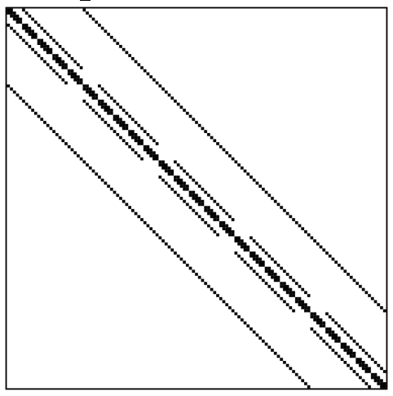
4. Arithmetic Performance
Values | Structure | Arithmetic Impl.
Arbitrary | Diagonal | SIMD 1
Collated | Diagonal | SIMD 2
Arbitrary | Uniform | SIMD 3
Collated | Uniform | SIMD 4
Arbitrary | Arbitrary | Scalar
Collated | Arbitrary | Scalar
Summary

Slide 75
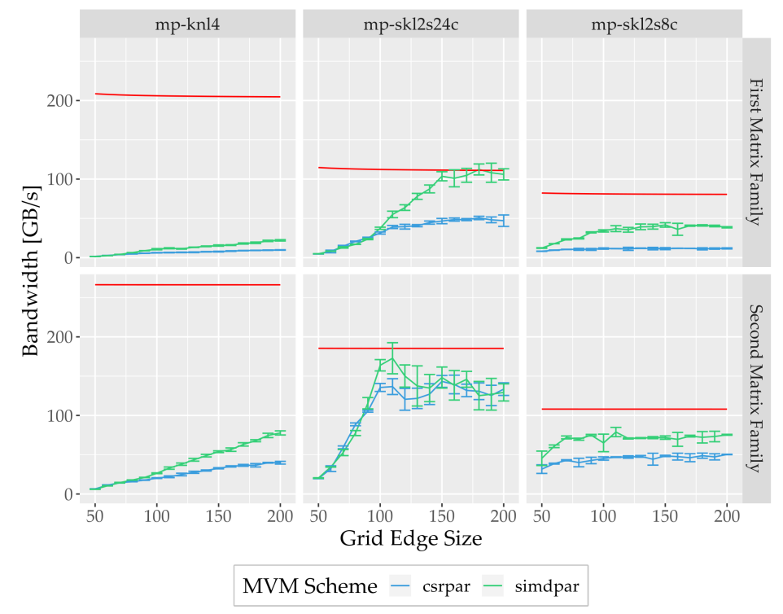
4. Arithmetic Performance
All values
equal
All values unique
SpMV Bandwidth vs. Grid Edge Size
Notes:
- spMV bw

Slide 76
4. Arithmetic Performance
All values
equal
All values unique
SpMV Bandwidth vs. Grid Edge Size
Notes:
- spMV bw
- for 2 matrix families

Slide 77
4. Arithmetic Performance
All values
equal
All values unique
SpMV Bandwidth vs. Grid Edge Size
Notes:
- spMV bw
- for 2 matrix families

Slide 78
4. Arithmetic Performance
All values
equal
All values unique
SpMV Bandwidth vs. Grid Edge Size
Notes:
- spMV bw
- for 2 matrix families
- 3 machines

Slide 79
4. Arithmetic Performance
All values
equal
All values unique
SpMV Bandwidth vs. Grid Edge Size
Notes:
- spMV bw
- for 2 matrix families
- 3 machines
- 2 mvm implementations

Slide 80
4. Arithmetic Performance
All values
equal
All values unique
SpMV Bandwidth vs. Grid Edge Size
Notes:
- spMV bw
- for 2 matrix families
- 3 machines
- 2 mvm implementations
- theoretical system bandwidth
- likwid bench (avx512 load & store to fixed data vol)
- volume of data mvmt

Slide 81
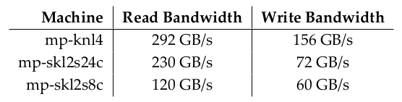
4. Arithmetic Performance
All values
equal
All values unique
SpMV Bandwidth vs. Grid Edge Size
Notes:
- spMV bw
- for 2 matrix families
- 3 machines
- 2 mvm implementations
- theoretical system bandwidth
- likwid bench (avx512 load & store to fixed data vol)
- volume of data mvmt

Slide 82
4. Arithmetic Performance
All values
equal
All values unique
SpMV Bandwidth vs. Grid Edge Size
Notes:
- spMV bw
- for 2 matrix families
- 3 machines
- 2 mvm implementations
- theoretical system bandwidth
- likwid bench (avx512 load & store to fixed data vol)
- volume of data mvmt

Slide 83
4. Arithmetic Performance
All values
equal
All values unique
SpMV Bandwidth vs. Grid Edge Size
Notes:
- spMV bw
- for 2 matrix families
- 3 machines
- 2 mvm implementations
- theoretical system bandwidth
- likwid bench (avx512 load & store to fixed data vol)
- volume of data mvmt
- slope → plateau: synchronization overhead (multithr)
- scales poorly with threads
- knl (64 cores x 4 SMT threads) = unusable
- size of matrix: fast gen && dram

Slide 84
4. Arithmetic Performance
All values
equal
All values unique
SpMV Bandwidth vs. Grid Edge Size
Notes:
- spMV bw
- for 2 matrix families
- 3 machines
- 2 mvm implementations
- theoretical system bandwidth
- likwid bench (avx512 load & store to fixed data vol)
- volume of data mvmt
- slope → plateau: synchronization overhead (multithr)
- scales poorly with threads
- knl (64 cores x 4 SMT threads) = unusable
- size of matrix: fast gen && dram
- Overreach: Object fits into L3 cache → bw does no apply

Slide 85
4. Arithmetic Performance
All values
equal
All values unique
SpMV Bandwidth vs. Grid Edge Size
Notes:
- spMV bw
- for 2 matrix families
- 3 machines
- 2 mvm implementations
- theoretical system bandwidth
- likwid bench (avx512 load & store to fixed data vol)
- volume of data mvmt
- slope → plateau: synchronization overhead (multithr)
- scales poorly with threads
- knl (64 cores x 4 SMT threads) = unusable
- size of matrix: fast gen && dram
- Overreach: Object fits into L3 cache → bw does no apply
- Overreach: sys bw limit slightly underestimated
- sys benchmark: composite instructions slightly faster
- General:
- Simd > scalar
- CSR missing: far worse performance
- csr comparison for mixed matrices

Slide 86
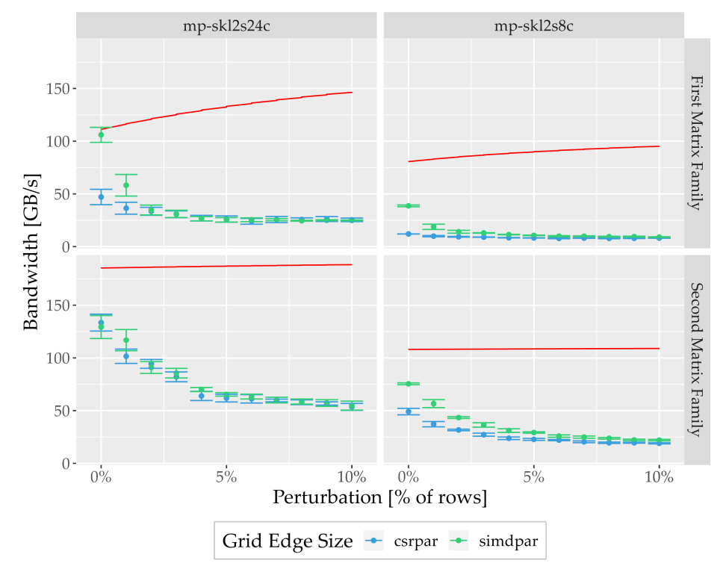
4. Arithmetic Performance
All values
equal
All values unique
SpMV Bandwidth vs. Perturbation
Notes:
- Same stuff
- grid edge size = 200 + Perturbation
- simdpar → csrpar (fallback)
- Slice of diagonal structure are perturbed → fallback
- Perturbations → randomization of x and y accesses
- erroneous evictions from cache
- benchmarks assume perfect, single access

Slide 87
4. Arithmetic Performance
Parallelization
  - object’s data layout unknown in advance (unlike CSR)
    - can’t tell size of any one data array – only upper limit
Further Aspects
Notes:
- V, J compressed → unknown size
- VS, JS, RS, JP rli-enc’d → unknown size

Slide 88
4. Arithmetic Performance
Parallelization
  - object’s data layout unknown in advance (unlike CSR)
    - can’t tell size of any one data array – only upper limit
V
6.1
4.4
3.3
2.5
...
V_{Start}
...
Further Aspects
Notes:
- V, J compressed → unknown size
- VS, JS, RS, JP rli-enc’d → unknown size

Slide 89
4. Arithmetic Performance
Parallelization
  - object’s data layout unknown in advance (unlike CSR)
    - can’t tell size of any one data array – only upper limit
  - worst-case strategy
    - well compressible matrices/slices → tiny object sizes
    - badly compressible matrices/slices → predictable data layout
      - ≡ bloated CSR → #_{nnz} per row ~ Arithmetic workload, memory accesses
    - spread across threads “evenly” by #_{nnz}
Further Aspects
Notes:
- V, J compressed → unknown size
- VS, JS, RS, JP rli-enc’d → unknown size

Slide 90
4. Arithmetic Performance
Parallelization
  - object’s data layout unknown in advance (unlike CSR)
    - can’t tell size of any one data array – only upper limit
  - worst-case strategy
    - well compressible matrices/slices → tiny object sizes
    - badly compressible matrices/slices → predictable data layout
      - ≡ bloated CSR → #_{nnz} per row ~ Arithmetic workload, memory accesses
    - spread across threads “evenly” by #_{nnz}
  - likewise NUMA locality
    - worst-case allocate evenly across numa regions
Further Aspects
Notes:
- V, J compressed → unknown size
- VS, JS, RS, JP rli-enc’d → unknown size

Slide 91
Outlook
Follow up:
  - accurate profiling (r/w/cache evictions)
  - larger grid sizes
  - heterogeneous matrices
  - higher dim. entities
Misc:
  - matrixgen → CSR-format → (transform) → C3SR-format
  - UMESimd = C++ SIMD vectorization lib (“hw-independent” code)
  - sysmakeshift = C++ multi-threading lib w/ thread-pinning
Next Steps
Notes:
- measured bandwidths dubious
- assumption of single read / single write

