Slide 1
Hallucination Evaluation in LLM-Based Medical Summarization
Hallucination Evaluation in LLM-Based Medical Summarization
Thesis Progress Presentation · Comp 696C California State University, Northridge
Student: Laya April 2026

Slide 2
Motivation & Problem Statement
Why This Matters
Clinical NLP is rapidly entering practice: LLMs are used to generate discharge summaries, referral letters, and patient-facing notes at scale.
Hallucinations are dangerous: Fabricated medications, incorrect dosages, or invented diagnoses in a clinical summary can directly harm patients.
Verification gap: Clinicians reviewing AI-generated text may over-trust outputs without systematic verification frameworks.
RAG as a mitigation: Retrieval-Augmented Generation constrains the model to retrieved source passages — but its effect on hallucination rates is poorly quantified in the medical domain.
The Core Problem
We lack a reproducible, claim-level metric framework that quantifies how often LLM-generated medical summaries introduce unsupported or contradicted facts — and how much RAG helps.

Slide 3
Research Questions & Hypotheses
Research Questions
RQ1: To what extent do LLM-generated medical summaries contain unsupported or contradicted facts relative to the source document?
RQ2: Does retrieval-augmented generation (RAG) significantly reduce hallucination rates compared to a non-retrieval baseline?
RQ3: What types of hallucinations persist even with RAG, and can verification-stage prompting (CoVe) address them?
Hypotheses
H1: Baseline LLM summaries will exhibit UFR > 0.5, reflecting a high rate of ungrounded claims in unconstrained generation.
H2: RAG-augmented summaries will have significantly lower CR than baseline (p < 0.05, Wilcoxon signed-rank test).
H3: A verification stage (E3 CoVe) will further reduce UFR beyond what retrieval alone achieves.

Slide 4



Methodology — Evaluation Pipeline
Source
Document
Summary Generation (E0/E1/E2)
Claim Segmentation (spaCy)
Evidence Retrieval (cos-sim)
NLI
Classification (cross-encoder)
Metrics
UFR / CR
E0:
GPT-4o-mini (no retrieval)
E1:
GPT-4o-mini
+ RAG chunks
E2:
Centroid extraction (no LLM)
NLI Output Labels
Supported: claim entailed by evidence (p_entail ≥ 0.5)
Not-Supported: claim not entailed or contradicted
Contradicted: claim contradicted by evidence (p_contra ≥ 0.5)

Slide 5
Dataset & Experimental Setup
Dataset — MTSamples
Experimental Conditions
Public de-identified clinical transcriptions
Specialties: Discharge Summary + Consult–H&P
50 samples, random seed = 42 (reproducible)
Source docs: median ~300 words each
E0 — Baseline GPT-4o-mini given full note, no retrieval
E1 — RAG Top-3 retrieved chunks fed to GPT-4o-mini
E2 — Extractive Top-5 centroid sentences, no LLM
Models
Metrics
LLM: GPT-4o-mini (OpenAI), T=0.3, max 450 tok
Bi-encoder: all-MiniLM-L6-v2 (retrieval + embed)
Cross-encoder: nli-MiniLM2-L6-H768 (NLI labels)
SpaCy en_core_web_sm (sentence segmentation)
UFR = (Contradicted + Not-Supported) / n_claims
CR = Contradicted / n_claims
Wilcoxon signed-rank test (two-sided) for significance
Claim Statistics
E0: 653 claims evaluated E1: 478 claims evaluated E2: 242 claims evaluated

Slide 6
3-Way Results — E0 vs E1 vs E2
Metric | E0 Baseline | E1 RAG | E2 Extractive | E1−E0 Δ | E2−E0 Δ | Wilcoxon p
UFR | 0.7967 | 0.8070 | 0.1220 | +0.0103 | -0.6747 | 0.576 n.s.
CR | 0.2262 | 0.1536 | 0.0963 | -0.0726 | -0.1299 | 0.0001 ***
UFR = (Contradicted + Not-Supported) / total claims · CR = Contradicted / total claims · Δ = condition − E0 Green Δ = improvement over baseline · *** p < 0.001 (Wilcoxon signed-rank, two-sided)
Key Takeaways
RAG (E1) significantly reduces Contradiction Rate by 32% (p = 0.0001) but does not improve UFR.
Extractive baseline (E2) achieves near-zero UFR = 0.122, confirming pipeline validity.
Residual Not-Supported claims in E1 point to hallucinations beyond simple contradiction.

Slide 7
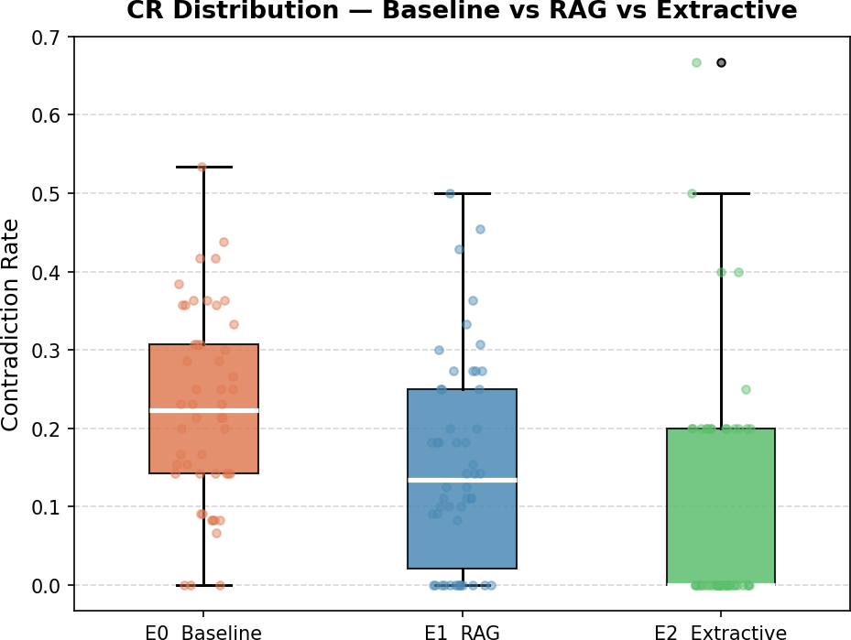
CR Finding — RAG Significantly Reduces Contradictions
Contradiction Rate
p = 0.0001 ***
E0 Mean CR: 0.2262 E1 Mean CR: 0.1536 E2 Mean CR: 0.0963
E1 reduction: 32%
E1 improved: 72% of samples
RAG constrains the model to retrieved source passages, preventing outright contradictions of stated facts. The reduction is highly significant (Wilcoxon W, two-sided).
Figure: CR distribution across 50 samples (orange=E0, blue=E1, green=E2)

Slide 8
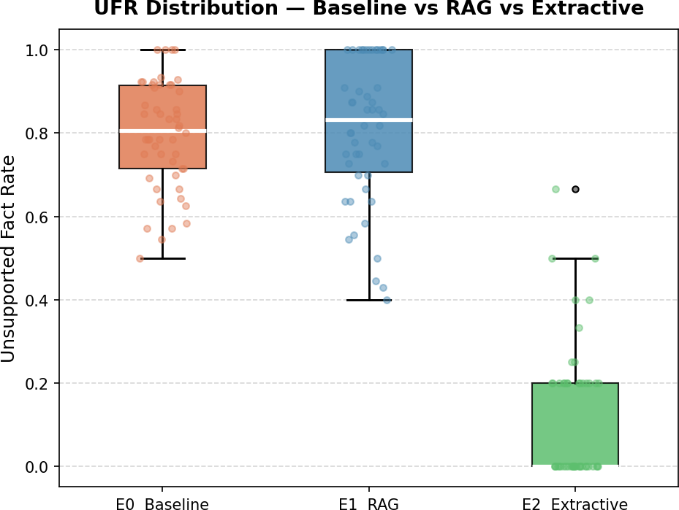
UFR Finding — E2 Validates Pipeline; RAG Alone Insufficient
Unsupported Fact Rate
p = 0.576 n.s.
E0 Mean UFR: 0.7967
E1 Mean UFR: 0.8070
E2 Mean UFR: 0.1220 ✓ near-zero
E1 improved: 42% of samples
E2 improved: 100% of samples
RAG does not significantly reduce UFR — the model still produces ungrounded claims even when given retrieved context. E2's near-zero UFR confirms the NLI pipeline correctly identifies source-faithful text, ruling out measurement error.
Figure: UFR distribution across 50 samples (orange=E0, blue=E1, green=E2)

Slide 9
Qualitative Examples
RAG-Fixed: Contradicted → Supported
Persistent Hallucination: Not-Supported in E0 & E1
E0: Your abdomen was soft and without tenderness, and your lungs and heart sounded normal.
E0: You visited today due to concerns about your menstrual periods and a possible pregnancy.
→ Contradicted (baseline hallucination)
E1: You've been experiencing stomach pain with most meals for the past year and a half, along with urinary symptoms during the same time frame.
→ Supported (RAG grounded the claim)
→ Not-Supported in E0
E1: You visited us today due to concerns about your menstrual periods and possible pregnancy.
→ Not-Supported in E1 (RAG did not help)
Interpretation
RAG eliminates contradictions by anchoring the model to retrieved excerpts. However, claims that reference follow-up instructions, future events, or context not present in any retrieved chunk remain Not-Supported in both conditions — suggesting a retrieval coverage gap rather than a generation defect. E3 (verification prompting) targets these residual failures.

Slide 10
Next Steps & Semester 2 Plan
Immediate (Next 4 Weeks)
Thesis Completion (Semester 2)
Await PhysioNet credentialing approval and migrate pipeline to MIMIC-III notes.
Obtain ann-pt-summ annotated dataset; compute inter-annotator agreement baseline.
Run E3 — Chain-of-Verification prompting on E0 outputs; measure ΔCR and ΔUFR.
Begin qualitative error taxonomy: categorize persistent Not-Supported claims by type.
Chapter 2 — Literature Review (LLM hallucinations, RAG, NLI evaluation).
Chapter 3 — Methodology (finalize with MIMIC results if available).
Chapter 4 — Results (quantitative + qualitative findings for all conditions).
Chapter 5 — Discussion: limitations, future work, clinical implications.
Committee review, defense preparation, and final submission.
Timeline
Now
May
Jun
Aug
Oct
Dec
E0/E1/E2
Complete
E3 CoVe Verification
PhysioNet Migration
Draft Chapters
Committee Review
Defense

