Slide 1
Evaluating and Reducing Hallucinations in LLM-Based Medical Report Summarization
Progress Report, Fall 2026 (COMP 698C)
Srilaya Ponangi, M.S. Computer Science
Advisor: Dr. Taehyung (George) Wang
California State University, Northridge, September 16, 2026

Slide 2
Goal and research questions (from the proposal)
• Goal: measure hallucinations in LLM-generated patient-facing summaries at the claim level with a judge validated against medical experts, and test whether retrieval grounding and verification reduce them on real clinical notes
• RQ1: how often are LLM summary statements unsupported by, or contradicting, the source note?
• RQ2: which statements are unsupported, and how well does the automatic judge agree with medical experts?
• RQ3: do retrieval-augmented generation and verification reduce unsupported and contradicted statements, compared with an extractive bound, and at what cost in coverage?
• Two tasks in the proposal: summarization (main task) and document-grounded question answering (piloted with abstention)
• Three studies: pilot on public MTSamples notes with GPT-4o-mini; judge selection against expert labels; main study on MIMIC-IV hospital courses with a locally run open-weight model

Slide 3
Proposal commitments and where they stand
Commitment in the proposal | Status
Claim-level NLI judge calibrated against expert labels | Done: pilot judge validated (kappa 0.06); five candidates compared; DeBERTa-v3-large NLI selected (kappa 0.33, AUROC 0.78); MedNLI fine-tune: dev accuracy 87.8%
Experiments on MIMIC data | Done: 110 MIMIC-IV hospital courses, Qwen2.5-7B-Instruct served locally, no protected text leaves the laptop
RAG, verification and an extractive baseline | Done in both studies: E0 zero-context, E1 RAG (excerpts), E1b RAG (note + excerpts), E3 RAG + Chain-of-Verification, E2 extractive
Coverage against a reference | Done: share of the clinician-written discharge-instruction sentences that the generated summary supports (judge run in reverse)
Citation accuracy | Done: retrieval conditions cite an excerpt after every sentence; the judge checks each citation
Retrieval ablations (chunk size, top-k, BM25 vs dense, citations) | Done: six E1 variants on the same documents
Question answering with abstention | Pilot: three questions per course (medications, follow-up, warning signs), full course vs retrieved excerpts, 'Not stated in the note.' allowed

Slide 4
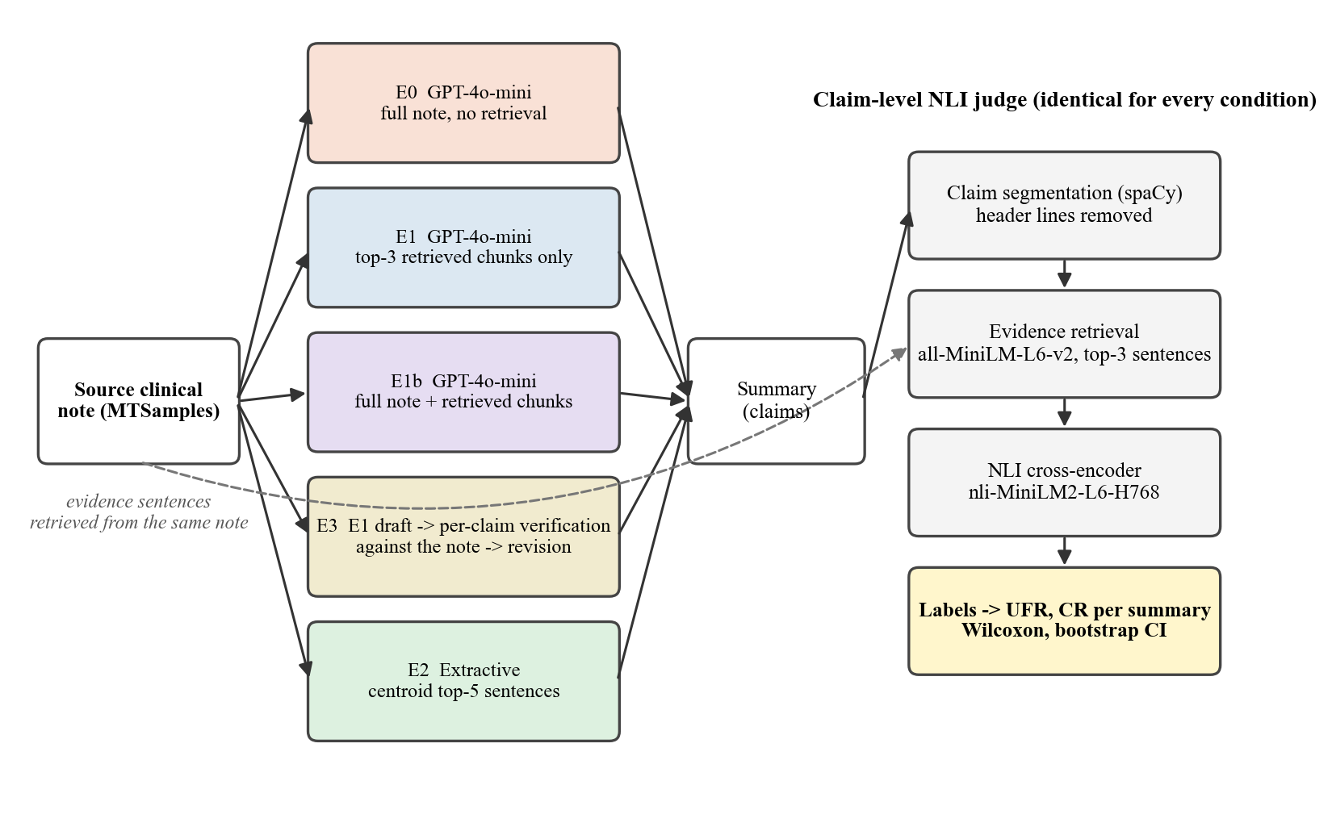
Pipeline (identical judge for every condition)
Every summary is scored by the same claim-level NLI judge; evidence comes from the same source document.

Slide 5
Data status
• MTSamples (public): 4,999 transcriptions, 624 eligible consult and discharge notes, 50 sampled (seed 42); 2,016 pilot claims labeled
• ann-pt-summ v1.0.1 (PhysioNet, DUA signed): 210 expert-annotated patient summaries with 423 unsupported-fact spans for judge validation and selection; its 110 MIMIC-IV hospital courses with clinician-written discharge instructions are the main-study corpus
• MedNLI v1.0.0 (PhysioNet, DUA signed): 14,049 clinician-written premise and hypothesis pairs from MIMIC-III, used to adapt the judge
• MIMIC-IV-Note v2.2 (PhysioNet, credentialed): downloaded and verified in May 2026; the source of the hospital courses
• Ethics: CITI 'Data or Specimens Only Research' and 'Conflicts of Interest' completed April 10, 2026; every credentialed text is processed by models running on the author's laptop; nothing is sent to an API or to cloud storage

Slide 6
Pilot study: five conditions on 50 MTSamples notes (GPT-4o-mini, MiniLM judge)
Metric | E0 zero-context | E1 RAG excerpts | E1b RAG + note | E3 RAG + CoVe | E2 extractive
UFR mean | 0.811 | 0.807 | 0.759 | 0.688 | 0.122
CR mean | 0.172 | 0.130 | 0.148 | 0.164 | 0.096
Supported share of claims | 19% | 20% | 24% | 33% | 89%
Claims per summary | 10.4 | 8.9 | 10.2 | 5.9 | 4.8
Words per summary | 182 | 156 | 180 | 120 | 69
Coverage of source sentences (cos ≥ 0.6) | 16.7% | 13.4% | 18.5% | 16.6% | 18.3%
Paired Wilcoxon versus E0: E1 CR p = 0.011 (−24%), E1 UFR p = 0.977; E1b UFR p = 0.020; E3 UFR p < 0.001 (−15%; versus E1 p < 0.001), E3 CR p = 0.913; E2 UFR p < 0.001. Verification lowers unsupported facts the most; retrieval alone lowers contradictions modestly; the extractive bound exposes a non-zero judge error floor. Header lines and abstentions excluded.

Slide 7
Pilot headline: the small MiniLM judge disagrees with medical experts
Group | Sentences | Expert-flagged | Judge-flagged (UFR) | Precision | Recall | Kappa | AUROC
all | 1,781 | 20.4% | 84.1% | 0.23 | 0.94 | 0.06 | 0.65
generated | 805 | 12.5% | 83.7% | 0.14 | 0.96 | 0.04 | 0.68
doctor written | 976 | 26.8% | 84.3% | 0.30 | 0.94 | 0.07 | 0.66
llama 70b original | 159 | 26.4% | 83.0% | 0.30 | 0.95 | 0.10 | 0.67
gpt4 zero shot | 151 | 6.0% | 87.4% | 0.06 | 0.89 | 0.00 | 0.50
On 1,781 expert-annotated sentences the pilot judge flags 84% where experts flag 20%; kappa 0.06 is chance level; no aggregation variant raised kappa above 0.14. This motivated the judge selection study.

Slide 8
Judge selection: candidates scored against the expert annotations (1,781 sentences)
Judge | Evidence | AUROC | Precision | Recall | Kappa | Flag rate
DeBERTa-v3-large NLI | whole course, windowed | 0.78 | 0.44 | 0.54 | 0.33 | 25%
MiniCheck DeBERTa-v3-large | whole course, windowed | 0.73 | 0.41 | 0.57 | 0.31 | 28%
DeBERTa-v3-large NLI fine-tuned on MedNLI | whole course, windowed | 0.75 | 0.44 | 0.46 | 0.31 | 21%
DeBERTa-v3-large NLI | top-3 sentences | 0.75 | 0.36 | 0.74 | 0.29 | 42%
DeBERTa-v3-large NLI fine-tuned on MedNLI | top-3 sentences | 0.74 | 0.41 | 0.48 | 0.28 | 24%
MiniCheck DeBERTa-v3-large | top-3 sentences | 0.73 | 0.34 | 0.68 | 0.25 | 41%
MiniCheck RoBERTa-large | whole course, windowed | 0.72 | 0.41 | 0.36 | 0.24 | 18%
MiniCheck RoBERTa-large | top-3 sentences | 0.70 | 0.33 | 0.60 | 0.22 | 37%
DeBERTa-v3-large cross-encoder NLI | top-3 sentences | 0.69 | 0.28 | 0.85 | 0.17 | 62%
MiniLM cross-encoder | top-3 sentences | 0.66 | 0.28 | 0.71 | 0.15 | 52%
DeBERTa-v3-large cross-encoder NLI | whole course, windowed | 0.64 | 0.27 | 0.60 | 0.13 | 44%
MiniLM cross-encoder | whole course, windowed | 0.58 | 0.24 | 0.68 | 0.07 | 58%
Decision rule fixed in advance: highest kappa on all sentences, threshold chosen on the other subset. Selected: DeBERTa-v3-large NLI (whole course, windowed), kappa 0.33, AUROC 0.78, precision 0.44, recall 0.54: moderate agreement, so main-study rates are estimates from an instrument with a known error profile, and the paired comparisons carry the weight.

Slide 9
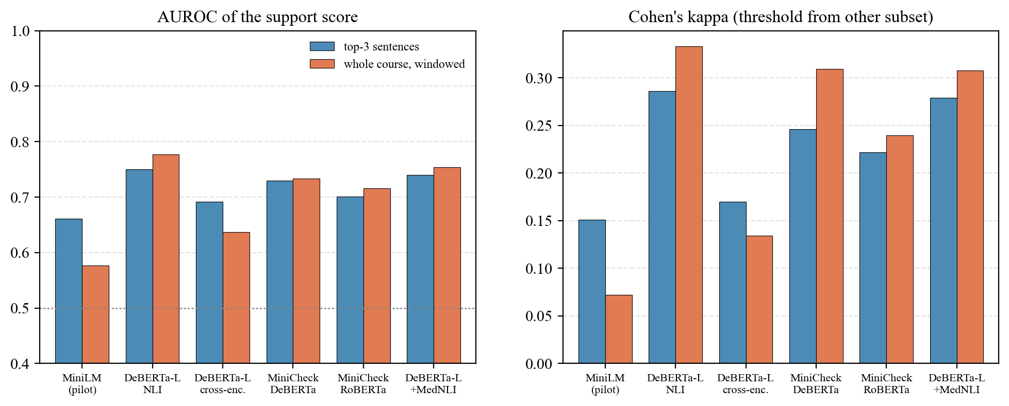
Judge selection: AUROC and kappa by candidate and evidence mode
Model size and training data matter more than the aggregation rule; whole-course evidence helps the large models.

Slide 10
Main study design: MIMIC-IV hospital courses
• 110 de-identified Brief Hospital Course sections (ann-pt-summ), each paired with the discharge instructions the treating clinician wrote
• Generator: Qwen2.5-7B-Instruct, 4-bit, served on the laptop with Apple MLX through an OpenAI-compatible interface; the pilot pipeline runs unchanged and no protected text leaves the machine
• Same five conditions; retrieval conditions must cite the excerpt behind every sentence; 'Not stated in the note.' allowed for unsupported sections
• Judge: DeBERTa-v3-large NLI with whole-course evidence; UFR and CR per summary; the doctor-written instructions scored as a human reference
• Coverage measured against the clinician's own instructions (judge in reverse); citation accuracy; six retrieval ablations (3- or 8-sentence chunks, top-2 or top-5, BM25, no citations)
• Question-answering pilot: medications, follow-up and warning signs; full course versus three retrieved chunks; abstention rate, UFR/CR, and support by the clinician's instructions

Slide 11
Main study results (n = 110 hospital courses; judge: DeBERTa-v3-large NLI, τ = 0.20)
Metric | E0 zero-context | E1 RAG excerpts | E1b RAG + course | E3 RAG + CoVe | E2 extractive | Clinician-written
UFR mean | 0.135 | 0.066 | 0.072 | 0.070 | 0.056 | 0.289
CR mean | 0.029 | 0.027 | 0.031 | 0.032 | 0.051 | 0.080
Coverage of the clinician's sentences | 54.3% | 36.9% | 53.2% | 33.6% | 22.5% | —
Citation accuracy | — | 71.8% | 38.1% | — | — | —
Abstentions per summary | 0.0 | 0.0 | 0.0 | 0.7 | 0.0 | 0.0
Claims per summary | 16.0 | 8.4 | 13.8 | 7.9 | 4.9 | 8.9
Words per summary | 261 | 151 | 228 | 150 | 87 | 133
E1 vs E0: UFR p < 0.001, CR p = 0.791, coverage p < 0.001. E1b vs E0: UFR p < 0.001, CR p = 0.305, coverage p = 0.449. E3 vs E0: UFR p < 0.001, CR p = 0.358, coverage p < 0.001. E2 vs E0: UFR p < 0.001, CR p = 0.125, coverage p < 0.001. Paired two-sided Wilcoxon tests on the same documents.

Slide 12
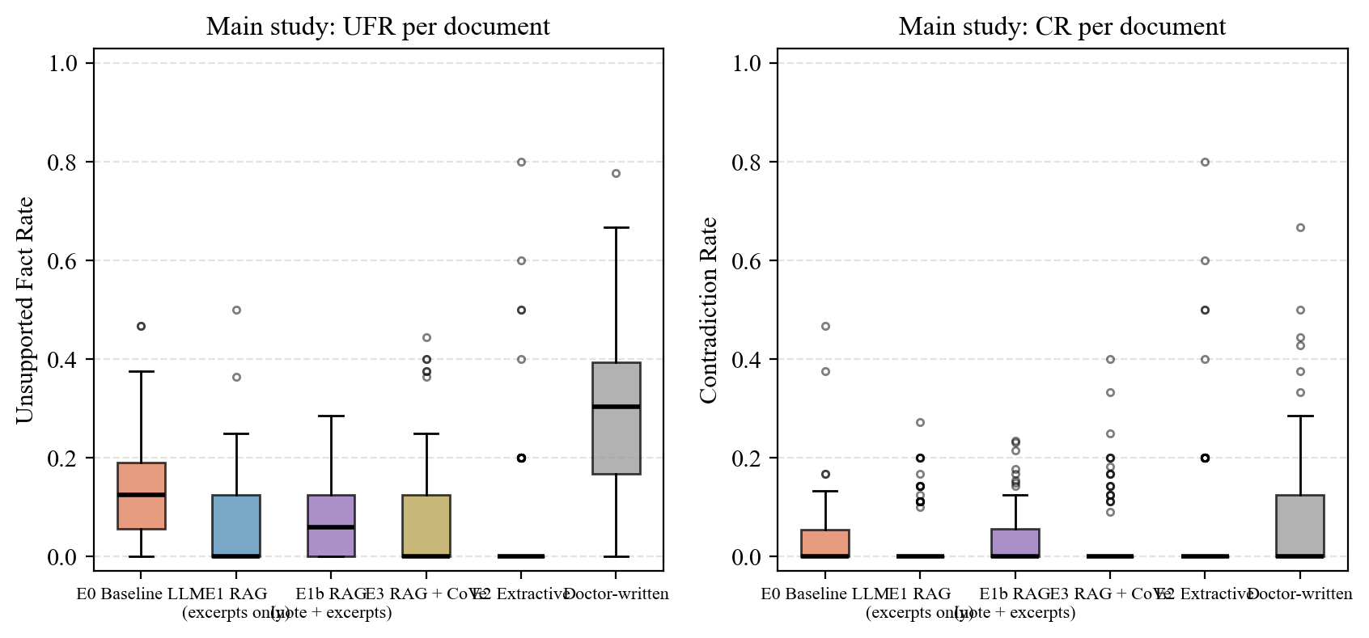
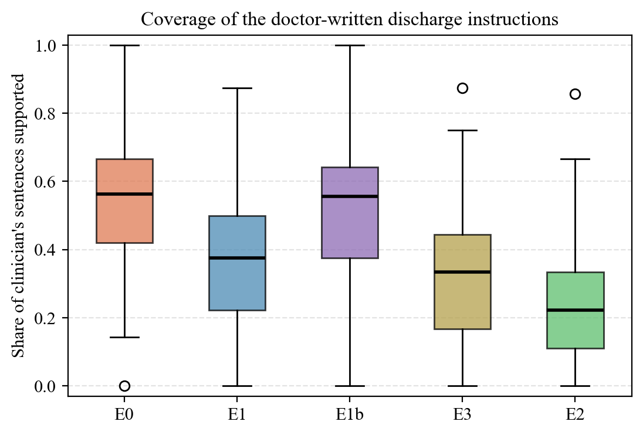
Main study: per-document distributions

Slide 13
Main study: what the results say
• Every grounded condition cut the unsupported fact rate by about 46 percent versus zero-context (E1 0.066, E1b 0.072, E3 0.070 versus E0 0.135; all p < 0.001); the three do not differ from one another; CR did not change
• Omission separates them: excerpt-only RAG covered 37% of the clinician's sentences and verification 34%, against 54% for E0; RAG with the whole course kept 53% (p = 0.449 versus E0)
• Verbatim extraction scores UFR 0.056: the judge's error floor; the grounded LLM conditions sit within a few hundredths of it
• The clinicians' own instructions score UFR 0.289 under the same judge: support by the hospital course measures source-faithfulness, not clinical correctness
• Citations: 72% accurate for excerpt-only RAG but 38% for RAG with the whole course; requiring citations lowered UFR (dropping the requirement raised it by 0.030) and three-sentence chunks raised CR, while other retrieval settings changed only coverage; coverage followed the amount of retrieved text
• Question answering: abstention 23% (full course) versus 33% (excerpts), highest for warning signs, which the course rarely states; retrieval lowers unsupported answers partly by abstaining more

Slide 14
Retrieval ablations: paired difference from the E1 base configuration
Variant | Δ UFR (p) | Δ CR (p) | Δ coverage (p) | Δ citation accuracy (p)
3-sentence chunks | +0.009 (p = 0.485) | +0.020 (p = 0.045) | -0.072 (p < 0.001) | +0.050 (p = 0.172)
8-sentence chunks | -0.003 (p = 0.834) | -0.005 (p = 0.308) | +0.060 (p = 0.003) | +0.012 (p = 0.492)
top-2 chunks | +0.018 (p = 0.427) | +0.017 (p = 0.094) | -0.058 (p < 0.001) | +0.059 (p = 0.060)
top-5 chunks | +0.009 (p = 0.493) | +0.000 (p = 0.838) | +0.072 (p < 0.001) | -0.084 (p = 0.020)
BM25 retrieval | +0.007 (p = 0.596) | +0.007 (p = 0.687) | +0.028 (p = 0.177) | +0.035 (p = 0.393)
citations not required | +0.030 (p = 0.017) | -0.007 (p = 0.178) | +0.019 (p = 0.314) | —
Negative UFR and CR differences and positive coverage and citation differences favour the variant. Base: 5-sentence chunks, top-3, dense retrieval, citations required.

Slide 15
Question-answering pilot (three questions per course)
Condition | Question | n | Abstained | UFR | CR | Supported by clinician's instructions | Words
QA-E0 | all | 330 | 23% | 0.429 | 0.032 | 16% | 31
QA-E0 | follow up | 110 | 15% | 0.309 | 0.018 | 15% | 30
QA-E0 | medications | 110 | 7% | 0.272 | 0.055 | 18% | 41
QA-E0 | warning signs | 110 | 46% | 0.893 | 0.017 | 13% | 20
QA-E1 | all | 330 | 33% | 0.307 | 0.032 | 15% | 25
QA-E1 | follow up | 110 | 24% | 0.246 | 0.008 | 15% | 24
QA-E1 | medications | 110 | 10% | 0.212 | 0.054 | 15% | 36
QA-E1 | warning signs | 110 | 65% | 0.679 | 0.026 | 15% | 14
QA-E0 answers from the full hospital course; QA-E1 from the three chunks retrieved with the question. UFR and CR are computed on answered questions only.

Slide 16
Thesis writing status
• Complete draft generated from the result files: 136 pages in CSUN format (1-inch margins, 12-pt Times New Roman, double-spaced, roman-numbered preliminary pages, arabic body)
• Nine chapters: 1 Introduction, 2 Literature Review, 3 Data, 4 Methodology, 5 Pilot Study on MTSamples, 6 Selecting a Valid Judge, 7 Main Study on MIMIC-IV, 8 Discussion, 9 Conclusion; IEEE references with DOIs; Appendices A to E (prompts, per-document results, worked examples, repository, threshold sweep)
• Since the September 4 draft: judge selection study, MedNLI adaptation, main study on MIMIC-IV with a local model (citations, coverage against the clinician's instructions, citation accuracy, ablations), question-answering pilot
• Open items: committee composition to be confirmed with the advisor; advisor review of the draft; final title on the ETD planning form (with or without 'and Question Answering')
• Every table and figure is regenerated by one command from the result files

Slide 17
Plan to the defense (aligned with CSUN ETD deadlines)
By | Milestone
Sep 22, 2026 | Advisor review of the complete draft; committee composition discussed
Oct 9, 2026 | ETD Planning Form filed (title and committee)
Oct 16, 2026 | Revised draft to advisor for approval; Canvas upload and Turnitin check after approval
Oct 23, 2026 | Draft to committee (two-week review); Doodle poll with 1-hour slots over 3 to 4 weeks
Nov 6, 2026 | ETD preliminary format review
Nov 16 to 24, 2026 | Defense (40 min presentation, 10 min Q&A); slides to advisor one week before
Dec 4, 2026 | Final ETD upload after revisions
The December 12 defense date in the May report is after the December 4 ETD deadline and has been moved.

Slide 18
Risks and requests
• Judge validity: the selected judge agrees with experts moderately (kappa 0.33); main-study rates are reported with this error profile, and conclusions rest on paired comparisons
• Generator difference: the pilot used GPT-4o-mini on public notes and the main study a 7-billion-parameter local model on MIMIC-IV, so the two studies are compared qualitatively
• Schedule: advisor approval, Turnitin and two weeks of committee review must all precede the November 6 format review
• Requests to the advisor: review the complete draft, confirm the committee, and decide the final title for the ETD planning form

