Slide 1
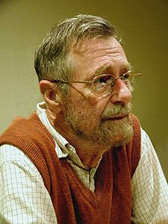
Dijkstra’s Algorithm
Dijkstra’s Algorithm
-- Single Source Multiple Destination Shortest Path Algorithm

Slide 2
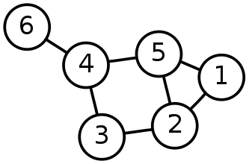
Single-Source Shortest Path Problem
The problem of finding shortest paths from a source vertex v to all other vertices in the graph.

Slide 3
Requirements
Works with directed and undirected graphs
Works with weighted and unweighted graphs
Graph with negative edges is not applicable.
Rare type of algorithm ➔
A greedy algorithm that produces an optimal solution

Slide 4
Dijkstra's algorithm
Dijkstra's algorithm - is a solution to the single-source shortest path problem in graph theory.
Works on both directed and undirected graphs. However, all edges must have nonnegative weights.
Input: Weighted graph G={E,V} and source vertex v∈V, such that all edge weights are nonnegative
Output: Lengths of shortest paths (or the shortest paths themselves) from a given source vertex v∈V to all other vertices
A greedy algorithm that produces an optimal solution

Slide 5
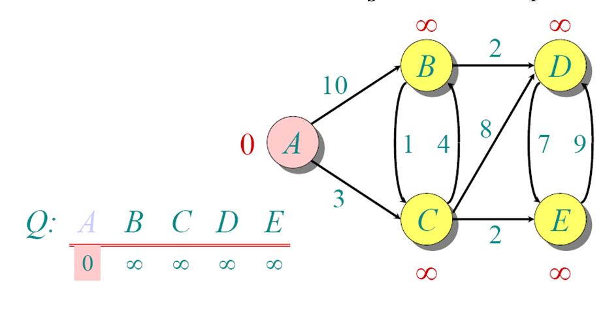
Example

Slide 6
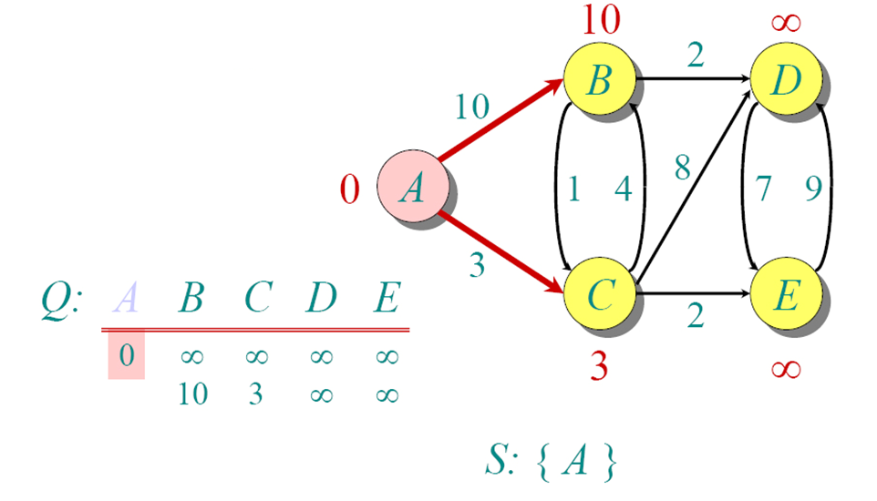
Example

Slide 7
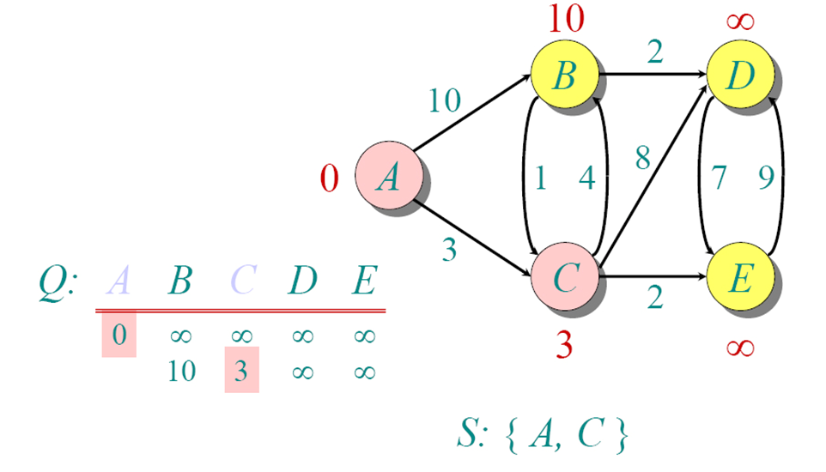
Example

Slide 8
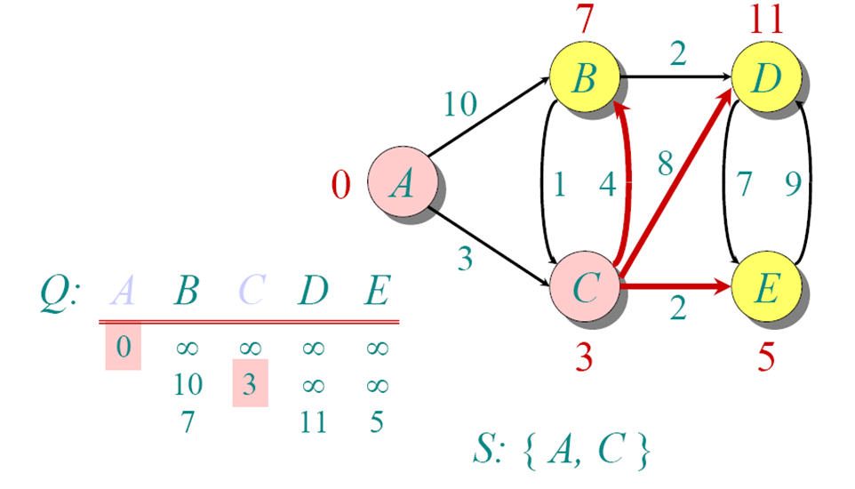
Example

Slide 9
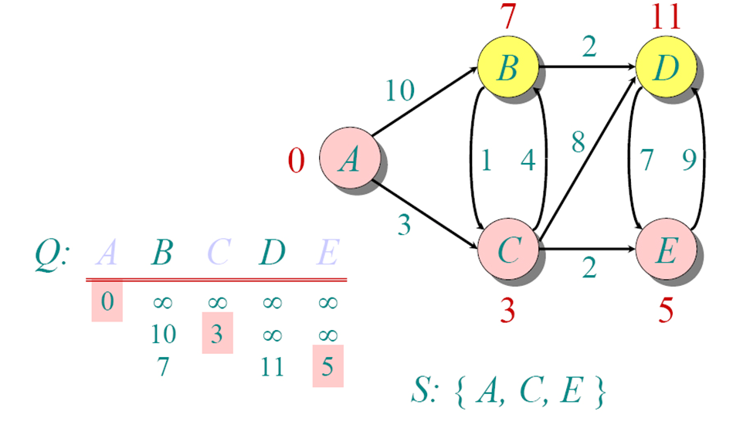

Slide 10
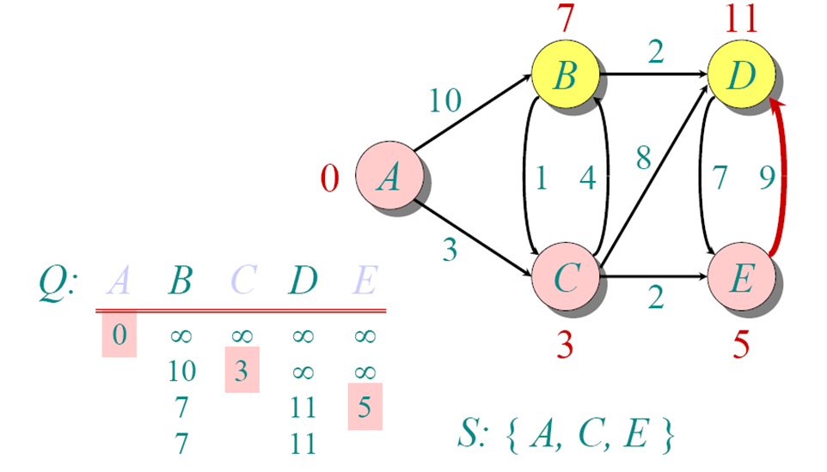
Example

Slide 11
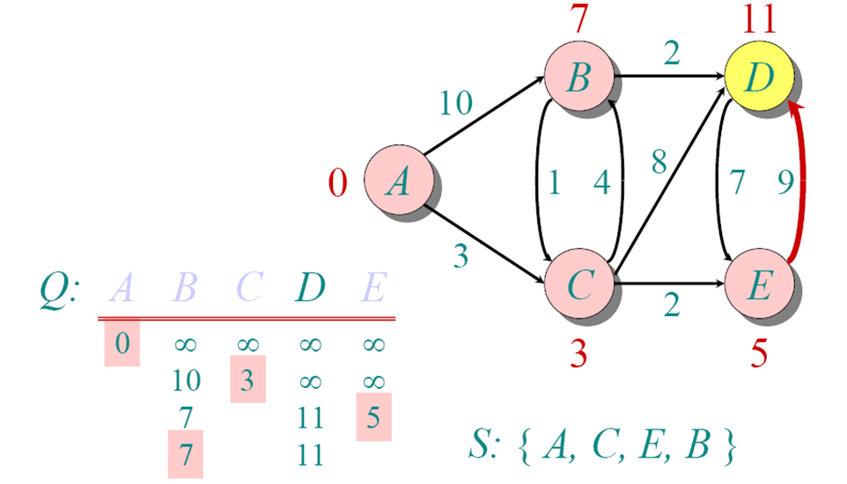
Example

Slide 12
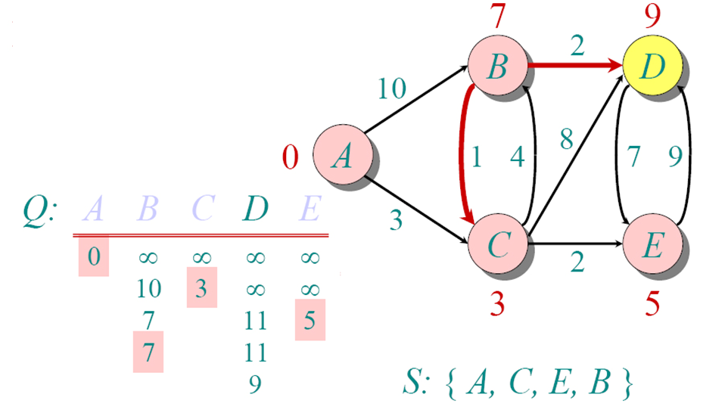
Example

Slide 13
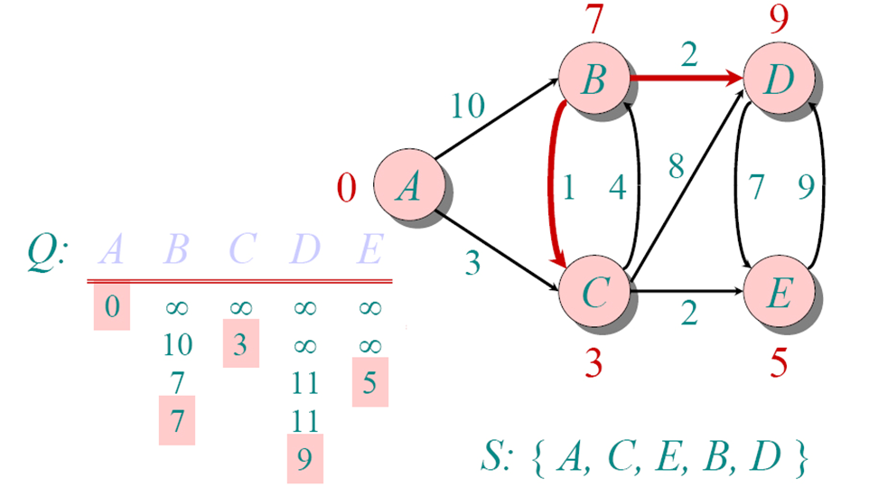
Example

Slide 14
Floyd-Warshall Algorithm
Representation of the Input
We assume that the input is represented by a weight matrix W= (w_{ij})_{i,j in E} that is defined by
w_{ij}= 0 if i=j
w_{ij}= w(i,j) if i≠j and (i,j) in E
w_{ij}= ∞ if i≠j and (i,j) not in E
Format of the Output
If the graph has n vertices, we return a distance matrix (d_{ij}), where d_{ij} the length of the path from i to j.

Slide 15
Floyd-Warshall Algorithm
Intermediate Vertices
Without loss of generality, we will assume that V={1,2,…,n}, i.e., that the vertices of the graph are numbered from 1 to n.
Given a path p=(v₁, v₂,…, v_{m}) in the graph, we will call the vertices v_{k} with index k in {2,…,m-1} the intermediate vertices of p.

Slide 16
Some points to be noted
A shortest path does not contain any vertex twice, as this would imply that the path contains a cycle. By assumption, cycles in the graph have a positive weight, so removing the cycle would result in a shorter path, which is impossible.
Consider a shortest path p from i to j such that the intermediate vertices are from the set {1,…,k}.
If the vertex k is not an intermediate vertex on p, then d_{ij}^{(k)} = d_{ij}^{(k-1)}
If the vertex k is an intermediate vertex on p, then d_{ij}^{(k)} = d_{ik}^{(k-1)} + d_{kj}^{(k-1)}
Interestingly, in either case, the subpaths contain merely nodes from {1,…,k-1}.
Therefore, we can conclude that
d_{ij}^{(k)} = min{d_{ij}^{(k-1)} , d_{ik}^{(k-1)} + d_{kj}^{(k-1)}}

Slide 17
Floyd-Warshall Algorithm : Recursive Formulation

Slide 18
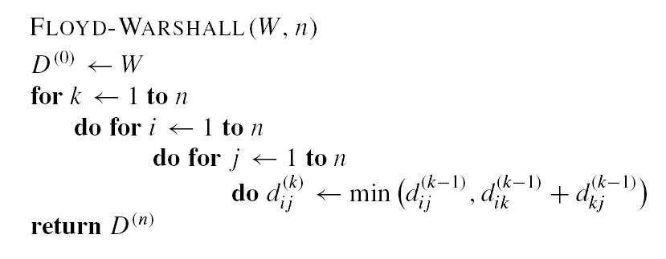
The Floyd-Warshall Algorithm
The running time is O(n³).
Memory required O(n²) (if we drop the superscripts).

Slide 19
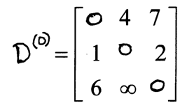
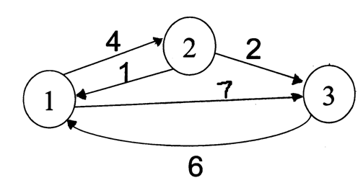
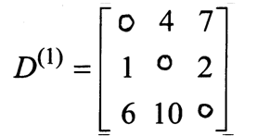
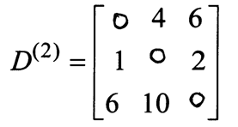
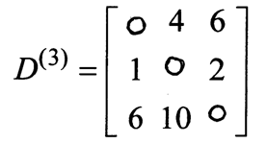
Floyd Warshall Algorithm – Example 1
Original weights.
Consider Vertex 1:
D(3,2) = D(3,1) + D(1,2)
Consider Vertex 2:
D(1,3) = D(1,2) + D(2,3)
Consider Vertex 3:
Nothing changes.

Slide 20
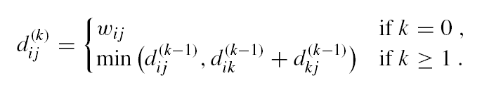
Example 2

Slide 21
Step 1

Slide 22
Step 2

Slide 23
Step 3

Slide 24
Step 4

Slide 25
Step 5

