Slide 1
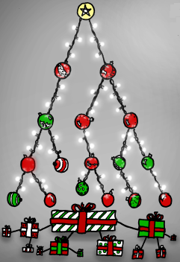
HEAPS

Slide 2
Heaps
A heap is a certain kind of complete binary tree.
When a complete binary tree is built, its first node must be the root.
The second node is always the left child of the root.
The third node is always the right child of the root.
The next nodes always fill the next level from left-to-right.

Slide 3
Heaps
Each node in a heap contains a key that can be compared to other nodes' keys.
Notice that this is not a binary search tree, but the keys do follow some order.
Each node's key is >= to the keys of its children. The biggest node is always at the top.
Because of this, a heap can easily implement a priority queue.
45
35
23
27
21
22
4
19

Slide 4
Adding a Node to a Heap
Put the new node in the next available spot.
Push the new node upward, swapping with its parent until the new node reaches an acceptable location.
45
35
23
27
21
22
4
19
42

Slide 5
Adding a Node to a Heap
45
Put the new node in the next available spot.
Push the new node upward, swapping with its parent until the new node reaches an acceptable location.
35
23
42
21
22
4
19
27

Slide 6
Adding a Node to a Heap
Put the new node in the next available spot.
Push the new node upward, swapping with its parent until the new node reaches an acceptable location. The process of pushing the new node upward is called re-heapification upward.
45
42
23
35
21
22
4
19
27
We stop here, because 42 is less than (or equal to) its parent. Otherwise the new node reaches the root.

Slide 7
Removing the Top of a Heap
Move the last node onto the root.
45
42
23
35
21
22
4
19
27
Notes:
We can also remove the top node from a heap. The first step of the removal is to move the last node of the tree onto the root. In this example we move the 27 onto the root.

Slide 8
Removing the Top of a Heap
Move the last node onto the root.
27
42
23
35
21
22
4
19

Slide 9
Removing the Top of a Heap
Move the last node onto the root.
Push the out-of-place node downward, swapping with its larger child until the new node reaches an acceptable location.
27
42
23
35
21
22
4
19
Notes:
We'll fix the problem by pushing the out-of-place node downward. Perhaps you can guess what the downward pushing is called....reheapification downward.

Slide 10
Removing the Top of a Heap
Move the last node onto the root.
Push the out-of-place node downward, swapping with its larger child until the new node reaches an acceptable location.
42
27
23
35
21
22
4
19

Slide 11
Removing the Top of a Heap
Move the last node onto the root.
Push the out-of-place node downward, swapping with its larger child until the new node reaches an acceptable location.
42
35
23
27
21
22
4
19

Slide 12
Removing the Top of a Heap
The children all have keys <= the out-of-place node, or the node reaches the leaf.
The process of pushing the new node downward is called re-heapification downward.
42
35
23
27
21
22
4
19

Slide 13
Implementing a Heap
We will store the data from the nodes in a partially-filled array.
Data from the root goes in the first location of the array.
42
35
23
27
21
42
An array of data
Notes:
Following the usual technique for implementing a complete binary tree, the data from the root is stored in the first entry of the array.

Slide 14
Implementing a Heap
Data from the next row goes in the next two array locations.
42
35
23
27
21
42
35
23
An array of data

Slide 15
Implementing a Heap
Data from the next row goes in the next two array locations.
42
35
23
27
21
42
35
23
27
21
An array of data
We don't care what's in
this part of the array.
Notes:
and so on.

Slide 16
Height of a heap
Proposition: A heap H storing n keys has height
h = ⎡ log₂(n+1)⎤ ( ceiling function )
Justification: Due to H being complete, we know:
No. of internal nodes is at least :
1 + 2 + 4 + ... 2 ^{h-2} + 1 = 2 ^{h-1} -1 + 1 = 2 ^{h-1}
No. of internal nodes is at most:
1 + 2 + 4 + ... 2 ^{h-1} = 2 ^{h} - 1
∴ 2 ^{h-1} ≤ n and n ≤ 2 ^{h - 1}
⇒ log₂ (n + 1) ≤ h ≤ log₂ n + 1
⇒ h = ⎡log₂ (n+1)⎤

Slide 17
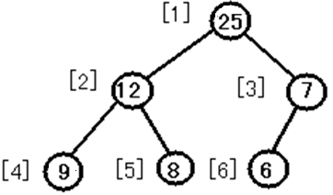
Max heap
Max-Heap: root node has the largest key.
A max tree is a tree in which the key value in each node is larger than the key values in its children.
A max heap is a complete binary tree that is also a max tree.

Slide 18
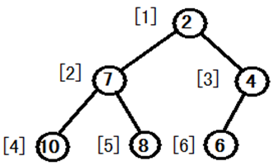
Min Heap
Min-Heap: root node has the smallest key.
A min tree is a tree in which the key value in each node is smaller than the key values in its children.
A min heap is a complete binary tree that is also a min tree.

