Slide 2
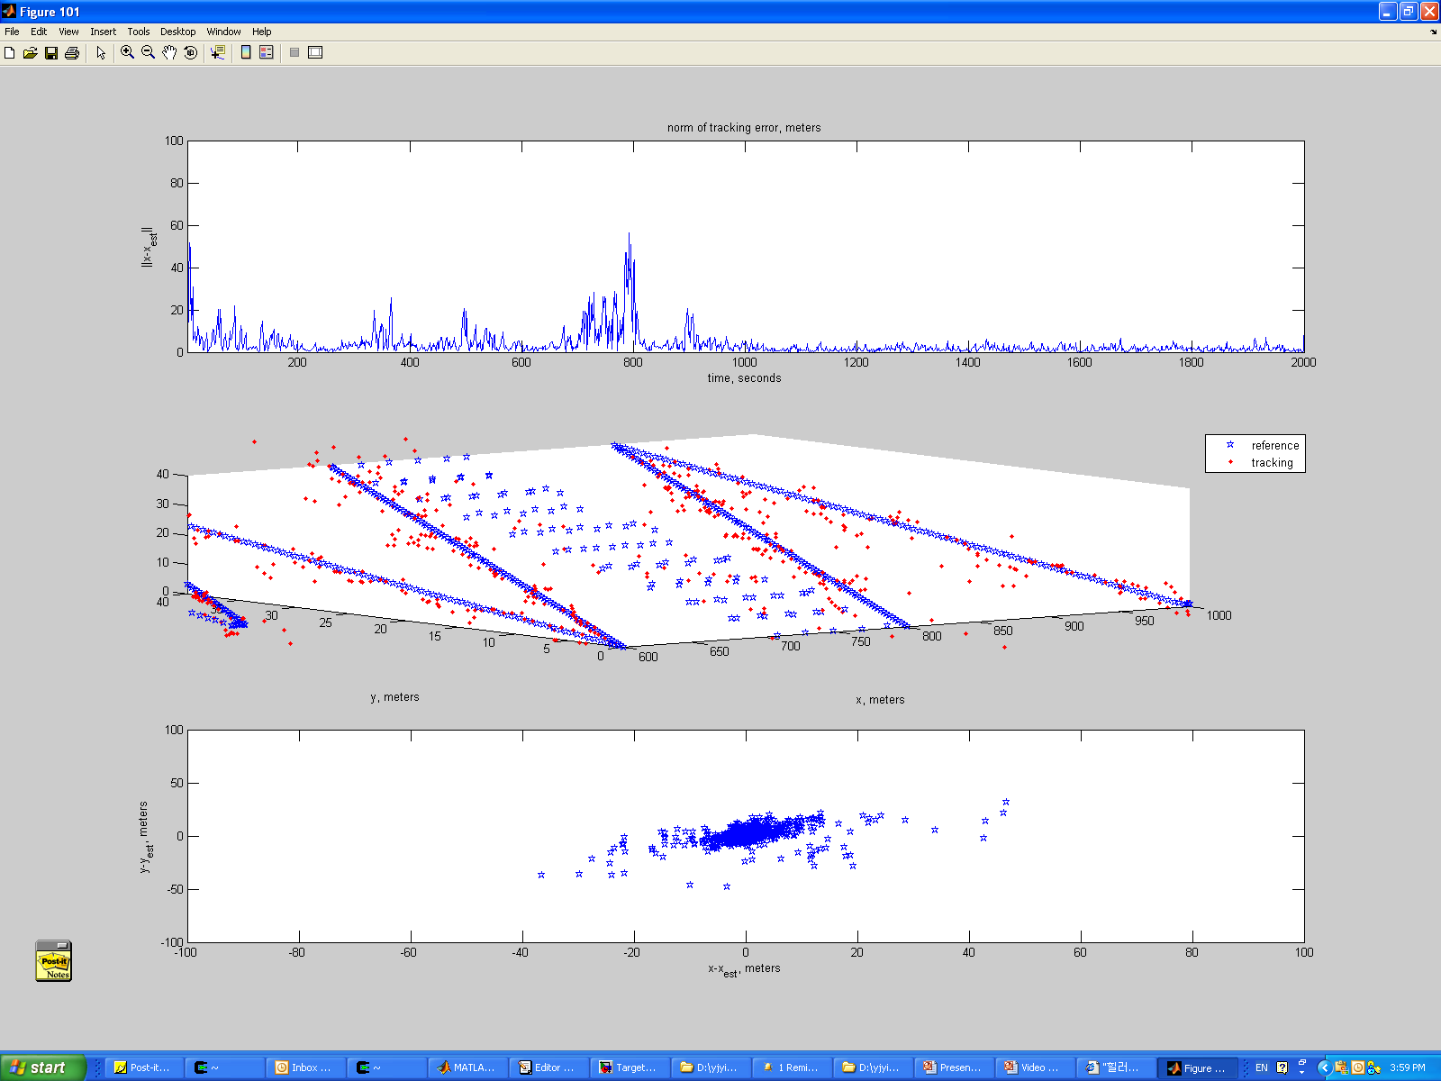
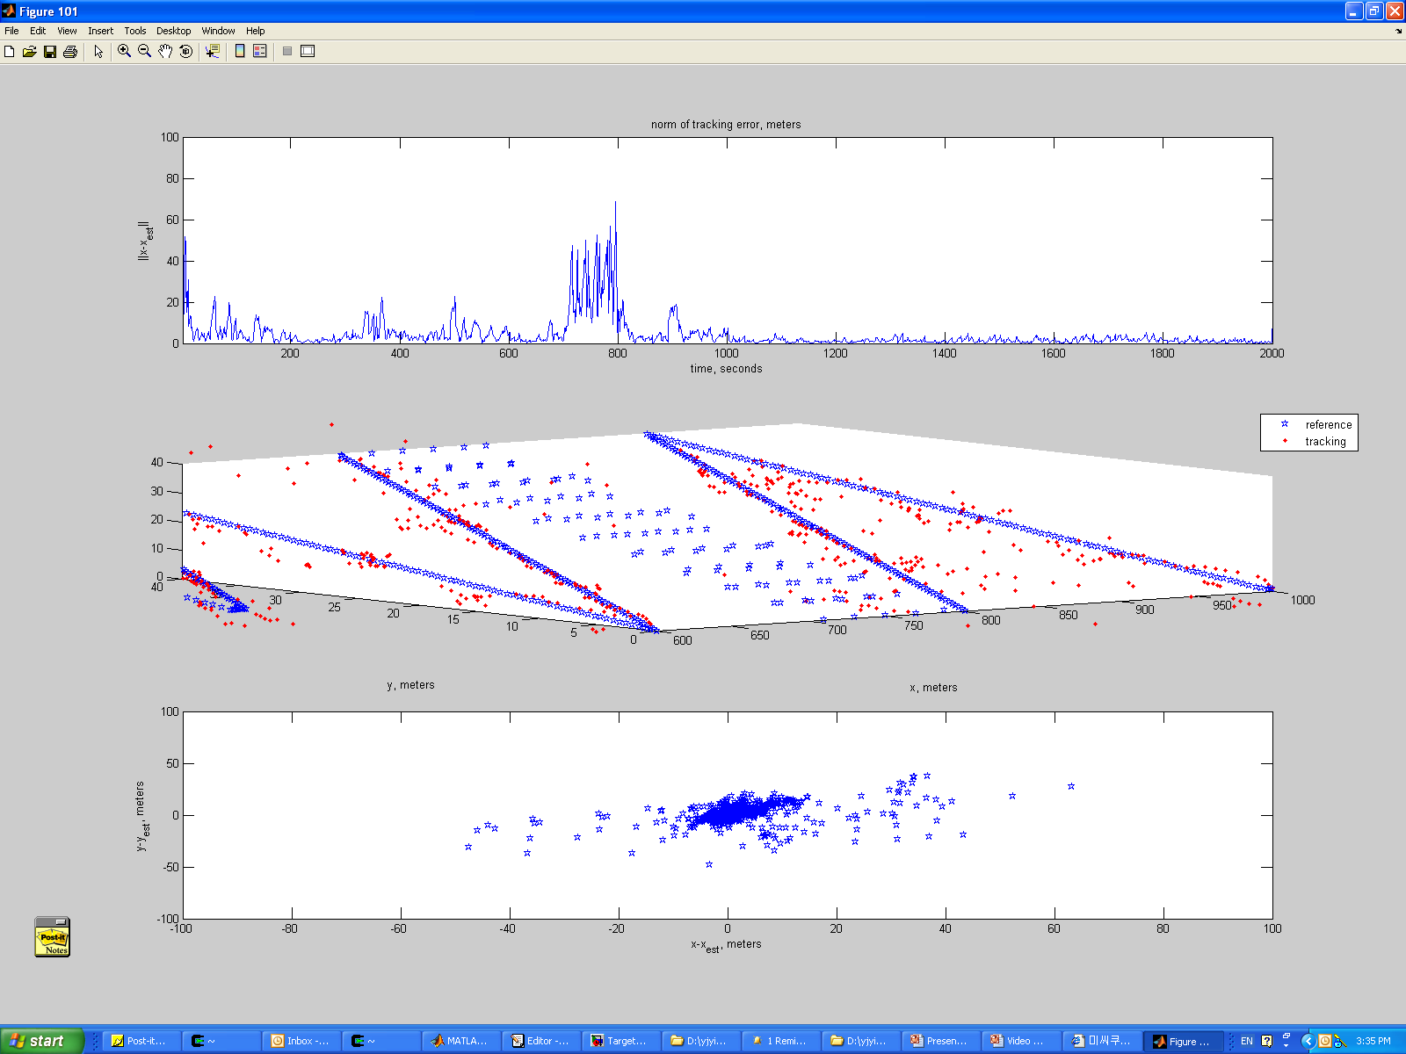
Impact of time-sync errors-low mobility(1)
Norm errors vs Time
Actual Target Track vs Estimated Track
Error Distribution in [x,y] plane
No clock drift
0.0001 clock drift
10 Sensors in the network with 5 seconds sampling interval
Clock drift does not make huge impact on QoI

Slide 3
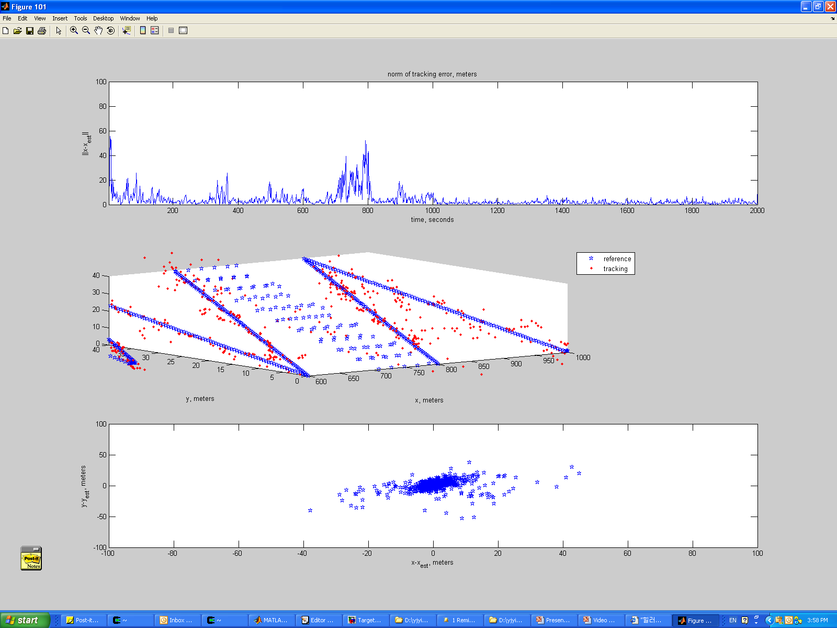
Impact of time-sync errors-low mobility (2)
Norm errors vs Time
Actual Target Track vs Estimated Track
Error Distribution in [x,y] plane
No clock drift
clock drift + random timing error < 1ms
Timing inaccuracy does not make huge impact on QoI

Slide 4
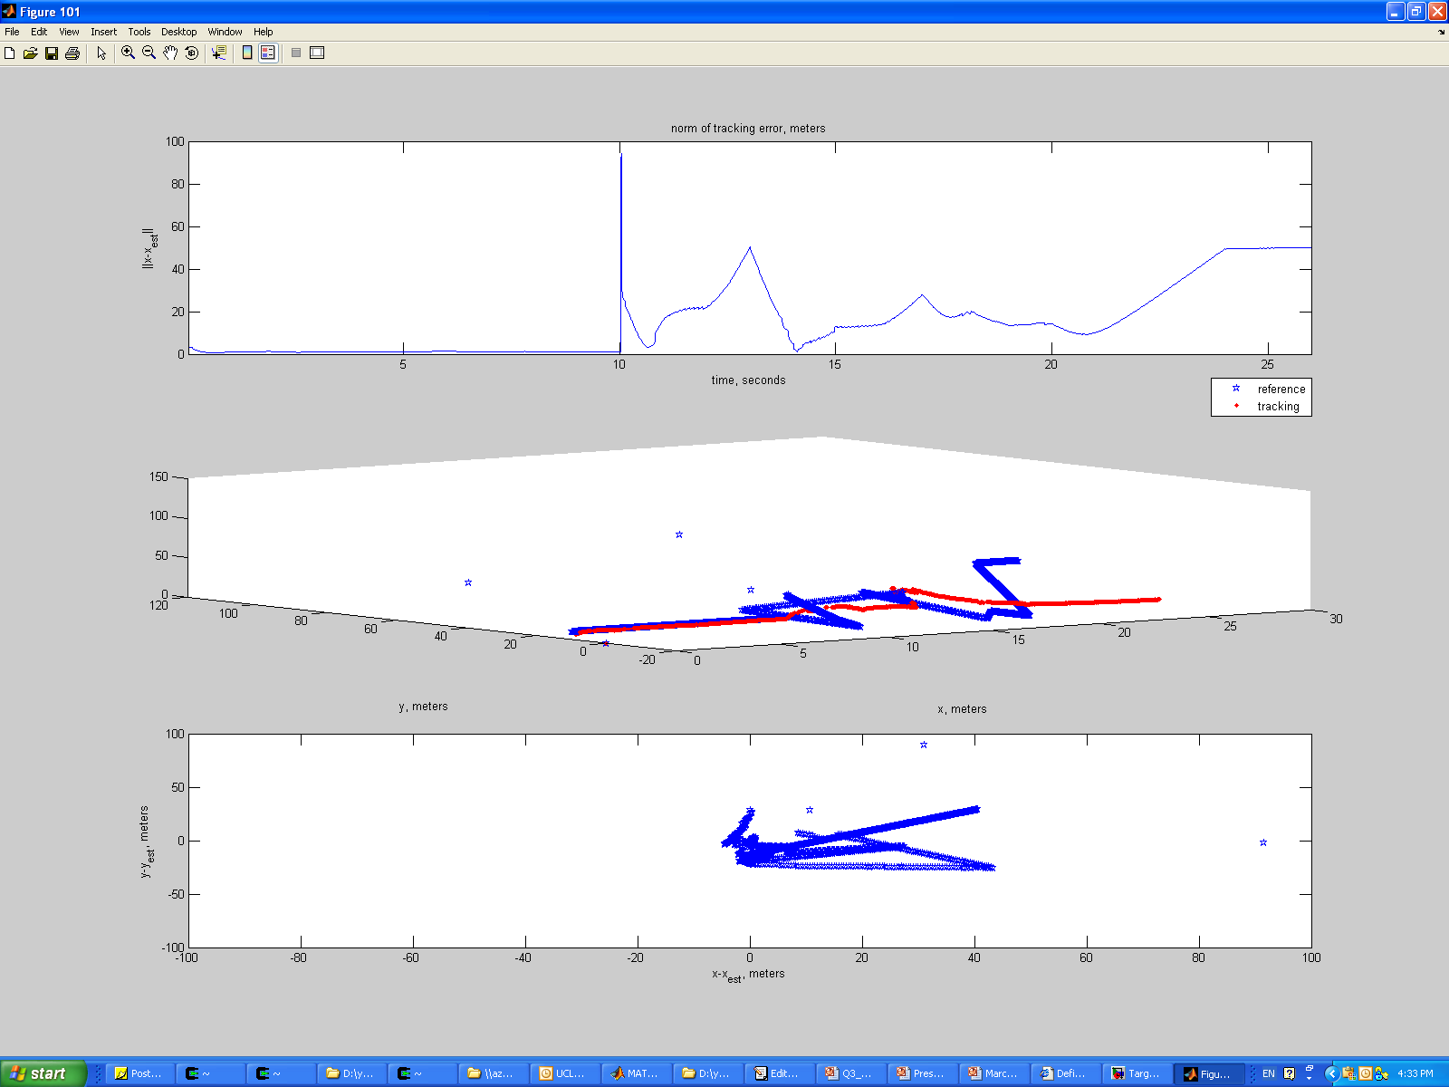

Medium Speed (10-20 m/s)
Norm errors vs Time
Actual Target Track vs Estimated Track
Error Distribution in [x,y] plane
No clock drift
0.0001 clock drift
10 Sensors in the network with 0.1 seconds sampling interval
Clock drift does not make huge impact on QoI

Slide 5
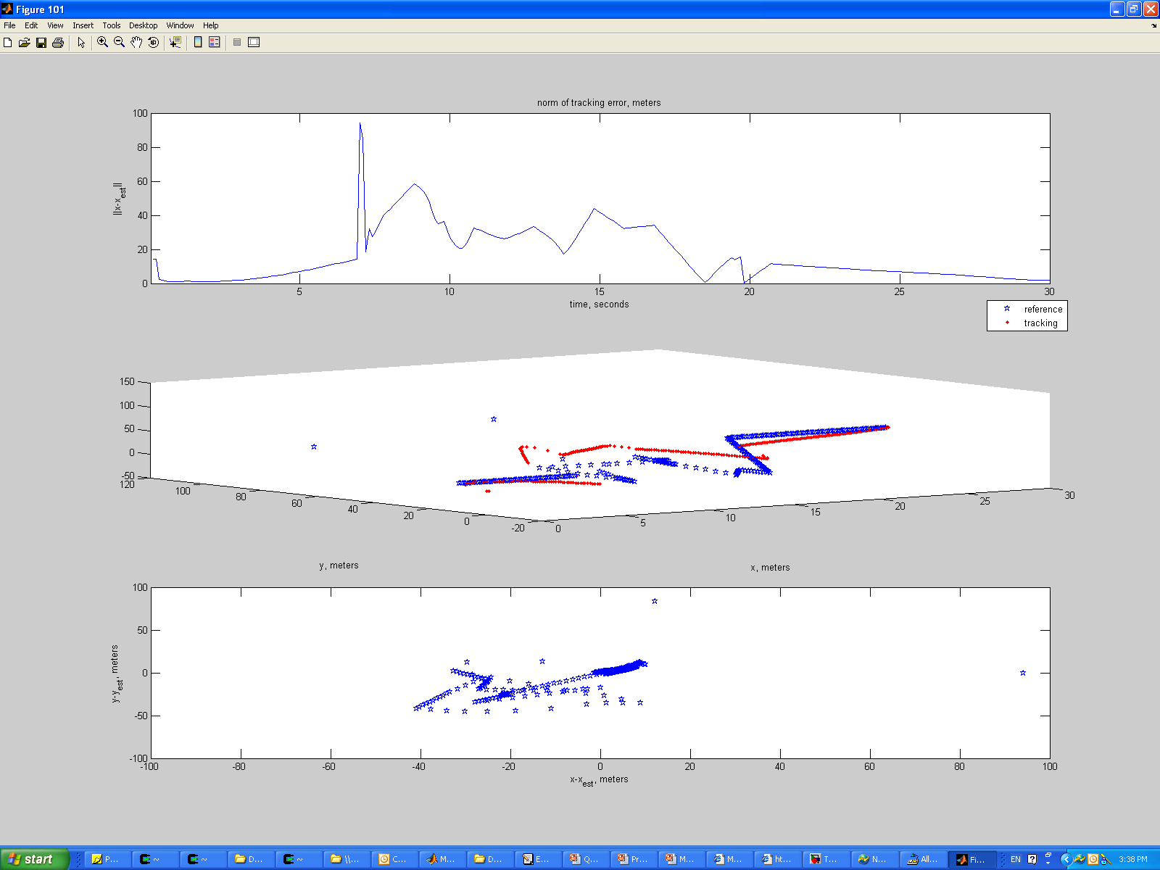
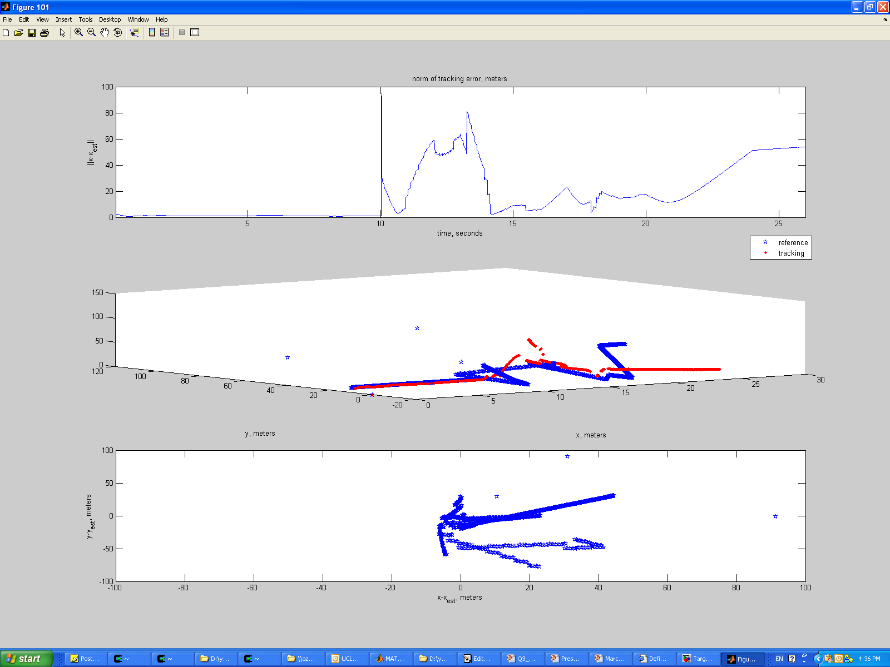
Medium Speed (10-20 m/s)
Norm errors vs Time
Actual Target Track vs Estimated Track
Error Distribution in [x,y] plane
No clock drift
clock drift + random timing error < 1ms
Timing inaccuracy does make a little impact on QoI

