Slide 1
A computationally efficient linear semi-Lagrangian scheme for the advection of microphysical variables in cloud-resolving models E. Gavze, E. Ilotoviz and A. Khain The Hebrew University of Jerusalem, Israel Krakow, 2019

Slide 2
NUMBER OF MICROPHYSICAL VARIABLES and COMPUTATIONAL TIME
Large-scale models, weather prediction models
Cloud resolving models (CRM)
u,p, T, q
u, p, T, q,
No microphysical species
Bulk microphysics
Bin microphysics
Mass contents, number concentrations, the three moment: reflectivity, particle densities,…
About 20-30 positive definite microphysical variables.
HUCM: 10-15 Size distributions (liquid water fractions, rimed fraction) x 43 bins=430 to 645 microphysical variables
Several hundred positive definite microphysical variables.
Advection takes about 80% of computer time and other computer resources.
To expand the field application of CRM with bulk, and especially bin-microphysics, it is necessary to make them computationally efficient.
We need to start with reconsideration of advective schemes.

Slide 3
REQUIREMENTS TO THE ADVECTION OF MICRIPHYSICAL VARIABLES IN CRM
There are fundamental differences between the requirements for
for advection schemes applied in large-scale models to vector variables, humidity and potential temperature | to transport microphysical species within clouds
1. Sensitivity to initial conditions and importance of very precise advection schemes
Large-scale processes | Microphysical variables
High sensitivity to initial conditions (inertial forecast) (large time scales) | The structure of cloud fields (cloud ensembles) does not depend on initial conditions (low time scales)
Forcing is relatively weak, large time scales | Large , but short scale sources and sinks.
High accuracy of advection is required | Requirements for precision of advection are not so strict.

Slide 4
REQUIREMENTS TO THE ADVECTION OF MICRIPHYSICAL VARIABLES IN CRM
2) the conservation requirements
We would also like to stress the fundamental difference between the conservation requirements
for momentum and global thermodynamic variables (e.g., temperature and humidity), on one hand,
and the conservation requirements for cloud species within clouds.
Momentum, velocity and pressure fields | Microphysical variables
Even a small error in air-mass conservation will result in a forecast distortion. | A loss of a few percent of, say, graupel mass content (say, 2.5 g/m³ vs 2.49 g/m³) during a hail storm (during several hours) will not produce any effect on the storm parameters. It cannot be identified either by a general analysis of the storm structure or by comparison with observations.

Slide 5
3) numerical diffusion
Momentum, velocity and pressure fields (large scale) | Microphysical variables
Numerical diffusion is highly non-desirable | The requirements for low numerical diffusion for microphysical species are not as strict as for the advection of synoptic-scale variables. Indeed, it is a usual practice to use diffusive schemes to describe the settling of cloud particles (Milbrandt and McTaggart-Cowan, 2010; Khain et al., 2015; Khain and Pinsky, 2018). Moreover, some diffusivity of the settling schemes is often desirable property

Slide 6
Strict requirements for advection of microphysical variables:
current non-linear schemes (properties) | Requirements: Microphysical variables
Computationally time consuming | The advection schemes should be computationally efficient.
Positive definite | Positive definite (at least this condition should be valid with high precision).
The non-linear advection do not retain linear relationships between different scalars. | Retaining linear relationships between different scalars should be the main property of microphysical advection schemes.

Slide 7
Non-linear high order schemes utilize many grid points.
These points affect the values in cloud

Slide 8
OUR CHOICE
Despite of different requirements, all CRM use non-linear high order advection schemes
Non-linear schemes | Linear schemes
Non-linear Eulerian flux methods are time consuming, because the advection coefficient matrix has to be calculated for each field separately every time step. | In linear schemes, on the other hand, the same matrix is used for all fields and has, therefore, to be calculated only once at each time step.
Non-linear schemes do not retain linear relationships | Linear schemes retain linear relationships between microphysical variables.
We propose to use linear a hybrid semi-Lagrangian scheme.
which is a blend of first- and second-order linear schemes.

Slide 9
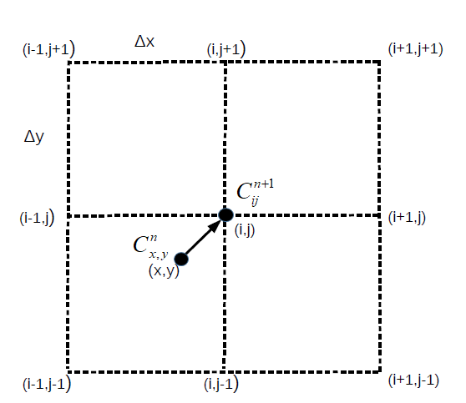
The concept of a hybrid semi-Lagrangian scheme
.
The value in point (x,y) is advected to point (i,j)
during time step
The first-order is positive definite, but suffers from large numerical diffusion.
The second-order scheme is oscillatory, but has little numerical diffusion.
The combination of these schemes substantially decreases the deficiencies of each component.

Slide 10
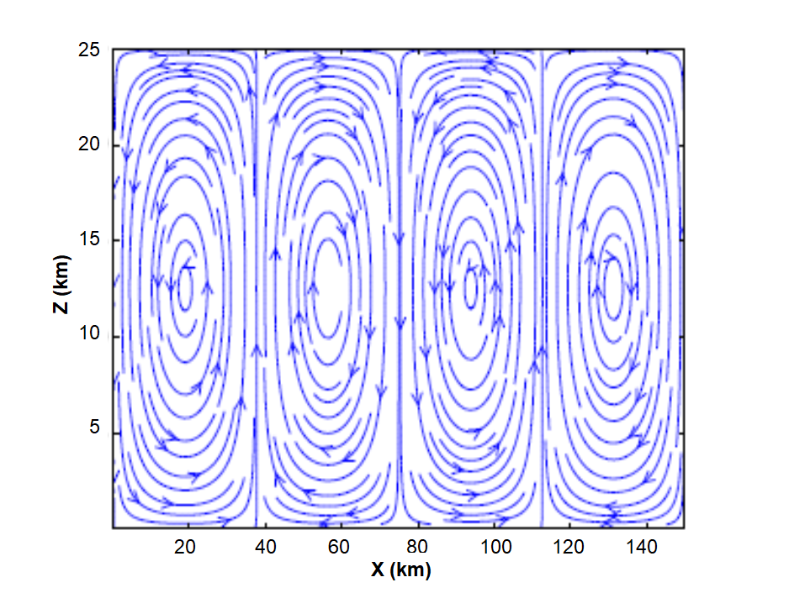
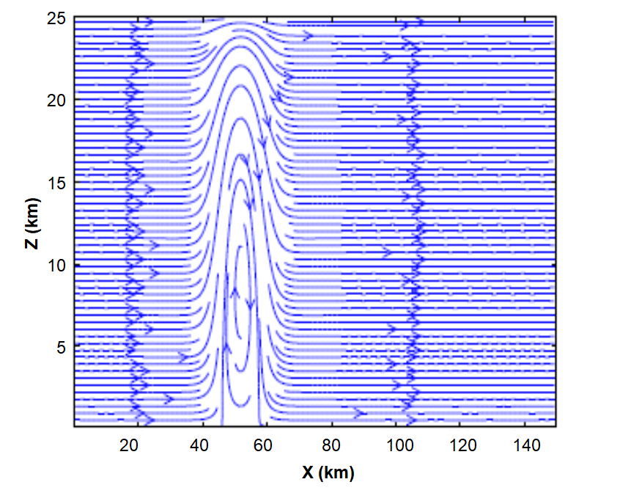
Idealized tests: Comparison of different advection schemes
We compared between different schemes:
a)SL-first order (the Corner Transport Upwind (CTU) (Colella, 1990; LeVeque, 2002)
b) The Bi-Quadratic SL scheme, BiQ
c) Hybrid-0.5; ; d) Hybrid -0.8
e) TVD-Superbee (Sweby, 1984; LeVeque, 1990; Thuburn,1997; Kemm, 2011; Zhang et al., 2015);
f) The Bott (1989) scheme (non-linear positive definite, second order)
Idealized steering currents

Slide 11
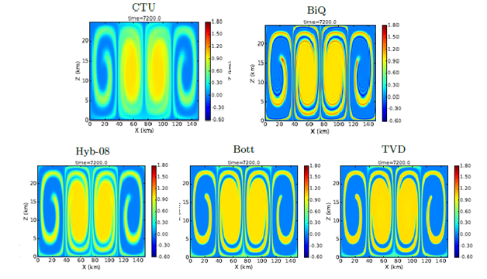
Initial concentration=1
SL schemes are 10 times faster!
Hyb-05

Slide 12
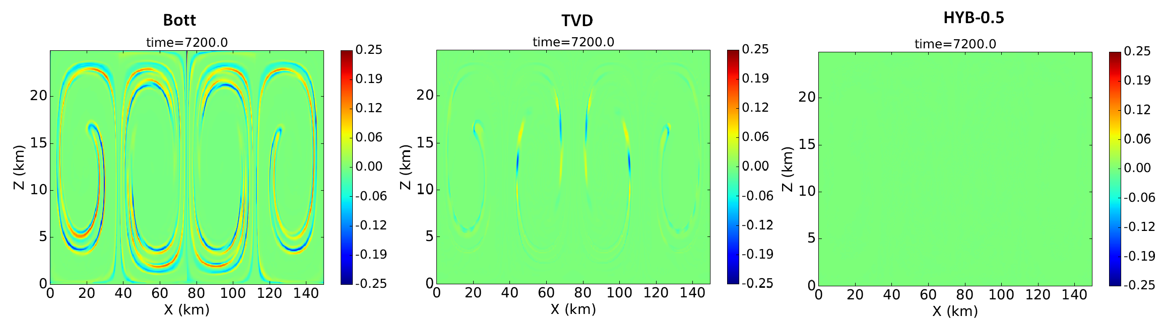
Test: Effects of linearity/non-linearity with respect to initial conditions
3 concentrations:
Advection of C₂+C₃- C₁
No mistake!
Errors are significant
SL schemes are 10 times faster!
Fields of C2 + C3 - C1 calculated using the Bott, TVD and Hyb-05. The exact value should be zero.

Slide 13
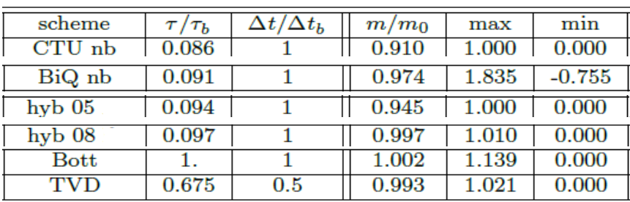
Conservative properties (2 hours simulations)
The mass errors in SL schemes contain include the errors related to fluxes through the boundaries.
So, real mass loss is lower than is shown in the table.

Slide 14
Test of the SL schemes using the Hebrew University Cloud Model (HUCM)
1. Brief model description and case study
HUCM is 2D cloud model with bin microphysics
The microphysical scheme describes the interactions between nine types of hydrometeors:
1)aerosols,
2)water drops,
3-5)three types of ice crystals (plates, columnar and dendrites),
6) aggregates (snow),
7) graupel,
8) hail
9) freezing drops (FD).
10-13) the liquid water mass in FD, graupel, snow and hail.
14) the rimed mass within each bin of snow-size distribution
As a result, the microphysical scheme contains 14 size distributions described using 43 mass bins each, i.e., more than 600 positive definite variables that must be advected at each time step. Grid spacing: 300 m x 100 m. Computational area: 150 km x 20 km.

Slide 15
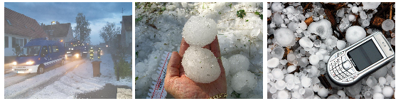
CASE STUDY: Hail storm in Oklahoma on 1 June 2008
CCN concentrations were ranged from 100 to 5000
Radar parameters: wavelength=5.6 cm, C-band
In both cases observations CCN concentration was around 3000-4000 cm-3
Ryzhkov, A., M. Pinsky, A. Pokrovsky, A.P. Khain, 2011
Khain, A. P., D. Rosenfeld, A. Pokrovsky, U. Blahak and A. Ryzhkov, 2011
Kumjian M. R., A. P. Khain, N. Benmoshe, E. Ilotoviz, A. V. Ryzhkov and V. T. J. Phillips, 2013
Ilotoviz E., A.P. Khain, A. V. Ryzhkov and J. C. Snyder, 2018

Slide 16
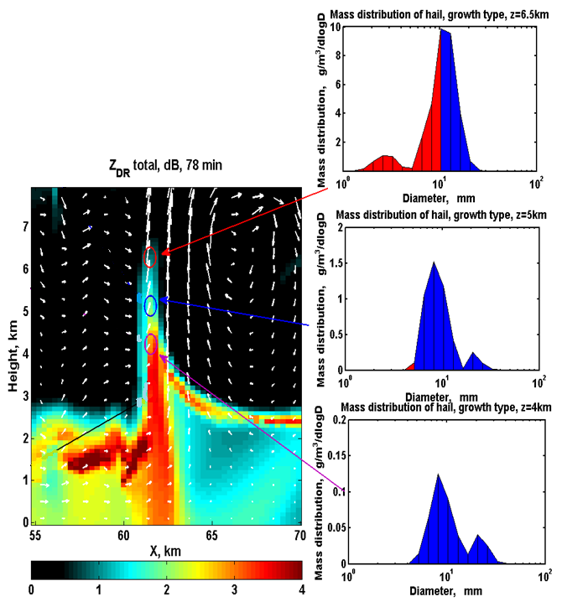
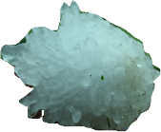

3
Dry growth
An example: Zdr field, size distributions of hai
(Ilotoviz et al, 2018)
Wet growth
Liquid shells
2
Wet growth
1
Wet growth

Slide 17
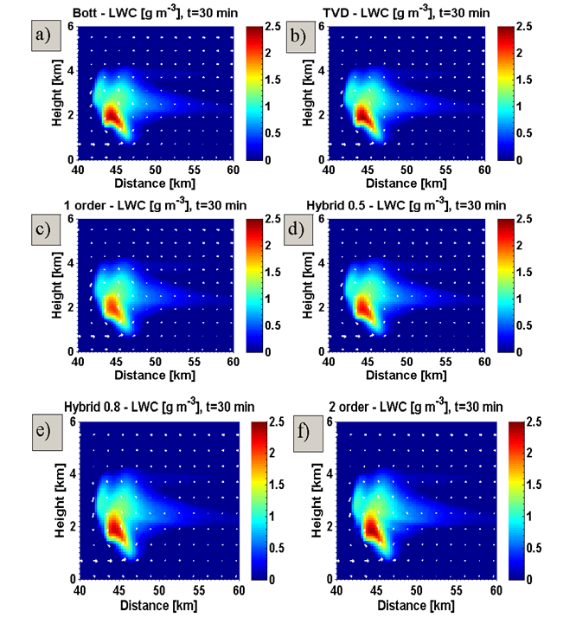
LWC at t=30 min obtained using different advection schemes

Slide 18
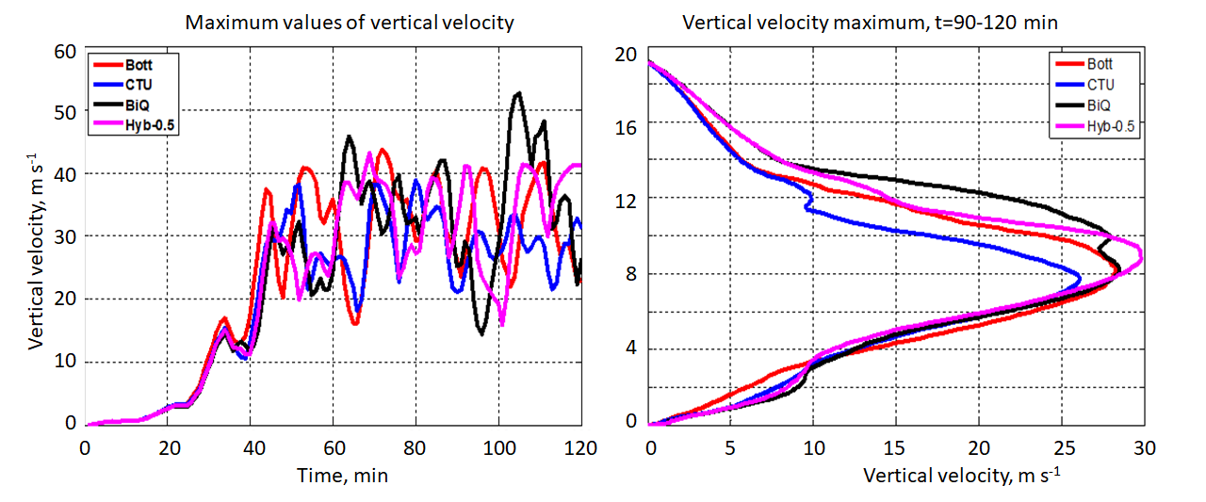
Maximum of vertical velocity (t)

Slide 19
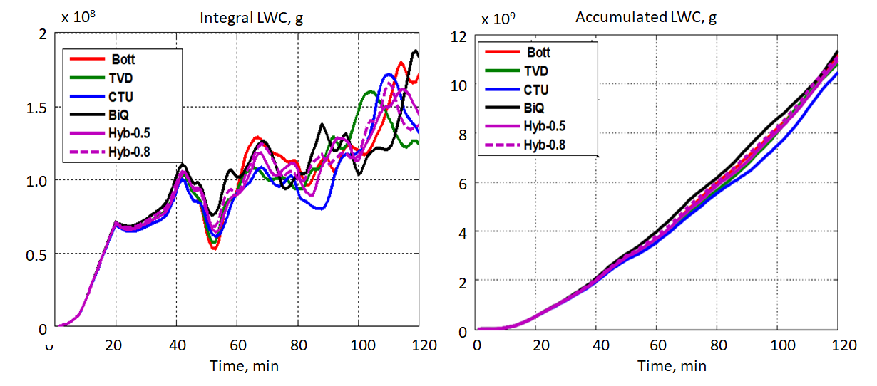
a) Time dependences of the domain-integrated LWC
b) Time dependences of LWC accumulated over the entire domain.

Slide 20
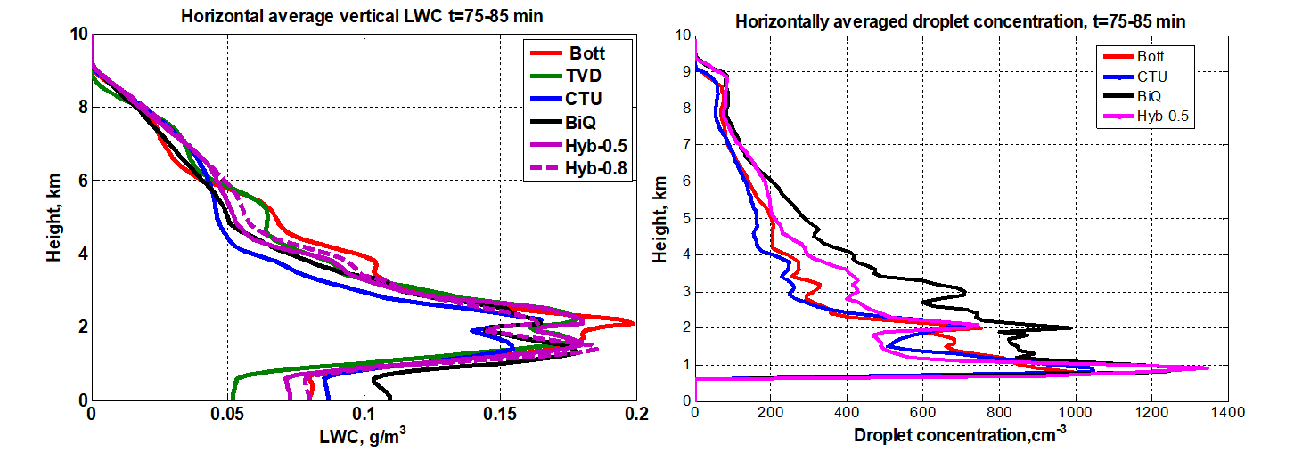
Vertical profiles of horizontally cloud-averaged LWC. Vertical profiles of horizontally averaged in-cloud
droplet concentration.

Slide 21
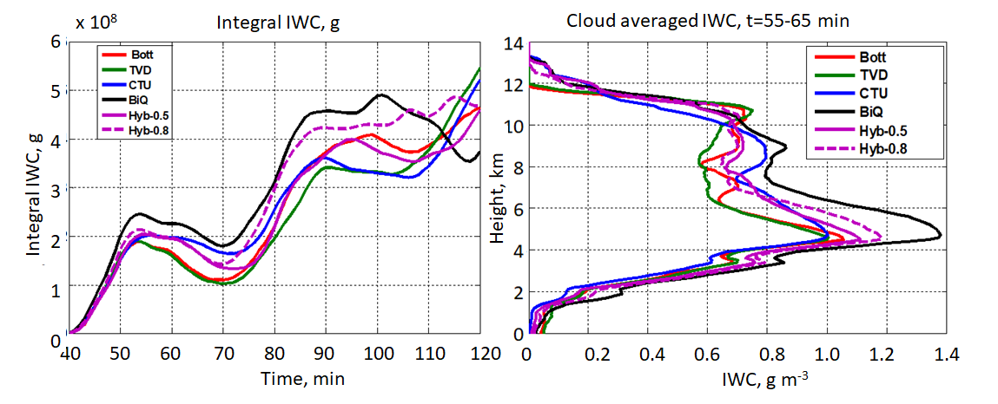
ICE MICROPHYSICS

Slide 22
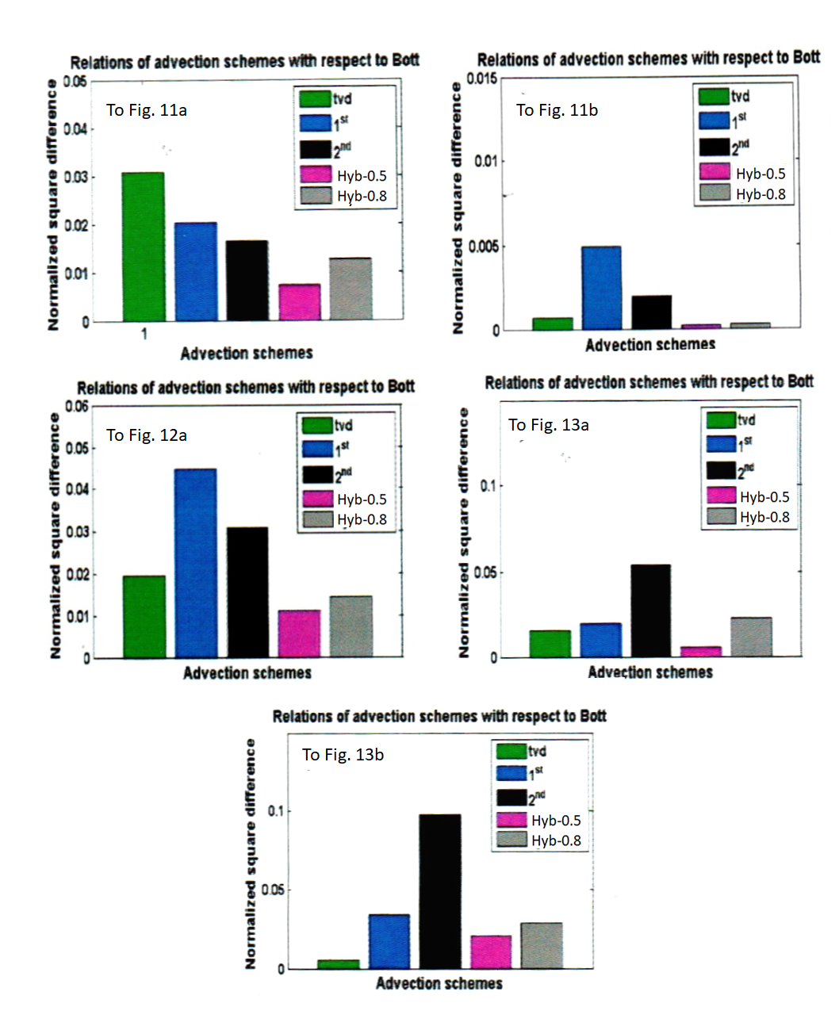
Statistics: normalized difference
Time dependences of the domain-integrated LWC
Time dependences of LWC accumulated over the entire domain
Normalized difference
Time dependences of the domain-integrated IWC
Vertical profiles of horizontally cloud-averaged LWC
SL schemes are 10 times faster!
Vertical profile of the cloud-averaged IWC over the period 55-65 min.
HYB-0.5 is closest to Bott

Slide 23
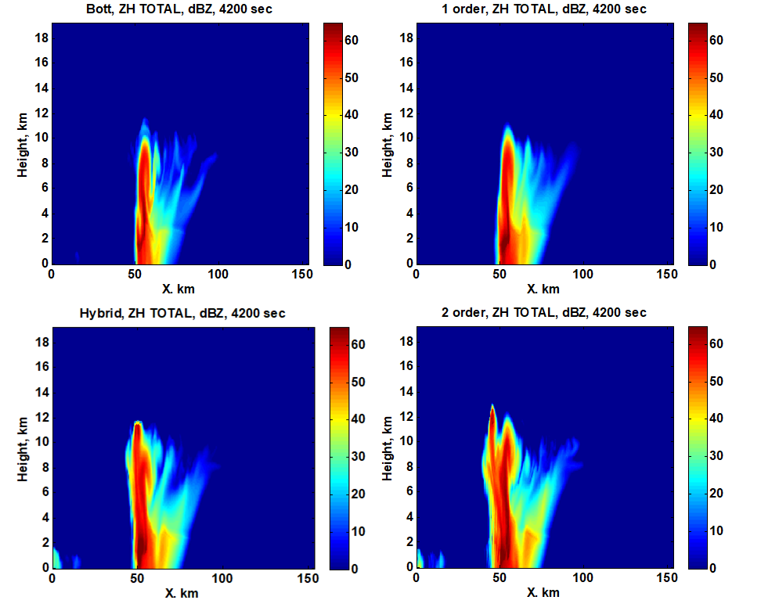
Snapshots of the radar reflectivity fields simulated using different advection schemes: The Bott, CTU, Hyb-05 and BiQ at t=4200s.

Slide 24
CONCLUSIONS
The requirements to advection schemes for positive definite microphysical species are formulated.
Basing on these requirements a linear hybrid SL scheme which is a combination of the first order (CTU) and second order (BiQ) schemes was constructed (Hyb-05, Hyb-08).
2. The idealized tests of advection of a highly inhomogeneous concentration field within highly sheared flows show that the hybrid SL schemes have a low diffusivity and no artificial oscillations. Besides, they are nearly positive definite and have excellent (but not exact) conservative properties.
3. While the accuracy of hybrid SL scheme was found to be close to that of non-linear positive definite advection Eulerian schemes (the Bott and TVD), its computational cost is about 10 times lower.
4. The semi-Lagrangian schemes conserve relationships between variables.
5. A detailed comparison of the advection schemes in simulations of a hailstorm using HUCM showed that the results produced by SL schemes are close to those produced by Boot’s scheme, which is taken as our benchmark.
A good agreement was observed in time-averaged and space-averaged values, and even in particular snapshots. This agreement is quite remarkable if one takes into account the high non-linearity of the microphysical processes.
6. The test simulations showed that the proposed SL schemes require between 7–10 less computer time than the non-linear positive definite advection Bott scheme.

Slide 25
The conclusions support, therefore, our hypothesis that accurate results of cloud modeling can be obtained using simple linear SL schemes that require much less computer time than high-order non-linear schemes.
As the next step in the investigation, we intend to perform a test of the semi-Lagrangian schemes in the 3D framework.

Slide 26
THANK YOU!

