Slide 1
Large eddy simulation of turbulent convection in the Pi Chamber: Laboratory meets LES with cloud microphysics
R. A. Shaw
Michigan Technological University
W. Cantrell (MTU), K. Chandrakarr (MTU), N. Desai (BNL), G. Kinney (MTU), S. Krueger (Univ. Utah), M. Ovchinnikov (PNNL), S. Thomas (MTU), and F. Yang (BNL)
Acknowledgement: Pi Chamber supported by U.S. National Science Foundation, Dynamic and Physical Meteorology Program and Major Research Instrumentation Program; additional support from DOE ASR, NASA, and AFRL

Slide 2
Large eddy simulation of turbulent convection in the Pi Chamber: Laboratory meets LES with cloud microphysics
R. A. Shaw
Michigan Technological University
W. Cantrell (MTU), K. Chandrakarr (MTU), N. Desai (BNL), G. Kinney (MTU), S. Krueger (Univ. Utah), M. Ovchinnikov (PNNL), S. Thomas (MTU), and F. Yang (BNL)
Acknowledgement: Pi Chamber supported by U.S. National Science Foundation, Dynamic and Physical Meteorology Program and Major Research Instrumentation Program; additional support from DOE ASR, NASA, and AFRL

Slide 4
Laboratory and LES…
Jim’s NCAR career extended over 16 years and was marked by unusually creative research
that was increasingly recognized and appreciated. The research was of two main types:
pioneering work in the numerical modelling technique now known as large-eddy simulation,
and laboratory studies of turbulent free convection.
The large-eddy simulation work was inspired by the earlier work of Jim’s senior NCAR
colleague, Douglas Lilly, who developed its theoretical outlines some years earlier at the
Geophysical Fluid Dynamics Laboratory in Princeton, New Jersey. Under Lilly’s tutelage
at NCAR, Jim developed the code for and carried out what was probably the first
three-dimensional, time-dependent numerical simulations of turbulent flow with spatial and
temporal resolution adequate to resolve the dynamics and evolution of the energy-containing
eddies. That work attracted wide recognition, and began to be adopted in other research centres,
including the Center for Turbulence Research at Stanford that soon gave the semantically
precise name, large-eddy simulation.
Wyngaard (Boundary-Layer Meteorology 2015) – Obituary of Jim Deardorff

Slide 5
Pi Chamber - Philosophy:
Create a ‘convective mixed-layer’ in a controlled environment… to investigate aerosol-cloud interactions in a turbulent environment (fluctuating velocity, temperature and water vapor concentration)

Slide 6
Pi Chamber - Philosophy:
Create a ‘convective mixed-layer’ in a controlled environment… to investigate aerosol-cloud interactions in a turbulent environment (fluctuating velocity, temperature and water vapor concentration)
Why the laboratory?
Well characterized boundary conditions and forcing
Remove large-scale feedbacks… e.g., constant forcing (aerosol-cloud interactions with no “meteorology”)
Aerosol-cloud microphysics can be measured in detail (scavenging efficiencies, condensation vs. collision growth, etc.)

Slide 7
Pi Chamber - Philosophy:
Create a ‘convective mixed-layer’ in a controlled environment… to investigate aerosol-cloud interactions in a turbulent environment (fluctuating velocity, temperature and water vapor concentration)
Why the laboratory?
Well characterized boundary conditions and forcing
Remove large-scale feedbacks… e.g., constant forcing
Aerosol-cloud microphysics can be measured in detail
What makes the Pi Chamber different?
Time and Turbulence

Slide 8



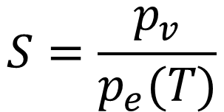






$$[T_{0},p_{e}\left(T_{0}\right)]$$
$$p_{v}$$
$$p_{e}(T)$$
Convection and mixing visualized by illuminated cloud droplets.
$$p_{v}>p_{e}(T_{mix})$$
$$p_{e}(T_{mix})$$
$$T_{0}$$
$$T_{mix}$$
$$T_{0}+ΔT$$
$$S=\frac{p_{v}}{p_{e}(T)}$$
$$[T_{0}+ΔT,p_{e}\left(T_{0}+ΔT\right)]$$

Slide 9
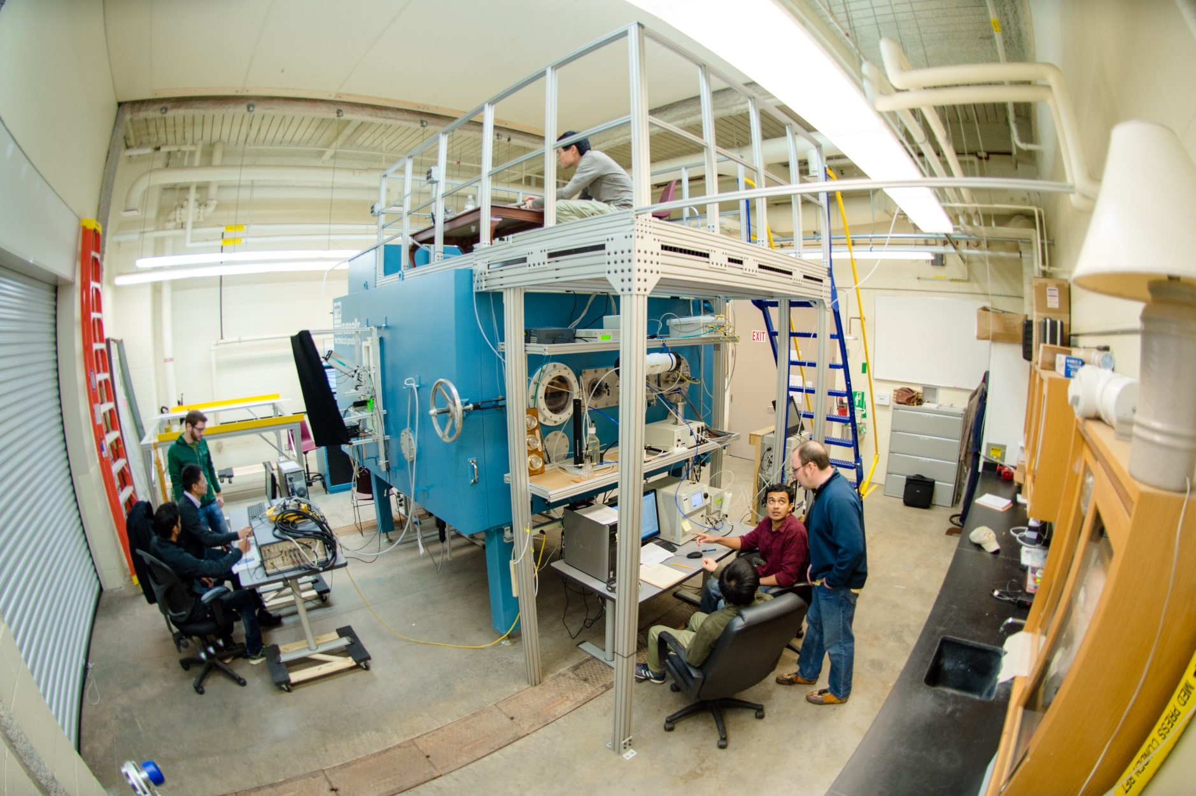
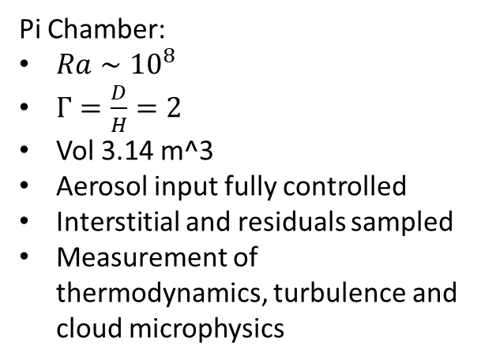
Pi Chamber:
$Ra∼{10}^{8}$
$Γ=\frac{D}{H}=2$
Vol 3.14 m^3
Aerosol input fully controlled
Interstitial and residuals sampled
Measurement of thermodynamics, turbulence and cloud microphysics
Chang et al. BAMS (2016)

Slide 10
Snapshots of ‘steady-state’ clouds… decreasing aerosol injection rate to the right

Slide 11
Niedermeier et al. Phys. Rev. Fluids (2018)

Slide 12
Condensation broadening and dispersion indirect effect
PDF (μm⁻¹)
Chandrakar et al. (2016, 2018)

Slide 13
Large-Eddy Simulation of Pi Chamber
Quantities to be measured :
– Velocity field of the fluid
– Temperature field
– Water vapor field
– Aerosol numbers
– Aerosol size distribution
– Cloud droplet numbers
– Cloud droplet sizes
– Cloud droplet velocities
Equation of motion
System for Atmospheric Modeling
Thermodynamic states
[ Khairoutdinov and Randall (2003) ]
Cloud microphysics
HUJI Spectral Bin Microphysics
[ Khain et. al (2000) & Fan .J et al (2009) ]

Slide 14
Large-Eddy Simulation of Pi Chamber
3.125 cm
Grid size | 3.125 cm
# Grid points | 64 x 64 x 32 (2m x 2m x 1m)
Step size | 0.02 seconds
# Steps | 180000 (3600 seconds)
3.125 cm
z
y
x

Slide 15
Large-Eddy Simulation of Pi Chamber
For, t = 0:
Temperature
Top wall
Top wall
Top wall
T_{top} = Cold
w
v
u
Sidewall
For t = 0
U = V = W = 0
At walls, for all t
U = V = W = 0
T_{side} = T_{s}
Sidewall
z
y
T_{bot} = Hot
x
Bottom wall
Temperature
Bottom wall
Bottom wall

Slide 16
Thomas et al. (JAMES, in review)

Slide 17
Thomas et al. (JAMES, in review)

Slide 18


$$A_{t}=A_{b}$$
$$A_{s}$$
Mean fluid
temperature:
Thomas et al. (JAMES, in review)

Slide 19
Large-Eddy Simulation of Pi Chamber
System for Atmospheric Modeling (SAM; Khairoutdinov)
~3-cm grid scale
Spectral-bin microphysics (Khain/Pinsky)
Thomas et al. (JAMES, in review)

Slide 21
Large-Eddy Simulation of Pi Chamber
Thomas et al. (JAMES, in review)

Slide 22
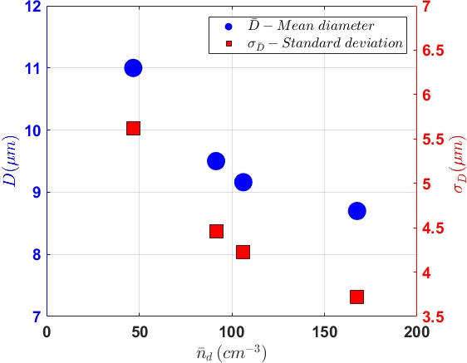
Large-Eddy Simulation of Pi Chamber
Thomas et al. (JAMES, in review)

Slide 23
Cloud Modeling Workshop @ Pune, India – August 2020
Pi Chamber Case
Warm microphysics: cloud droplet activation, growth by condensation, and removal by sedimentation
Comparison of simulations to experiment
LES vs DNS
Eulerian vs Lagrangian
Lagrangian explicit vs Lagrangian super-droplet
Pi Chamber modeling workshop in Houghton, Michigan, USA May 23-24

Slide 24
Summary...
Moist Rayleigh-Bénard convection: steady-state turbulence, thermodynamics, and microphysics via isobaric mixing
For steady-state conditions, large droplet tail appears for decreasing aerosol injection rate
LES of the Pi Chamber: Captures trends of observed dynamics and microphysics
LES of the Pi Chamber: Scaling of the chamber influences the microphysics.

