Slide 1
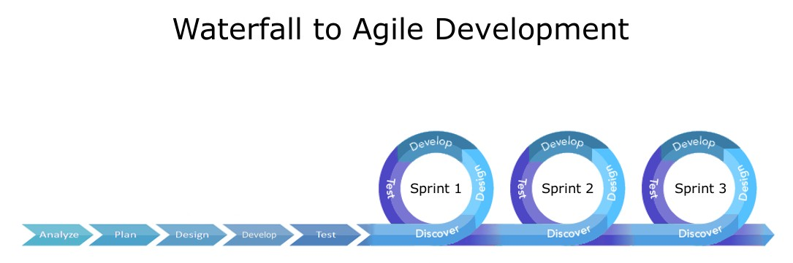
By: Steven Lazar CS-250 Final Project

Slide 2

Agile Roles
Product Owner: The product owner represents the voice of the customer and stakeholders. Their key responsibilities include defining and prioritizing the product backlog, writing user stories and acceptance criteria and ensures the team builds the right product by clarifying requirements and communicating ever changing environments.
Scrum Master: The scrum master facilitates the scrum process and supports the team. The responsibilities of the scrum master is to organize scrum ceremonies, remove any obstacles they may hinder progress, and coaches the team on agile principles and practices.
Development Team: This team is a cross functional group responsible for delivering the product increment. The team designs, builds, test and delivers working software while collaborating closely to ensure quality and efficiency, Taking accountability and being self organizing to complete sprint goals
Testers play a vital role in ensuring that the product meets high quality standards. They validate user stories, design and execute test cases, identify and report bugs, and perform regression testing to maintain stability. Testers also contribute to the continuous improvement of the product by providing feedback throughout development. Embedded within the development cycle, they help ensure that each product increment is functional, user-friendly, and free of defects.

Slide 3
Explaining Agile Phases
Requirements Gathering: This is the process of identifying, documenting and prioritizing what a software system needs to meet user and business goals. This is an ongoing and dynamic phase of the agile method.
Planning: Refers to the process of preparing for a sprint by selecting and organizing the work needed to be completed by the team. It is a collaborative, timed activity that sets the stage for focused and achievable progress
Design: This is a continuous and evolving process that adapts with each sprint. Design is a iterative and collaborative phase focused on creating just enough structure to support development without overplanning.
Development: Translating user stories into working software. Code is written, integrated, and refined collaboratively. Testing Continuous validation through automated and manual tests. Ensures functionality, usability, and alignment with acceptance criteria.
Deployment Releasing working increments to users or staging environments. Enables early feedback and real-world validation.
Maintenance Ongoing support, bug fixes, and enhancements. Keeps the product relevant and responsive to user needs.

Slide 4
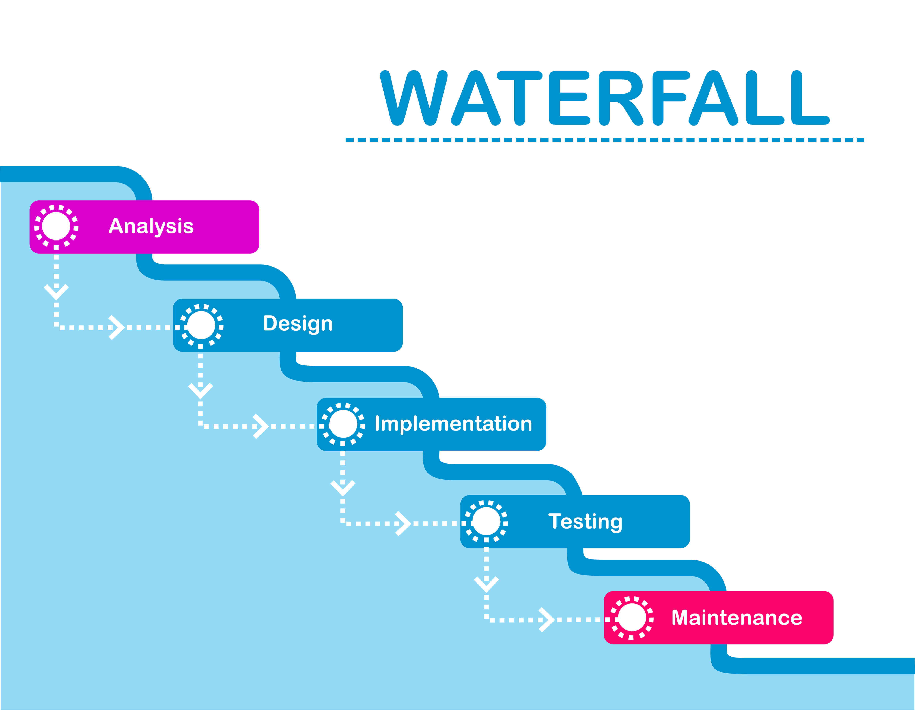
Waterfall Model
The Waterfall model is a traditional, linear approach to software development where each phase must be completed in sequence before the next begins. This rigid structure assumes that all requirements can be known and finalized upfront, making it very difficult to accommodate changes once development is underway.
In environments where user needs, technologies, or business goals evolve rapidly, the Waterfall method becomes inefficient. Updating a feature, changing a design element, or responding to stakeholder feedback requires revisiting earlier phases, often involving extensive documentation, approvals, and rework. This slows down progress and increases the risk of delivering a product that no longer meets user expectations by the time it's complete.
While the Agile approach embraces change and promotes flexibility. Development is broken into short sprints allowing teams to continuously refine requirements, adapt to feedback, and deliver working software incrementally. Agile encourages collaboration, early testing, and ongoing stakeholder involvement, making it far more effective in fast-paced or uncertain environments.

Slide 5
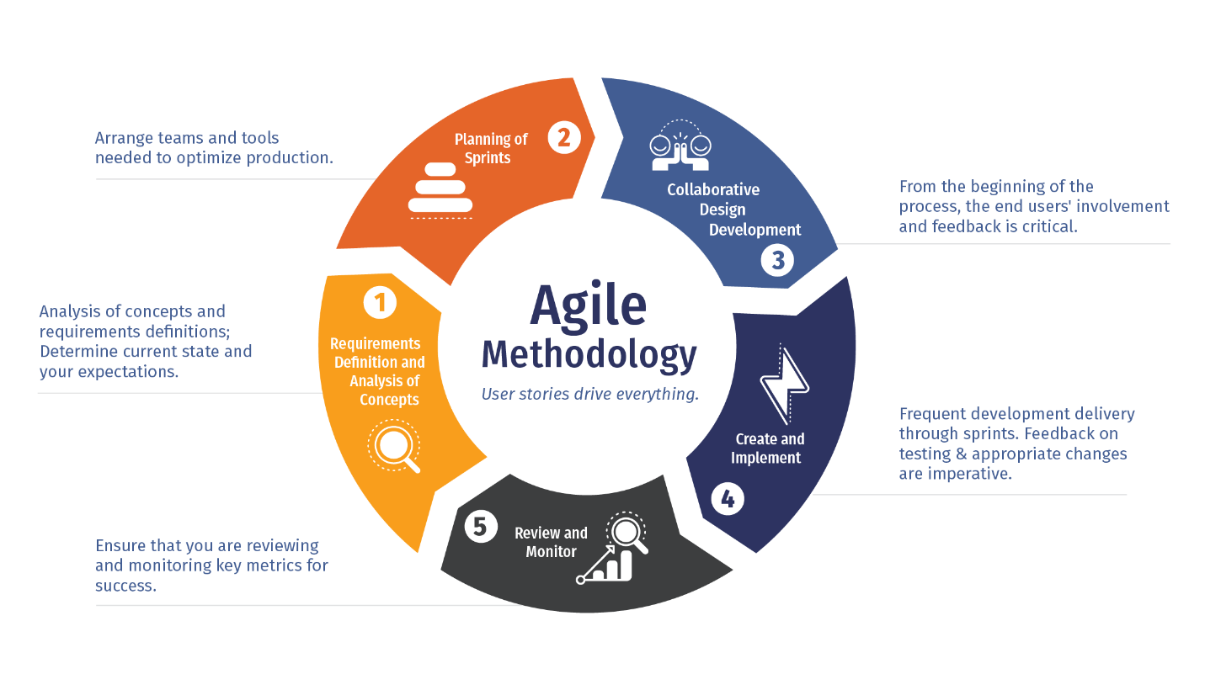
Features | Waterfall Model | Agile Method
Structure | Linear and Sequential | Iterative and incremental
Flexibility | Low, Changes are difficult once phasing begins | Welcomes changes at any stage during the product
User Involvement | Very minimal after initial requirements are set | Continuous through reviews and feedback
Delivery Timeline | Final product is delivered at the end of the project | Working software delivered at the end of each sprint
Risk Management | Issues often discovered late in testing which leads to delays or extreme financial loss | Early detection through continuous testing lowers exposure risk.
Documentation | Heavy upfront documentation with major documentation throughout if modifications are needed. | Light documentation with the team being focused on working software.
Adaptability to Change | Very difficult to change during the process and requires heavy involvement. | The product backlog can be modified at any time making changes extremely easy.
I prefer the Agile method for software development because it supports fast, flexible progress. Its iterative approach lets me build and test features in short sprints, helping me catch bugs early and improve the UI based on feedback. Agile makes it easy to adapt to user input or changing stakeholder requests through backlog updates and clear communication. By focusing on user stories, Agile keeps development aligned with real user needs. Continuous testing ensures the product stays functional and bug-free as it's being built. Sprint retrospectives help me reflect on what worked, what didn’t, and how to improve in the next cycle.

Slide 6
Resources
1. Schwaber, K., & Sutherland, J. (2020).
The Scrum Guide. Scrum.org. https://www.scrum.org/resources/scrum-guide
2. Bourk, S. (2024, January 4).
The journey and future of Scrum and Agile – A reflection. Scrum.org. https://www.scrum.org/resources/blog/journey-and-future-scrum-and-agile-reflection
3. Sassa, A. C., de Oliveira, M. F., & da Silva, R. A. (2023).
Scrum: A systematic literature review. International Journal of Advanced Computer Science and Applications, 14(4), 147–153. https://thesai.org/Publications/ViewPaper?Volume=14&Issue=4&Code=IJACSA&SerialNo=20
4. Dong, H., Dacre, N., Baxter, D., & Ceylan, S. (2024).
What is Agile project management? Developing a new definition. Project Management Journal. Advance online publication. https://journals.sagepub.com/doi/pdf/10.1177/87569728241254095

